Slide 1
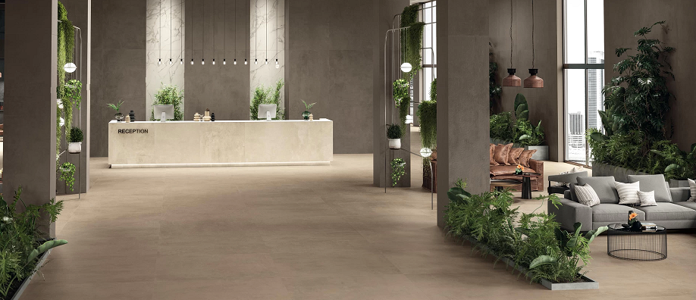



REDUCING OUR CARBON FOOTPRINT WITH TILE AND STONE
Provider

Slide 2

INHERENT SUSTAINABLE ATTRIBUTES OF TILE

Slide 3
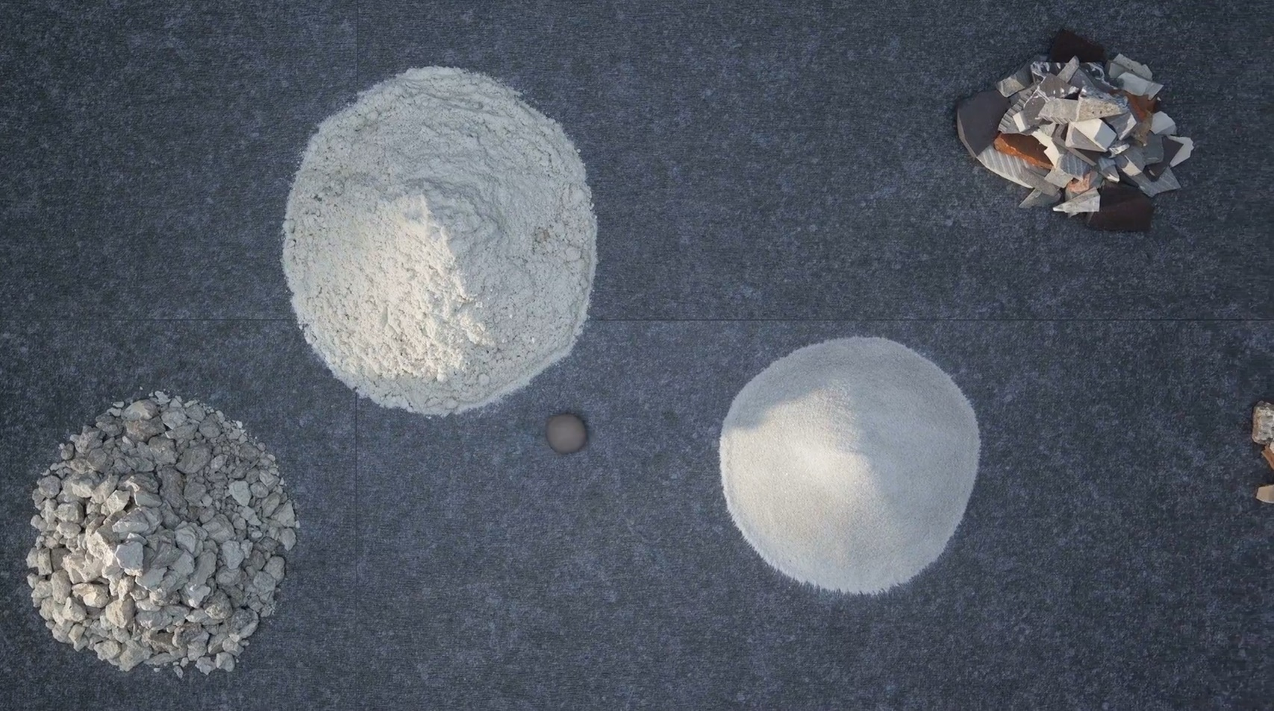

TILE | INHERENT SUSTAINABLE ATTRIBUTES
Manufactured with materials that are natural and plentiful
Clay
Kaolin
Feldspar
Production waste
Materials reused from other industries

Slide 4
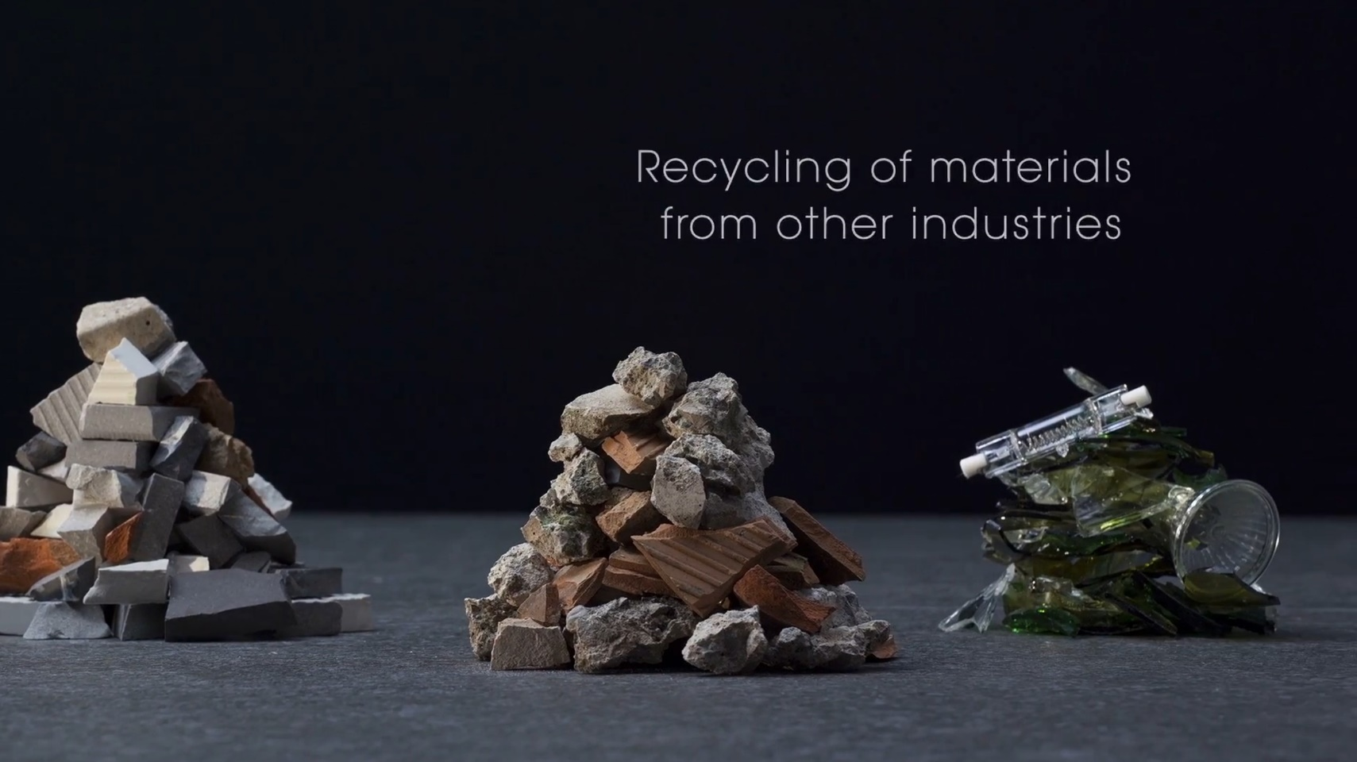
TILE | INHERENT SUSTAINABLE ATTRIBUTES
Manufactured with materials that are recycled and reused
Production waste
Materials reused from other industries

Slide 5

TILE | INHERENT SUSTAINABLE ATTRIBUTES
Manufactured locally

Slide 6
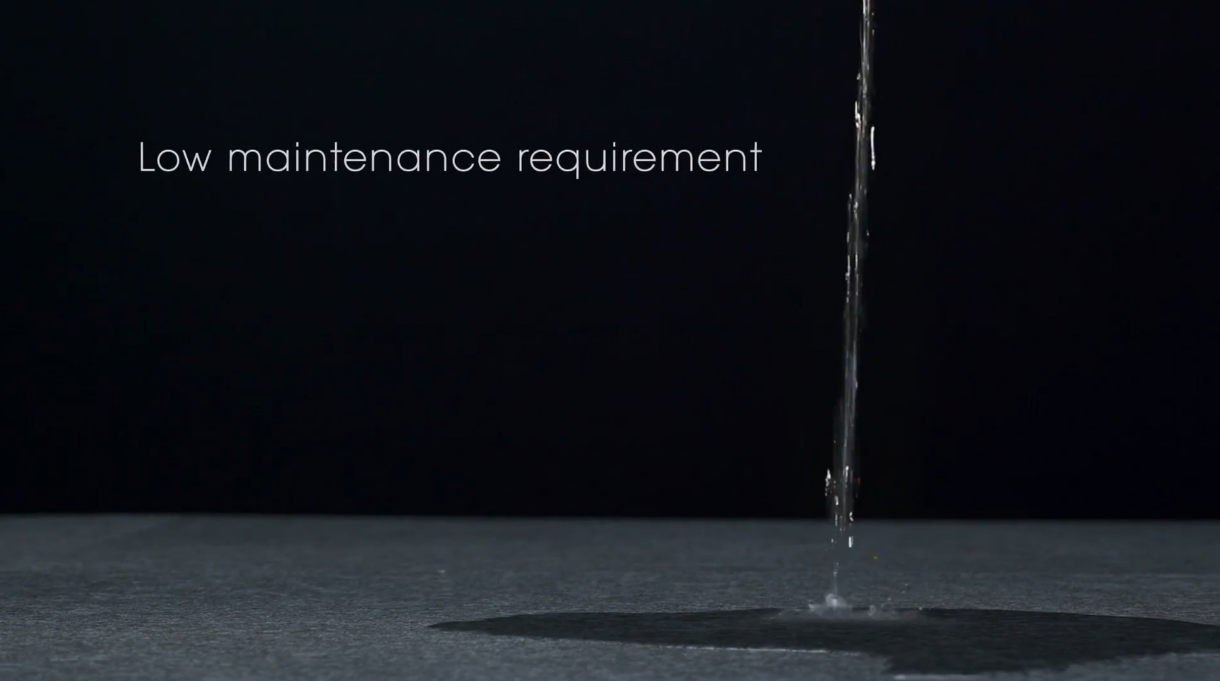
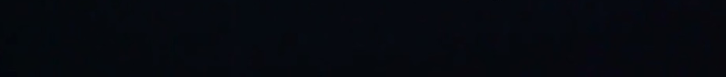
TILE | INHERENT SUSTAINABLE ATTRIBUTES
Moisture tolerant

Slide 7

TILE | INHERENT SUSTAINABLE ATTRIBUTES
Impact and abrasion resistant

Slide 8

TILE | INHERENT SUSTAINABLE ATTRIBUTES
Non-combustible

Slide 9

TILE | INHERENT SUSTAINABLE ATTRIBUTES
Mold resistant

Slide 10
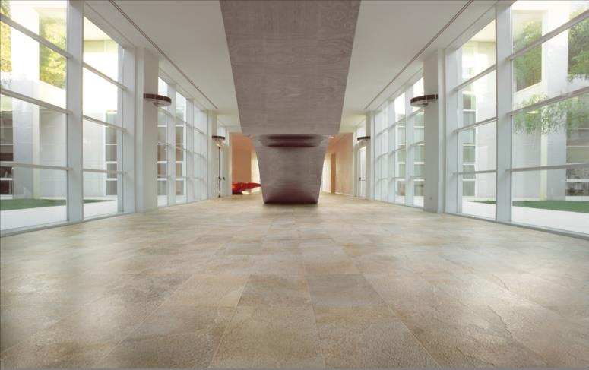
TILE | INHERENT SUSTAINABLE ATTRIBUTES
Non emitting; contributes to indoor air quality

Slide 11
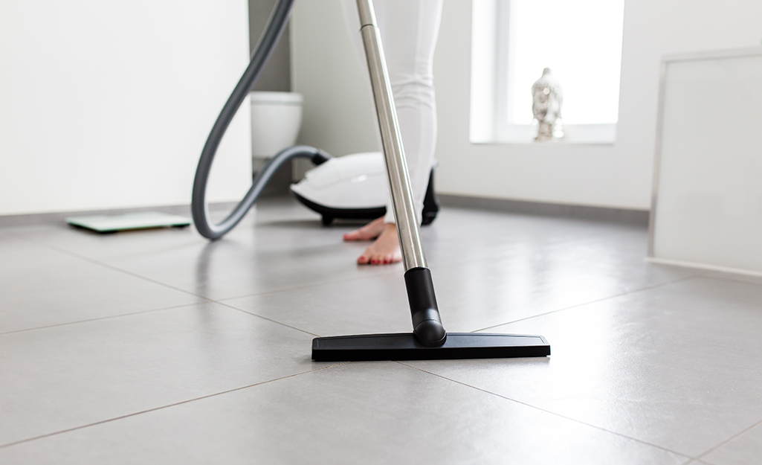

TILE | INHERENT SUSTAINABLE ATTRIBUTES
Easy to clean and maintain
Notes:
Source: TCNA, Chitty, Griese: Selling Tile Post Pandemic, Coverings Connected 2020

Slide 12
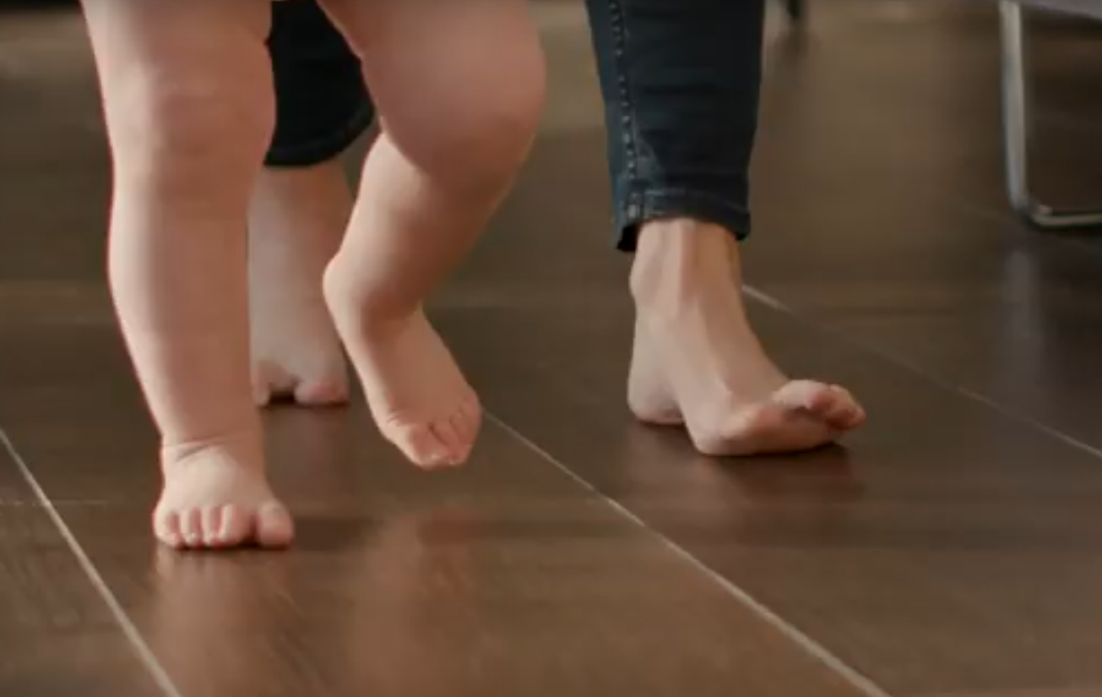
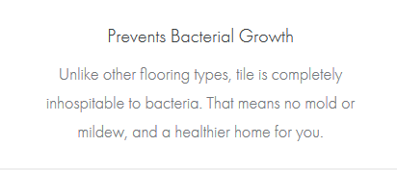
TILE | INHERENT SUSTAINABLE ATTRIBUTES
Inhospitable to bacteria

Slide 13
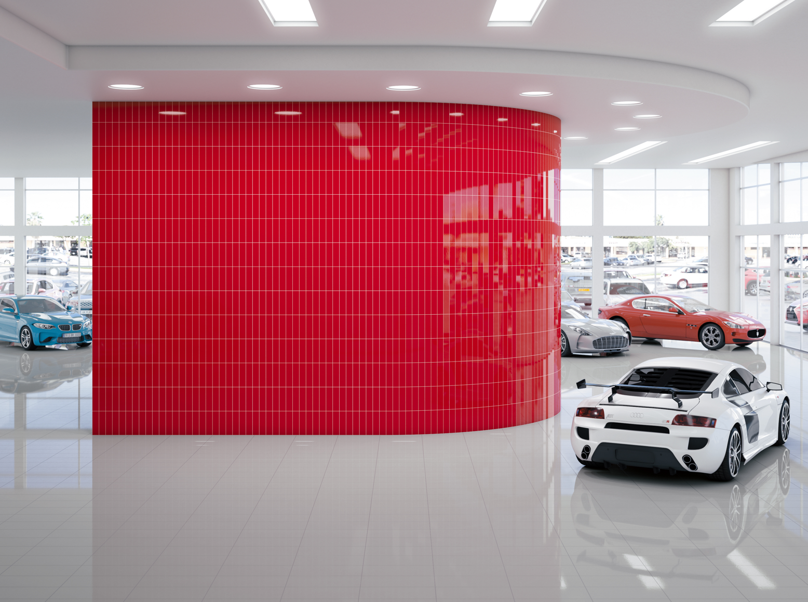
TILE | INHERENT SUSTAINABLE ATTRIBUTES
Durable

Slide 14
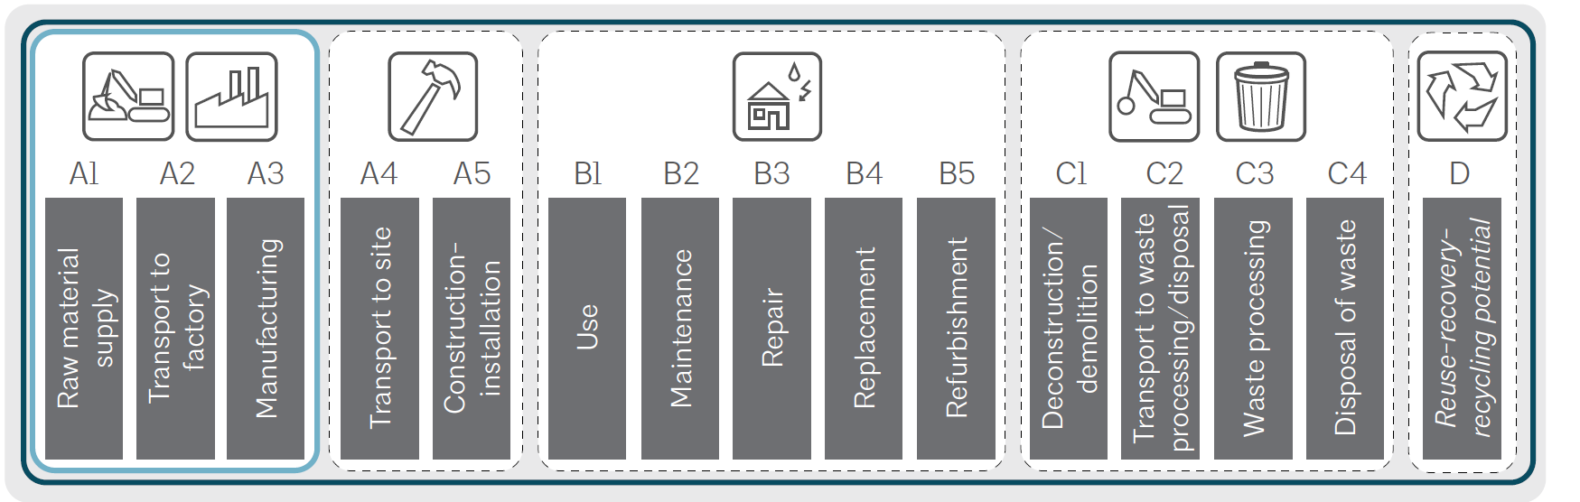
TILE | INHERENT SUSTAINABLE ATTRIBUTES
Competitive life cycle cost

Slide 15
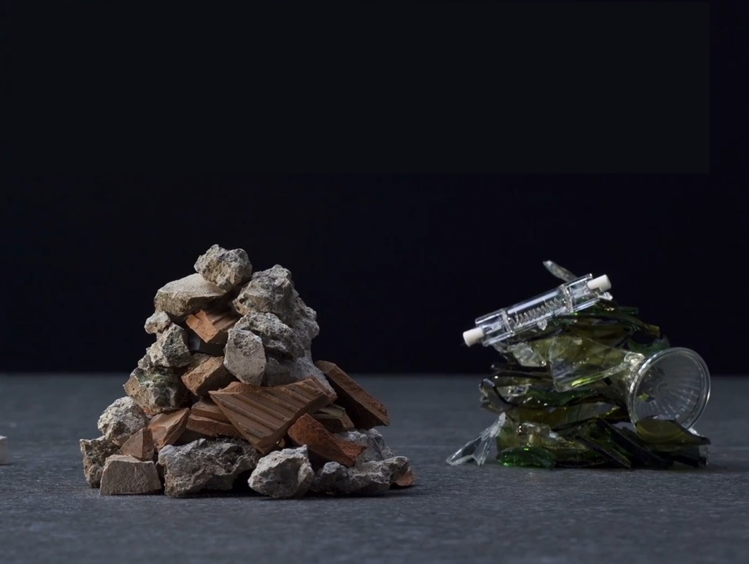
MANUFACTURING AND MATERIAL INGREDIENTS

Slide 16
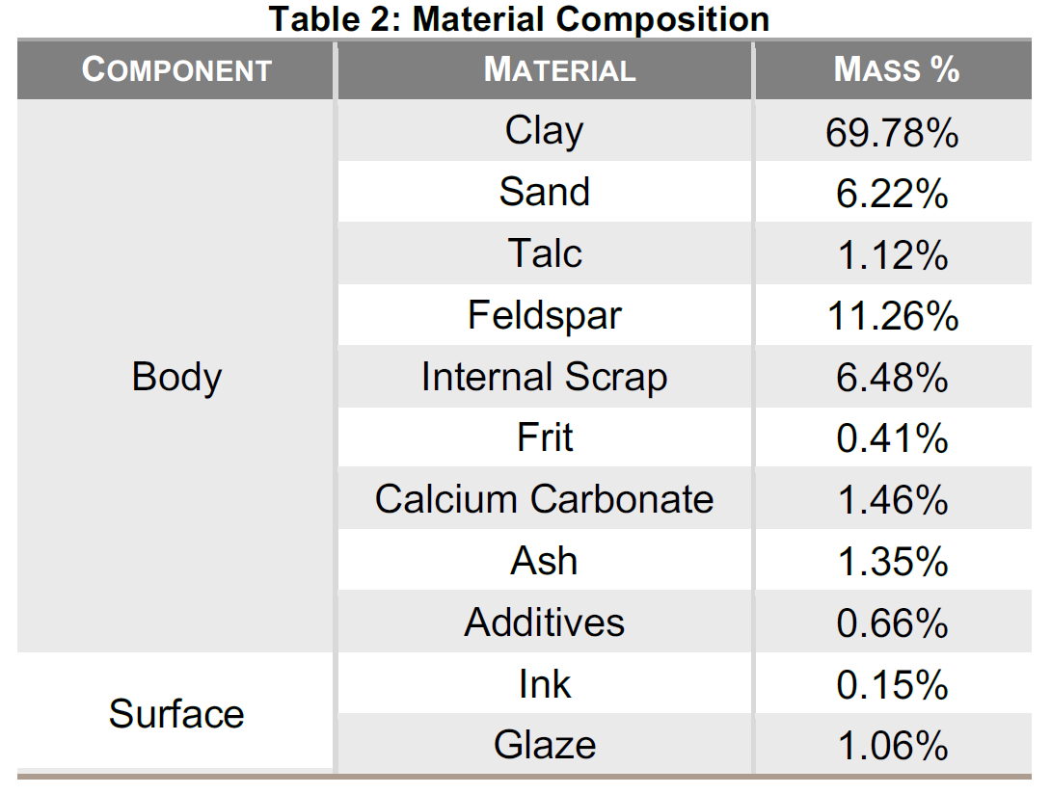
MANUFACTURE OF TILE
Raw materials
From the industry-wide EPD for ceramic tiles manufactured in North America
Notes:
This table is from the industry-wide EPD for ceramic tiles manufactured in North America. The general composition is presented as a production-weighted average to protect the confidentiality of the composition of individual manufacturers’ products.
Clay - Wikipedia
Wikipediahttps://en.wikipedia.org › wiki › Clay
Clay is a type of fine-grained natural soil material containing clay minerals (hydrous aluminium phyllosilicates, e.g. kaolinite, Al2Si2O5(OH)4).

Slide 17
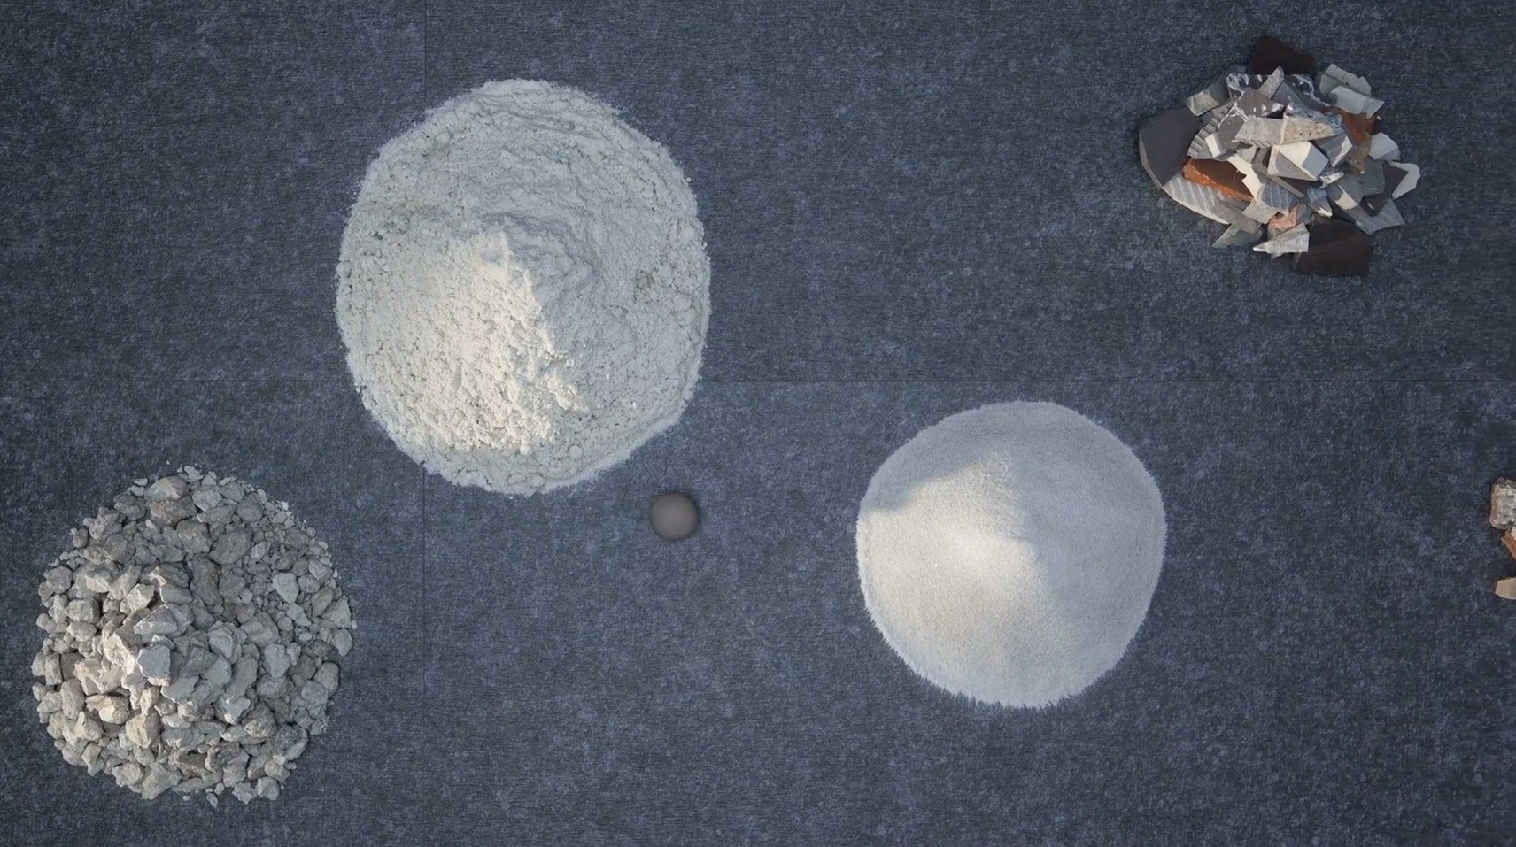
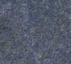
MANUFACTURE OF TILE
Raw materials
Clay
Kaolin
Feldspar
Notes:
Conceptual slides on the manufacture of tile are from Ceramics of Italy YouTube video, https://www.youtube.com/watch?v=87ca2H2LtzY&t=332s
Clay - Wikipedia
Wikipediahttps://en.wikipedia.org › wiki › Clay
Clay is a type of fine-grained natural soil material containing clay minerals (hydrous aluminium phyllosilicates, e.g. kaolinite, Al2Si2O5(OH)4).

Slide 18
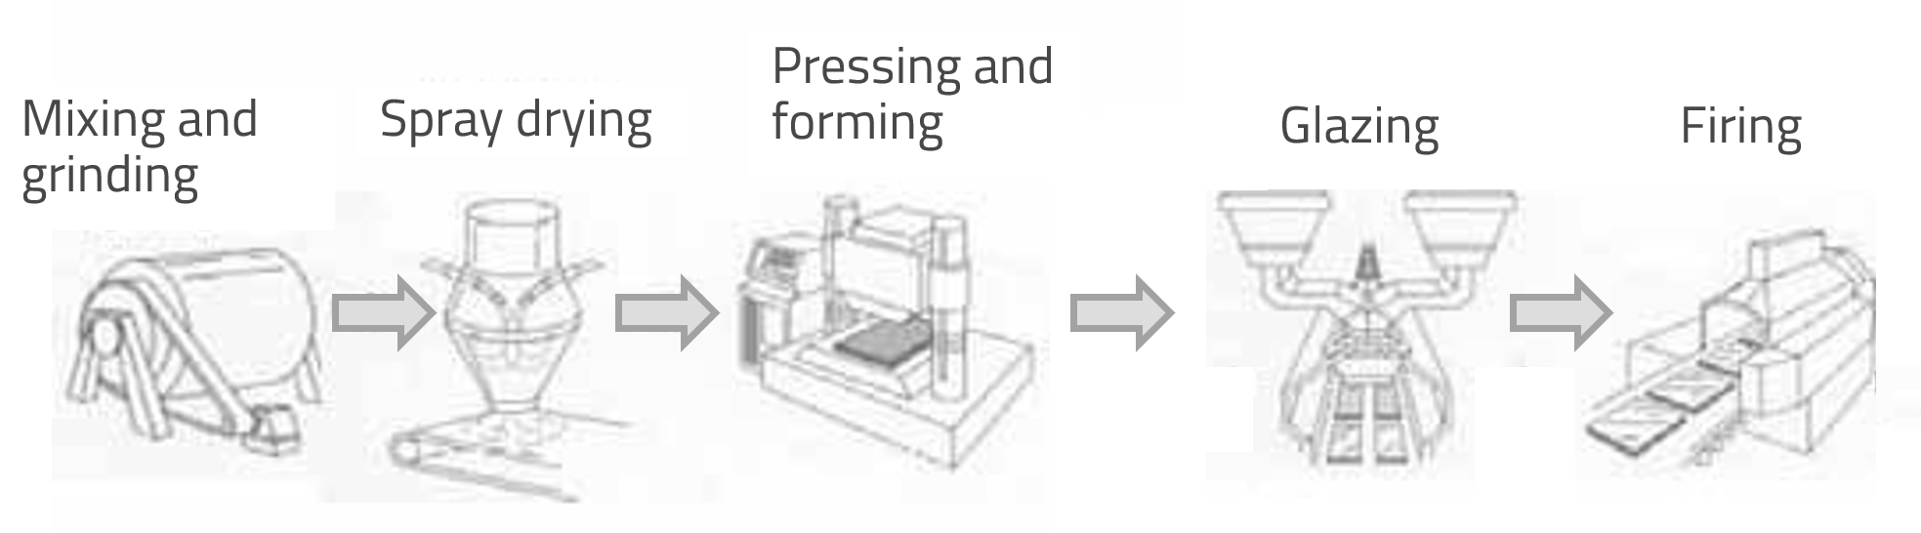
MANUFACTURE OF TILE
Raw materials
Clay
Kaolin
Feldspar
Production waste
Materials reused from other industries
Notes:
By reusing construction waste and materials from other industries. This way we reduce the consumption of raw materials and the CO2 emissions deriving from transport.
Conceptual slides on the manufacture of tile are from Ceramics of Italy YouTube video, https://www.youtube.com/watch?v=87ca2H2LtzY&t=332s

Slide 19
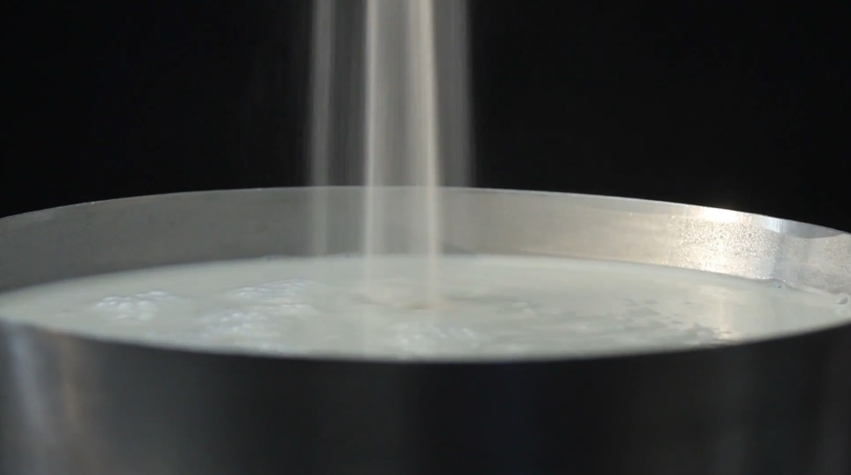
MANUFACTURE OF TILE
Mixing, grinding, creating slurry
Raw materials are mixed, ground, and pulverized
BATCHING
Water is added to form a slurry
100% of the wastewater discharged from the production process is retrieved
Notes:
Conceptual slides on the manufacture of tile are from Ceramics of Italy YouTube video, https://www.youtube.com/watch?v=87ca2H2LtzY&t=332s

Slide 20
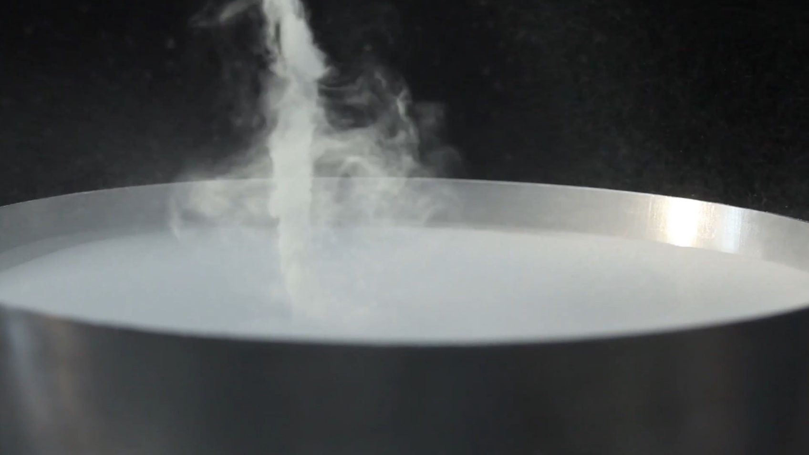
MANUFACTURE OF TILE
Drying
Slurry is spray-dried with a quick-drying process
Notes:
Conceptual slides on the manufacture of tile are from Ceramics of Italy YouTube video, https://www.youtube.com/watch?v=87ca2H2LtzY&t=332s

Slide 21
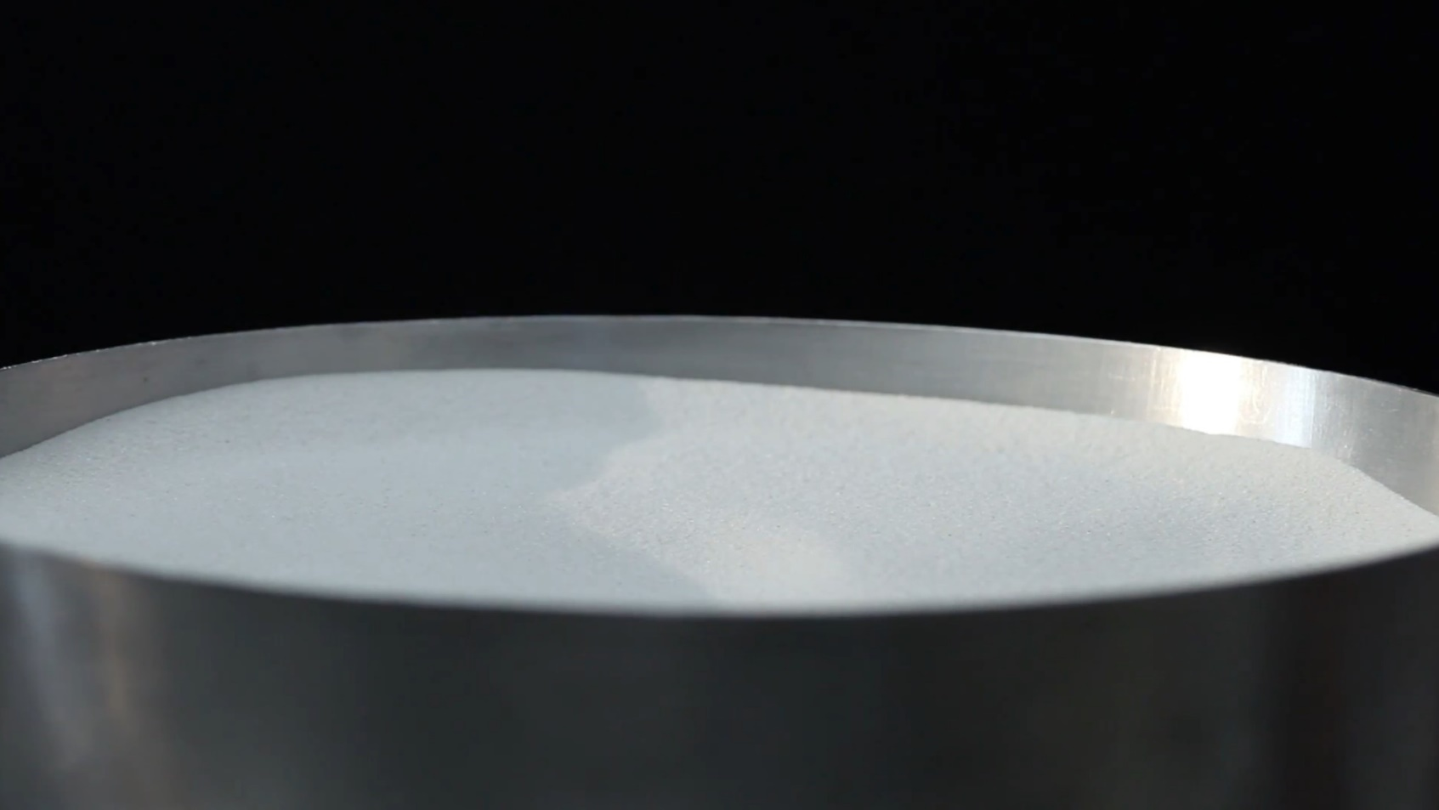
MANUFACTURE OF TILE
Drying
Slurry is spray-dried with a quick-drying process
Water is eliminated leaving a fine powder
Notes:
Conceptual slides on the manufacture of tile are from Ceramics of Italy YouTube video, https://www.youtube.com/watch?v=87ca2H2LtzY&t=332s

Slide 22
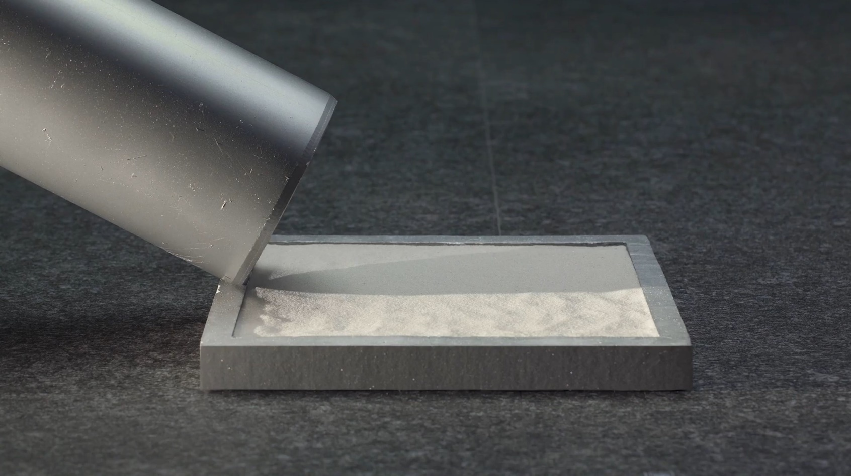
MANUFACTURE OF TILE
Pressing
Spray-dried powder is placed into a die
Notes:
Conceptual slides on the manufacture of tile are from Ceramics of Italy YouTube video, https://www.youtube.com/watch?v=87ca2H2LtzY&t=332s

Slide 23
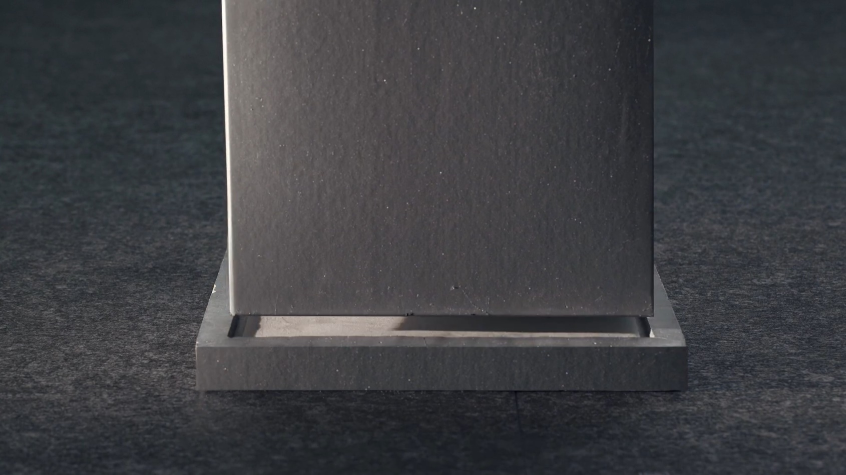
MANUFACTURE OF TILE
Pressing
Spray-dried powder is placed into a die
Spray-dried powder is pressed…
Notes:
Conceptual slides on the manufacture of tile are from Ceramics of Italy YouTube video, https://www.youtube.com/watch?v=87ca2H2LtzY&t=332s

Slide 24
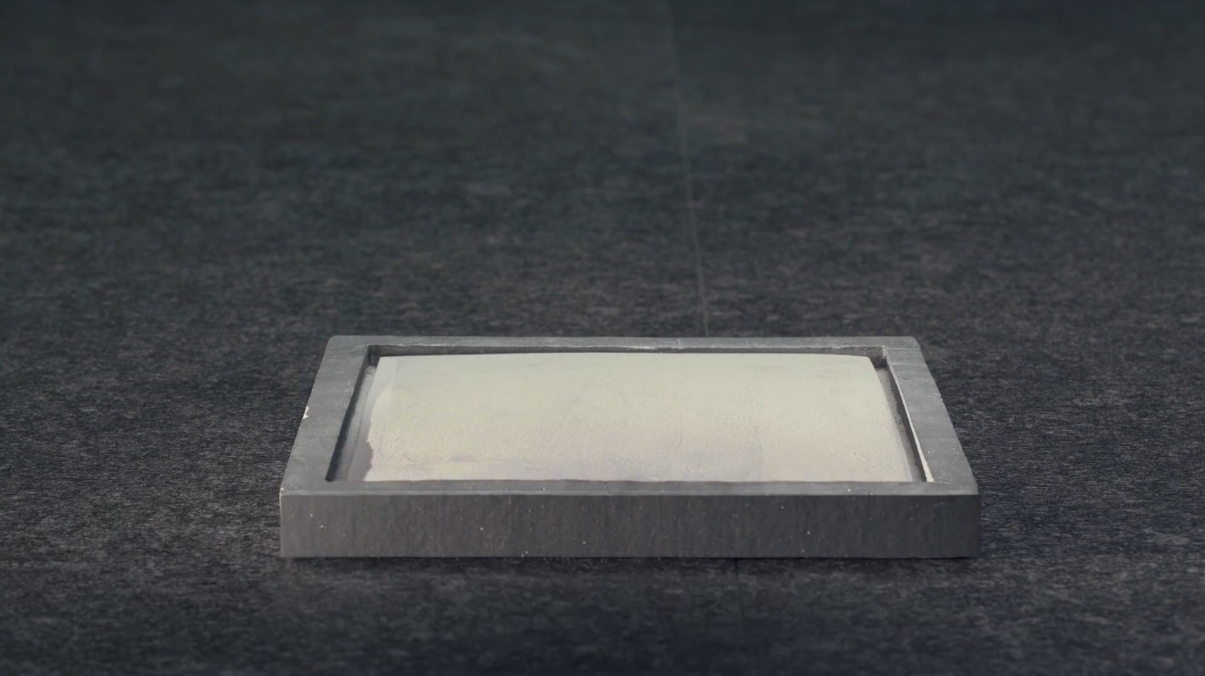
MANUFACTURE OF TILE
Pressing
Spray-dried powder is placed into a die
Spray-dried powder is pressed…
to create the formed product
Notes:
Conceptual slides on the manufacture of tile are from Ceramics of Italy YouTube video, https://www.youtube.com/watch?v=87ca2H2LtzY&t=332s

Slide 25
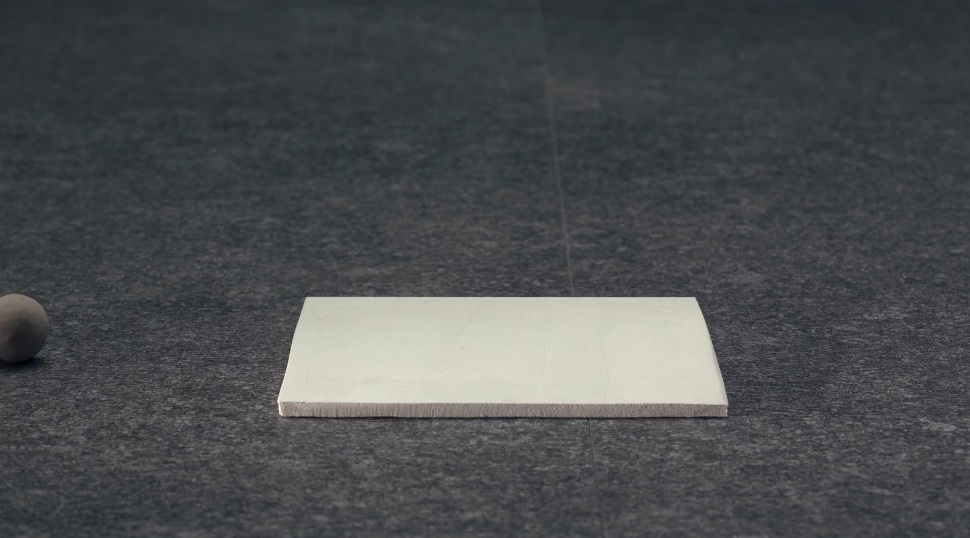
MANUFACTURE OF TILE
Drying
Tile is dried
Notes:
Conceptual slides on the manufacture of tile are from Ceramics of Italy YouTube video, https://www.youtube.com/watch?v=87ca2H2LtzY&t=332s

Slide 26
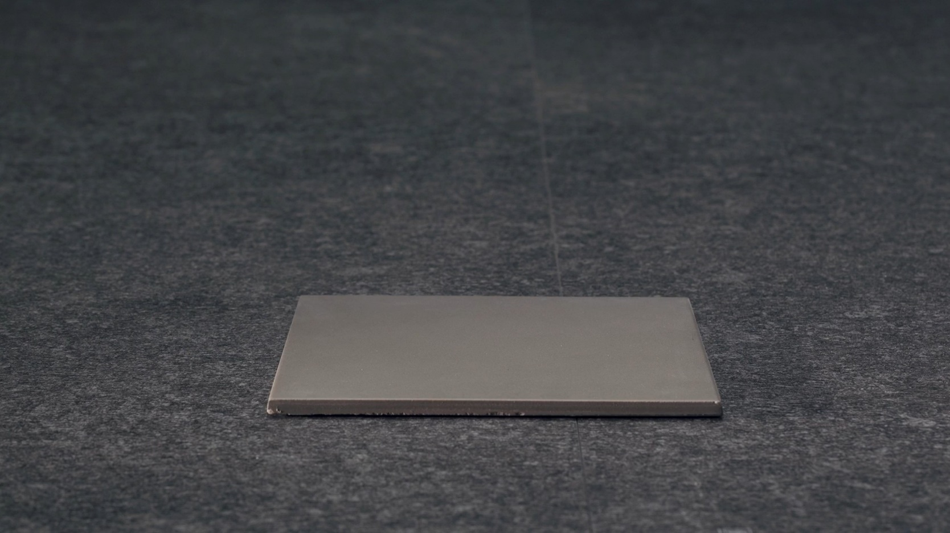
MANUFACTURE OF TILE
Glazing
Tile is glazed
Notes:
Conceptual slides on the manufacture of tile are from Ceramics of Italy YouTube video, https://www.youtube.com/watch?v=87ca2H2LtzY&t=332s

Slide 27

MANUFACTURE OF TILE
Firing
Tile is fired; this is the most process that requires the most amount of energy.
Roller kiln technology has reduced firing times.
Heat recovery technologies have reduced energy consumption 47% since 1980.
Notes:
Conceptual slides on the manufacture of tile are from Ceramics of Italy YouTube video, https://www.youtube.com/watch?v=87ca2H2LtzY&t=332s

Slide 28
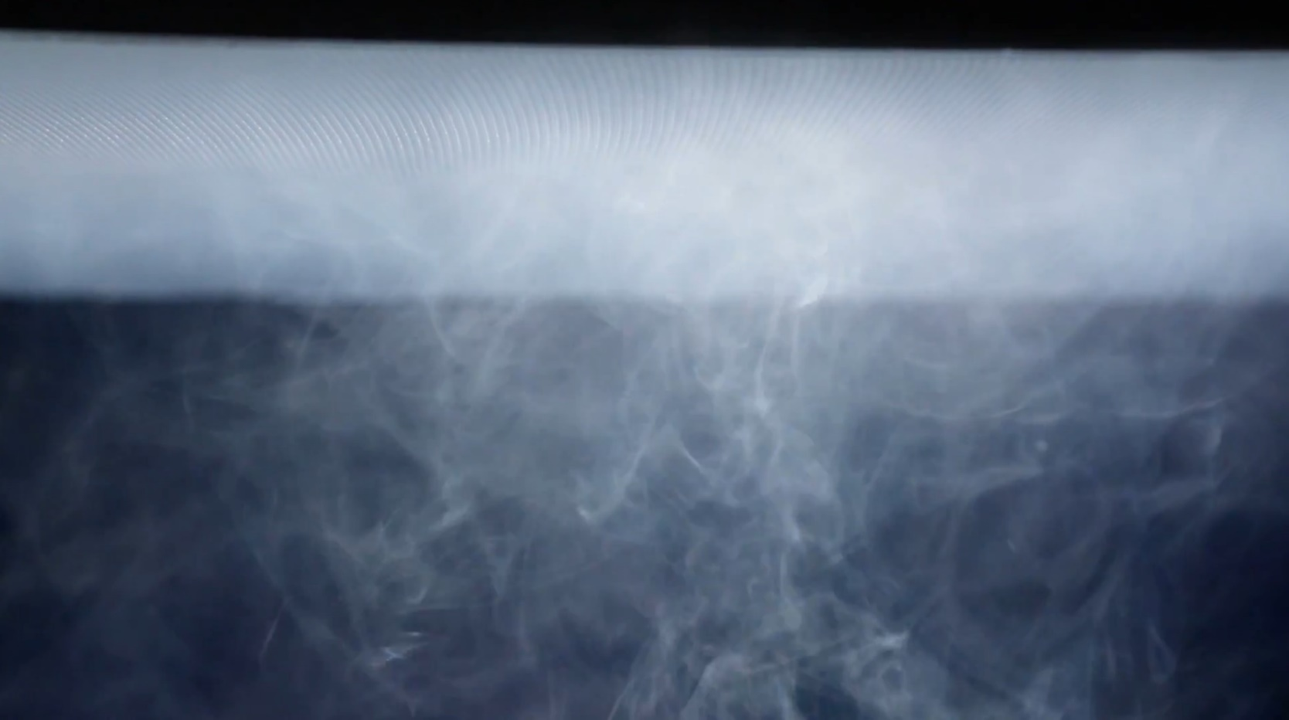
MANUFACTURE OF TILE
Firing
During firing, 99% of dust emissions are captured using abatement filters.
Notes:
Conceptual slides on the manufacture of tile are from Ceramics of Italy YouTube video, https://www.youtube.com/watch?v=87ca2H2LtzY&t=332s

Slide 29

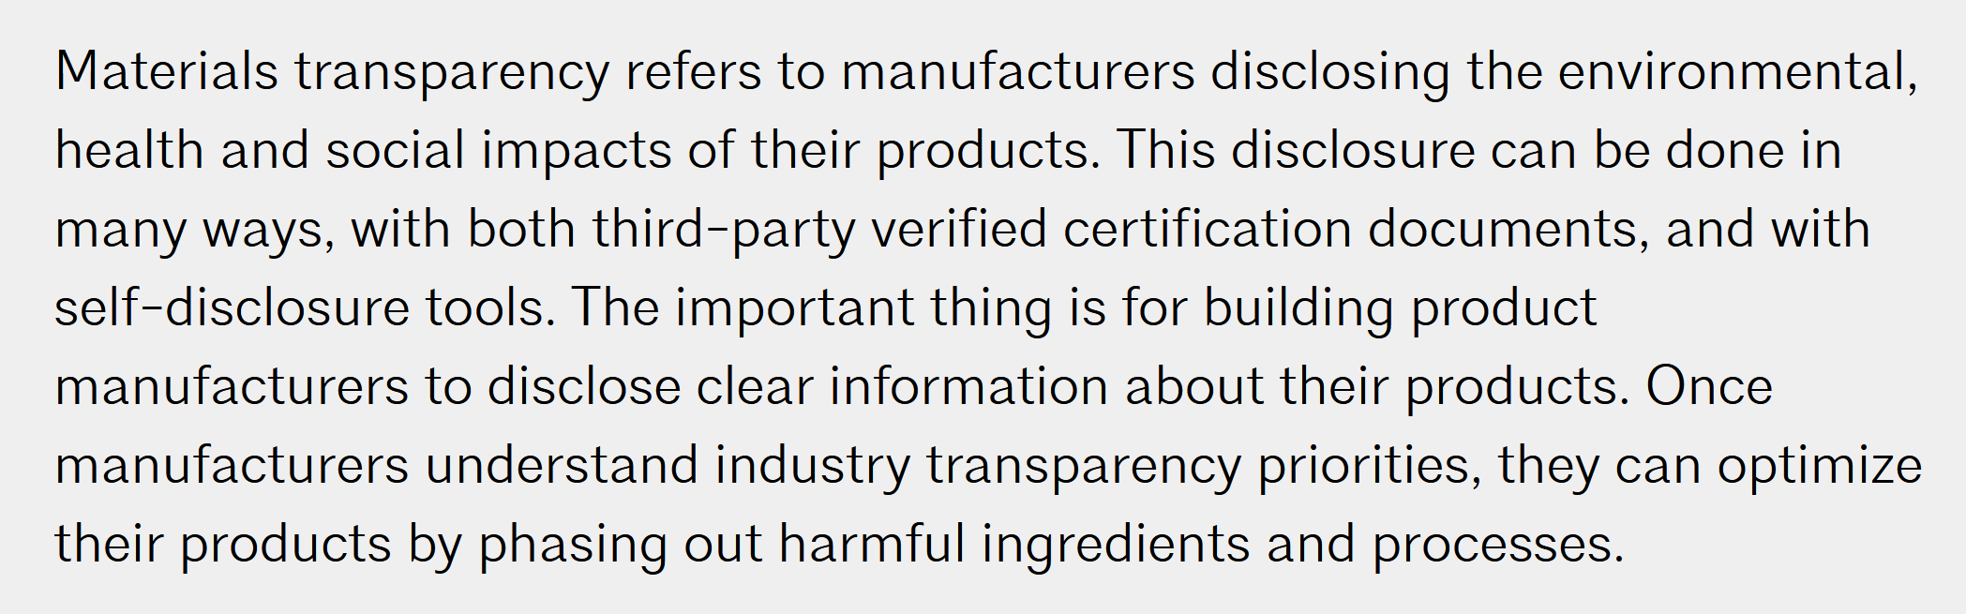
MATERIAL INGREDIENT TRANSPARENCY
What is transparency?
https://www.aia.org/pages/150126-how-materials-transparency-affects-your-pra
Notes:
Why should I care about a resource for manufacturers if I’m not a manufacturer?

Slide 30

MATERIAL INGREDIENT TRANSPARANCY
Why is transparency important?
Material ingredient transparency is a fundamental step manufacturers take toward compliance with green and healthy building certification programs.
LEED
WELL
Living Building Challenge (LBC)
… others
Notes:
Why should I care about a resource for manufacturers if I’m not a manufacturer?

Slide 31
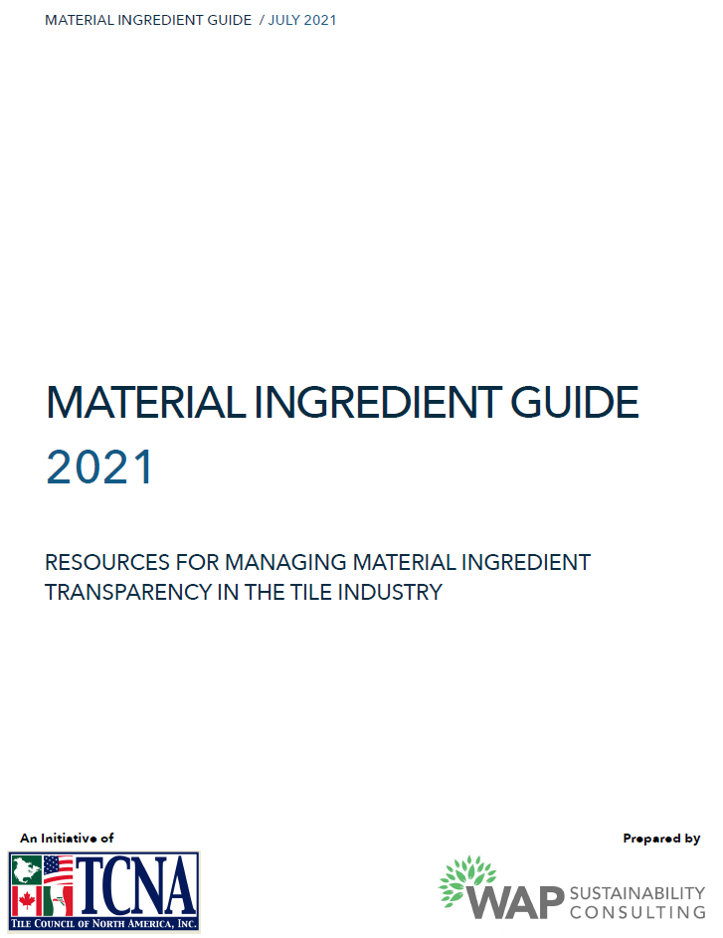
MATERIAL INGREDIENT GUIDE
What is the Material Ingredient Guide?
A resource for ceramic tile, mortar, and grout manufacturers to use when providing the content and chemical makeup of their products.
Uses standard reporting formats:
Health Product Declaration (HPD)
Manufacturer Inventory (MI)
Why should I care about a resource for manufacturers?
Notes:
Why should I care about a resource for manufacturers if I’m not a manufacturer?

Slide 32
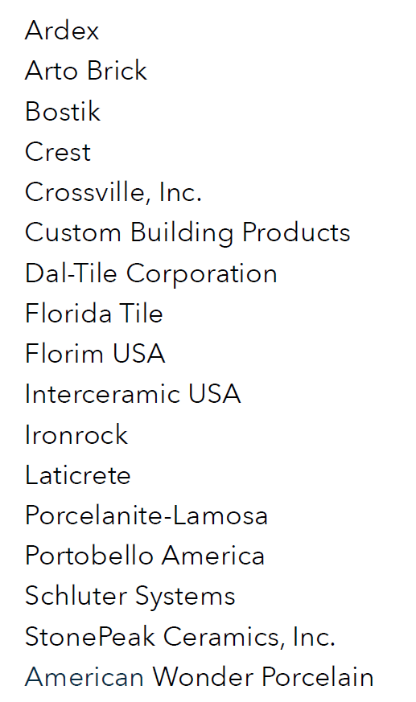

MATERIAL INGREDIENT GUIDE
Participants & Supporters
Who is behind it?
Initiative of the Tile Council of North America (TCNA).
17 manufacturers collaborated on crowdfunding GreenScreen® benchmark scores.
Notes:
Greenscreen benchmark scores

Slide 33
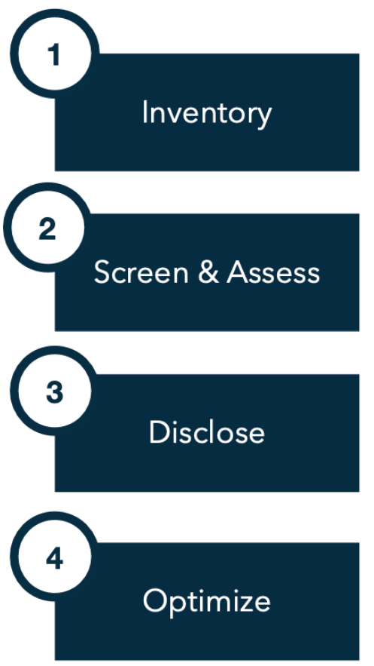
MATERIAL INGREDIENT GUIDE | FOUR STEPS OF TRANSPARENCY
These steps guide ceramic tile, mortar, and grout manufacturers in developing material ingredient reports using formats such as HPD and MI that satisfy common A&D criteria.

Slide 34
MATERIAL INGREDIENT GUIDE | STEP 1: INVENTORY
For all building products, the risk of chemical exposure should be considered high unless proven otherwise.
Chemicals are required to be inventoried if present at minimum threshold.
Manufacturers must identify the substances used in their products to a threshold of 1,000 ppm or 100 ppm.
Notes:
It is important to note that 100ppm is more stringent and requires
inventorying substances present at lower concentrations than a threshold of 1,000 ppm, and
hence, is likely to require inventorying more substances. WAP Sustainability recommends that
manufacturers target a threshold of 100 ppm for all intentionally added substances to maximize
contribution toward green and healthy building program requirements. Additionally,
concentrations can be expressed as percentages, with 100 ppm = 0.01%, 1,000 ppm = 0.1%,
and 10,000 ppm = 1.0%.

Slide 35
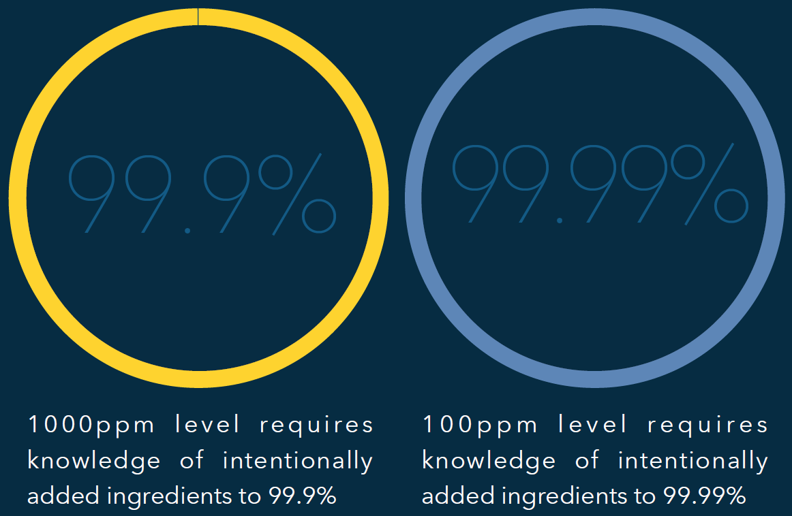
MATERIAL INGREDIENT GUIDE | STEP 1: INVENTORY
Inventory Thresholds
1,000 ppm level requires knowledge of intentionally added ingredients to 99.9%
100 ppm level requires knowledge of intentionally added ingredients to 99.99%
Notes:
It is important to note that 100ppm is more stringent and requires
inventorying substances present at lower concentrations than a threshold of 1,000 ppm, and
hence, is likely to require inventorying more substances. WAP Sustainability recommends that
manufacturers target a threshold of 100 ppm for all intentionally added substances to maximize
contribution toward green and healthy building program requirements. Additionally,
concentrations can be expressed as percentages, with 100 ppm = 0.01%, 1,000 ppm = 0.1%,
and 10,000 ppm = 1.0%.

Slide 36

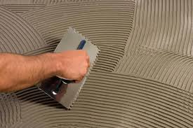
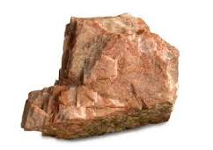
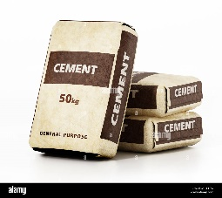

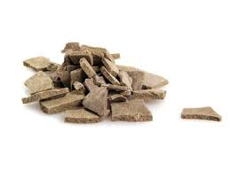
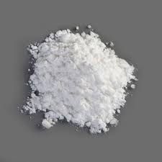
MATERIAL INGREDIENT GUIDE | STEP 1: INVENTORY
Tile
Mortar
Portland cement
Feldspar
Quartz, aluminum oxide, calcium oxide, potassium oxide, sodium oxide
Calcium oxide, quartz, aluminum oxide, iron oxide, sulfur trioxide
Notes:
Feldspar is a group of naturally occurring aluminosilicate minerals, meaning they contain aluminum, silicon, and oxygen, as well as various amounts of potassium, sodium, and calcium. Specifically, the three compositional endmembers of feldspar are K-feldspar (KAlSi3O8), albite (NaAlSi3O8), and anorthite (CaAl2Si2O8)

Slide 37
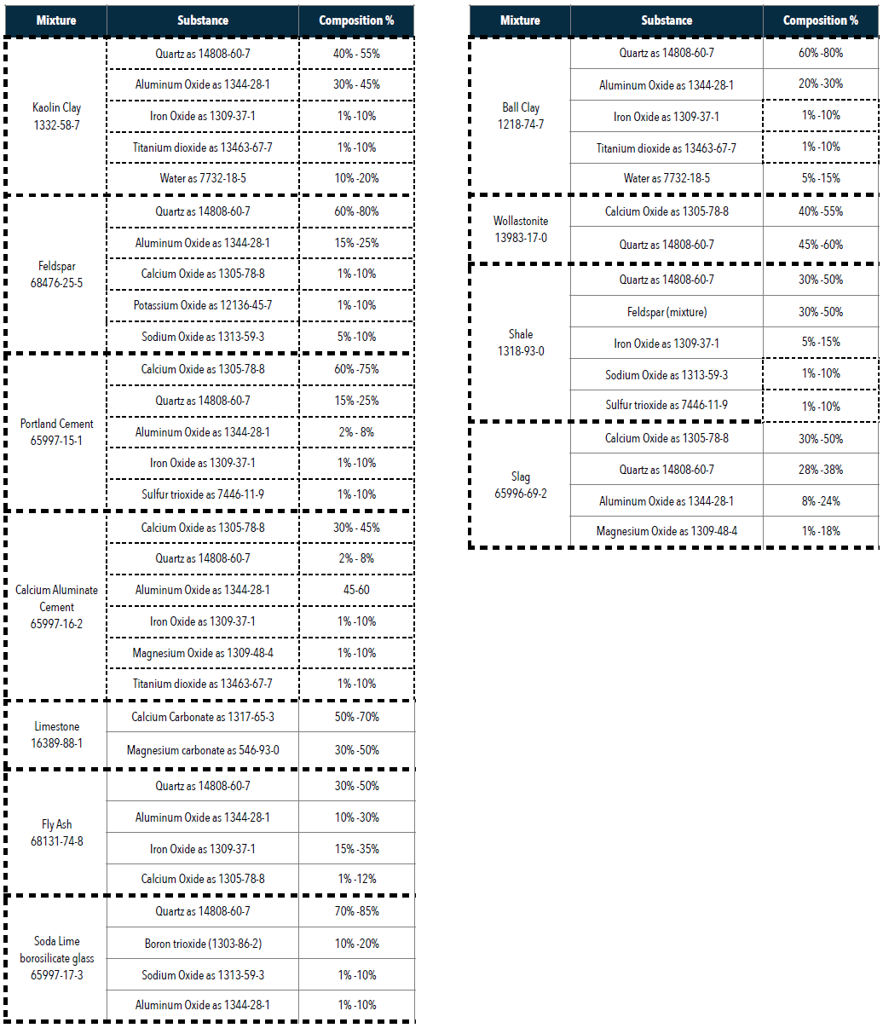
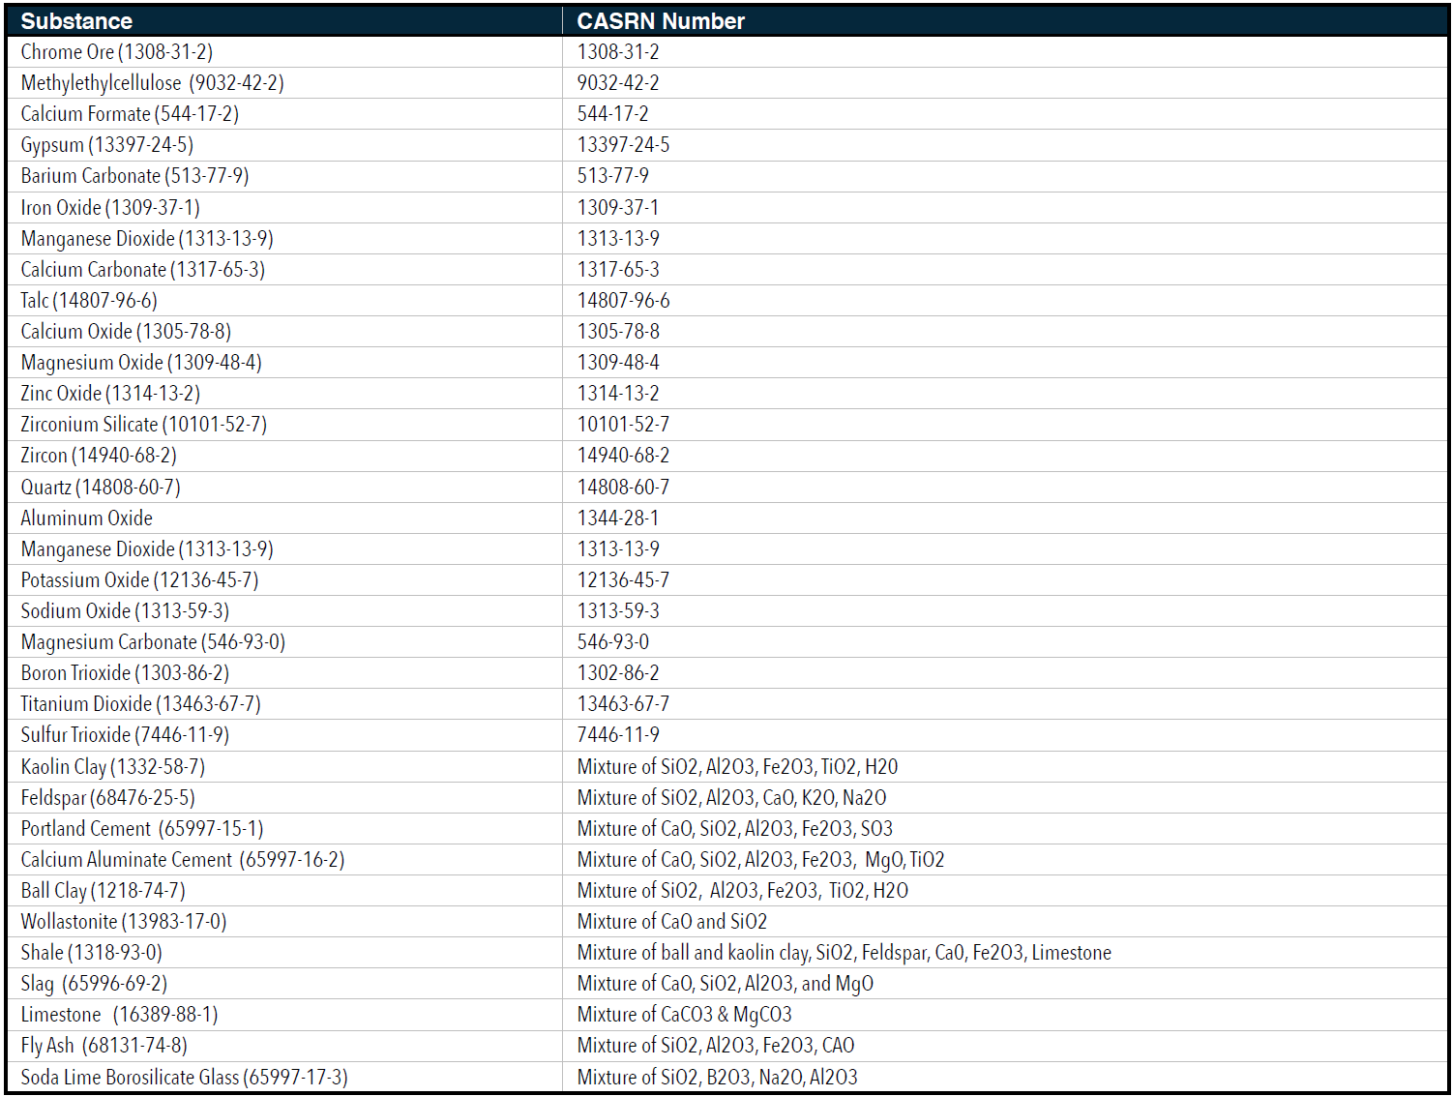
MATERIAL INGREDIENT GUIDE | STEP 1: INVENTORY
Table 2-1: Mixture compositions
Table 2-2: List of chemicals common to ceramic tile, mortar, and/or grout
Notes:
CASRN = Chemical Abstracts Service Registry Number

Slide 38
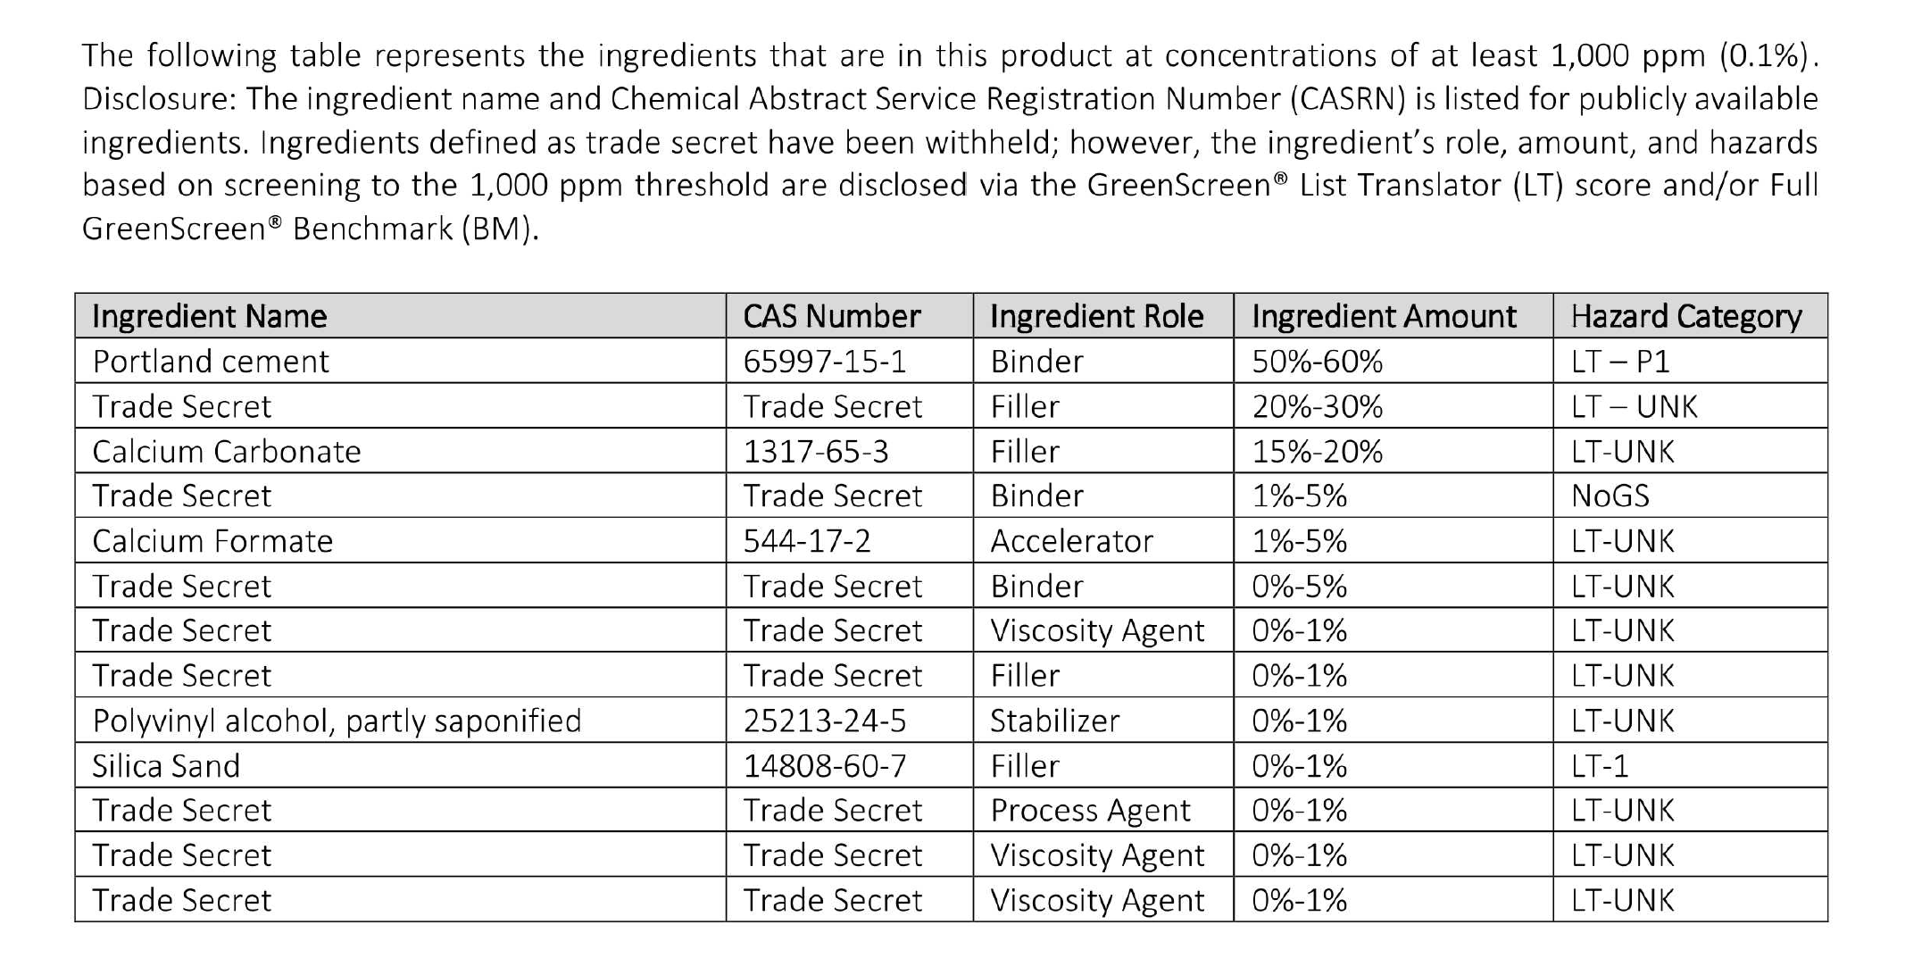
MATERIAL INGREDIENT GUIDE | STEP 1: INVENTORY
Example of manufacturer inventory report
Notes:
Received from Jim Whitfield, Mapei, 3/8/23
CASRN = Chemical Abstracts Service Registry Number

Slide 39
MATERIAL INGREDIENT GUIDE | STEP 2: SCREEN & ASSESS
Evaluate the toxicological profile associated with the individual CASRN identified for each substance in the inventory
Various screening methods from basic automated online tools to GreenScreen® assessment
Notes:
CASRN = Chemical Abstracts Service Registry Number

Slide 40

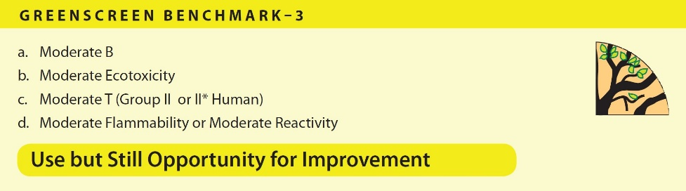

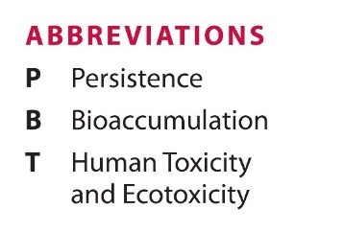

MATERIAL INGREDIENT | GREENSCREEN BENCHMARK SCORES
Each chemical evaluated under GreenScreen® is assigned a Benchmark between 1 and 4.
A higher benchmark indicates progressively safer chemicals.
The Benchmark score is determined by analyzing specific combinations of hazard classifications for the 18 endpoints included in GreenScreen.
https://www.greenscreenchemicals.org/learn/full-greenscreen-method
Notes:
https://www.greenscreenchemicals.org/learn/full-greenscreen-method
PERSISTENCE: “The length of time the chemical can exist in the environment before being
destroyed (i.e., transformed) by natural processes.” (USEPA, https://www.epa.
gov/sites/production/files/2014-01/documents/aa_criteria_v2.pdf, accessed
9/20/17)
BIOACCUMULATION: “A process in which a chemical substance is absorbed in an organism by all routes
of exposure as occurs in the natural environment (e.g., dietary and ambient environment
sources). Bioaccumulation is the net result of competing processes of
chemical uptake into the organism at the respiratory surface and from the diet
and chemical elimination from the organism including respiratory exchange, fecal
egestion, metabolic biotransformation of the parent compound and growth dilution.”
(Arnot, J.A. and F.A. Gobas, A review of bioconcentration factor (BCF) and bioaccumulation
factor (BAF) assessments for organic chemicals in aquatic organisms.

Slide 41
MATERIAL INGREDIENT GUIDE | STEP 3: DISCLOSE
If transparency is a trust virtue, then disclosure is the tool to achieve that trust.
Consistency in disclosure is a necessary condition for transparency.
Ingredient information is disclosable using reporting formats widely accepted as transparent by green and healthy building certification programs:
Health Product Declarations (HPDs)
Manufacturer Inventories (MIs)
Notes:
Disclosure also creates an opportunity for the tile industry for three reasons: 1) the majority of
ingredients used by ceramic tile, mortar, and grout manufacturers have been inventoried,
screened, and fully assessed; 2) substance-level breakdown of the ingredients common to
ceramic tile, mortar, and grout is achievable and well-understood; 3) industry ingredient
information is disclosable using reporting formats widely accepted as transparent by green and
healthy building certification programs.

Slide 42

MATERIAL INGREDIENT GUIDE | HEALTH PRODUCT DECLARATION (HPD)
What is an HPD?
A voluntary technical specification for reporting information on product content associated with health information.
The most recognized and widely adopted material ingredient reporting format for disclosure throughout the building and construction supply chain.
A third party verification program (3PV) independently reviews and verifies completed HPDs.
Can be used to accrue credits in LEED and other rating systems.
Notes:
WAP Consulting provides 3PV for TCNA Material Ingredient Guide participants

Slide 43
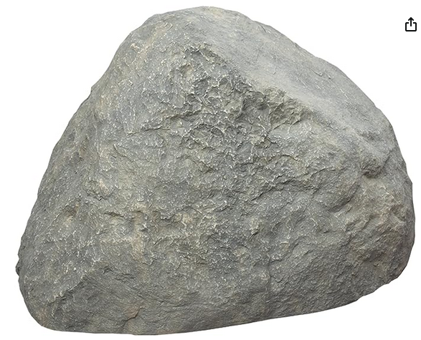
TRANSPARENCY | HEALTH PRODUCT DECLARATION (HPD)
What is an HPD?
A voluntary, 3rd party-verified material ingredient report that serves as a tool for providing transparency about the ingredients in building products.
An HPD for natural stone includes details such as the mineral composition, quarry location, and any additional treatments or finishes applied to the stone.
NSI member quarriers can create HPDs for their products using NSI’s HPD Builder tool. All members’ HPDs are available on NSI’s Sustainability Resources web page.
Notes:
From the NSI website:
Health Product Declarations
A Health Product Declaration (HPD) is a material ingredient report that serves as a tool for providing transparency about the ingredients in building products. An HPD for natural stone includes details such as the mineral composition, quarry location, and any additional treatments or finishes applied to the stone.
Natural Stone Institute member quarriers can use the steps below to easily create HPDs for their products. Once published, they will be publicly available in the HPD Public Repository providing visibility to design teams. With access to the HPDs they are able to check boxes needed to satisfy green building goals including LEED credits.
How to create a material ingredient report for your natural stone product(s):
Step 1: Review NSI’s HPD Templates.
Step 2: Register to use the HPD Builder.
Step 3: Purchase tokens ($375 for 5 HPDs) or become a member of HPDC (starting at $750 for unlimited HPDs).
Step 4: Email HPDC to request NSI’s HPD Templates be added to your HPD Builder account. Be sure to let them know which one(s) you need (limestone, granite, marble, etc).
Step 5: Customize the following fields in the HPDC dashboard:
(see sample forms, next slides)
Step 6: Click through the rest of the fields in the builder and edit as needed. Refer to the HPD Open Standard, if needed, and utilize their Knowledge Base for troubleshooting.
Step 7: Publish your HPDs. This will make them publicly available in the HPD Repository. You can also download them for use on your website and sharing with clients. Send them to the Natural Stone Institute for inclusion on our Sustainability Resources webpage.

Slide 44
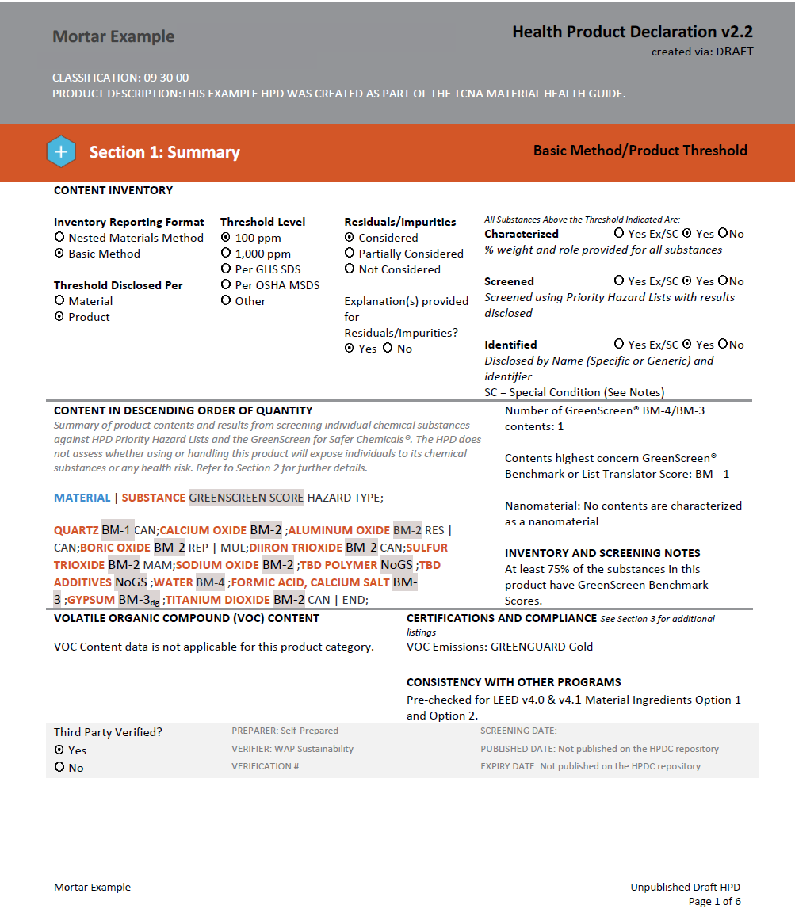
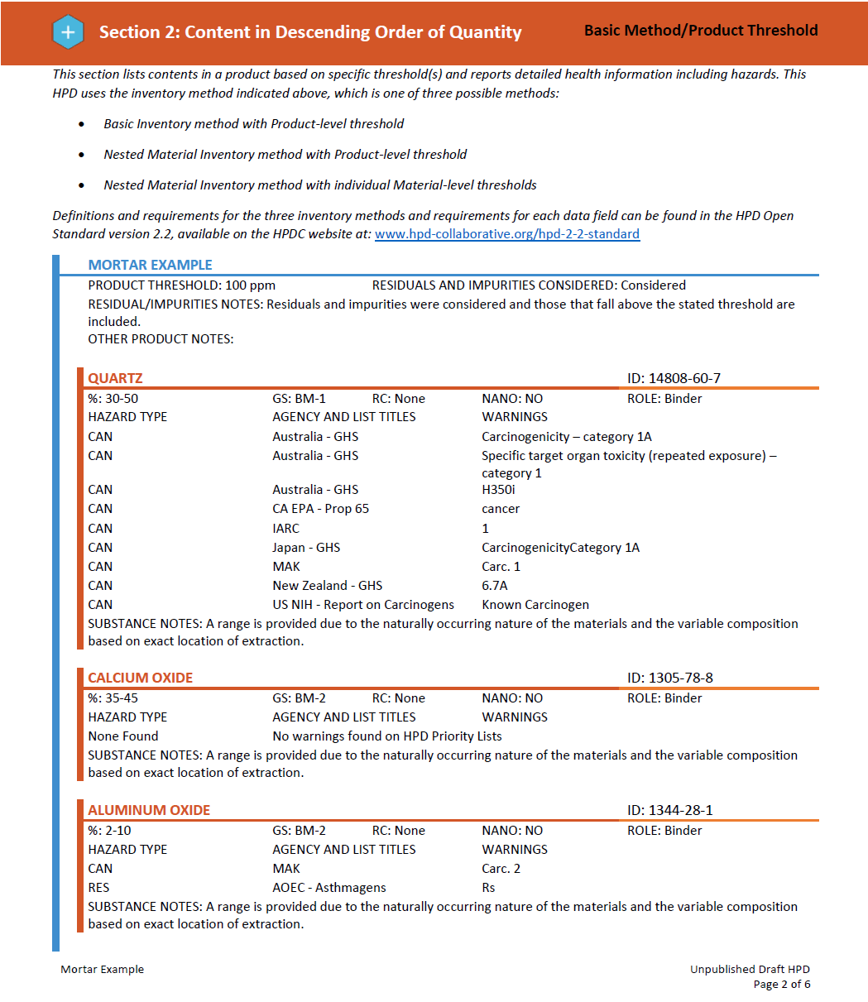
HPD example
Notes:
WAP Consulting provides 3PV for TCNA Material Ingredient Guide participants

Slide 45
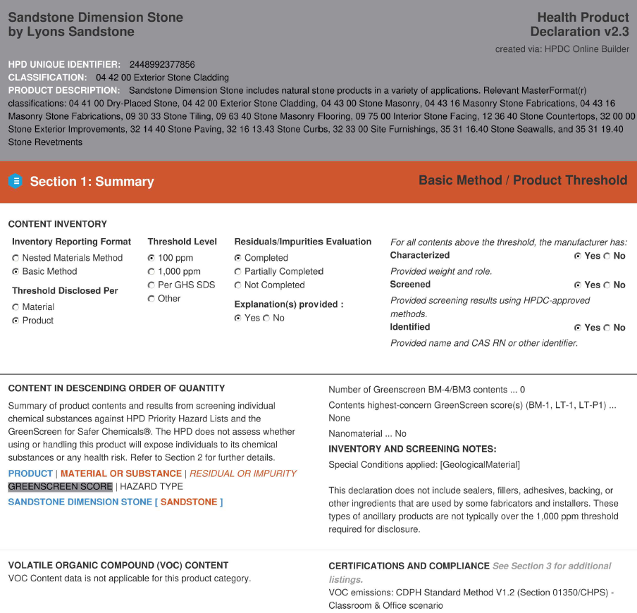
TRANSPARENCY | SUPPLIER HPD
HPD example (supplier):
Lyons Sandstone
Notes:
This is a sample HPD from Polycor for their limestone material. Does “SC” indicate “special condition”

Slide 46
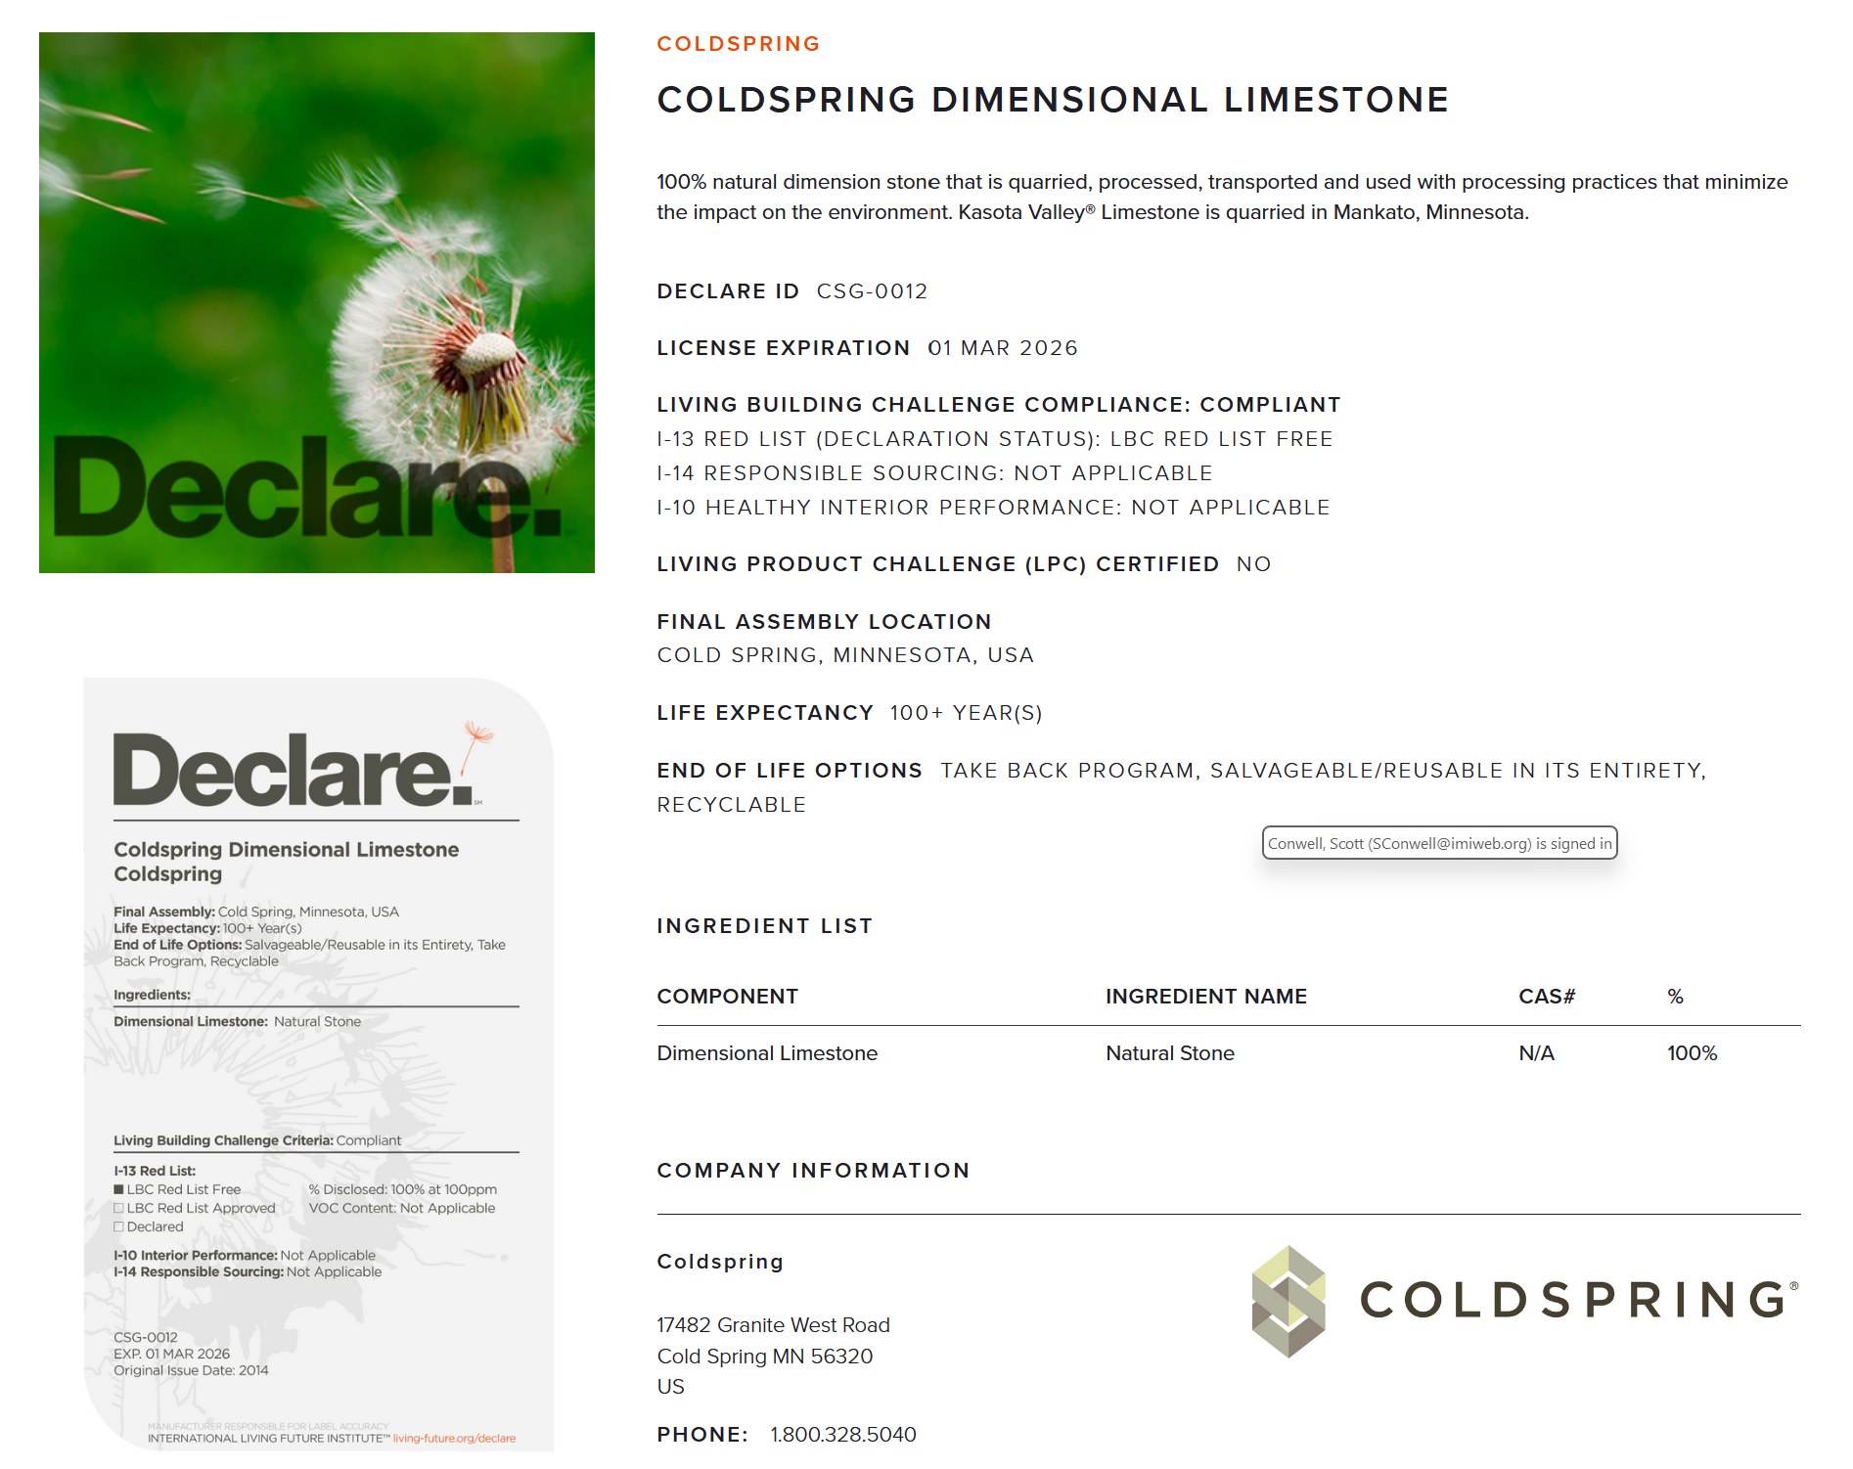
TRANSPARENCY | DECLARE LABEL
Declare label example: Limestone (Coldspring)
Notes:
I need help interpreting this.

Slide 47
MATERIAL INGREDIENT GUIDE | STEP 4: OPTIMIZE
Optimization involves selecting products with the most thorough material ingredient reports.
Green and healthy rating programs incentivize optimization. We’ll look at LEED v4 as an example.

Slide 48

MATERIAL INGREDIENT GUIDE | STEP 4: OPTIMIZE
Regarding the use of building products that exhibit material ingredient transparency, a project can earn up to two points:
Material Ingredient Reporting
1 point
20 different permanently installed products from at least 5 manufacturers use a LEED-specified material ingredient reporting format (HPD or MI) to disclose product ingredients to at least 1,000 ppm
Material Ingredient Optimization
1 additional point
5 different permanently installed products from at least 3 manufacturers satisfy other optimization pathways. This can be achieved by disclosing product ingredients at the substance level of 100 ppm

Slide 49
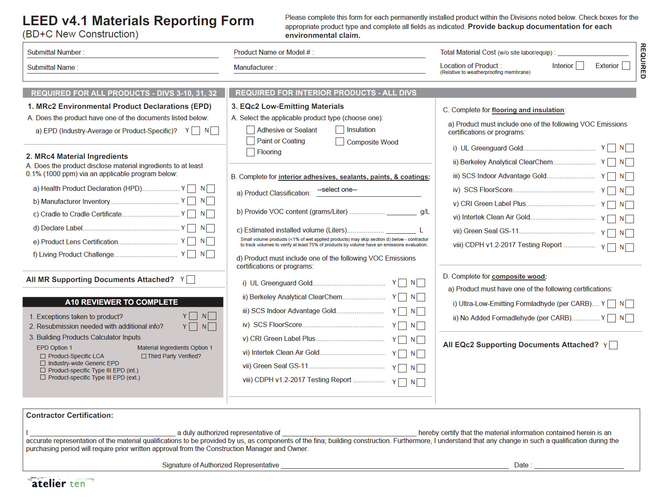
TRANSPARENCY | STEP 4: OPTIMIZE
MATERIALS REPORTING FORM
Does the product disclose material ingredients to at least 0.1% (1000 ppm) via HPD, MI, Declare Label, etc.?
Notes:
Who are making those requests?

Slide 50


RATINGS SYSTEMS | LBC & IWBI
Living Building Challenge
The International Living Future Institute (ILFI) and the LBC are the primary stewards of “The Red List,” a list of harmful chemicals and ingredients commonly used. LBC requires all products to be Red List Free or LBC Compliant using its own reporting format, the Declare Label.
International Well Building Institute
WELL Material Ingredient Transparency criteria are harmonized with LEED’s criteria with multiple levels of credit for manufacturers who effectuate higher levels of product ingredient reporting or third party verification.
Notes:
International Living Future Institute (ILFI) Living Building Challenge (LBC)

Slide 51
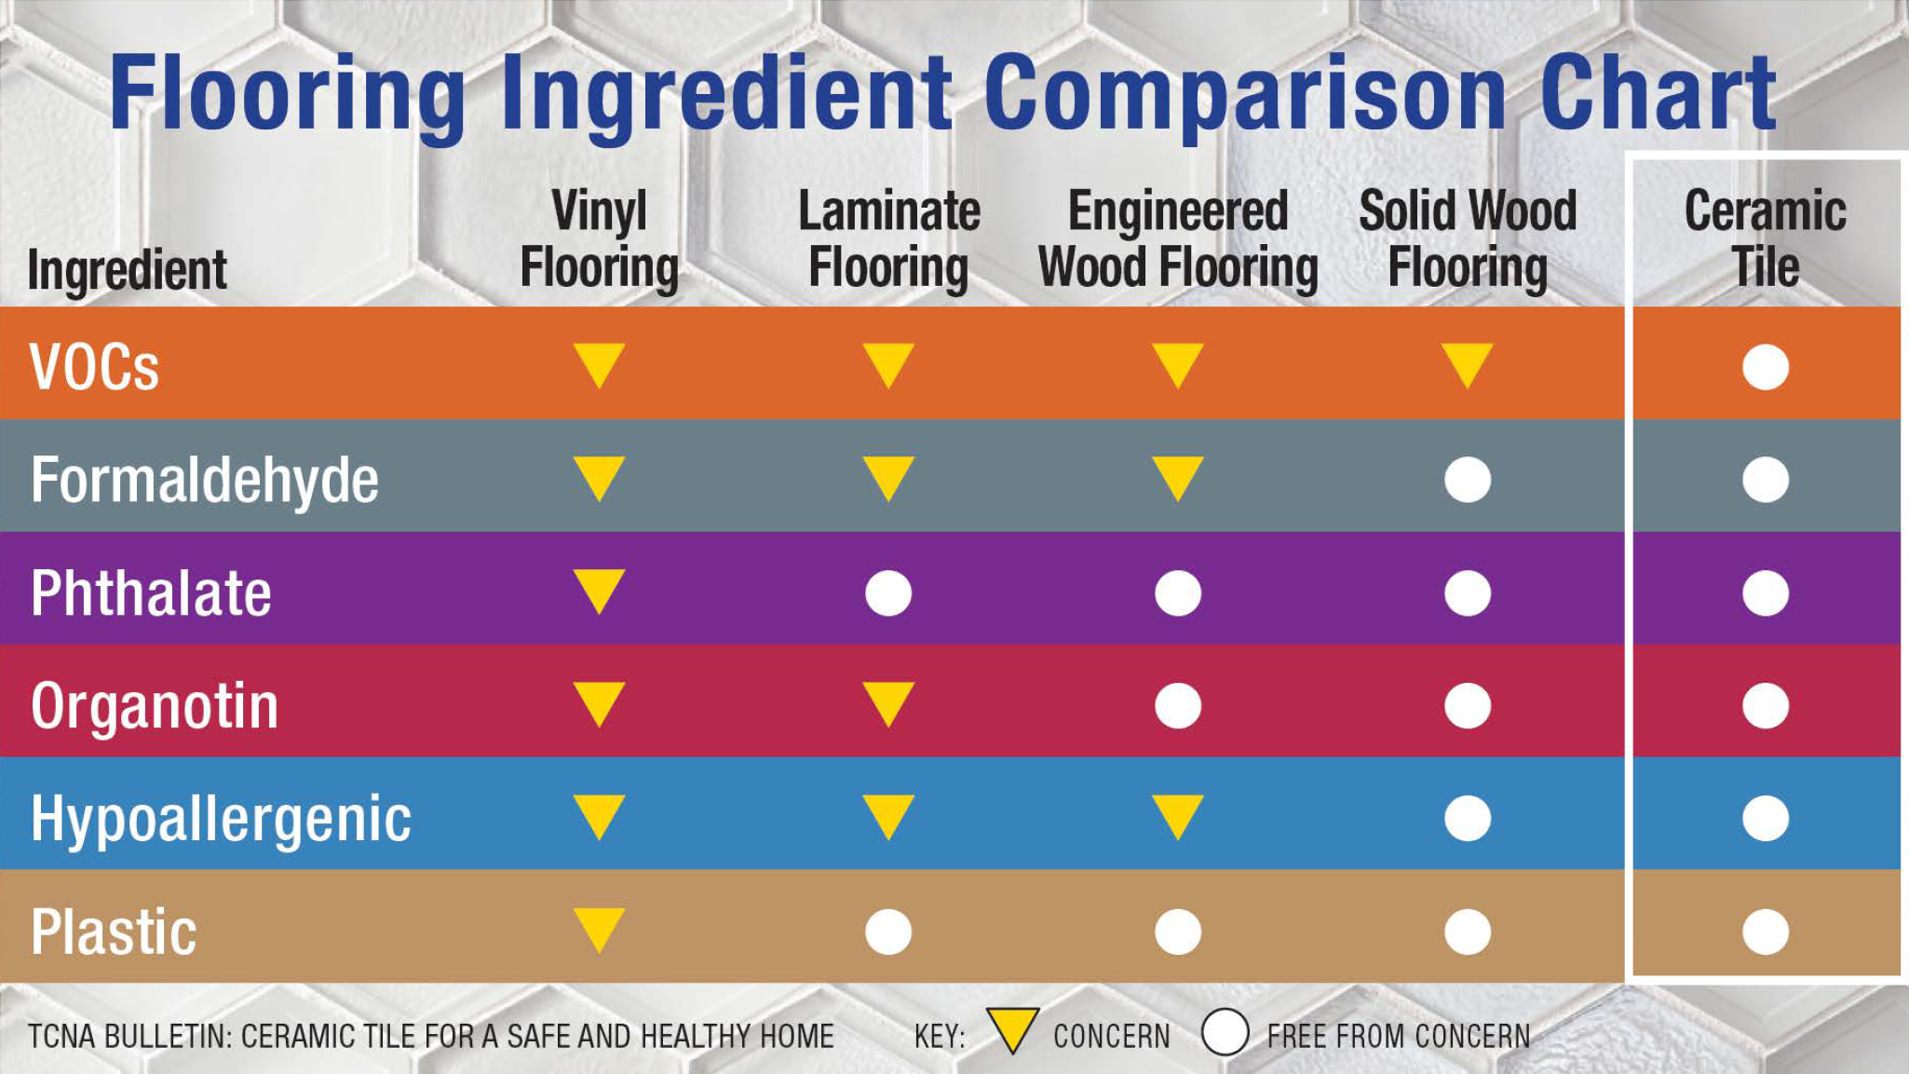
MATERIAL INGREDIENTS | FLOORING COMPARISON
TCNA
Inherently non-emitting
Unlike competing products, many of which contain plasticizers and other synthetic materials, ceramic tile is completely inert and contains no VOCs.
No hazardous ingredients
Ceramic tile is composed of naturally occurring materials extracted from the surface of the earth.
Notes:
From LinkedIn

Slide 52
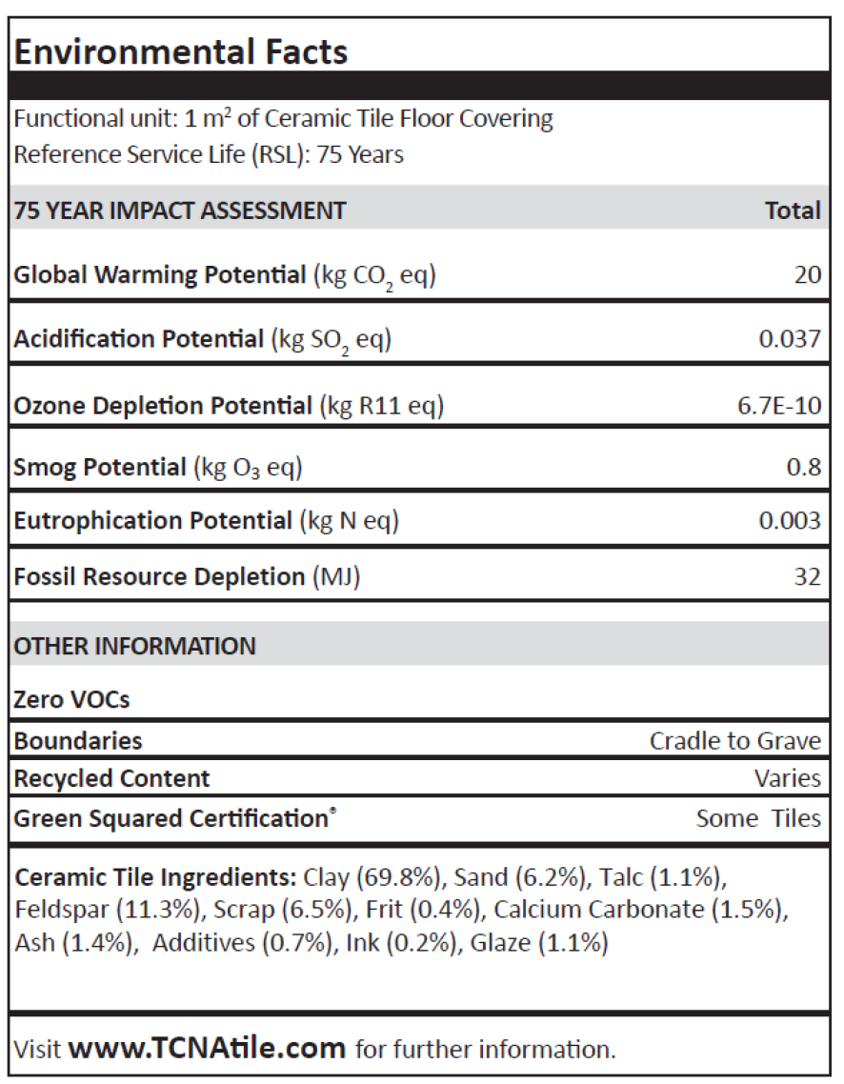
ENVIRONMENTAL PRODUCT DECLARATIONS (EPDs)

Slide 53


EPDs | ENVIRONMENTAL PRODUCT DECLARATIONS
There is a growing need among specifiers and designers for quantitative reporting of the impacts of products so the environmental footprint of a building can be calculated.

Slide 54

EPDs | ENVIRONMENTAL PRODUCT DECLARATIONS
What is an EPD?
An EPD is a summary of the many ways the production, distribution, use, and disposal of a particular product can impact people and the planet.
https://www.greenbuildingadvisor.com/article/a-guide-to-environmental-product-declarations
Notes:
https://www.greenbuildingadvisor.com/article/a-guide-to-environmental-product-declarations
An EPD should answer questions like: Is the product high in embodied carbon? Is itmade with renewable materials? Will it degrade atmospheric ozone? Making it ieasier for consumers and specifiers to make the most appropriate choices.

Slide 55
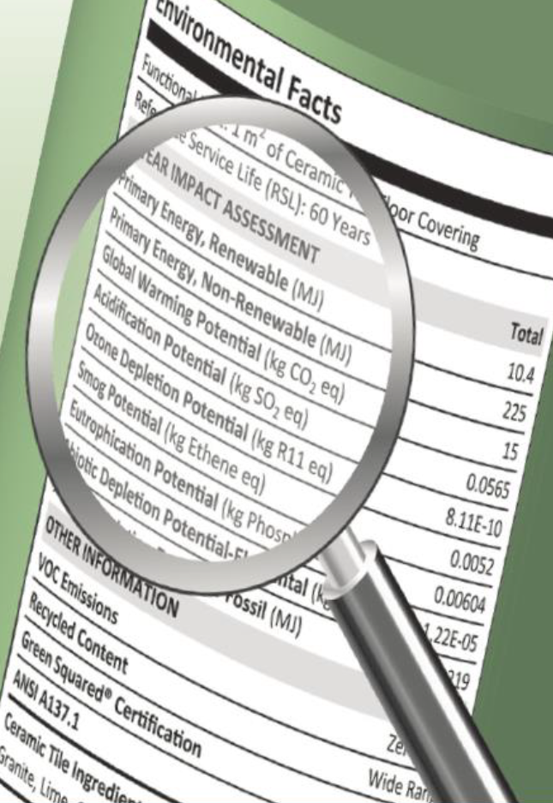
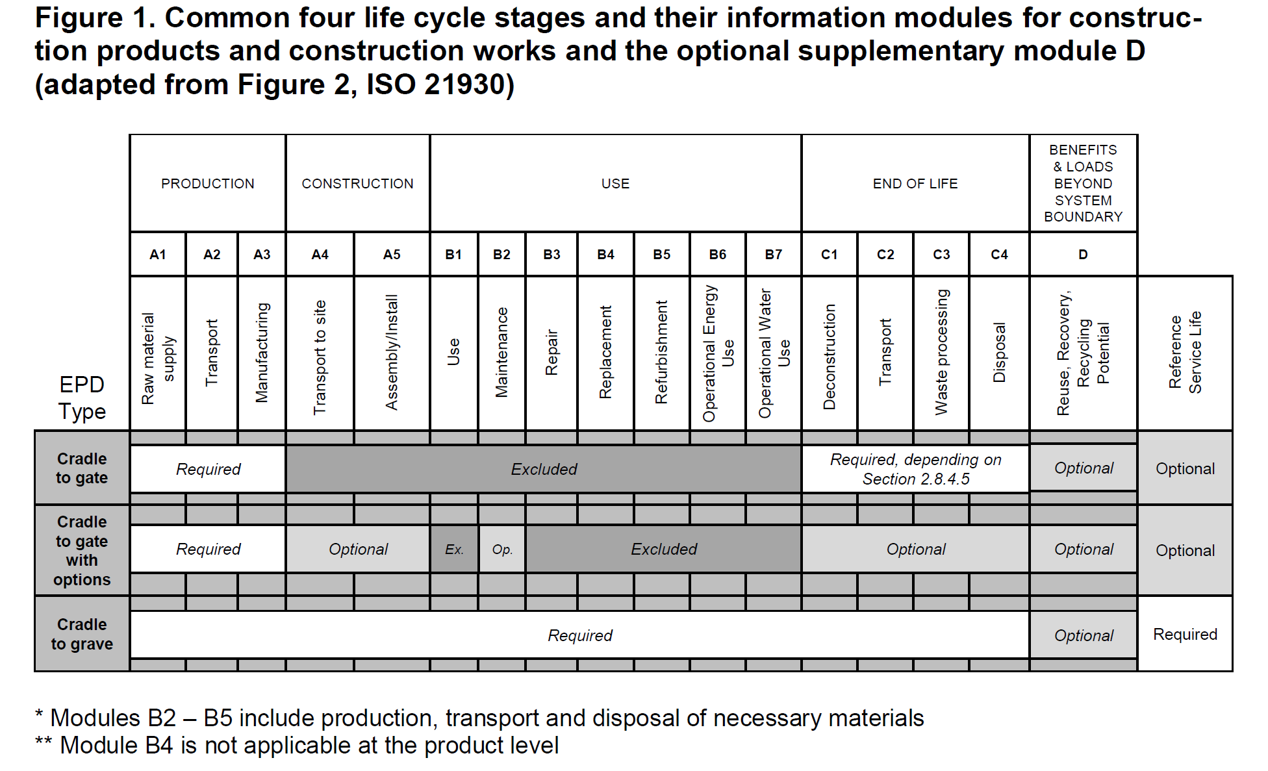
EPDs | ENVIRONMENTAL PRODUCT DECLARATIONS
What is an EPD?
An EPD is a vehicle for reporting product environmental data in a standardized manner.
EPDs provide a common framework for reporting across major environmental impact categories.
Life Cycle Assessment (LCAs) are the building blocks of EPDs.

Slide 56

LIFE CYCLE ASSESSMENT (LCA)
What is an LCA?
A standardized, science-based method for quantifying all the lifetime environmental impacts a product contributes throughout its life.
When applied to a building it is a building LCA.
Notes:
https://www.oneclicklca.com/life-cycle-assessment-explained/?utm_source=Google&utm_medium=cpc&utm_campaign=sitelink&gclid=CjwKCAjw79iaBhAJEiwAPYwoCLuedK31V1KHVSXmweTb5CYO-Kv-nW34Gi6fE5xHRX49XG_GpAtocBoC3ekQAvD_BwE
What it is: A Life Cycle Assessment (LCA) measures the environmental impacts of a product or service.
Measures both a building’s lifetime impacts and quantifies impact of individual building materials.
Takes into consideration all the steps that lead from raw material through manufacture, distribution, usage, to final disposal.
Why are we talking about it? - Well its tied to carbon and energy and wellness. Its how we are going to measure this stuff. Embodied carbon is inherently connected to climate justice and issues of public health and equity.
Benefits:
LCA allows decision makers to compare two products and to select the product that has the lowest impact on the environment.
An LCA may also provide insight in how to improve processes to achieve reduced environmental effects.
Calculate environmental impact to help find most sustainable options.

Slide 57

LIFE CYCLE ASSESSMENT (LCA) | EMISSION STAGES
Emissions are categorized in 4 stages
Product Stage (A1-3)
Construction Stage (A4-5)
Use Stage (B1-5)
End of life Stage (C1-4)
Reuse/Recycling (D)
GWP unit: (kgCO2e)
Kilograms of carbon dioxide equivalents
https://academy.oneclicklca.com/courses/take/onboarding-building-lca/texts/36851343-life-cycle-assessment-carbon-studies
Notes:
To calculate the final results of your LCA, you’ll add up the emissions from all of the life-cycle stages to get the total impacts for your project. This is typically referenced in kilograms of carbon dioxide equivalents (kgCO2e) if we’re focusing on Global Warming Potential (GWP), but we can also get results for other impact categories such as acidification or ozone depletion.
Life Cycle Stage D is benefits beyond the boundary like reuse-recycling potential.

Slide 58
LIFE CYCLE ASSESSMENT (LCA)
Notes:
THE ORIGIN OF THIS TABLE IS FIG 2: ISO 21930

Slide 59


EPDs | ENVIRONMENTAL PRODUCT DECLARATIONS
Two types of EPDs
Single-company, single-product EPD, the most common type. It describes the life cycle environmental impact of one product from a single manufacturer, or very similar products from a single manufacturer
Industry-wide EPD covers a general product category. These are developed by an industry association or trade group and describe an “average” product made by a number of companies in a clearly defined category
Notes:
https://www.greenbuildingadvisor.com/article/a-guide-to-environmental-product-declarations

Slide 60
EPDs | ENVIRONMENTAL PRODUCT DECLARATIONS
Industry-wide EPDs
TCNA and its members have developed industry-wide EPDs for ceramic tile, mortar, and grout
Provide comprehensive overview of how these products, on average per installed square meter, impact the environment over an estimated building service life of 75 years
Manufacturers provided data on their materials and operations and participated in a cradle-to-grave evaluation of their products, from raw material extraction through manufacturing , delivery, installation, use, and end of life
Notes:
https://www.greenbuildingadvisor.com/article/a-guide-to-environmental-product-declarations

Slide 61
EPDs | ENVIRONMENTAL PRODUCT DECLARATIONS
How is an EPD developed?
Product category rules (PCR) set the basis for measuring the environmental attributes of products in a certain group.
Manufacturer (with or without the help of consultants and/or software) develops LCA to serve as the framework for the EPD.
This information is verified by an independent third party (e.g. ASTM, UL, or NSF) to make sure they conform to ISO 14025.
https://www.greenbuildingadvisor.com/article/a-guide-to-environmental-product-declarations
Notes:
https://www.greenbuildingadvisor.com/article/a-guide-to-environmental-product-declarations

Slide 62
INDUSTRY-WIDE EPD | TILE (2020)
Reports environmental footprint of generic CERAMIC TILE produced in North America
Participating manufacturers:
American Wonder Porcelain
Arto Brick
Crossville
Dal-Tile Corporation
Del Conca USA
Florida Tile
Interceramica
Ironrock
Porcelanite-Lamosa
Portobello America
Quarry Tile Co.
StonePeak Ceramics
Vitromex USA

Slide 63

INDUSTRY-WIDE EPD | MORTAR (2022)
Reports environmental footprint of generic CEMENT MORTAR FOR TILE INSTALLATION produced in North America
Participating manufacturers:
Ardex
Bostik
Cemenquin/Cement Pro LLC
Crest
Custom Building Products
HB Fuller/TEC
Interceramic
Laticrete
Mapei
Parex
Schluter

Slide 64

INDUSTRY-WIDE EPD | GROUT (2022)
Reports environmental footprint of generic CEMENT GROUT FOR TILE INSTALLATION produced in North America
Participating manufacturers:
Ardex
Bexel
Bostik
Crest
Custom Building Products
HB Fuller/TEC
Interceramic
Laticrete
Mapei
Cemix/Texrite

Slide 65

INDUSTRY-WIDE EPD | TILE
ANSI A137.1 mosaic, quarry, pressed floor, glazed wall, and porcelain tile
Industry-average EPD
Cradle-to-grave

Slide 66

INDUSTRY-WIDE EPD | TILE
1.4
According to Part A of the PCR, the Estimated Service Life (ESL) of the building is assumed to be 75 years. Since ceramic tiles are expected to last as long as the building itself, the Reference Service Life (RSL) of ceramic tiles is taken to be 75 years.

Slide 67


INDUSTRY-WIDE EPD | TILE
GWP is measured in kg/m²
Raw material extraction
Manufacturing
Transportation to building site
Installation into the building
Maintenance
End of life

Slide 68

INDUSTRY-WIDE EPD | TILE
LCA Results

Slide 69

LVT AND LVP ENVIRONMENTAL IMPACT | RELATIVE TO CERAMIC TILE
Global warming potential
Vinyl tile: 2x higher than ceramic tile
Rigid core: 3x higher than ceramic tile
Fossil fuel resource depletion
Vinyl tile: 3x higher than ceramic tile
Rigid core: 5x higher than ceramic tile
Additionally, higher potential for acidification, eutrophication, smog formation, and ozone depletion
Based on 75-year data reported in UL-certified industry-wide EPDs for Vinyl Tile and Rigid Core
Source: TCNA
Notes:
Ocean acidification refers to a reduction in the pH of the ocean over an extended period time, caused primarily by uptake of carbon dioxide ...
Harmful algal blooms, dead zones, and fish kills are the results of a process called eutrophication — which occurs when the environment becomes enriched with nutrients, increasing the amount of plant and algae growth to estuaries and coastal waters.

Slide 70

PCR NONCONFORMANCE | EXAMPLE OF CARPET TILE REPORTING OMISSION
Repair, replacement, refurbishing impacts are omitted.
Use/maintenance impact for product life (15-yr) and building life (75-yr) are not reported.
Use/maintenance impact only reported for 1 year.
Notes:
Note: this is a product-specific declaration of a carpet tile manufacturer

Slide 71

PCR NONCONFORMANCE | EXAMPLE OF LVT REPORTING OMISSION
Repair, replacement, refurbishing impacts are omitted.
Use/maintenance impact for product life (15-yr) and building life (75-yr) are not reported.
Use/maintenance impact only reported for 1 year.
Notes:
Note: this is a product-specific declaration of a LVT manufacturer

Slide 72

EPDs | TILE vs. OTHER FLOORING TYPES
Global Warming Potential (GWP) of North American-made ceramic tile EPD vs. EPDs for other flooring types
https://www.tcnatile.com/component/content/index.php?option=com_content&view=article&id=247
Notes:
From Tile – The Natural Choice,
https://www.tcnatile.com/component/content/index.php?option=com_content&view=article&id=247

Slide 73

PERFORMANCE OF
TILE & STONE ASSEMBLIES

Slide 74


INSTALLER QUALIFICATIONS | TCNA HANDBOOK LANGUAGE
TCNA
Notes:
This is taken from the 2012 TCNA Handbook

Slide 75


INSTALLER QUALIFICATIONS | TCNA HANDBOOK LANGUAGE
TCNA
“Every aspect of a tile installation relies on the tile contracting company and its installers.”
“The following non-profit programs are well-established and recognized by the Handbook Committee:
“Journeyman Tile Layers Apprenticeship Programs… Contractors that employ union Journeymen Tile Setters can be found through the Union Locals that list their signatory contractors, primarily the Bricklayer and Allied Craftworkers (BAC)…
“IMI Contractor College…
“Tile Contractors’ Association of America (TCAA) Trowel of Excellence Program…”
“Advanced Certification for Tile Installers (ACT)”

Slide 76

PERFORMANCE
Dozens of factors contribute to the performance and durability of a stone installation. These factors can be categorized by the variability of materials, methods, and applications. To predict performance, we must understand:
WHAT is being installed?
HOW is it being installed?
WHERE is it being installed?
(How will it be used?)
WHO are the installers?

Slide 77
PERFORMANCE | WHAT IS BEING INSTALLED?
PERFORMANCE | HOW IS IT BEING INSTALLED?
PERFORMANCE | WHERE IS IT BEING INSTALLED?
PERFORMANCE | WHO ARE THE INSTALLERS?
Notes:
From Tile – The Natural Choice,
https://www.tcnatile.com/component/content/index.php?option=com_content&view=article&id=247

Slide 78










PERFORMANCE | WHAT IS BEING INSTALLED?
PROPERTIES
Aesthetics
Strength
Density
Hardness
Absorption
Abrasion resistance
Bond strength
Thermal shock
Freeze/thaw cycling
Impact resistance
Limestone
Travertine
Marble
Onyx
Slate
Granite
Sandstone
Quartzite
Basalt
Serpentine

Slide 79

PERFORMANCE | WHAT IS BEING INSTALLED?
ASTM Committee C18 on Dimension Stone
Subcommittee C18.03 on Material Specifications
ASTM C503
Standard Specification for
Marble Dimension Stone
ASTM C568
Standard Specification for
Limestone Dimension Stone
ASTM C615
Standard Specification for
Granite Dimension Stone
ASTM C616
Standard Specification for
Quartz-Based Dimension Stone
ASTM C629
Standard Specification for
Slate Dimension Stone
ASTM C1526
Standard Specification for
Serpentine Dimension Stone
ASTM C1527
Standard Specification for
Travertine Dimension Stone
Notes:
Subcommittees and Standards
Standards under the jurisdiction of C18
Each main committee in ASTM International is composed of subcommittees that address specific segments within the general subject area covered by the technical committee. Click on the subcommittee links below to see the title of existing standards for each subcommittee. Then, click on the resulting titles to see the standard's scope, referenced documents, and more.
C18.01 Test Methods
C18.03 Material Specifications
C18.06 Attachment Components and Systems
C18.07 Environmental Properties, Behavior, and Cleaning
C18.08 Selection of Dimension Stone
C18.90 Executive
C18.91 Nomenclature and Definitions

Slide 80

PERFORMANCE | WHAT IS BEING INSTALLED?
ASTM C568 Standard Specification for Limestone
Notes:
The modulus of rupture (MOR), also known as bending strength or flexural strength, measures the strength of a material before it breaks under bending stress. It's essentially a gauge of how much stress a material can withstand before it ruptures or fractures.
Here's a more detailed explanation:
What it measures:
MOR specifically quantifies the stress at the point of failure when a material is subjected to a bending load.
How it's used:
MOR is often used to determine the overall strength of materials like wood or concrete, and it can also be applied to other materials like tiles.
Why it matters:
High MOR values indicate that a material is more resistant to breakage under bending loads, making it suitable for applications where durability and strength are crucial, according to Infinita Lab.
Relationship to tensile strength:
In some cases, especially with concrete, the MOR can be significantly higher than the material's direct tensile strength, meaning the material is stronger under bending than under a direct pull.

Slide 81
PERFORMANCE | WHAT IS BEING INSTALLED?
PERFORMANCE | HOW IS IT BEING INSTALLED?
PERFORMANCE | WHERE IS IT BEING INSTALLED?
PERFORMANCE | WHO ARE THE INSTALLERS?
Notes:
From Tile – The Natural Choice,
https://www.tcnatile.com/component/content/index.php?option=com_content&view=article&id=247

Slide 82

PERFORMANCE | HOW IS IT BEING INSTALLED?
TCNA
As important as it is to have durable tiles, it is also imperative that the tile and everything behind it function together as a durable assembly.
Let’s look at how tile assemblies are described in the TCNA Handbook.
Method no.
F122 - STONE
Notes:
As important as it is to have durable tiles, it is also imperative that the tile and everything behind it function together as a durable assembly.

Slide 83
PERFORMANCE | HOW IS IT BEING INSTALLED?
TCNA
Method no.
F122 - STONE
Method description
Interior floor over on-ground concrete w/ waterproof membrane and natural stone tile

Slide 84
PERFORMANCE | HOW IS IT BEING INSTALLED?
TCNA
Method no.
F122 - STONE
Method description
Interior floor over on-ground concrete w/ waterproof membrane and natural stone tile
Service rating
Moderate

Slide 85

PERFORMANCE | HOW IS IT BEING INSTALLED?
TCNA
Service Ratings
Each stone tile floor assembly in the TCNA Handbook is assigned a service rating (A.K.A. performance rating). These service ratings indicate how well the assembly will perform.
There are five service rating designations for stone tile floor assemblies in the TCNA Handbook, each correlating to a category of use based on the types of loads expected:

Slide 86
PERFORMANCE | SERVICE RATINGS
TCNA
Extra Heavy
Extra heavy and high-impact use in food plants, dairies, breweries, and kitchens. Requires quarry tile, packing house tile, or tile designated by the tile manufacturer for the intended application.
Heavy
Shopping malls, stores, commercial kitchens, work areas, laboratories, auto showrooms, and service areas, shipping/receiving areas, and exterior decks.
Moderate
Normal commercial and light institutional use in public spaces of restaurants and hospitals.
Light
Light commercial use in office spaces, reception areas, kitchens, and bathrooms.
Residential
Residential kitchens, bathrooms, and foyers.

Slide 87


PERFORMANCE | ROBINSON FLOOR TEST
3-wheel triangle-shaped cart loaded with weights
Swivel caster wheels are equally spaced 15 in. from cart’s center
Standard Test Method for Evaluating Ceramic Floor tile Installation Systems Using the Robinson-Type Floor Tester
3/4 hp motor that drives the cart at 15 RPM
Loading schedule comprises 14 cycles; each cycle has specified type of wheels (soft rubber, hard rubber, steel), amount of weight to be stacked, and total revolutions to be executed.
Floor is visually examined after each cycle for chipped tiles, broken tiles, loose tiles, popped grout joints, cracked grout joints, powdered grout joints
Notes:
Test that provides indication of durability of the floor tile assembly
Informs the service category for the floor tile assembly

Slide 88


PERFORMANCE | ROBINSON FLOOR TEST
Standard Test Method for Evaluating Ceramic Floor tile Installation Systems Using the Robinson-Type Floor Tester
Floor is visually examined after each cycle for chipped tiles, broken tiles, loose tiles, popped grout joints, creaked grout joints, powdered grout joints

Slide 89

PERFORMANCE | ROBINSON FLOOR TEST
Residential
Kitchens, bathrooms, and foyers
Light
Light commercial use in office space, reception areas, kitchens, bathrooms
Moderate
Normal commercial and light institutional use in public space of restaurants and hospitals
Heavy
Shopping malls, stores, commercial kitchens, work areas, laboratories, auto showrooms, and service areas, shipping/receiving, exterior decks
Extra Heavy
Extra heavy and high-impact use in food plants, dairies, breweries, and kitchens. Requires quarry tile, packing house tile, or tile designated by tile manufacturer.

Slide 90
PERFORMANCE | WHAT IS BEING INSTALLED?
PERFORMANCE | HOW IS IT BEING INSTALLED?
PERFORMANCE | WHERE IS IT BEING INSTALLED?
PERFORMANCE | WHO ARE THE INSTALLERS?
Notes:
From Tile – The Natural Choice,
https://www.tcnatile.com/component/content/index.php?option=com_content&view=article&id=247

Slide 91
PERFORMANCE | WHERE IS IT BEING INSTALLED?
TCNA
Method no.
F122 - STONE
Method description
Interior floor over on-ground concrete w/ waterproof membrane and natural stone tile
Environmental Exposure Classification
Res 1, 2, 3, 5 Com 1, 2, 3, 5

Slide 92
ENVIRONMENTAL EXPOSURE CLASSIFICATIONS
TCNA
Com1 (Commercial Dry)
Tile surfaces that will not be exposed to moisture or liquid except for cleaning purposes. Examples: floors in areas with no direct access to the outdoors and no wet utility function such as hallways, dry area ceilings, accent walls, and corridor walls.
Com4 (Commercial High Humidity,
Heavy Moisture Exposure)
Tile surfaces that are subject to continuous high humidity or heavy moisture exposure, especially in enclosed areas. Examples: continuous use steam showers and steam room walls and ceilings.
Com2 (Commercial Limited Water Exposure)
Tile surfaces that are subjected to moisture or liquids but do not become soaked or saturated. Examples: floors where water exposure is limited and/or water is removed, as in bathrooms and locker rooms. Some backsplashes, bathroom walls, other walls, and wainscots may also fall in this category.
Com5 (Commercial High Temperature ≥125°F)
Tile surfaces frequently subjected to water or vapor greater than or equal to 125°F. Examples: commercial saunas, furnace and boiler areas, and some commercial kitchen floors and walls.
Com6 (Commercial Exterior)
Tile surfaces exposed to exterior conditions. Examples: exterior walls, balconies, and decks.
Com3 (Commercial Wet)
Tile surfaces that are soaked, saturated, or regularly and frequently subjected to moisture or liquids. Examples: shower and tub floors and walls, enclosed pool areas, natatoriums, public communal showers, and some commercial kitchen floors and walls.
Com7 (Commercial Submerged)
Tile surfaces exposed to continuous water submersion in interior or exterior conditions. Examples: swimming pools, water features, and fountains.

Slide 93
PERFORMANCE | WHAT IS BEING INSTALLED?
PERFORMANCE | HOW IS IT BEING INSTALLED?
PERFORMANCE | WHERE IS IT BEING INSTALLED?
PERFORMANCE | WHO ARE THE INSTALLERS?
Notes:
From Tile – The Natural Choice,
https://www.tcnatile.com/component/content/index.php?option=com_content&view=article&id=247

Slide 94






PERFORMANCE | WHO ARE THE INSTALLERS?
The tile & stone industry has well-established benchmarks to help identify contractors and installers with the qualifications necessary to provide durable and long-lasting installations.
The International Masonry Industry Training and Education Foundation (IMTEF) delivers comprehensive tile training for pre-apprentice, apprentice, and journeyworker tile setters and finishers.
TCAA’s Trowel of Excellence certification distinguishes best practice tile contractors who are signatory with the International Union of Bricklayers and Allied Craftworkers (BAC).
Installers who hold an Advanced Certifications for Tile Installers (ACT) certification have demonstrated outstanding technical efficiency.
Natural Stone Institute (NSI) Accreditation for Natural Stone Tile Installation. Contractors are evaluated with regard to best practices in installation and safety.
Requirements for minimum levels of competence can be written into a project’s specifications to ensure appropriate installation.
Notes:
Even if you have good material selection, appropriate installation methods, and consideration of environmental exposure, the assembly may still fail if not installed by qualified labor.
So far, we have examined the contributions to durability made by good material selection, appropriate installation methods, and consideration of environmental exposure. Even if all these boxes are checked, if qualified labor is not used to install it, the assembly may still fail over time. Fortunately, the tile industry has well-established benchmarks to help identify tile contractors and installers with the qualifications necessary to provide durable and long-lasting installations. TCAA’s Trowel of Excellence certification distinguishes best practice tile contractors who are signatory with the International Union of Bricklayers and Allied Craftworker (BAC). The International Masonry Industry Training and Education Foundation (IMTEF) delivers comprehensive tile training for pre-apprentice, apprentice, and journeyworker tile setters and finishers. Installers who hold an Advanced Certifications for Tile Installers (ACT) certification have demonstrated outstanding technical efficiency. Requirements for minimum levels of competence can be written into a project’s specifications to ensure appropriate installation.

Slide 95

PERFORMANCE | LCAs & EPDs
If the WHAT, HOW, WHERE, and WHO of installation are optimized, then natural stone will last 100 years or more.
A “cradle-to-grave” Life Cycle Analysis (LCA) should be considered in the Environmental Product Declaration (EPD)

Slide 96


INSTALLER QUALIFICATIONS | MASTERSPEC LANGUAGE

Slide 97

INSTALLER QUALIFICATIONS | PROJECT SPECIFICATIONS
Lavatory Renovation, Minneapolis, MN
1.05 QUALITY ASSURANCE
A. Installer Qualifications:
Installer employs at least one installer for Project that has completed the Advanced Certification for Tile Installers (ACT) certification for installation of membranes, shower receptors.

Slide 98








INSTALLER QUALIFICATIONS | ACT CERTIFICATIONS
B415
B421
B421C

Slide 99



INSTALLER QUALIFICATIONS | ACT CERTIFICATIONS
1.
BAC journeyman/
apprentice or
certified by CTEF
Experienced installer
BAC apprenticeship
or CTI certification
2.
Pass written exam based on TCNA & ANSI Standards
Orientation class
Study materials provided
Open-book test
Minimum passing grade 84%
Tests are widely available
3.
Pass hands-on skills assessment
Judged by certified evaluator
Judged on critical points
Testing and criteria are consistent
Certified in one or more skills
ACT-certified Installer
Certification good for 5 years
Credential is held by the installer

Slide 100


CRITICAL POINTS | LARGE FORMAT TILE
Maintain uniform grout joint width
Apply mortar to 80% coverage, min.
Lay out tile on 33% offset
Maintain minimum lippage
Determine areas of floor that are not flat
Correct substrate to acceptable flatness
Notes:
- Flattening a substrate is trickier than it sounds. The demands are stringent.
- Tiles are set with a 33% offset per A108.02.4.3.8 for large format tile.
- Grout joint width 1/8” as rectified tile is being used. If a calibrated tile was used, the minimum grout joint size would be 3/16”
Lippage do to workmanship, must be limited to 1/32”
Mortar coverage is paramount for tile installations 80% minimum for dry areas, and 95% in wet areas

Slide 101


CRITICAL POINTS | MEMBRANES
Return membrane vertically at walls
Pre-treat corners, drain, & pipe
Proper inside & outside corner connections
Seam min. 2” overlap @ sheet
Fabric fully embedded @ liquid
Correct wet mil thickness @ liquid
Proper adhesive coverage @ sheet
Notes:
Application of both liquid applied A118.10, and sheet A118.12 membranes
A118.10 = Waterproof Membrane
A118.12 Crack Isolation Membrane also know as Anti-Fracture Membrane
Attachment to the drain bodies are critical points
Preparation of the substrate to receive the membranes is a must
There are specific ways to connect to a protrusion to ensure water integrity
Proper use of specific pieces of sheet membrane at inside and outside corners are required to be installed

Slide 102


CRITICAL POINTS | MUD FLOORS
Wire reinforcement properly overlapped and suspended in mortar bed
Mortar bed flat, level, and thickness as specified
Cleavage membrane intact and properly overlapped
Notes:
Cleavage membrane requires a 4” overlap, and to be lapped in the direction of the mortar installation.
Reinforcement wire is to be “suspended” within the mortar, and not to be touching the substrate or the top of the mortar bed.
Mortar is to be floated level, and up to 1-1/2” thick minimum of 1-1/4” -
Mortar must be flat to within 1/8” in 10’ and 1/16” in 24”.

Slide 103


CRITICAL POINTS | MUD WALLS
Mortar applied to specified thickness
Metal lath installed shingle-fashion w/ proper laps, cut at inside corner
Inside & outside corners are square
Cleavage membrane intact & installed shingle-fashion proper laps, folded at corners
All walls are plumb and floated to exact dimensions
Notes:
Cleavage membrane to be overlapped 2” “shingle fashion”, with no rips or tears
Wire reinforcement to be lapped 2”
Mortar must be between 3/8” and 3/4” thick
Mortar must be flat to within 1/4” in 10’, and plumb, level, and square
Entire project must be made to specific dimensions and sizes
Movement joints to be clear to the cleavage membrane. No wire, or mortar per EJ171

Slide 104


CRITICAL POINTS | SHOWER RECEPTORS
Sheet membrane installation passes flood test
Sheet membrane wraps curb completely; curb is parallel to back wall and sloped to drain
No fasteners in membrane, vapor retarder, or backer board lower than 3” above finish curb
Mortar bed has proper thickness and slope
Sealant between membrane & drain flange; Weep holes protected
Pre-slope installed w/ cont. flat slope
Notes:
Pre-sloped base has 1/4” per foot continuous slope.
Sheet membrane must be properly attached to drain. Weep holes must be kept clear of mortar.
Sheet membrane installed with correct fastener placement, overlap, and correct sealant application.
Vapor barrier to overlap on to the Sheet waterproofing. CBU to be correctly installed, i.e., screw pattern, and movement joints at interior corners
Curb installed square, even, and sloped towards pan
Pan must be floated with a flat continuous sloped plane at 1/4”/ft from the furthest point out to the drain

Slide 105


CRITICAL POINTS | GAUGED PORCELAIN TILE & GPT PANELS
Proper tile embedment techniques for wall and floor tile
Maintain minimum lippage
Grout joint cleaned to proper depth
Clean & accurate cuts around openings
Perimeter abutments free of grout for EJ
Trowel mortar on substrate & tile in one direction, parallel to short side of tile
Determine out-of-flat areas in wall and floor, and correct accordingly
Notes:
Substrate must be flat to within 1/8” in 10’ & 1/16 in 24”
Mortar combed in same direction across both tile and substrate
Tile panels are to have no lippage, and align with all other adjoining panels
Walls and floor are to be square to each other
All edges are to be smooth and have even transition between panels.

Slide 106


CRITICAL POINTS | GROUTS
A118.7 high performance cement grout
Cement grout joints applied flush
A118.6 cement grout, sanded
A118.6 cement grout, unsanded
Finish free of smears & grout haze
A118.3 epoxy grout
Expansion joints free of grout; backer rod & sealant properly installed
Epoxy grout joints applied to proper depth
Notes:
- Four different tile types, each with dissimilar characteristics, and different size joints.
A118.3 Epoxy grout in the Quarry.
A118.6 Standard sanded grout in the Brick Veneer, and un-sanded grout in the 4-1/4” glazed ceramic
A118.7 High Performance Grout in the 6x6 porcelain tile
All grouts must be correctly mixed, and applied according to manufactures recommendations
A118.6 Standard Cement Grout, A118.7 High Performance Grout, A118.3 Epoxy Grout Fusion / Plasma / True Color / FlexColor are all considered a single component Polymer Resin Grout- No product or installation standard for these types of grout.

Slide 107

CONCLUSION
Let’s connect on LinkedIn
Thank you!
Please make sure you signed the attendance sheet (AIA members and non-AIA members)
Don’t forget to take a certificate if you need one for self-reporting
If you have a project or technical question re. masonry or tile you’d like to discuss, please contact us:
SCOTT CONWELL, FAIA SCONWELL@IMIWEB.ORG

