Slide 1
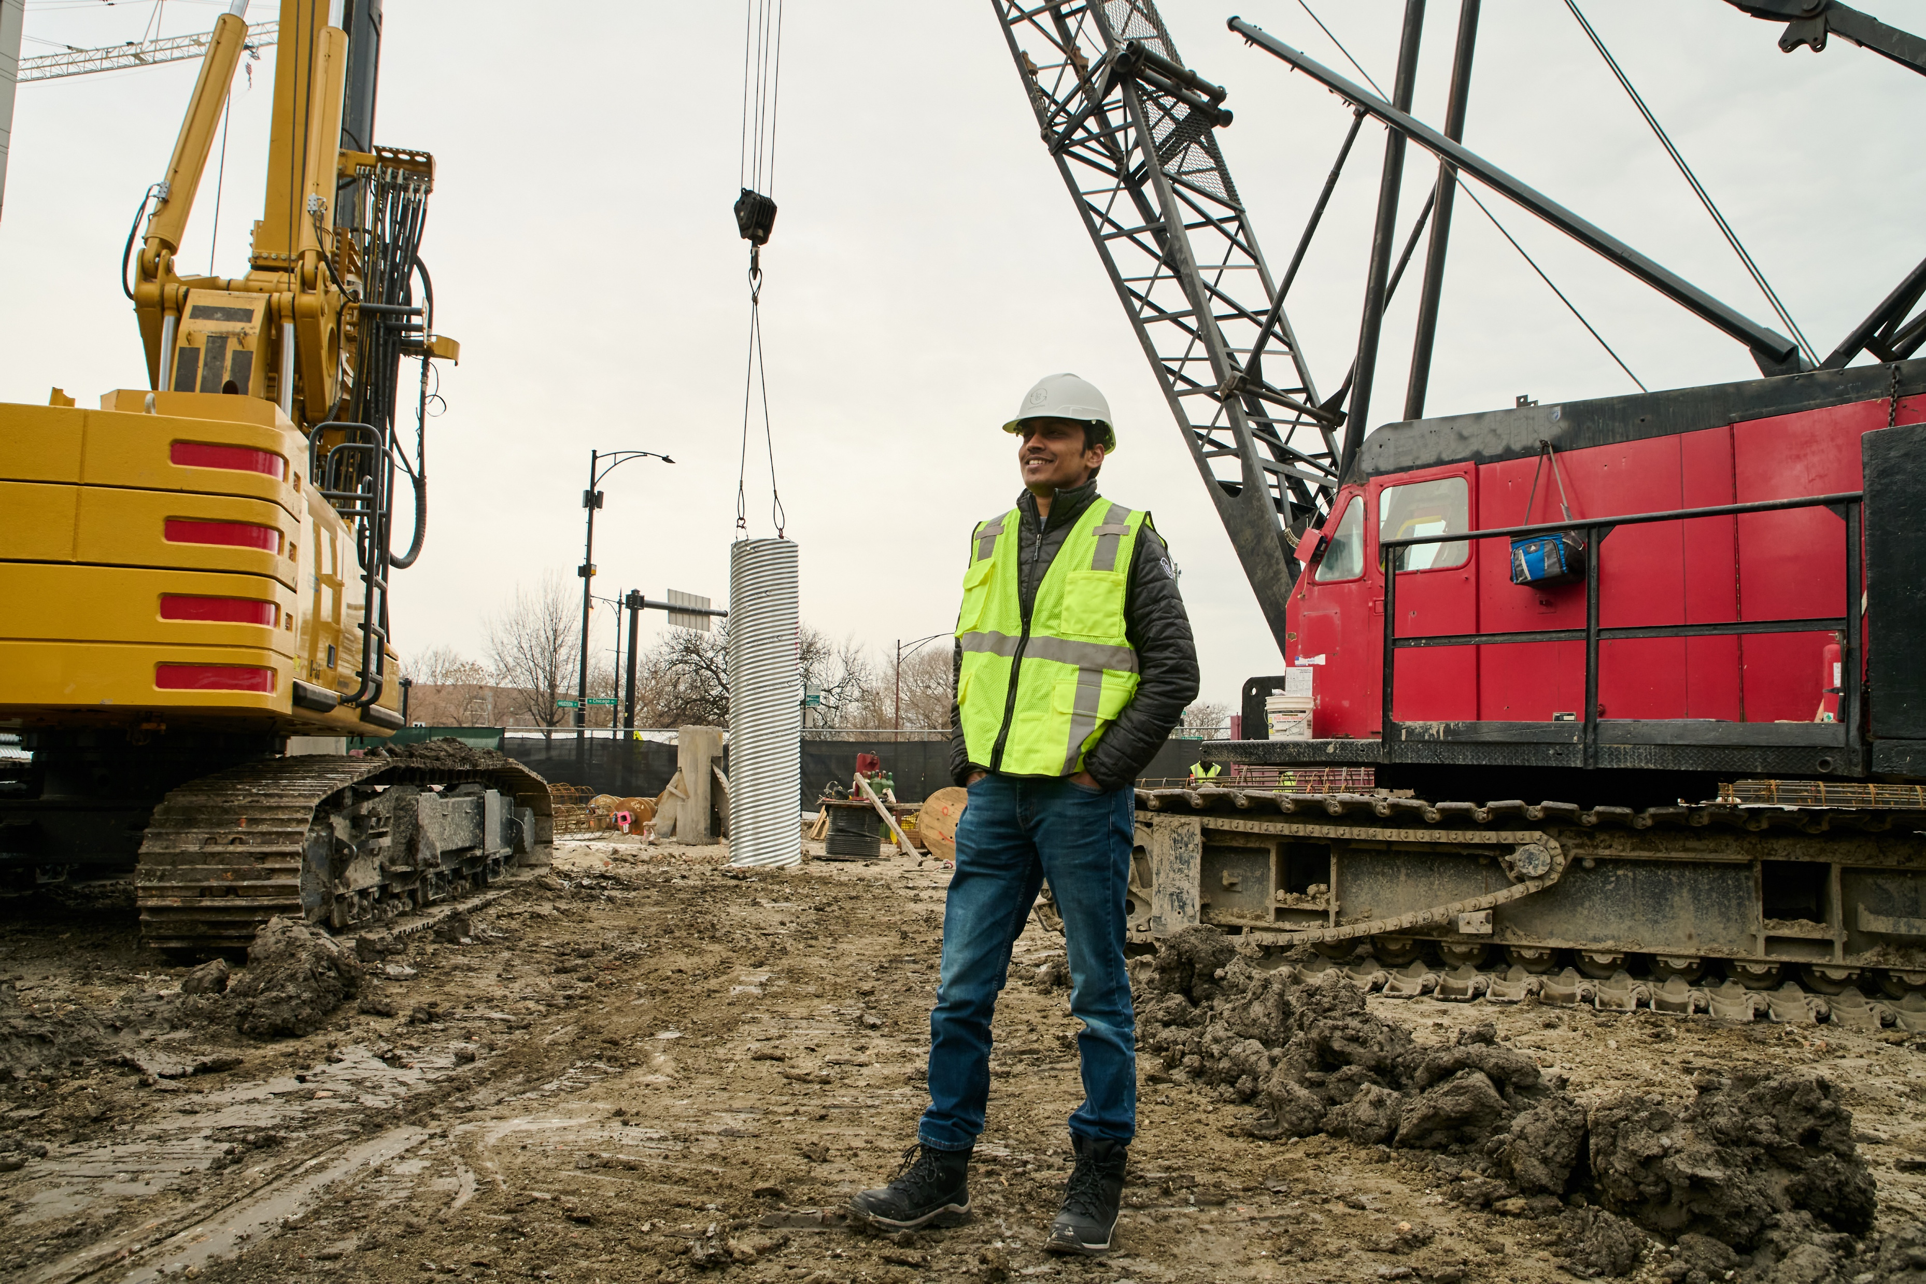
Hard Hats, Soft Skills
Applying Emotional Intelligence on the Jobsite
Enhancing teamwork and safety through emotional intelligence skills
Notes:
---
This workshop focuses on integrating emotional intelligence into the construction jobsite environment. We will explore practical tools to enhance communication, safety, and teamwork by applying EQ skills in real-world scenarios.

Slide 2

Laying the Foundation
Why Emotional Intelligence (EQ) Matters
EQ + Stress & Conflict Management
EQ’s Impact on Jobsite Safety, Culture, & Productivity

Slide 3
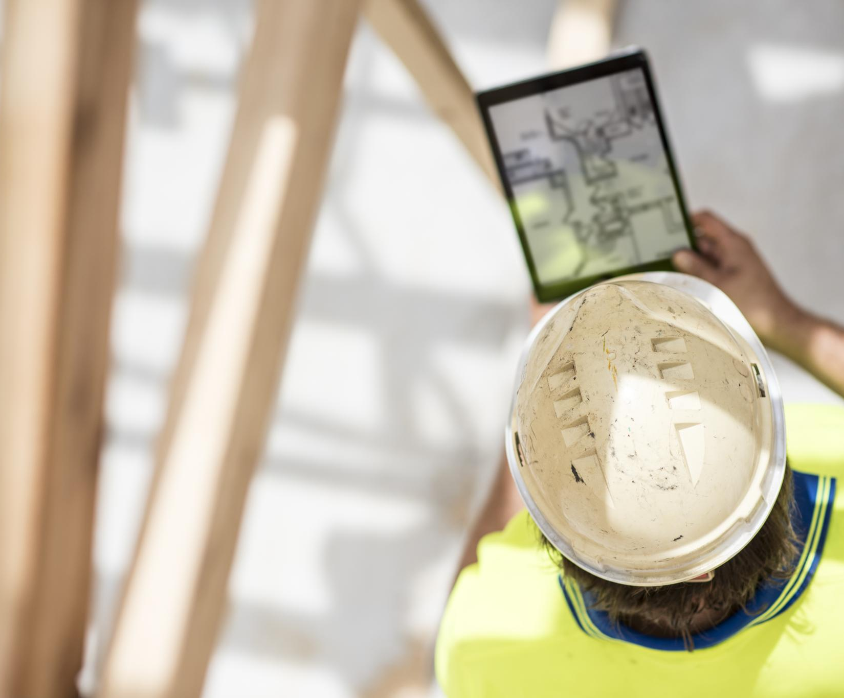
Workshop takeaways
  Tailored Strategies
  Strategies designed specifically for the real-world challenges you face in construction, helping you strengthen your emotional intelligence.
Actionable Tools Focus
  Practical, hands-on tools that you can use directly on construction sites, projects, and work environments.
  Immediate Application
  Get skills you can apply right away improving your communication, conflict resolution, safety practices, and collaboration on the job.
Oct. 30, 2025

Slide 4

Emotional Intelligence (noun). The capacity to be aware of, control, and express one’s emotions, and to handle interpersonal relationships judiciously and empathetically.
Notes:
Think of emotional intelligence (often shortened to EQ) as people-skills that go beyond just being “nice” or “good with others.” It’s about how you understand and manage both your own emotions and the emotions of the people around you.

Slide 5
REAL LIFE | WITH OR WITHOUT EQ
STRESS & PRESSURE
COMMUNICATION
RELATIONSHIPS
CONFLICT RESOLUTION
LEADERSHIP & INFLUENCE

Slide 6

REAL LIFE | WITH OR WITHOUT EQ
Without EQ:
You snap at a coworker or loved one when you’re overwhelmed.
STRESS & PRESSURE
With EQ:
You notice your stress rising, take a pause (deep breath, quick walk, ask for a quick break), and then return calmer preventing the situation from escalating.

Slide 7

REAL LIFE | WITH OR WITHOUT EQ
Without EQ:
A friend seems distant, and you assume they’re mad at you.
RELATIONSHIPS
With EQ:
You notice their body language, check in gently (“Hey, you seem off. Is everything okay?”) and find out they’re stressed at work.

Slide 8

REAL LIFE | WITH OR WITHOUT EQ
Without EQ:
You say, “That’s wrong” in a meeting,
and the other person shuts down.
COMMUNICATION
With EQ:
You say, “I see where you’re coming from and what if we also considered ___?” They feel heard, and the discussion stays productive.

Slide 9

REAL LIFE | WITH OR WITHOUT EQ
Without EQ:
You argue back immediately when a teammate criticizes your idea.
CONFLICT RESOLUTION
With EQ:
You listen first, reflect their concern (“I hear that you’re worried about cost”), then explain your reasoning. The conversation turns into problem-solving instead of a fight.

Slide 10

REAL LIFE | WITH OR WITHOUT EQ
Without EQ:
You dive straight into tasks when leading a project, and your team feels like just cogs in a machine.
LEADERSHIP & INFLUENCE
With EQ:
You take two minutes to ask how everyone’s doing, acknowledge good work, and then move to the tasks. Morale goes up, and so does performance.

Slide 11


Realities and Relevance
EQ is a critical driver of safety, efficiency, and project success.
Oct. 30, 2025
Emotional intelligence (EQ) equips workers to:
Manage stress and stay composed under pressure
Communicate clearly across diverse teams
Resolve and de-escalate conflicts before they impact safety or progress
Build trust and stronger working relationships
Grow as a leader and role model
Notes:
EQ isn’t abstract psychology—it’s the “glue” that keeps stress low, relationships strong, and teams (or families, or friendships) working smoothly. Construction sites are high-pressure, fast-moving, and constantly changing—demanding adaptability, focus, and teamwork from everyone on site. Beyond technical skill, emotional intelligence is critical: it enables workers and leaders to stay calm under stress, communicate clearly across diverse teams, de-escalate conflicts before they become safety risks, and build trust that keeps projects on track. EQ isn’t a “soft” skill—it’s a practical tool for improving safety, efficiency, and collaboration in dynamic construction environments.

Slide 12

Emotional Intelligence (EQ)
Stress & Conflict Management
Oct. 30, 2025
self-awareness | self-regulation | motivation| empathy | social skills
Notes:
Dive into the five EQ components — self-awareness, self-regulation, motivation, empathy, and social skills — and how each applies practically in construction work environments.

Slide 13
Self-Awareness: you can’t manage what you don’t recognize.
Oct. 30, 2025
Stress Runs High
Communication is Constant
Decisions Affect Safety
Self-Regulation: respond intentionally rather than instinctively.
Notes:
Construction projects are complex. There are tight schedules, changing conditions, safety risks, and a mix of personalities — from project managers and trades to clients and inspectors. In that environment:
Stress runs high. Self-aware people can recognize when they’re tense or frustrated and prevent that from spilling onto others.
Communication is constant. If you understand how your tone or body language changes when you’re under pressure, you can adjust before it causes conflict.
Decisions affect safety. Being aware of when fatigue or ego is influencing your judgment helps you make safer, more rational calls.
Following on from self-awareness, self-regulation is the next link in the emotional-intelligence chain and it’s especially critical in construction, where tempers, time pressure, and safety stakes run high. It’s not about suppressing emotion; it’s about staying in control enough to choose the right response for the situation. Self-regulation is your ability to manage your impulses, emotions, and reactions — especially under stress — so you respond intentionally rather than instinctively.

Slide 14

Pause & Breathe: Physiological Reset Techniques
Oct. 30, 2025
Calming the Nervous System
  Breathing exercises effectively calm the nervous system, promoting relaxation and reducing stress levels.
Enhancing Emotional Control
  Controlled breathing helps improve emotional regulation, allowing thoughtful and measured responses under pressure.
Notes:
Simple breathing exercises can calm the nervous system, enabling better emotional control and thoughtful responses under pressure.

Slide 15

Name It to Tame It: Identifying and Managing Strong Emotions
Oct. 30, 2025
Importance of Emotion Labeling
  Labeling emotions decreases their intensity, aiding in emotional regulation and clarity in stressful situations.
Constructive Reaction Management
  Identifying emotions empowers individuals to respond thoughtfully, improving workplace interactions and decision-making.
Notes:
Labeling emotions helps reduce their intensity and empowers individuals to manage reactions constructively on the jobsite.

Slide 16

Shift to Curiosity: Reframing Conflict and Seeking Understanding
Oct. 30, 2025
Curiosity Over Judgment
  Embracing curiosity instead of judgment promotes open-mindedness and deeper insight in conflicts.
Uncovering Root Causes
  Curiosity helps uncover underlying issues that cause conflicts, leading to more effective solutions.
Resolution Through Empathy
  Empathy enables understanding others’ perspectives, fostering resolution and cooperation in conflicts.
Notes:
Approaching conflicts with curiosity rather than judgment helps uncover root causes and facilitates resolution through empathy.

Slide 17

Motivation, Empathy, & Social Skills: Connecting EQ to Daily Site Scenarios
Oct. 30, 2025
Intrinsic Motivation
  Motivation in EQ isn’t just about showing up for a paycheck — it’s the inner drive to do your best, take pride in your work, and push through challenges with purpose and resilience.
  Empathy Among Coworkers
  Empathy is the ability to understand and care about what others are feeling or experiencing not necessarily to agree, but to recognize their perspective.
  Strong Social Skills
  Social skills are how you communicate, influence, and connect with people to get work done smoothly. It’s not small talk — it’s trust-building in action.
Notes:
Motivation
Why It Matters on Site
Construction is full of setbacks: weather delays, design changes, client demands. People who are self-motivated bring energy and problem-solving instead of frustration and blame.
On-Site Examples
A Project Manager stays late to rework a schedule after a delay, focusing on solutions instead of excuses.
A laborer takes pride in a perfectly finished pour, not because anyone’s watching, but because craftsmanship matters.
A Superintendent motivates the team by linking daily progress to the bigger picture — “This isn’t just a slab; this is the foundation of a new hospital wing.”
How to Strengthen It
Reconnect with purpose — why this project matters to the client or community.
Celebrate small wins: hitting a milestone, passing inspection, finishing a clean pour.
Encourage a culture where effort and improvement are noticed, not just results.
Construction brings together diverse teams: trades, engineers, owners, architects. Misunderstandings are common, and empathy helps bridge those gaps.
On-Site Examples
A foreman notices a crew member struggling and checks in before it becomes a safety issue.
A PM listens to a subcontractor’s concern about sequencing instead of dismissing it — preventing costly rework later.
A superintendent gives an owner space to vent frustrations, acknowledging their stress before guiding the conversation back to facts.
How to Strengthen It
Listen fully — no interrupting or rehearsing your next response.
Acknowledge emotions: “I can see this delay is frustrating.”
Ask questions: “What do you need from me to move forward?”
Remember everyone’s working toward the same end — a successful project.
Social Skills: Building the Relationships That Build the Work
What It Means
Social skills are how you communicate, influence, and connect with people to get work done smoothly. It’s not small talk — it’s trust-building in action.
Why It Matters on Site
Every construction project is a network of relationships: general contractors, subs, inspectors, and owners. How well those relationships function directly affects timelines, costs, and quality.
On-Site Examples
A site lead communicates clearly in daily huddles so everyone knows priorities.
A project manager mediates a dispute between trades, keeping the project moving.
A foreman greets every crew personally in the morning — small act, big morale impact.
How to Strengthen It
Communicate early and often; silence breeds confusion.
Follow through on what you say — reliability builds trust.
Give credit publicly and feedback privately.
Adapt your communication: a subcontractor may need plain talk, while an architect wants details and data.

Slide 18
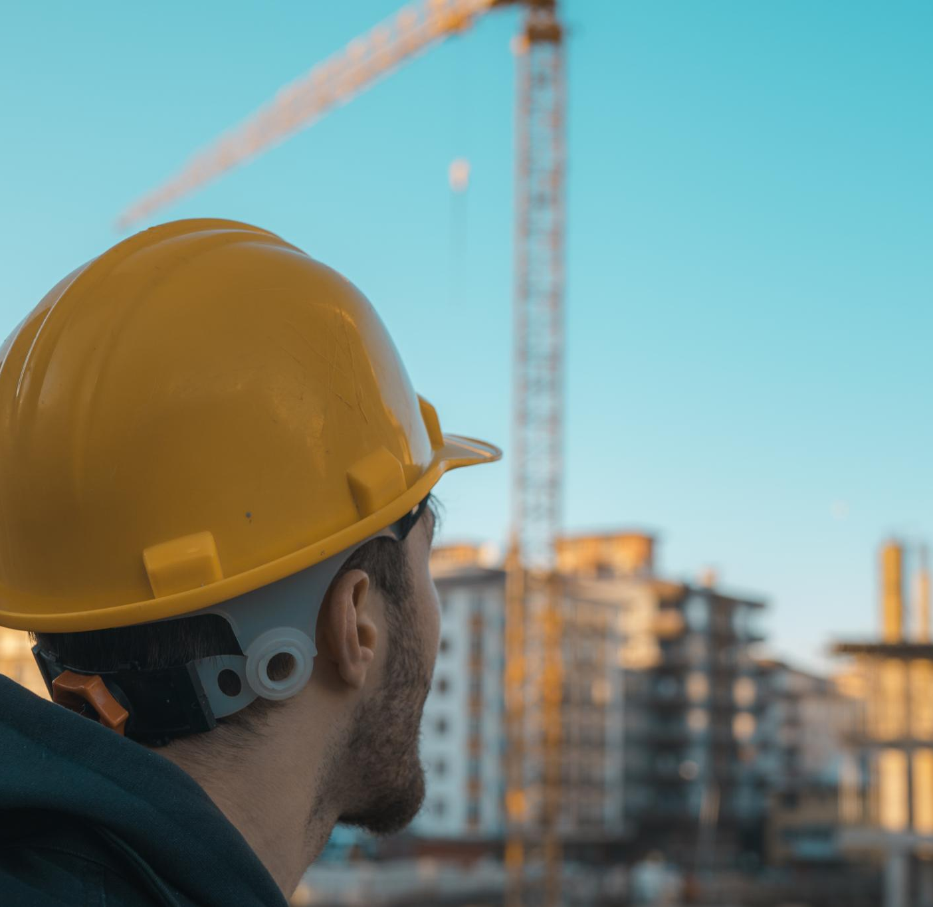

Staying Calm Under Jobsite Pressure
Oct. 30, 2025
Effective Response to Challenges
  The Heated Exchange
  The Weather Delay
  The Safety Violation
Stress Management Techniques
  Pause & Breathe.
  Name the Feeling (“Name it to Tame It”)
  Separate Fact from Emotion.
  Use Routines.
  Debrief.
Notes:
Real-World Examples
The Heated Exchange: A subcontractor misses a deadline. Instead of shouting, you take a breath, step aside, and ask, “Let’s figure out what’s causing the holdup.” That keeps work moving instead of creating resentment.
The Weather Delay: Rain shuts down exterior work for the third time this month. You recognize frustration rising, but you redirect energy into re-sequencing indoor tasks to keep crews productive.
The Safety Violation: You notice someone without PPE. Instead of barking at them in front of everyone, you pull them aside, correct the issue, and use it as a teachable moment.
Tools to Strengthen Self-Regulation
Pause & Breathe: A short pause before reacting can reset your nervous system.
Label the Feeling: Simply naming (“I’m frustrated”) helps diffuse its intensity.
Separate Fact from Emotion: Ask, “What’s actually happening vs. what I’m feeling about it?”
Use Routines: Morning check-ins, stretching, or quick site walk-arounds can ground you before chaos hits.
Debrief: Reflect after stressful moments — what triggered me, what worked, what could I do differently next time?

Slide 19
Cultivating Self-Awareness & Self-Regulation
Oct. 30, 2025
Identify Emotional Triggers
Notice what’s going on inside you in real time to understand how emotions and reactions (triggers) show up in your behavior, decisions, and the people around you. Ask for feedback, reflect daily, and notice what your body signals are.
Read Your Energy Levels
Awareness of your physical state – hunger, exhaustion, stress – helps avoid risky mistakes. Pause to hydrate, delegate a task so you don’t have to rush through it, or stand up instead of sit down during a meeting leveraging ways to be more present in your work.
Resets and Boundary Setting is Allowed
When you know you are getting frustrated, take a pause to reset. When you are pushed for unrealistic deadlines seek to understand while also communicating boundaries calmly and clearly. The crew and team around you takes cues from you.
Notes:
1. Recognizing Your Triggers
If you know that last-minute design changes make you irritable, you can take a breath before reacting, rather than snapping at a subcontractor who’s just doing their job. That moment of awareness can keep a small issue from becoming a site-wide problem.
2. Reading Your Energy Levels
On long days, awareness of your physical state — hunger, exhaustion, stress — helps you avoid risky mistakes. Maybe you pause to hydrate, or you delegate a task instead of rushing through it.
3. Managing Leadership Presence
If you’re a superintendent or PM, the crew takes cues from you. A self-aware leader realizes when their frustration is showing and resets their tone before it affects morale.
4. Navigating Client or Owner Interactions
When a client pushes for unrealistic deadlines, self-awareness lets you respond with professionalism — acknowledging your own frustration privately while communicating boundaries calmly and clearly.
Self-awareness doesn’t just make you “nicer.” It makes you safer, clearer, and more effective — the kind of person others want to follow because you stay steady even when the site isn’t.

Slide 20
EQ’s Impact on Jobsite Safety, Culture, and Productivity
Oct. 30, 2025
Notes:
Examine how emotional intelligence directly influences jobsite safety outcomes, shapes workplace culture, and enhances overall productivity through better communication.

Slide 21

Linking Emotional Intelligence to Safety Outcomes
Oct. 30, 2025
  Construction safety isn’t just about PPE and procedures — it’s about people behavior under pressure. Hard hats and harnesses protect bodies, but emotional intelligence protects judgment.
Notes:
---
Higher EQ leads to increased awareness and responsiveness, reducing accidents and promoting a culture of safety on the jobsite.
Image source: Microsoft 365 content library

Slide 22
Linking Emotional Intelligence to Safety Outcomes
Oct. 30, 2025
Research in occupational psychology and safety management supports this link:
Most accidents are caused not by lack of technical knowledge, but by human factors — stress, distraction, poor communication, and fatigue.
Leaders with high EQ create psychological safety, meaning workers feel comfortable stopping work or speaking up when something doesn’t look right.
Teams with emotionally intelligent leaders report higher trust, fewer incidents, and faster recovery after near-misses because they talk openly about what went wrong and how to fix it.
Notes:
---
Higher EQ leads to increased awareness and responsiveness, reducing accidents and promoting a culture of safety on the jobsite.
Image source: Microsoft 365 content library

Slide 23

How EQ Shapes Team Culture and Relationships
Oct. 30, 2025
In construction, where success depends on coordination, communication, and trust across dozens of people and trades, EQ is the foundation of strong team culture and relationships.
This is where EQ transforms HOW work gets done, not just WHAT gets done.
Notes:
---
EQ fosters respect, trust, and cooperation among team members, building a positive and collaborative work environment.
Image source: Microsoft 365 content library

Slide 24
How EQ Shapes Team Culture and Relationships
Oct. 30, 2025
Self-Awareness Builds Accountability
Self-Regulation Sets the Emotional Tone
Motivation Creates Shared Purpose
Empathy Strengthens Trust and Belonging
Social Skills Create Collaboration instead of Conflict
Notes:
1. Self-Awareness Builds Accountability
When individuals understand their own triggers and tendencies, they take responsibility for their impact on others.
Workers with self-awareness own their mistakes instead of deflecting blame.
Leaders with self-awareness recognize when their tone or stress is affecting the crew.
Result: A culture of honesty, self-correction, and psychological safety — people can admit errors early, preventing bigger issues later.
2. Self-Regulation Sets the Emotional Tone
On a jobsite, emotion is contagious — especially from leadership.
When a superintendent stays composed under stress, it steadies the crew.
When a foreman loses their temper, tension and resentment ripple outward.
Result: Teams mirror calm, solution-oriented behavior rather than reacting emotionally. Stability and respect become cultural norms.
3. Motivation Creates Shared Purpose
Teams thrive when individuals connect their daily tasks to something meaningful.
A motivated team doesn’t just “pour concrete” — they’re building someone’s home, school, or hospital.
Leaders who share that sense of purpose inspire pride and commitment, even in tough conditions.
Result: High morale, low turnover, and stronger team identity.
4. Empathy Strengthens Trust and Belonging
Empathy transforms jobsite relationships from transactional to human.
Crew members check in when someone’s off their game.
Leaders take time to listen to challenges instead of dismissing them.
Result: People feel valued as individuals, not just workers. That belonging drives loyalty, cooperation, and retention.
5. Social Skills Create Collaboration Instead of Conflict
Construction relies on handoffs between trades — framing, electrical, plumbing, finish. When social skills are strong, coordination flows.
Team members communicate clearly, resolve conflicts early, and adapt to each other’s needs.
Leaders facilitate difficult conversations without blame.
Result: Fewer bottlenecks, less rework, and a sense of “we’re in this together.”

Slide 25

Boosting Productivity THROUGH EQ
Emotional Intelligence (EQ) doesn’t just make teams nicer — it makes them faster, safer, and more efficient. EQ doesn’t slow you down — it keeps you from having to do it twice.
Improves Focus & Decision-Making
Reduces Miscommunication
Strengthens Team Collaboration
Lowers Stress and Burnout
Reduces Rework and Safety Incidents
Improves Retention and Knowledge Transfers
Notes:
1. EQ Improves Focus & Decision-Making
Workers with strong self-awareness and self-regulation are less likely to let frustration, fatigue, or distractions derail their performance.
They catch mistakes early because they’re paying attention — not working on autopilot.
Leaders who regulate emotions make calmer, faster decisions under pressure, which keeps progress moving instead of pausing for rework or conflict.
Result: Fewer errors, faster corrections, less downtime.
2. EQ Reduces Miscommunication
Construction involves dozens of moving parts — trades, schedules, materials, inspectors, owners. Miscommunication is one of the biggest causes of lost productivity.
Empathy and social skills help people listen, clarify instructions, and adapt their communication to the audience (crew vs. client vs. engineer).
Fewer misunderstandings mean fewer do-overs and delays.
Result: Better coordination, cleaner handoffs, less rework.
3. EQ Strengthens Team Collaboration
When emotional intelligence shapes the culture, people share information, ask questions, and problem-solve together instead of working in silos.
Crews feel safe to speak up when they see an issue, rather than hiding it until it becomes a bigger problem.
Leaders foster trust, so people want to help each other instead of competing.
Result: Smoother workflows and higher efficiency across trades.
4. EQ Lowers Stress and Burnout
High-pressure projects often lead to stress, fatigue, and conflict — all of which reduce productivity.
EQ helps individuals recognize their own stress signals and regulate them before burnout hits.
Leaders who show empathy and check in regularly help crews recover faster and stay engaged.
Result: More consistent energy and fewer absentee days.
5. EQ Reduces Rework and Safety Incidents
Mistakes caused by emotional reactions — rushing, arguing, zoning out — are costly.
EQ-driven teams manage emotions better, so they work carefully even under stress.
A psychologically safe environment means people report hazards or errors immediately.
Result: Less rework, fewer injuries, and more time spent on actual progress.
6. EQ Improves Retention and Knowledge Transfer
High turnover kills productivity. Teams with strong EQ keep people longer because:
They feel valued and respected.
They trust leadership and enjoy the team dynamic.
They share knowledge willingly.
Result: Stable, experienced crews who get faster and better over time.

Slide 26
Conclusion
Oct. 30, 2025
Enhancing Safety
Emotional intelligence helps individuals and teams improve jobsite safety through better awareness and empathy.
Improving Communication
Effective communication rooted in emotional intelligence fosters collaboration and reduces conflicts at work.
Leading with Empathy
Using empathy and resilience supports leadership that inspires and motivates teams daily.
EQ is the Glue
Emotional Intelligence is the glue that holds construction teams together.
It turns groups of skilled individuals into cohesive, high-performing crews built on trust, communication, and shared respect. “You can teach someone how to build a wall. EQ teaches them how to build a team.”
Notes:
By applying emotional intelligence on the jobsite, individuals and teams can enhance safety, improve communication, and create a more positive, productive work environment. Use these practical tools to lead with empathy and resilience every day.

