Slide 1
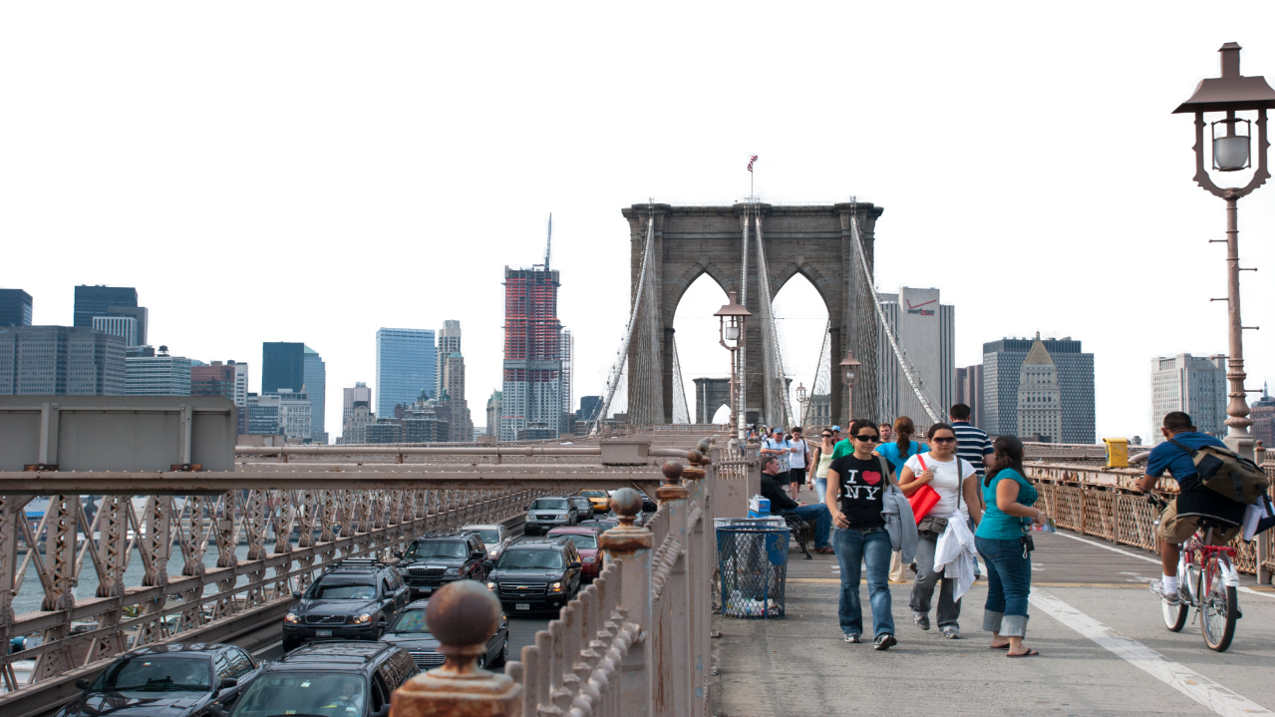
Pedestrian Engineering
New York Build Workshop 2023
Roadway Reallocations, Grade Integration and The Choreography of Chaos
Michael Fishman
NASA Cities Practice Lead

Slide 2
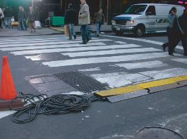

Safety Moment
Pedestrian Engineering
Slips, trips, and falls cause nearly 700 fatalities per year. There are three physical factors involved in slips, trips, and falls: friction, momentum, and gravity. Each one plays a role.
Fishman for Times Square Alliance
Avoid Tripping Hazards for Temporary Events
and Construction
Notes:
ALL PHASES ALL JOBS WORKER AND PUBLIC SAFETY

Slide 3
1
What is Pedestrian Engineering?
(what isn’t?!)
Agenda
New York City Centric
(Lower Manhattan, Times Square +)
2
3
Mott MacDonald Pedestrian Engineering
(ahead of the queue)

Slide 4

What is Pedestrian Engineering?
Central to any design or construction project that includes people.
Ubiquitous!
Source: Glasgow Liveable Neighbourhoods
Notes:
Quantifying the Pedestrian Experience
For generations traffic engineers have been quantifying and predicting traffic behavior with modeling techniques and analyses to maximize vehicular throughput and improve safety on our roads and highways. Pedestrian modeling is far more complex because it must predict human behavior while vehicles (for the most part) stay in lanes, follow rules of the road – are even being made autonomous. The implications of modelling pedestrian flows reach far beyond levels of service and thruput to determine economic, social and physical quality of life improvements to our environment and must be flexible to facilitate day to day, emergency evacuation or peak/event scenarios often in the same space.

Slide 5



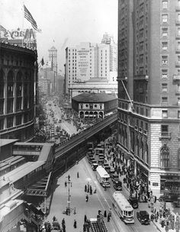
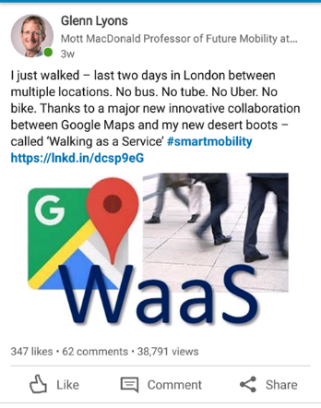
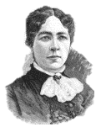
Pedestrian Engineering is NOT ‘Pedestrian’
EVERYBODY’S TRIP HAS A FIRST AND LAST MILE
WALKING AS A SERVICE
A reminder to practice empathy:
Mary T. Lathrap
“Judge Softly” written in 1895, later came to be known by its most famous and quoted line
“Walk a Mile in Another’s Moccasins.”
Notes:
Even the phrase ‘Pedestrian Engineering’ initially sounds like the minimization of a field of study. Upon further investigation, we find that the pedestrian is far from banal but the most dynamic element of the urban environment. Designing for the pedestrian is not simply a matter of widening sidewalks or connecting dots with bridges or tunnels.

Slide 6
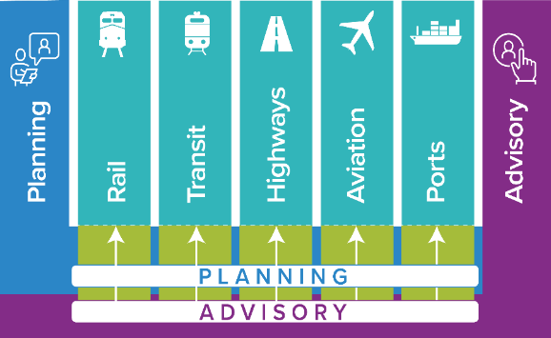
Pedestrian Engineering
What is Pedestrian Engineering?
Basics
- Full consideration of pedestrian needs and requirements;
- Understanding and predicting human behavior, movements and priorities;
- Actively designing for pedestrians first (pre-construction through phases,
turnover, operations and maintenance);
- Diverse, equitable and inclusive outcomes.
We do this already
Now let us give pedestrians more forethought and focus…
Notes:
Far from simple: Pedestrians are the most dynamic element in the urban landscape.
Elements of Pedestrian Engineering:
Predicting human behavior from concept through construction.
Staging operations, maintenance and protection of pedestrians, signage and way-finding.
Pedestrian Engineering Results:
Safer, more comfortable, internationally comprehensible and universally accessible public spaces.
Appropriate sidewalk, bridge and tunnel widths, vertical circulation, traffic calming and physical improvements to stations, hubs, event venues and streetscapes.

Slide 7
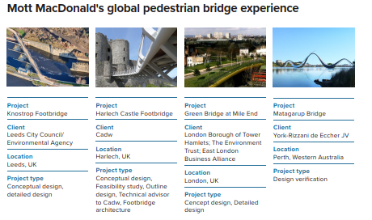
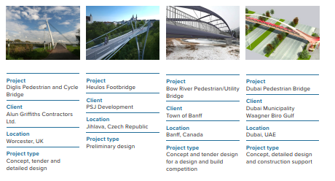
Traditional and Innovative Processes and Services
We do this already
Notes:
Grade Integration: Manhattan was originally planned as a multi-level City. Note how useful grade separation is already without any ‘master plan’. One development at a time, pedestrians are being elevated on decks, highlines, terraces and viaducts.
Future densities require evolutionary solutions. From the waterfront, to the existing street network, and underground rail or vehicular links, we can make seamless connections between existing and future grades that will move people vertically as well as horizontally. Daylight and convenience can give the public the feeling that they have never left the street, (plaza, ground, concourse, entry, platform) level. Designing a framework, system, network or landscape upon which people will travel from where they are to where they want to be, with minimal effort or confusion might best be described as ‘grade integration’.

Slide 8
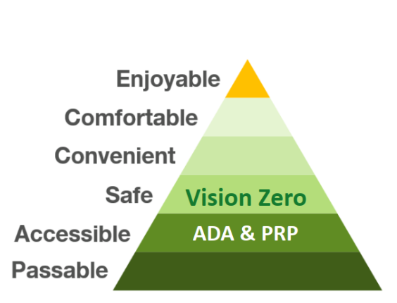
Pedestrian Engineering
We do this already
Hierarchy of
Pedestrian Considerations
TAKE YOUR PROJECT TO THE NEXT LEVEL
Street Level
Sidewalks
Road reallocation
Pedestrian plazas and zones
Building access
Constructability Phasing
Grade Separated
Pedestrian bridges and walkways
Underground and overground networks
Indoors
Transit hub movements
Event spaces
Evacuation routings
Infrastructure epidemiology
Wayfinding
Source: NYCDOT Pedestrian Unit
Notes:
ALL PHASES ALL JOBS WORKER AND PUBLIC SAFETY

Slide 9
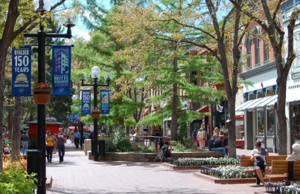
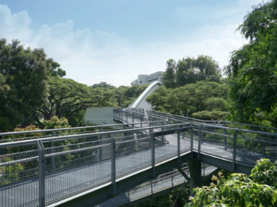
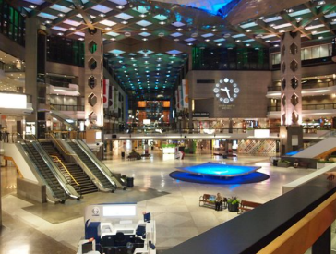
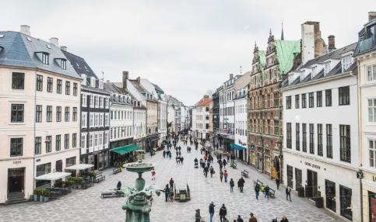
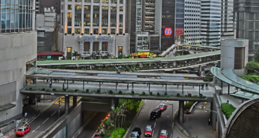
Grade Separation is Pedestrian Protection
Pedestrians don't always belong next to roads
Pedestrians do not share the same physical limitations (rules) as vehicles.
People go above/under ground with agency to use completely different and new paths of travel…
Source: Bouider, Convention and Visitors Bureau
Source: Mott MacDonald Singapore
Source: Wikimedia Commons
Source: GPS/Flickr
Source: Donghee Eim
Notes:
NYC (Fredrick Law Olmstead) Invented Grade Separation prior to the advent of the automobile with bridges and tunnels in Prospect and Central Parks. The most technically sophisticated engineering feats of their time, this led to more expansive bridges and tunnels and ultimately point to the genesis of our (inter)national highway networks by eliminating at grade conflicts. We continue to push engineering boundaries today with pedestrian engineering analyses and solutions.

Slide 10
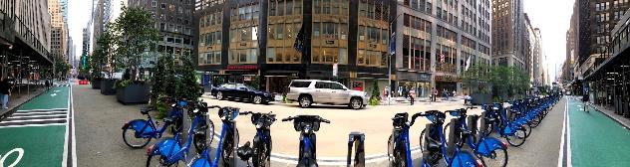
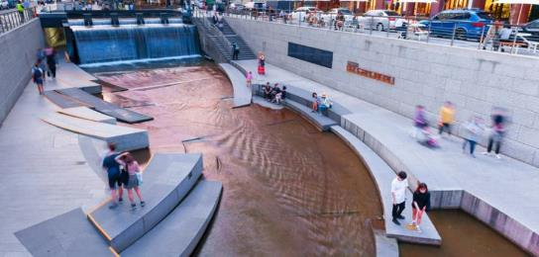
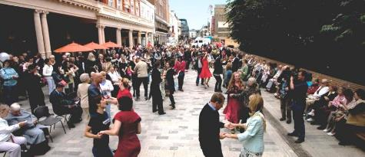
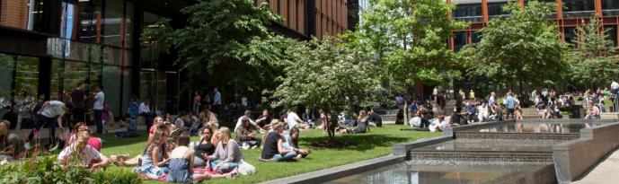
Putting Humans and Nature Back into City Centers
People places are natural spaces
Source: Mott MacDonald Korea
Micro Mobility Transfers
Stormwater Capture
(Water Rooms and Green Infrastructure)
Dancing!
Source: Mott MacDonald/Valerie Holt
Source: Brighton and Hove City Council
Notes:
Identify synergies between technical engineering practices beyond project boundaries at origins and destinations.
Demonstrate how to save time and (make) money for owner/operators of transport infrastructure.
Expose practitioners to digital tools (pedestrian modelling/big data) to assist in decision making for roadway reallocations and TODs.
Clockwise from 12 – Cheonggyecheon stream, Seoul; Kings Cross London; Hayes London – all from “Great Places and How to Make Them”.

Slide 11
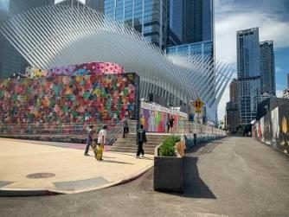
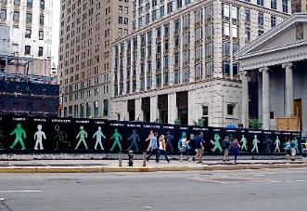
Transportation Planning Services
Improving Levels of Service / Customer Experience DURING Construction
Pedestrian Engineering Focused skills and capabilities:
Front End Station Area Planning
Inter-Modal Simulation Technologies
Public Infrastructure Economics
Infrastructure Epidemiology
Future Mobility
Logistics and Phasing
Support
Transit Operational Readiness
No more ‘pardon our appearance during construction’
Lower Manhattan
Notes:
No More: ‘Pardon Our Appearance’ During Construction
Public and private infrastructure projects require a wide variety of constituents, significant intellectual and economic investment up front and enduring commitment over time. Improving levels of service for commuters, patients, visitors should start at the beginning of renovations to existing facilities. If impacts to pedestrians are a focus from ground breaking through ribbon cutting, not only will levels of service be maintained or improved during construction but also staging can be designed to feel invisible (instructive) for daily and first time users.

Slide 12
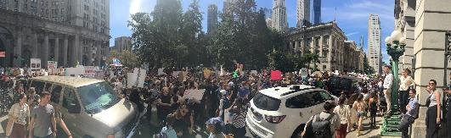
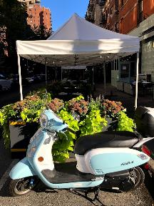
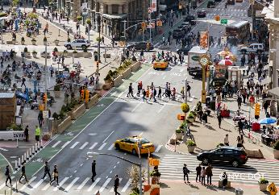
More Than Movement
It’s Evolutionary
The Covid 19 ‘Lane Grab’
Traditional Road Space is being transformed to include more diverse transportation (micro-mobility) and more frequently accommodate commercial programs beyond parking lanes.
Transit stops / intermodal transfers
Greenstreet / stormwater infrastructure
Green spaces / active and passive recreation
Outdoor dining
Meeting spaces / plazas
Open retail storefronts / markets
Community activities
Pedestrian Engineering = Quality of Life Improvements
saving time and money from concept through delivery
Roadway reallocations, sidewalk expansions, physical traffic calming improvements and seamless connections
Results are safer from the start, more comfortable by design, internationally comprehensible and cater to universal accessibility.
Notes:
Pedestrian Engineering considers infrastructure investments, staging, operations and maintenance from concept through delivery. Results are safer from the start, more comfortable by design, internationally comprehensible and cater to universal accessibility. within stations, streetscapes, downtowns and between origins and destinations.
New Road, Brighton and San Francisco from “Great Places and How to Make Them”.

Slide 13
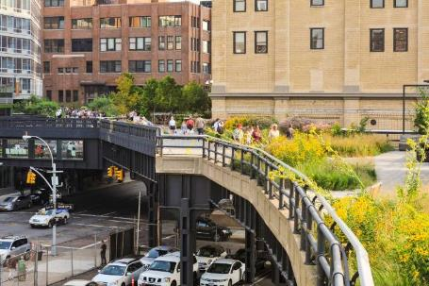
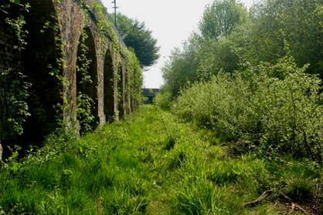

New York City Centric
World Trade Center Master Plan
East West Bikeway Connection
Times Square Redevelopment (Broadway Closure)
Source: Fishman
Mott MacDonald shared grade separation insights from NYC’s Highline with The Wirral City Council who seek to transform the working waterfront (also once served by an abandoned elevated rail).
Source: Wirral City Council
Notes:
100 miles added with Covid as ‘safe streets’ continues expanding
adapting 1.5miles of abandoned rail into pedestrian space on the ‘Highline’ has resonated with our international TPN teams around the world (Auckland, NZ, Birmingham to Wirral, UK and the UAE). Having played critical roles in these aggressive efforts for 2 decades we are looking forward to exporting NYC’s success within the company and making our key clients.

Slide 14
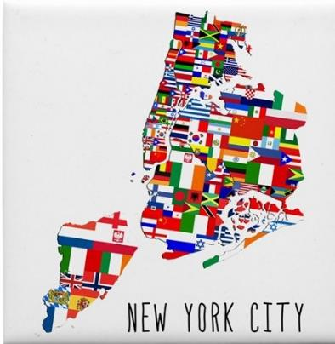
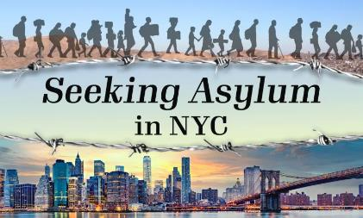
NYC DIVERSITY
Over 3 million residents (1/3) are foreign-born.
All of us are pedestrians.
Orders of Magnitude:
Who are we to tawk?!
1/2 of all New Yorkers speak a language other than English at home.
  The largest Chinese population of any city outside Asia.
  The largest Puerto Rican population of any city in the world.
Over 200 spoken languages
(180+ in NYC City Public Schools)
Notes:
5 year average stay for ‘New Yorker’

Slide 15
NYC DENSITY
Note: Proximity and synergy with Toronto to deliver Transport Planning Services in the NE Corridor
8.5MM Live & 12MM People Work Here
All of us are pedestrians.
1of 38
people living in the USA
2X
the size of Los Angeles
30K
people
per sq./mi
More people live in NYC than 40 of the 50 U.S. states.
More transit riders in NYC than the next 16 largest systems combined.
Notes:
180 diversity

Slide 16
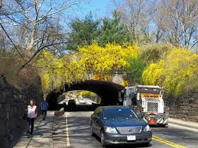
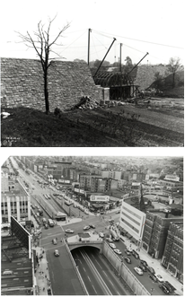
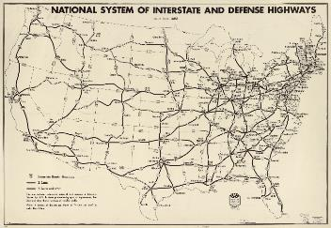
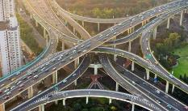
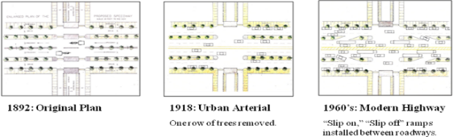
NYC Origin of Grade Separation
Central Park to the Grand Concourse to National and International Highway Networks Origin of Grade Separation
CENTRAL PARK 1857
THE GRAND CONCOURSE 1892
NATIONAL HIGHWAY SYSTEM 1958
Fredrick Law Olmstead’s Central Park Transverse Roads allow many movements without conflicts. Affording occupancy of the same space on separate levels.
Source: Bronx Historical Society/Fishman
Notes:
NYC (Fredrick Law Olmstead) Invented Grade Separation prior to the advent of the automobile with bridges and tunnels in Prospect and Central Parks. The most technically sophisticated engineering feats of their time, this led to more expansive bridges and tunnels and ultimately point to the genesis of our (inter)national highway networks by eliminating at grade conflicts.

Slide 17
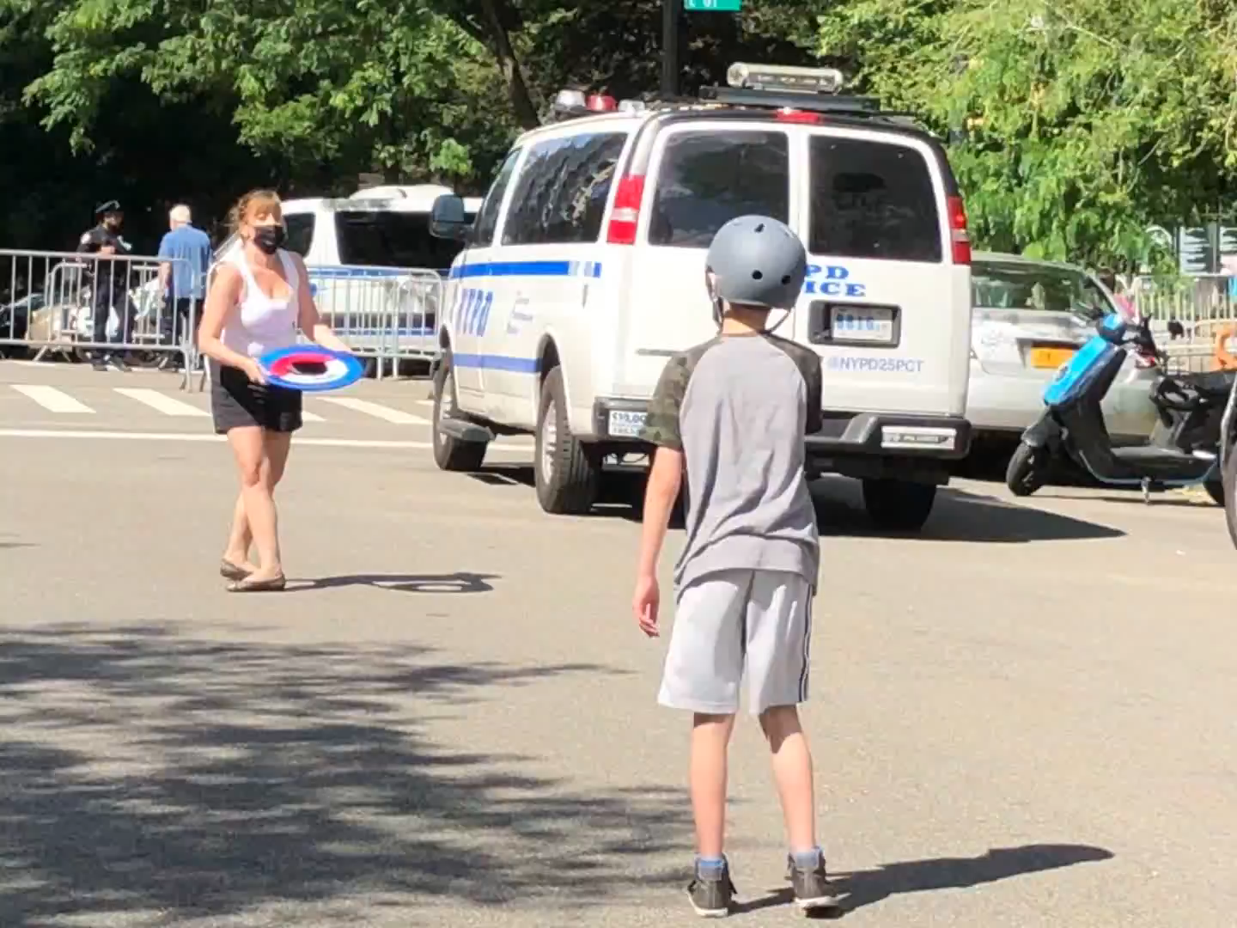
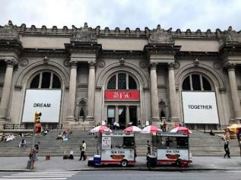
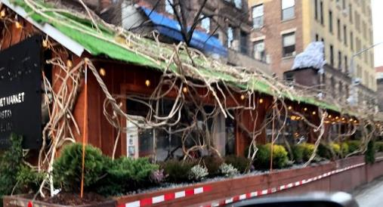
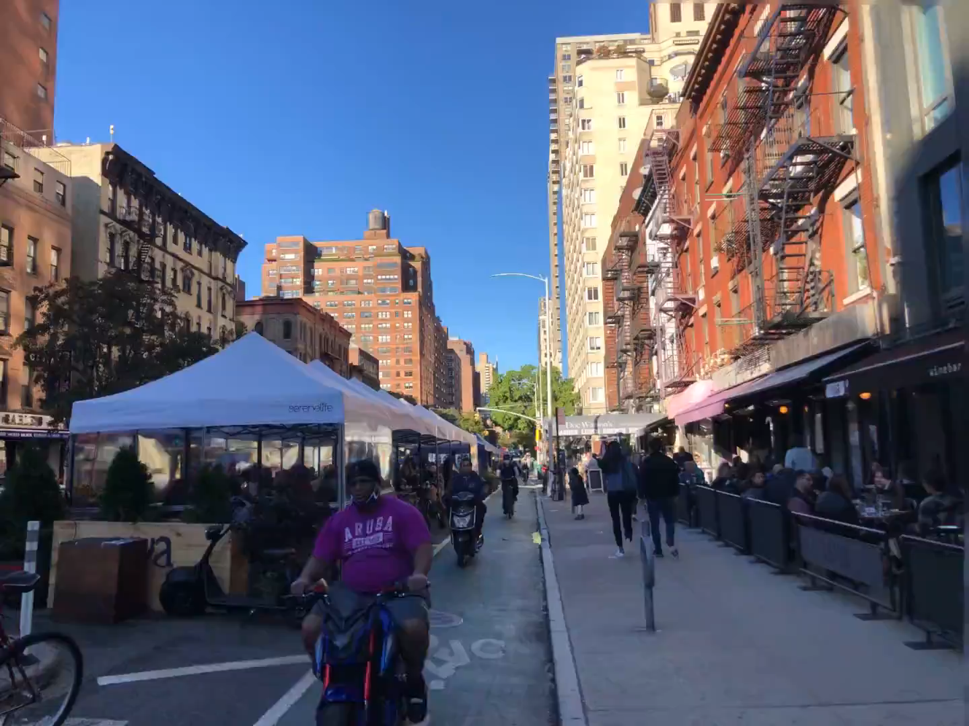
Citywide Road Reallocations
Real Estate Land Grab
Over the last two years pandemic data has legitimized many initiatives aimed to improve the pedestrian realm, reallocate roadway space to people, healthy patterns and resilient economic outcomes.
Photos Source Fishman

Slide 18
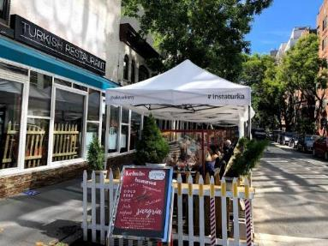
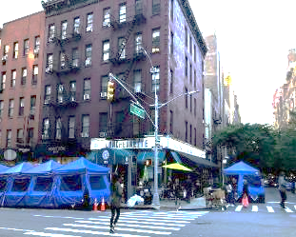
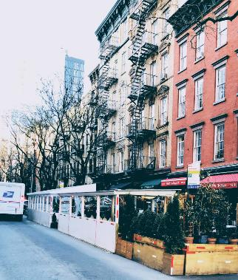
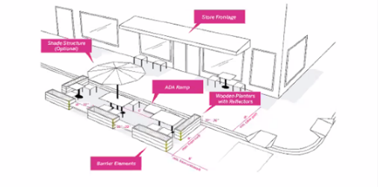
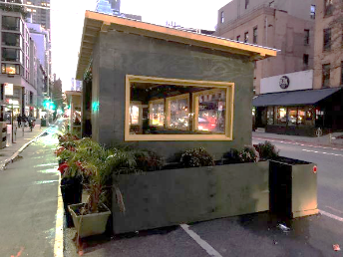
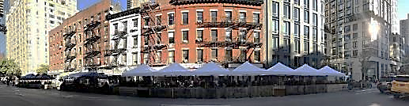
Citywide Road Reallocations
Real Estate ‘Lane Grab’
Over the last two years pandemic data has legitimized many initiatives aimed to improve the pedestrian realm, reallocate roadway space to people, healthy patterns and resilient economic outcomes.
Source Kaja Kuhl
You Are The City
Photos Source Fishman
Notes:
As we see lanes of traffic reallocated for commercial, green infrastructure and micro-mobility functions, safety issues have given rise to a new set of technical engineering requirements from vehicular and pedestrian safety to land use functionality and stormwater capture and conveyance.

Slide 19
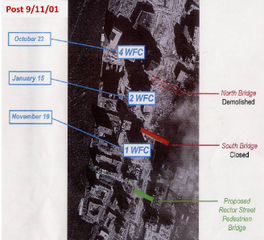
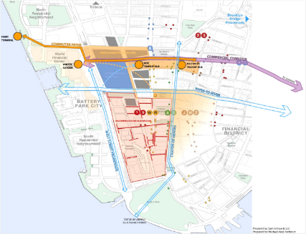
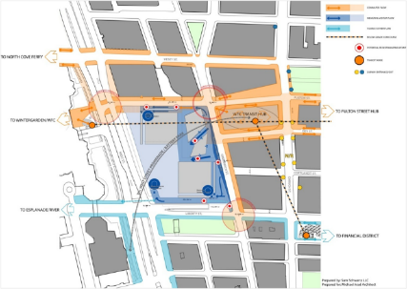
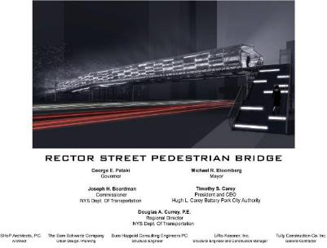
World Trade Center Response and Lower Manhattan Master Plan
NYCentric Pedestrian Engineering
WTC Memorial Design
WTC Pedestrian Master Plan
(design for over 6M pedestrians annually)
Work done as VP of Sam Schwartz Engineering
Source: SSE
First infrastructure built post 9/11: 2 box trusses prefabricated for overnight assembly over 5 days to reflect hope and honor sensitivities.
Notes:
Charged with technical analyses of all 7 WTC masterplan competition entries, pedestrians were put front and center for anticipated 5M visitors annually to the memorial and given the level of transit connections in the area. To allow decision makers to understand technical information at a glance, 250 postage stamp diagrams were developed in 6 weeks to make sense of how each entry impacted daily commutes, quality of life and visitor experience at the site and area wide.

Slide 20
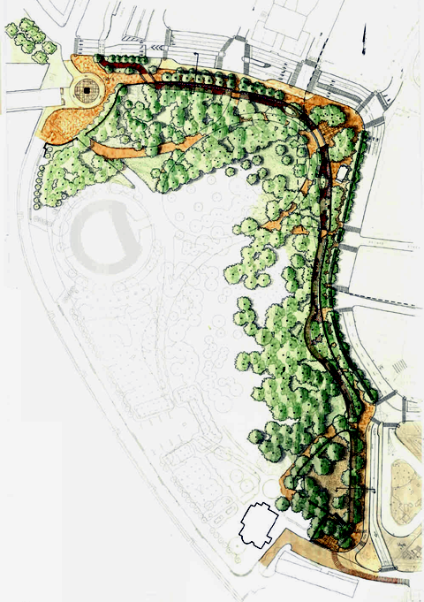
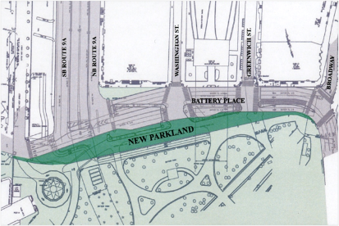
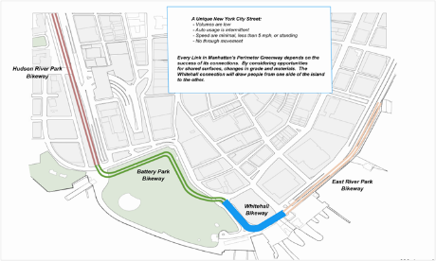
East – West Greenway: The Battery
NYCentric Pedestrian Engineering
Question: How can the east and west greenways be connected around the tip of lower Manhattan without compromising over 3 million visitors to Ellis Island and the Statue of Liberty on the waterfront or taking up valuable open space within Historic Battery Park?
Answer: Over an acre of new parkland was created contiguous to Battery Park by narrowing the right of way of Battery Place and connecting to Peter Minuet Plaza. This led to the east west greenway connection at Manhattan’s southern tip.
Over an Acre of NEW Parkland Created
Source: Battery Conservancy as VP of Sam Schwartz Engineering
Notes:
The greenway was not originally a welcome addition to this complexity for having a new set of technical geometric and safety requirements beyond bus, ferry, car, truck and subway needs already on site. Pedestrian access to and from multiple modes at the narrow southern tip of Manhattan forced designers to engineer individual and complex streetscape geometries to maintain the integrity of historic structures, trees and park functions while meeting safety and mobility standards to gain agency approvals (City and State DOT among others).

Slide 21


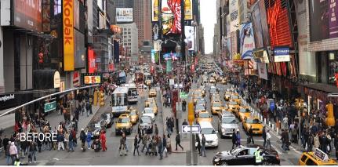




TIMES SQUARE PRE-2009
Pedestrian Epicenter
Mayhem on the Streets Tripping Hazards for Event Infrastructure
Where else in NYC do we have 7-8 moving lanes of SB traffic?
Fishman/Times Square Alliance credit for all images
Notes:
Use experience closing Times Square to traffic to broaden understanding of how TOD directly relates to people and improves social outcomes. Explain the process, from community engagement, data and alternative analyses and conceptual engineering to design, delivery, and stewardship of this high-profile roadway reallocation.

Slide 22

Overcrowding
Design Trust for Public Space Fellowship 2003/4
PUBLIC + PHILANTHROPIC + PRIVATE
3 Community / Business Leader Workshops
Over 20 invited professional designers, urbanists, artists, traffic planners, and City Agencies including NYCDOT focused on innovative approaches to solving Times Square’s Streetscape conditions.
Yields Pedestrian Engineering Fellowship
  Safety First
  Choreograph Chaos
  Enhance Quality of Life
  Blend Design and Technical Demands
  Facilitate Economic Development
  Navigate Authorities Having Jurisdiction
Source: Times Square Alliance
Notes:
Community engagement is can be challenging when solutions must be engineered for safety and mobility. Pedestrian models are invaluable in this process as they allow for technical information to be communicated to facilitate design processes and can then allow for scenario testing for emergency and event management as well as public information tool to communicate changes in patterned behavior.

Slide 23


Situation – Insufficient Infrastructure
Consistent overcrowding - Sidewalks don’t’ accommodate pedestrian volume or activities
Source: Times Square Alliance

Slide 24


Situation – Dangerous for Pedestrians
Pedestrians forced into the streets
Source: Times Square Alliance

Slide 25



Data Driven Documentation
Time Sensitive and Labor Intensive…
Source: Fishman/Times Square Alliance
Notes:
Surveys showed over 50% of TS traffic was yellow cabs (pre uber etc) and that 40-60% of these were EMPTY trolling for fares through TS over and over again.
Subsequently the 2020 land use projections have come to pass – irony is that 2020 also saw the streets empty for covid.
Manual counts vs. big data sources makes this data collection and analyses far less labor intensive and time dependent for historical and real time information now readily available. Note: our global Replica license has access to origin destination and modal split data of this kind NASA wide.

Slide 26


Data Driven Documentation
2023 News Flash: data collection is no longer a time and cost issue for clients!
Global Big Data License
Source: Fishman/Times Square Alliance
Notes:
How we make data collection and aggregation easier for owner operators.
Surveys showed over 50% of TS traffic was yellow cabs (pre uber etc) and that 40-60% of these were EMPTY trolling for fares through TS over and over again.
Subsequently the 2020 land use projections have come to pass – irony is that 2020 also saw the streets empty for covid.
Manual counts vs. big data sources makes this data collection and analyses far less labor intensive and time dependent for historical and real time information now readily available. Note: our global Replica license has access to origin destination and modal split data of this kind NASA wide.

Slide 27
Establish Common Goals
Times Square - Verbal Vision
Pedestrian Engineering Priorities
Movement Defines Times Square
• Crossroads of the World: where art and life collide.
• The spectator and spectacular share one space.
• Where the world marks the passage of time.
• Historically, a reflection of our times.
Beyond Incremental Sidewalk Extensions
• Set the stage for what Times Square will become.
• Set the standard for public private partnerships.
• Set the tone for a new century.
Promote Activity: Go Vertical
• Activate balconies, terraces and platforms.
• Integrate subway and pedestrian passage.
• Inhabit signage superstructure.
The Streets Never Sleep: Multi-Tasking
• Enhance paths for all modes.
The bowtie is also a destination (not just a pass thru).
• Host vendors/information/trash receptacles/furniture.
• Energy/light/telecom/sound/ REVENUE SOURCE.
Maintain the Vernacular
• Celebrate local flavors and character.
• Reference historical iconography.
• Theater set / event space.
Balance Regulation and Creation
• Choreograph chaos.
• Establish flexible boundaries.
• Institutionalize constant change.
Notes:
Human power vs. motors EV are great but get out of ped / bike space!

Slide 28


How to deal with vehicle traffic ‘the bowtie’
Back to The Numbers: Balance the Network – Loosen the Tie!
EXISTING STREET NETWORK
BALANCE THE NETWORK
35%
65%
48%
52%
32%
68%
42%
58%
45%
55%
66%
33%
51%
49%
38%
62%
47%
53%
% split of 7th Avenue traffic to Broadway
Source: Habib/Fishman/Times Square Alliance
Notes:
The 60/40 split that existed at the crossover between Broadway and 7th Ave was an indicator that there was no traffic engineering justification for the crossover itself. This is because it turned into a 40/60 split below 44th Street (7th Ave could clearly be decoupled to accommodate all SB traffic north and south of the crossover). That said, it begged the question: ‘do we need southbound redundancy at all?!’

Slide 29


Process: Phased Design Build Coordination Strategy
Responsible Party Timeline
Source: Fishman

Slide 30



‘Temporary’ Test Pilot
Source: Glasgow Liveable Neighbourhoods
Pedestrian Engineering
Source: Molly Dilworth
Notes:
Glasgow Source!
Once you gain approval good luck taking space away from pedestrians… a matter of public opinion.

Slide 31




Events Infrastructure Plan
Paid for Within 3 Years – Profitable in Perpetuity
BUILT INTO THE STREETSCAPE
Generates Revenue
Eliminate Event Based Trip Hazards & Idling Trucks
Traffic Calming & Vertical Public Spaces
Source: Fishman/Times Square Alliance
Notes:
Revenue generation was achieved by engineering utility access for an event infrastructure to facilitate regular and one off events being held year round. This eliminated trip hazards and payed back the investment within 3 years of operations to operate at a profit in perpetuity making TS safer and cleaner than ever before.

Slide 32


Union Square District Vision
NYCentric Pedestrian Engineering
Source: Union Square Partnership

Slide 33

Vision 42
NYCentric Pedestrian Engineering
Question: What are the issues and opportunities associated with reestablishing a streetcar on 42nd Street, river to river?
Answer: Transitways with minimal utility relocation can turn the street over to pedestrians and have local traffic impacts that can be mitigated. Costs are reasonable given comparable forms of east west access in midtown Manhattan. Economic impacts are great given the volume projections for foot traffic.
Source for all images: Vision 42
Notes:
Construction workzone safety is a prime example of how pervasive pedestrian engineering is across our sectors. In this case we are describing how to maintain traffic levels of service and utility functionality while reconstructing 42nd Street river to river as a transit way. BRT was subsequently implemented in this fashion on 14th Street and Vision 42 remains a potential project to connect the UN in the east to Times Square and the Port Authority Bus terminal to the west.

Slide 34



Pedestrian Engineering
Mott MacDonald Tools and Techniques
Mott MacDonald was selected by The City of New Orleans wanted to creatively address drainage and environmentally sensitive design needs while fully reconstructing eight blocks of Bourbon Street without retracting from the historical (and pedestrian) aspects of the French Quarter.
Notes:
Other Cities have taken a lead in this realm (Toronto, Hong Kong, Shanghi, Paris and others) separating grades to make access safer for pedestrians; enhancing the public realm by separating the multitude of functions that the ‘traditional main street’ has come to bear in dense urban environments. In this way, New York Urbanism offers an alternative to the New Urbanism in relation to building on not harkening back to) tradition, integration of transit and street life, site specificity for land use program and design and true urban revitalization and sustainability.

Slide 35




STEPS Description
Key Aspects of Pedestrian Modelling
Focus on safety and customer experience
Peak ingress (total) and peak egress (total) periods
Levels of Service (LOS)
Simulate arrivals / departure intervals for multiple mode
Emergency egress beyond code compliance
Density of people and use patterns
Elevator optimization within standards Average journey times
Target investments to optimize performance
Geometric information from architectural (Revit) model
Analyze and anticipate origins / destinations
Control flow base on capacity levels and size of spaces
MEMORIAL SLOAN KETTERING CANCER CENTER VISUALIZATION
Notes:
Modelling emergency evacuation of city-wide area through public facilities.
Layouts are tested and then modified to reduce congestion on platforms through addition of concourse staging options.

Slide 36



Built Environment
STEPS Pedestrian Modelling
Office building, stadia and transit station layout changes are recommended after modelling typical pedestrian behavior. Day-to-day movements and emergencies focus on vertical and horizontal integration with information screens/wayfinding.
Various layouts are prepared, and scenarios analyzed so owner/operators can target capital and operational investments to improve movement fluidity and reduce potential conflicts.
A view of the STEPS model during the 9am ingress simulation at 30 minutes, scale showing usage patterns
You Tube STEPS Video Link
Notes:
Modelling has resulted in exponentially saving time and money on transit, stadia and other critical infrastructure projects by identifying hot spots to target investment strategies that solve safety and level of service problems without over engineering solutions. Building access and egress based on the most efficient route between origins and destinations sets the parameters for engineering beyond the basics: safety, time and money.

Slide 37




JFK Airport Master Plan C-19 Immediate Response
Infrastructure Epidemiology
Quantify The Risk of Transmission … Design to Reflect Risk Minimized the spread of diseases in the public realm Detailed mapping of all potential hotspots in the facility Re-engineered how people circulate through a facility
PRE / POST COVID CLIENT CONTINUITY
JFK AIRPORT MASTER PLAN (HEALTHCARE + TRANSPORTATION INFRASTRUCTURE INSIGHTS)
Notes:
Quantifying Risk of Transmission: We use risk comparison tools that enable us to assess and compare the levels of transmission risk when different measures are applied, based on the latest science. In this way, we can estimate relative changes in risk against operational metrics such as capacity or economic activity. Quantifying the risk of transmission

Slide 38








Early Works Packages
Establish Baseline
  Identify rail, surface, bus performance metrics during construction
  Deliver the message of what we face without the program
  Integrate with initiatives introduced by others (NYCDOT, MTA Ferries etc.)
  Model at strategic/ operational level
Keep People Moving
Intermodal Model
Strategically Tests Scenarios,
Evaluates Options and
Assists in Real Time Ops
Introduce Construction Impacts
  Define impacts to rail, surface & bus performance
  Overlay on baseline
  Output is a phased plan forecasting known impacts
  Repeated for key phases of work
Preferred
Outcomes
Schedule and Costs Benefits
Operations and Community Impacts
Mitigations Measures (Scenario Testing)
  Evolve remote / local measures to improve phase on phase
  Re-test strategic and local models for holistic benefits and improvements
  Mitigation beyond Manhattan
Yield
Most Effective Options
(by phase)
Comms Strategies
  Engage public and private sectors
    High level relationships establishment
    Evolve information to assist decide on best
    mitigation (mobility improvement) approaches
    Keep relationships alive
Travel
Demand Management
  Identify target movement reductions (e.g. 15%)
  Develop strategies to achieve
    Re-time trips
    Re-mode
    Re-route
    Re-think
Notes:
PABT by the numbers:
Daily over 250K bus trips (23% of all trans Hudson traffic)
20-30% increase demand (from precovid) anticipated – remote sensors and autonomous busses referenced
Intermodal Modelling To Strategically Evaluate Options
Establish baseline condition and threshold levels of service at key work stages and times of day
End to end journey and specific local modelling will demonstrate the worst case; scenario with no TDM overlay
Construction restrictions for holistic (area wide) operations.
Physical/ management/ operational interventions overlaid to test TDM scenarios
Loop back to the assessment modelling platforms
Outward information provides what is expected to assist behaviour change
Relevant experience
Hewitt - TFL
Fishman JFK Air Train?

Slide 39


Port Authority Manhattan Bus Terminal
    Improving Customer Experience While Facilitating Construction
Rebrand ‘Bridge and Tunnel’ Communities
TIME TESTED LOGISTICS AND STAGING
  FROM GROUNDBREAKING THROUGH OPERATIONS
  GRADE SEPARATION (OLMSTEAD AND RISSE)
    DECKS BRIDGES TUNNELS MAINTAIN AND
    PROTECT PEDESTRIANS
  WATERBORNE (MANHATTAN) – 1950s)
    DEBRIS OUT – OVERSIZE / PREFABRICATION IN
    FLEXIBLE STAGING POTENTIAL
    PASSENGER CROSSING ALTERNATIVE
PABTR
WEST MIDTOWN FERRY TERMINAL
WATERBORNE STAGING AND LOGISTICS
PH 2
HUDSON
YARDS
1
CUSTOMER EXPERIENCE IMPROVEMENTS
2
TIME AND MONEY SAVINGS
3
COMMUNITY BENEFITS
Notes:
(largest in the world by volume) Port Authority’s namesake (our beloved bus terminal) is poised to rebrand the very concept of a bridge and tunnel neighborhood and transform the reputation of Hell’s Kitchen itself. Changing people’s minds and experiences here can begin now, even before groundbreaking.
Building effective means and methods into construction contracts, such as off-site and oversized component prefabrication, waterborne staging and logistics, and off hours material handling will help maintain commuter levels of service and protect vehicular and pedestrian traffic.
Digital trip planning and wayfinding can be layered onto these working together with traffic demand management strategies and real time command center systems to begin improving mobility area wide now, and gain momentum phase upon phase until the public are fluent in the methods and the doors to the new facility open.
Capitalizing on theatrical and dynamic 24/7 activity by enhancing adjacencies and redefining terminal retail at multiple grade levels indoors and out
An integrated phasing plan will save time, money, carbon and allow regular customers, visitors and even the community itself to benefit during (not simply due to) the coming decade of construction.

Slide 40




“Outstanding Customer Experience across the entire customer journey is one of the three core pillars of achieving our vision of becoming a world-class operator of world-class airports. This Manual sets a clear and attainable standard for the Port Authority and our stakeholders to achieve this vision.”
Huntley Lawrence
  Chief Operating Officer
  Port Authority of New York and New Jersey (PANYNJ)
Notes:
The science of temporary and permanent signage and wayfinding is as the heart of pedestrian engineering. Economic models are generated to help determine tenant rental costs in locations like Heathrow or the future Port Authority Bus Terminal. JFK wayfinding and signage set the standard for the largest transportation agency in N. America …

Slide 41

Questions/Discussion
‘All we are saying…
is give PEDS a chance.’

