Slide 1
A Beginners Guide to All Things Website Design
14 Feb 2024, 15:00 - 15:50, Skills and Marketing Hub (Stage 6)

Slide 2
OUR STORY
Fortune 500 and Big Brand Experience put to work for Small Businesses Startups and Nonprofits

Slide 3
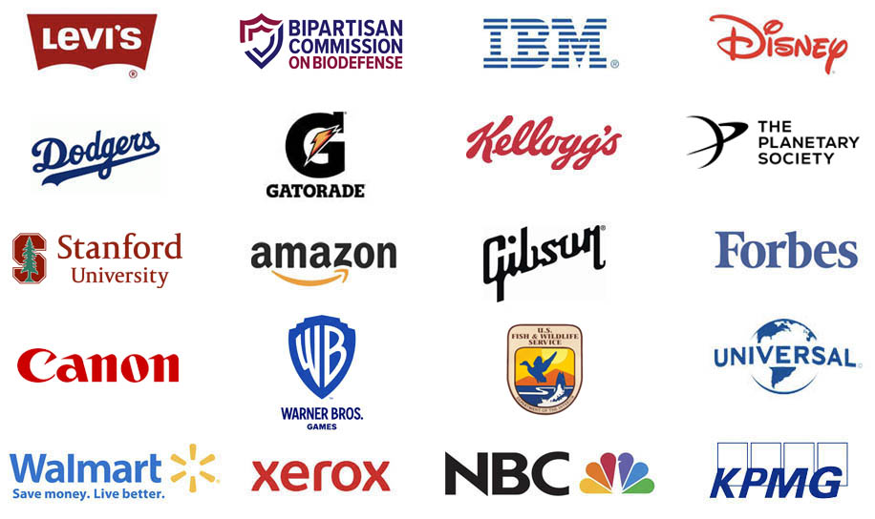

Slide 4
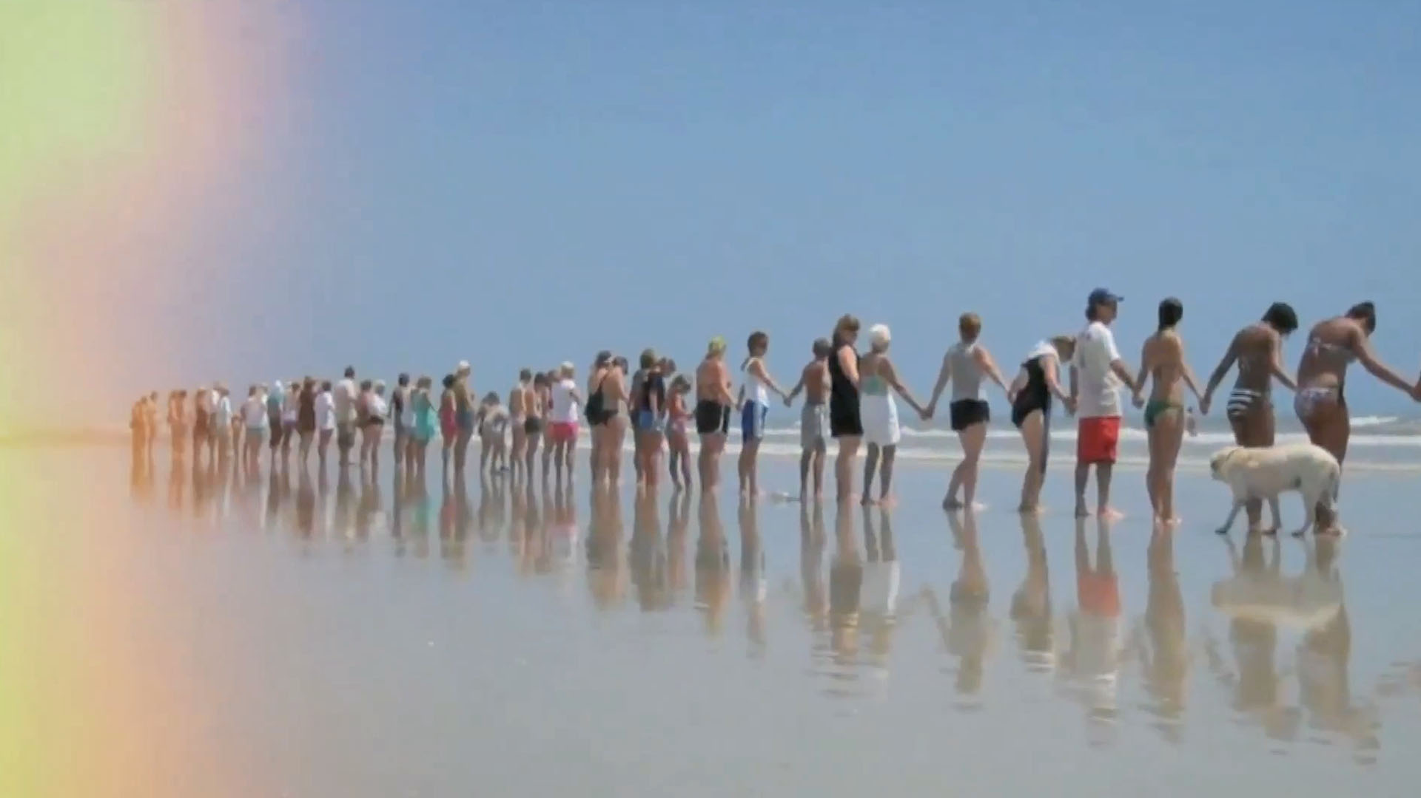
We used to work exclusively with Big Brands and Fortune 500 companies. A few years back, we produced a documentary called “Kindness Is Contagious.” A film all about being nice and the benefits of being nice. (Get your free copy here.) While filming, we worked with a lot of startups, health care organizations and nonprofits. People who made money making the world a better place. And we got jealous. We wanted to make money making the world a better place, too.
Kindness is contagious

Slide 5
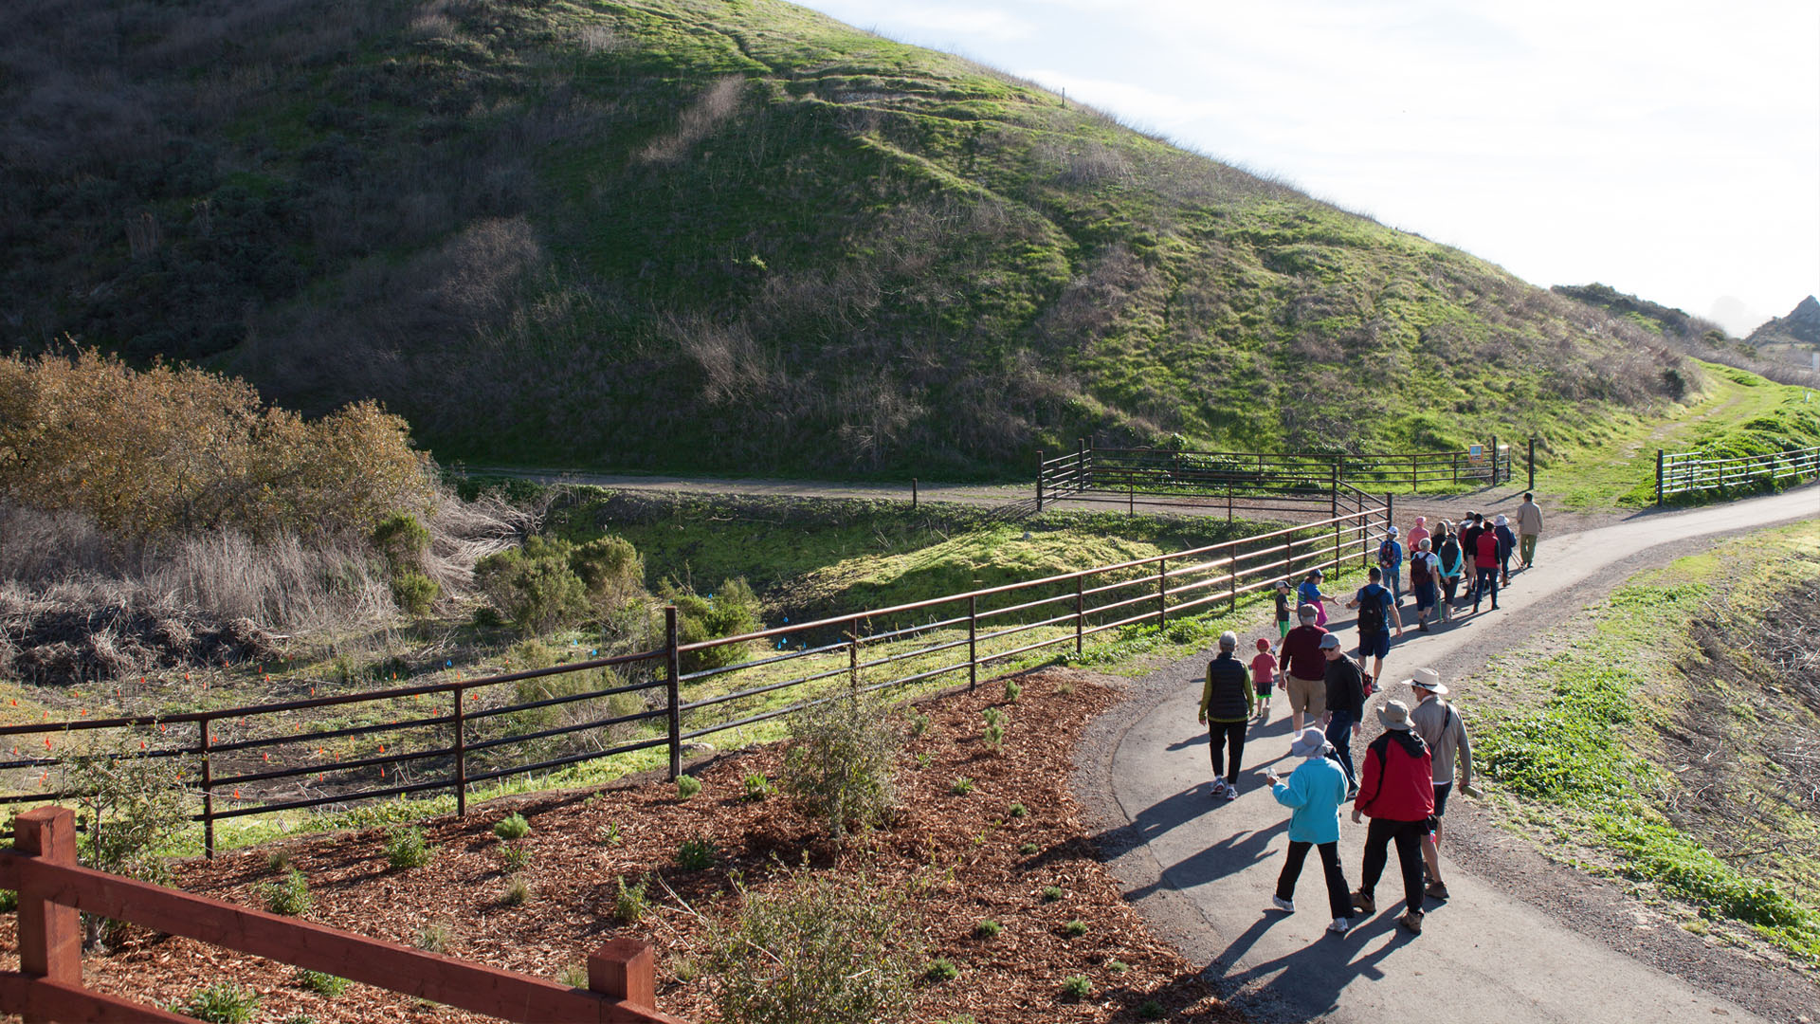
The U.S. Department Of Fish And Wildlife
So we decided to take the principles that made Big Brands and Fortune 500 companies so successful and adapt them to small business, startups and nonprofits.
The challenge was to massively simplify the marketing process, not only because these organizations could not afford the countless revisions, studies and strategy sessions, but because it also made their marketing better.

Slide 6
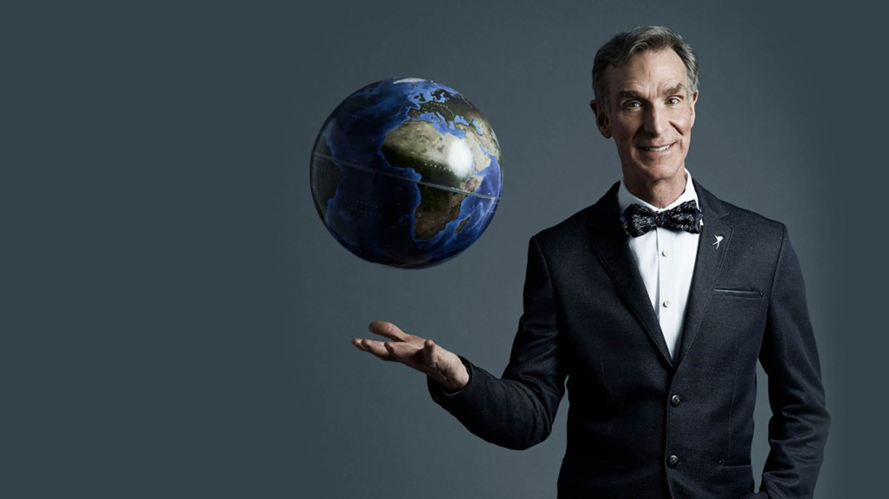
1) Why your website is the single most important marketing tool for your business 2) How to build a website yourself that looks as good as any custom website built by an agency 3) How to turn it into an “attractor” so you never have to cold call again
The Planetary Society
we’re Going To Cover:

Slide 7
New wave entertainment
Why your website is the single most important marketing tool for your business

Slide 8
TIM BARBER ARCHITECTS
it is the first point of contact for you business
People will always visit your website before they call you.
We are in the age of research, people check out everything!
8

Slide 9
Paul McCartney for Everyone matters
Credibility & Trust
Your website is where they decide if it’s safe doing business with you.
…and if it’s safe to send you money.

Slide 10
CANON
Makes you look bigger than you are
Fake it ‘till you make it. Your website can help you grow and land bigger and better projects.

Slide 11
How to build a website yourself that looks as good as any custom website built by an agency
IMAGISTA

Slide 12
1) Build a custom website 2) Use a template 3) Customize a template
Sensei biotherapeutics
Building a website is like building a house – there are 3 ways to do it:

Slide 13
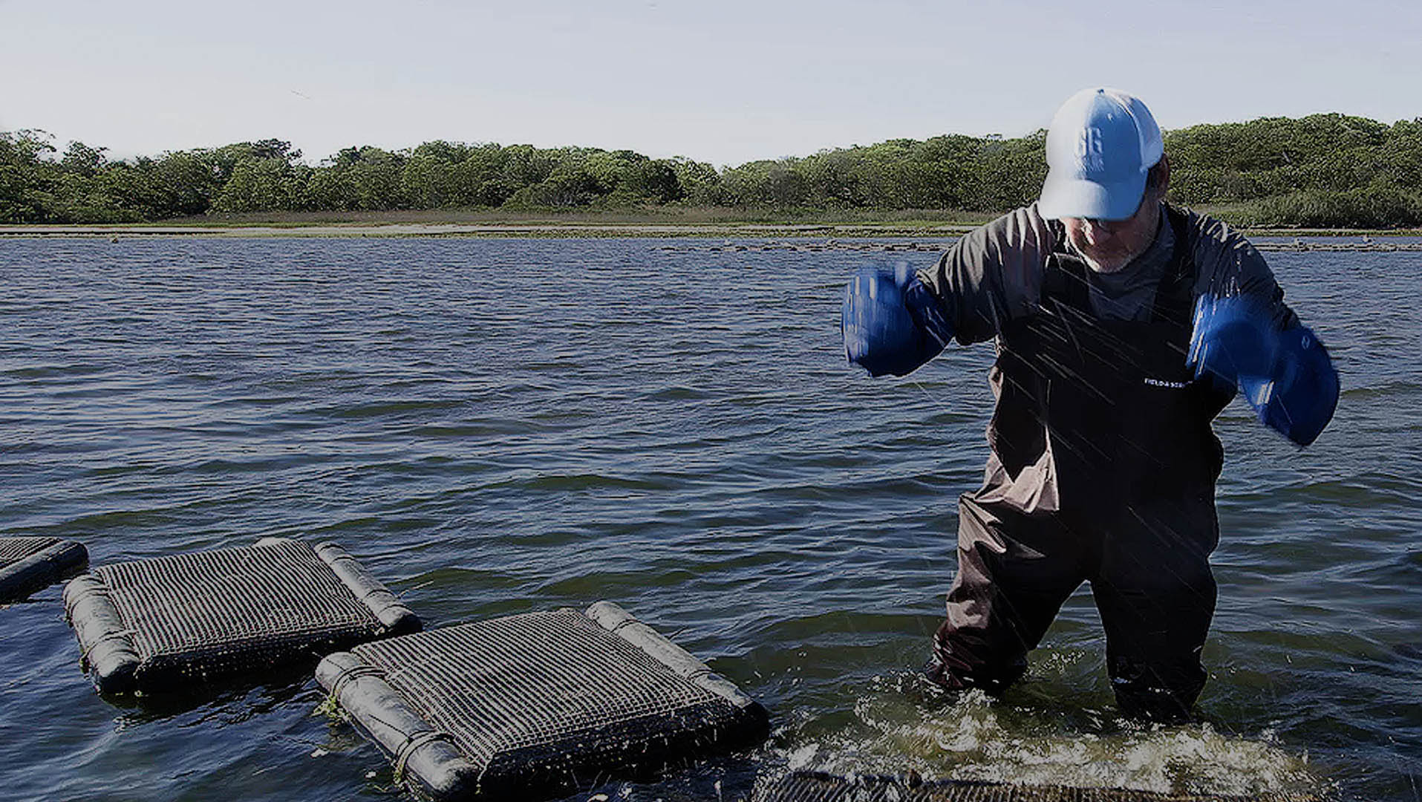
1) Wordpress – Open Platform, Lots Of Plugins, Hard(er) To Use 2) Shopify – E-Commerce, Easy To Use, Closed Platform 3) Wix – AI Builder, Easy To Use, Closed Platform 4) Squarespace – Great Templates , Easy To Use, Closed Platform 5) Webflow – Easy To Use, Up And Coming, Closed Platform 6) Magento, Drupal, Joomla.... – Open Platforms, Slowly Disappearing
GREAT GUNS OYSTERS
Popular platforms - pros/cons:

Slide 14
1) Designed for your profession 2) Well supported 3) Lots of page options 4) Designed to sell
IMAGISTA
What is a template
And how to choose
the right one:

Slide 15
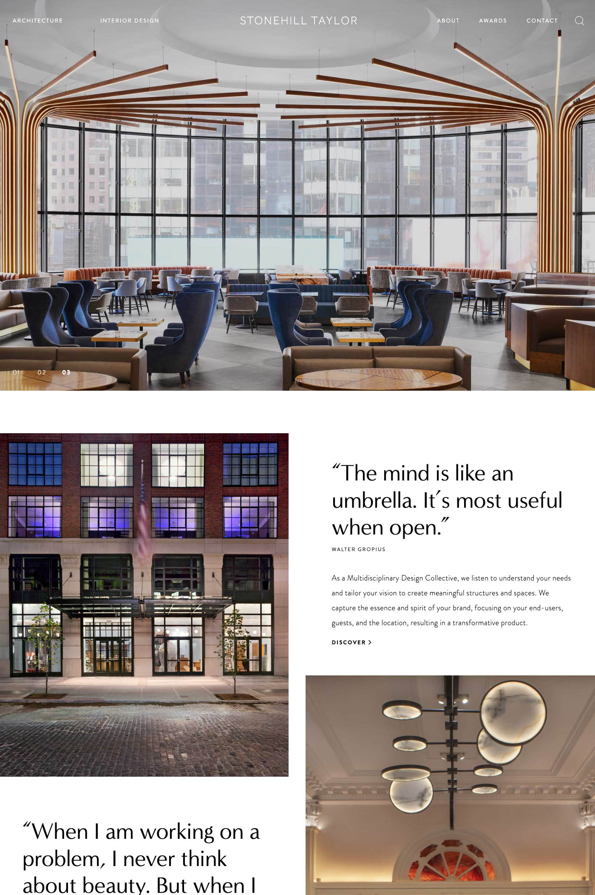
STONEHILL TAYLOR
3 powerful Strategies:
Social Proof Model
Value Proposition Model
Infomercial Model
15

Slide 16
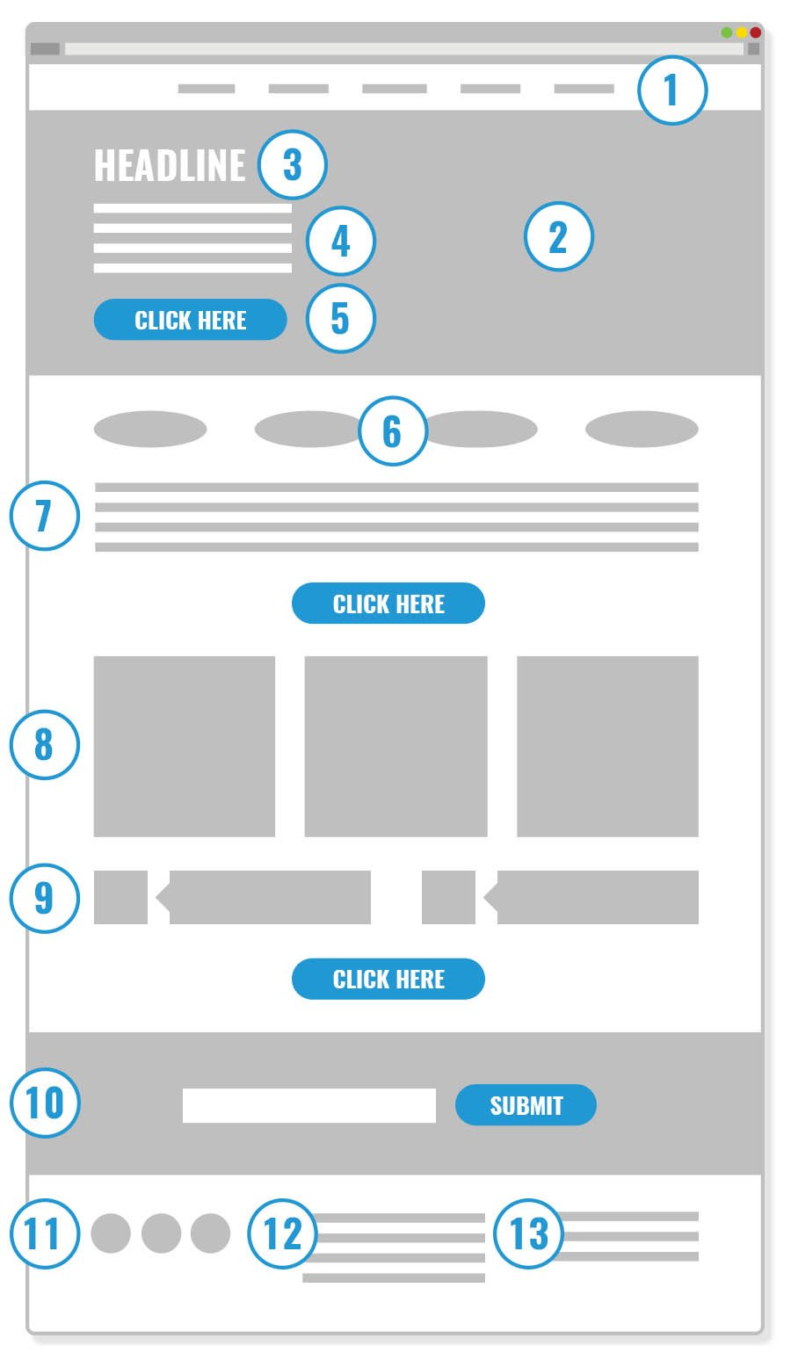
1. A Menu That Converts. 2. An Engaging Image. 3. An Irresistible Headline. 4. List Of Benefits. 5. Call To Action. 6. Social Proof. 7. Elevator Pitch. 8. Gorgeous Images or Blog Posts. 9. Testimonials From Satisfied Customers. 10. Email Capture. . 11. Social Media Links. 12. About Your Organization. 13. Your Address.
SOCIAL PROOF Model

Slide 17
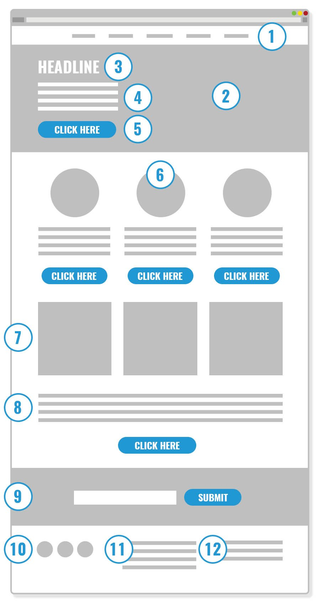
VALUE PROPOSITION Model
1. A Menu That Converts. 2. An Engaging Image. 3. An Irresistible Headline. 4. Your Value Proposition. 6. Icons. 7. Gorgeous Images or Blog Posts. 8. Elevator Pitch. 9. Email Capture. 10. Social Media Links. 11. About Your Organization. 12. Your Address.

Slide 18
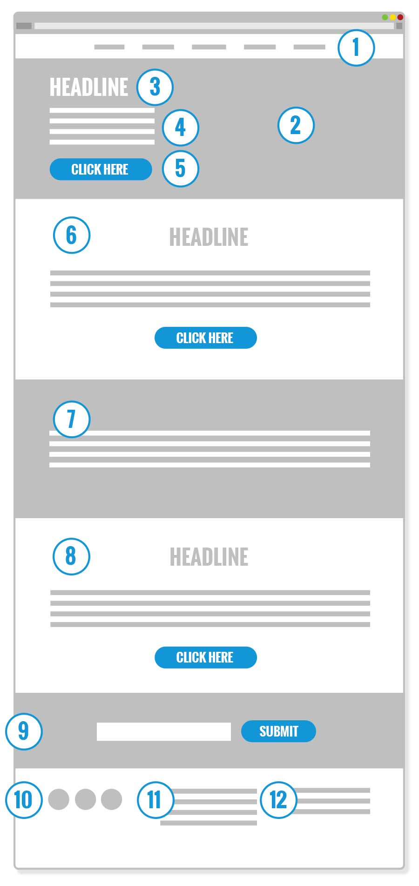
INFOMERCIAL Model
1. A Menu That Converts. 2. An Engaging Image. 3. An Irresistible Headline. 4. Your Value Proposition. 5. Call To Action. 6. Still Not Convinced. 7. Divider. 8. Still Not Convinced. 9. Email Capture. 10. Social Media Links. 11. About Your Organization. 12. Your Address.

Slide 19
1) Swap images for images and text for text 2) Make sure your images are gorgeous 3) Images should attract not explain 4) Cheap video (and imagery) says cheap company
Sheep inc.
Content:

Slide 20
How to turn your website into an “attractor” so you never have to cold call again
IMAGISTA

Slide 21
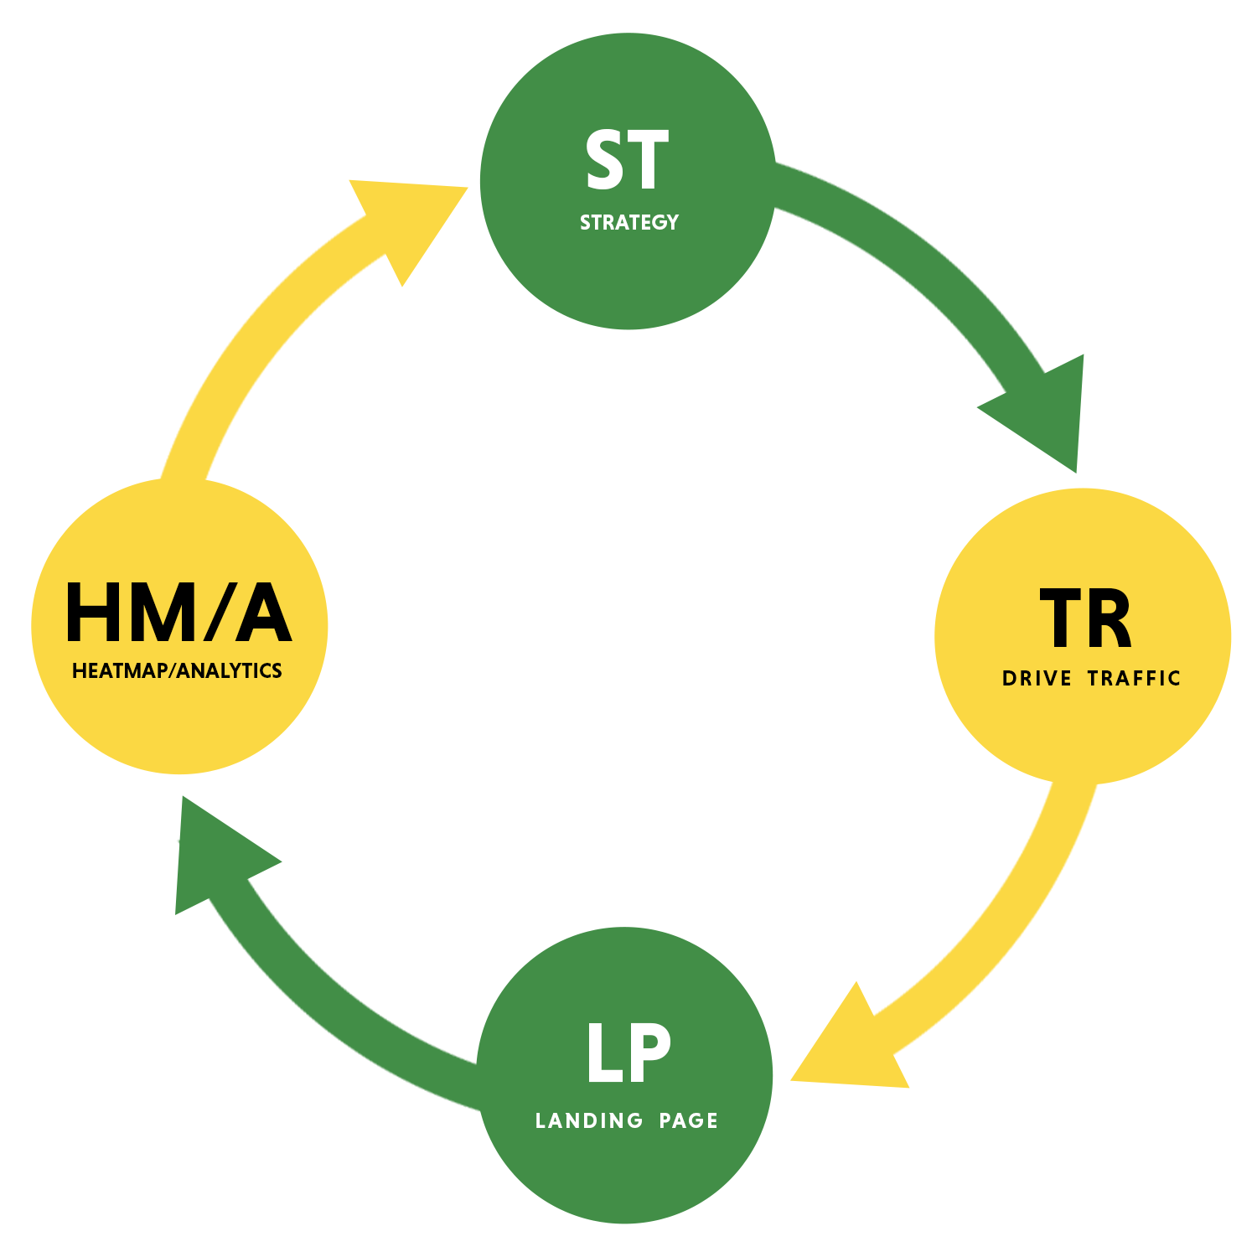
APT EDGE AI
The wheel of fortune
1) Strategy
2) Drive traffic to your website
3) Optimize your website
4) Look at the data and Adjust
5) Rinse and repeat

Slide 22
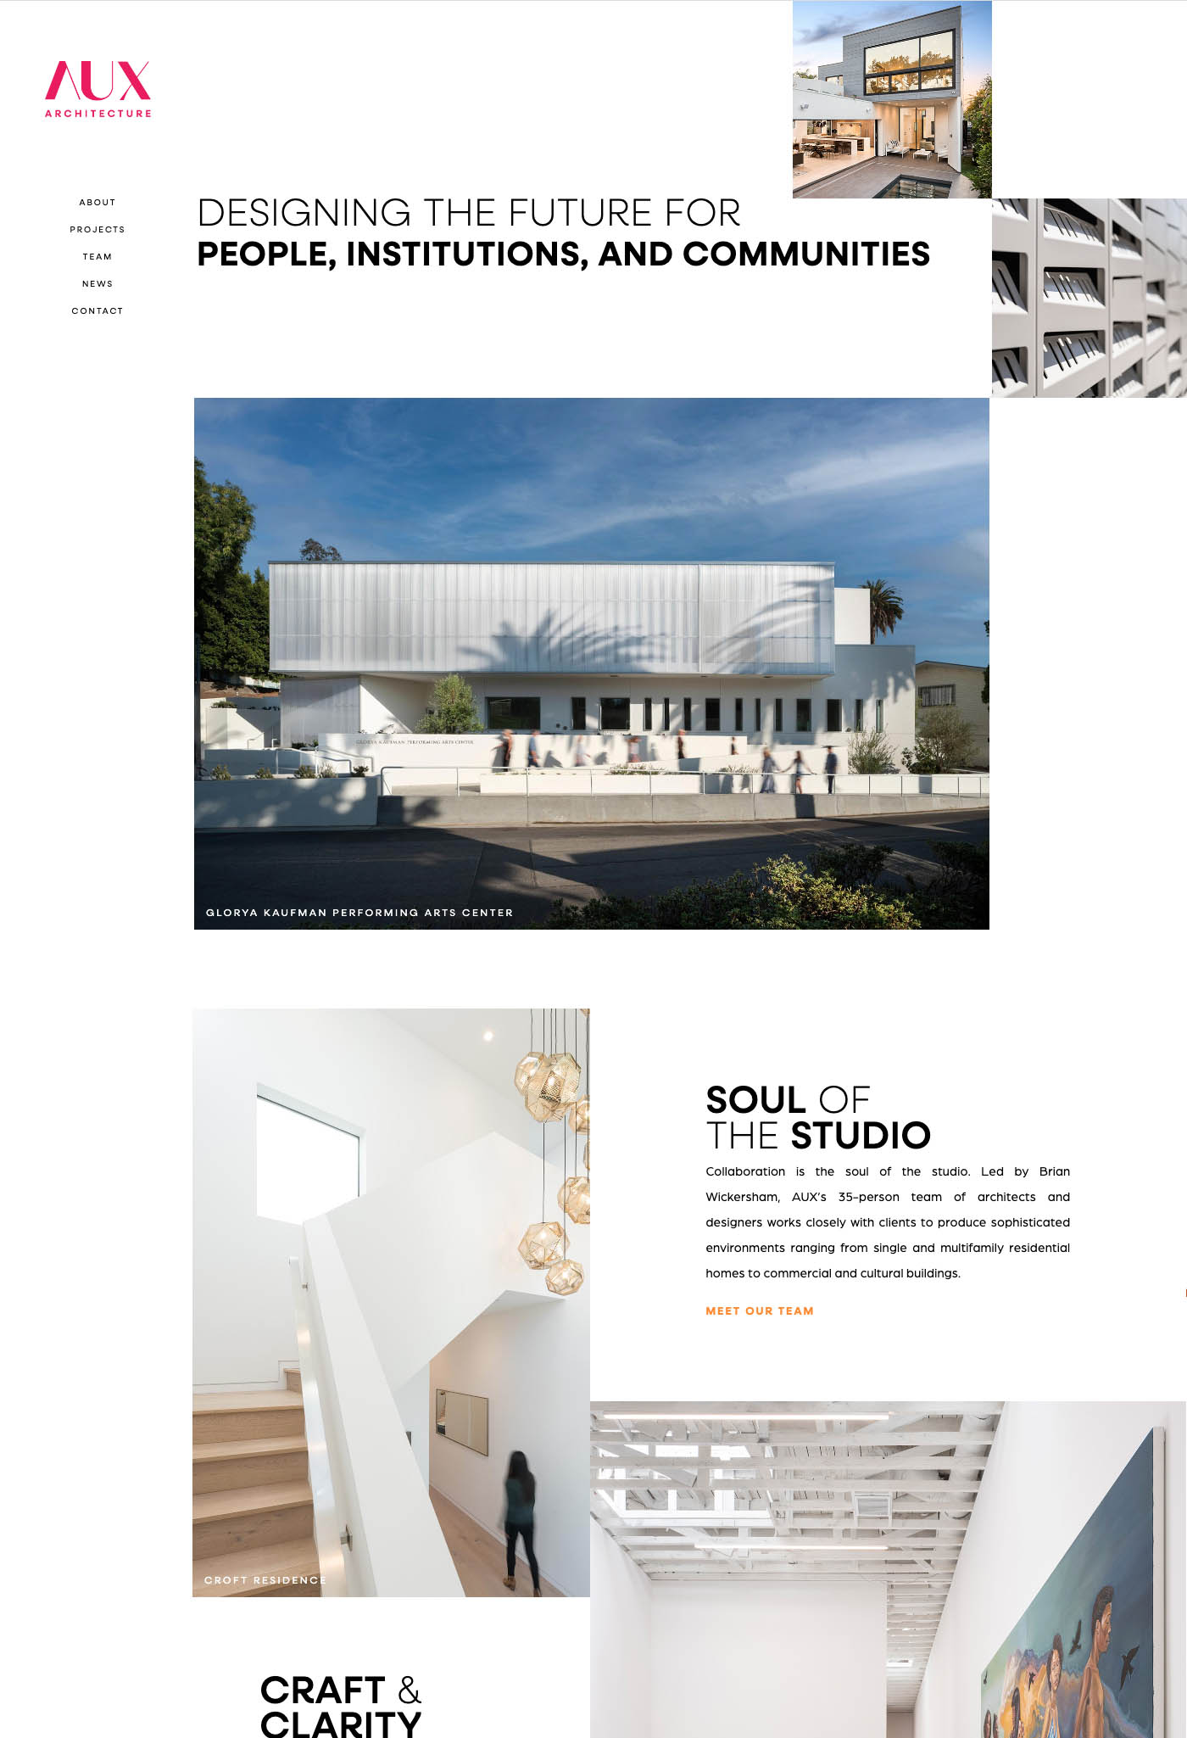
AUX ARCHITECTURE
Strategy
Everything starts with strategy. What you do differently and better than your competitors.
Set the goals for your marketing initiatives, a strategy to hit them and drive traffic with ads and a landing page designed to achieve those goals.
22

Slide 23
ROGALL & CO.
Traffic
Next you want to apply the strategy to your Google Ads, Email Marketing, Meta, LinkedIn, X, Pinterest, Reddit, and other channels that drive traffic.
This is important because getting people to click on ads is not hard. Getting the RIGHT people to click on ads is much more difficult.

Slide 24
JACKSON DESIGN AND REMODELING
Optimize Your Website
This is the part most people skip. You want to apply the strategy to your website too.
This is important because regardless of the expertise used to generate traffic, the destination must be thoroughly optimized to drive sales.
Getting people to come to your website is easy, getting them to buy stuff is hard.
24

Slide 25
Klang & Associates
Look At The Data and Adjust
Now that you have a great strategy have clear goals, great ads and a great landing page, you need to adjust to hit your goals.
Make sure you have Heatmapping and Analytics Software Installed
Look at the Time On Page, How far they scroll, where they click (and don’t). Then fix what is not working.

Slide 26
US Department Of Fish And Wildlife
Rinse and Repeat – its all about learning:
It Takes 6 Months To Dial This In
Don’t Skip Steps
If Things Get Worse: Revert

Slide 27
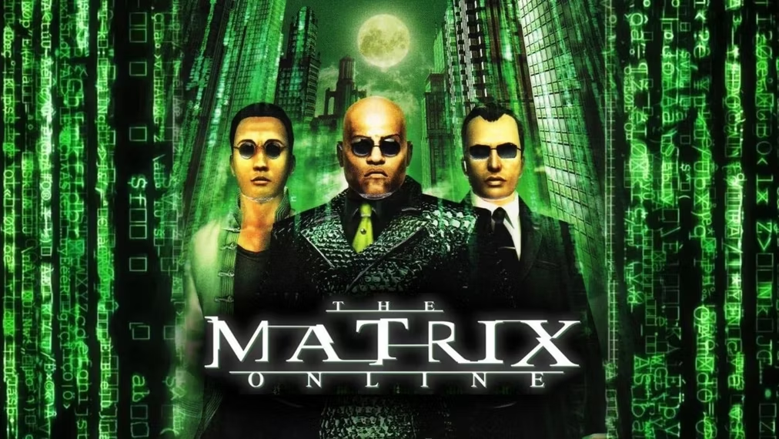
1) Remarketing for your “brand” (not products) 2) How to use LinkedIn the cheap and easy way 3) Marketing is like fly fishing
WARNER BROS / MONOLITH
Sneaky Little Tricks BIG BRANDS AND FORTUNE 500 BUSINESS USE

Slide 28
resources
Platforms
https://wordpress.com/
https://www.shopify.com/
https://www.squarespace.com/
https://www.wix.com/
https://webflow.com/
Templates
https://themeforest.net/
https://www.templatemonster.com/
Content
https://chat.openai.com/
https://unsplash.com/
https://www.shutterstock.com/
https://stock.adobe.com/
https://www.behance.net/
Tools
https://analytics.withgoogle.com/
https://www.hotjar.com/
https://www.crazyegg.com/

Slide 29
