Slide 1
financing building decarbonization in New York
how to access creative capital solutions
New York Build 2023
Kaitlin Butler Associate, Investment & Portfolio Management, NY Green Bank
Mike Doty Director, Originations, Nuveen Green Capital

Slide 2
NY Green bank

Slide 3
Who We Are
Mission-driven, solutions-oriented investment professionals with deep credit, project finance, and technical experience, along with unique expertise in New York State energy and environmental policy.
Largest
green bank
in the nation
$1 billion
capitalization with New York ratepayer funds
Goal
alleviate financing gaps in New York’s sustainable infrastructure markets to create a cleaner, more equitable, and more resilient energy system and built environment
2013
year established
$10–50 million
typical investment size

Slide 4
How We Help Overcome Barriers
NY Green Bank steps in to fill gaps in the market where financing may not be available from conventional lenders due to various barriers.
Barrier
Limited Number of Financing Partners
Unfamiliarity with Asset Class
Perceived Uncertainty of Revenue Streams
Small Transaction Size
Minimal Standardization
NY Green Bank Solution
Be a first-mover to build market scale and standardization attracting more private capital to the sector
Utilize deep expertise in financing clean energy projects and leverage expertise of NYSERDA colleagues
Consider all types of revenue contracts, merchant markets, and incentive payments, with a focus on building replicable structures
Provide financing for, and help standardize, portfolios of small- to mid-sized transactions
Be solutions-oriented in finding creditworthy approaches to financing projects with limited transactional precedent

Slide 5
What We Finance and HOW
Investments span a wide range of climate change-mitigating technologies, from building efficiency to grid-scale energy storage to clean transportation.
Primary Investment Criteria
To be a fit for NY Green Bank’s mandate, a transaction must:
Demonstrate potential for greenhouse gas reductions in support of New York State clean energy policies
Demonstrate how it contributes to market transformation in terms of:
Mobilization of private capital
Additionality in proposed investments
Be economically and technically feasible, and have expected financial returns to support NYGB’s self-sufficiency
NY Green Bank operates and lends much like a commercial project ​finance provider, including replicable structured transactions, market pricing and terms, and full diligence process
Notes:
What do we mean by additionality?
→ Because of this investment, did something happen differently than it would have otherwise? Without NY Green Bank’s involvement, would the clean energy project have been completed more slowly, at a smaller scale, or not at all?
We are a self-sustaining fund
Important to note – we are not a subsidized or concessionary capital provider. Since our mission is to get private capital sources excited about investing in clean energy, we want to demonstrate that deals in this sector can be done profitably and efficiently; that they can be done within market norms
We aim to be flexible and competitive in pricing; however, if you can get a better option from another lender, we encourage you to utilize that option – we are here to fill gaps where viable options are not available elsewhere

Slide 6
Projects
Financing for a wide variety of building decarbonization projects.
Counterparties
Property owners & developers
Building services or equipment providers
Other lenders that invest in high-performance buildings
Building types
Multifamily
C&I
MUSH
Community facilities, nonprofits, & houses of worship
Existing & new buildings
Technologies
Electrification (HVAC, domestic hot water)
Efficiency (passive design, appliances, envelope, demand management)
Clean heating & cooling (geothermal, thermal energy storage)

Slide 7
Notes:
We are primarily a debt provider, though we can also offer preferred equity where appropriate
We’re a project finance shop – specialize in project-based, asset-backed lending
We are flexible in terms of product types and structures, including ones that aren’t mentioned here (not an exhaustive diagram) – we are always open to ideas & getting creative.
We can create bespoke solutions where needed

Slide 8
Financing solutions
Products developed to fill gaps & overcome barriers in capital stacks.
Predevelopment
Incentive bridging
ESCO facilities
Lending alongside C-PACE
Notes:
For each - explain the gap or barrier and how our product addressed it
On-lease financing for commercial tenant efficiency improvements
Energy saving loans for ESCOs
Predevelopment loans for NYCHA PACT conversions
Ability to bridge incentives (e.g., NYSERDA and utility incentives)
Use of proceeds are not limited to energy- or sustainability-related measures
Ability to underwrite to higher expected energy savings than is typical of other lenders
Can support pay-as-you-save/energy-as-a-service structures
Flexible financing available for affordable housing

Slide 9
Predevelopment Financing
Indicative Product Structure:
Sponsors and Guarantors
NYGB advances funds to Borrower for eligible predevelopment costs
Guarantors guarantee the Facility
Interest payments are capitalized, accruing on quarterly basis and paid at earlier of (i) the Maturity Date or (ii) the close of construction financing
Principal is repaid at the earlier of (i) the Maturity Date or (ii) the close of construction financing
2
Managing Member
1
Lender [NYGB]
Debt proceeds
Borrower
Debt service
3
4
Project
Notes:
To finance predevelopment costs required before closing on construction/term financing for a project.
E.g. consultants, permitting, design/analysis/studies, deferred maintenance needs
Alternative to using costly equity dollars at this early stage
We’ve done 2 transactions with a similar structure

Slide 10
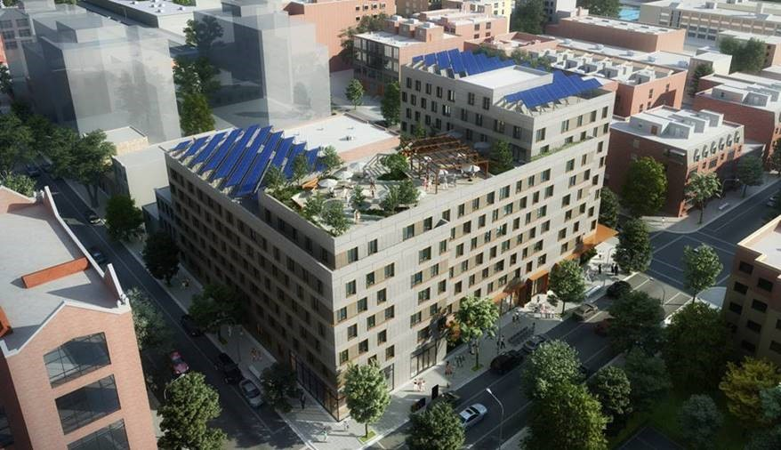
Transaction Profile
RiseBoro Community Partnership &
United Jewish Organizations of Williamsburg
Predevelopment lending to support 140 units of all-electric affordable housing at Broadway Triangle
Transaction amount: $2.6MM
Date closed: November 2021
Lifetime metric tons CO₂e reduced: 14.9 thousand
“We see this project as the beginning of a continued partnership and an exciting example of how NY Green Bank’s innovative financing products can catalyze our progress towards a decarbonized New York affordable housing stock.”
Kelly Biscuso, Director of Real Estate Development at RiseBoro

Slide 11
Incentive bridge Financing
Sponsor provides separate Guaranty of existing portfolio of property companies, backed by real property equity based on appraisals and stabilized rent valuations, as well as cash on balance sheet
NYGB makes an advance to the Borrower under the Facility: the lesser of 90% of committed incentive value or construction lender’s equity requirement
Borrower uses advance to make equity contribution required for construction loan. Sponsor required to contribute at least 5% of project costs, inclusive of all aspects of construction.
Construction Lender provides construction loan to purchase-and-retrofit or to construct new building
Energy efficiency and generation installations generate Incentives to Borrower
Borrower pays debt service to NYGB
Indicative Product Structure:
Sponsor
6
Lender [NYGB]
Debt service
Borrower
Debt proceeds
2
NYSERDA
Construction lender
Property company
5
Incentives
Utility
4
Debt proceeds
Notes:
Sponsor provides separate Guaranty of existing portfolio of property companies, backed by real property equity based on appraisals and stabilized rent valuations, as well as cash on balance sheet
NYGB makes an advance to the Borrower under the Facility: the lesser of 90% of committed incentive value or construction lender’s equity requirement
Borrower uses advance to make equity contribution required for construction loan. Sponsor required to contribute at least 5% of project costs, inclusive of all aspects of construction.
Construction Lender provides construction loan to purchase-and-retrofit or to construct new building
Energy efficiency and generation installations generate Incentives to Borrower
Borrower pays debt service to NYGB

Slide 12
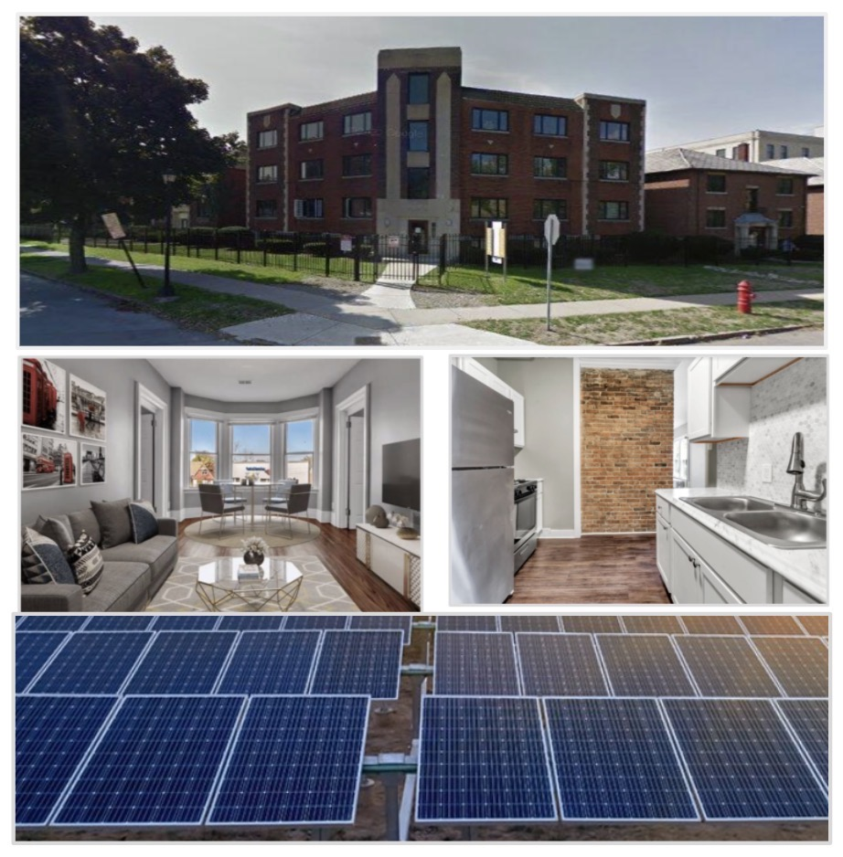
Transaction Profile
e2i
Bridging incentive payments for the electrification of naturally-occurring affordable housing in western NY
Transaction amount: $8MM
Date closed: March 2022
Lifetime metric tons CO₂e reduced: 68 thousand
“NY Green Bank has been hugely supportive of our growth and will help us bring thousands of affordable green apartment units to New York over the next 5–7 years. Their team is smart, creative, flexible, and accommodating. They worked with us to create a solution that works for our current company size and a structure that will scale as we grow as a business.”
Adam Serbert, President and Founding Partner, e2i
Notes:
This multi-draw term loan facility provides e2i, a small locally-based developer, with liquidity to decarbonize multifamily buildings in the Buffalo area while maintaining affordability.

Slide 13
ESA Financing for service providers
Indicative Product Structure:
Sponsor [ESCO]
ESCO sells a Project to Customer and installs the Project. Borrower purchases the fully-installed Project for the Purchase Price if it meets the Eligibility Criteria.
NYGB makes an advance to the Borrower under the Facility for the same amount as the Purchase Price.
Customer makes Services Payments to Borrower under ESA.
Borrower pays debt service to NYGB.
Remaining cash in Borrower is distributed to Sponsor if distribution requirements are satisfied.
Asset Manager enters into contract with Borrower to provide ongoing asset management services.
Asset Manager [Sponsor or 3rd-party]
Lender
[NYGB]
Sponsor Distribution
Asset Sale
1
5
Advances
2
Borrower
[SPV]
Debt
Service
4
Services Contract
6
Control Account
3
ESA Payments
Customers
Customers
Customers
Notes:
We’ve used this structure successfully to support a variety of ESCOs. Would be excited to provide a similar model to contractors like the ones in the room today.

Slide 14
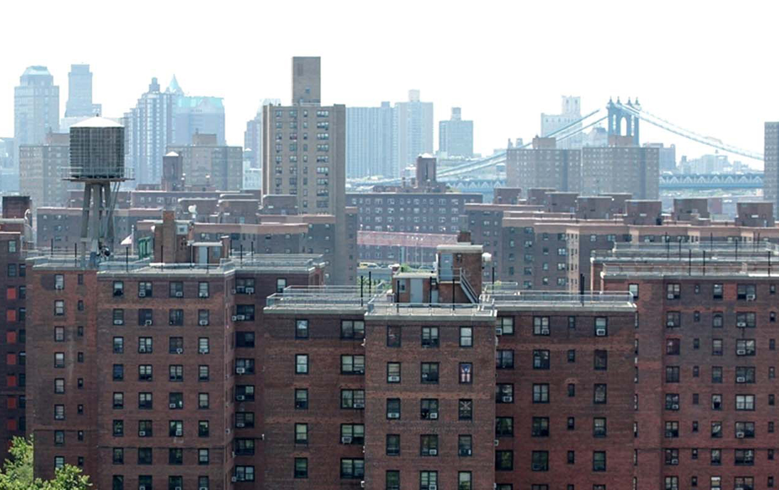
Transaction Profile
Ecosave, Inc.
Multi-draw term loan to support HVAC and energy efficiency upgrades in New York buildings
Transaction amount: $30MM
Date closed: June 2019
Lifetime metric tons CO₂e reduced: 105.1 thousand
By capitalizing energy service agreement (ESA) and energy performance contract (EPC) revenues, ESCOs can offer energy improvements at low or no upfront cost to the customer.

Slide 15
Introduction to C-PACE & Nuveen Green Capital
January 2023
19 Old Kings Highway South
Suite 210
Darien, CT 06820

Slide 16
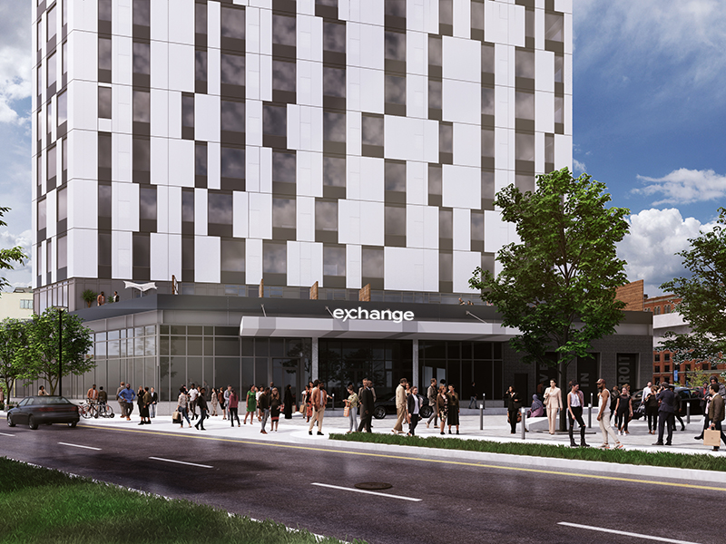
Introduction
Nuveen Green Capital is a national leader in sustainable commercial real estate financing solutions and an affiliate of Nuveen, the $1T+ asset manager and wholly owned subsidiary of TIAA. The company, which was established by the C-PACE industry’s founders and standard-setters, has grown to offer a market-leading suite of accretive financing products for commercial real estate owners who seek to improve the energy, water and resiliency performance of their property. Nuveen Green Capital is a private capital provider dedicated to making sustainability a smart financial decision for commercial property owners and developers.

Slide 17
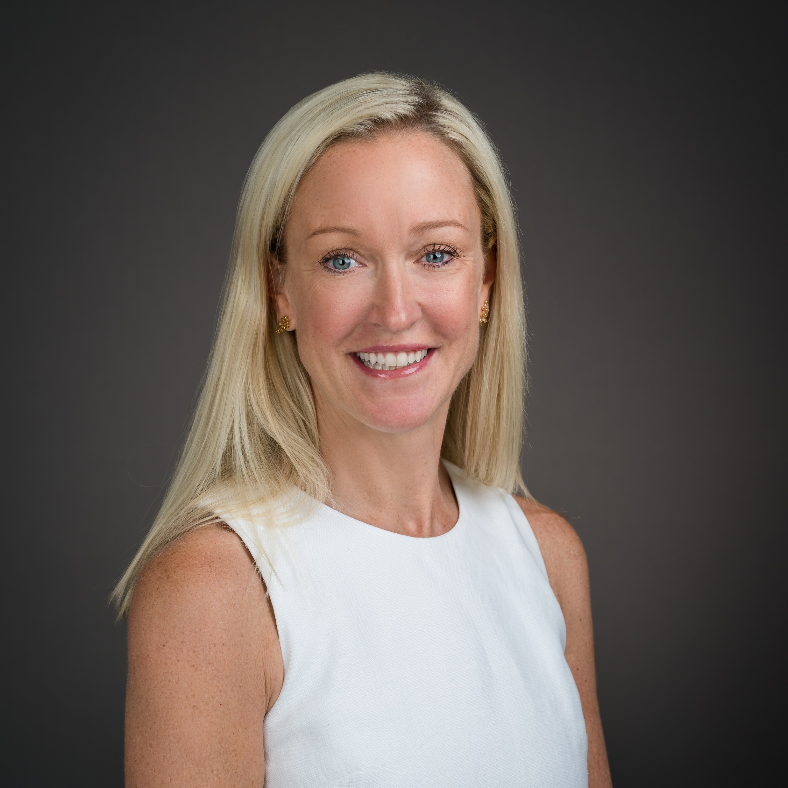
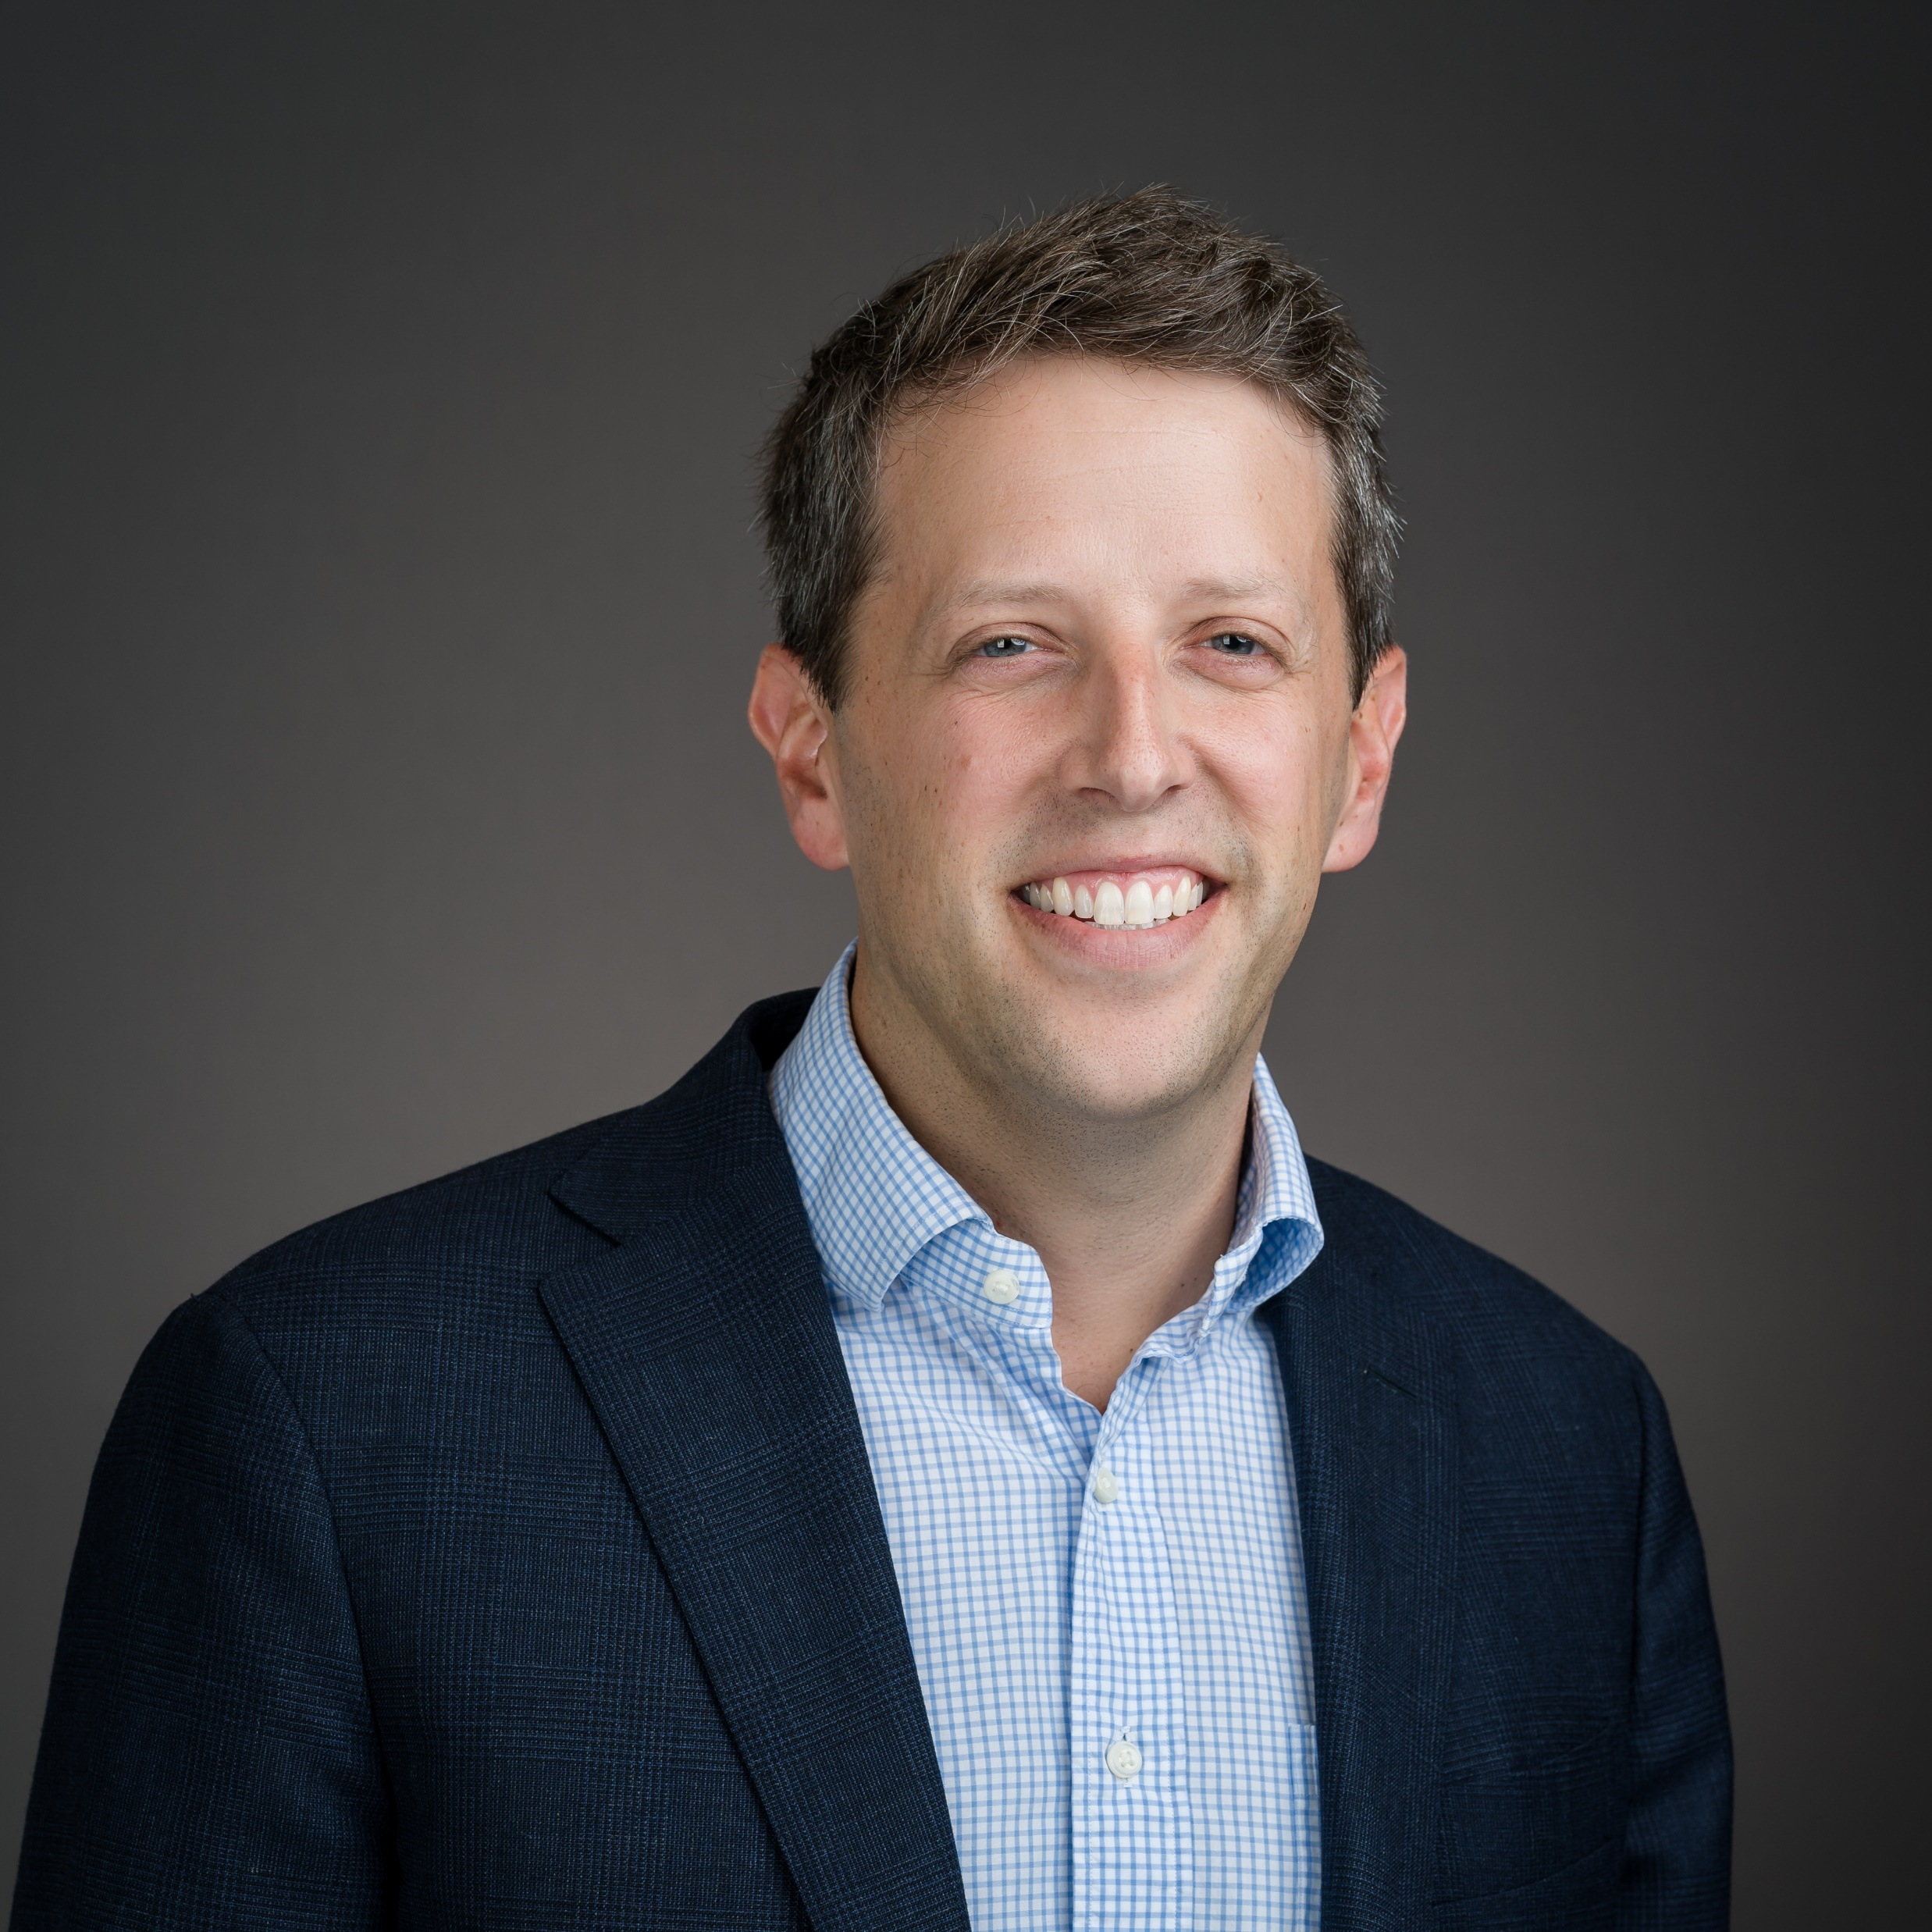
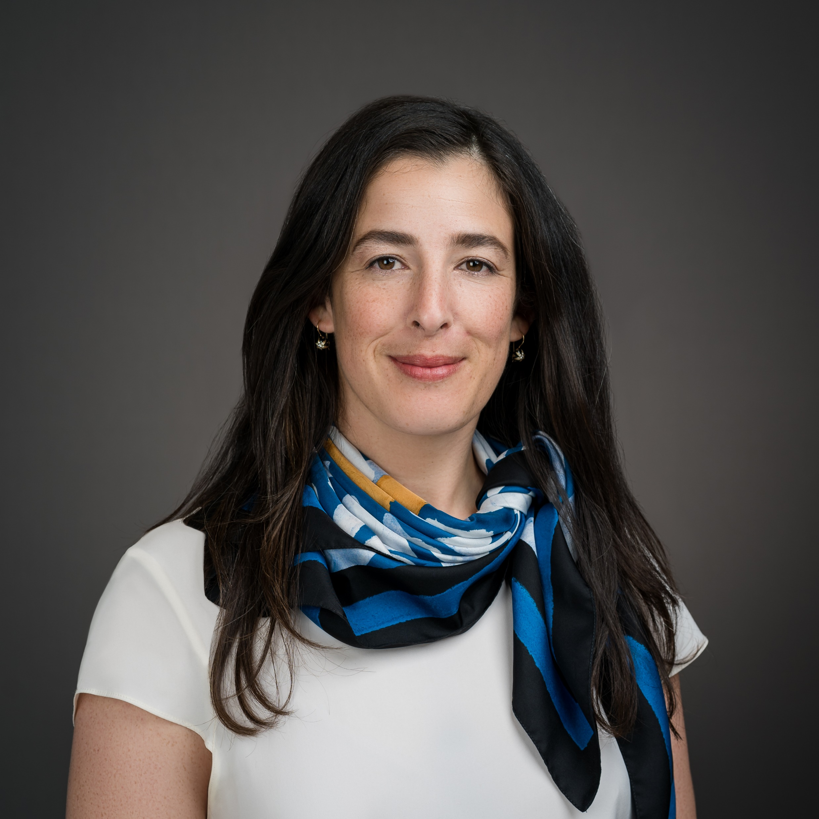
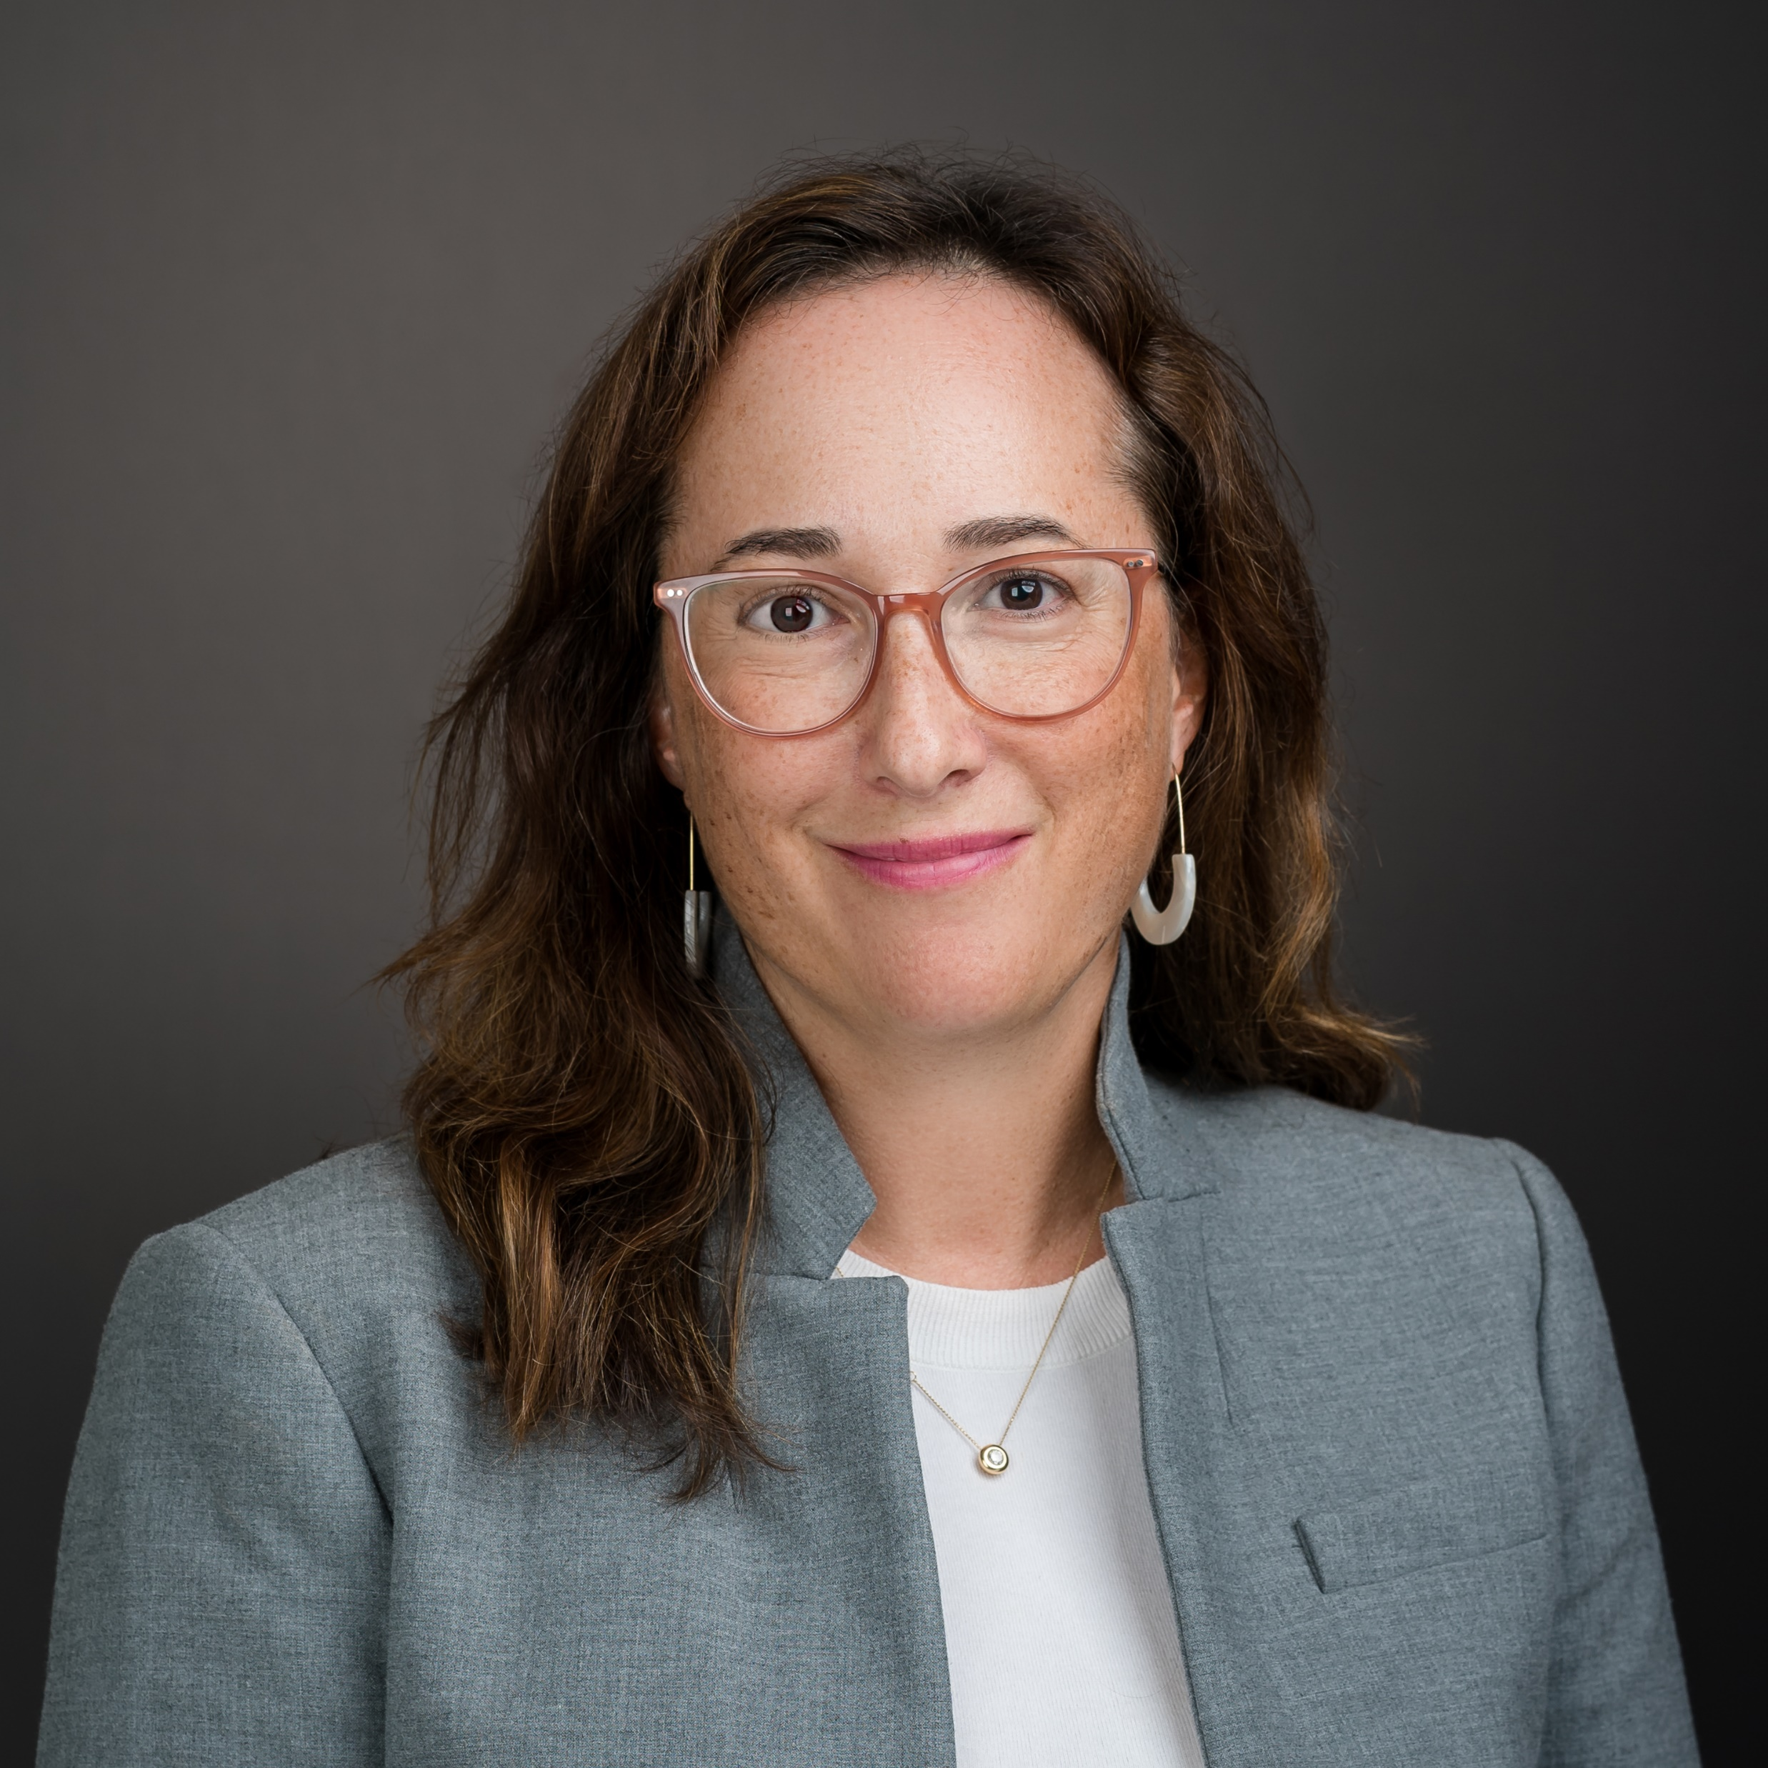
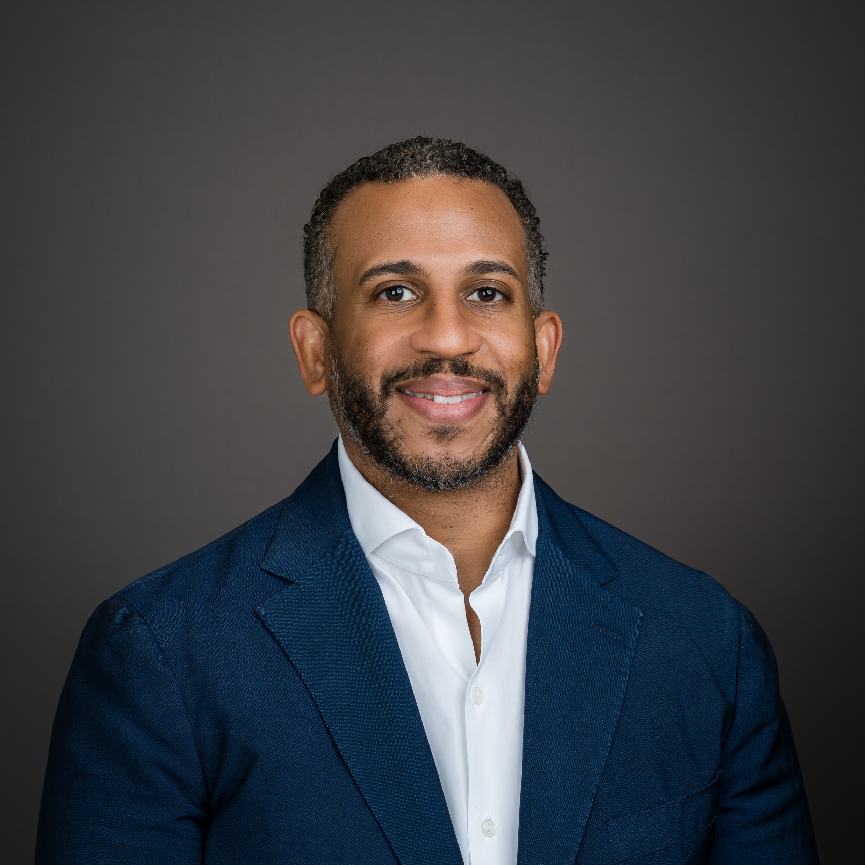
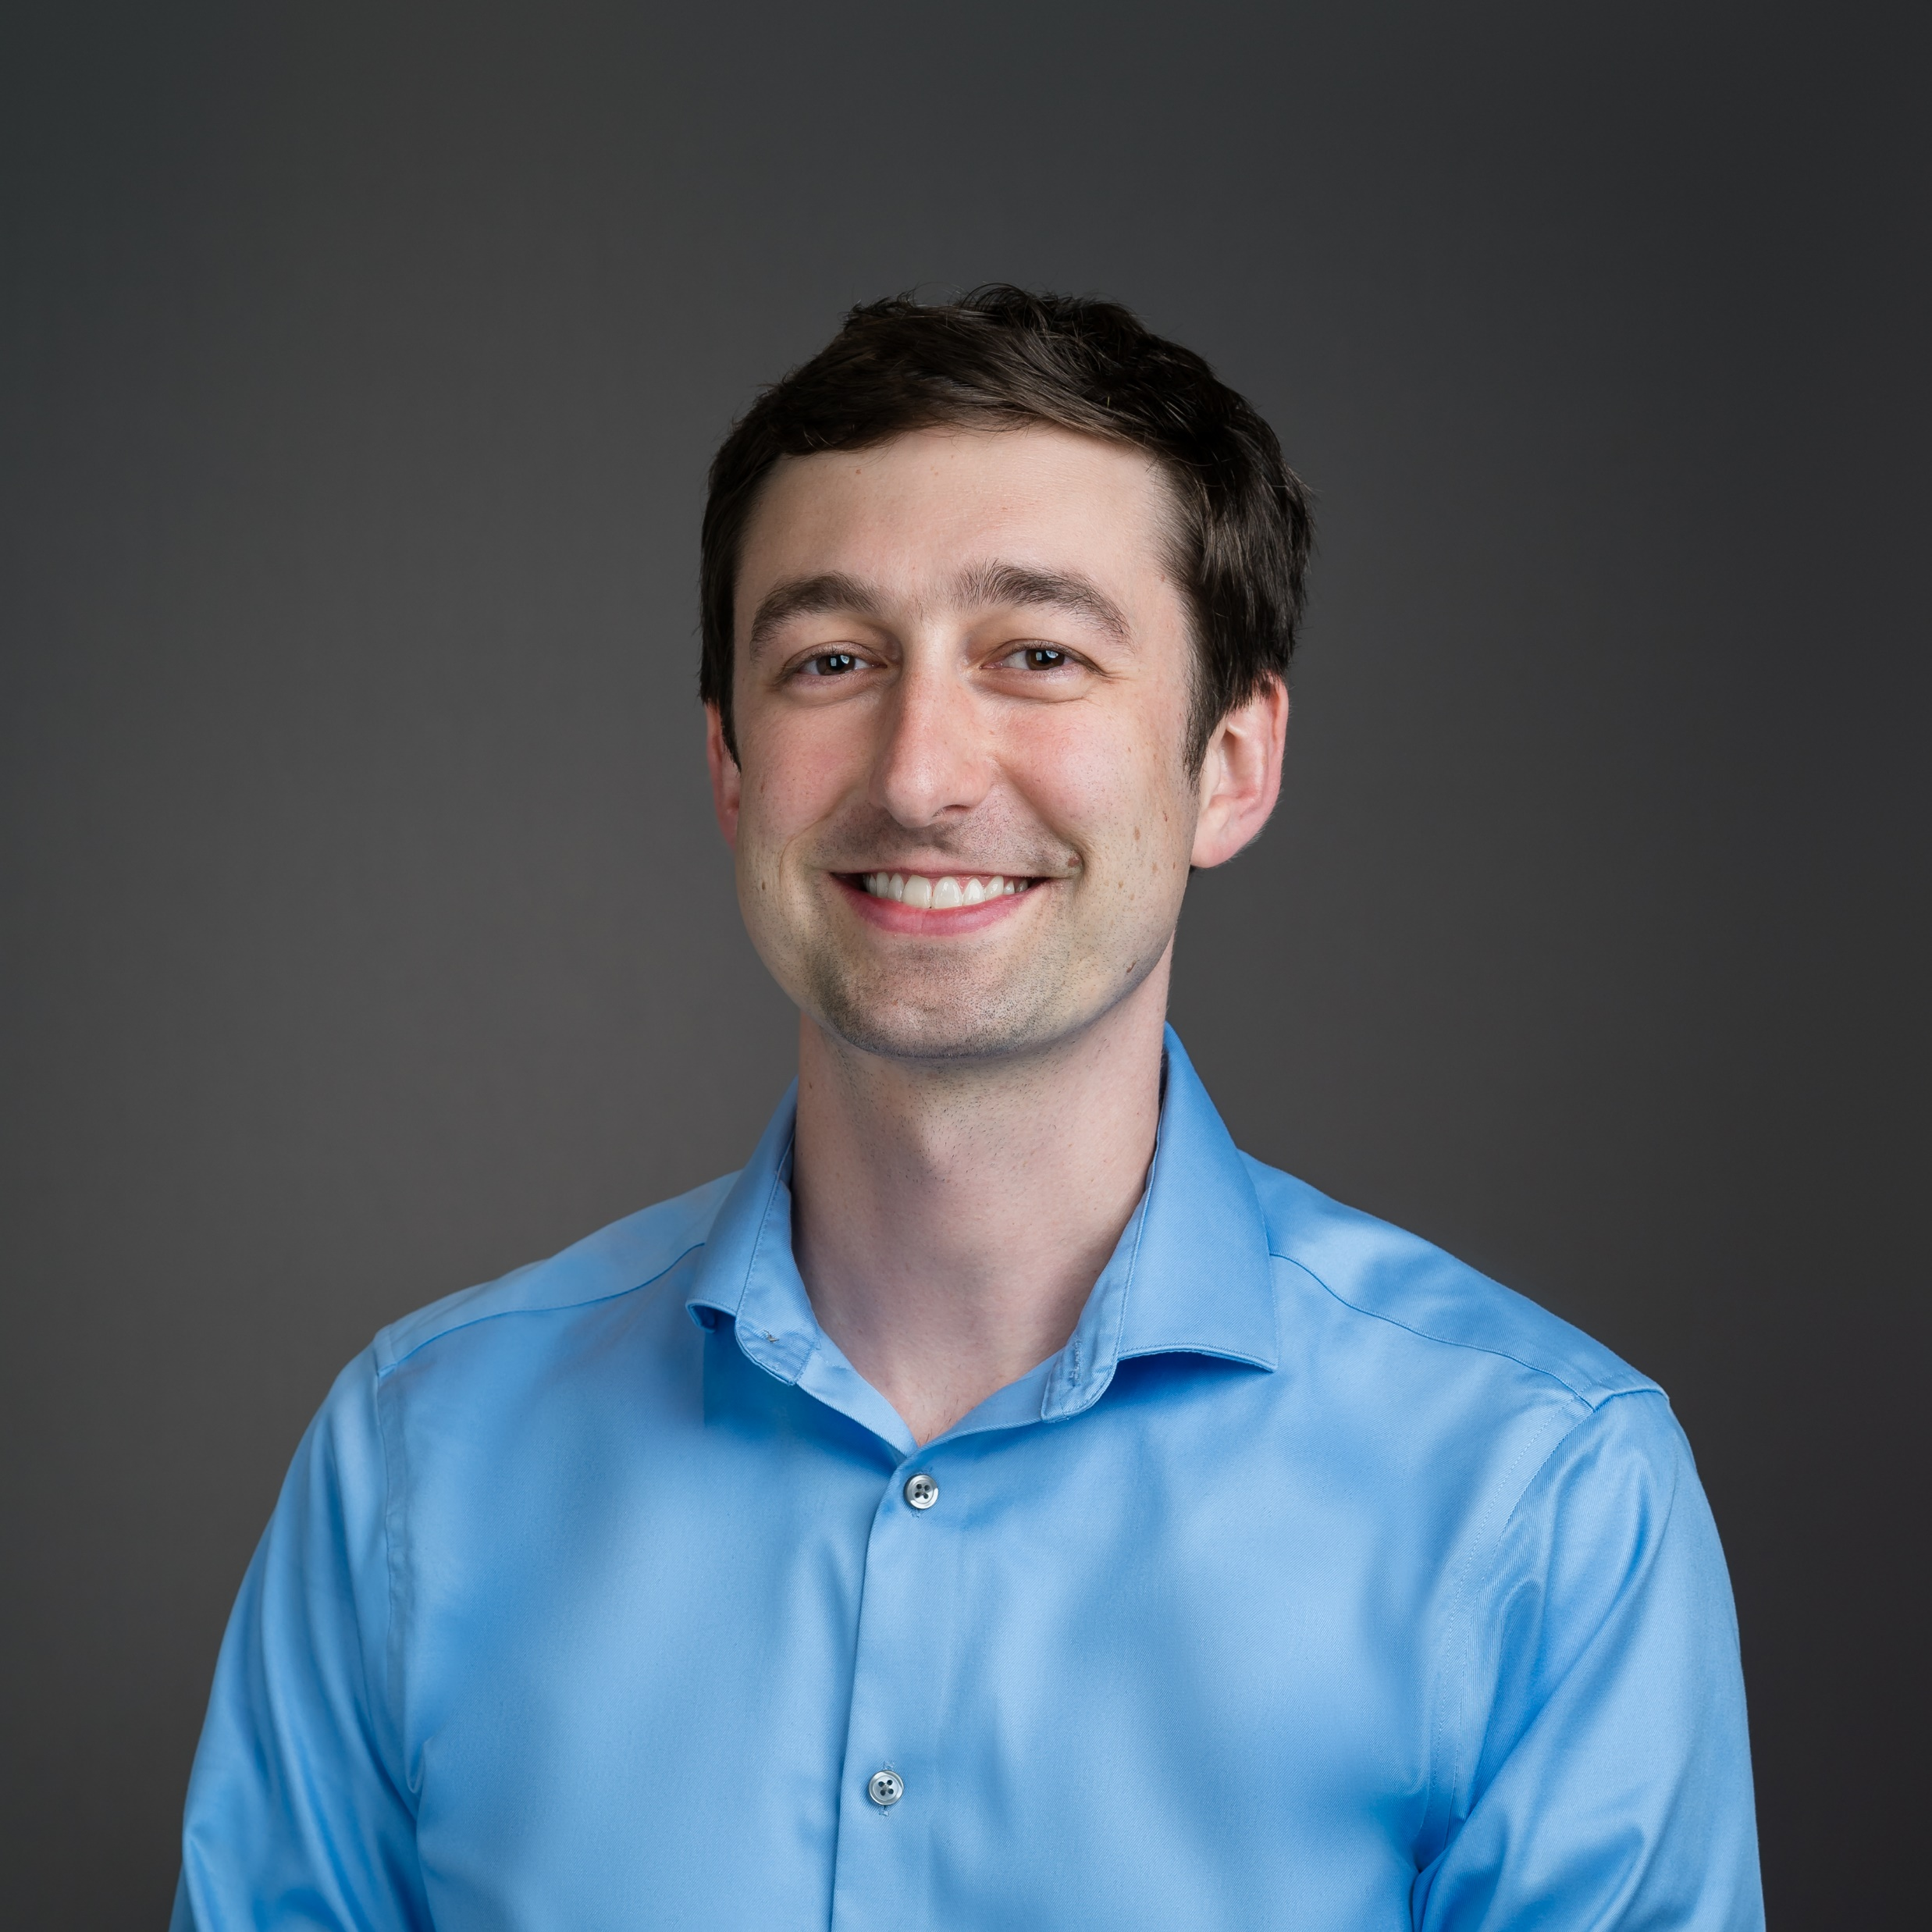
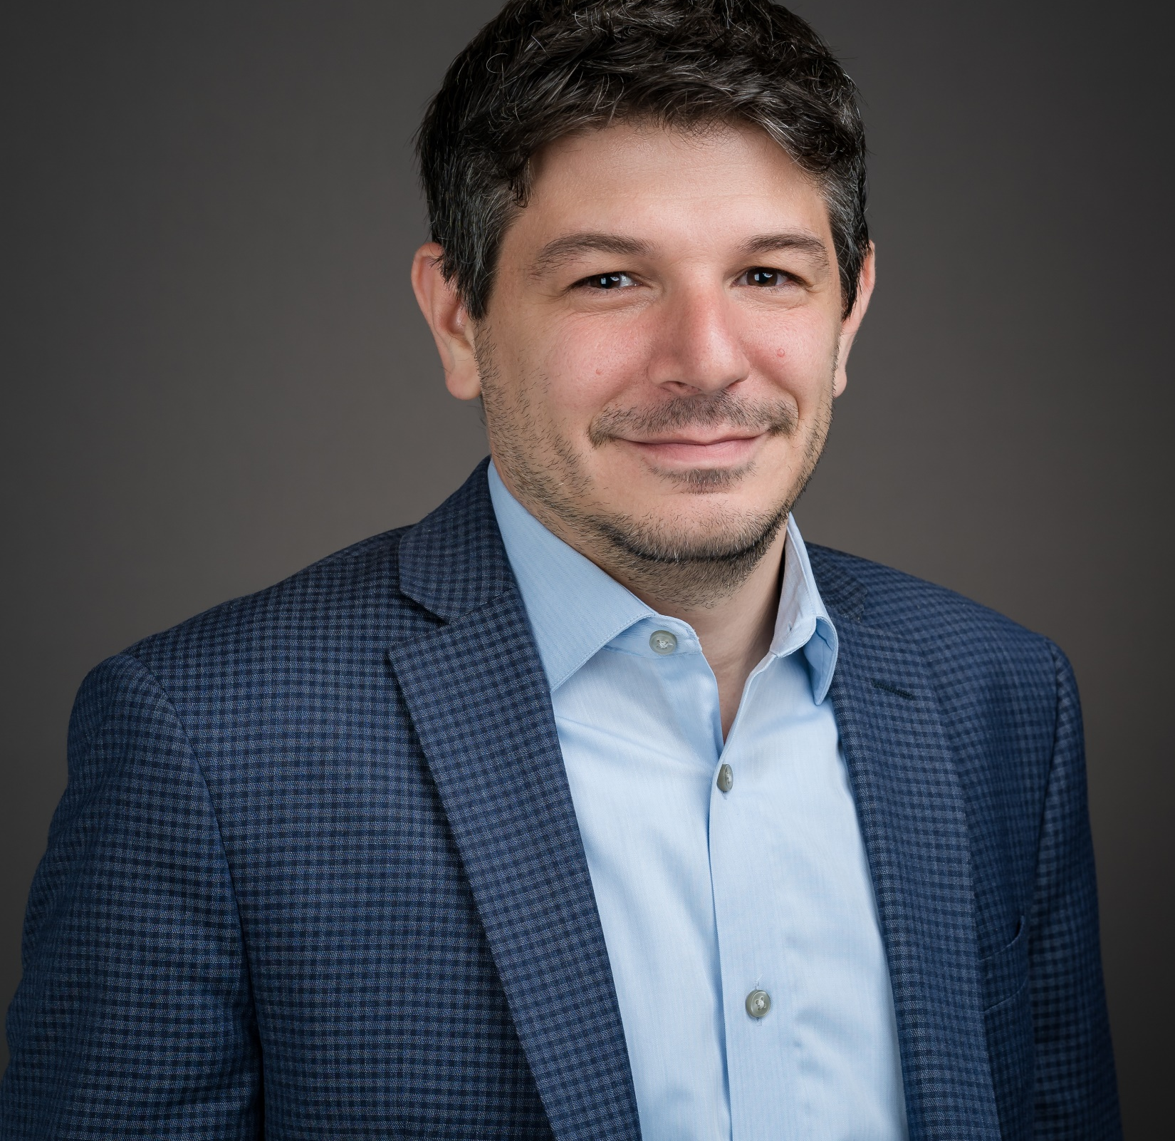
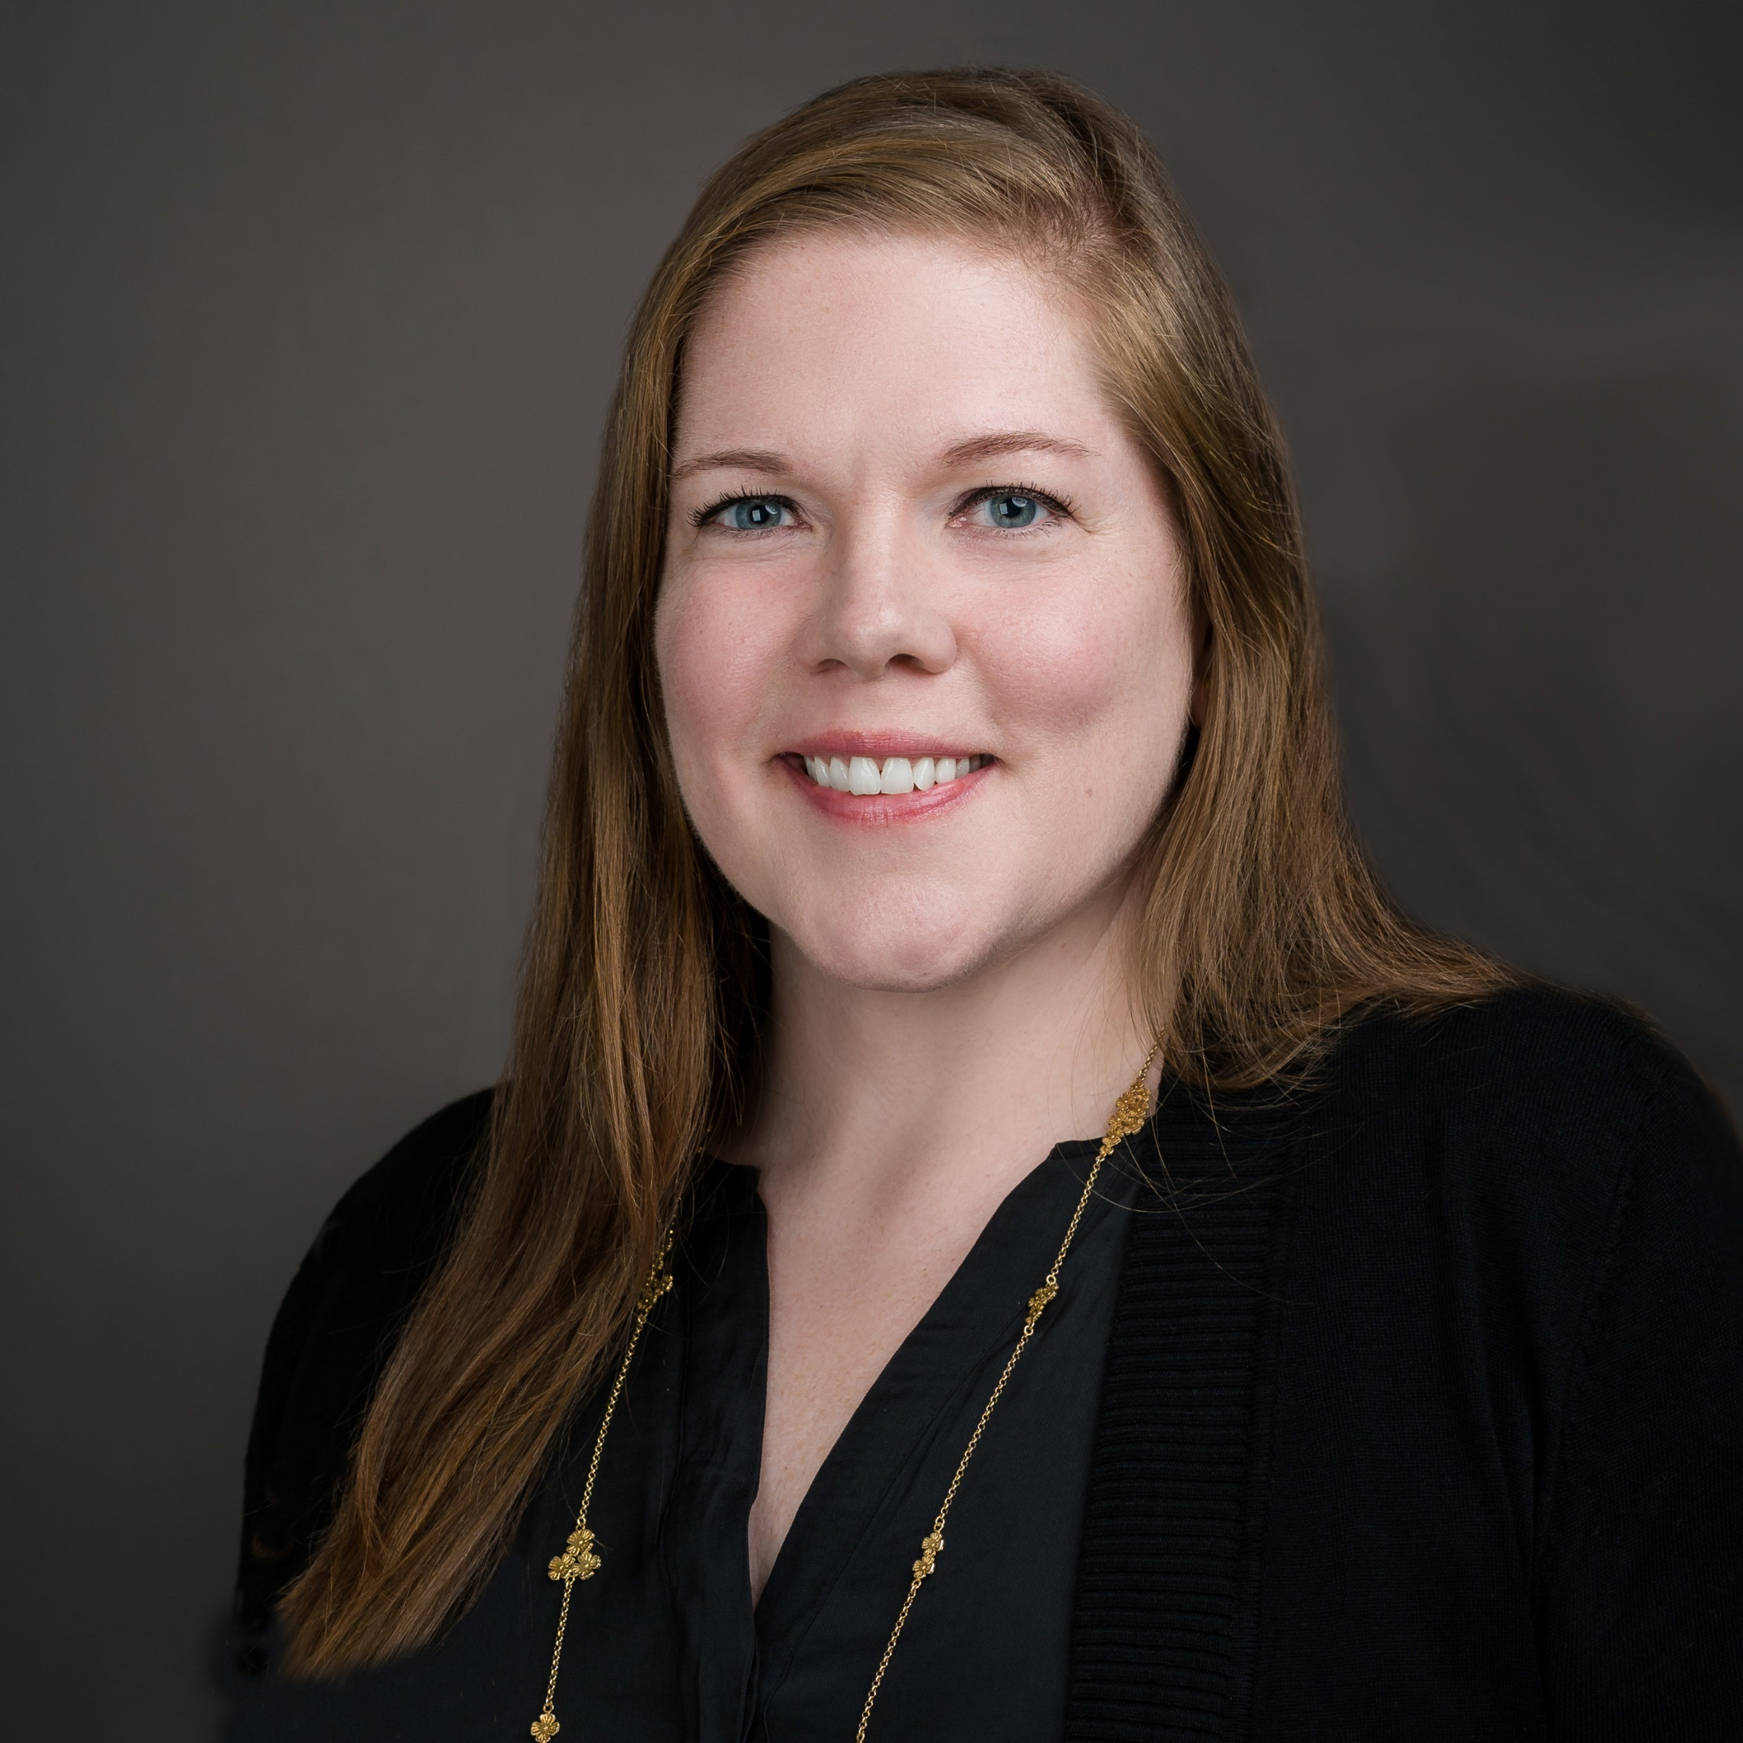
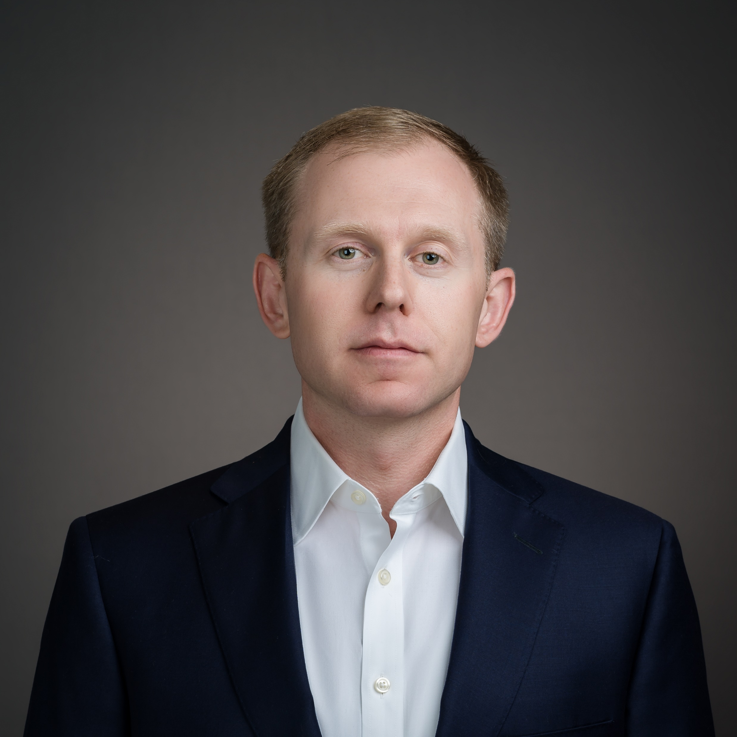
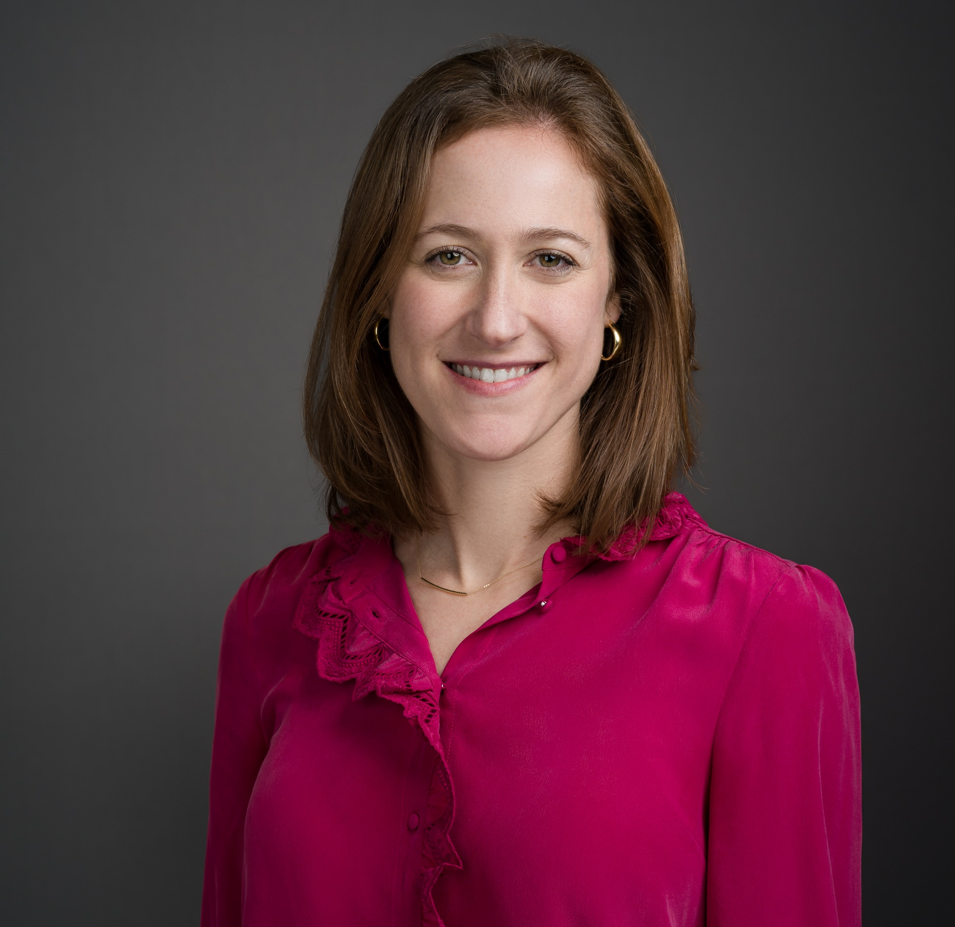
Nuveen Green Capital Senior Leadership
Business sector experts with several decades of experience
Jessica Bailey
Alexandra Cooley
Andrew Zech
Genevieve Rose Sherman
Co-founder, CEO, and President
18 years of experience
Co-founder and CIO
10 years of experience
Chief Operating Officer
15 years of experience
Head of Sustainability & Policy
15 years of experience
Robert Bewkes
Tara Crotty
Kate Cusack
Alexander Hancock
Lucas Johnson
Counsel
8 years of experience
Head, Asset Management
22 years of experience
Vice President, Originations
22 years of experience
Vice President, Clean Energy Finance
15 years of experience
Director, Transaction Management
14 years of experience
Aaron Kraus
Laura Laumont
Jamie McCorry
Leo Nemirovsky
Rebecca Nemirovsky
Vice President, Market Development and Strategy
16 years of experience
Vice President, Product & Capital Strategy
15 years of experience
Vice President, Marketing and Communications
17 years of experience
Managing Director - Head, Corporate Finance
21 years of experience
Vice President, Credit
12 years of experience

Slide 18
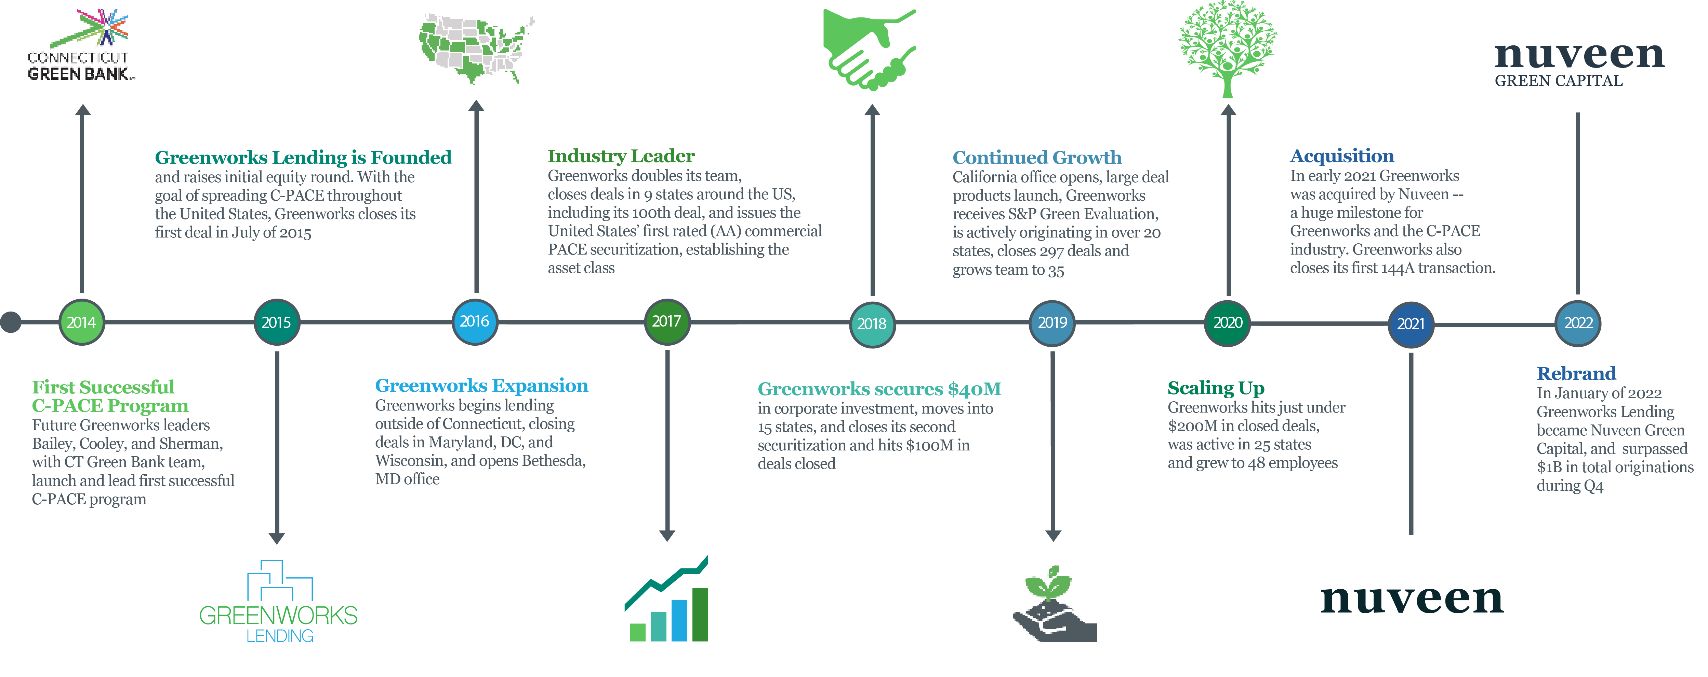
Nuveen Green Capital Timeline

Slide 19
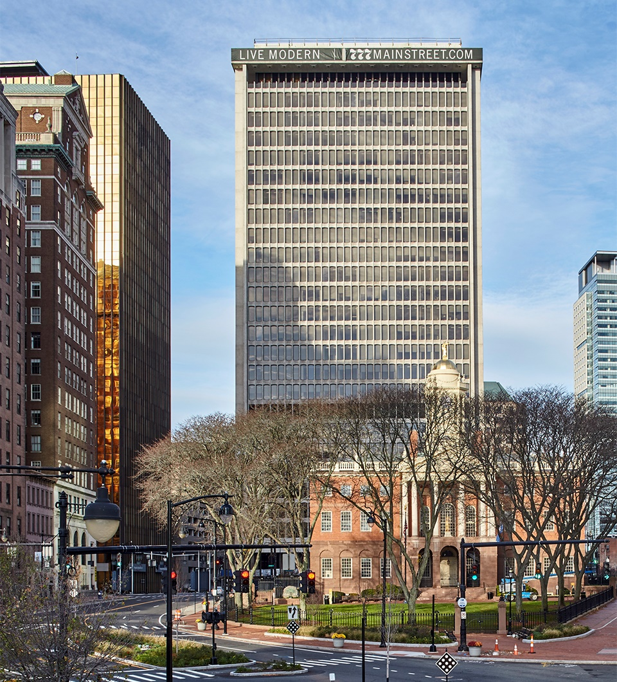
C-PACE 101
C-PACE provides commercial property owners with low-cost, long-term financing for energy efficiency and renewable energy projects. The program starts with a state-level government policy that classifies clean energy upgrades as a public benefit – like a new sewer, water line or road. These upgrades can be financed with no money down and then repaid as a benefit assessment on the property tax bill over a term that matches the useful life of improvements and/or new construction infrastructure. The assessment transfers on the sale of the property and can be passed through to tenants where appropriate. The program saves property owners money by ensuring that the combination of energy savings and incentives is greater than the cost of repayment.
100% Financing: Both hard and soft costs related to energy improvements and/or new infrastructure can be funded
Long-term: Payback periods are designed to match the expected useful life of the energy saving equipment (often 20+ yrs)
Cash flow positive: Savings from improvements generally exceed the cost of repayment, starting day one
19

Slide 20
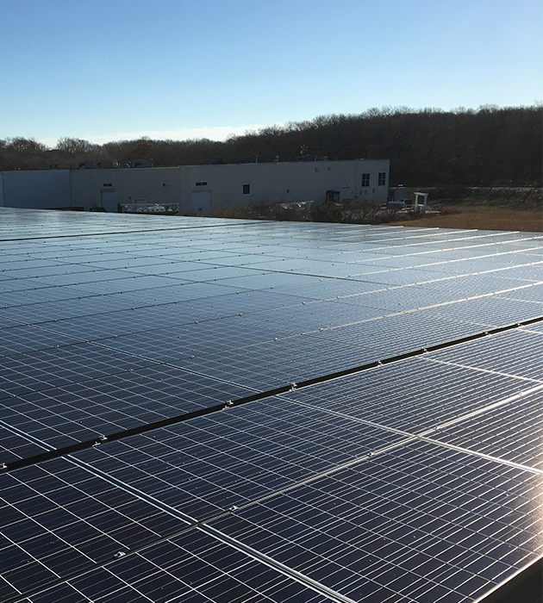
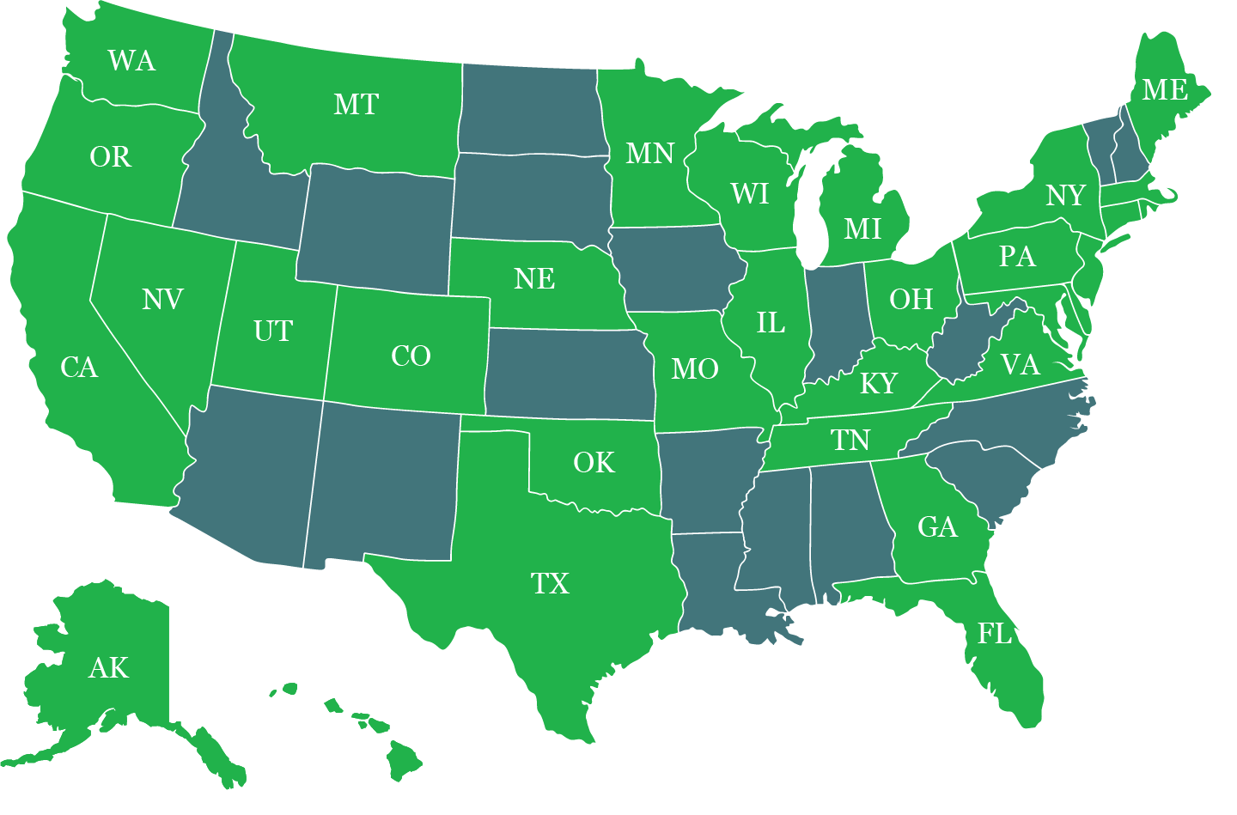
Where We Lend
Founded by the architects of the first successful C-PACE program (CT)
Nuveen Green Capital and its founders have closed 400+ PACE projects across the country
Best in class underwriting platform ensures a smooth funding process
Current States

Slide 21
Projects We Finance
New Construction and Gut Rehabs
Reduces owner equity needs
Fixed rate construction through term
Tax assessment structure may allow pass-through on NNN leases, room surcharges
Obligation may transfer on sale or be prepaid
Non-recourse after construction completion
Works well with new market and historic tax credits
Energy Efficiency & Resiliency
Preserves capital expenditure using C-PACE financing to replace old equipment
New equipment boosts NOI and increases property value
Tax assessment structure may allow pass-through on NNN leases and room surcharge
Measures include automated building controls, HVAC, boilers, chillers, furnaces, high efficiency lighting, water heating systems, variable speed drivers, water conservation, resiliency such as seismic, wildfire, wind, flood, stormwater, energy storage, and microgrids measures.
Solar and Renewables
100% financing
Allows building owner to take advantage of all tax credits and incentives
Financing transferable upon building sale
Can be paired with 3rd party tax equity
Cash flow positive from day one
Financing can cover roof and related installation costs
Recapitalization
Retroactively finance recently completed projects
Fund construction cost overruns
Replenish operating reserves
Cover existing lender debt service
Pay down existing leverage
Delayed first repayment 24 months post-closing

Slide 22
Most Buildings Qualify
Building Requirements
Commercial, Industrial, Non-Profit, Multi-Family >5 Units
Does NOT work for residential, government
Located within operational PACE municipality
Current on property taxes
Financial Requirements
Financed amount cannot exceed 35% of property value – and 25% for new construction
Total property debt (mortgage + PACE) cannot exceed 90%-95% of property value
Not in bankruptcy
Meets other state statutory requirements
Hotels and Offices
Increase tenant and guest comfort as well as net operating income
Retail
Invest in windows, lighting and more with long-term, low-cost capital
Manufacturing
Offset high energy use with renewables and ensure operations with resiliency measures
Multifamily
Properties with greater efficiency are not only more profitable, but marketable to tenants as well

Slide 23
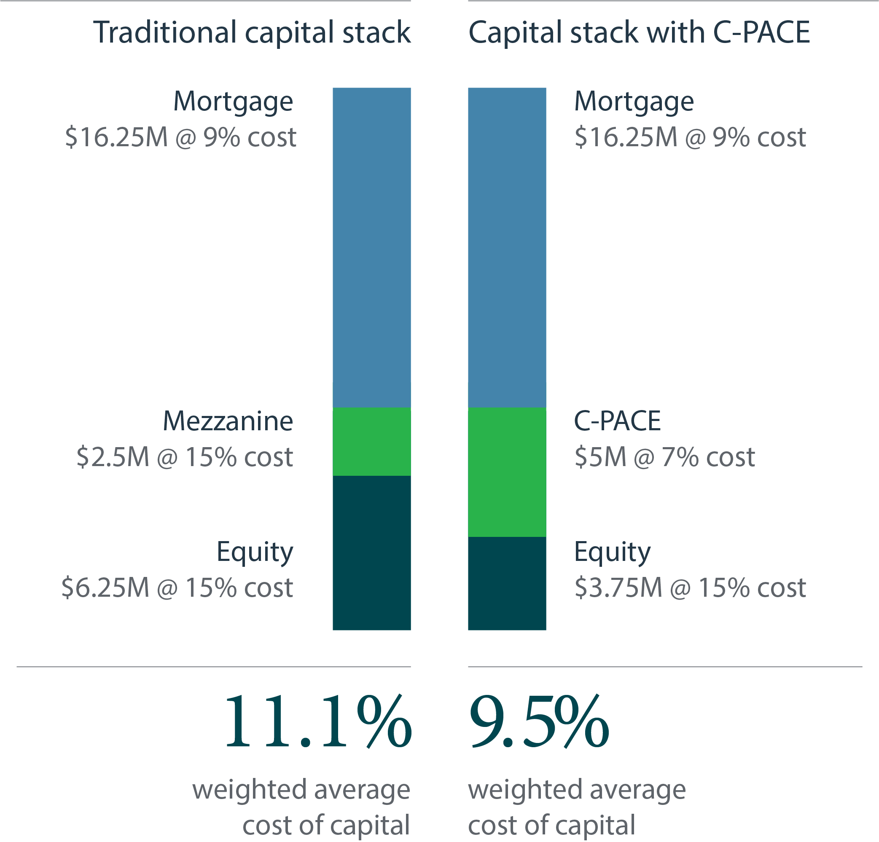
New Construction
Nuveen Green Capital capital is roughly half the prize of mezz/pref
Sized and structured in partnership with senior construction lender
Can be fully repaid at any time with no yield maintenance
Increase return on equity:
In this example, ROE improved 46.5% via the replacement of mezzanine debt and reduction in equity
Decrease weighted cost of capital:
WACC improves with C-PACE financing, in this case 160bps. The scenario at left yielded an estimated $310k/yr
Permanent financing from day one:
Long-term fixed rate capital that stays with the property from construction through term

Slide 24
Recapitalization
C-PACE Recapitalization Provides Liquidity for Businesses:
Nuveen Green Capital can reimburse property owners for recently completed C-PACE-eligible projects - generating immediate liquidity and freeing up capital for operations and reserves.
C-PACE Helps Complete Capital Stacks:
Nuveen Green Capital can fill funding gaps in new construction, gut rehab, and retrofit projects – solving issues with construction delay, cost overruns. Proceeds may be used to cover existing lender debt service and pay down existing leverage.
C-PACE Allows 24-Month Repayment Delay for CRE Owners:
Financing is fixed rate, non-recourse, does not include financial covenants, and includes no payments for up to 24 months post-closing. Funding levels up to 35% of property value.
Completes Capital Stack
Catalyst to help projects move forward
Provides liquidity through reimbursement for qualified capital improvements

Slide 25
Solar & Renewables
Allows building owner to take advantage of all tax credits and incentives with attractive buy down option for non-profit customers through CollectivePACE.
100% financing for solar projects which is transferable upon building sale.
Financing can cover roof and related installation costs

Slide 26
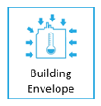
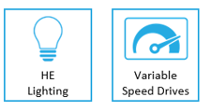
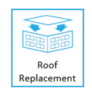
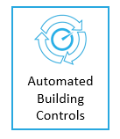
Energy Efficiency Upgrades & Deferred Maintenance
Eligible Improvements
Improve building value by dropping operating expense and improving building equipment
Preserve capital expenditure using C-PACE financing to replace old equipment
Tax assessment structure may allow pass-through on NNN leases and room surcharge

Slide 27
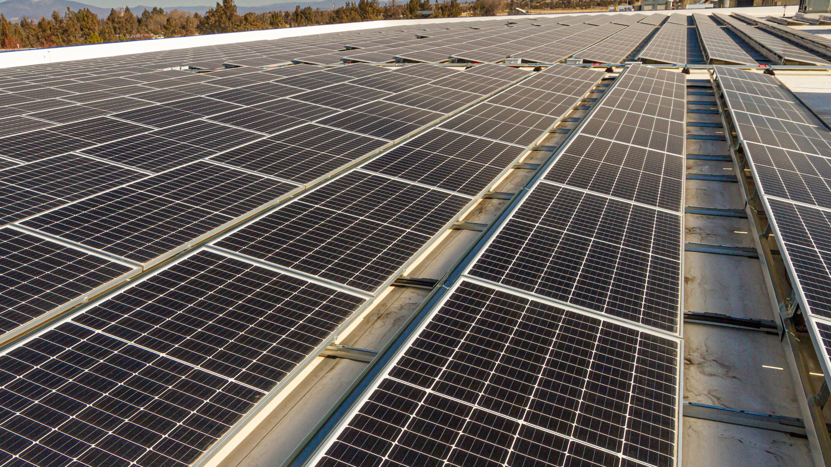
Revenue Generating Solar
PROPERTY SUMMARY
An owner-occupied light industrial building located about an hour outside of New York City turned their roof into and income generator.
OPPORTUNITY
The owners utilized $1.724M in C-PACE financing for the installation of a 739 kW community solar project. Community solar will allow them to turn their previously empty roof into a revenue generating asset, resulting in an average NOI of $72,000 per year. The solar array will also provide significant tax savings as well as rental income of $2.14 PSF with 3% escalation for 25 years. The owners are expected to realize $5.4M of net income over the life of the solar array, all with $0 out of pocket.
Rooftop Solar: Long Island, NY
Building Type: | Measures: | Term: | Financed Amount: | Rental Income PSF: | Year 1 Tax Savings:
Light Industrial | Solar (739 kW) | 25 years | $1,724,000 | $2.14, escalating 3%/year for 25-years | $700,000

Slide 28
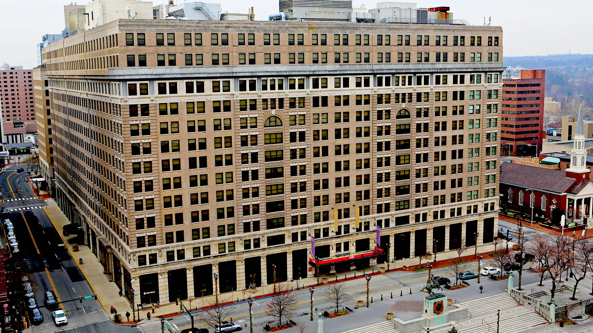
Complex Historic Rehab
PROPERTY SUMMARY
Owned by The Buccini/Pollin Group, the DuPont Building is a hallmark of downtown Wilmington, DE. Originally constructed in 1908, it was the longtime home to the DuPont Company headquarters. At approximately 1,000,000 square feet and taking up an entire city block, the building has been undergoing significant renovations which will modernize and overhaul the building to convert it into a mixed-use facility consisting of a hotel, luxury apartments, a theatre, retail space, and office space.
OPPORTUNITY
C-PACE financing has come into the project which is already underway and filled a gap in a complex capital stack, working with a CMBS mortgage, condo parcels, and historic tax credits. C-PACE will be used to cover multiple energy efficiency measures including chiller plant replacement, boiler replacement, and cooling tower refurbishment. These upgrades will save the property owner an estimated $14,217,721 over the lifespan of the equipment.
Energy Efficient Upgrade: Wilmington, DE
Building Type | Measures | Term | Financed Amount
Mixed Use | Chiller & boiler replacement, cooling tower refurbishment | 25 years | $7M

Slide 29
Multi-family Portfolio
PROPERTY SUMMARY
Twelve multifamily buildings averaging 60 years in age in Washington, DC and Maryland suburbs.
OPPORTUNITY
Owner faced with per-asset deferred HVAC, lighting, and plumbing CapEx of $350k-$1.5M ($8.8M total) across 18 assets. 100% financing and long amortization let energy savings pay for expensive capital expenditures projects with no disruption to equity holder distributions.
Deferred Capex: Bethesda MD & Washington D.C.
Building Type | Measures | Term | Financed Amount | Lifetime Savings
Multifamily | HVAC, lighting, plumbing | 20 years | $8.8M | $9.6M

Slide 30
Green New Construction
PROPERTY SUMMARY
The Exchange is a new construction development project in Detroit’s Greektown district that will be a state-of-the-art, 16-story mixed use commercial and multifamily property.
OPPORTUNITY
Greenworks provided $13M in C-PACE capital to the total $64M development project cost. C-PACE funds removed the need for expensive mezzanine debt or additional equity - reducing the owner's cost of capital and improving their equity position. Qualifying measures included roofing, windows, HVAC, plug load controls, smart thermostats, elevator systems and low-flow fixtures. Building is estimated to save nearly $40M in energy costs over 25 years vs. code standards.
New Development: Detroit, MI
Building Type: | Measures: | Term: | Financed Amount:
Mixed Use | Roof, HVAC, Windows Thermostats, Elevators | 25 years | $13M

Slide 31
Important information
These materials are provided solely for use in private meetings and are intended for informational and discussion purposes only. These materials are only for use by the intended party and may only be circulated only to persons whom they may lawfully be distributed. Persons who do not fall within such descriptions may not act upon the information contained in these materials. Any entity responsible for forwarding this material to other parties takes responsibility for ensuring compliance with local laws, and in particular any applicable financial promotion rules.
The information presented in these materials is believed to be materially correct as at the date hereof, but no representation or warranty (express or implied) is made as to the accuracy or completeness of any of this information. Data was taken from sources deemed reliable, but cannot guarantee its accuracy. The statements contained herein reflect opinions as of the date written and are subject to change without further notice. Nothing set out in these materials is or shall be relied upon as a promise or representation as to the past or future.
This document is not a prospectus and does not constitute an offer to the public. No public offering or advertising of investment services or securities is intended to have taken effect through the provision of these materials. It is not intended to provide specific investment advice including, without limitation, investment, financial, legal, accounting or tax advice, or to make any recommendations about suitability for any particular investor.
Nuveen Green Capital is an indirect subsidiary of Nuveen LLC and Teachers Insurance and Annuity Association of America (TIAA) and a member of the TIAA group of companies.

Slide 32
Thank You!
January 2023
19 Old Kings Highway South
Suite 210
Darien, CT 06820
nuveen.com/greencapital
GPP-1887758PW-O1021X

Slide 33
Financing Construction Adjacent to C-PACE Lender
Indicative Product Structure:
Sponsor
Investors
Sponsor and Investors hold 100% equity interest in Borrower
Borrower’s sole purpose is to own and operate the Project
SPV that owns Borrower is owned by Sponsor and Investors
Borrower pays PACE Assessment Payments to PACE Lender (through the local tax authority) and debt service to NYGB
Distributions from Borrower to Sponsor subject to Senior Loan conditions
[SPV owned by Sponsor & Investors]
3
Lender [NYGB]
100%
1
Debt Service
Borrower
[SPV]
2
4
C-PACE Lender
5
PACE Assessment Payments
100%
Project
Notes:
To finance predevelopment costs required before closing on construction/term financing for a project.
E.g. consultants, permitting, design/analysis/studies, deferred maintenance needs
Alternative to using costly equity dollars at this early stage
We’ve done 2 transactions with a similar structure

Slide 34
Discussion
Notes:
Ask questions – ask audience what financing barriers they see in their projects, etc. Not sure if we want a slide w list of questions

Slide 35
Contact Info
NY green bank
Kaitlin Butler: Kaitlin.Butler@greenbank.ny.gov
https://greenbank.ny.gov/
https://www.linkedin.com/company/ny-green-bank/
Nuveen green capital
Mike Doty: Michael.doty@nuveen.com
https://greencapital.nuveen.com/

