Slide 1
DeCarb for MASSings Decarbonization tool to help categorize your concept massings
14 February 2024

Slide 2
The Team
Sarah Buffaloe,
Associate: Embodied Carbon Analysis
Peter Wildfeuer,
Computational Design Developer, Massing and Structural
Joseph Fiorello,
Vice President: Structural Principal Technical Specialist
Jessica Chen,
Associate Consultant, Energy and Carbon Analysis

Slide 3
Table of Contents
REVIEW
1
Introduction
2
Methodology
3
Case Study
4
Comparisons

Slide 4
01 Introduction

Slide 5
01 INTRODUCTION
This DeCarb for MASSings aims to evaluate early embodied carbon and operational energy impacts.
The methodology section explains the breakdown of the geometric inputs, structural assumption inputs, embodied carbon database selection and assumptions inputs, energy model inputs, simulation engine, and the final outputs.
The results of this study would allow the user to identify trade-offs between embodied carbon and operational carbon and explore possibilities in design options to reduce carbon from both perspectives.

Slide 6
02 Methodology

Slide 7
02 PROCESS
inputs
simulation /data query
outputs
Massing Model
Energy Modeling Software
EnergyPlus
Massing Model
Embodied Carbon and Operational Energy Use Results
Results including total site energy use intensity (kWh/m2)
Total A1-A3 Global Warming Potential from structures and envelope (kgCO2e/m2)
Breakdown of the Total A1-A3 Global Warming Potential by Category
Envelope Properties
Envelope
The results allow users to evaluate:
Structural
Properties
Embodied Carbon Database
The embodied carbon and the operational energy usage impact of design options
Structures
Notes:
PETER

Slide 8
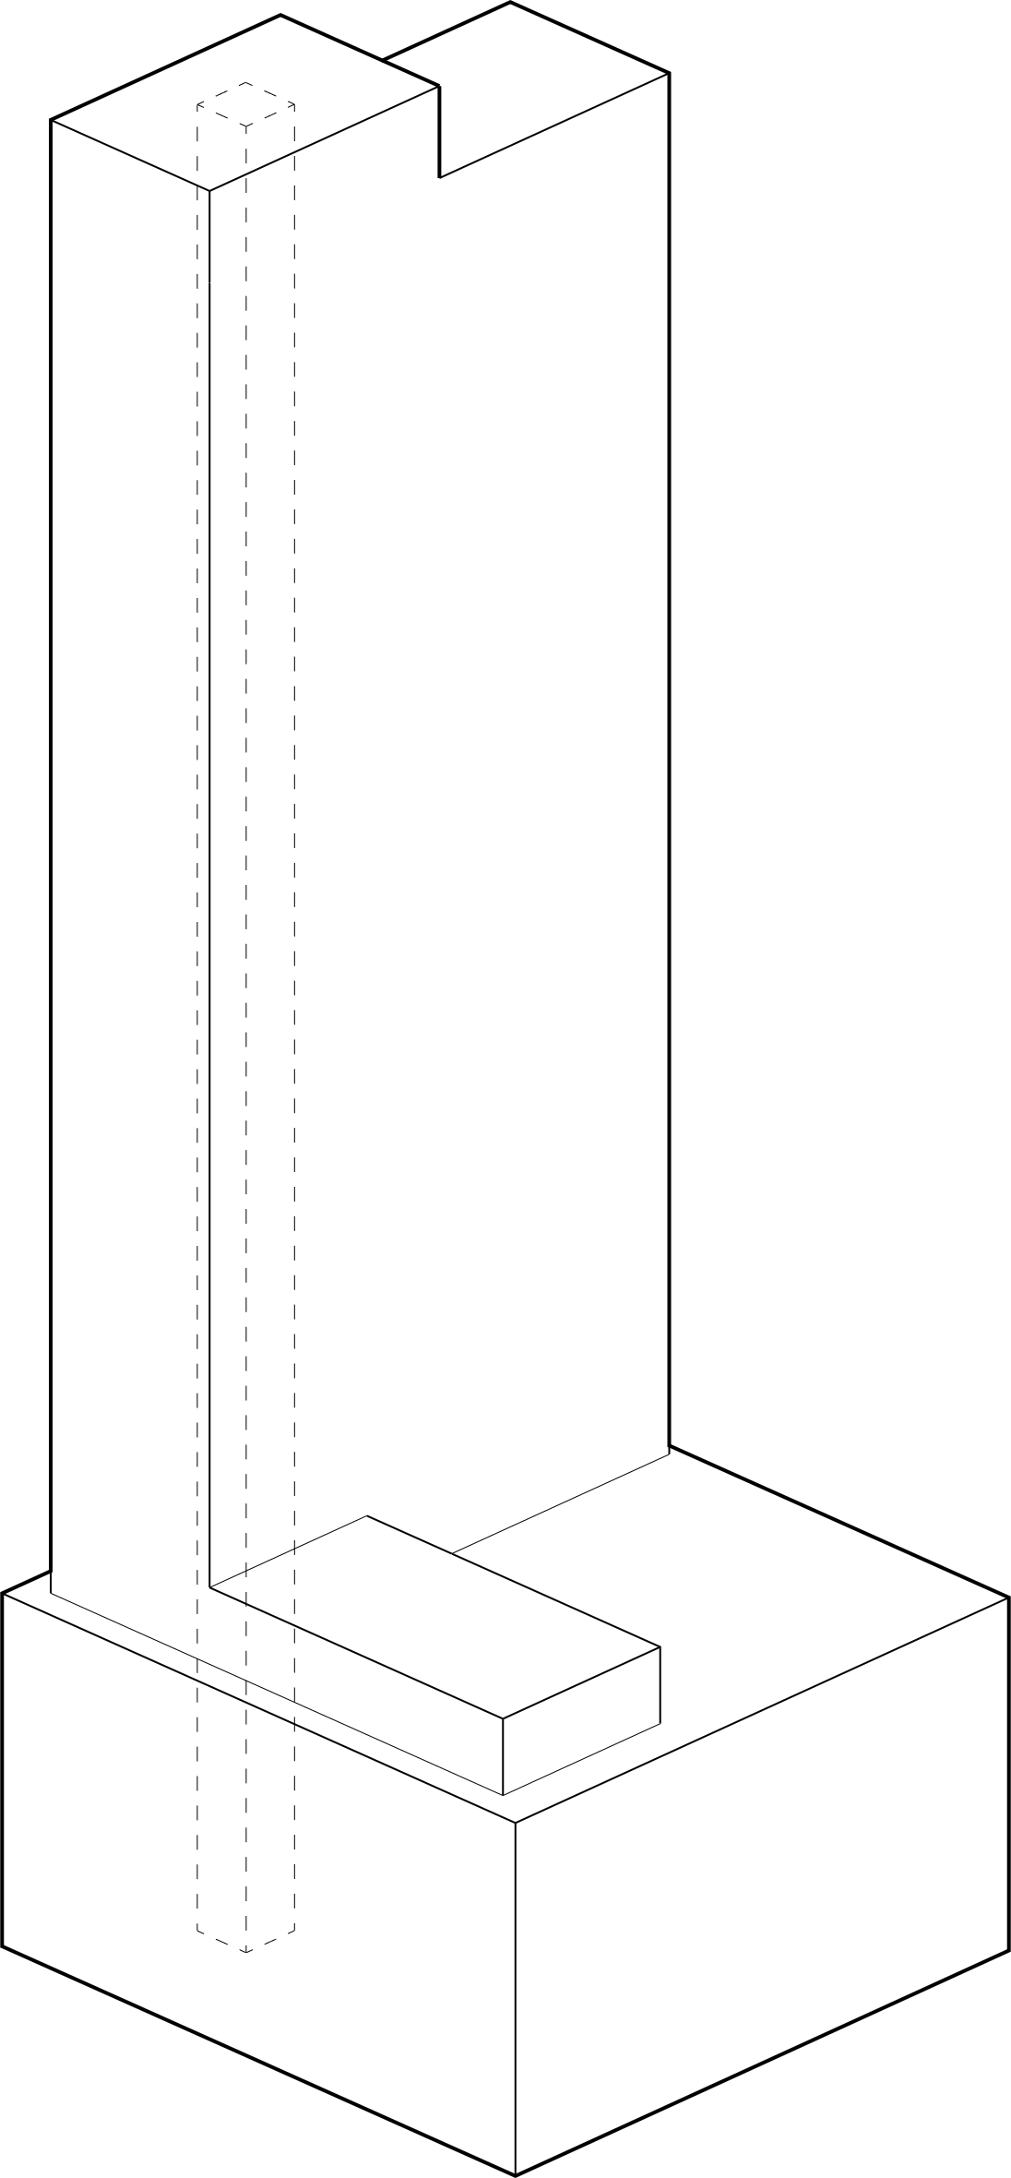
02 INPUTS – MASSING MODEL
Envelope
Structure
Tool Environment
The massing scheme determines the envelope area, structural requirements, and more, making it an essential input for early design comparisons. Three early massing models built in Rhino, based on an actual project, were used to test the calculator. Due to the Rhino environment, the easiest platform for building the calculator was in Grasshopper.
Notes:
PETER – mention rhino and grasshopper environment

Slide 9
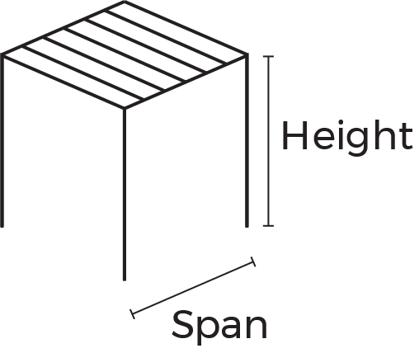
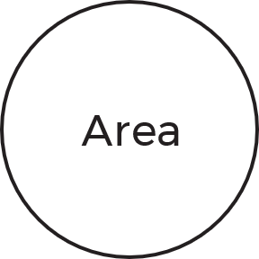
02 INPUTS – STRUCTURAL PROPERTIES
Geometry
Reinforced Concrete Core
CIP Concrete Columns
Steel Columns
CMU Walls
Precast System
Precast System
CIP Concrete Slabs and beams
Waffle Slabs
Post Tension Slab
Steel Framing and Composite Slab
Precast System
CIP Concrete Slabs and Beams
Steel Framing and Composite Slab
Lateral
Horizontal
Vertical
Mass Timber
Mass Timber
System
Valid options based on selected lateral system.
Concrete
SCM Type
SCM %
Compressive Strength (psi)
Compressive Strength Day
Type 1L
Material
Steel
Steel Type
Structural Dependencies
Depending on the choice of lateral system, the choices for a vertical and horizontal system are limited, and an assumed percentage of steel and concrete are assigned to each combination of systems for a particular massing.
Notes:
JOE

Slide 10
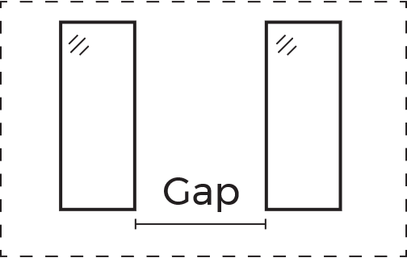
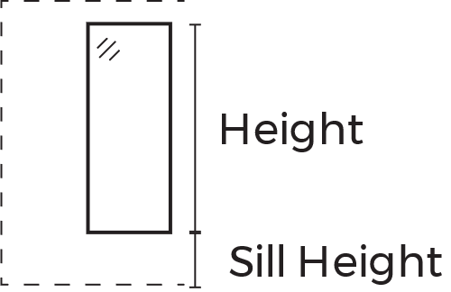
02 INPUTS – ENVELOPE PROPERTIES
Geometry
Glazing WWR
Punched Windows + Walls
Curtain Wall
Windows
Wall Assembly (ASHRAE 90.1)
Spandrel
Glazing
Façade Geometry
Façade Components
Façade Type
Mullion
Roof
Roof Assembly (ASHRAE 90.1)
Roof Geometry
Roof Component
System
Glazing/Windows
Number of Panes
Spandrel
Back pan thickness
Insulation R-Value
Insulation Type
Number of Panes
Material
Mullion
Material thickness
Wall Assembly
Insulation Type
Insulation Material
Additional Insulation R-Value (on top of ASHRAE 90.1)
Other assembly specific inputs
Roof Assembly
Insulation Type
Insulation Material
Additional Insulation R-Value (on top of ASHRAE 90.1)
Roof Membrane Type
Windows and Walls
The WWR determines the amount of opaque surface area (walls) and window surface area there are. In the case of a curtain wall, the sill height, window height, and gap determine the total spandrel and mullion areas.
Notes:
JESSICA

Slide 11
02 ENERGY MODELING – METHODOLOGY
The DeCarb for MASSings uses Grasshopper to generate the energy model geometry, ladybug/honeybee grasshopper plugins to generate the Energy Plus models, and the EnergyPlus simulation engine to generate the annual energy use intensity results.
Ladybug and Honeybee have components and preset libraries that allow users to make simple and complex parametric energy models. For an early comparative tool, the DeCarb for MASSings simplifies the complexity of the energy model by limiting the HVAC system to an ideal air system, using the ASHRAE 90.1 preset library for the “office” building type, and assumes zones in the model have the same space types.
Refined and detailed HVAC modeling, zone assignment, and other adjustments can be implemented according to specific project requirements.
Notes:
JESSICA

Slide 12
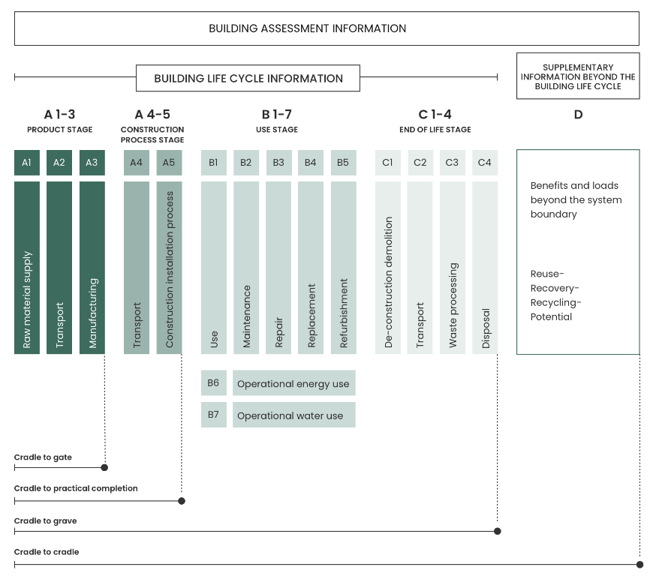
02 EMBODIED CARBON CALCULATION – METHODOLOGY
For this phase of DeCarb for MASSings, the embodied carbon scope includes the product stage (A1-A3) carbon emission of major materials associated with the structures and envelope. There are two essential parts to estimating the total quantity of the embodied carbon of a building: the material quantity takeoff and the embodied carbon factors of each of the materials.
DeCarb for MASSings gathers the quantity of the material model and additional structural and envelope inputs. For each material, DeCarb for MASSings makes a query to the EC3 database, requesting the average global warming potential value of the material and its functional unit. Then DeCarb for MASSings sums up the global warming potential of each building component and provides the global warming potential estimation of a total building (total embodied carbon of the building)
$${EC}_{m}=Q_{m}×\sum_{LS}{{ECF}_{LS}}$$
${EC}_{b}$ Embodied Carbon of the building
${EC}_{m}$ Embodied carbon of material
$${EC}_{b}=\sum_{m}{{EC}_{m}}$$
$Q_{m}$ Quantity of material
${ECF}_{LS}$ Embodied carbon factor of material of LCA Stage
Notes:
JESSICA

Slide 13
03 Case Study

Slide 14
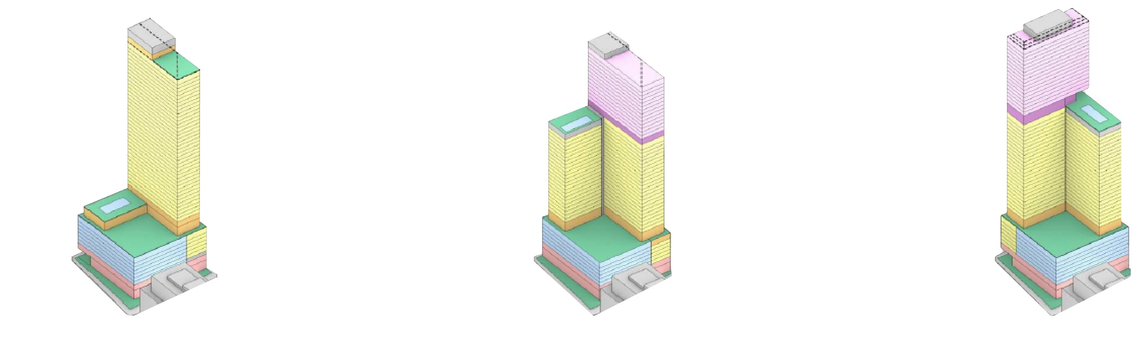
03 Massings
Option 1
Option 2
Option 3
Location: Boston | Climate: 5A | ASHRAE 90.1 2019
Notes:
SARAH

Slide 15
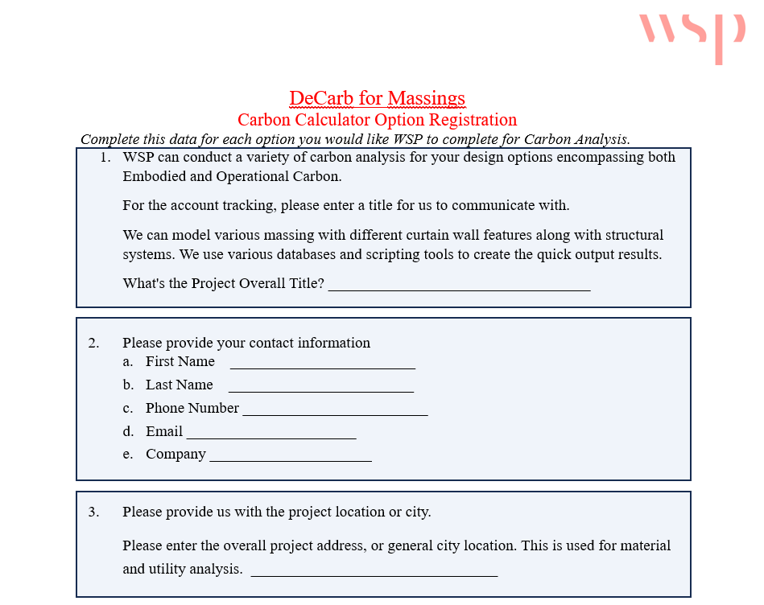
03 Inputs – Memo From Clients
Notes:
SARAH

Slide 16
03 Inputs
Project Information |  |  |  | Window/Curtain Wall |  |  |  |  |  |  |  |  | Structural |  |  |  |  |  |  |  |  |  |  |  |  | Embodied Carbon Envelope |  |  |  |  |  |  |  |  |  |  |  |  |  |  |  | Embodied Carbon Structures
Run Name | Climate Zone | Standards | Ashrae 90.1 Construction Type | WWR North | WWR South | WWR West | WWR East | Sill Height (ft) | Window Height (ft) | Window Width (ft) | Window Gap (ft) | Curtain Wall | Beam Span (ft) | Column Span (ft) | Girder Section (ft2) | Column Section (ft2) | Beam Section (ft2) | Perimeter Section (ft2) | Floor Thickness (ft) | Core Thickness (ft) | Foundation Wall Thickness (ft) | Foundation Footing Span (ft) | Foundation Depth (ft) | Footing Width (ft) | Foundation Pile Diameter (ft) | Opaque Wall Additional Insulation (R-IP) | Opaque Wall Insulation Type | Opaque Wall Insulation Material | Opaque Wall Concrete Strength (if construction = mass) (psi) | Opaque Wall % Insulation (if construction = steel framed) | Opaque Wall % Steel Frame (if construction = steel framed) | Glazing U-Value | Window Type | Spandrel Insulation R-Value (if curtain wall = true) | Spandrel Insulation Type (if curtain wall = true) | Spandrel Insulation Material (if curtain wall = true) | Mullion/Window Frame Cross-section Thickness | Roof Additional Insulation (R-IP) | Roof Wall Insulation Type | Roof Wall Insulation Material | Roof Membrane Type | Foundation Concrete Compressive Strength (psi) | Foundation Concrete Compressive Strength Day | Foundation Concrete SCM Replacement | Foundation Concrete SCM Replacement Percentage | Foundation Concrete SCM Replacement Type | Foundation Type 1L Cement | Above Ground Concrete Compressive Strength | Above Ground Concrete SCM Replacement | Above Ground Concrete Compressive Strength Day | Above Ground Concrete SCM Replacement Percentage | Above Ground Concrete SCM Replacement Type | Above Ground Type 1L Cement | Above Ground Steel Deck Thickness (m)
Baseline | 5A | ASHRAE 90.1 2019 | Mass | 0.5 | 0.5 | 0.3 | 0.3 | 3 | 8 | 7 | 3 | FALSE | 8 | 24 | 4 | 6.25 | 2 | 2 | 0.75 | 2 | 1 | 24 | 2 | 6 | 1 | 0 | Board | XPS | 3000 | NA | NA | 0.3 | double pane IGU | NA | NA | NA | 0.006 | 0 | Board | XPS | Membrane Roofing | 5000 | 28 | FALSE | NA | NA | FALSE | 5000 | 28 | FALSE | NA | NA | FALSE | 0.001214
Increased SCM in Concrete | 5A | ASHRAE 90.1 2019 | Mass | 0.5 | 0.5 | 0.3 | 0.3 | 3 | 8 | 7 | 3 | FALSE | 8 | 24 | 4 | 6.25 | 2 | 2 | 0.75 | 2 | 1 | 24 | 2 | 6 | 1 | 0 | Board | XPS | 3000 | NA | NA | 0.3 | double pane IGU | NA | NA | NA | 0.006 | 0 | Board | XPS | Membrane Roofing | 5000 | 28 | TRUE | 40% | Slag | TRUE | 5000 | TRUE | FALSE | 40% | Slag | TRUE | 0.001214
Increased Insulation Quantity | 5A | ASHRAE 90.1 2019 | Mass | 0.5 | 0.5 | 0.3 | 0.3 | 3 | 8 | 7 | 3 | FALSE | 8 | 24 | 4 | 6.25 | 2 | 2 | 0.75 | 2 | 1 | 24 | 2 | 6 | 1 | 5 | Board | XPS | 3000 | NA | NA | 0.3 | double pane IGU | NA | NA | NA | 0.006 | 10 | Board | XPS | Membrane Roofing | 5000 | 28 | FALSE | NA | NA | FALSE | 5000 | 28 | FALSE | NA | NA | FALSE | 0.001214
Increased Insulation Quantity + Changed Insulation Material | 5A | ASHRAE 90.1 2019 | Mass | 0.5 | 0.5 | 0.3 | 0.3 | 3 | 8 | 7 | 3 | FALSE | 8 | 24 | 4 | 6.25 | 2 | 2 | 0.75 | 2 | 1 | 24 | 2 | 6 | 1 | 5 | Board | Mineral wool | 3000 | NA | NA | 0.3 | double pane IGU | NA | NA | NA | 0.006 | 10 | Board | PolyIso | Membrane Roofing | 5000 | 28 | FALSE | NA | NA | FALSE | 5000 | 28 | FALSE | NA | NA | FALSE | 0.001214
WWR Alternative | 5A | ASHRAE 90.1 2019 | Mass | 0.4 | 0.4 | 0.25 | 0.25 | 3 | 8 | 7 | 3 | FALSE | 8 | 24 | 4 | 6.25 | 2 | 2 | 0.75 | 2 | 1 | 24 | 2 | 6 | 1 | 0 | Board | XPS | 3000 | NA | NA | 0.3 | double pane IGU | NA | NA | NA | 0.006 | 0 | Board | XPS | Membrane Roofing | 5000 | 28 | FALSE | NA | NA | FALSE | 5000 | 28 | FALSE | NA | NA | FALSE | 0.001214
Notes:
SARAH

Slide 17
03 Climate Zone 5A - Boston – Massing Comparison
6.52%
6.53%
581.1
5.14%
1.91%
552.6
Notes:
SARAH

Slide 18
03 Climate Zone 5A - Boston – Massing 1
Notes:
SARAH

Slide 19
03 Climate Zone 5A - Boston – Massing 2
Notes:
SARAH

Slide 20
03 Climate Zone 5A - Boston – Massing 3
Notes:
SARAH

Slide 21
Thank you
wsp.com

