Slide 1
Materials and Health: Designing
Building Solutions for Human Well-Being

Slide 2


WORKSHOP | Materials and Health:
Designing Building Solutions for Human Well-Being
Learning Objectives
Learn what defines a Healthy Material
Understand the current Industry Movements promoting Healthy Materials
Gain an understanding of the industry tools available for finding and
specifying healthy materials
Learn how to integrate healthy materials in your project
Discover exciting new materials on the frontier
New York Build Conference | February 13, 2023

Slide 3
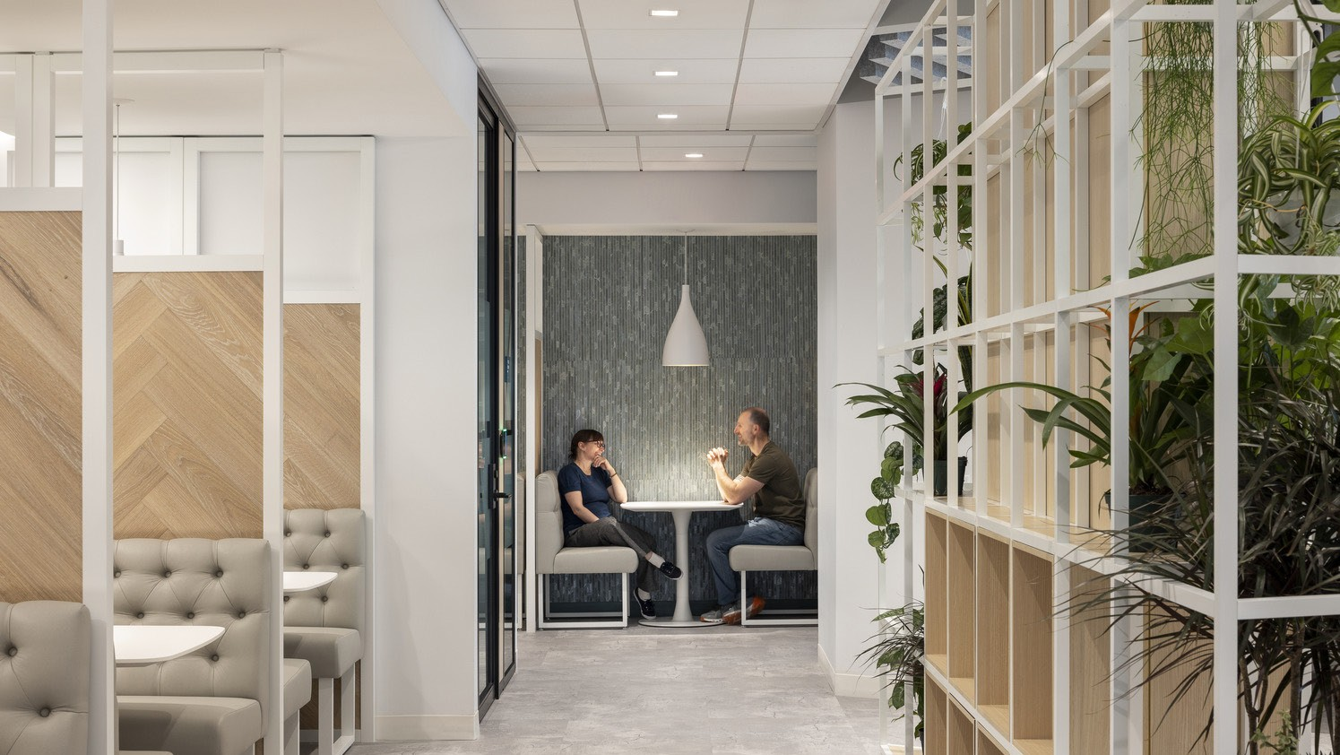
Section 1:
What Defines a Healthy Material?

Slide 4
WORKSHOP | Materials and Health:
Designing Building Solutions for Human Well-Being
Ways to Look at Material Health
Human Health
Social Health & Equity
Ecosystem Health
Climate Health
Circular Economy

Slide 5

WORKSHOP | Materials and Health:
Designing Building Solutions for Human Well-Being
Questions We Ask All the Time:
Is the material aesthetic / on trend?
Is it durable?
Is it cost effective?
Does it have a long lead time?
And Sometimes We Ask...
Does it comply with code?
What are the acoustic properties?
Will this get me points towards sustainability certification?

Slide 6

WORKSHOP | Materials and Health:
Designing Building Solutions for Human Well-Being
Questions We SHOULD Be Asking:
Is this going to be harmful to my health and the health of those around me?
Does the creation or disposal of this create health risks to those handling it?
What is even IN this?

Slide 7

WORKSHOP | Materials and Health:
Designing Building Solutions for Human Well-Being
Human Health Factors & Exposure Pathways
Respiratory
  Breathing in harmful chemicals off gassing from materials
Oral
  Ingestion of harmful chemicals can happen through exposure to dust and contaminated water
Dermal
  Toxic chemicals can enter the body through the skin
Manufacturing and Installation
  Poor workplace safety and waste management practices can expose workers and nearby communities to harmful substances during product manufacturing
End of Life
  Toxic chemicals can continue to leach out of products disposed in landfills and contaminate the surrounding environment
  Incineration of toxic chemicals can produce harmful combustion byproducts

Slide 8

Harmful Classes of Chemicals found in Materials
PFAS
  Used for their oil-, stain-, and water-repellent properties
  Found in carpets, furnishings, adhesives and sealants
  Linked to kidney and testicular cancer, elevated cholesterol, decreased fertility, and thyroid problems and decreased immune response to vaccines in children
Antimicrobials
  Halogenated aromatic compounds, nanosilver, and quaternary ammonium compounds used to kill or inhibit the growth of microbes
  Found in paints, textiles, flooring, and countertops
  Antimicrobials, such as triclosan and quats, can harm beneficial organisms and disrupt hormone functioning, leading to developmental, reproductive, and respiratory issues, as well as antibiotic resistance.
WORKSHOP | Materials and Health:
Designing Building Solutions for Human Well-Being

Slide 9

Harmful Classes of Chemicals found in Materials
Fame Retardants
  Organohalogen and organophosphate chemicals such as polybrominated diphenyl ethers (PBDEs) and chlorinated tris (TDCPP) are used to slow ignition and prevent fires
  Use in furniture, insulation, paints and coatings, and carpet padding
  Some flame retardants are associated with lowered IQ and hyperactivity in children as well as cancer, hormone disruption, and decreased fertility in adults.
Bisphenols & Phthalates
  Used for making plastics stronger or more flexible
  Found in vinyl flooring, caulks and adhesives, and PVC pipes
  Even at low levels, bisphenols and phthalates pose hormone- disrupting risks, especially for young children, including asthma, neurodevelopmental issues, behavioral problems. Adult health concerns include obesity, diabetes, heart disease, reduced fertility, and cancer risk.
WORKSHOP | Materials and Health:
Designing Building Solutions for Human Well-Being

Slide 10

Harmful Classes of Chemicals found in Materials
Some Solvents
  Aromatic hydrocarbon solvents (e.g. toluene, xylene, benzene) and halogenated organic solvents (e.g. methylene chloride, perchloroethylene, and trichloroethylene) are used to dissolve or disperse other substances
  Found in oil-based paint, pain strippers, wood finishes, adhesives, and sealants
  Breathing solvent vapors can cause temporary nervous system symptoms like headaches, dizziness, and brain fog, while prolonged exposure to certain solvents may heighten cancer risk
Certain Metals
  Mercury, arsenic, cadmium, and lead used in industrial processes
  Found in paint, plumbing fixtures, and recycled vinyl products
  Exposure to certain metals can lead to adverse effects on the nervous and cardiovascular systems increased risk of cancer, lung and kidney damage as well as weakened bones.
WORKSHOP | Materials and Health:
Designing Building Solutions for Human Well-Being

Slide 11
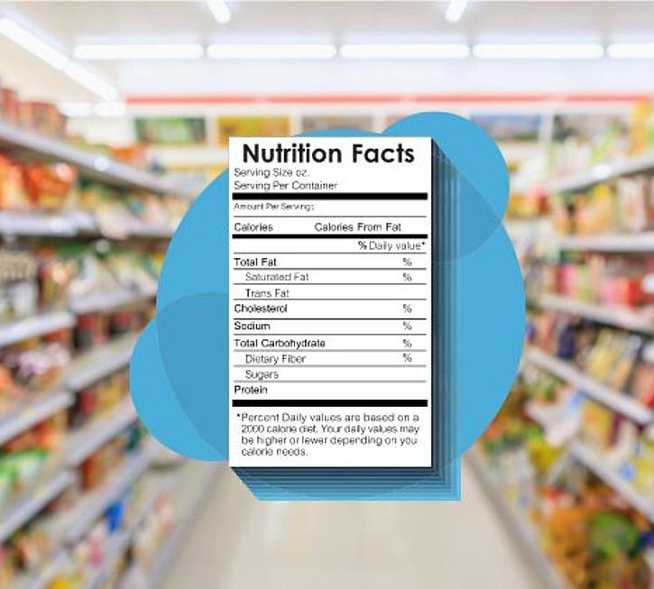
WORKSHOP | Materials and Health:
Designing Building Solutions for Human Well-Being
What Defines 'Healthy'?
Ingredients Disclosure
Health Product Declaration with a Disclosure Level of 100 vs 1000 parts per million
Verification Label (third party or self-disclosed)
Free of Restricted Substances
No GreenScreen Benchmark 1 Chemicals: Chemicals of High Concerns linked to carcinogenicity, mutagenicity, reproductive or developmental toxicity, and endocrine disruption
  e.g. triclosan - an antimicrobial used in personal care products and textiles
ILFI RedList Free: “Worst in class” materials, chemicals, and elements known to pose serious risks to human health and the greater ecosystem that are prevalent in the building products industry
e.g. phthalates - a plasticizer found in plastic and vinyl products
Low or No VOCs (Volatile Organic Compounds)
Verification Label (third party or self-disclosed)

Slide 12


WORKSHOP | Materials and Health:
Designing Building Solutions for Human Well-Being
A Word on Greenwashing:
What You See....
May Not Be What You Get

Slide 13
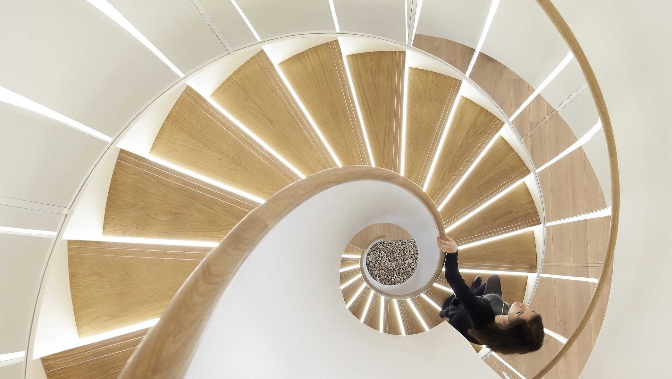
Section 2:
Industry Movements Promoting Healthy Materials

Slide 14

WORKSHOP | Materials and Health:
Designing Building Solutions for Human Well-Being
How LEED Defines Healthy Materials
Ingredients Disclosure
  Applicable LEED Credit: Materials and Resources - Material Ingredients Option 1
  Points awarded for specifying products with Declare, Cradle to Cradle, and Health Product Declaration disclosure labels
Free of Restricted Substances
  Applicable LEED Credit: Materials and Resources - Material Ingredients Option 2
  Uses product declarations to ensure no Benchmark-1 substances or Red List ingredients are used.
Low or No VOCs (Volatile Organic Compounds)
  Applicable LEED Credit: Indoor Environmental Quality - Low Emitting Materials
  Uses CDPH Standard Method v1.2-2017, Section 8.
  Tracks paints and coatings, flooring, wall panels, ceilings, insulation, furniture, and/or composite wood

Slide 15


WORKSHOP | Materials and Health:
Designing Building Solutions for Human Well-Being
How WELL Defines Healthy Materials
Ingredients Disclosure
  Applicable WELL Feature: Materials Transparency
  Points awarded for specifying products with Declare, Cradle to Cradle, and Health Product Declaration disclosure labels
Free of Restricted Substances
    Applicable WELL Feature: Materials Optimization
    Uses product declarations to ensure no Red List ingredients are used and products meet chemical thresholds in the Cradle to Cradle Basic Level Restricted Substances List.
Low or No VOCs (Volatile Organic Compounds)
    Applicable WELL Feature: X06 VOC Restrictions
    Uses CDPH Standard Method v1.2-2017, Section 8.
    Tracks paints and coatings, flooring, wall panels, ceilings, insulation, furniture, and/or millwork

Slide 16
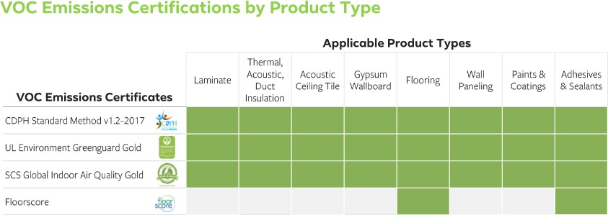
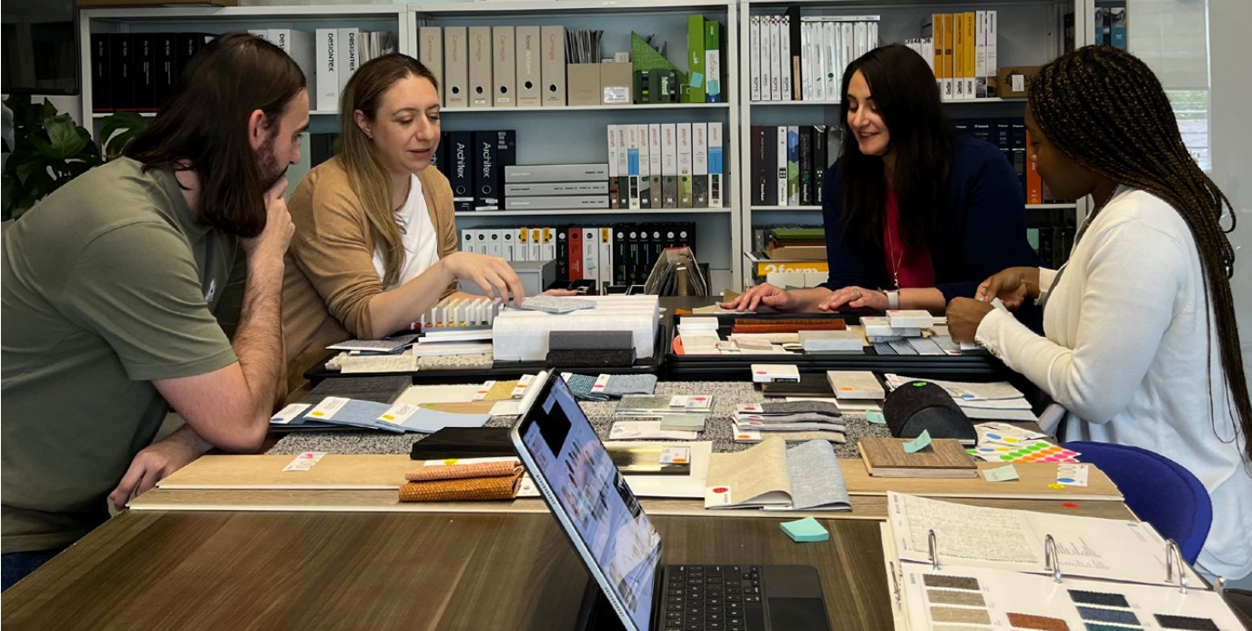
WORKSHOP | Materials and Health:
Designing Building Solutions for Human Well-Being
How Companies are Implementing Healthy Materials into Projects
Following a Building Certification System: LEED, WELL, or LBC
Creating a Healthy Materials Guideline or Standard
How Firms can Implement Healthy Materials into Projects
Creating a Healthy Materials Library and designer resources
Working with Vendors and Reps to advocate for healthy materials
Sign the AIA Architecture & Design Materials Pledge

Slide 17

Section 3:
Industry Tools for Identifying Healthy Materials

Slide 18


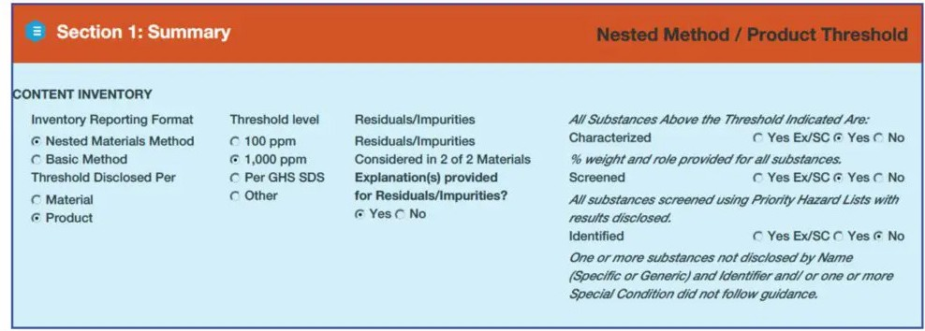

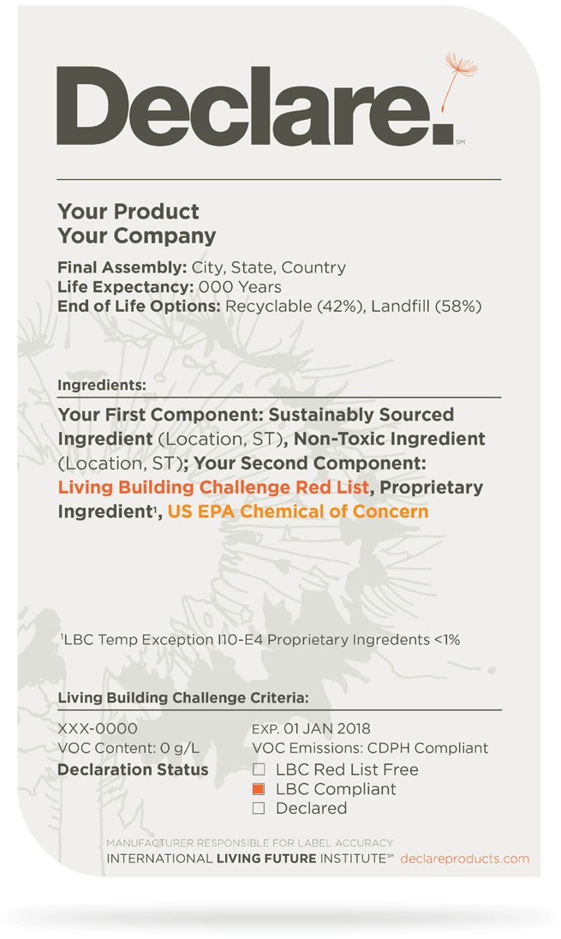
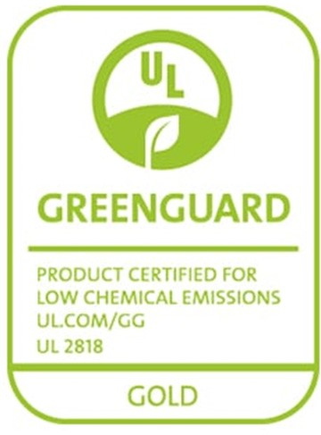
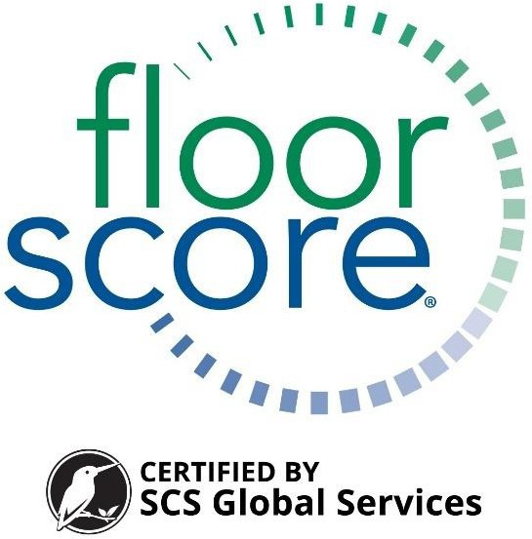


WORKSHOP | Materials and Health:
Designing Building Solutions for Human Well-Being
Industry Tools
Cradle to Cradle
  Third-party verified
  Asses materials to 100 ppm
  Look for Material Health score of Silver or above
Declare Program
  LBC Red List Free Label or Declare Label
  If Label is LBC Compliant or LBC Red List Approved, look material assessment to 100 ppm
Health Product Declaration
  Content Inventory disclosed to 100 ppm - 1000 ppm
  Third-party verified
VOC Emissions Documentation
  Third-party verification for low/no VOC Emissions

Slide 19
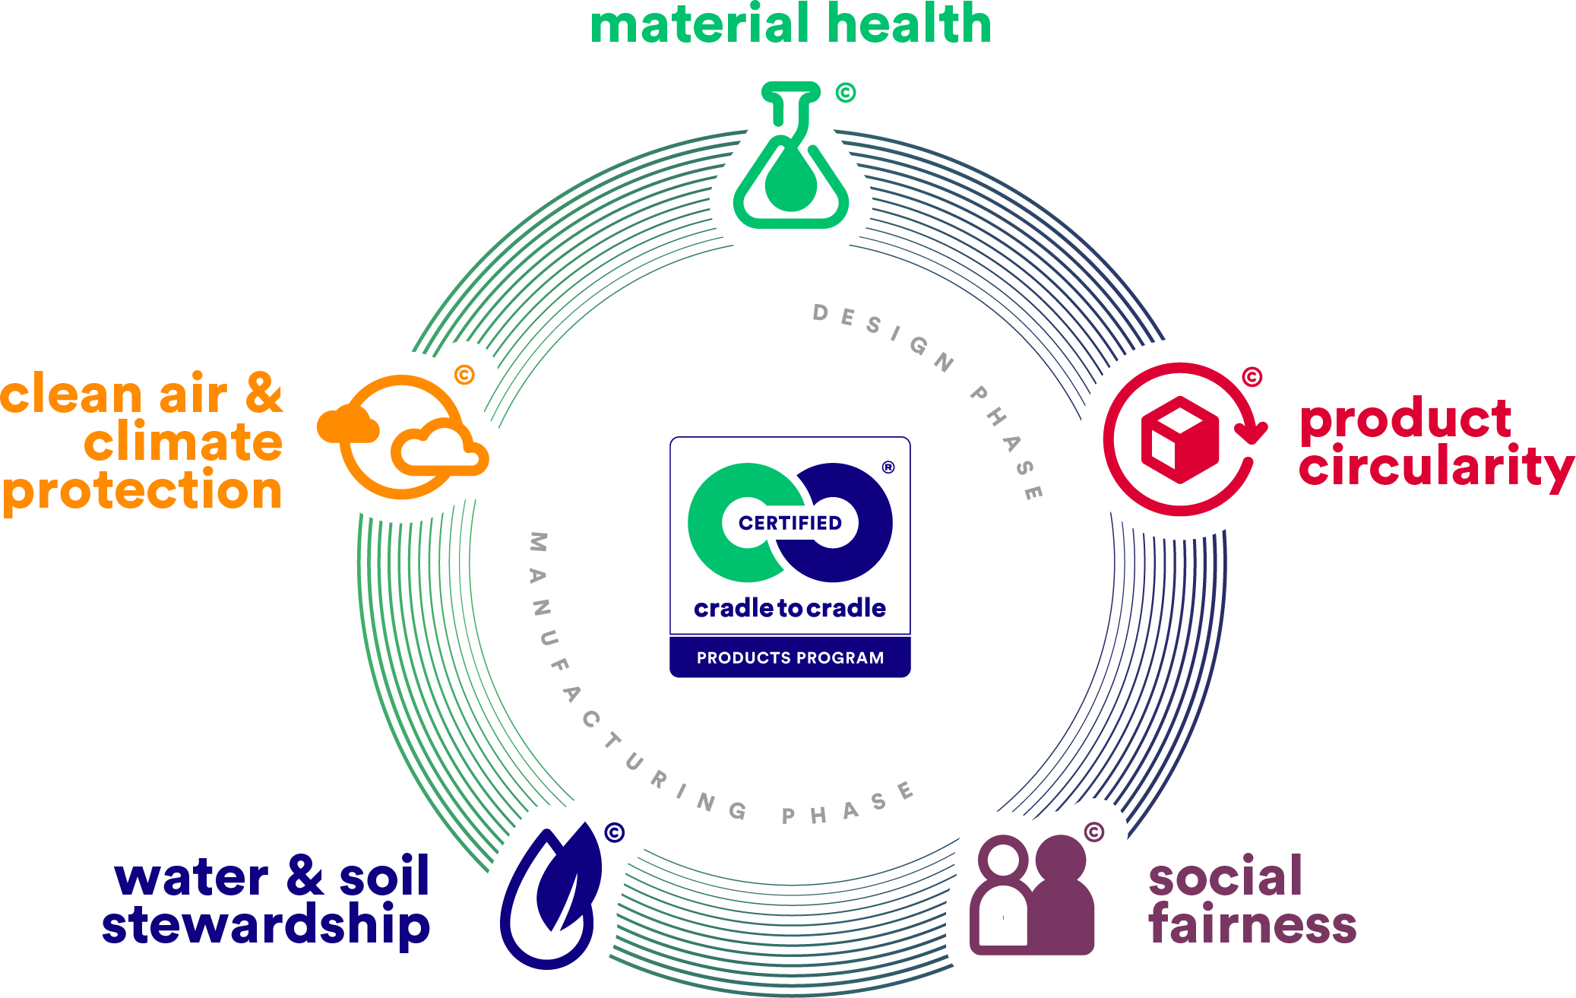
WORKSHOP | Materials and Health:
Designing Building Solutions for Human Well-Being
Cradle to Cradle
Managed by the Cradle to Cradle Products Innovation Institute
Measures material health, product circularity, social fairness, water and soil stewardship, and clean air & climate protection
Has Bronze, Silver, Gold, and Platinum levels of product certification
Bronze products are in the process of being or intent to be certified; whereas Silver and above have become certified
All active Cradle to Cradle products are accessible on a free and searchable
database.

Slide 20
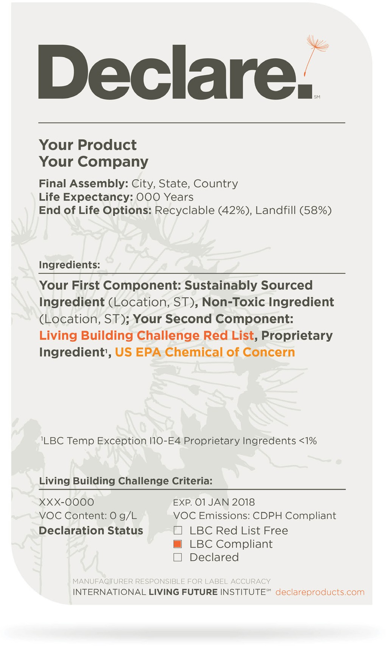
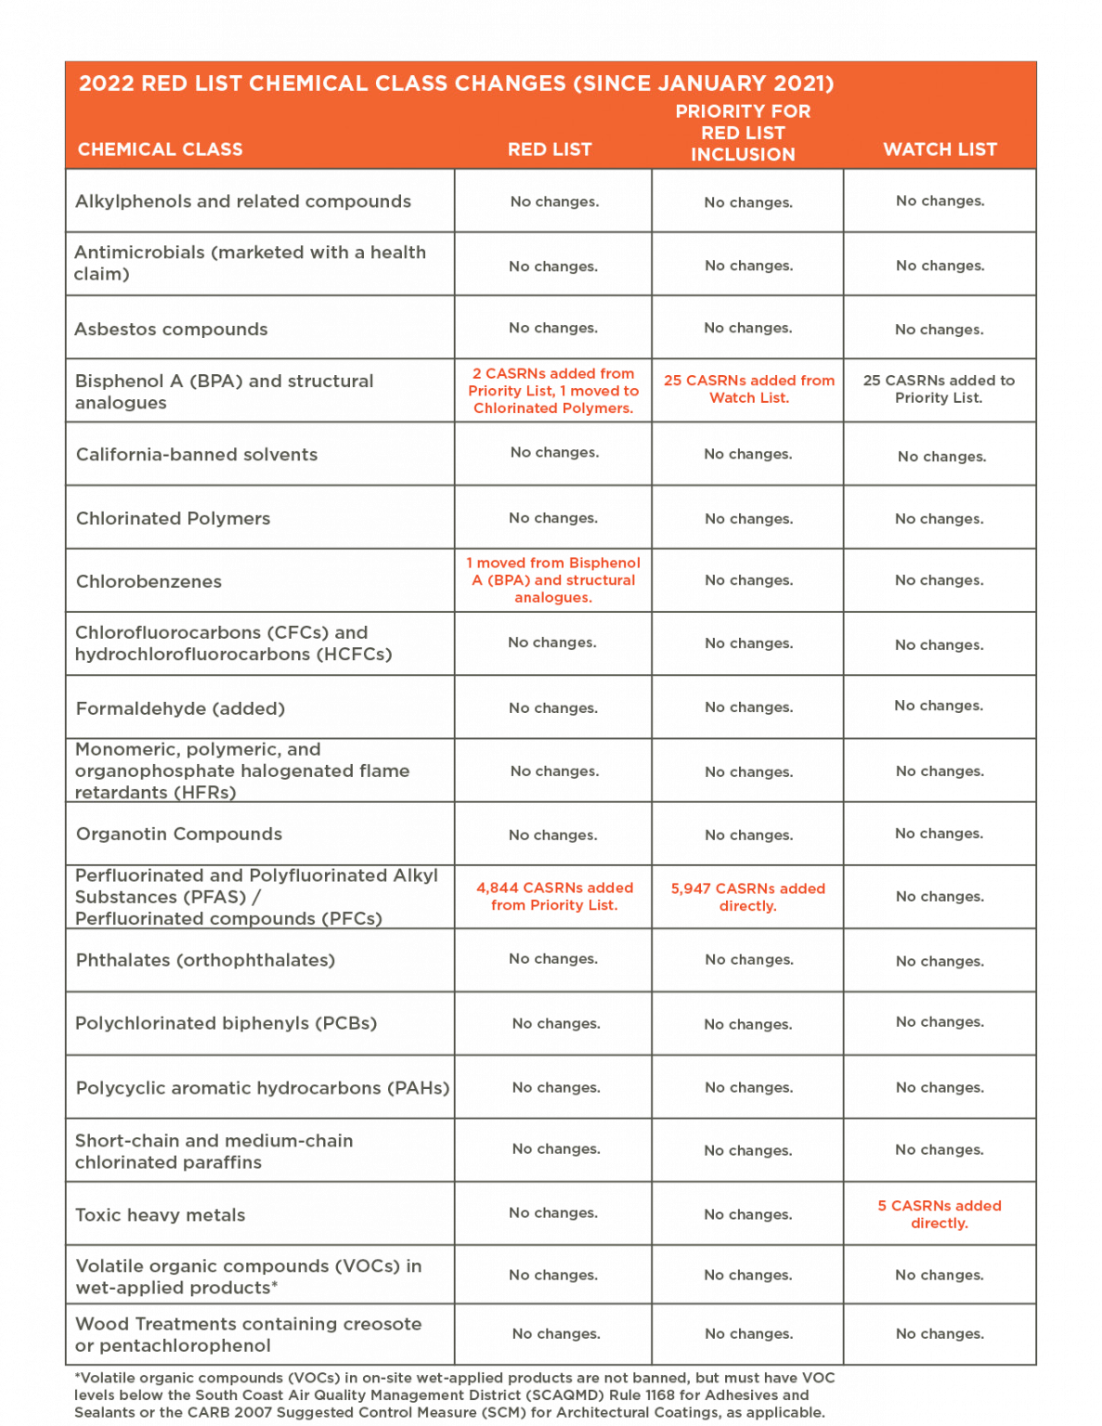
WORKSHOP | Materials and Health:
Designing Building Solutions for Human Well-Being
Declare
Managed by the International Living Future Institute
A "Nutrition Label" for building products
Manufacturers voluntarily disclose product information on labels and use a color code system to flag chemicals of concern.
LBC Red List Free disclose 100% of ingredients present at or above 100 ppm
Declared disclose 100% of ingredients, but contain a Red List chemical
If LBC Compliant or LBC Red List Approved disclose 99% of ingredients and/or contain a red list chemical with an exception
All active Declare labels are accessible on a free and searchable database.

Slide 21
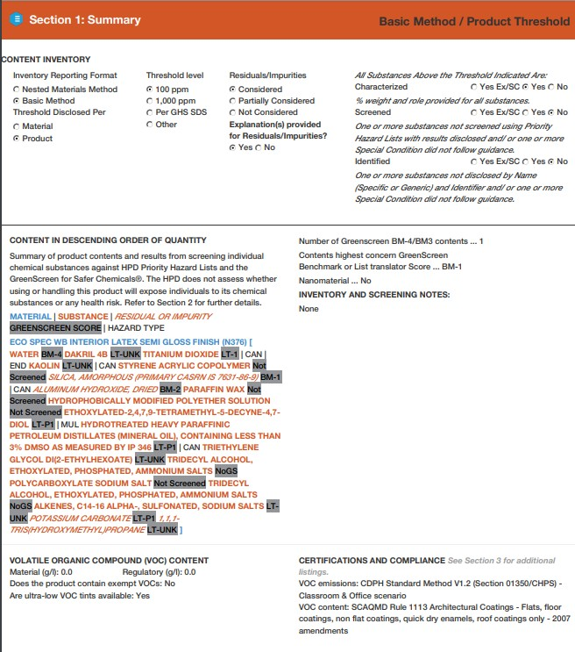
WORKSHOP | Materials and Health:
Designing Building Solutions for Human Well-Being
Health Product Declaration
Managed by the HPD Collaborative
An Open Standard Database
Data available to check if information is third-party verified
Data is available to check if information is pre-checked for LEED compliance
Includes ingredient list
HPDs are accessible via a free and searchable database.
Always check dates of certification
PPM (parts per million) disclosed Look for 100 ppm
- 1,000 ppm (high concentration)
Ingredient List

Slide 22
WORKSHOP | Materials and Health:
Designing Building Solutions for Human Well-Being
VOC Emissions Documentation
Greenguard Gold
Berkeley Analytical
Intertek Clean Air Gold
FloorScore (Flooring)
CRI Green Label Plus (Flooring)
Always check dates of certification

Slide 23

Section 4:
How to Integrate Healthy Materials in your Project

Slide 24

WORKSHOP | Materials and Health:
Designing Building Solutions for Human Well-Being
Communicating with Stakeholders
Manufacturer Reps
Communicate material health company and client goals.
Ask for information, learning opportunities and health labels.
Verify the face material, backers, and any other install materials meet requirements.
Clients
Communicate and educate clients at beginning of the project.
Ask client goals for health and wellness.
Keep in touch with the client on healthy alternatives that meet project goals and budget.

Slide 25

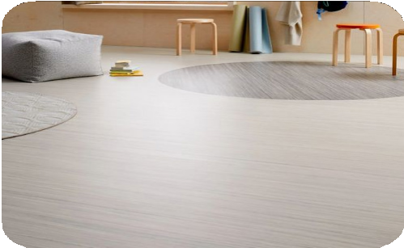
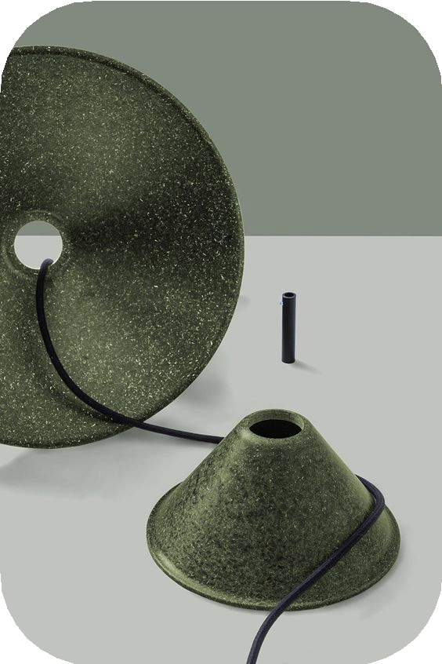

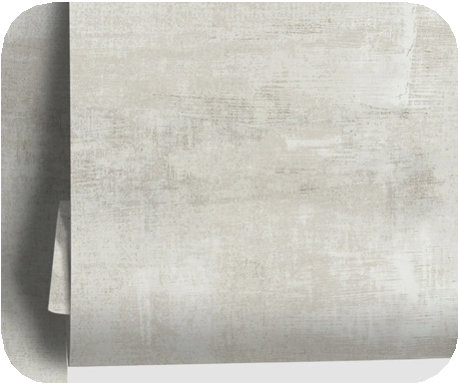
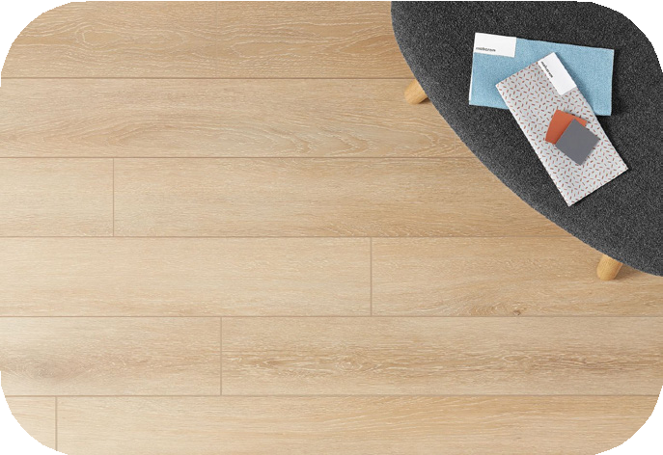
WORKSHOP | Materials and Health:
Designing Building Solutions for Human Well-Being
2 Paths to Healthy Materials
The Purist Approach
The Value Approach
All materials on the project follow the guideline of real/ true materiality.
Wood is real wood, stone is real stone, metal is real metal.
Value driven materials giving the look for less.
This is inclusive of wood look linoleum or laminate mineral products, plant based materials, recycled content faux look materials, cellulose wallcoverings.
Explore creative alternates made from natural sources.

Slide 26

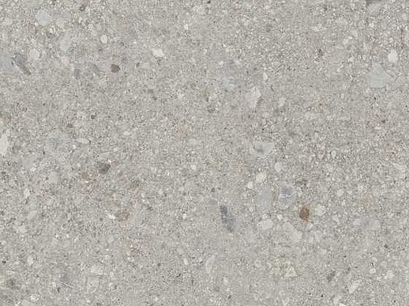
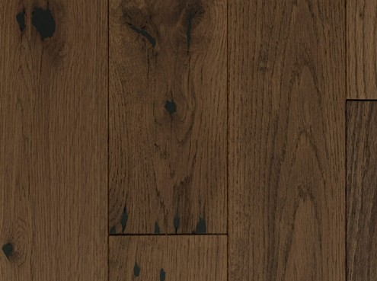

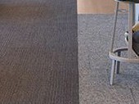



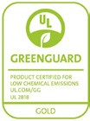








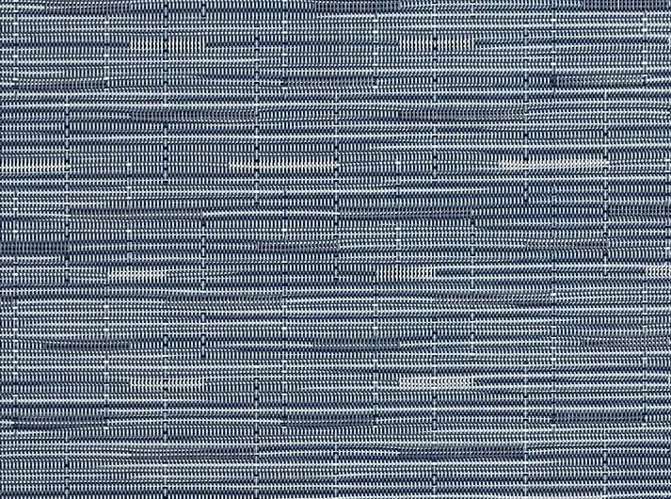


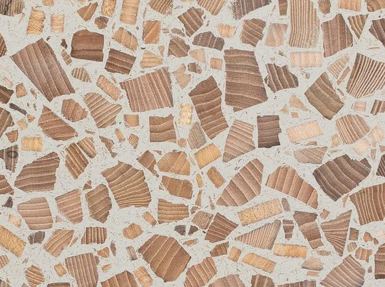




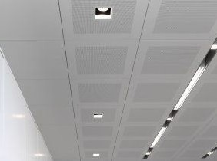
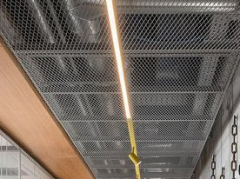
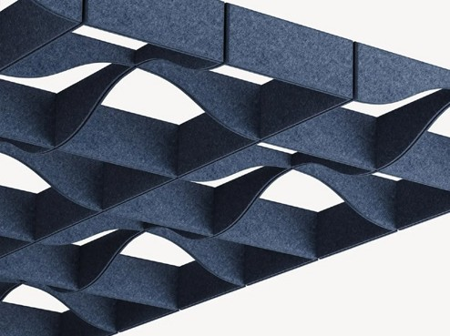

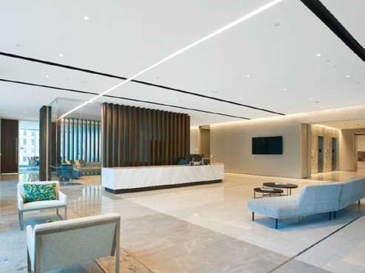
WORKSHOP | Materials and Health:
Designing Building Solutions for Human Well-Being
Materials Concept
FLOOR
1
CONCRETE LOOK
PORCELAIN TILE
2
REAL WOOD PLANKS
3 STATIC
DISSIPATIVE TILE
4 CARPET TILE
₅ WOOD LOOK LUXURY VINYL TILE
WALLS & MILLWORK
6
WOVEN
BIOPOLYMER WALLCOVERING
7
FAUX LEATHER UPHOLSTERY
8 REAL WOOD VENEER
9 RECYCLED RESIN & WOOD SOLID
SURFACE
10 MARBLE LOOK QUARTZ
CEILING
11 | ACOUSTIC CEILING | 12 | METAL MESH | 13 | ACOUSTIC FELT | ₁₄ REAL WOOD CEILING | ₁₅ ACOUSTIC GYPSUM
 | TILE PLANT BASED |  | CEILING TILE |  | CEILING PANELS | BAFFLES | CEILING

Slide 27
Thank You

