Slide 1








New York Build 2024
From Digital to Reality: A Case Study of Successful Digital Implementation
Sadia Janjua Chief of Digital Transformation, Port Authority of NY & NJ
Wes Beaumont Digital Transformation Advisory Lead, AECOM

Slide 2

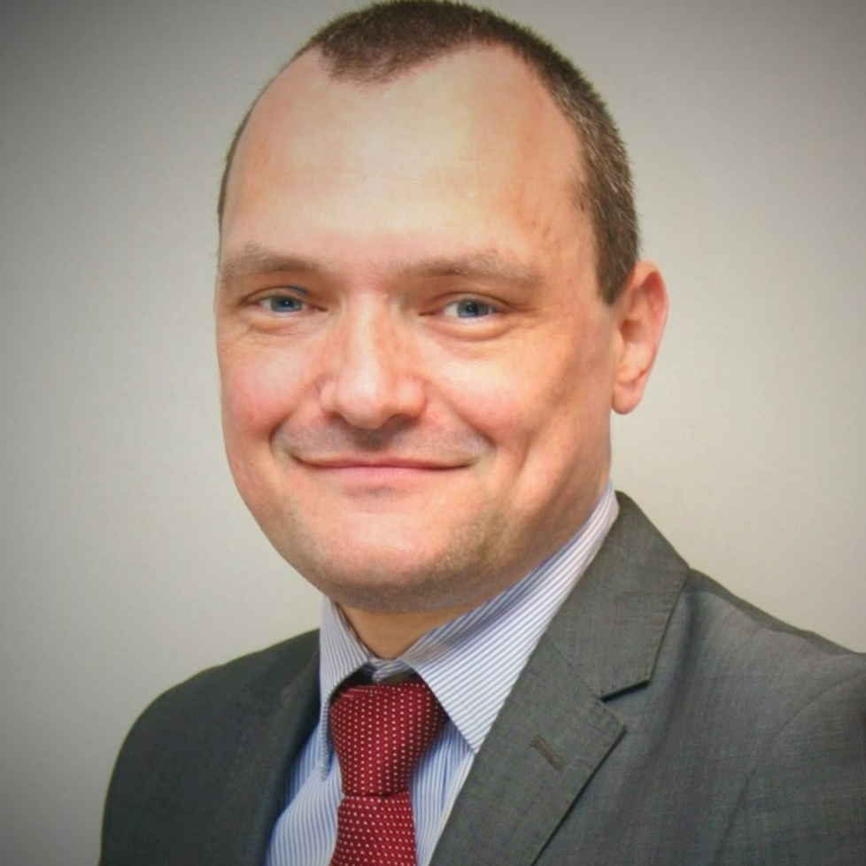
Speakers
Sadia Janjua, LEED, AP, PSP
Chief of Digital Transformation
Port Authority of New York and New Jersey
Wes Beaumont, MSc MCIOB
Digital Transformation Advisory Lead
AECOM US East and LATAM
Notes:
LEARNING OUTCOMES
Understand Digital Transformation in the context of a large infrastructure owner’s engineering department.
Explore how to develop a Digital Transformation Program, manage innovation and how to measure successful implementation.
Discover real world methodologies on change management, lean, agile and product development to create and/or enhance organizational capabilities.
Analyze real world examples of improvement initiatives and how they collectively support transformation efforts.

Slide 3
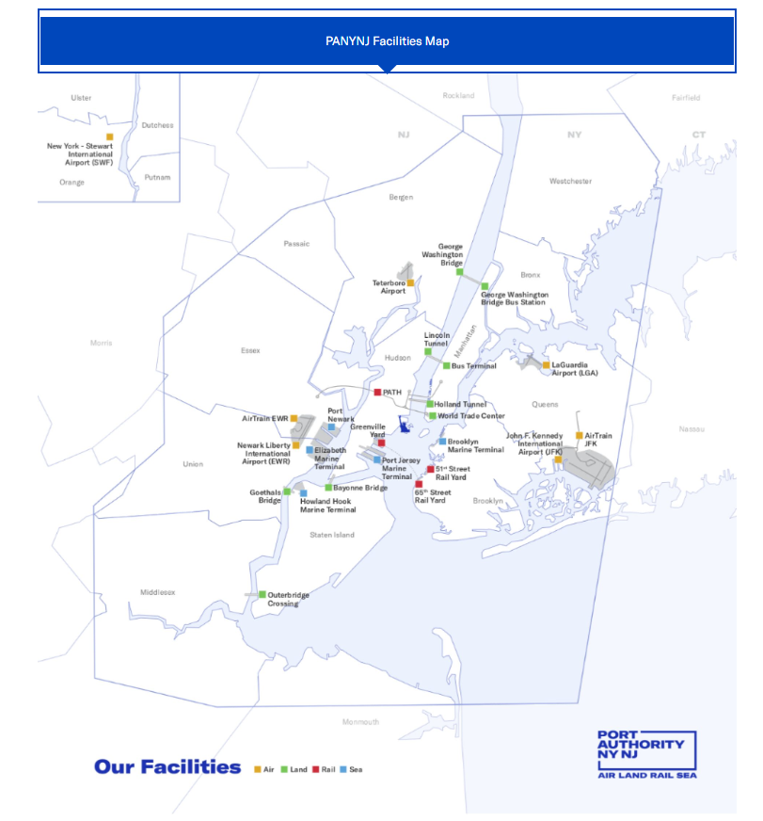
Aviation
John F. Kennedy International Airport
LaGuardia Airport
Newark Liberty International Airport
Stewart International Airport
Teterboro Airport
Bridges
Bayonne Bridge
George Washington Bridge
Goethals Bridge
Outerbridge Crossing
Terminals
Port Authority Bus Terminal
George Washington Bridge Bus Terminal
Journal Square Transportation Center
Tunnels
Holland Tunnel
Lincoln Tunnel
Ports
Port Jersey-Port Authority Marine Terminal
Brooklyn-Port Authority Marine Terminal
Elizabeth-Port Authority Marine Terminal
Howland Hook Marine Terminal
Port Newark
Port Authority Trans-Hudson
PATH Rail Transit System
World Trade Center
WTC

Slide 4
01. Establishing the Digital Transformation Program

Slide 5







Engineering Department Organization
Office of the
Chief Engineer
Project Management
and Delivery
Engineering and Architectural Design
Construction Management
Quality
Assurance
Enterprise Asset Management
Business
Operations
Engineering Program Executives
Alternate Project Delivery
Architectural
Civil
Contracts
Electrical
Environmental
Geotechnical
Mechanical
Resiliency/Sustainability
Structural
Traffic
Resident Engineer Offices
Central Survey
Clean Construction
Materials Engineering
Construction Standards
Design Standards
Structural Integrity
Asset Management Implementation
Asset Management Policy, Governance and Development
Digital Transformation
Financial Services
Engineering Solutions
Estimating
Project Controls
Virtual Design & Construction

Slide 6
Engineering Department Organization
1
Engineering Department
6
Divisions
42
Units
???
‘Things we do’

Slide 7
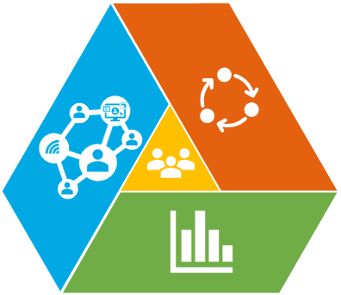
Digitally Transforming
Then
Now
Future
Disconnected
Data silos
Technology not integrated
Operating model not optimized
Consequences
Takes longer
Miscommunication
Reinventing the wheel
Connected
Highly standardized
Highly integrated
Benefits
Faster
Better
Smarter
Digital Transformation Program

Slide 8







Top Findings for Improvement in 2022
People
Process
Technology
Data
DATA
Reliability Data is often incomplete (incl. design info).
Timeliness Real time data and reporting is needed.
Availability Access through single data source (esp. survey / cost).
PEOPLE
Define Roles and clarify responsibilities.
Develop Technical Skills across all divisions.
Enhance Training around project delivery and asset mgmt. practices.
PROCESS
Scalability of processes and systems.
Clarity of project delivery guidelines.
Improvement of scoping, estimating and change mgmt.
TECHNOLOGY
Modernize technology by replacing obsolete systems.
Digitize inefficient processes with cloud-based / mobile tools.
Organize project sites (Teams or SharePoint) and workflows.

Slide 9
02. The Operating Framework

Slide 10
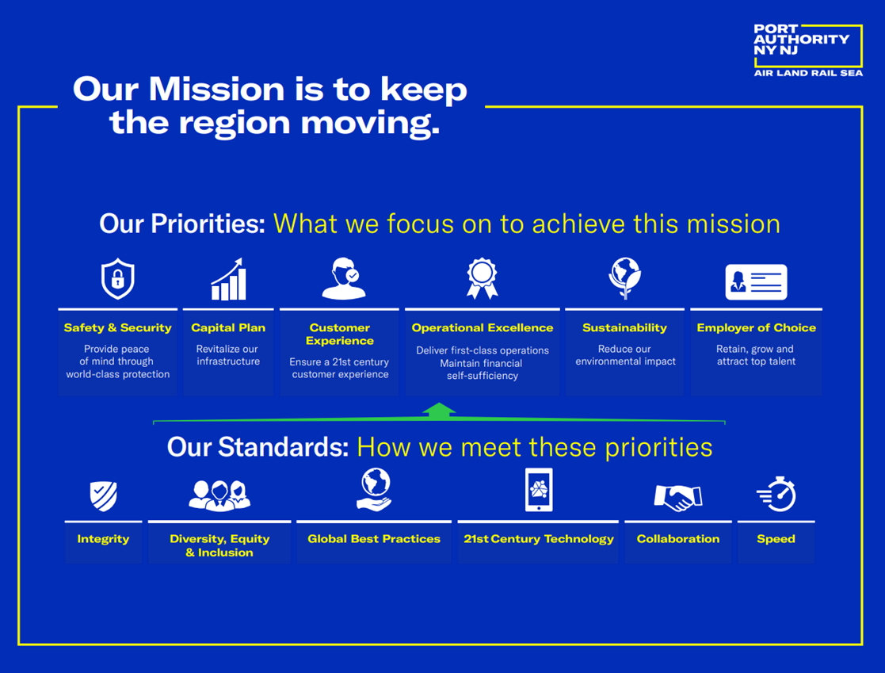
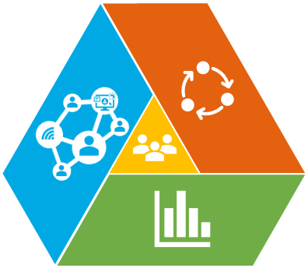






Digital Transformation Strategy
Digitize our department with a data pipeline to support automation and decision making.
Establish a revamped project delivery system with clear roles, responsibilities and processes.
Digitize and Automate
Project Delivery
Our Engineering Department
Designing, building and operating world class infrastructure to help keep the region moving.
Develop a culture where continuous improvement is the norm and ideas are celebrated and developed.
Connect our people, and our line departments to improve collaboration and shared thinking.
Customer Experience
Culture of Innovation
Connect “One Engineering Department” to support world class delivery.

Slide 11
Digital Transformation Organization
1. What we do, how do we do it and who do we do it with
2. The services that the unit provides and the interactions that unit has with other units
Objective
3. The data that the unit produces, collects or uses
Connect as “One Engineering Department” to support world class delivery
4. The technology or systems that the unit uses
1. Define the problem or the challenge
Strategic Themes
Digitize and Automate
Project Delivery
Customer Experience
Culture of Innovation
5. The procedures and processes that are in use and how they connect with other units in the value chain
2. Identify the data, process and procedure and technology requirements for a solution
Workstreams and Tactics
Unit Transformation
Initiatives and Productization
6. The skills, competencies and knowledge that exist within the unit and how that can be captured, retained and shared
3. Develop a minimal viable product (MVP) and test with user group
Connect the units to perform as one department through common processes, shared data and technology that supports the delivery of each function
Produce a solution that meets everyday needs of the department, our people and our projects
4. Deploy MVP and gather feedback
5. Decide on build or buy to scale solution
6. Monitor and support for continuous improvement

Slide 12
Digital Transformation Team
Executive Sponsor
Program Director
Communications Manager
Digital Transformation Core Team
People and Business Change
Process Re-Engineering
Data Governance
Technology and Systems
Legal and Contracts
Suppliers and Vendors
Transformation
EADD
CMD
OPS
EPD
QAD
EAM
Note: Terms of reference exist for each area
Initiatives
Initiative 1
Initiative 2
Initiative 3
Initiative 4
Initiative 5
Initiative n

Slide 13
Digitalization Blueprint
Engineering and Architectural Design Division
Construction Management Division
Engineering Operations Division
Project Delivery Division
Quality Assurance Division
Enterprise Asset Management Division
Digital Blueprint
Service
New products, business models, organizational design and ways of working.
People & Skills
Enhanced skills and developing our people to be digitally enabled.
Revised Operating Model
Procedures
World class procedures for consistency, accuracy and automation.
Technology
21st Century Technology and integrated cloud-based solutions.
Data
The right data, in the right format, at the right time and place.

Slide 14

Our Methodology
Unit Transformation
01
START
Discovery
Review and validate process, technology, data and capability to understand issues and needs.
Options
Ideate to discover opportunities.
Initiatives
02
Recommendations
Initiatives
Continuous Improvement
Agree on recommendations and vote for improvement initiatives.
Implement as initiatives. Transition to the future state.
Review and measure success of solutions to apply continuous improvement principles.

Slide 15

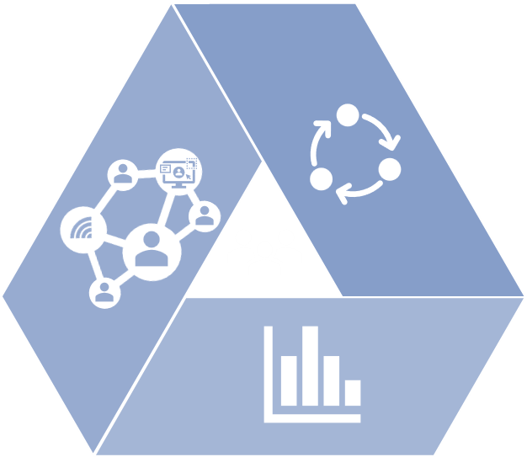







Operating Model
Digital Transformation Transforming our Department, Unit by Unit
Geospatial
Project Delivery Systems
Virtual Design and
Construction
Program and
Project Portal
Processes, Procedures, Roles and Responsibilities
Technology
Data

Slide 16
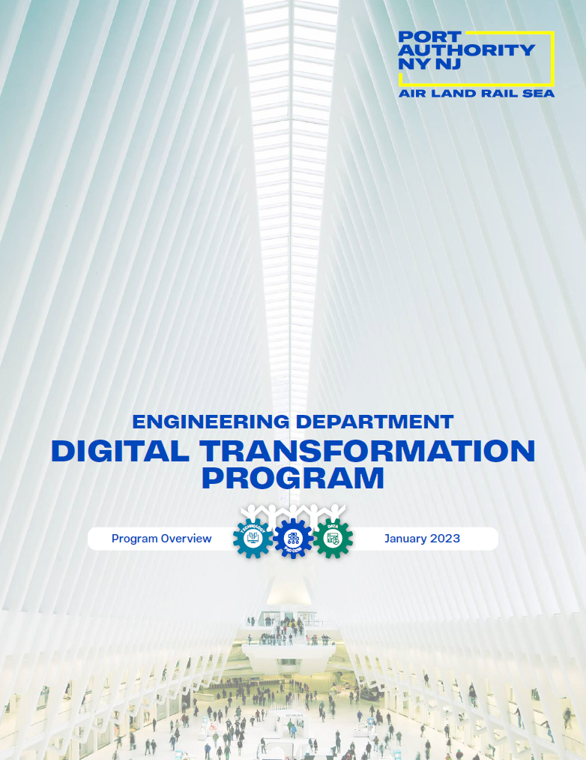
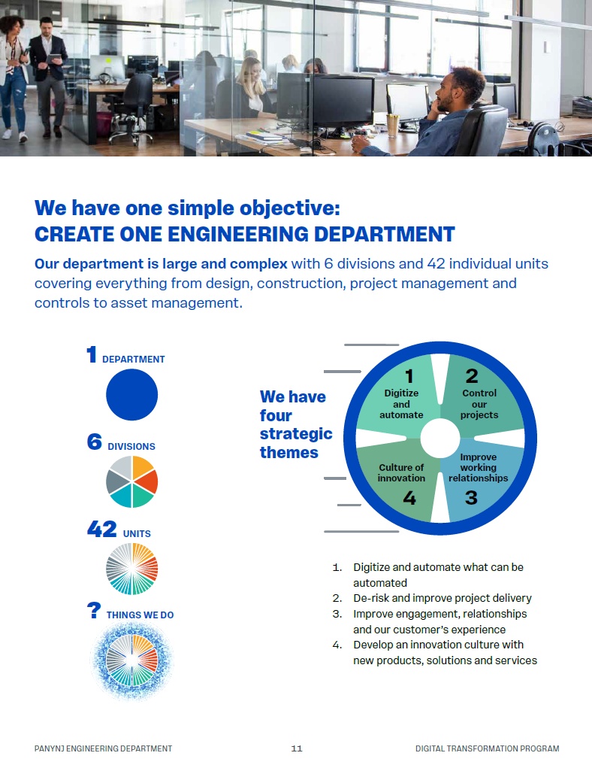
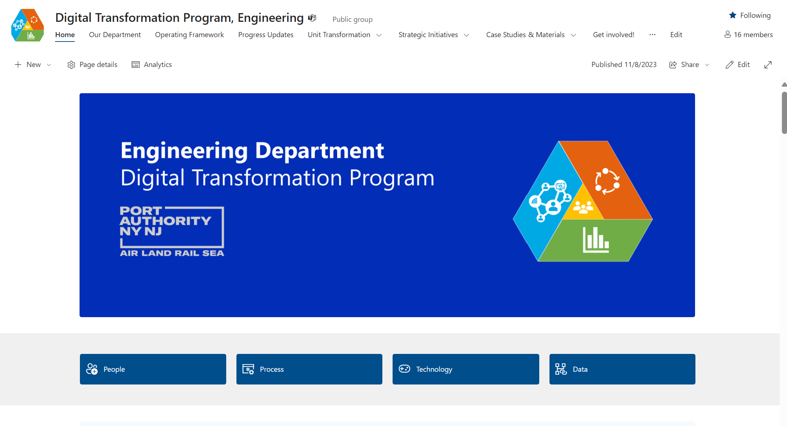
Communications

Slide 17
03. The Application and Results (So far)

Slide 18
Unit Transformation Sprints
1
2
3
4
5
6
7
8
9
10
11
12
13
14
15
16
Short Term: 0 – 6 months
Medium Term: 6 - 18 months
Long Term: > 12 months
Stakeholder analysis and service outcomes
Process and technology discovery
Create value stream map, inputs-process-output, data creation and delivery assessment
Identify sources of waste, variance analysis and root cause evaluation
Ideation of potential services and propose recommendations
Evaluate service improvements
Design to- be process maps and update macro department map
Product development
Solution outline, test and pitch. Develop revised operating model
Discovery
Success plan and continuous improvement
Options
Future State

Slide 19
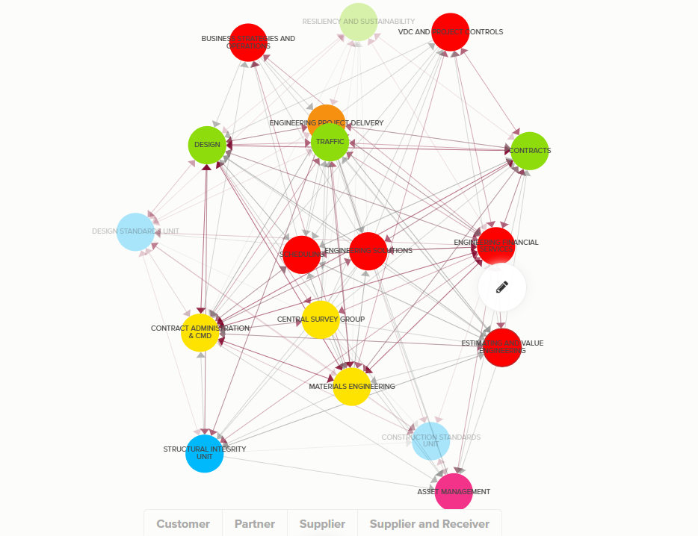
Map Stakeholders and Value Proposition(s)

Slide 20
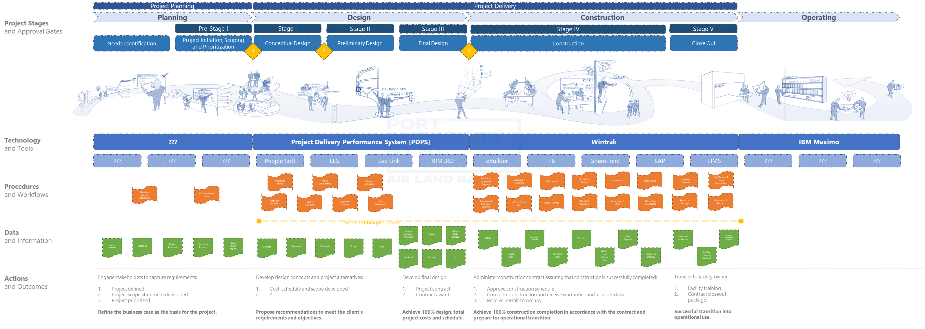
Service and Capability

Slide 21
Process
SUPPLIER
INPUT
PROCESS
OUTPUT
CUSTOMER
Who is supplying the inputs?
e.g.,
Design team
What is the input?
e.g.,
Cost estimate
What are the major steps in the process?
What is the output?
e.g.,
Cost report
Who is the customer?
e.g.,
Project Manager

Slide 22
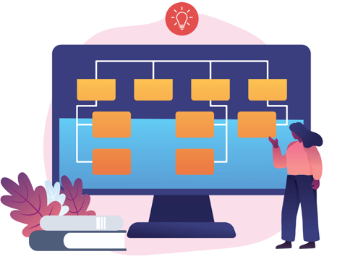


Technology
Data Curation
Creation
Curation
Consumption
Data Creation

Slide 23
Technology
Define what ‘technology’ is in the Engineering Department
Master Software List
Confirm what we have
Confirm technology provision
Technology Baseline Discovery Report
Map against lifecycle, division, and capability / service
Confirm strengths and weaknesses
Rationalize and Optimize
Define technical and functional requirements per user group / technology
Analyze any interdependencies and overlaps between technology and eliminate overlaps and redundancy
Technology Landscaping Optimization Report/Recommendations
Notes:
Confirm what we have
Define what ‘technology’ is in the Engineering Department.
Confirm technology provision within the department through surveys, workshops, user workshops and metering of software.
Map technology provision against lifecycle, division, and capability / service.
Confirm strengths and weaknesses with current technology and systems provision.
Rationalize and optimize
Define technical and functional requirements per user group / technology.
Analyze any interdependencies and overlaps between technology and eliminate overlaps and redundancy in technology provision

Slide 24
Data
5
5
5
5
Roles and Responsibilities
Reference &
Master Data
Roles and Responsibilities
Data Modelling
& Design
Data Security
Data Storage
& Operations
Metadata
Data
Quality
Data
Architecture
Data Integration & Interoperability
Document & Content Management
Data Warehousing
& Business
Intelligence
Requirements definition, capture and specification
Requirements definition, capture and specification
Requirements definition, capture and specification
Data Requirement(s)
1
1
1
1
Creation, collection and management
Creation, collection and management
Creation, collection and management
Data Management
2
2
2
2
Data
Governance
Quality assurance, control and feedback
Quality assurance, control and feedback
Quality assurance, control and feedback
Data Quality
3
3
3
3
Analytics and migration
Analytics and migration
Analytics and migration
Data Use and Analytics
4
4
4
4
10 Data Governance Knowledge Areas
5 Data Governance Buckets Aligned to our Strategic Goals

Slide 25
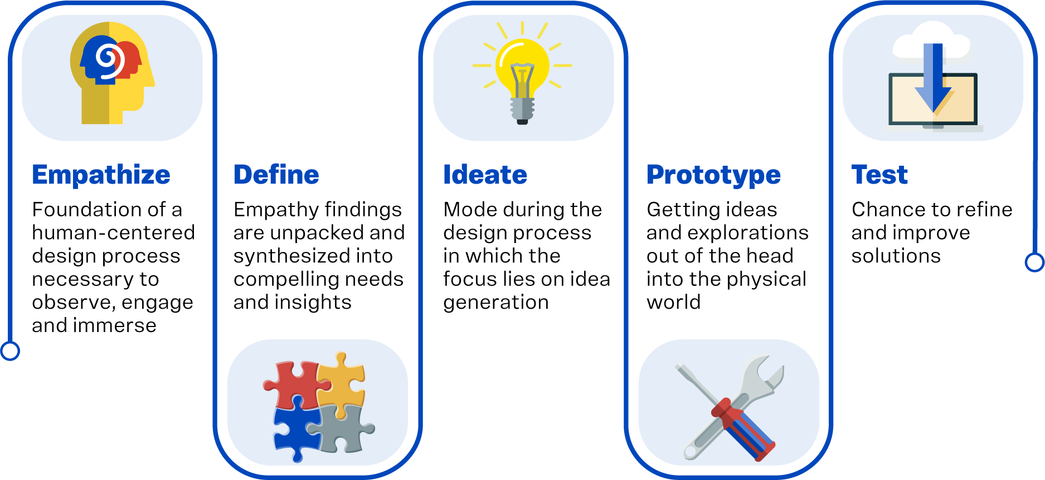
Designing the Solution

Slide 26
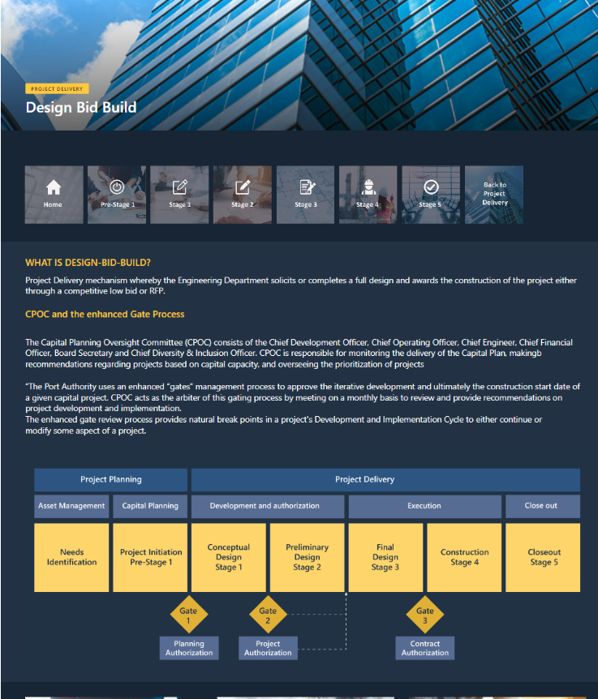
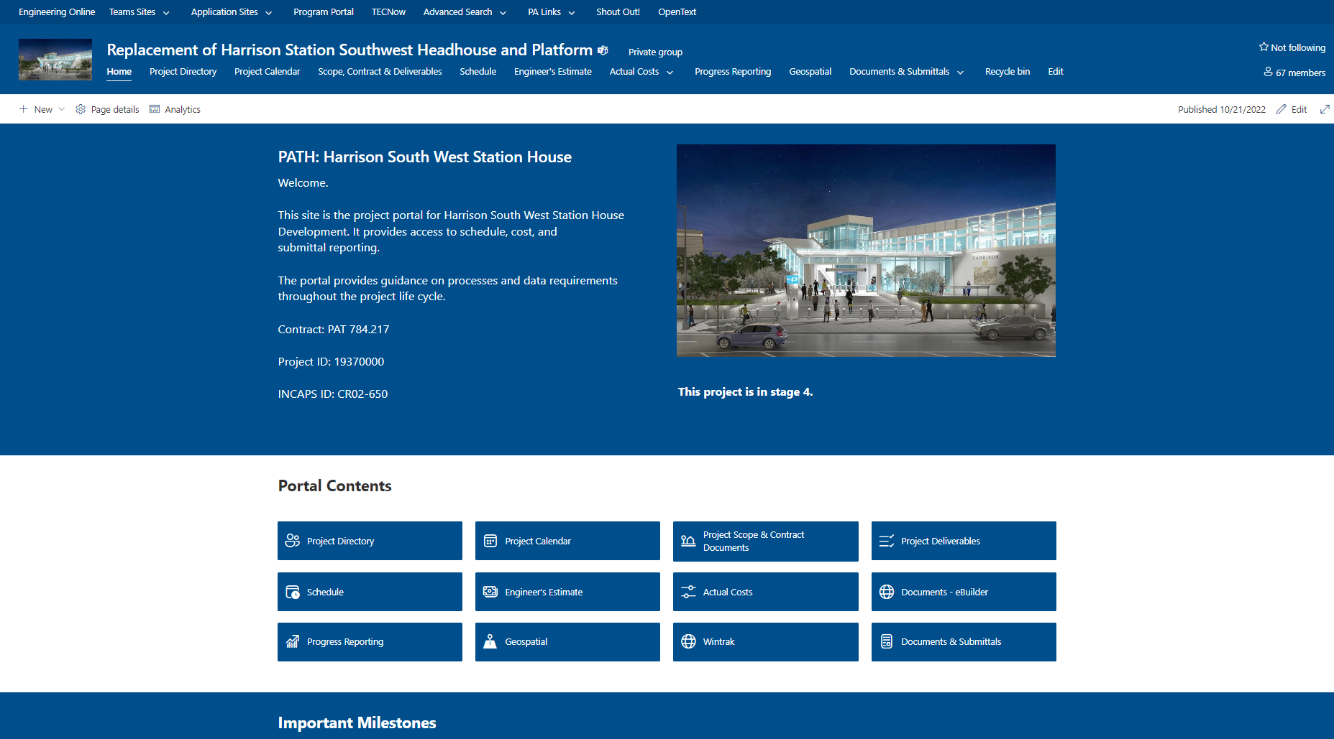
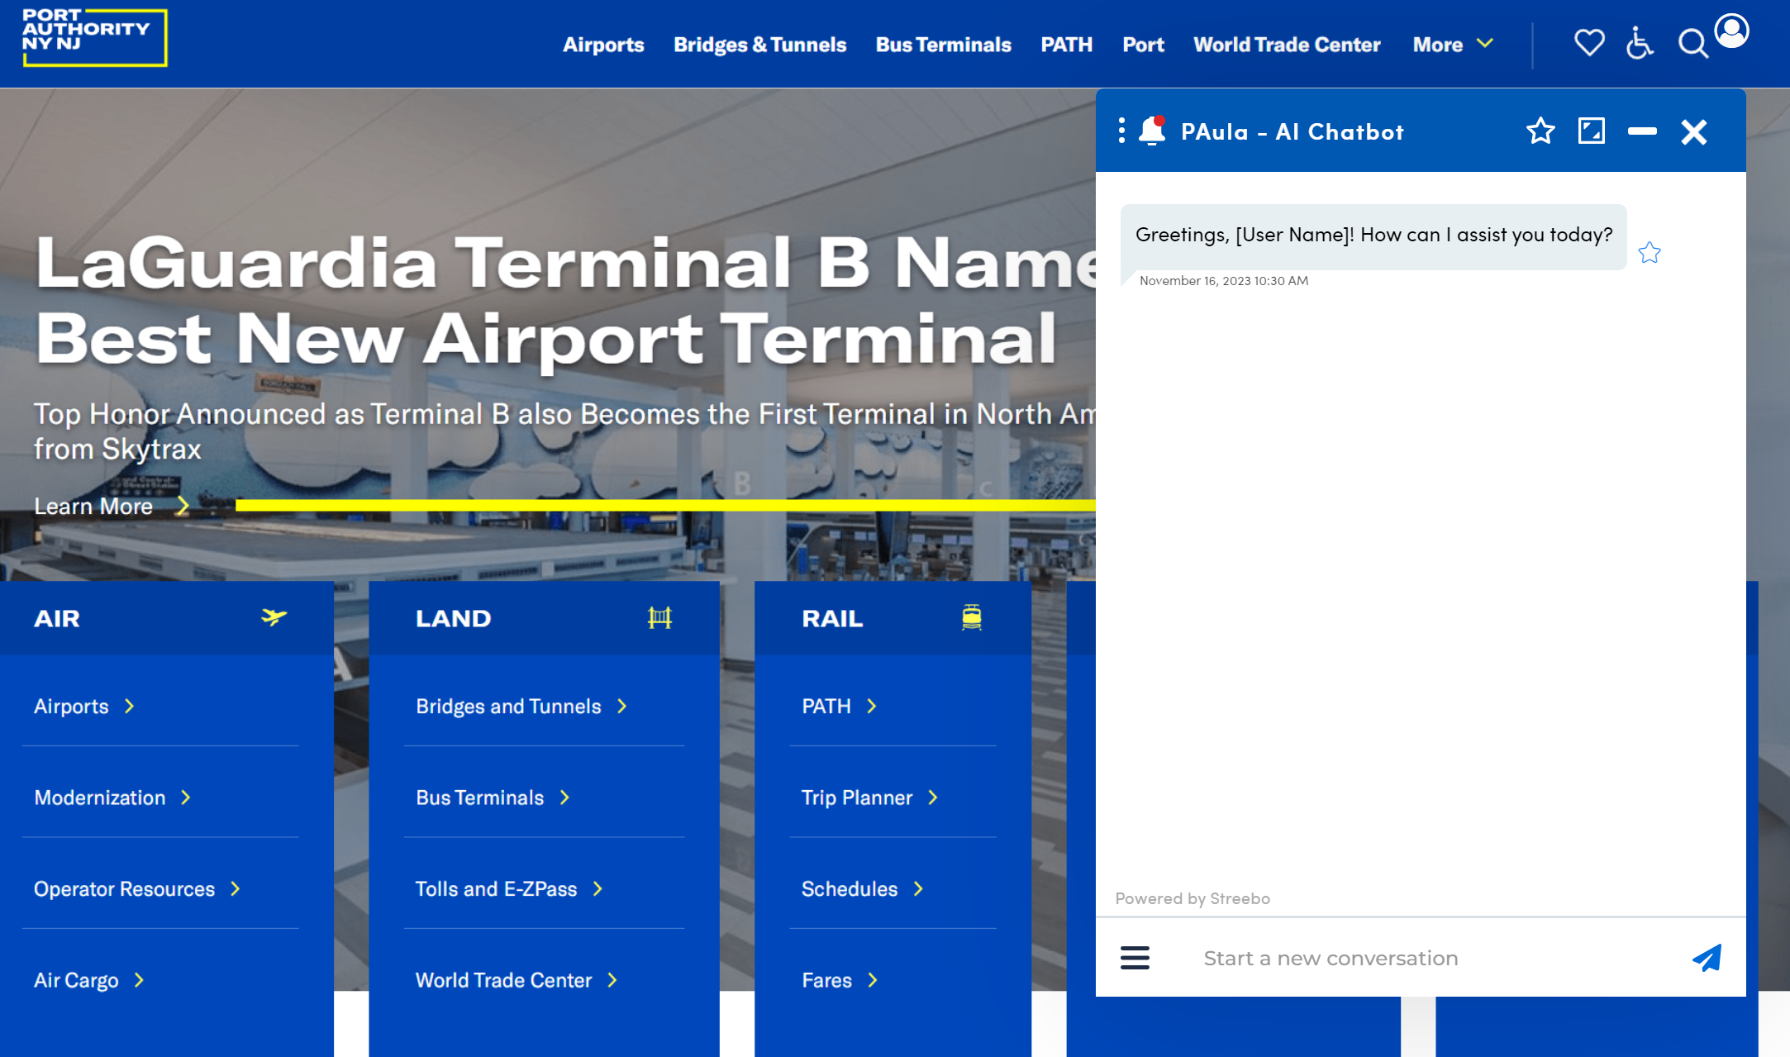
The Solution
Knowledge Management System
1
Do we want a platform that tells our people what to do, when to do it and how to do it?
2
Portal
Do we want a platform that provides everything we need to do our role, and all the insights we need to make a decision?
3
Do we want a platform that gives us accurate answers to any question about our department?
“PAula”
Virtual Assistant

Slide 27
The Solution
Guidelines
Project Directory
Workflows
Reports
Stage Activities
Costs & Schedules
Deliverables Trackers
Processes
“How do I perform an estimate?”
“What takes place in stage 3?”

Slide 28
04. Measuring Maturity and Lessons Learned

Slide 29

Maturity Roadmap
Predict & Act
      Reactive Managed Optimized
Prescriptive Analytics
Predictive Analytics
How can we make it happen?
Diagnostic Analytics
What will happen?
Descriptive Analytics
Why did it happen?
Integrated & Automated Workflows, Predictive Modeling, AI/Smart Data
What happened?
Integrated Electronic Data, Smart Workflows
Competitive Advantage
Electronic Data, Standard, Repeatable Workflows & Reports
Agile Resiliency function to respond to all stakeholder needs, e.g. customer, suppliers, finance, risk, design, construction, asset management.
Respond to real world and dynamic conditions.
Advanced analytics and learning:
  Deep learning with large language models
  Proactive assessment of conditions, trends and ‘push’ advisory for decision making
Disconnected Data, Paperless Siloed Process
Data-driven decisions making
  Direct input from the field
  Advanced KPIs
  Baseline & Benchmarking Analysis
Digital Tools, Systems and Processes with Improved Data Integrity & Quality
  Performance & Workflow Dashboards
  Integrated reporting, cost and schedule
  Forecasting using real-time data
Analog Records Raw Data
Excel formatted sheets, manually updated and controlled
Excel ‘dumps’
Paper-based Data, Non-Standard Process
Managing process by Email
Paperwork
Level 1
Level 2
Level 3
Level 4
Level 5
Digital Capability

Slide 30
Lessons Learned
1
Create a department policy and guidelines around innovation and improvement initiatives
2
Develop a ‘shared services’ approach to managing resources for innovation and improvement initiatives
3
Have clear accountability and ownership, with a delineation for innovation and business-as-usual
4
Identify current state baseline to enable progress monitoring and calculation of return-on-investment
5
Establish senior leadership champions to enable the development, and scaling up, of improvement initiatives
6
Act fast when recommendations are made
7
Find the intrinsic value for every human being involved!

