Slide 1
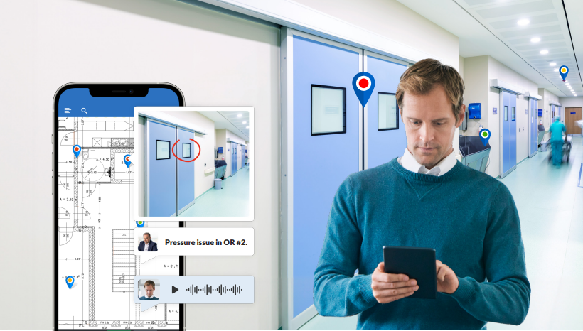

App-solute
Efficiency
Harnessing Mobile Tech to
Future-Proof
Healthcare Facilities
Booth #260
Notes:
*** PlanRadar – image to be updated ***

Slide 2
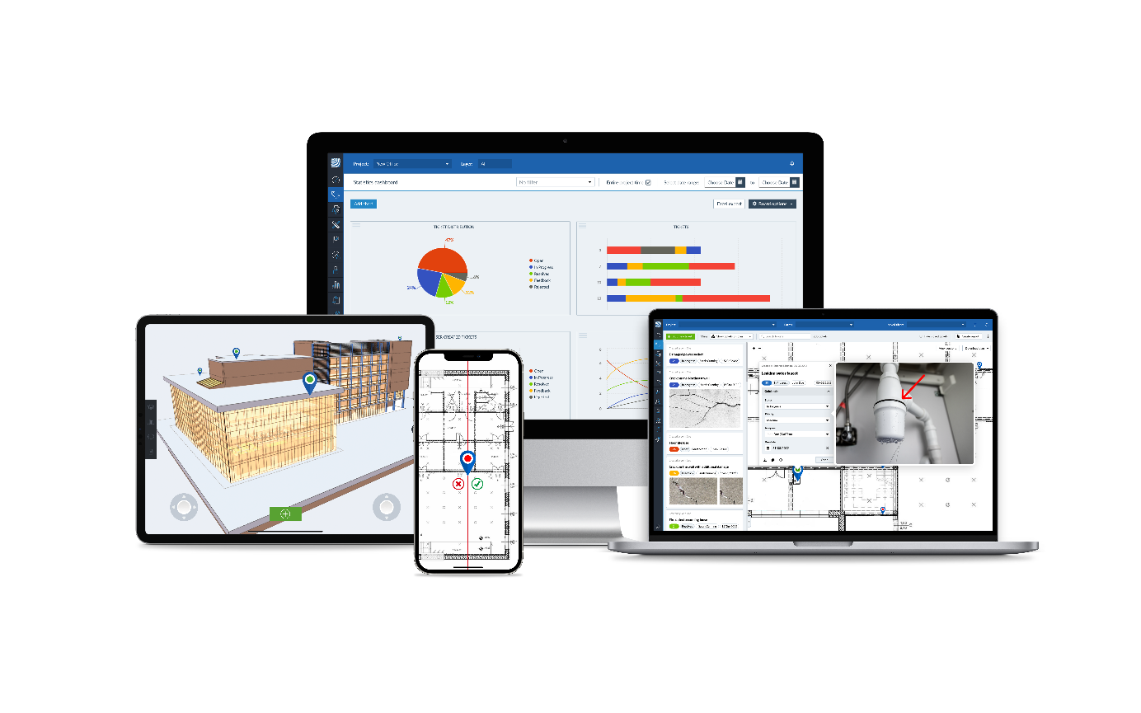
2024
PlanRadar Company Profile
Our Mission
We make working together easier.
Our Vision
For every building and asset in the world to be constructed and operated with a digital solution.
400+
16
150k+
75+
Employees
Global Locations
Users Worldwide
Countries
Notes:
*change image

Slide 3

Who benefits?
Speciality
Contractors
Protect your margins & guarantee compliance
General
Contractors
Keep the build on-time and on-budget
Facility- &
Property Managers
Manage and optimise your property operations with smart insights
Owners & Developers
Increase profitability with full project oversight, visibility and control
Architects
Get work delivered
to match the design
Engineers
Ensure project compliance every time

Slide 4
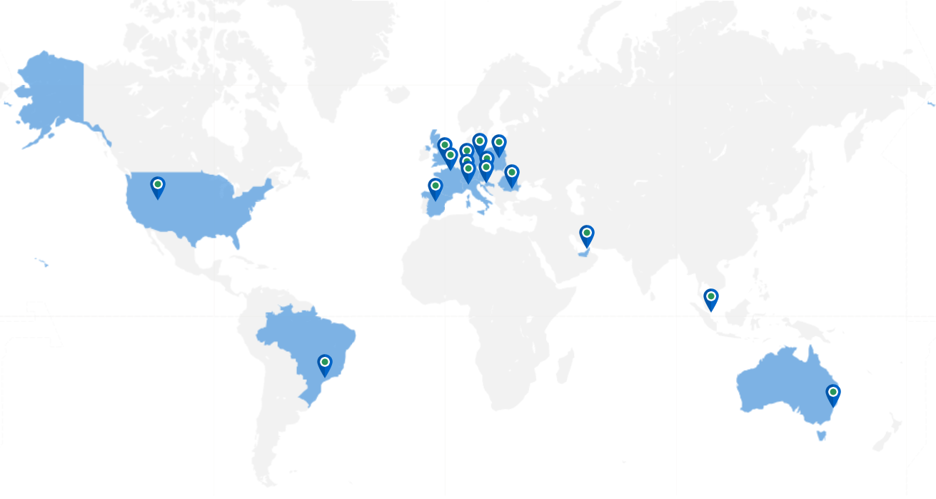






Some of Our Valued Customers
Notes:
**Do you want just US clients or do you want to showcase o

Slide 5

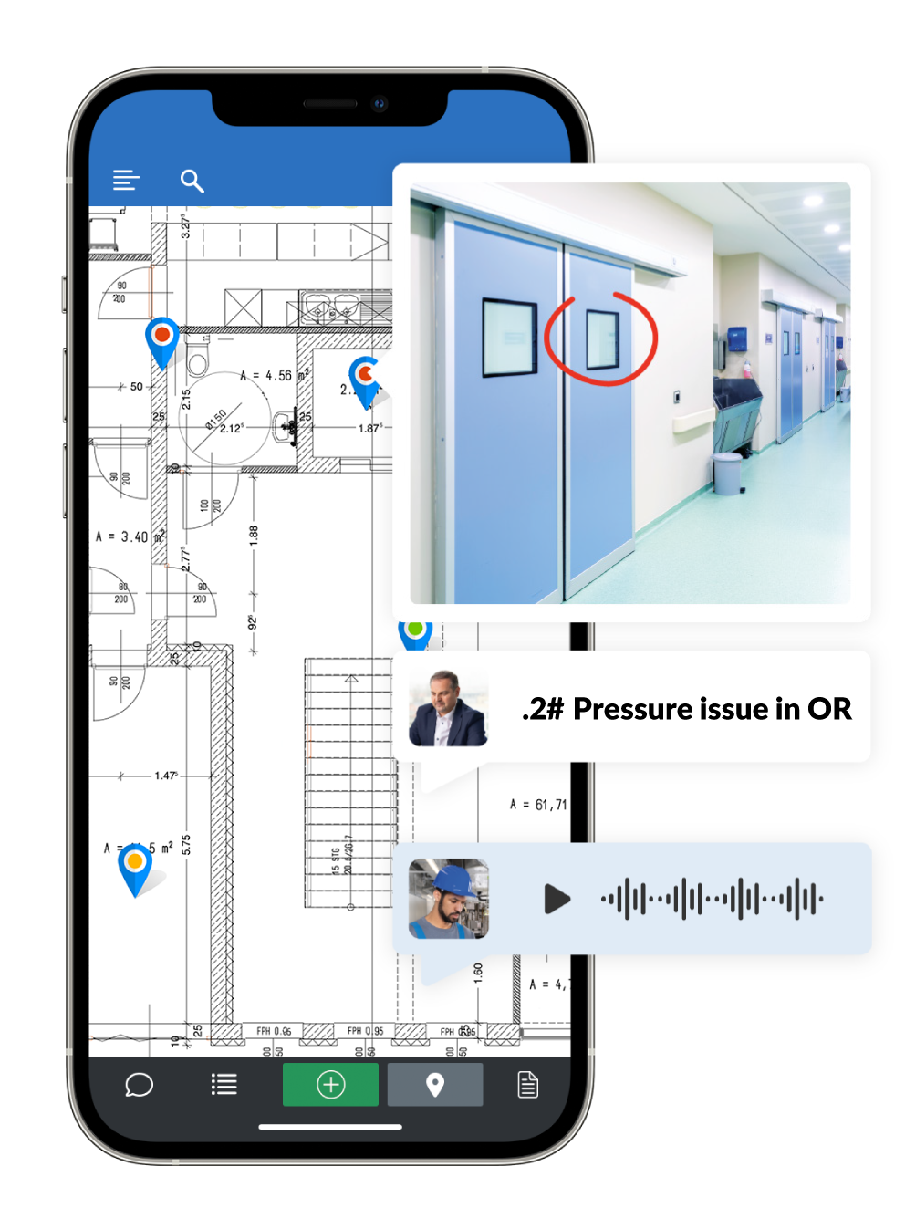
Outdated Methods for Documenting
Deficencies
Before PlanRadar: No automation
Write issue/deficiency
Create report without tracking capabilities
Send email with issue and photos to responsible party
Follow-up on completion
Go back to report and document issue closed
Notes:
*change image

Slide 6
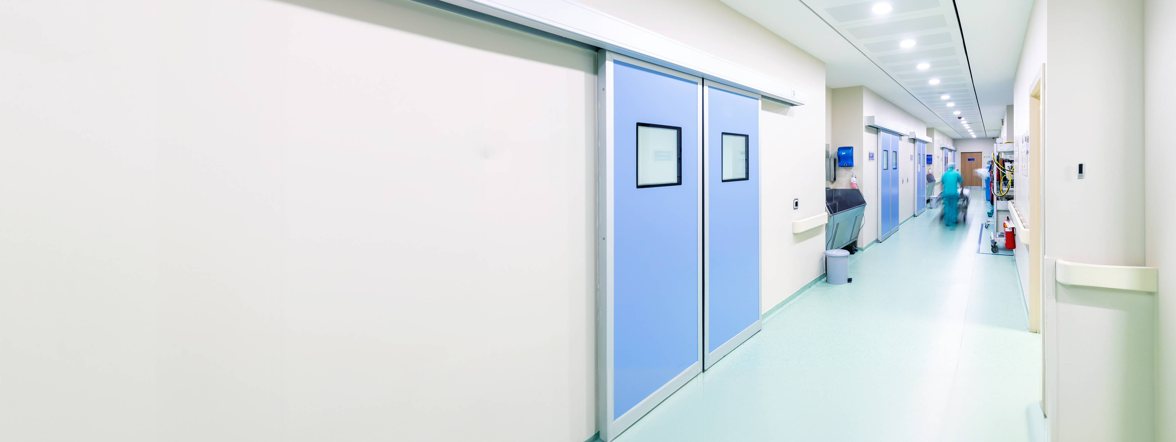




Why PlanRadar?
"PlanRadar's digital platform has revolutionized our approach to surveying hospital facilities, replacing the traditional pen and paper method with an efficient and streamlined solution. The platform's capabilities have simplified the entire survey process, offering significant benefits in issue identification, tracking, and resolution. Through real-time updates and seamless communication, all parties involved are constantly informed, eliminating redundancies and alleviating the workload for our dedicated hospital facilities teams."
Easy to use app to track and resolve compliance issues in healthcare facilities
Go Digital!
No More Paper and Pencil!
Accessible
Works on any internet connected computer through your browser as well as any mobile device on iOS, Android and Windows online and offline
Customizable
Able to make the platform yours with workflows, checklists, reports and terminology
Easy to Use
Be up and running on the platform fast with easy-to-use interface and support
Notes:
*change image

Slide 7




Streamlining Compliance
Taking your business
to the next level
A one-of-a-kind platform
Trustworthy
Built for you and free
to configure at any time
Quick onboarding means no
down time
Easy to use interface, with 3 click maximum navigation
Free live web training
Upscale easily at anytime
Superior integration capabilities
Tamperproof audit trail
Security & data privacy: AWS – 2 factor authentication, SSO
GDPR & ISO compliant
Gold standard support program
Generate PDF reports quickly from your mobile device
No more paper and pencil
Unlimited free of charge subcontractors and stakeholders
Notes:
Add more buzz words i.e. NFPA 10, TJC, Life Safety Codes…

Slide 8
Healthcare Compliance Examples
NFPA 101 Life Safety Code
NFPA 99 Health Care Facilities Code
NFPA 13 Sprinkler Heads
NFPA 70E Electrical Workplace Safety
NFPA 72 National Fire Alarm Code
NFPA 96 Kitchen Fire Protection
NFPA 80 Fire Doors
NFPA 88A Garages & Parking Structures
EC.02.03.05 Fire Protection and Suppression Testing and Inspection
EC.02.05.07 Emergency Power Systems are Maintained and Tested
EC.02.05.09 Medical Gas and Vacuum Systems are Inspected and Tested
EC.02.03.05 Fire Protection
EC.02.03.03 Fire Drills
EC.02.05.01 Manages Risks Associated with Utility Systems
EC.02.05.02 Manages Risks Associated with Utility Systems – Water Mgmt
EC.02.04.01 Management of Medical Equipment Risks
EC.02.04.03 Medical Equipment Inspection, Testing, and Maintenance
EC.02.05.05 Utility System Inspection, Testing, and Maintenance
EC.02.06.01 Built Environment
EC.04.01.05 Hospital Improves its Environment of Care
EC.02.06.01 Kitchen Equipment Inspection
LS.01.01.01 Buildings Serving Patients comply with NFPA 101
LS.01.02.01 Interim Life Safety Measures
LS.02.01.20 Means of Egress
LS.02.01.35 Automated Suppression

Slide 9

Compliance and Survey Lifecycle
Continuous Survey Readiness MODEL
Initial Survey
Facility Action
Follow-up and Education
Mock Survey
SOC Review
Utilities Management review
EC Issues
Document review
Submission of Report
Client has access to PlanRadar
Facility performs corrective action
Consultant reviews progress offsite
Internal communication and correction between stakeholders
Follow-up review/survey
Educated staff on issues
Ability to identify vulnerbilities
START CYCLE AGAIN
Notes:
Circle back with Bob about these words

Slide 10
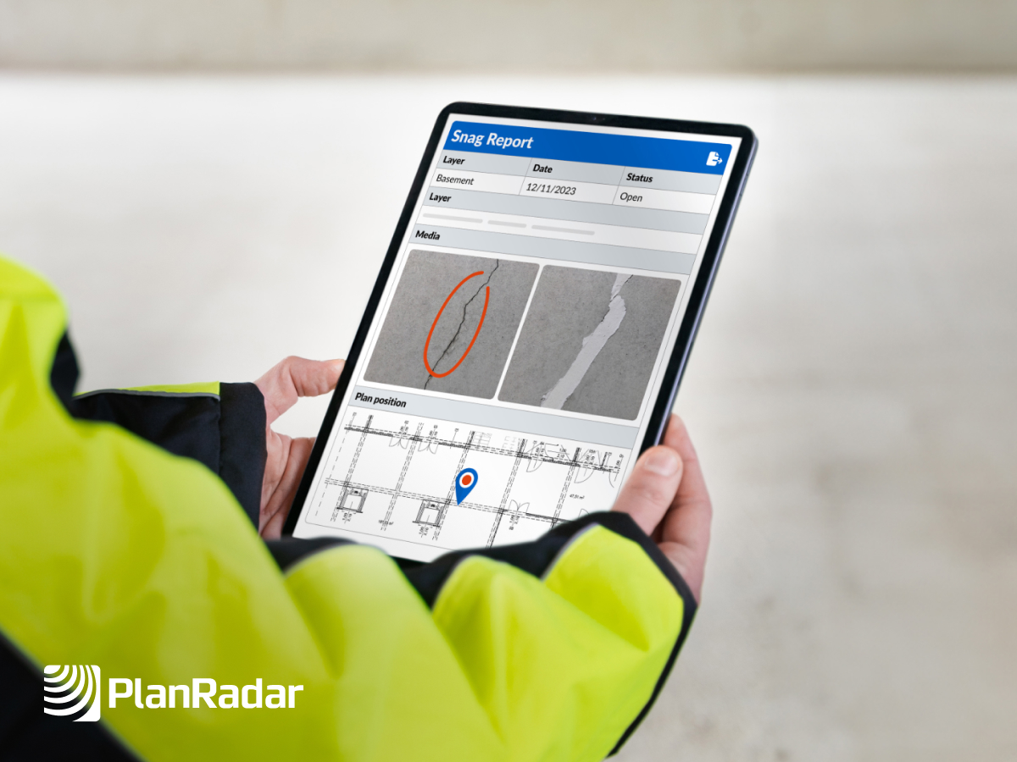
Paperless Process
Survey Preparedness, EC Rounds, LS Surveys
Document issues as they are found
Send to responsible party immediately, not in days
Track and close
Efficient processes with digital site diary
Photo evidence
Ability to create a digital report immediately

Slide 11
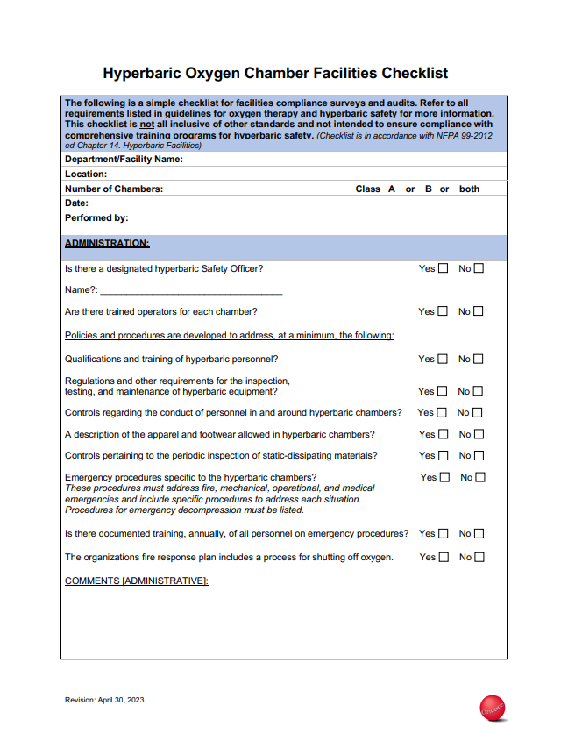
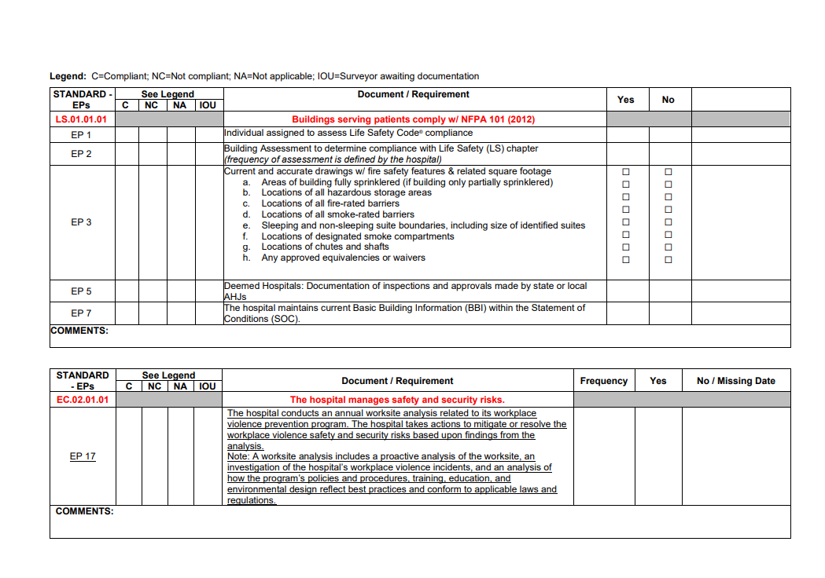
Custom Aplications
-Construction Rounds
-ICRA, ILSM
-Compliance Checklists
-Condition reports
-Custom Report Format

Slide 12
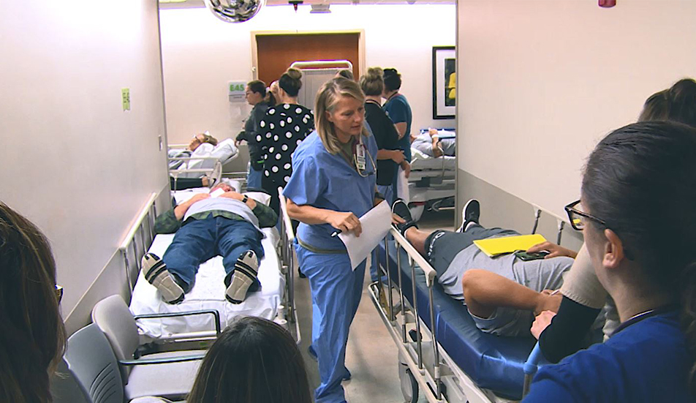
Real Time Tracking
Effective method for tracking issues during survey or disastersS during TJC Surveys
Communication with ICS during TJC Surveys
Communication with ICS during disasters
"We're not just in the business to ensure compliance; we're here to guarantee safety. With PlanRadar, we can perform real-time reporting and trigger immediate action on life safety issues in healthcare facilities. This isn't just about meeting standards; it's about saving lives."
Notes:
*change image

Slide 13




Thank you!
Visit Booth #260

