Slide 1
Healthy Sustainable Practices Addressing the Housing Crisis
February 13th 11:00
Notes:
YES—11:00AM

Slide 2
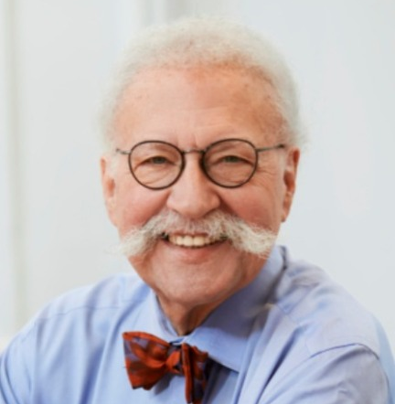
Theodore Liebman
FAIA
Principal, Perkins Eastman Architects
Bd. Member CSU, Sr. Fellow GUD,
Exec.Bd NGO CSD-NY/Urban Cluster

Slide 3
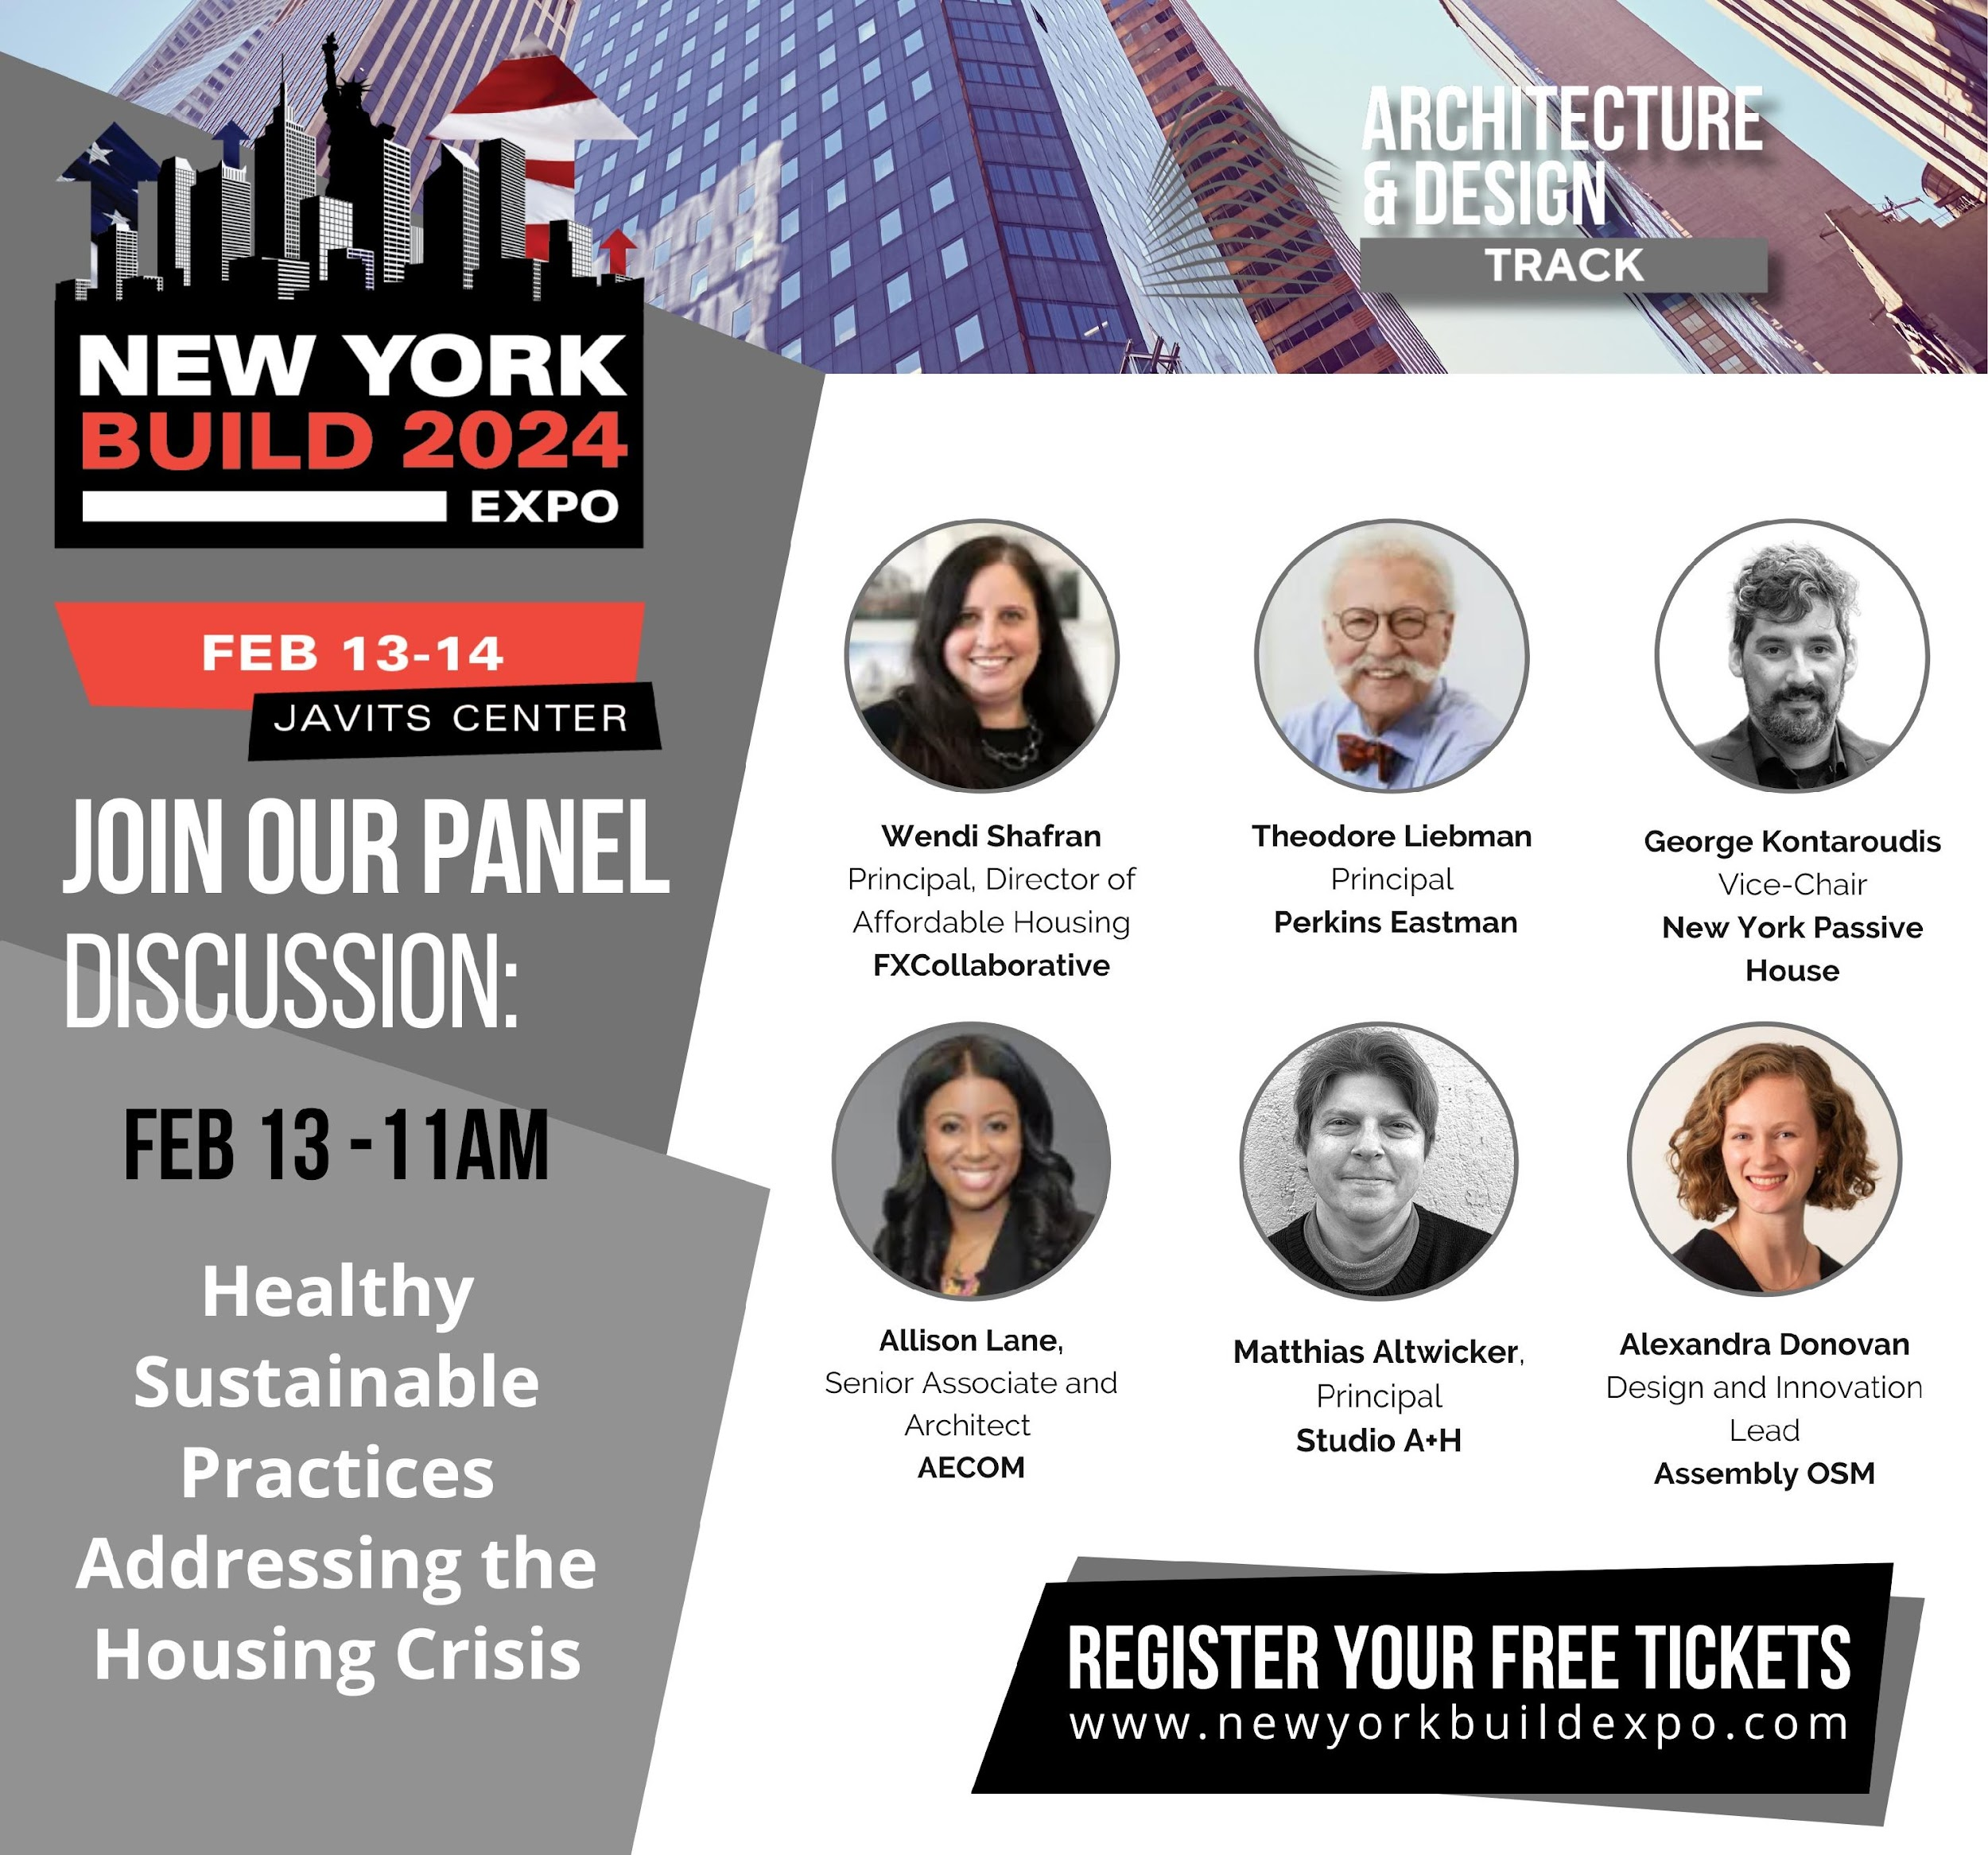
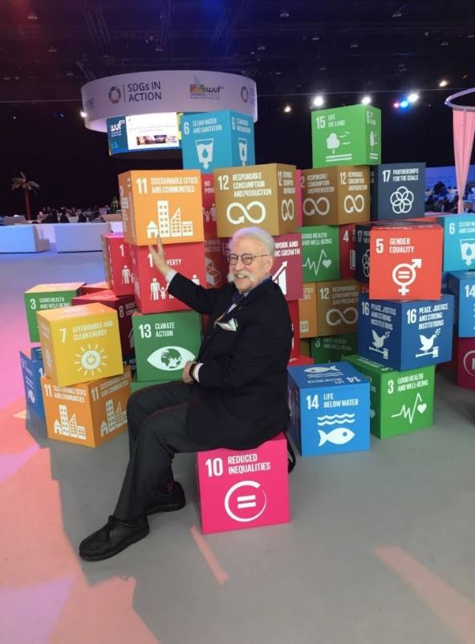
Local & Global Challenges
To Ponder:
To Achieve Healthy Sustainable Practices
as We Address the Housing Crisis
THEODORE LIEBMAN, FAIA
Principal, Perkins Eastman Architects
Bd. Member CSU, Sr. Fellow GUD,
Exec.Bd NGO CSD-NY/Urban Cluster
Notes:
‹#›

Slide 4
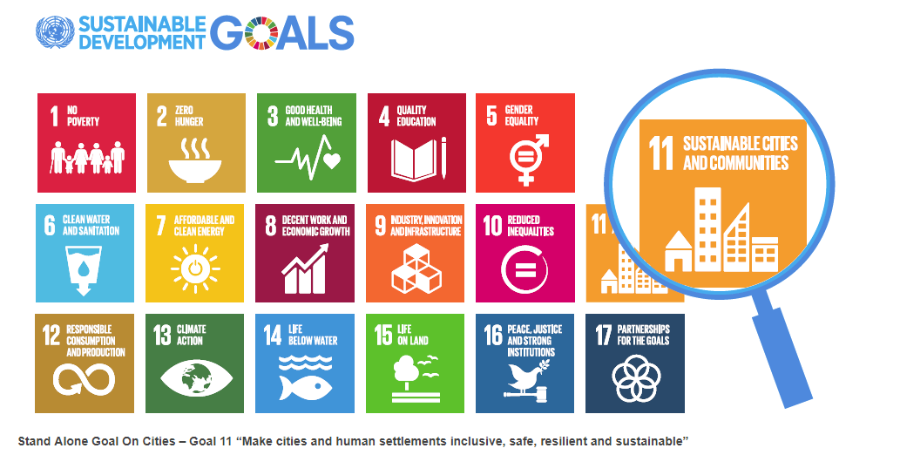
Global Sustainability Issues: UN Habitat SDG 11
Housing Density Issues/Solutions
Global Sustainability Issues: UN Habitat SDG 11
Housing Density Issues/Solutions
Global Sustainability Issues:
Understanding Housing Density
Urban Housing Models
THEODORE LIEBMAN, FAIA
Principal, Perkins Eastman Architects
Bd. Member CSU, Sr. Fellow GUD,
Exec.Bd NGO CSD-NY/Urban Cluster
Notes:
‹#›

Slide 5
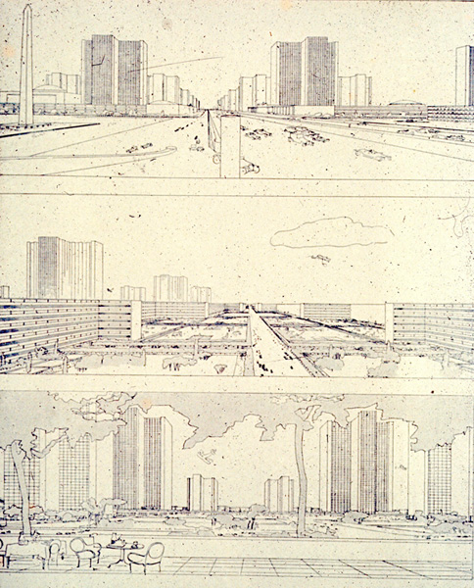
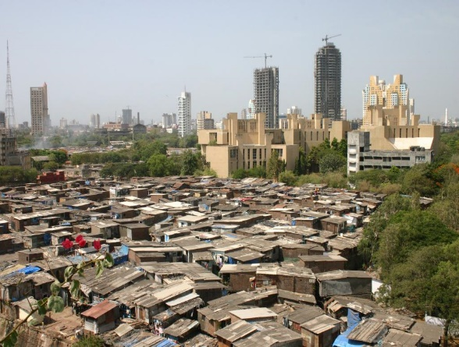
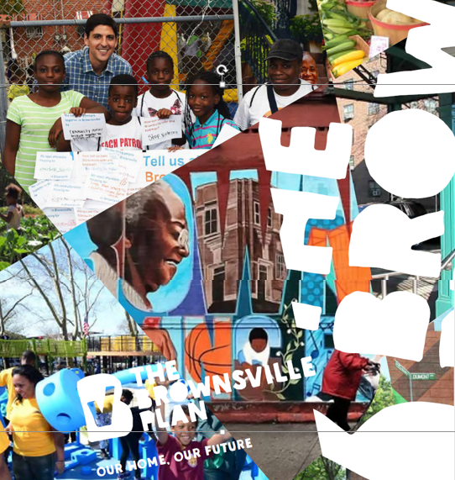
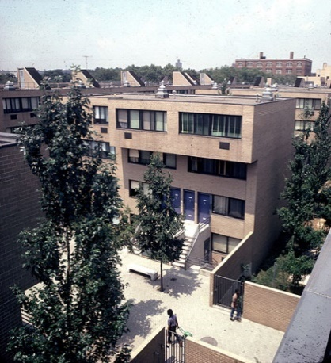
We must understand the Limits of Land and Natural Resources on our Planet . Let this Knowledge Guide us to BUILD BETTER CITIES for our Rapidly Changing World
HOW CAN WE ACHIEVE QUANTITY in NUMBERS (people/ acre) and QUALITY (LIVABILITY- WELLNESS- AFFORDABILITY- ECONOMIC VITALITY) IN OUR HOUSING, OUR NEIGHBORHOODS & OUR FUTURE URBAN COMMUNITIES ?
Notes:
‹#›

Slide 6
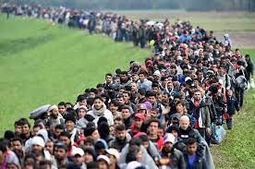
CLIMATE POPULATION MASS MIGRATION
CHANGE GROWTH WORLDWIDE
Rising Temperature, Forest Fires, Sea Rise, Storm Surge & Weather Extremes are occuring Worldwide.
By 2030–6 in 10 People will be Urban Dwellers
Notes:
‹#›

Slide 7
CITIZEN ENGAGEMENT/CULTURE/COMMUNITY
LISTEN to the needs and aspirations of All
Encourage Participation of all Stakeholders in our City
Notes:
‹#›

Slide 8
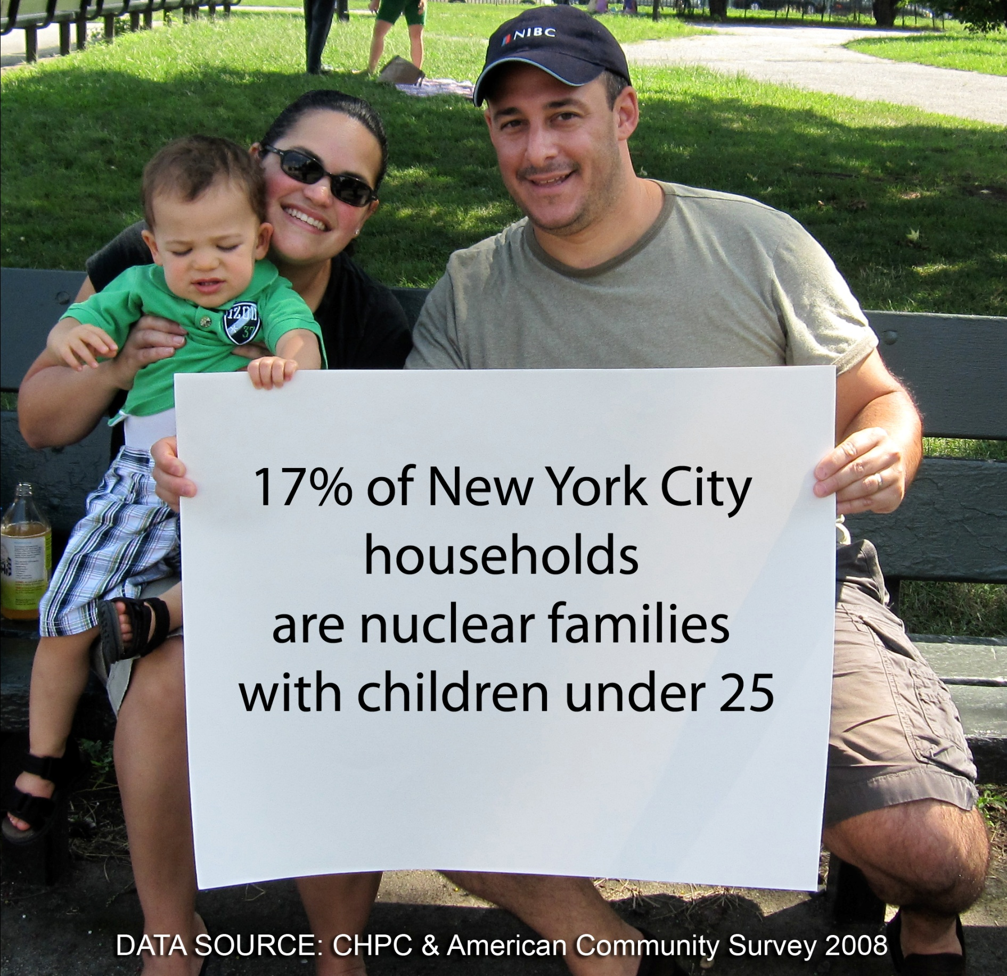
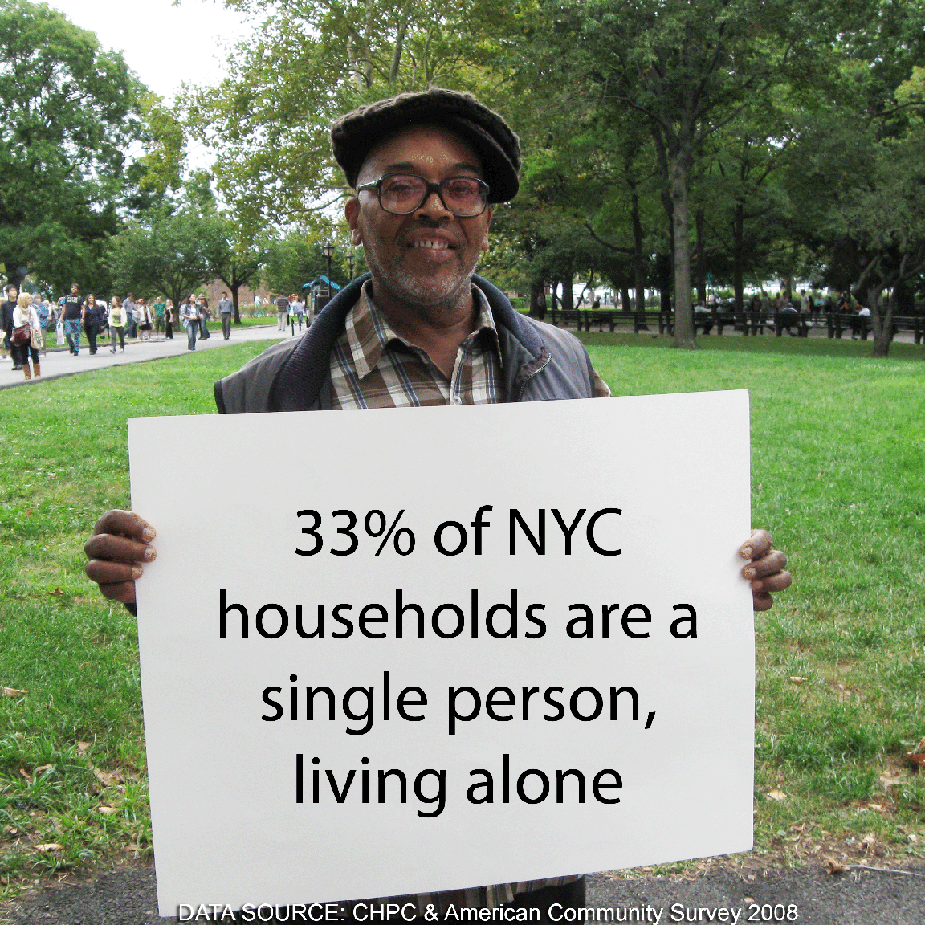
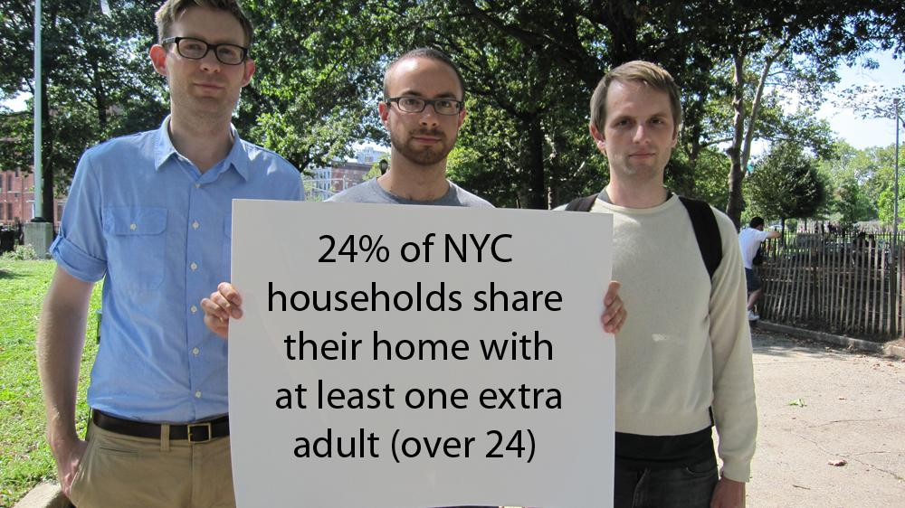
CHANGING HOUSEHOLDS
Notes:
‹#›

Slide 9
UNDERSTANDING DENSITY
HIGH-RISE MODEL -
OFTEN FEELINGS of ANONYMITY, ISOLATION & DYSFUNCTION in DENSE HIGH-RISE COMMUNITIES
INFORMAL COMMUNITIES –
OFTEN SOCIAL/ECONOMIC VITALITY –BUT NEED
for CITY SERVICES, HEALTH & LEGAL ISSUES
Notes:
‹#›

Slide 10
WE MUST CREATE HOUSING IN INNOVATIVE SUSTAINABLE COMMUNITIES RESPONSIVE
TO SDG 11.
MAKE CITIES AND HUMAN SETTLEMENTS INCLUSIVE, SAFE, RESILIENT AND SUSTAINABLE
Notes:
‹#›

Slide 11
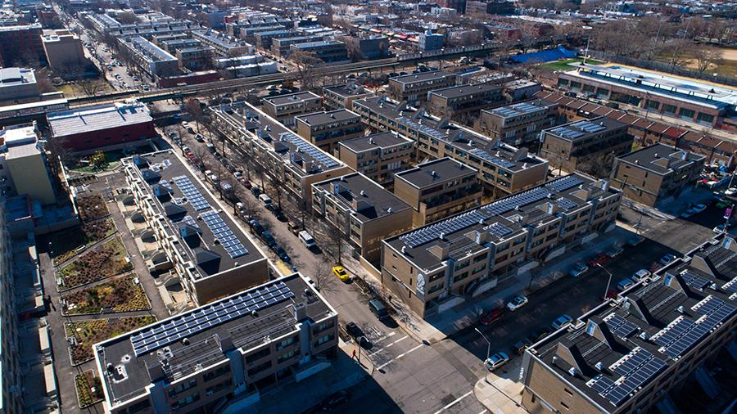
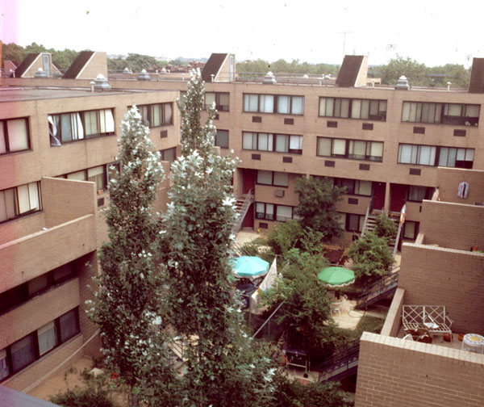
Low-Rise High Density Housing in Walkable Communities will Create a Better Quality of Life for Cities
Low-Rise doesn’t always
mean Low Density
Marcus Garvey Park Village,
Brooklyn, New York
Mews View
Notes:
‹#›

Slide 12
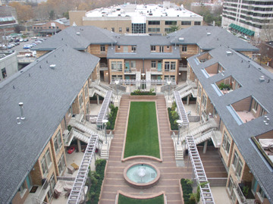
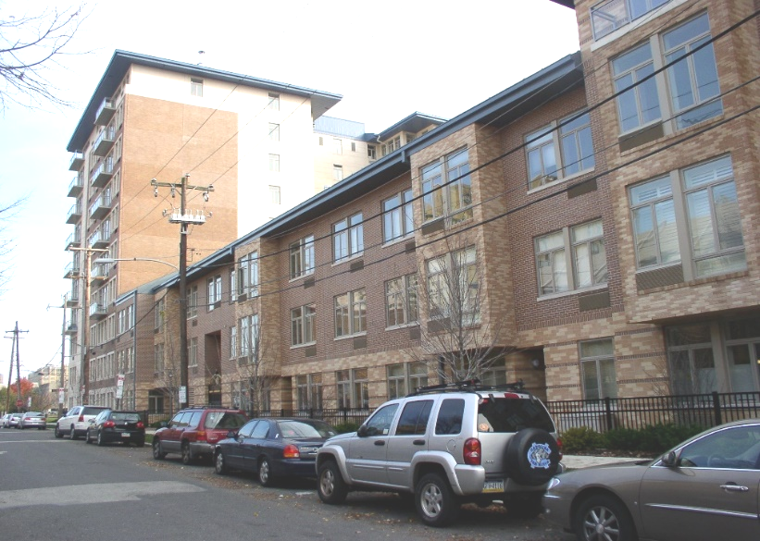
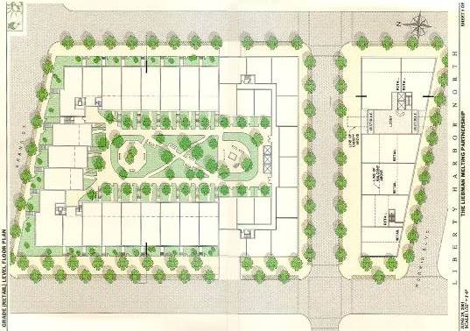
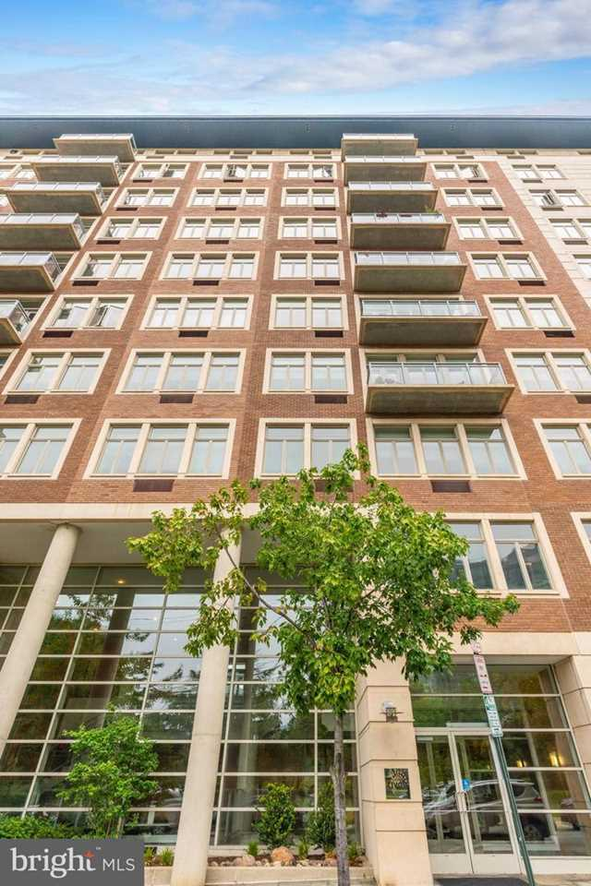
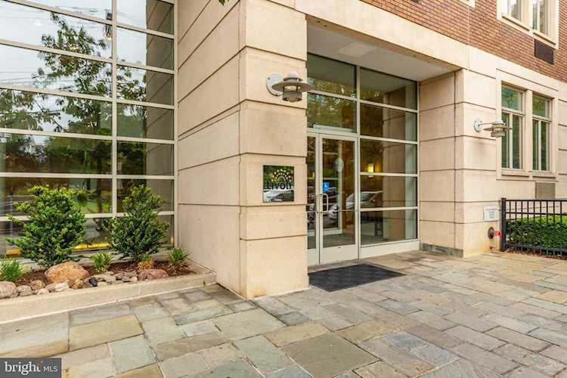
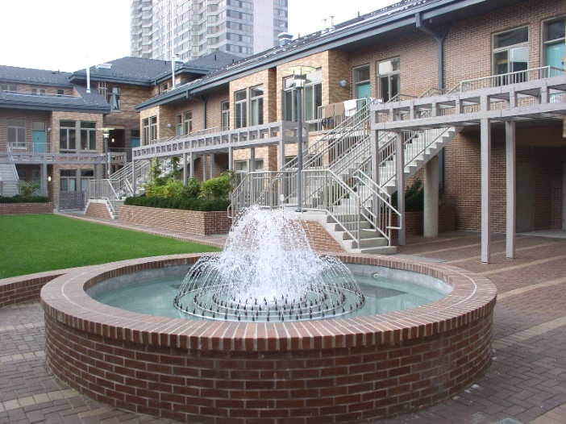
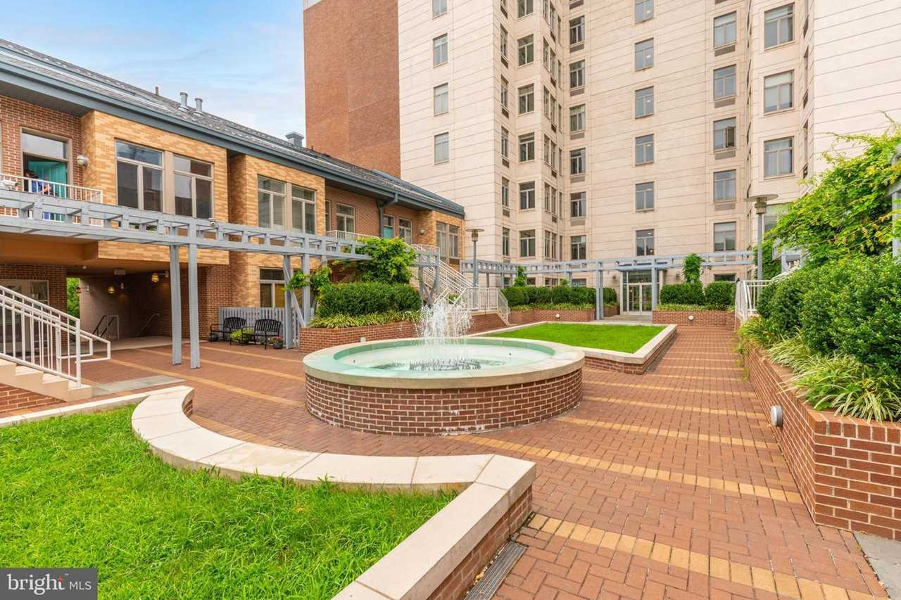
TIVOLI RESIDENTIAL PHILADELPHIA, PA
LOW-RISE TOWNHOUSES & MID- RISE RESIDENTIAL SHARING A COURTYARD
*HIDE THE CAR
*CREATE ACTIVE STREETS
*EVERY DOOR A FRONT DOOR
*CREATE USABLE COURTYARD
80 DU/ACRE
Notes:
‹#›

Slide 13
EQUITY / EQUALITY / INCLUSION
HOUSING
HEALTH
ECONOMY
CULTURE
JUSTICE
WORK
EDUCATION
Notes:
‹#›

Slide 14
LET’S USE OUR EXPERTISE & OUR HUMANITY TO PLAN OUR CITIES & CREATE A MORE SUSTAINABLE & INCLUSIVE WORLD !!
Thank You!!
THEODORE LIEBMAN, FAIA
Principal, Perkins Eastman Architects
Bd. Member CSU, Sr. Fellow GUD,
Exec.Bd NGO CSD-NY/Urban Cluster
Notes:
‹#›

Slide 15
Notes:
‹#›

Slide 16
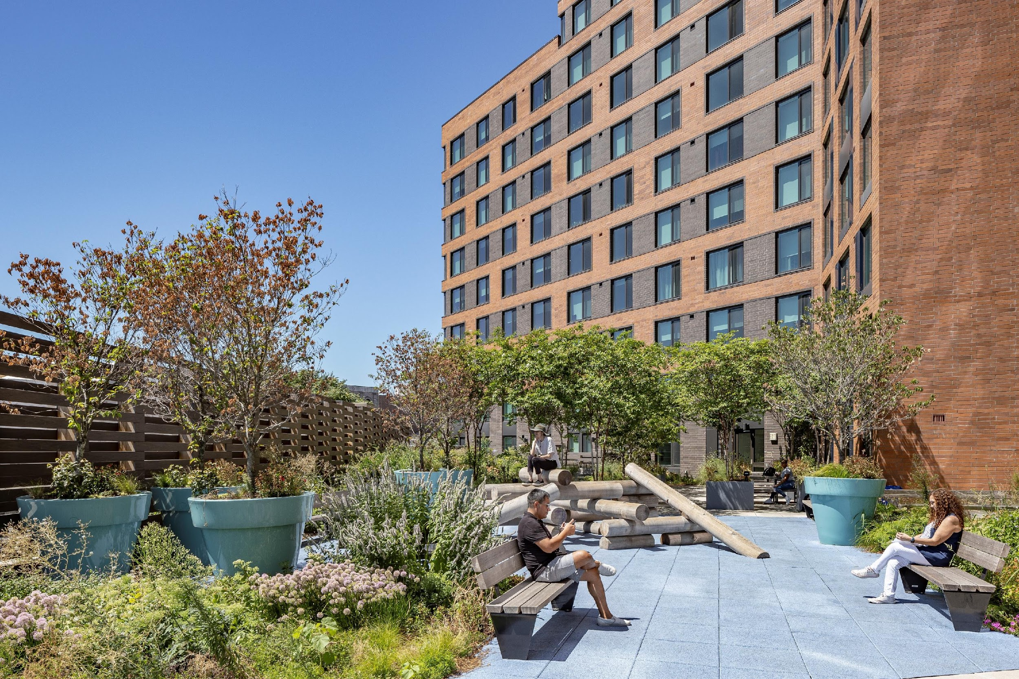
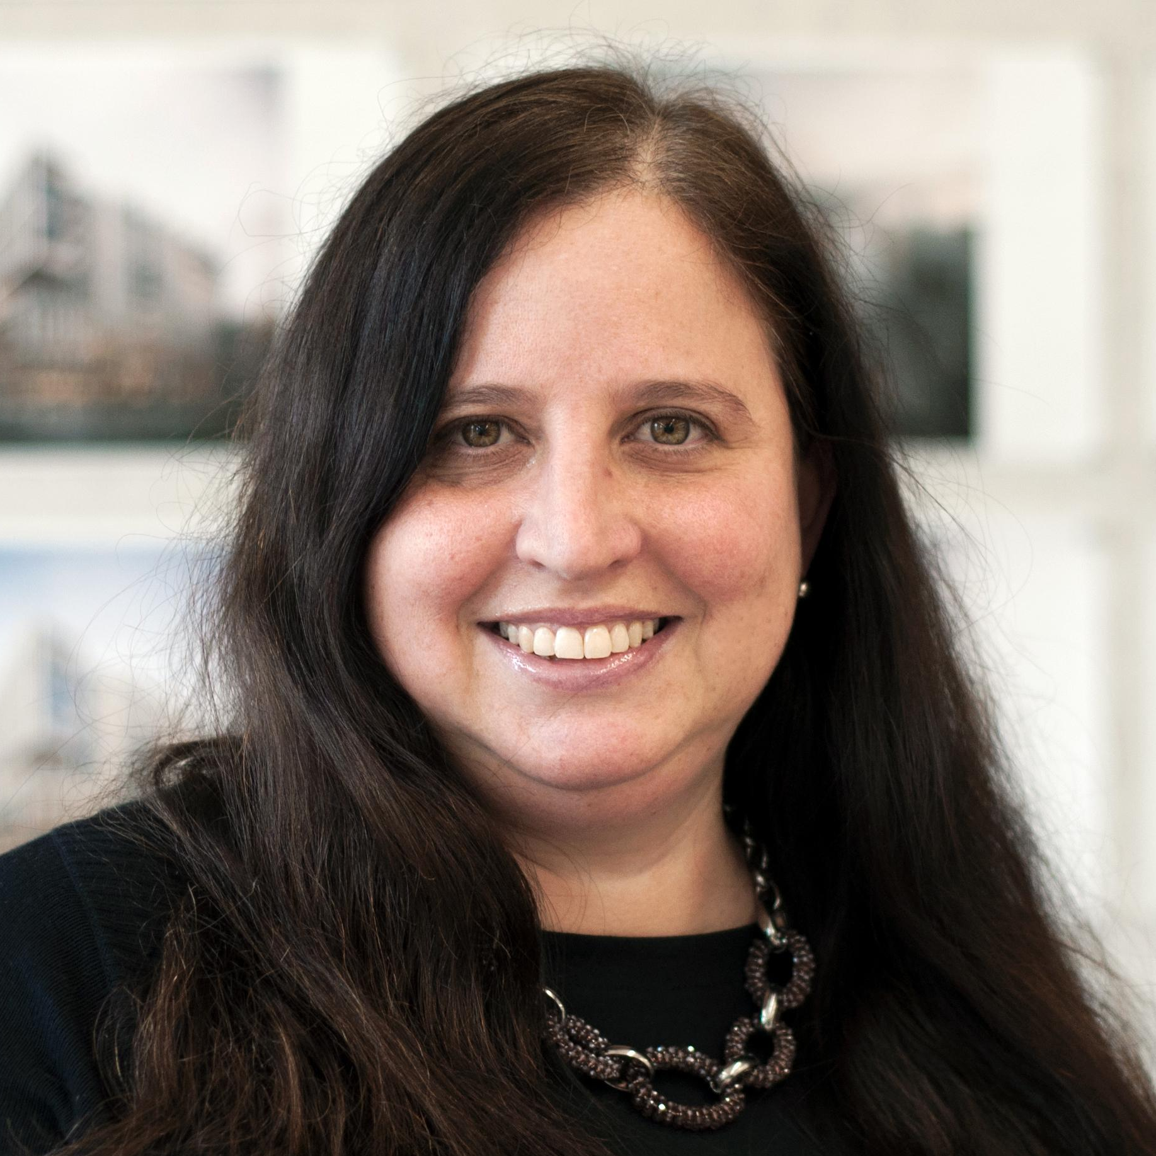
Wendi Shafran
AIA, LEED AP
FXCollaborative
Principal, Director of Affordable Housing

Slide 17
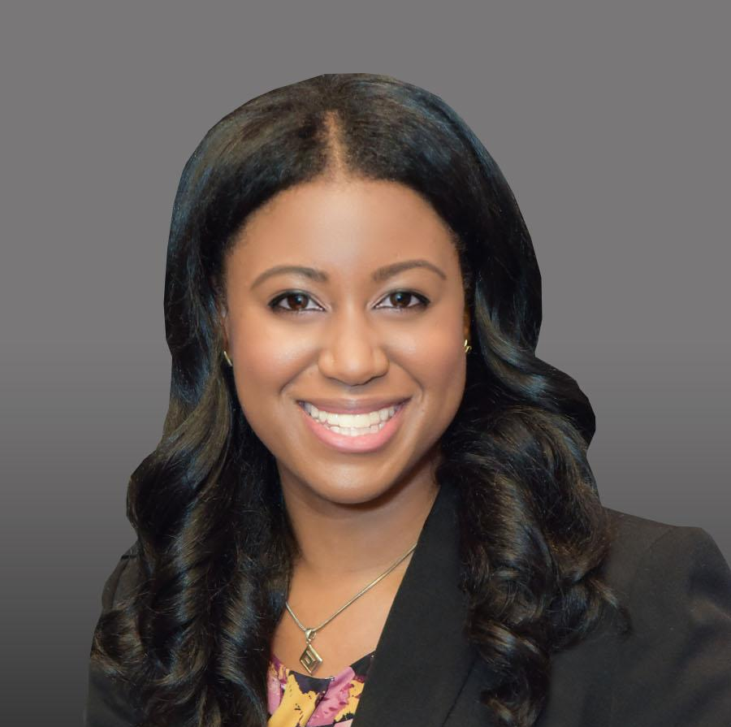
Allison E. Lane
AIA, ASID, NOMA, LEED AP BD+C, WELL AP, NCARB, NCIDQ
AECOM
Senior Associate, NYCHA / Multifamily Lead
nycoba|NOMA
President, 2023-2024
aecom.com
nycoba.org

Slide 18
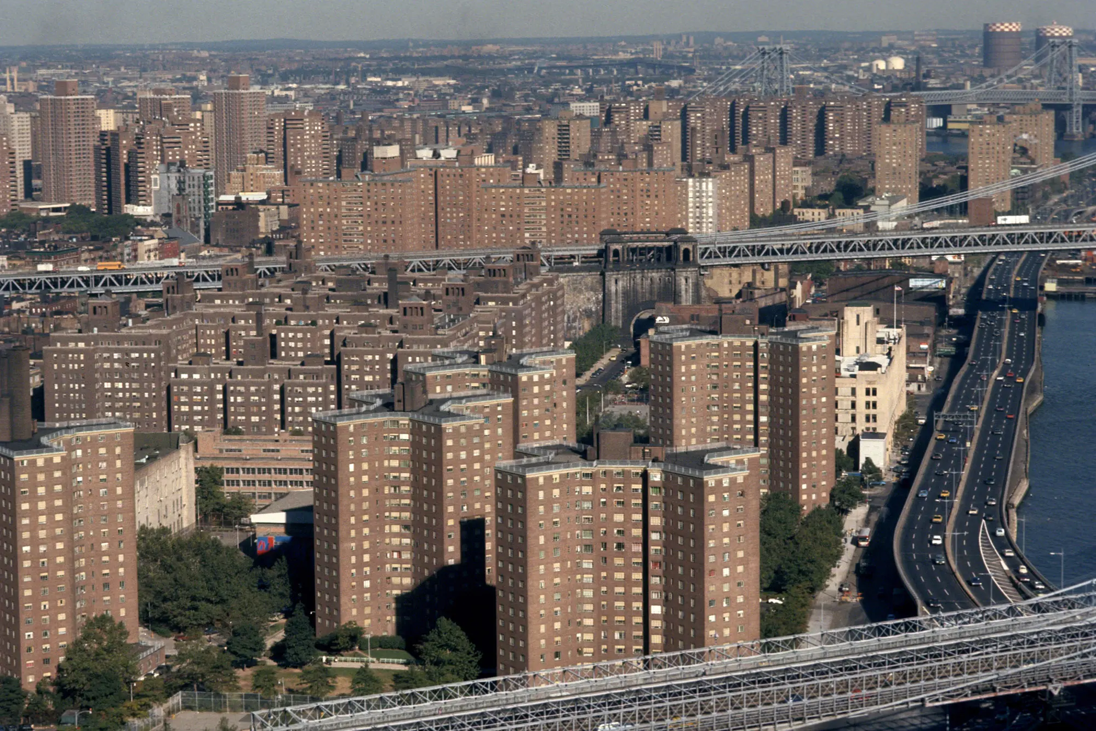
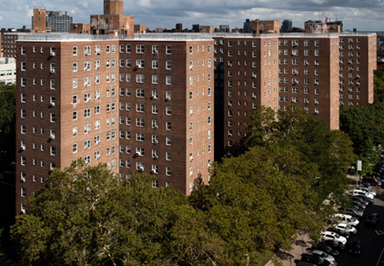
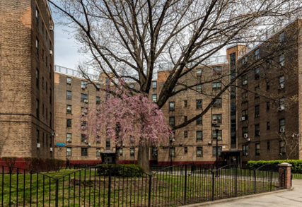
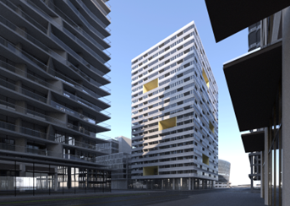
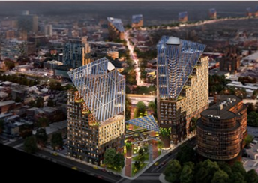
NYCHA / Multifamily Studio:
Diverse Scales . Comprehensive Modern Rehabilitation . Sustainable New Developments

Slide 19
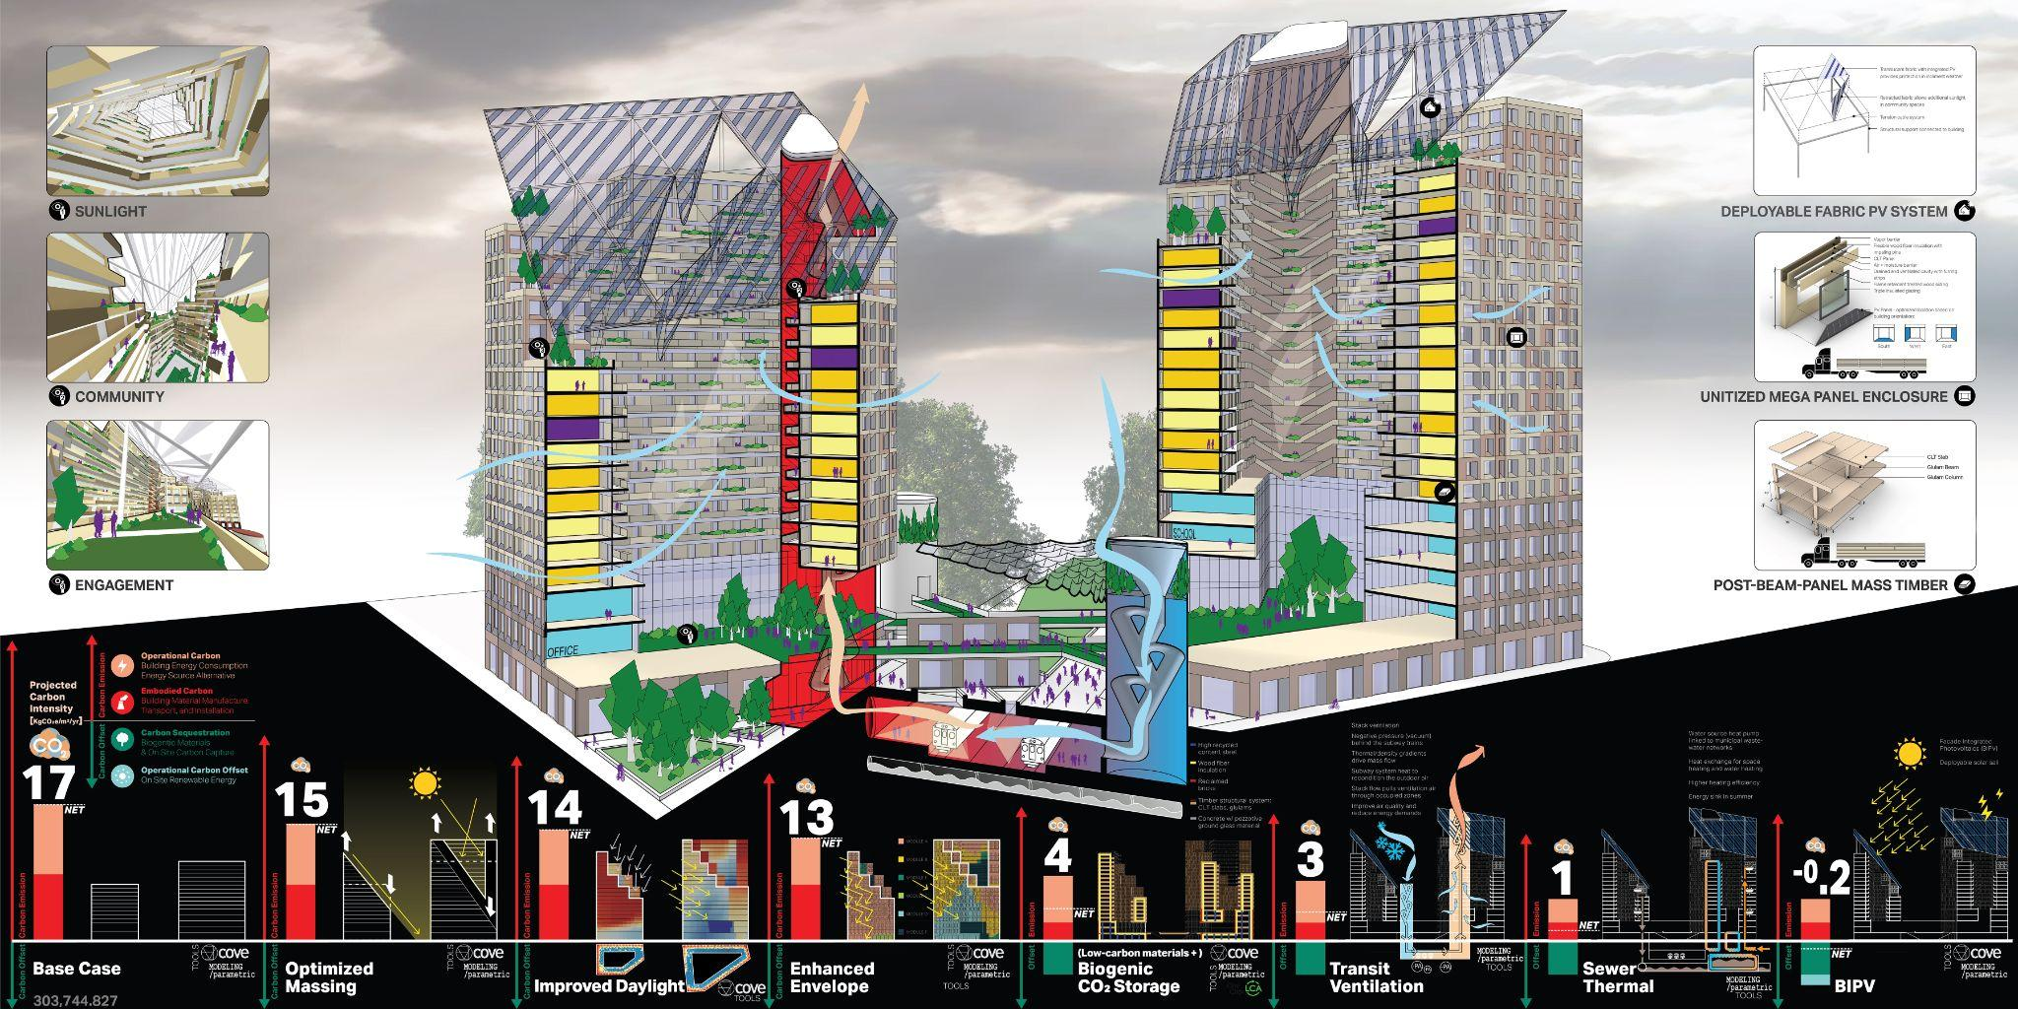
Philadelphia Net-Zero Case Study:
Transit Oriented Development . Carbon Positive. Social Housing

Slide 20
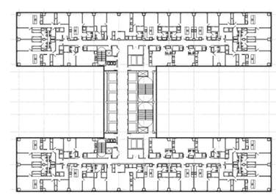
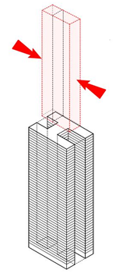
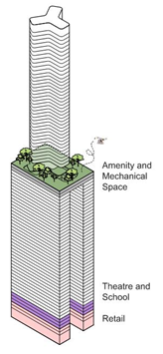
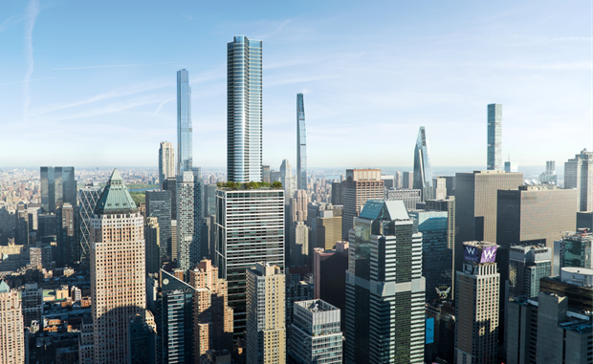
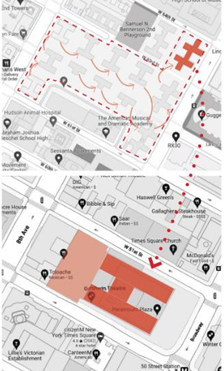
Office to Residential Case Study:
Mixed Income. Mixed Use. Adaptive Reuse

Slide 21
George Kontaroudis
AIA, LEED AP BD+C, CPHD
kw/h architecture
Principal Architect
New York Passive House
Vice-Chair

Slide 22
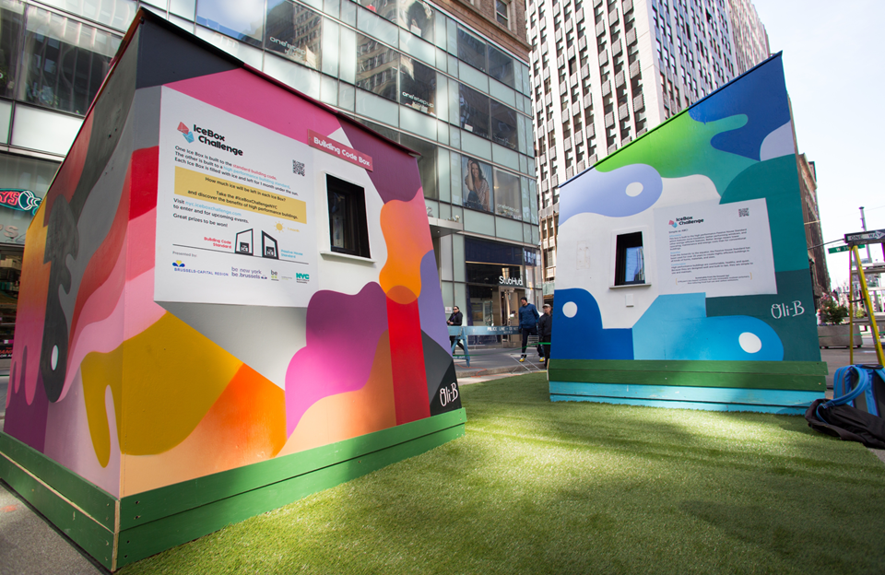
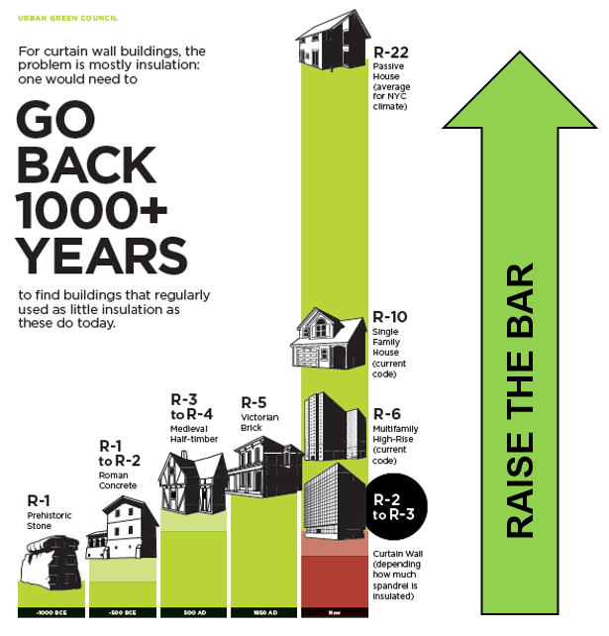
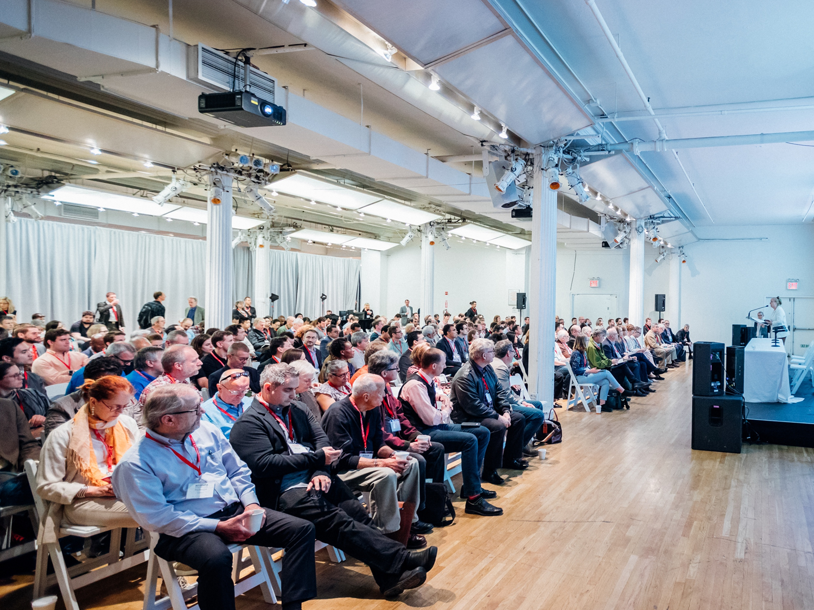

Slide 23
Notes:
6) Alexandra Donovan, Design and Innovation Lead - Assembly OSM

Slide 24
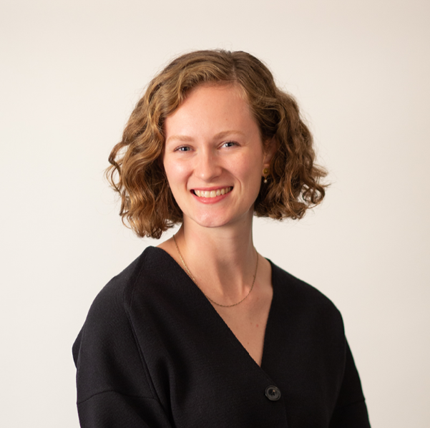
Alexandra Donovan
Assembly OSM
Design & Innovation Lead

Slide 25
SCALING URBAN DEVELOPMENT
2023

Slide 26
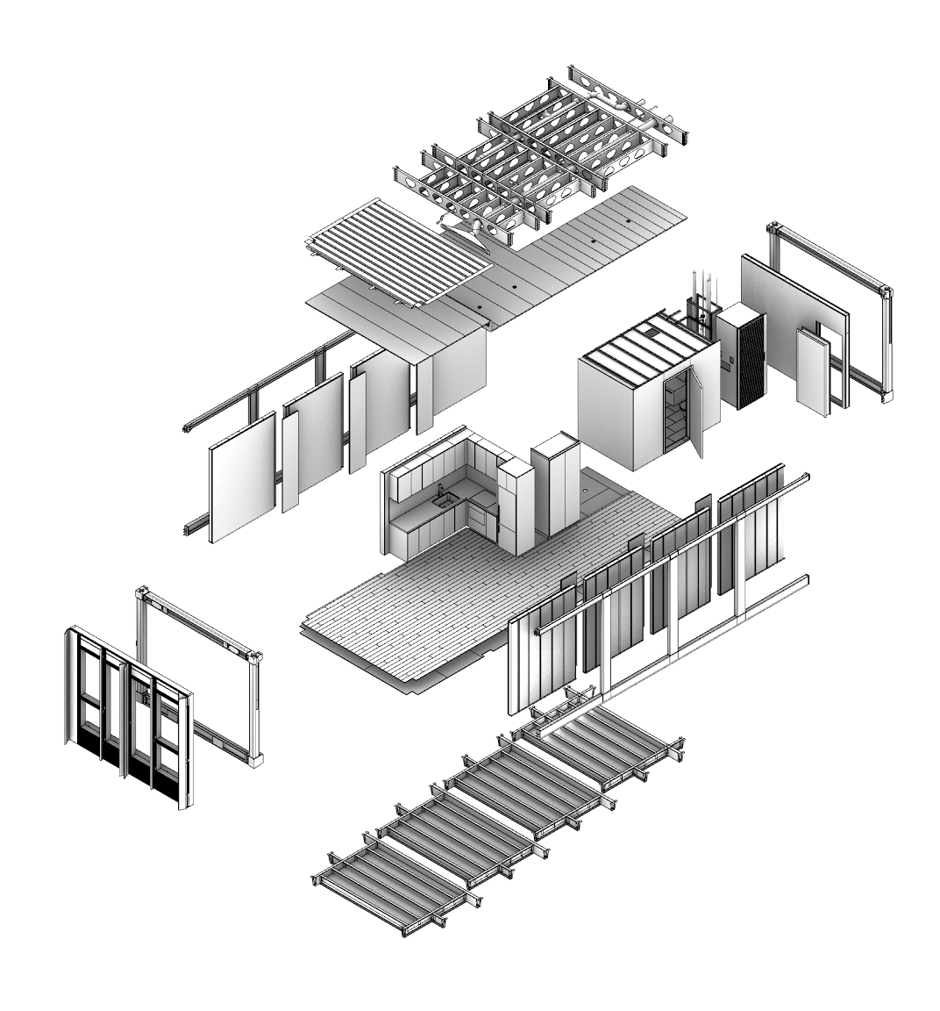
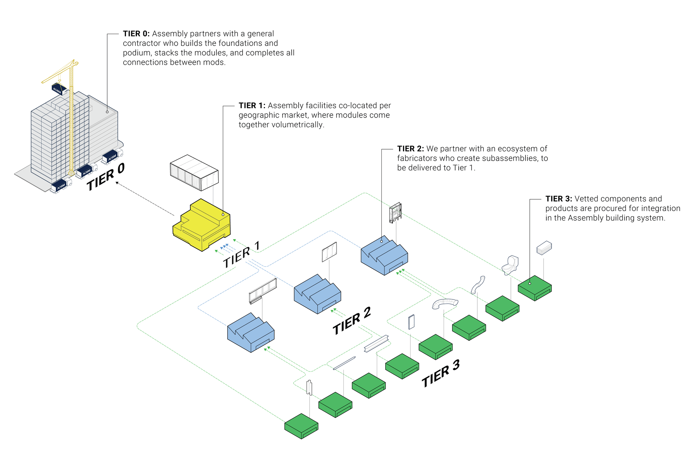
Distributed Supply Chain

Slide 27
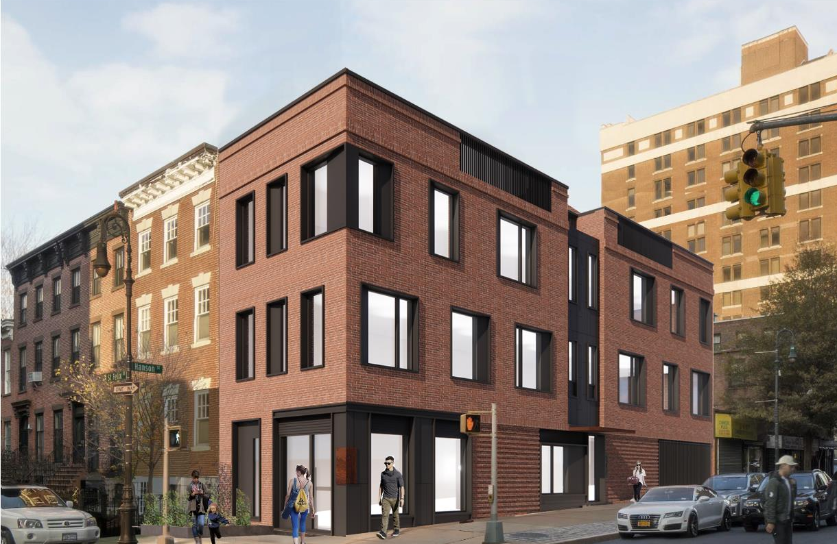
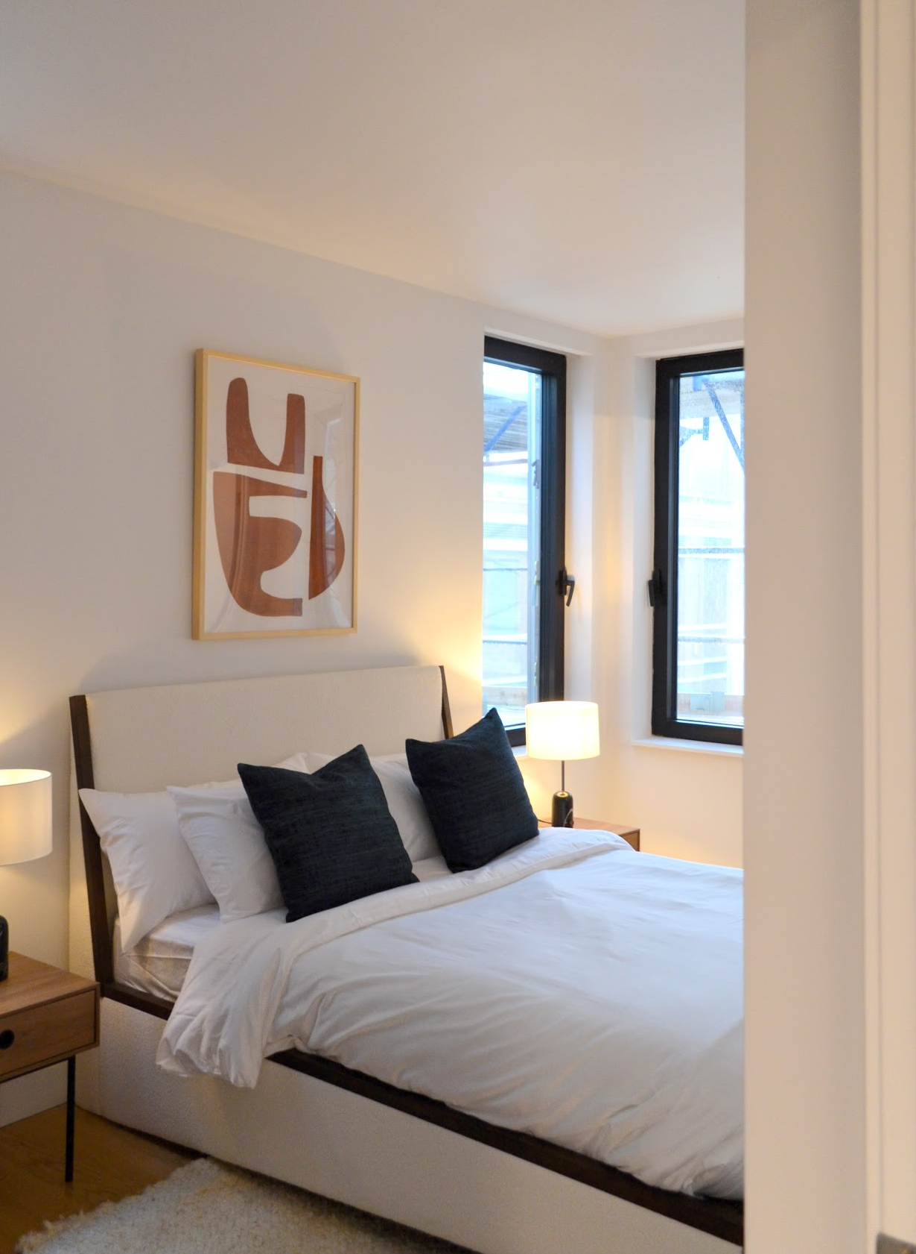
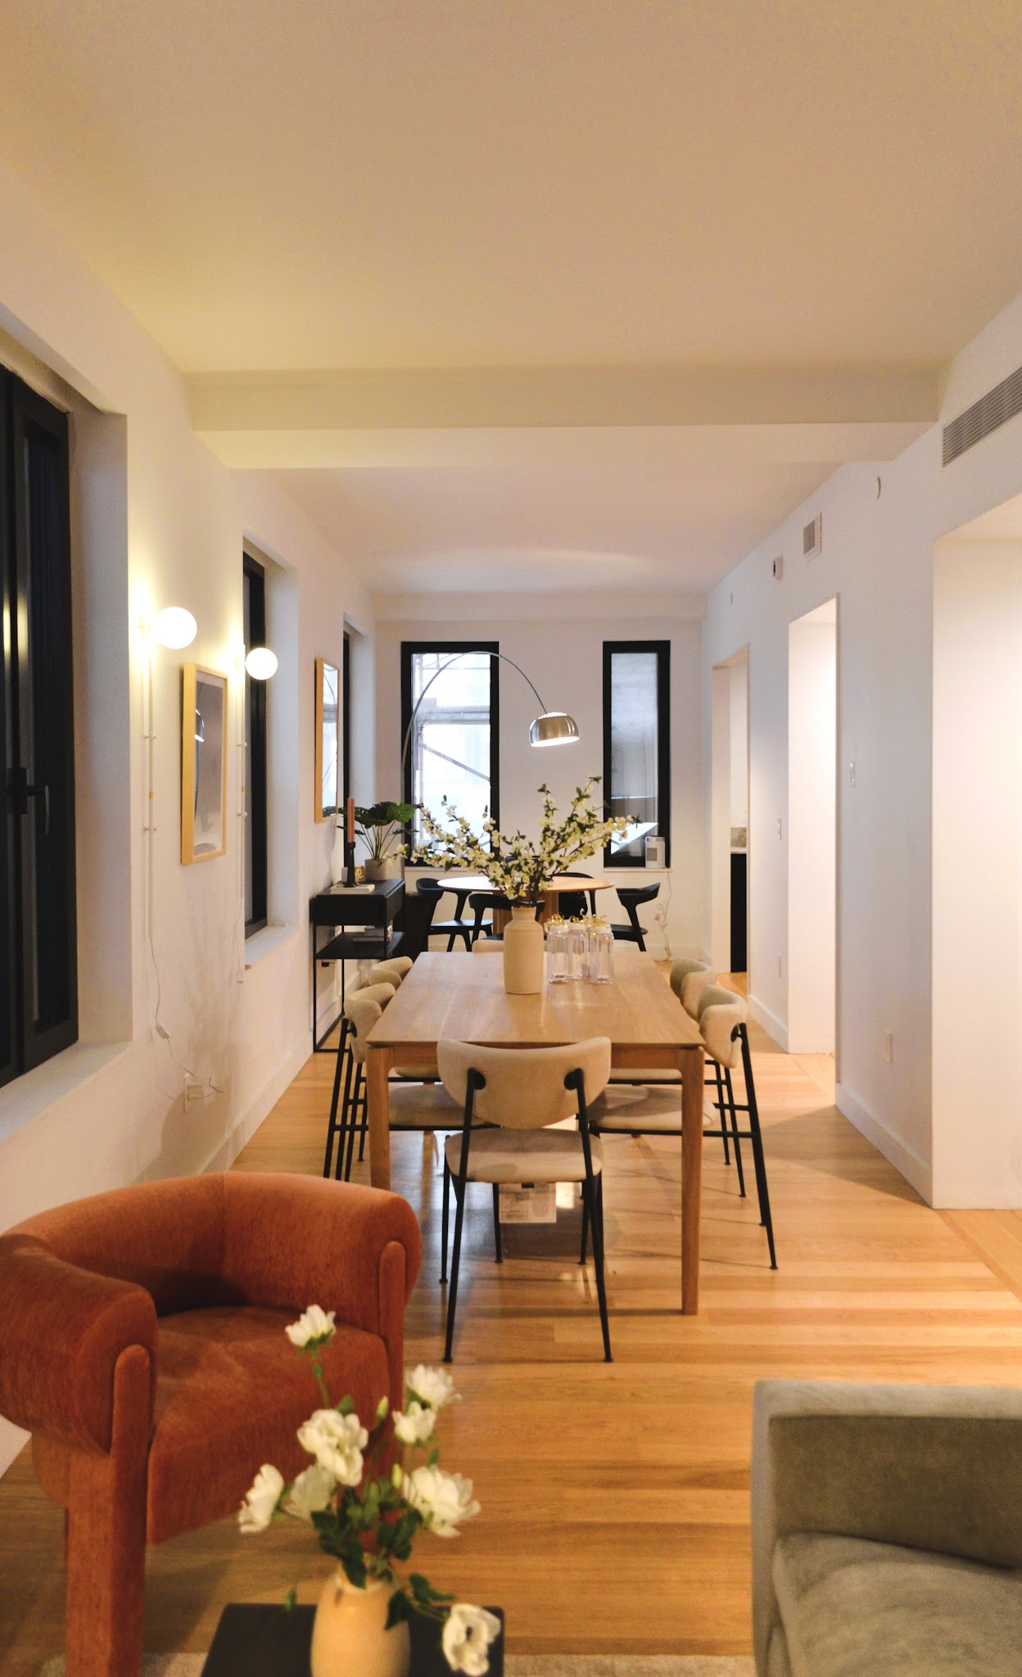
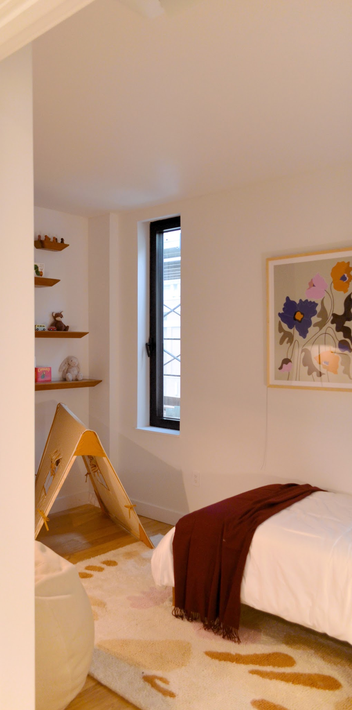
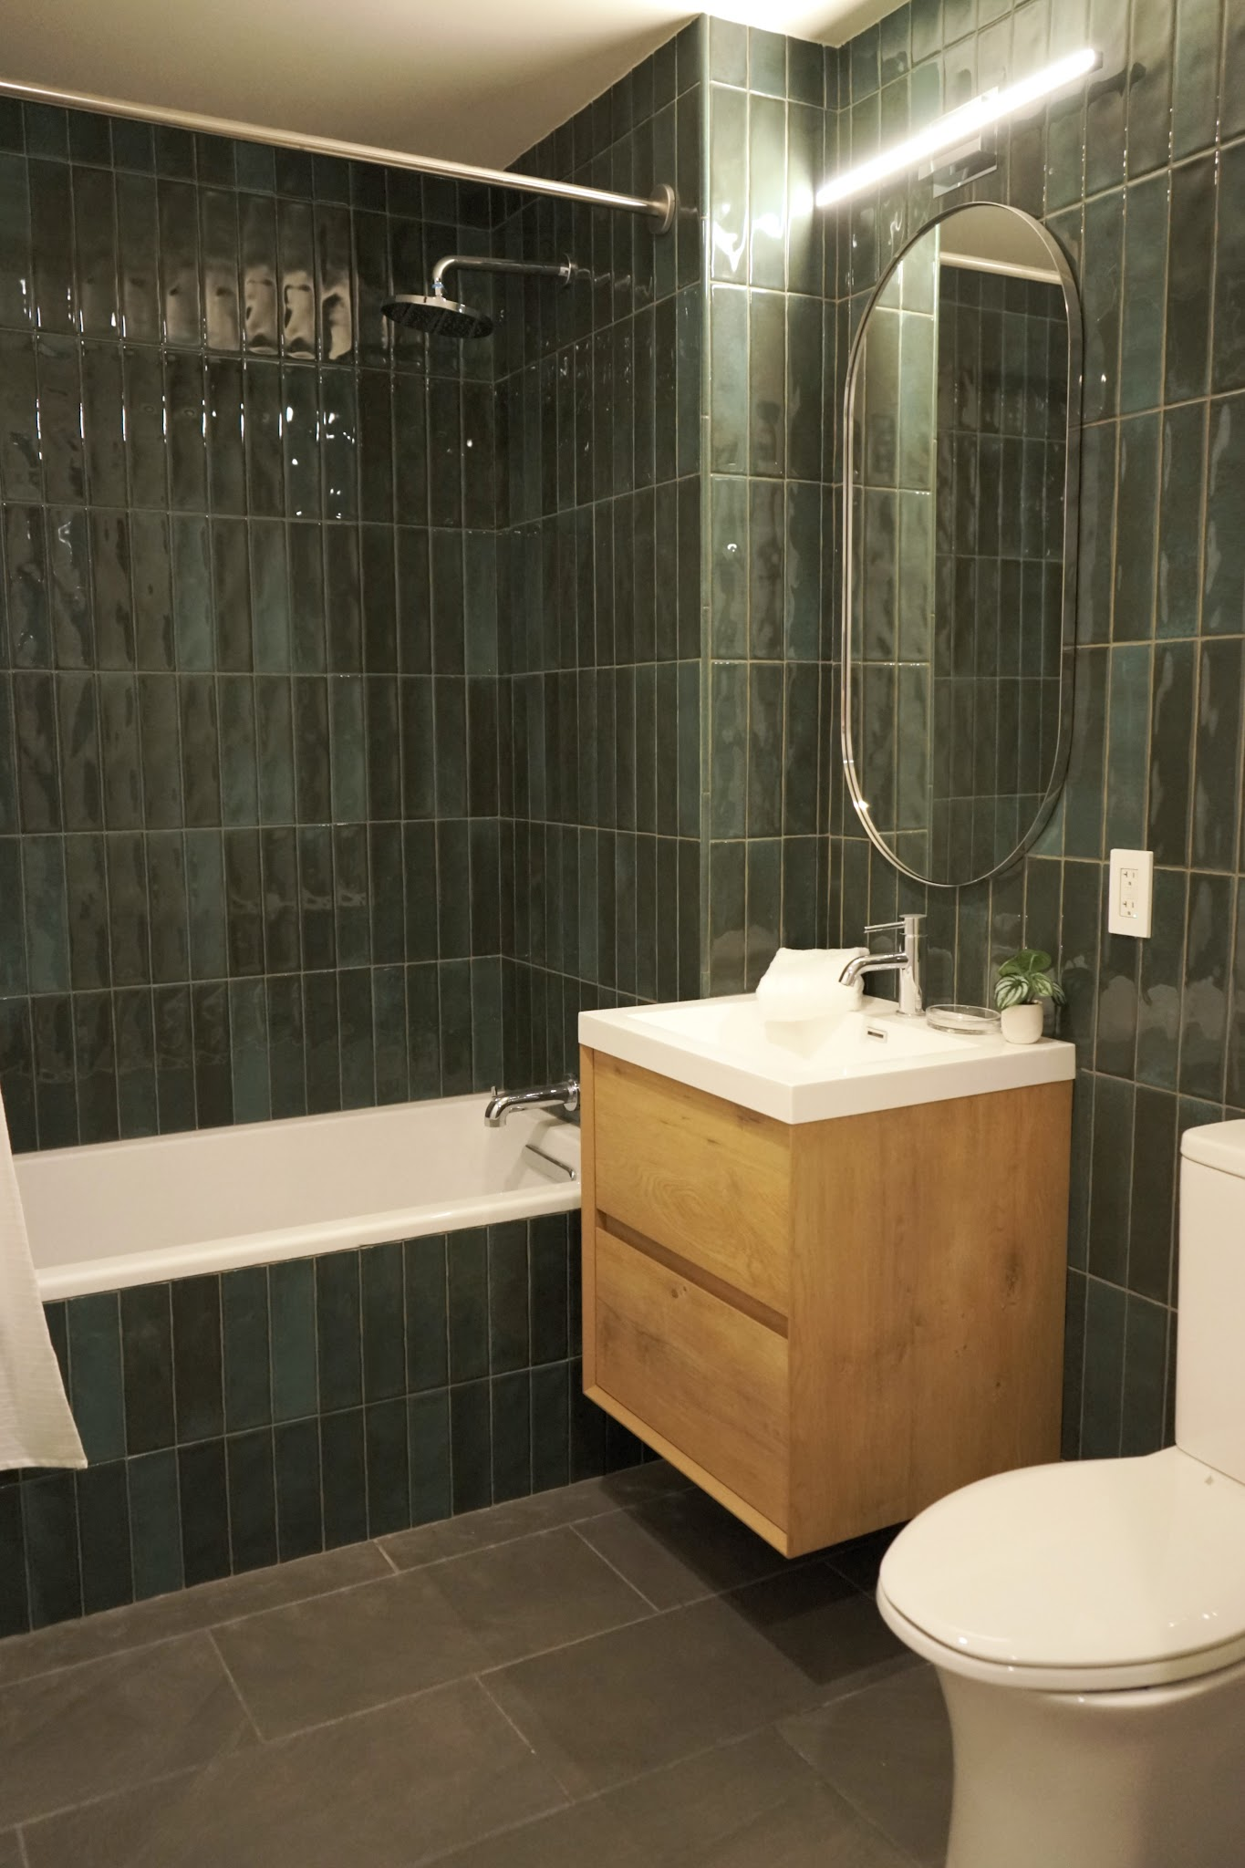
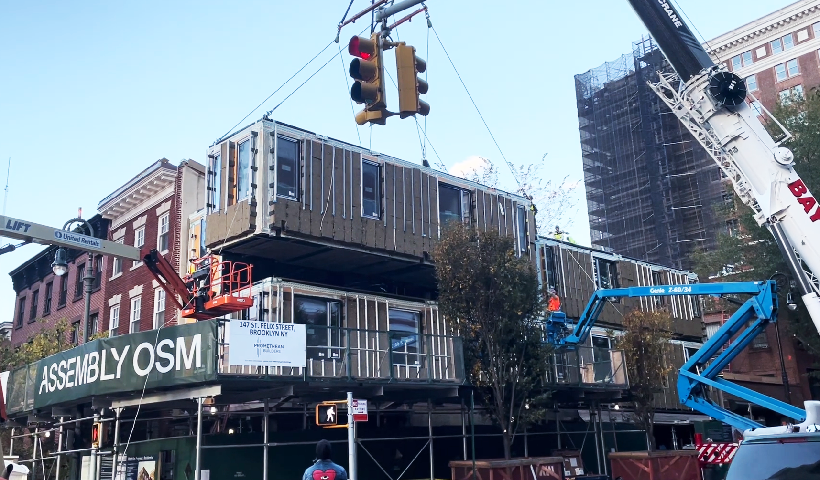
147 St. Felix
Spring 2024

Slide 28
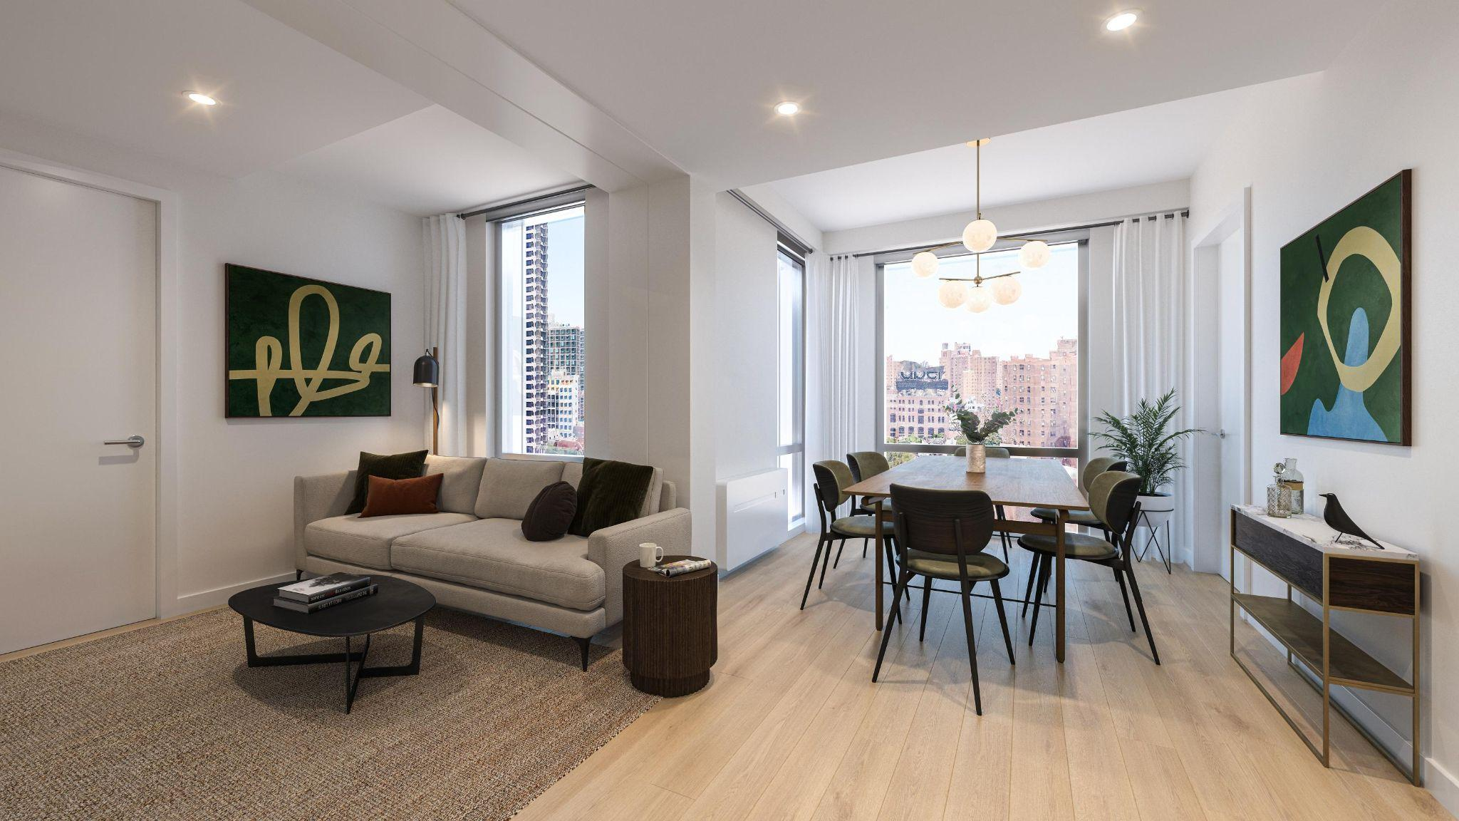
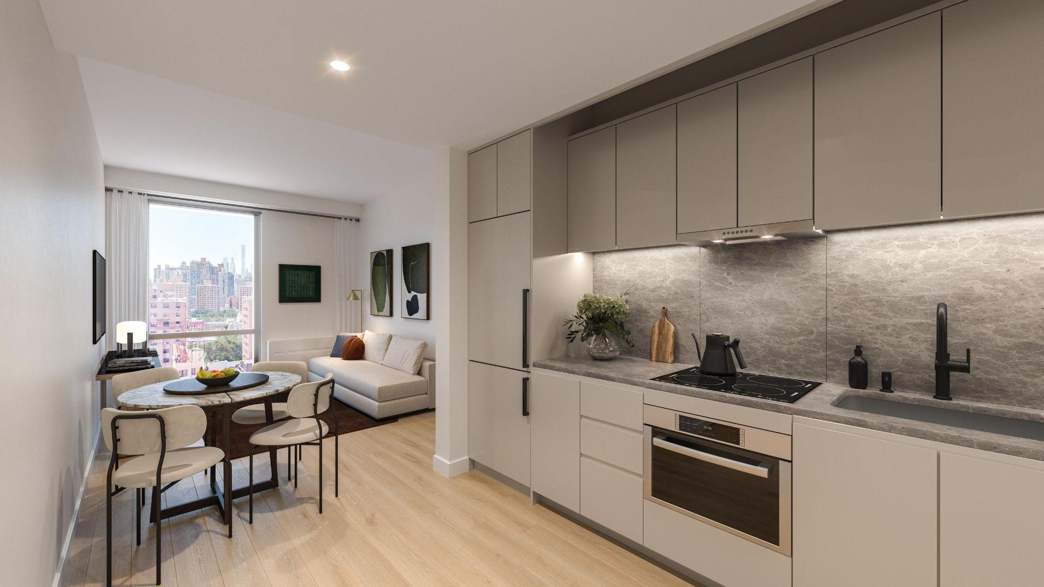
247 East 117th St.
Spring 2025

Slide 29
Matthias Altwicker, Principal, Studio A+H and Associate Professor of Architecture, NYIT - Studio A+H
Notes:
4) Matthias Altwicker, AIA NCARB LEED AP, Principal, Studio A+H and Associate Professor of Architecture, NYIT - Studio A+H

