Slide 1
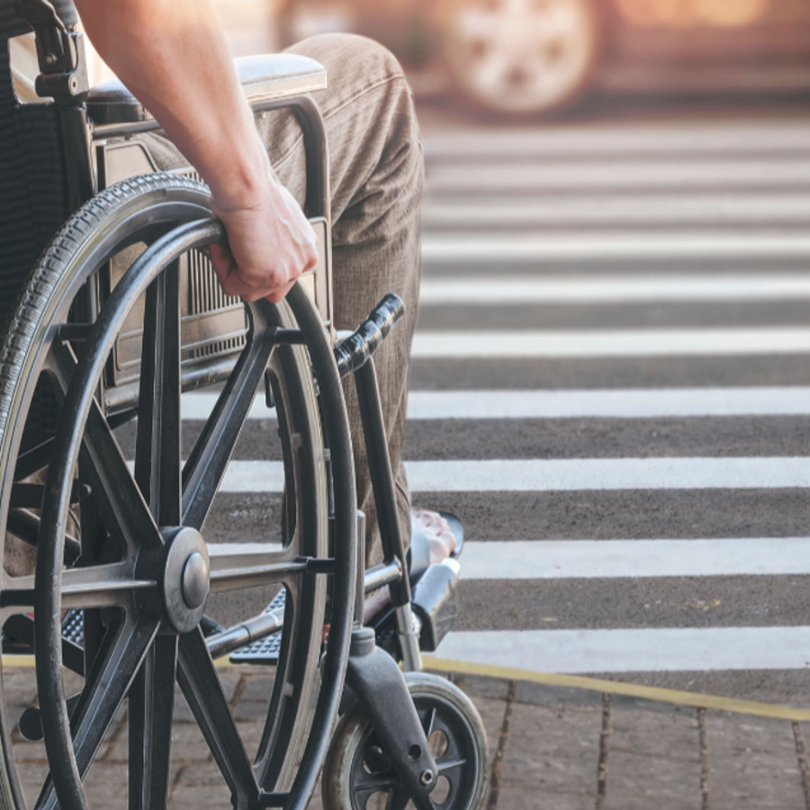
Accessible Design and Inclusive City Centers: Understanding the Public Right of Way Rule
Steven Mifsud MBE - Director, Direct Access

Slide 2
Accessible Formats
If anyone requires this presentation in alternative, accessible formats, please let us know and we will accommodate.

Slide 3
International Award-Winning Access Consultants
Accessibility Consultancy established for 20 years
Certified DOBE – Disability Owned Business Enterprise
Majority of team are people with disabilities
Broad client and sectors base which includes Outdoor Areas, Leisure, Sports, Education, Heritage and Museums.
Base
Two offices in the US (Boston & Clearwater), further offices in UK and United Arab Emirates
(Dubai)

Slide 4
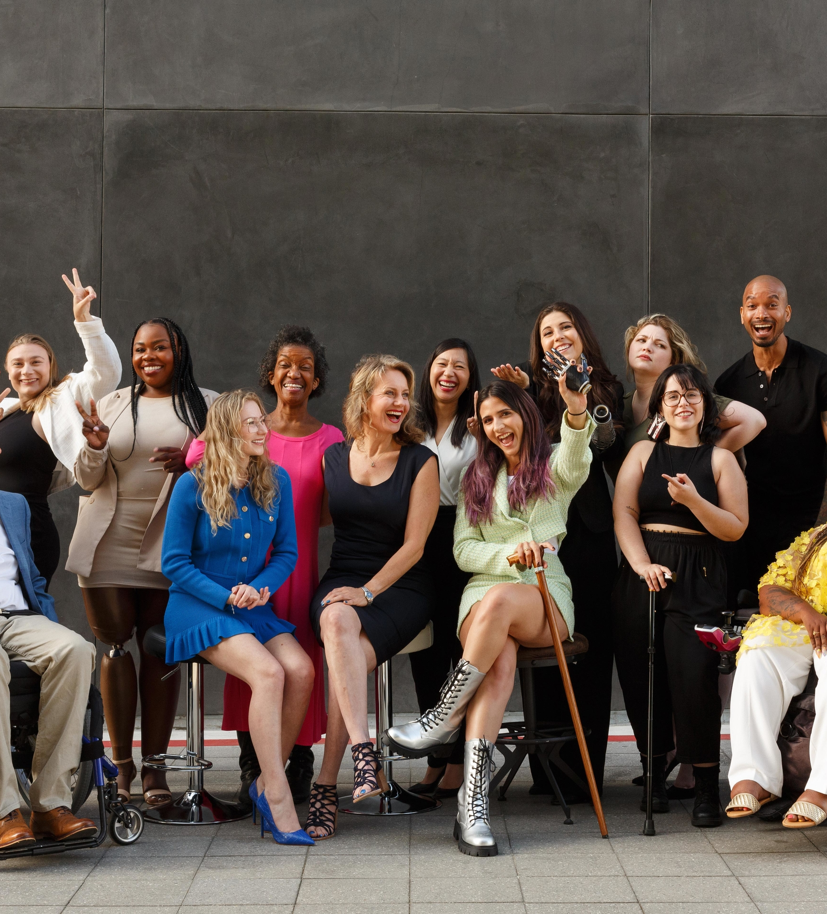
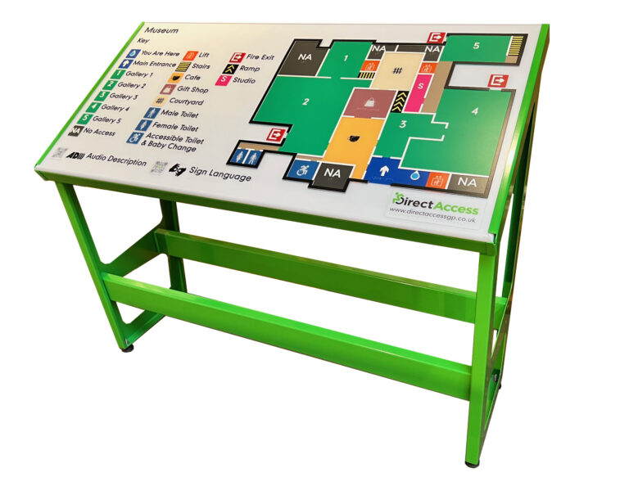
Introducing Direct Access
Key Services
Accessibility Consultancy
Universal Design and Inclusion Experts
Accessibility Audits
Design and Access Statements
All Design Stages from Concept to Handover
Inclusive Operations and Management
Bespoke Strategy, Guidance and Benchmarking
Event Planning
Policy Planning
Tactile and Braille Mapping
Wayfinding
Mystery Shopping of Services
Disabled User Feedback i.e. Websites
4

Slide 5
Introducing Direct Access
Clients

Slide 6
Accessible Design and Inclusive City Centers
Learning Objectives
Learning Objective 1 - The significance of accessibility and its impact, along with supporting data and statistics.
Learning Objective 2 - Grasping the concept of the four fundamental pillars of accessibility
Learning Objective 3 - What legal protections are in place for individuals with disabilities in the United States?
Learning Objective 4 - Understand the new legislative context for public-right-of-way for people with disabilities.
Learning Objective 5 - Acknowledging the distinction between compliance and inclusion
6

Slide 7
The significance of accessibility and its impact, along with supporting data and statistics.
Learning Objective 1
7

Slide 8
Steven Mifsud MBE - Director, Direct Access

Slide 9
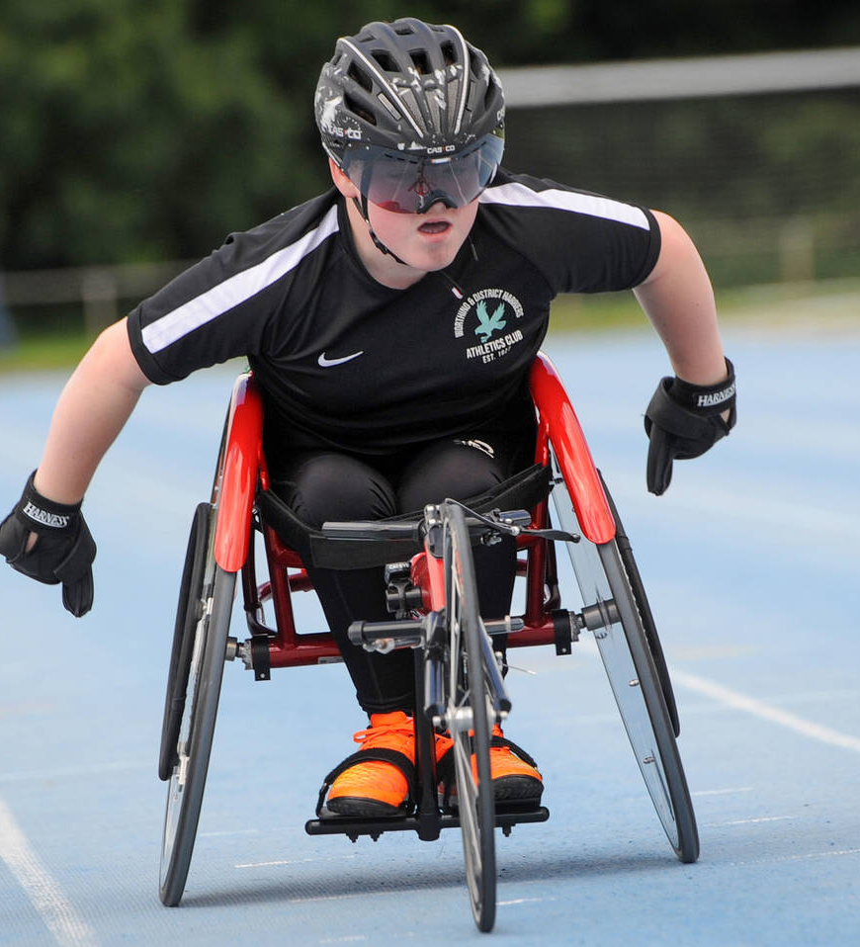
Statistics on People with Disabilities – Globally
According to the World Health Organization (WHO), more than 1 billion people worldwide, or approximately 15% of the global population, live with some form of disability. This figure includes a wide spectrum of disabilities such as physical, sensory, cognitive, and mental health impairments.
9

Slide 10
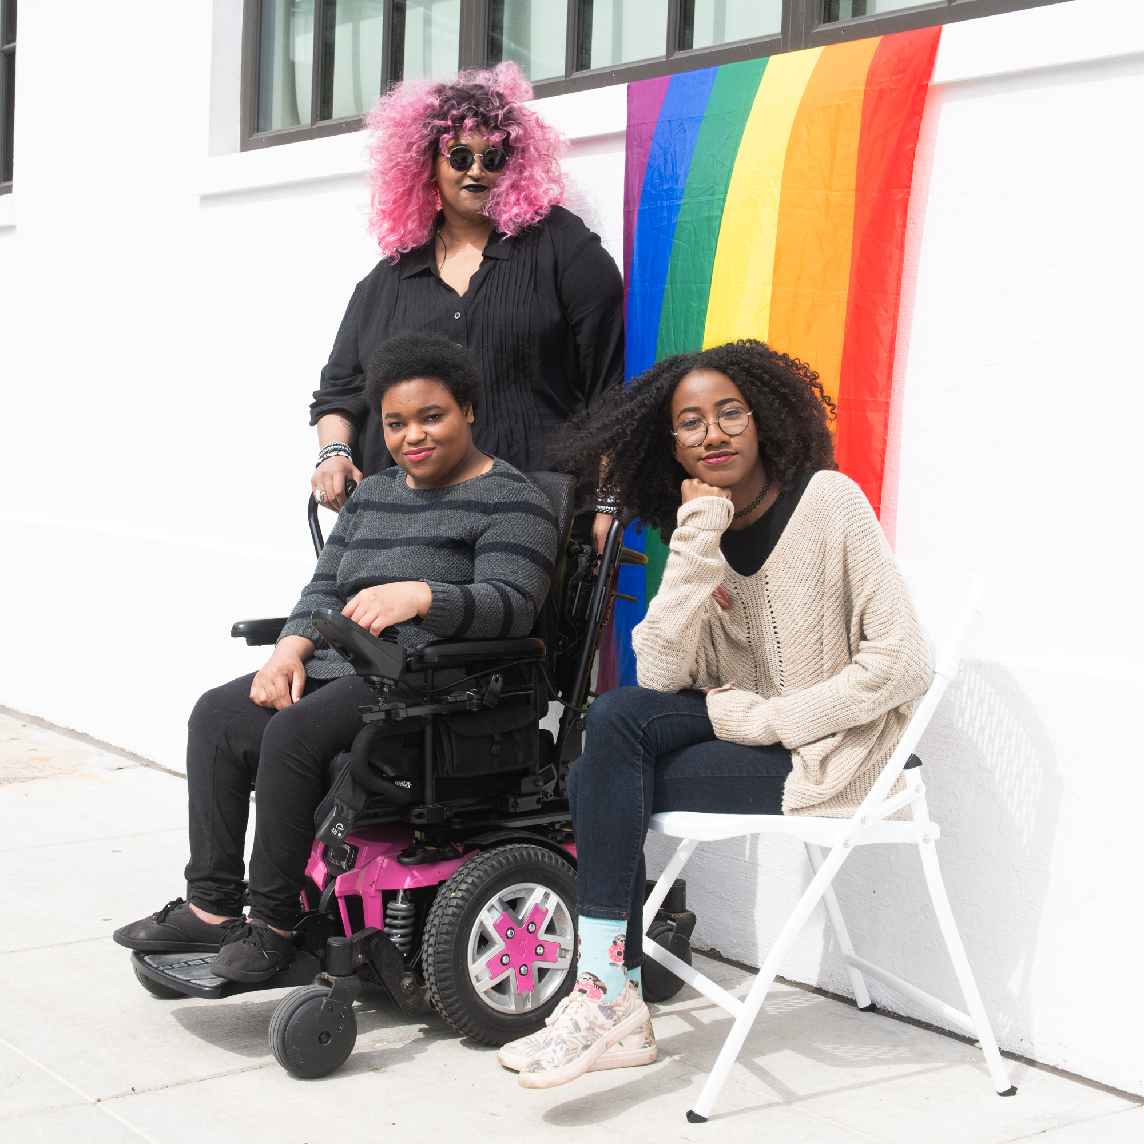
Statistics on People with Disabilities – United States
According to the U.S. Census Bureau, as of 2020, approximately 61 million adults in the United States are living with a disability, which represents around 26% of the adult population.
10

Slide 11
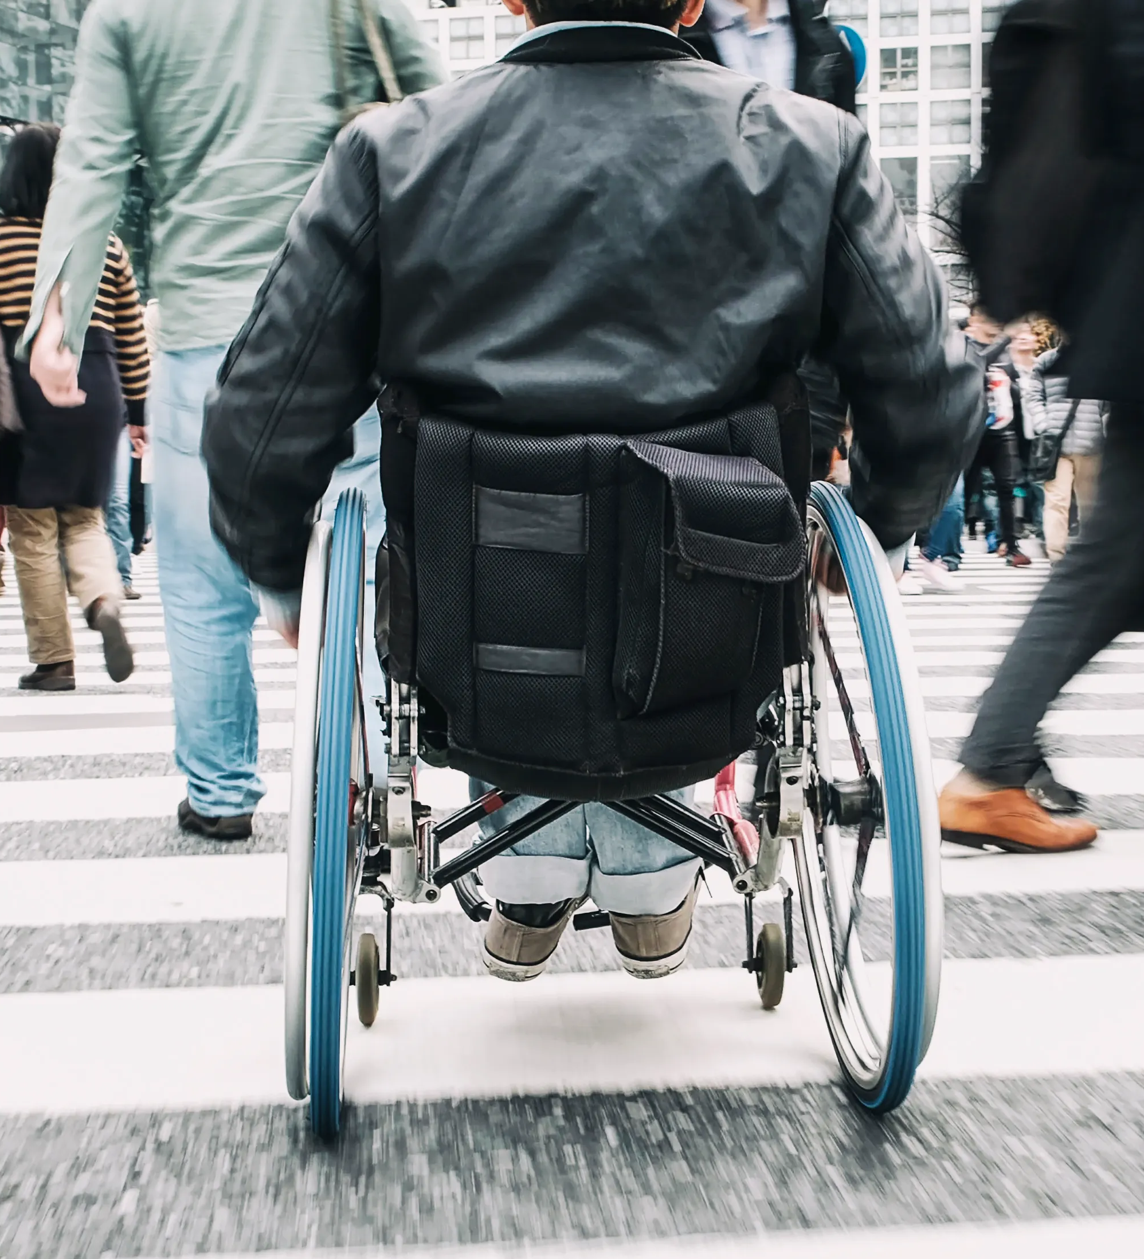
Statistics on People with Disabilities – NY State
The most recent data indicates that in New York State, there are approximately 3.8 million individuals living with a disability. This statistic encompasses a wide range of disabilities, including physical, cognitive, sensory, and other types of impairments.
11

Slide 12
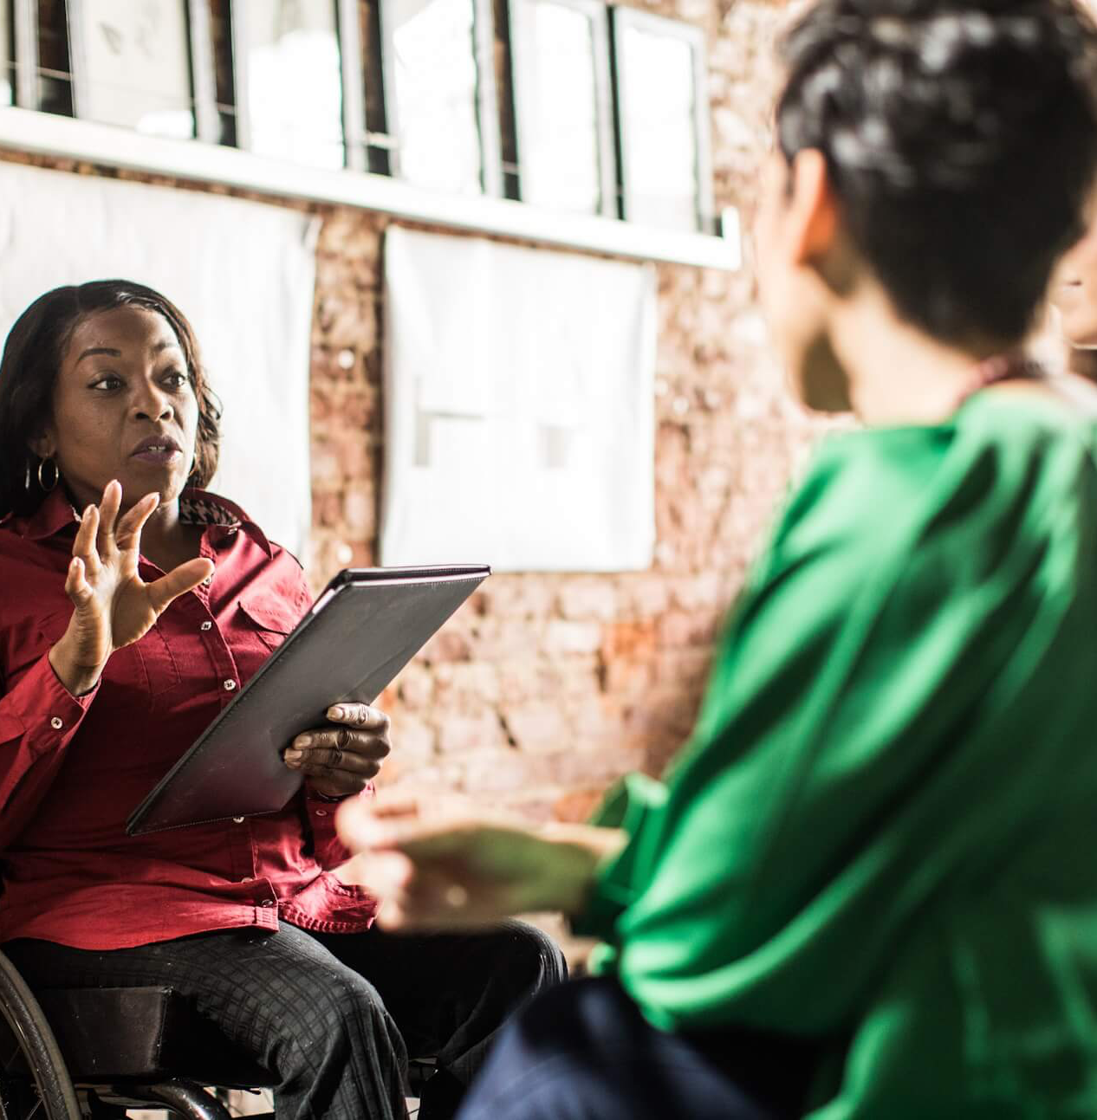
c
Wheelchair users
People with sight loss
Deaf / Hard of hearing
Hidden disability / Non – Apparent disability
Families
Elderly people
People with mobility difficulties
Expectant mothers
c
Who
Benefits from Accessibility?
c
c
c
c
c
c
12

Slide 13
Learning Objective 2
Grasping the concept of the four fundamental pillars of accessibility
13

Slide 14
Four key pillar approach to accessibility :-
Physical Environment
Digital Environment
Social Environment
Sensory Environment
Only once all four are covered, then can we create true inclusion.

Slide 15
What legal protections are in place for individuals with disabilities in the United States?
Learning Objective 3
15

Slide 16
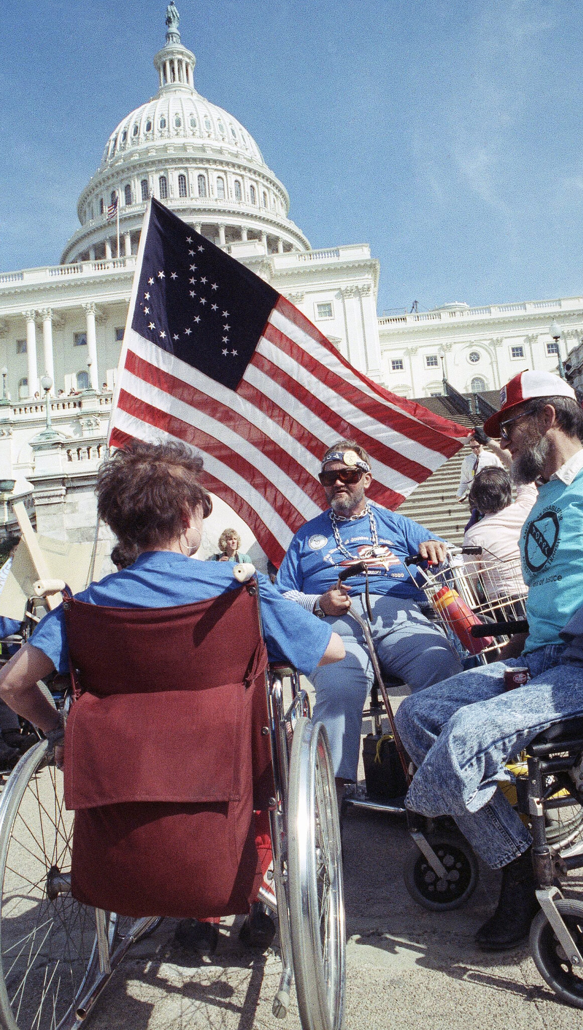
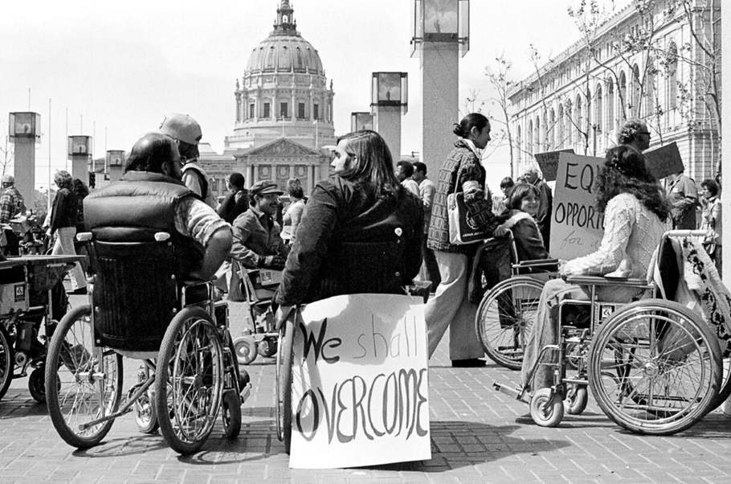
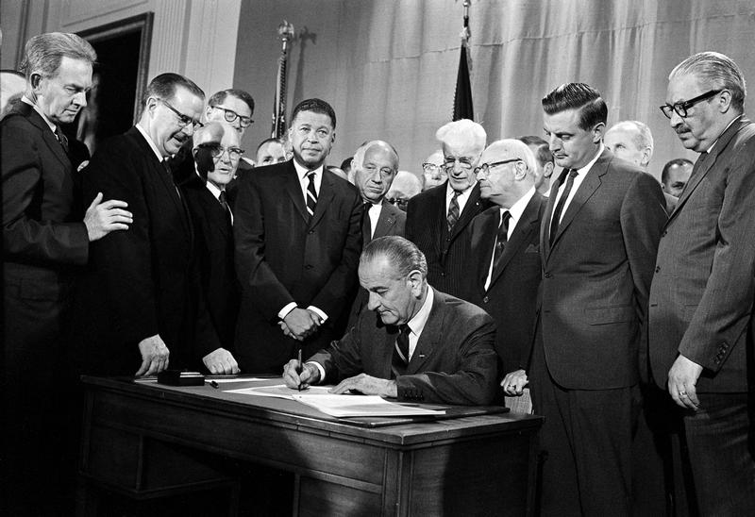
Legal Protections
Americans with Disabilities Act (ADA)
Rehabilitation Act of 1973
Fair Housing Act
Enacted in 1990, the ADA prohibits discrimination against individuals with disabilities in all areas of public life, including jobs, schools, transportation, and public and private places that are open to the general public.
Prohibits discrimination on the basis of disability in programs conducted by federal agencies, in programs receiving federal financial assistance, in federal employment, and in the employment practices of federal contractors.
Makes it unlawful to discriminate against people with disabilities in housing and housing-related transactions.
These and other laws exist to ensure that individuals with disabilities have equal opportunities, rights, and protections across various aspects of life, including employment, education, public accommodations, transportation, and more.

Slide 17
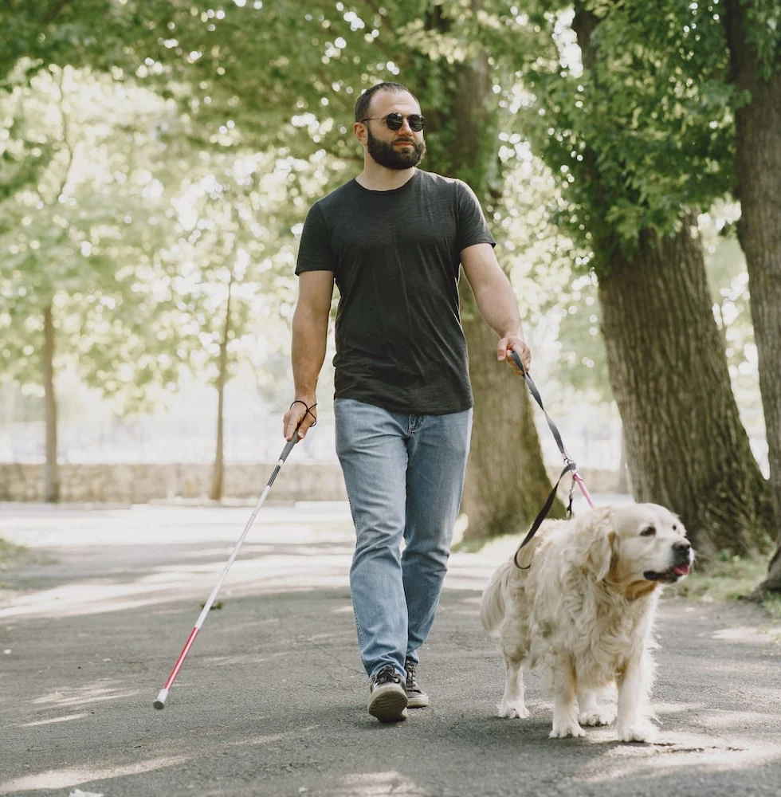
Understand the new legislative context for public-right-of-way for people with disabilities.
Learning Objective 4
17

Slide 18
New Final Rule for Public Right of Way
In August 2023, the Architectural and Transportation Barriers Compliance Board issued its final rule that sets out minimum guidelines for the accessibility of pedestrian facilities in the public right-of-way.
The new Public Right-of-Way Accessibility Guidelines (PROWAG) are intended to establish design standards for pedestrian facilities in the public right-of-way, ensuring accessibility for all, including individuals with disabilities. These guidelines, which are part of the Americans with Disabilities Act (ADA), cover aspects such as sidewalks, curb ramps, crosswalks, pedestrian signals, and other pedestrian features in public rights-of-way.
The rules aim to create environments that facilitate independent navigation and ensure equal access to amenities and services for all members of the community.

Slide 19
New Final Rule for Public Right of Way
What Hasn’t Changed: Equivalent Facilitation
One important aspect of the ADA that remains unchanged with this final rule is the provision for equivalent facilitation, which section R102 states:
“that under the ADA, the use of alternative designs, products, or technologies that result in substantially equivalent or greater accessibility and usability than the proposed guidelines is permitted”
19

Slide 20
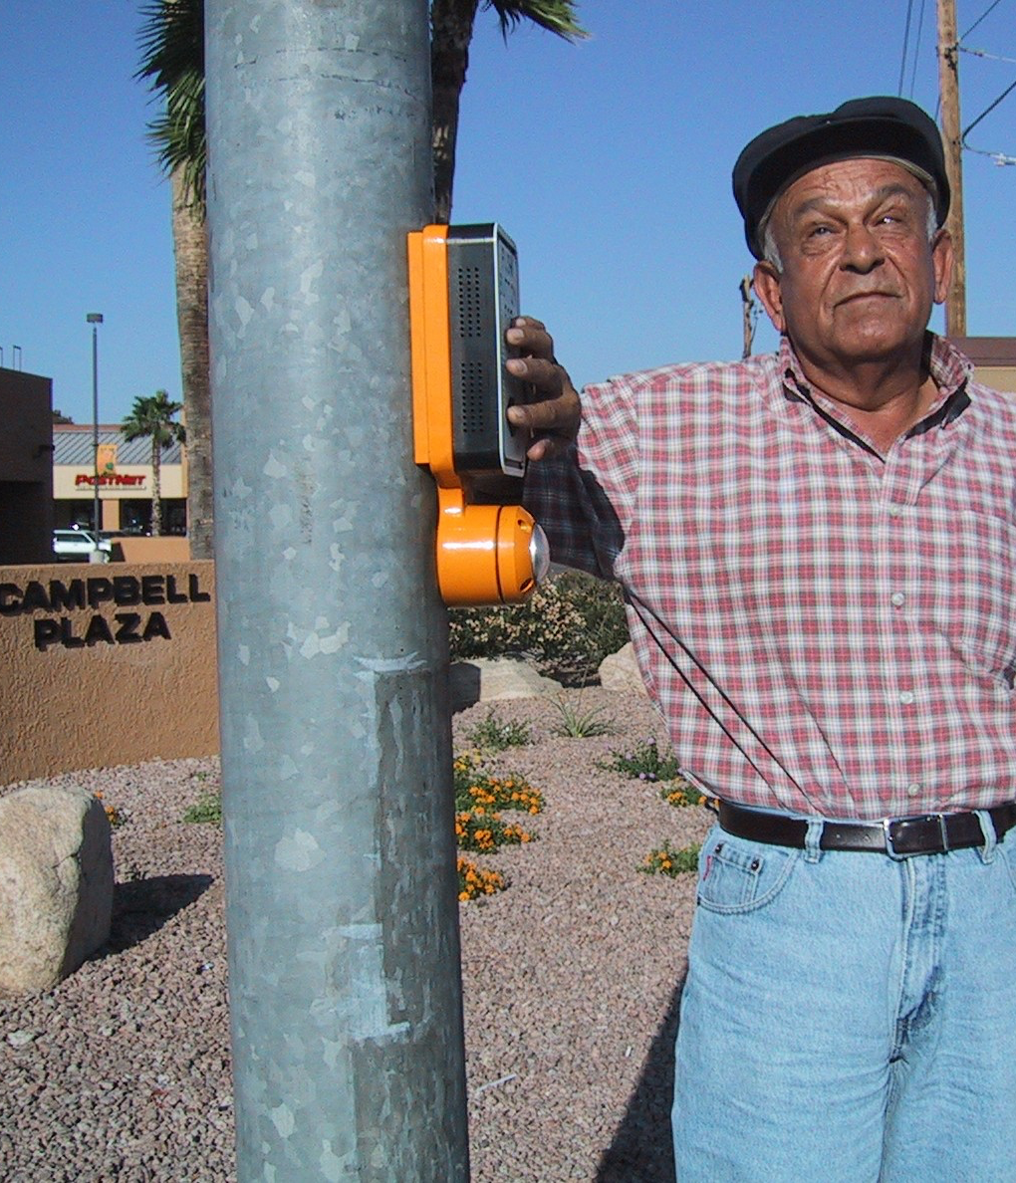
New Final Rule for Public Right of Way
Audible Pedestrian Push Buttons
Revised - The new rule now requires that pedestrian push buttons provide audible and vibrotactile walk indicators. Therefore, moving forward, agencies will no longer have the option of choosing not to install audible push buttons.
20

Slide 21
New Final Rule for Public Right of Way
Corner Treatments at Intersections and Roundabouts
Revised - PROWAG still mandates the inclusion of a buffer or a detectable vertical edge treatment between the road and pedestrian path in roundabouts. The preamble particularly addressed cobblestones as a "prepared" surface. Additionally, PROWAG updated the specification for the vertical edge treatment (limiting the bottom edge to a maximum of 15 inches above the pedestrian path) instead of prescribing specific treatments such as fencing.
NEW: PROWAG introduced a comparable mandate for a buffer or detectable vertical edge treatment at additional intersections where pedestrian crossings are prohibited. This implies that simply using a sign to indicate a closed pedestrian crossing is insufficient.
21

Slide 22
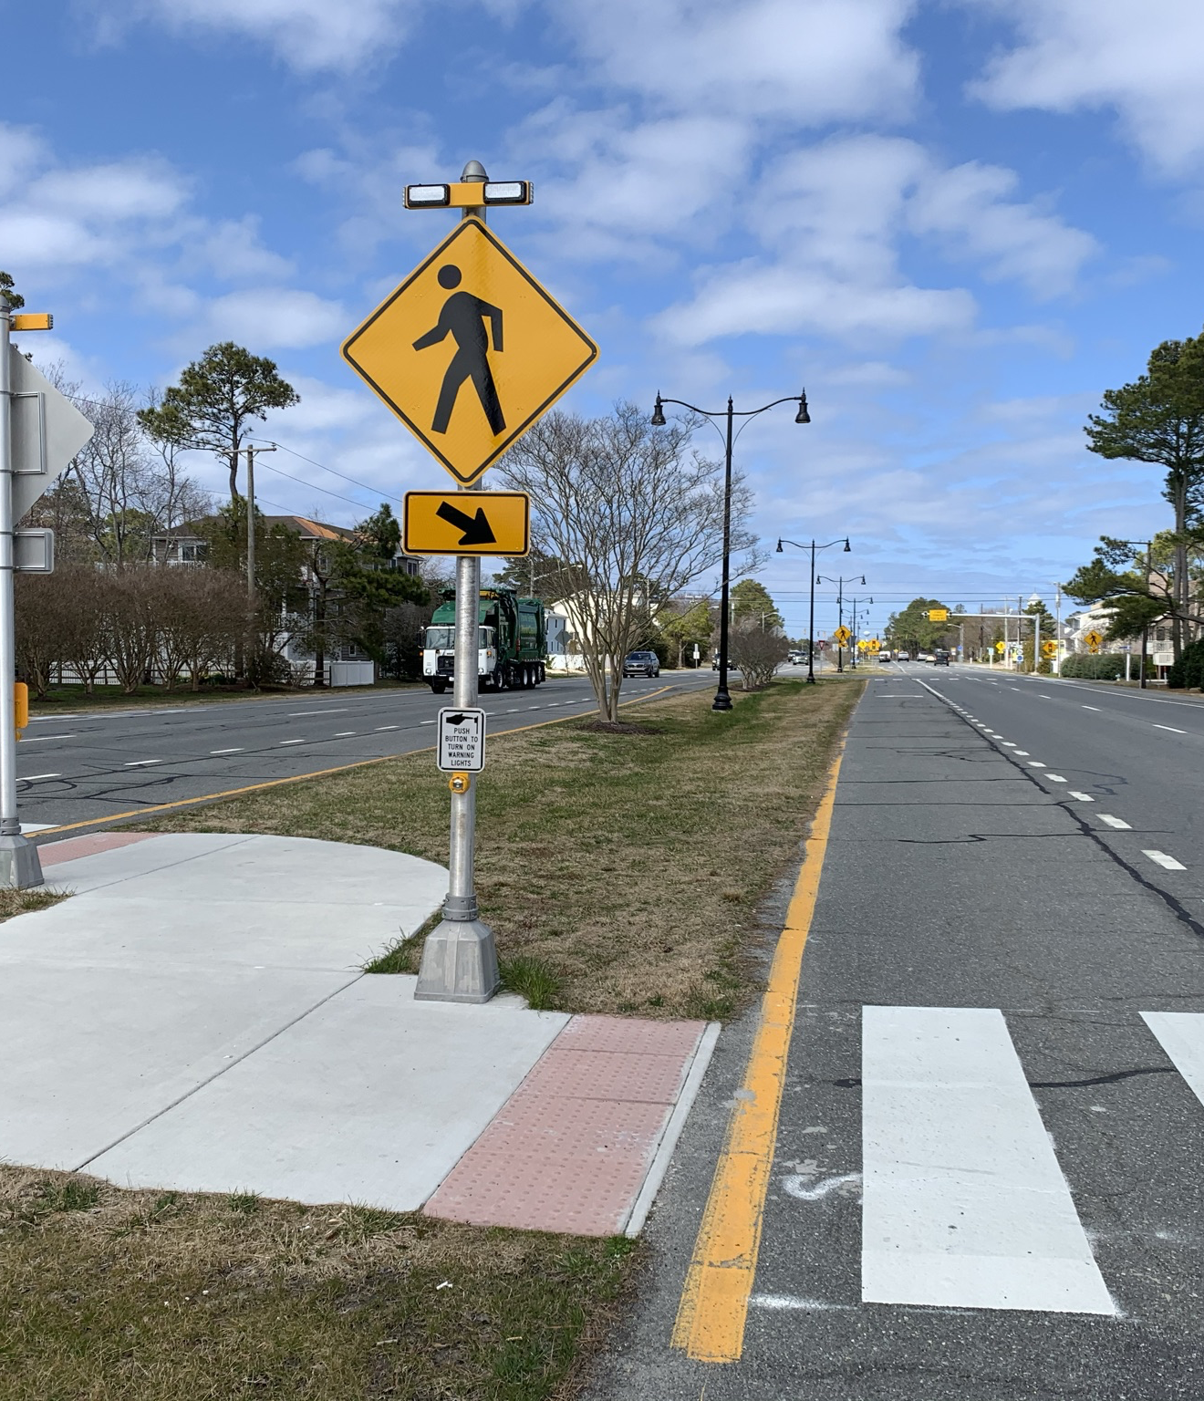
New Final Rule for Public Right of Way
Crossing Treatments for Multilane Crossings at Roundabouts and Channelized Turn Lanes
Revised - Similar to the proposed regulation, multilane roundabouts must feature pedestrian treatments to ensure accessibility for individuals who are blind or have low vision. The Access Board has broadened the range of treatments to include pedestrian signals, pedestrian hybrid beacons (PHBs), rectangular rapid flashing beacons (RRFBs), and raised pedestrian crossings—these are the four treatments studied in NCHRP Report 674 and NCHRP Research Report 834.
While PROWAG doesn't define a performance threshold, the new Guide for Roundabouts (NCHRP Research Report 1043) incorporates an assessment framework, based on these research projects, to help practitioners make informed decisions regarding the most suitable pedestrian treatment
22

Slide 23
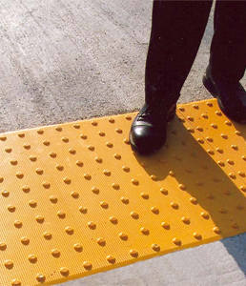
New Final Rule for Public Right of Way
Detectable Warnings at Driveways
Revised - Additional clarification has been issued to mandate the installation of detectable warnings at driveways regulated by yield signs, stop signs, or traffic signals.
23

Slide 24
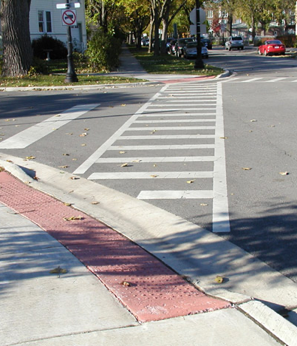
New Final Rule for Public Right of Way
Crosswalk Slopes
Revised - The segment concerning mandatory cross slopes at various intersection controls has been broadened and more precisely delineated. Specifically, the cross slope of crosswalks at roundabouts is now permissible to align with the grade of the street.
24

Slide 25
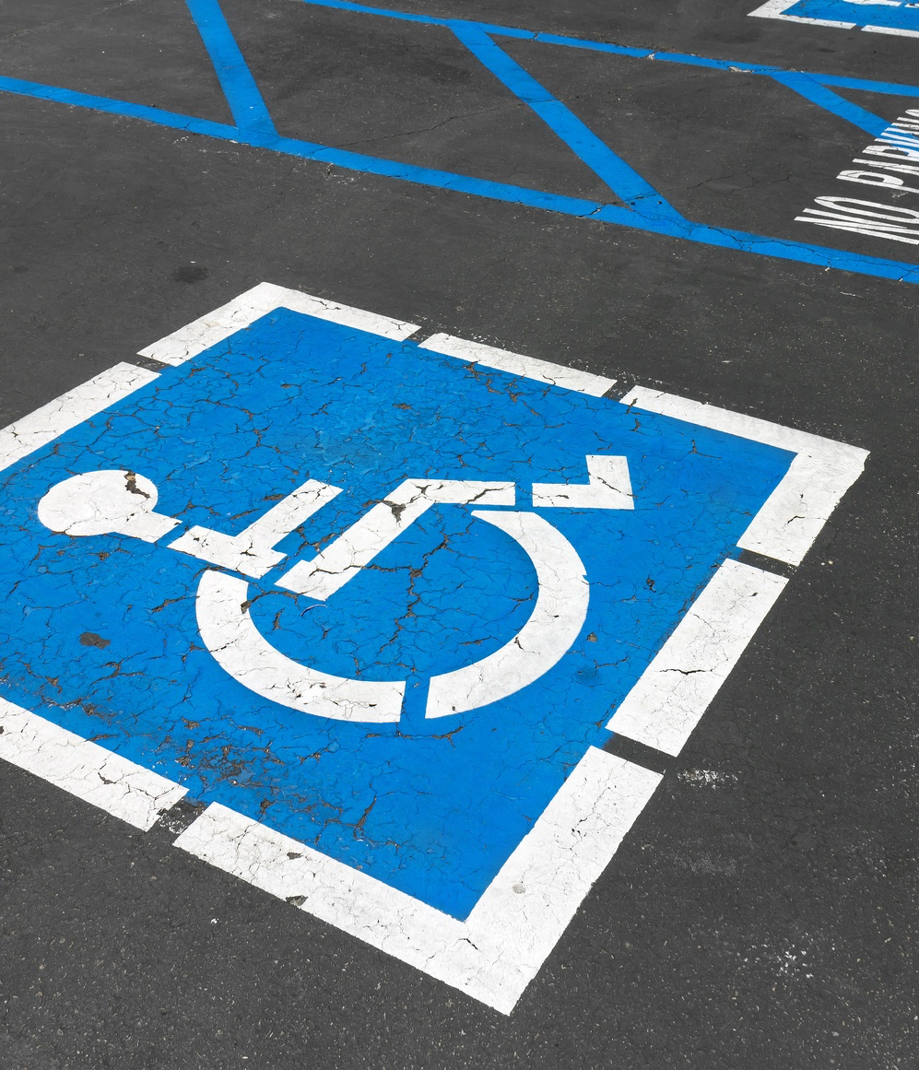
New Final Rule for Public Right of Way
On-Street Parking Spaces
Revised - Specific measurements and dimensions have been established for on-street parking spaces designed to be accessible for individuals with disabilities. These measurements are intended to ensure that the parking spaces provide adequate space and accessibility features, such as adjacent access aisles, to accommodate vehicles with wheelchair lifts or ramps. By implementing these standardized measurements, authorities aim to enhance accessibility and usability for people with disabilities when parking on public streets.
25

Slide 26
Acknowledging the distinction between compliance and inclusion
Learning Objective 5
26

Slide 27
Distinction between Inclusion and Compliance
Compliance
Inclusion
Inclusion, goes beyond mere compliance. It involves creating an environment where people of all abilities are fully integrated and have equal access to opportunities, services, and resources. Inclusion focuses on embracing diversity and ensuring that individuals with disabilities are not only accommodated, but actively and meaningfully involved in all aspects of society.
Compliance refers to adhering to laws, standards, or regulations. In the context of disability rights, compliance often involves meeting legal requirements, such as providing accessible facilities as mandated by the Americans with Disabilities Act (ADA).
27

Slide 28
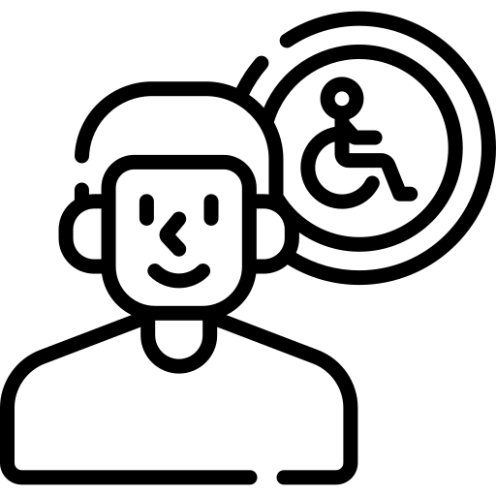
Going Beyond ADA Compliance
Acoustics for those who are hearing impaired
Calm/quiet space for neurodivergence
Sign language, wayfinding, tactile maps
Lighting, flooring, color coding
Shade/temperature control
Assistance animals
Changing Places/lockers
Seating, sightlines
Height adjustable work stations
Deaf or Hard of hearing
Blind or low vision
Neurodiversity
Cognitive impairment
Elderly, injured, pregnant
Physical impairment
28

Slide 29
````
``````````````
True Inclusion
“We are bound to uphold laws, but as a society, we bear a collective responsibility to surpass mere compliance and foster genuine inclusion. It is not just a choice, but a necessity, and individuals with disabilities rightfully deserve nothing less”
Steven Mifsud MBE
Direct Access
29

Slide 30
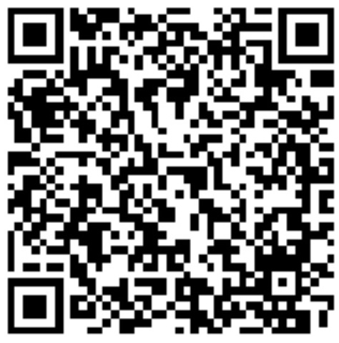
Questions and Answers
Steven Mifsud MBE
smifsud@directaccess.group

