Slide 1
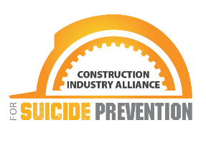
Mental Health and Suicide Prevention in Construction
It’s time to rethink traditional safety and culture
PREVENTCONSTRUCTIONSUICIDE.COM

Slide 2
What is the Construction Industry Alliance for Suicide Prevention (CIASP)?
Born out of necessity in response to a statistic released in a CDC study ranking construction and extraction as the #1 occupation for deaths by suicide
CIASP was formed in 2018 as a 501(c)(3) nonprofit organization
Vision: A zero-suicide construction industry
Mission: CIASP exists to save lives by eliminating suicide in the construction industry.
10-Year Goal: The construction industry suicide rate will be no higher than the average of all other industries: approximately 18 deaths per 100K employees.

Slide 3
Let’s clear up some language
Die by vs. Commit
Has vs. Is
Weak, selfish
Notes:
Importance of using proper language, how it reframes the conversation and gives dignity and respect –
“Using person-first language is a great place to start, as it helps validate individuals’ experiences without reducing them to a diagnosis or condition. It also fosters greater understanding, dignity and respect for everyone, whether they are experiencing mental health challenges or not.” Source: https://www.mentalhealthfirstaid.org/2022/04/use-person-first-language-to-reduce-stigma/#:~:text=Using%20person%2Dfirst%20language%20is,mental%20health%20challenges%20or%20not.

Slide 4
CIASP believes that…
Construction work is noble, and all people in the industry matter and are worthy of our resources and investment.
Every suicide is preventable – even one suicide is too many – and we have the ability to reduce suicide in our industry.
Working in the construction industry can pose risks and stresses that contribute to mental health issues; the work and life experience of construction workers can be improved by addressing mental health and suicide.
Physical safety includes mental health; therefore, industry health and safety programming must include mental health.
Every person should have access to mental health resources.
Caring and connection make a difference; caring people and caring organizational cultures can give hope and make a meaningful impact.
Every construction organization – regardless of its scale – can make a meaningful impact on suicide prevention.

Slide 5
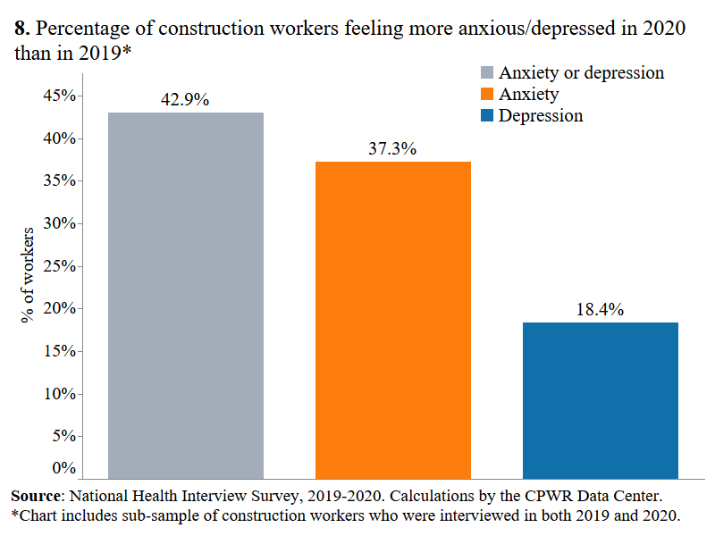
Impact of COVID-19
During June 24-30, 2020, U.S. adults reported considerably poorer mental health conditions due to the pandemic. 40% of all adults reported struggling with mental health or substance abuse.
42% of construction workers reported feeling MORE anxious or depressed in 2020 than in 2019.
In 2020, the prevalence of anxiety/depression (based on feelings or medication) in workers was 15%, and was particularly high in those who were:
age 18-34 (18%),
female (24%),
living below the poverty line (18%),
or working part-time (19%).
Notes:
Sources: https://www.cdc.gov/mmwr/volumes/69/wr/mm6932a1.htm
https://www.cpwr.com/wp-content/uploads/DataBulletin-January2022.pdf

Slide 6
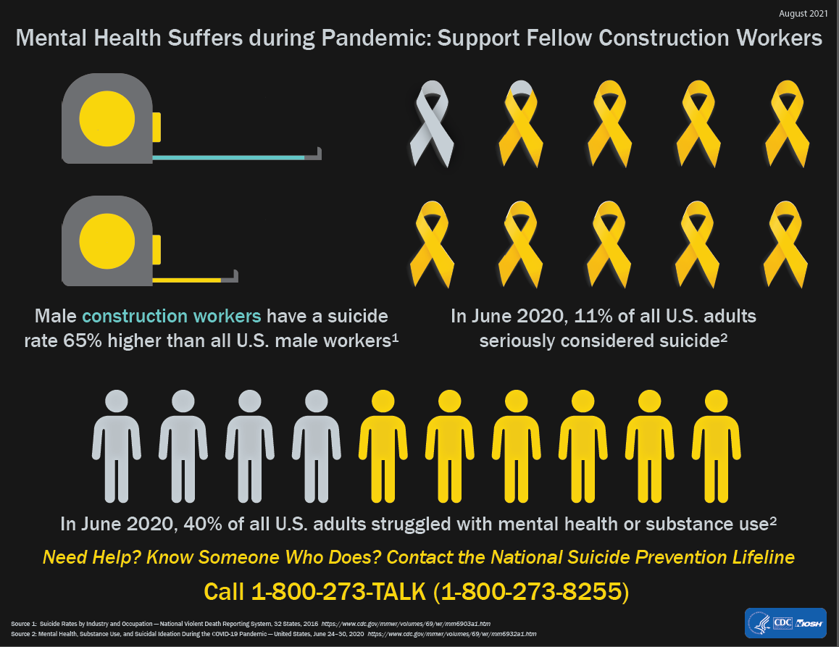
Why do we need to address mental health in the construction workplace?
In 2017, nearly 38,000 people of working age (16 – 64) died by suicide, a 40% rate increase in less than 20 years
The suicide rate in the U.S. is rising, but construction workers are at a greater risk of suicide than the average worker
All levels: laborers, skilled trades, operators, management
Male construction workers have a suicide rate 65% higher than all U.S. male workers
Notes:
Sources: https://www.cdc.gov/mmwr/volumes/69/wr/mm6903a1.htm
https://www.cpwr.com/research/research-to-practice-r2p/r2p-library/other-resources-for-stakeholders/mental-health-addiction/suicide-prevention-resources/
Rates – per 100,000
Construction Industry: 45.3 male; 9.4 female
Construction & Extraction Occupation: 49.4 male; 25.5 female
Equipment operators: 52.8 male
All industries or occupations: 27.4 male; 7.7 female

Slide 7
Joiner’s Interpersonal Theory of Suicide
Thoughts of / Desire for Suicide
Perceived Burdensomeness
“The world would be better without me”
Thwarted Belongingness
“I am alone”
Acquired Capacity for Suicide
“I am not afraid to die”
Suicide Attempt or Death
Notes:
Brief overview at this time – more detailed information will be discussed later in this presentation.

Slide 8
Two issues… same root cause?
Lack of control
Low perception of skill
Notes:
In studies of suicide tied to occupation, common factors that seemed to lead to higher rates of suicide were population groups who experienced low levels of control over their daily work/tasks, and whose occupation was perceived to have a low skill level.
These same two factors are often cited as barriers to young workers joining the construction industry.
By focusing on these issues at a cultural level can we improve the working environment in the industry and save lives at the same time?

Slide 9
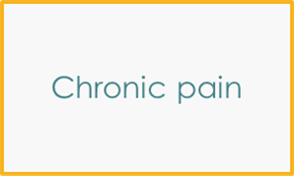
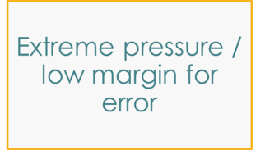
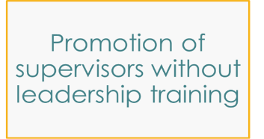
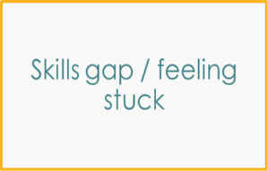
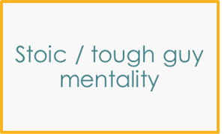
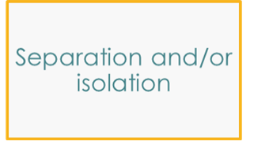
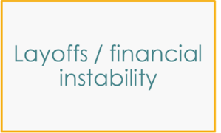
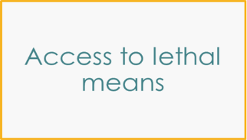
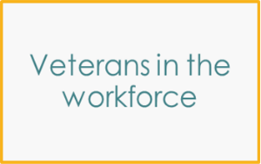
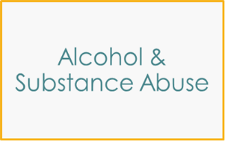
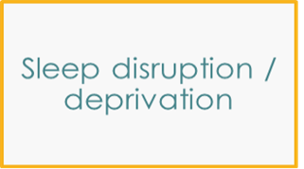
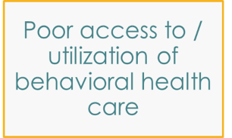
What are the Construction Risk Factors?
Notes:
These are animated to fly in in the order that correspond to the three elements of Joiner’s theory:
First four – Perceived burdensomeness
Next three – Thwarted belongingness
Next four – Capacity for suicide
Last 3 – additional factors

Slide 10
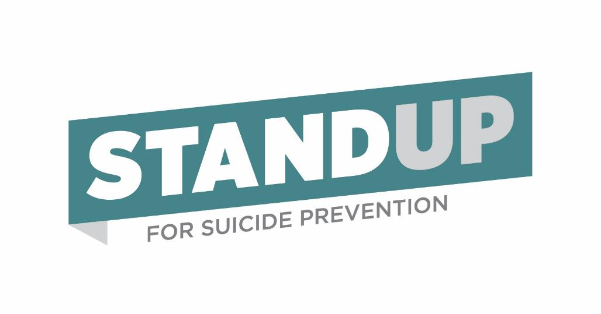
Ignoring is NOT an Answer
“We don’t have a mental health or suicide problem…”

Slide 11
How can mental health and suicide prevention be woven into existing management practices?
Getting Started…
Upstream:
Caring Culture
Preventative Factors
Identify & Promote Resources
Mental Health Literacy
Midstream:
Education on warning signs
Early Identification
Mental Health Screenings
Connection to care
Downstream:
Manage Crises
Restrict Access to Lethal Means
Provide Resources
Crisis Response Management
Offer Support
Notes:
If we are aligning with Mental Health with Safety –
Upstream is providing the training to prevent the issue –
Midstream reduces the risk if the event occurs (fall protection, PPE) –
Downstream is our emergency response/evacuation plan.
Upstream:
Have vocal leadership support
Hang up posters
Include in company meetings, newsletters
Include in toolbox talks, safety trainings
Support work life balance
Build and encourage peer support
Midstream:
Gatekeeper training
Referral process
Integrate into wellness programs
Have EAP resources available
Include in performance reviews / as a component of incident-accident reviews
Include protective factors in WC claims – pain prescriptions, contact, follow up, return to work
Downstream:
Have a plan in place
Have access to counsellors – R3 Continuum
Always address – don’t ignore / think it will pass
Involve the family

Slide 12
Recognize that mental health IS a workplace concern
6.9% Depression
18.1% Anxiety
Can lead to up to 27 lost workdays per year
1 in 5 Adults Will Experience Mental Illness
52.9 Million People
60% are left untreated
6.7% (17 million people) experienced a co-occurring substance use disorder and mental illness in 2020
Depression and anxiety disorders cost the global economy $1 trillion each year in lost productivity
Depression is the first leading cause of disability & increases risk of other chronic medical conditions.
When employees are depressed, they miss an average of 31.4 days per year and lose another 27.9 to unproductivity
A $1 investment in mental health results in a $4 Return on Investment
Mental and nervous conditions are ranked #3 of all disability claims
Notes:
The world health organization’s definition of mental health is “A state of well being in which every individual realizes his or her own potential, can cope with the stress of normal life, can work productively and fruitfully and is able to make a contribution to his or her community”.
Absenteeism, presenteeism, lost productivity and safety incidents, caused by mental illness + substance abuse is estimated to cost $80 – 100 billion annually
“…the total cost of presenteeism in the United States to be more than $150 billion per year. Furthermore, most studies confirm that presenteeism is far more costly than illness-related absenteeism or disability. The two Journal of the American Medical Association studies, for example, found that the on-the-job productivity loss resulting from depression and pain was roughly three times greater than the absence-related productivity loss attributed to these conditions. That is, less time was actually lost from people staying home than from them showing up but not performing at the top of their game.” Source: https://hbr.org/2004/10/presenteeism-at-work-but-out-of-it
“depression set U.S. employers back some $35 billion a year in reduced performance at work and that pain conditions such as arthritis, headaches, and back problems cost nearly $47 billion.” Source https://hbr.org/2004/10/presenteeism-at-work-but-out-of-it
1 in 5 Adults will experience mental illness: https://www.cdc.gov/mentalhealth/learn/index.htm
52.9 Million People Source: https://www.nimh.nih.gov/health/statistics/mental-illness 60% are left untreated source: https://pphr.princeton.edu/2017/04/30/untreated-mental-illnesses-the-causes-and-effects/
6.9% source: https://namityler.org/mental-health-numbers/#:~:text=6.9%25%20of%20adults%20in%20the,million%20adults%20in%20the%20U.S.
6.7% source: https://www.nami.org/mhstats
$1 investment source: https://www.nsc.org/newsroom/new-mental-health-cost-calculator-demonstrates-why
$1 trillion lost Source: https://www.nami.org/NAMI/media/NAMI-Media/Infographics/NAMI_Impact_RippleEffect_2020_FINAL.pdf

Slide 13
Notes:
Go over the warning signs

Slide 14
Performance Issues That Can be Warning Signs
Decreased problem-solving ability
Decreased self confidence
Decreased productivity
Increased tardiness & absenteeism
Increased conflict among co-workers
Increased near hits, incidents, injuries
Notes:
Discuss how changes in performance should be addressed with care and concern first – not instantly as a disciplinary action. Ask what is going on to cause these changes in behavior – give opportunity to ask for help.

Slide 15
Know How to Respond: TASC
Tune in
Tune in: When you notice or sense that a person may need help, focus your attention on them for warning signs
Ask
Ask: Ask if they are thinking about suicide clearly, directly & calmly – and without judgement
State
State: State that suicide is serious and that connecting to help is important
Connect
Connect: Connect the person to a helping resource who knows suicide first-aid skills
Notes:
Quick overview of how to have the conversation – use this opportunity to encourage LivingWorks training.

Slide 16
What is a “caring culture” and how can it positively impact a company?
Leadership support / encouragement
Injury management programs / return to work /pain management
Considering the person and their needs in scheduling, assigning to out of town jobs
Creating / encouraging peer support relationships – building teams
Personal financial management / education
Substance abuse education / screening programs / second chance agreements
Staff projects appropriately / have reasonable expectations
Gun safety education
Reduce jobsite access to lethal means
Confirm access to benefits / educate employees on availability including EAP
Train managers/supervisors in people management – soft skills, communication
Train & develop employees to reach full potential, given future hope
Build in Veteran protective factors

Slide 17
Joiner’s Interpersonal Theory of Suicide
Thoughts of / Desire for Suicide
Perceived Burdensomeness
“The world would be better without me”
Thwarted Belongingness
“I am alone”
Acquired Capacity for Suicide
“I am not afraid to die”
Workplace Protective Factors:
Encouraging peer relationships
Creating social connectedness
Watching out for people at times of relationship changes
Workplace Protective Factors:
Management support
Realistic expectations
Constructive correctional actions
Suicide Attempt or Death
Workplace Protective Factors:
Trauma exposure reduction
Crisis management
Notes:
This brings those protective factors in to correspond with the areas of risk.

Slide 18
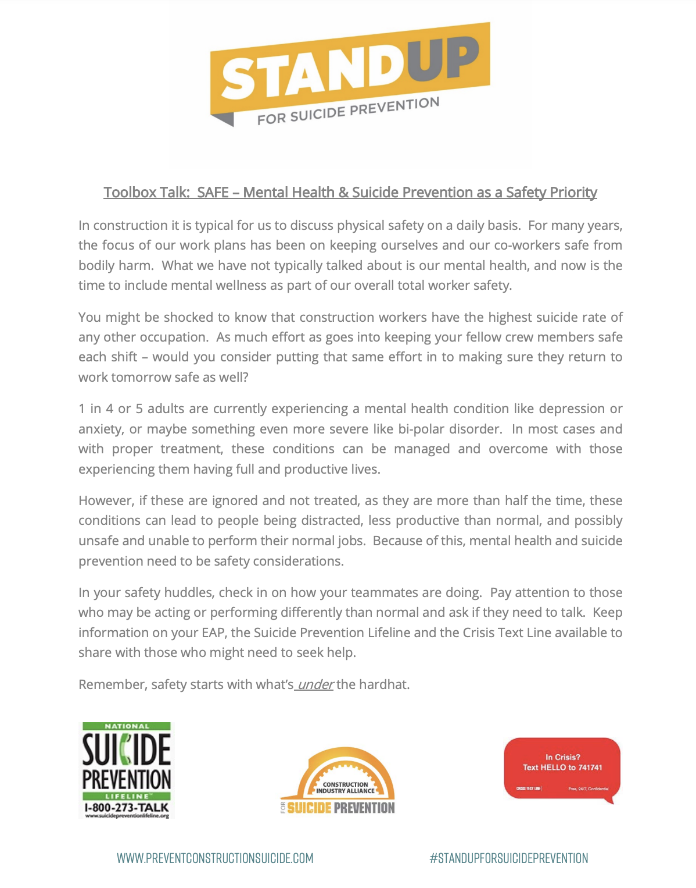
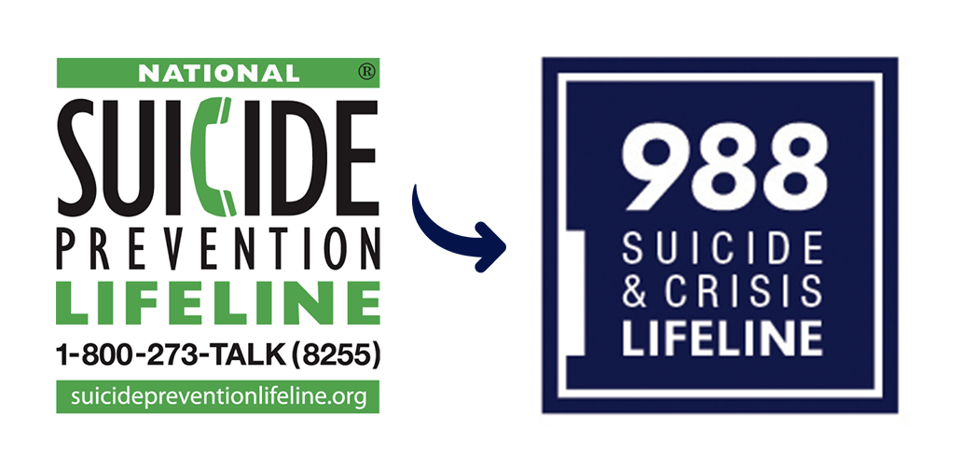
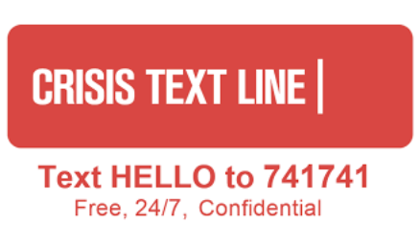
Suicide Prevention Resources
Toolbox Talks & Resources @ www.preventconstructionsuicide.com
LIVINGWORKS Training @ preventconstructionsuicide.com/Training
screening.mentalhealthscreening.org/ciasp

Slide 19
What role does the opioid epidemic play in all of this?
Injured workers in all industries often receive powerful prescription pain medication, including opioids. According to the CDC, 1 out of 4 people prescribed opioids for long-term pain become addicted.
One study linked New Mexico workers’ compensation data for workers injured in 1994 through 2000 with SSA earnings and mortality/cause of death data through 2013.
For men, a lost‐time injury was associated with a 72% increased risk of suicide and a 29% increase in the risk of drug‐related death.
Among women, lost‐time injuries were associated with a near tripling in the risk of drug‐related deaths and a 92% increase in the risk of deaths from suicide.
Construction workers have one of the highest injury rates compared to other industries, making them more likely to be prescribed opioids.
Construction workers also rely on their bodies and often feel the need to overcome pain in order to work and get paid.
Notes:
Source - https://blogs.cdc.gov/niosh-science-blog/2019/08/08/injury-suicide-opioids/#_edn7

Slide 20
Opioids Have No Place in the Workplace
16,416 Prescription Opioid Overdose Deaths
68,630 Opioid Overdose Deaths Overall
Illegitimate Use:
Impairing
Probably a sign of an opioid misuse disorder
Legitimate Use (Prescribed):
Impairing
Addicting
Increases risk of future disability
Delays recovery
Increases medical costs
Less effective than alternatives
Notes:
Opioids are definitely a part of the suicide issue but an issue all on their own - no place at work.
68,630 opioid od deaths overall: https://nida.nih.gov/research-topics/trends-statistics/overdose-death-rates
“Opioid-involved overdose deaths rose from 21,088 in 2010 to 47,600 in 2017 and remained steady in 2018 with 46,802 deaths. This was followed by a significant increase through 2020 to 68,630 overdose deaths.”
16,416 Prescription Opioid Overdose Deaths source: https://nida.nih.gov/research-topics/trends-statistics/overdose-death-rates
“Drug overdose deaths involving prescription opioids rose from 3,442 in 1999 to 17,029 in 2017. From 2017 to 2019, the number of deaths declined to 14,139, followed by an increase to 16,416 in 2020. The bars are overlaid by lines showing the number of deaths involving prescription opioids in combination with synthetic opioids other than methadone (primarily fentanyl) or without any other opioid from 1999 to 2020 (Source: CDC WONDER).”

Slide 21
Duration of acute use:
1 Day = 6% chance of still using the drug a year later
7 Days = 13.5% chance
31 Days = 29.9% chance
Long term use leads to:
Increased sensitivity to/perception of pain
Increased risk of depression
Increased risk of suicide
Acute Rx Leads to Long Term Use
Notes:
Need to educate employees about not taking these longer than needed, about their addictive effects.
Need to manage WC cases to be sure that long term prescriptions are not being issued, work with WC carrier and treating physician.
https://www.cdc.gov/mmwr/volumes/66/wr/mm6610a1.htm

Slide 22
Be a Best-In-Class Employer
Risk Factor | How to Address
Stoic / Tough Guy Mentality “Suck it Up” | Leadership: Zero tolerance for bullying, harassment Sharing of stories of overcoming struggle
Chronic Pain | Injury management programs – stretch & flex – coordination with WC carrier for pain management
Sleep Disruption &/Or Sleep Deprivation | Considering the person and their needs in scheduling
Separation &/Or Isolation | Consideration of the person – creating support structure with solid teams
Layoffs | Communication – Financial Management Education
Alcohol & Substance Abuse | Screening programs – Last Chance Agreements – Leaves available for treatment
Notes:
So what do you do?
Let’s start by looking at the risk factors and how to address them

Slide 23
Be a Best-in-Class Employer
Risk Factor | How to Address
Extreme Pressure / Low Margin for Error | Staff according to need – Reasonable expectations – Celebrate the Wins/Learn from the Losers
Access to Lethal Means | Gun Safety – Reduce Jobsite Access
Poor Access &/Or Utilization of Behavioral Health Care | Education – Confirm Benefits – Build Awareness
Promotion of Supervision without Leadership Training | Address Soft Skills/People Skills – Project Management is different than People Management
Skill Gaps – Feeling Stuck | Train & Develop employees to reach full potential
Large Veteran Workforce | Have a plan to accommodate physical and emotional needs – Partner with Veteran organizations
Notes:
So what do you do?
Let’s start by looking at the risk factors and how to address them

Slide 24
Drug free workplace policies:
Should be used as a safety/health tool for workers
Update to include random drug screens on employees in safety sensitive positions
Refer positive tests to an EAP that can evaluate and treat Opioid Use Disorder
Educate employees about the dangers of opioids

Slide 25
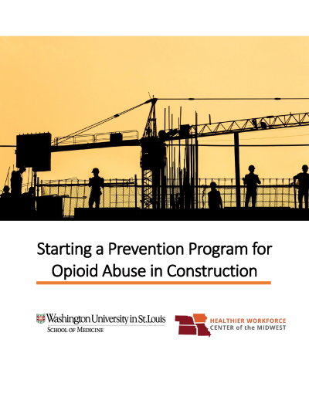
Resources to Reduce Opioid Use in Construction
CPWR – The Center for Construction Research & Training – collection of resources to prevent opioid deaths in construction
Opioid Awareness Training Program
Healthier Workforce Center of the Midwest – Opioid Management Guidelines for the Construction Trades
Washington University in St. Louis/Healthier Workforce Center of the Midwest – Starting a Prevention Program for Opioid Abuse in Construction

Slide 26
Notes:
Review organization – what the STAND up stands for – take the pledge.

Slide 27
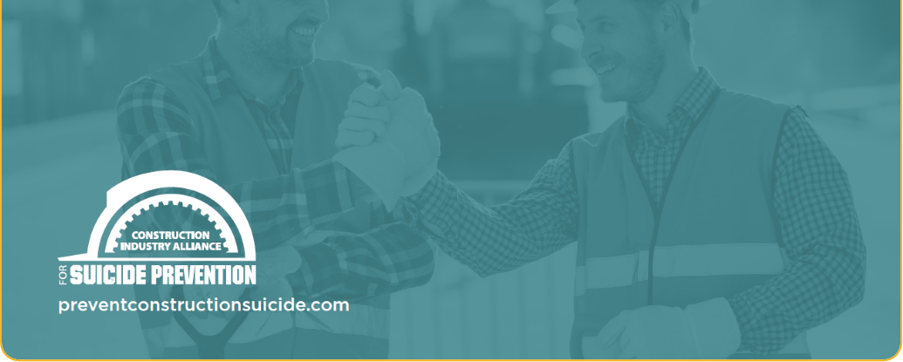
Take the pledge, download resources, order supplies, access free training and screening tools, and donate at
www.preventconstructionsuicide.com

