Slide 1
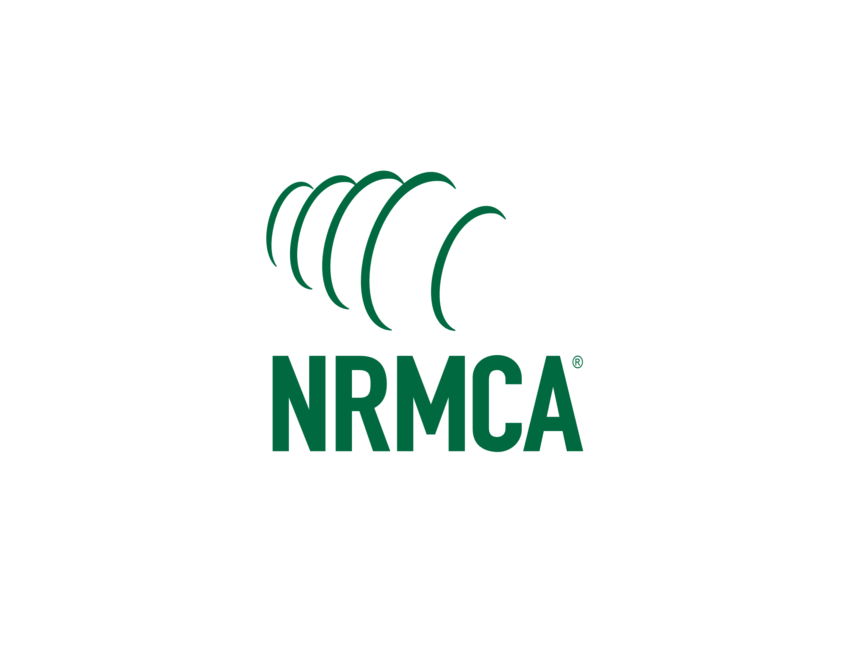
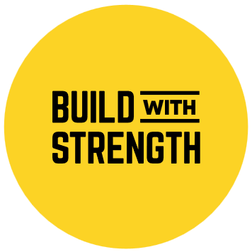
Resiliency: Consideration Beyond Code Requirements
Shamim Rashid-Sumar, PE, FSFPE
Senior Vice President, Codes & Standards
Notes:
I’d like to thank everyone for joining the presentation today, and a special thank you to the organizers of New York Build for inviting me to speak with you today.
We are going to be talking Resiliency today, this presentation is an intro or a primer to the concept of resiliency to the architecture, design and construction community, to communicate a sense of why resiliency should be an important consideration beyond minimum code requirements and provide a sense of scale to the impact that natural disasters pose to our society today.

Slide 2
About the Course
Learning Objectives
Recognize the increased risks from natural hazards and how resilient construction can support long-term sustainability by addressing life safety and building functionality
Identify approaches to mitigate the effects of natural hazards
Underpin a community’s economic vitality and safety through natural hazard mitigation
Demonstrate the importance of incorporating resilient standards in construction.
Notes:
Over the past several decades, there has been a continuous increase in human and economic loss from disaster events. The rise in disasters and their consequences is related to a rise in people’s vulnerability, induced by human development. However, examples of resiliency planning and more stringent building code requirements still lag. This presentation offers a view on emerging risks and opportunities as human and economic losses from disasters increase, with the overarching goal of supporting and advancing resilience in future construction of buildings and critical infrastructure.
At the end of this program, participants will be able to:
Recognize the increased risks from natural hazards and how resilient construction can support long-term sustainability by addressing life safety and building functionality
Identify approaches to mitigate the effects of natural hazards through both voluntary and mandatory strategies such as adopting updated building codes and high-performance standards, incentivizing disaster resilient construction and building with robust materials
Underpin a community’s economic vitality and safety through natural hazard mitigation
Demonstrate the importance of incorporating resilient standards in construction through enhanced building codes, fortified programs, and rating systems

Slide 3
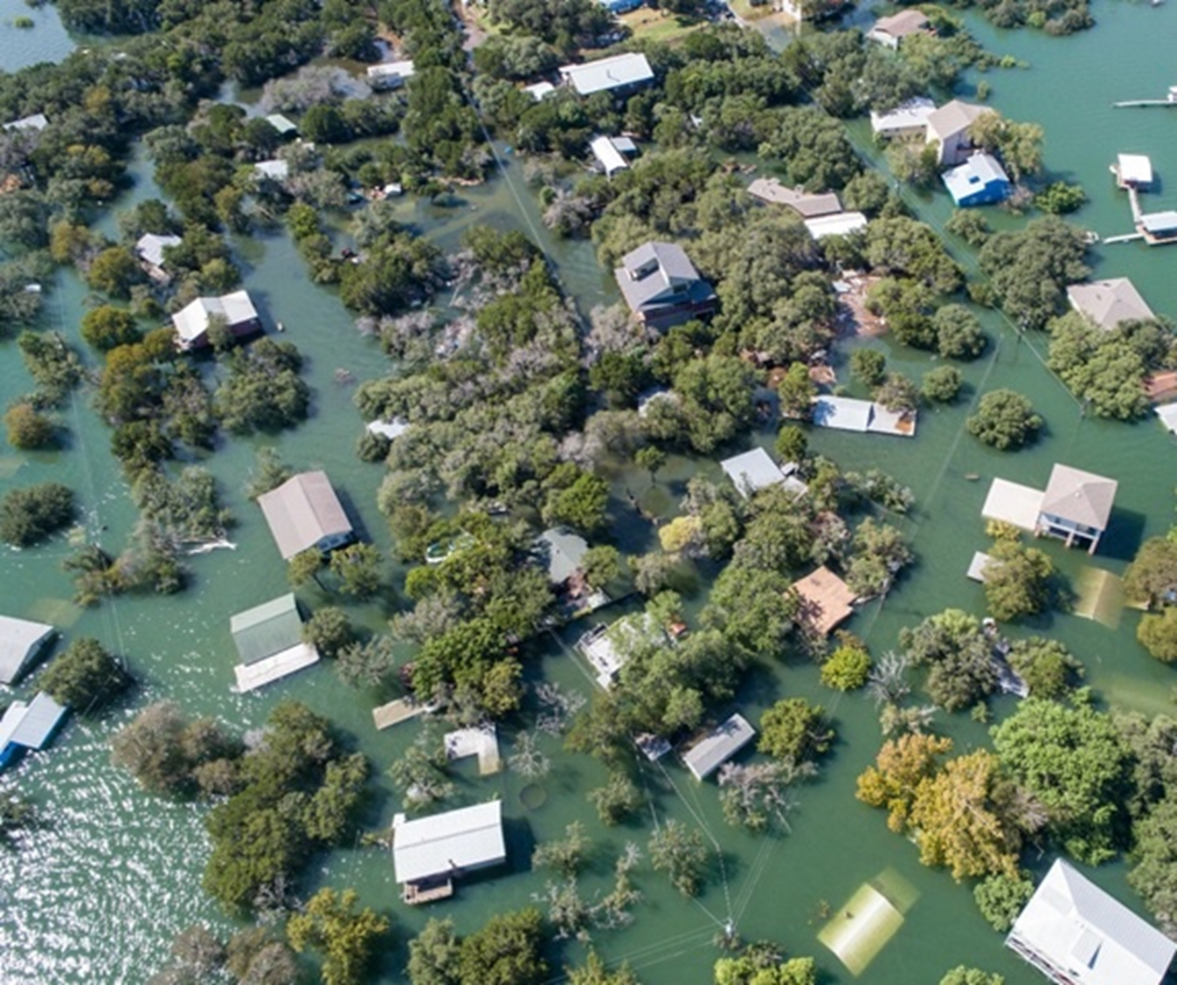
Contents
The Impact of Fire and other Natural Disasters
Definition of Resilience
Steps to Disaster Resilience
Quantifying the Benefits of Resilient Construction
Case Studies
Conclusions
Photo credit: RoschetzkyIstockPhoto
Notes:
Over the past several decades, there has been a continuous increase in human and economic loss from disaster events. The rise in disasters and their consequences is related to a rise in people’s vulnerability, induced by human development. However, examples of resiliency planning and more stringent building code requirements still lag. This presentation offers a view on emerging risks and opportunities as human and economic losses from disasters increase, with the overarching goal of supporting and advancing resilience in future construction of buildings and critical infrastructure.

Slide 4
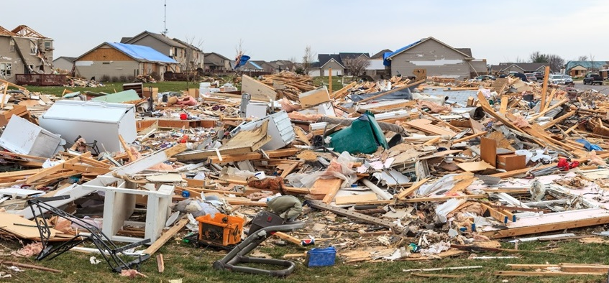
The Impact of Natural Disasters
Photo credit: ghornephoto/iStock
Notes:
When I say impact of fire and other natural disasters, we are going to focus heavily on the costs of natural disasters versus the cost to build for resilience

Slide 5
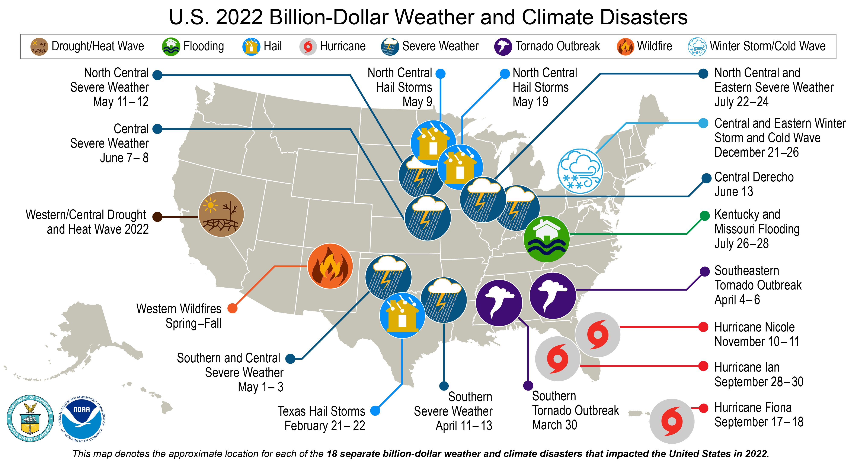
The Impact of Natural Disasters
For millions of people in the U.S., the consequences of natural disasters have become increasingly real, personal, and devastating.
In 2022, there were 18 separate weather and climate disaster events with losses exceeding $1 billion each across the United States.
2022 is the eighth consecutive year (2015-2022) in which 10 or more billion-dollar weather and climate disaster events have impacted the United States.
Credit: National Oceanic and Atmospheric Administration https://www.ncei.noaa.gov/access/billions
Notes:
2. These events in 2022 included 1 drought event, 1 flooding event, 11 severe storm events, 3 tropical cyclone events, 1 wildfire event, and 1 winter storm event.
Overall, these events resulted in the deaths of 474 people and had significant economic effects on the areas impacted.
That’s a lot of fatalities, when you consider 262 deaths in 2020 and 44 people losing their lives in these disasters in 2019.
[The 1980–2022 annual average is 7.9 events (CPI-adjusted); the annual average for the most recent 5 years (2018–2022) is 17.8 events (CPI-adjusted).]
Over the last 42 years (1980-2022), the years with 10 or more separate billion-dollar disaster events include 1998, 2008, 2011-2012, and 2015-2022.
https://www.ncdc.noaa.gov/billions/

Slide 6
The Impact of Natural Disasters
According to the National Oceanic and Atmospheric Administration (NOAA), 2017 was the costliest year on record for natural disasters in the U.S., with a price tag of at least $306 billion.
Requests for federal disaster aid increased tenfold in 2017 compared to 2016, with 4.7 million people registering with the Federal Emergency Management Agency (FEMA).
These once-rare events are becoming more common and costlier according to NOAA. Hurricane Harvey’s record flooding in Houston was the city’s third 500-year flood event in as many years.
Notes:
1. According to the National Oceanic and Atmospheric Administration (NOAA), HOWEVER, 2017 was the costliest year on record for natural disasters in the U.S., with a price tag of at least $306 billion.
Hurricane Harvey broke a rainfall record for a single tropical storm with more than 4 feet of rain in southeast Texas matching Hurricane Katrina as the costliest tropical cyclone on record.
Puerto Rico is still mired in recovery after Hurricane Maria in 2017, and nearly 3,000 are estimated to have died in the storm and its aftermath.

Slide 7
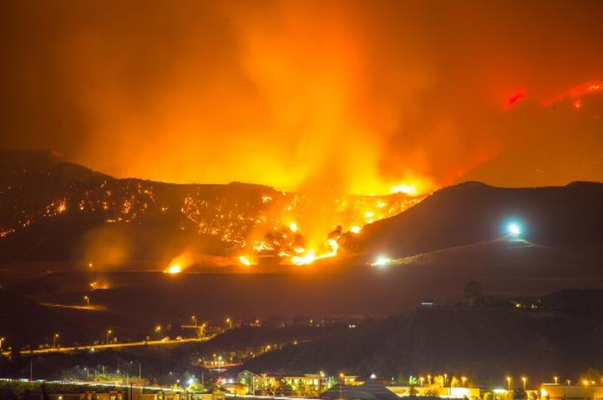
Cost of Wildfires
According to Verisk Insurance Solutions, 4.5 million U.S. homes are at high or extreme risk of wildfire, with more than two million in California alone.
According to Munich RE, a reinsurer, there have been $23.1 billion in losses to wildfires in the U.S. over the past five years.
2017 was by far the worst year with $17 billion losses and that number will likely continue to grow due to climate change which is creating warmer and drier conditions.
Photo credit: FrozenShutter / iStock
Notes:
Here are some statistics on the Cost of Wildfires in the United States.

Slide 8
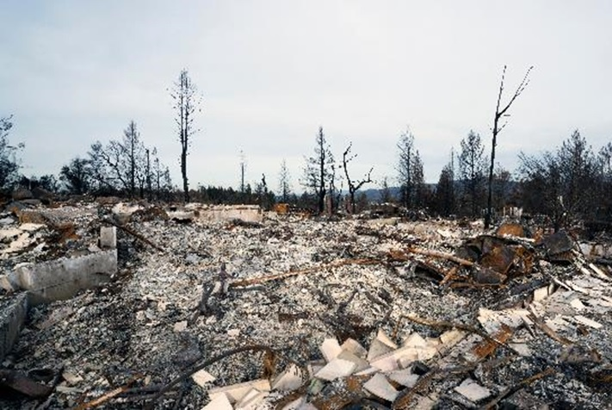
Aftermath of Wildfires
According to the Bloomberg Businessweek article Why Is California Rebuilding in Fire Country? Because You’re Paying for It!, the 1964 Hanley Fire in Sonoma County destroyed 100 homes whereas the 2017 Tubbs Fire, which covered nearly the same area, destroyed more than 5,000 homes and killed 22 people.
The Tubbs Fire was one of 131 across California in October of 2017. By the end of 2017, more than 1 million acres and 10,000 buildings had been destroyed.
Photo credit: Janos Rautonen/Shutterstock
Notes:
0. As we continue to build near fire prone areas, damages caused by wildfires will continue to increase.
2. What is most surprising is that instead of building back to higher standards after the devastating fires, California policymakers are issuing permits to rebuild without updating building codes and even exempting residents from zoning rules so they can build even larger homes. State officials are even mandating that insurance companies not raise insurance rates for people in fire-prone areas thus passing the cost onto homeowners elsewhere in California.
The state paid nearly $700 million in fire suppression in 2017 [yet California Governor Jerry Brown suspended the fee homeowners in fire prone areas pay to offset the higher risk of wildfires.]

Slide 9
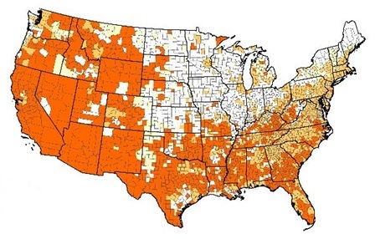
Wildfire Risk
Although recent attention has been on California because of the major wildfires in 2017, there are wildfire risks in most states.
According to Forest and Rangelands, the map shows the counties with the greatest risk of wildfires characterized by the higher-than-average annual area burned, structures lost, and homes exposed within the wildland urban interface.
U.S. Wildfire Risk
High
Moderate
Low
Very low
Image courtesy of: https://www.forestsandrangelands.gov/

Slide 10
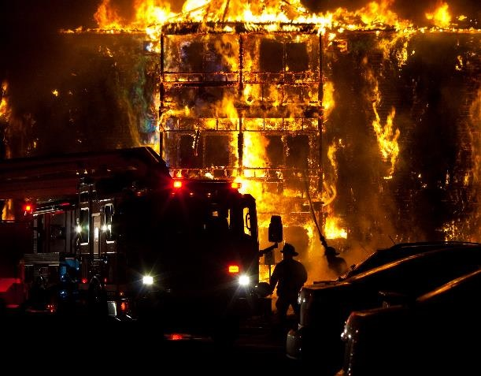
Proper Damage Due to Fires
According to NFPA, there were 499,000 structure fires in 2017, causing 2,815 civilian deaths, 12,160 civilian injuries, and $23 billion in damages.
NFPA estimates 262,500 fires occurred in homes resulting in 2,290 deaths, 7,470 injuries, and $6.1 billion in damages, and 95,000 occurred in apartment buildings resulting in 340 deaths, 3,130 injuries, and $1.6 billion in damages. Property damages from fires have been increasing over time.
Photo credit: REKINC1980/iStock
Notes:
Structure fires, whether caused by accident, arson, or wildfires result in significant loss of life and property each year.
FIRE KILLS MORE AMERICANS THAT ALL NATURAL DISASTERS COMBINED.
Designing buildings using a balanced design approach—combining active and passive fire protection strategies—can help save lives and reduce property damage.

Slide 11
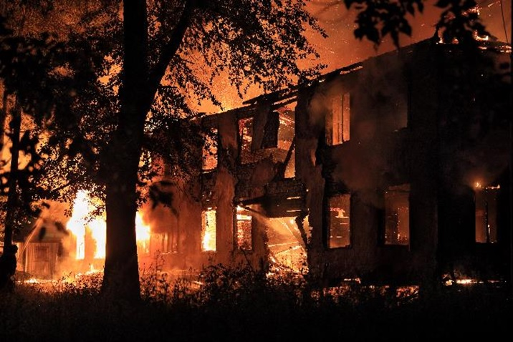
Proper Damage Due to Fires
Developers have increased the use of combustible wood-frame construction for multifamily construction (apartments, condominiums, hotels, dormitories, and long-term care facilities) resulting in a rash of fires across the country that are reducing these buildings to ashes, putting lives and communities at risk.
Photo credit: whiterabbit83/iStock
Notes:
As a result of relaxed building codes, developers have increased the use of combustible wood-frame construction for multifamily construction (apartments, condominiums, hotels, dormitories, and long-term care facilities) resulting in a rash of fires across the country that are reducing these buildings to ashes, putting lives and communities at risk.
According to the article America Is Burning, by Build with Strength, “The recent spate of fires in low- and mid-rise structures throughout the country is raising questions and concerns about the safety of wood-frame buildings,” of this size.

Slide 12
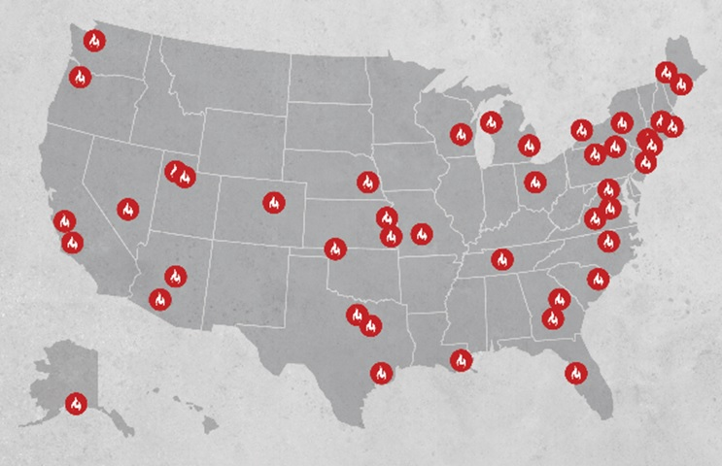
Massive Structure Fires
Not only are these wood-frame building fires total losses, but they often cause considerable damage to surrounding buildings and property.
Massive structure fires in multifamily buildings built using wood-frame have become commonplace since the building codes have relaxed the requirements for passive fire protection.
Image courtesy of: Build with Strength, www.buildwithstrength.com/america-is-burning
Notes:
[Communities and surrounding businesses often don’t survive.
Not only must businesses and residents endure the disruption of construction of the original building, but they then must endure further losses from business disruption and relocation while the new building is rebuilt after one of these devastating fire events.]
When we talk about building code requirements, It should be noted that codes are the minimum requirements not the highest performing systems or buildings.
Codes are the minimum requirements – “the basement”
Worst building you can legally build

Slide 13
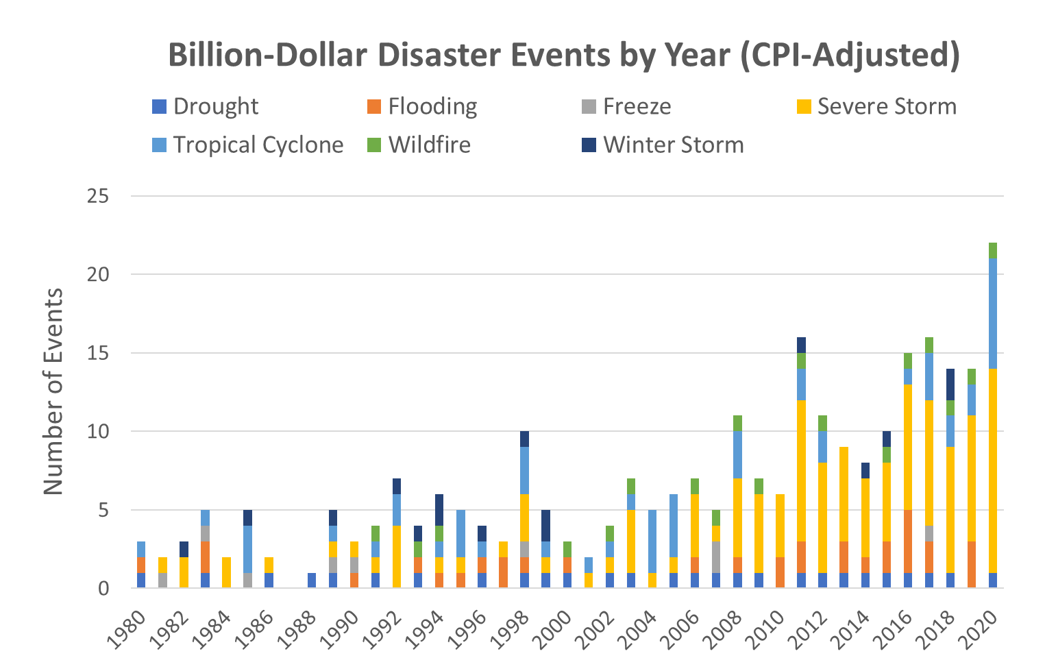
Billion-Dollar Disaster Events on the Rise
You can see in this graph adapted from the NOAA that billion-dollar disaster events are increasing.
Notes:
You can see in this graph adapted from the NOAA that billion-dollar disaster events are increasing.

Slide 14
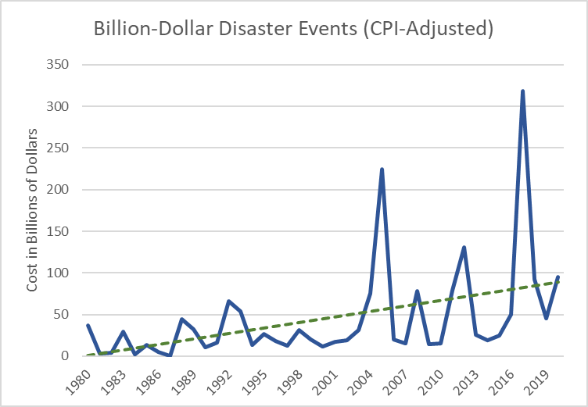
Cost of Billion-Dollar Disaster Events
This graph (adapted from the NOAA) shows the upward trend of the cost of disaster events.
Notes:
Cost of billion dollar disaster events
2017 – 318.6
2018 – 92.1
2019 – 45.4
2020 – 95.0

Slide 15
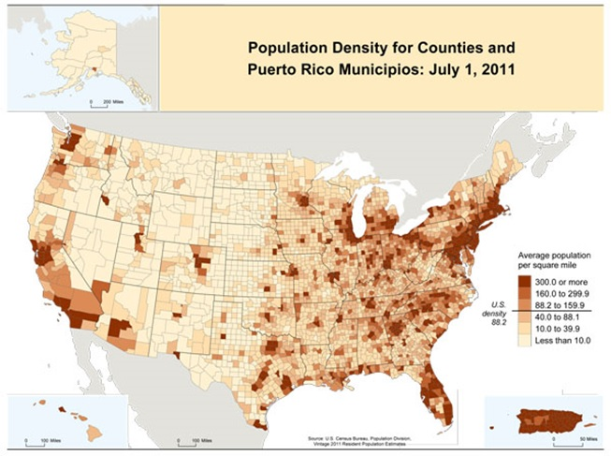
Why Are Disasters Costing More?
Over 60% of the U.S. population lives within 50 miles of one of its coasts, including the Great Lakes. At the same time, wealth and the value of possessions have increased substantially.
These changes in concentration of population and property values are significant contributors to the increased human and property loss.
Image courtesy of: www.census.gov
Notes:
0. This is because According to the United States Census Bureau, in the last several decades, population in the United States has increased and migrated toward the coasts, concentrating along the earthquake-wildfire-prone Pacific coast and the hurricane-prone Atlantic and Gulf coasts.
1. For example, while California’s Los Angeles County accounts for only 2.5% and Florida's Miami-Dade County accounts for only 14% of their respective states land area, they contain 30% of their state’s property value.
4. It’s time to rethink the way we build to meet the challenge of the next natural disaster.

Slide 16
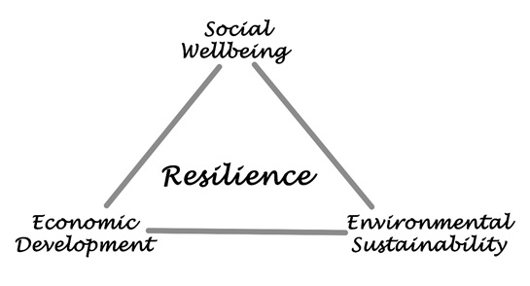
What Is Resilience?
There are several definitions of resilience. The Urban Land Institute (ULI) defines resilience as “the ability to prepare and plan for, absorb, recover from, and more successfully adapt to adverse events.”
Basically, addressing changes in the environment, whether the changes are natural or man-made, requires actions to mitigate their negative effects and adapt to those changes.
Notes:
0. This leads us to the definition of Resilience. The dictionary definition for resilience is “The capacity to recover quickly from difficulties; toughness.”
1. Expressed in other words, resilience is the time it takes a community to recover from a natural disaster, such as fire or other …

Slide 17
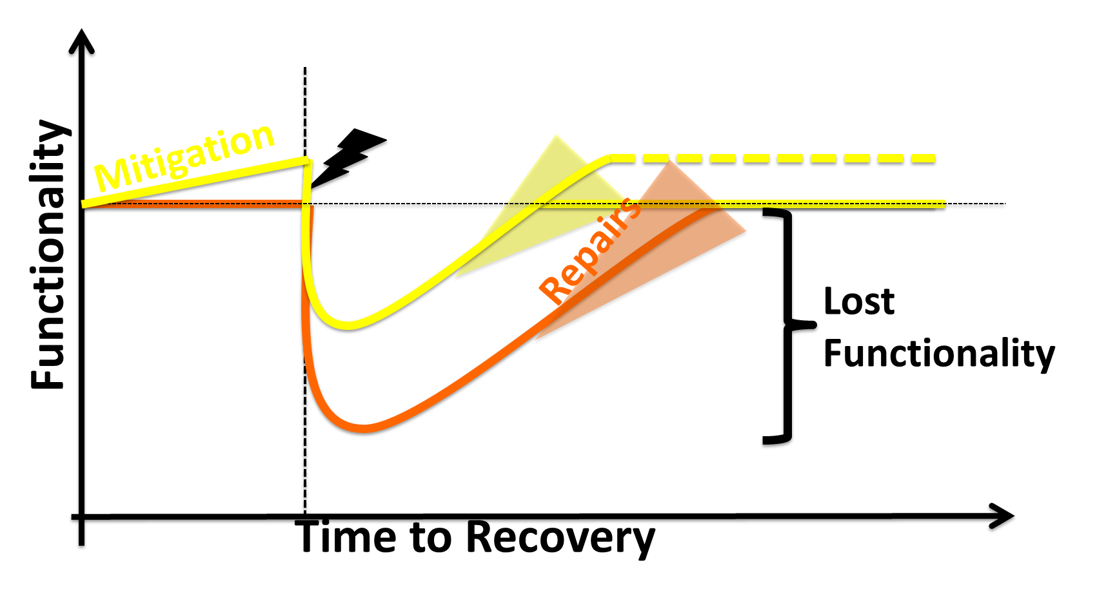
Resilience and Sustainability
For a building to be sustainable, one must consider potential for future use and reuse and design for long-service life with minimal maintenance costs.
There is significant guidance on reducing environmental impacts with green building codes and rating systems such as LEED, International Green Construction Code (IgCC), Green Globes, among others. But the guidance for designing a building to adapt to and mitigate the effects of natural hazards are now only beginning to take shape.
Notes:
0. If we identify resiliency, not solely as a state of preparedness for disaster (such as stocking up on food and water and having a plan in place to search and recover people in distress), but as a desired characteristic of a sustainable society, one that has more control of its basic human needs such as shelter, food, water, energy, communications, and commerce, we can begin to see the relationship between resilience and sustainability.
For a community to be truly resilient it must address all human needs to some degree, but the very basic of all human needs is shelter. This means designing buildings to resist hazards such as flooding, wind, sea level rise, wildfires, and other hazards.
1. Otherwise, the environmental, economic, and societal burden of our built environment could be overwhelming. A building that requires frequent repair and maintenance or complete replacement after a disaster would result in unnecessary cost, from both private and public sources, and environmental burdens including energy, waste, and emissions due to disposal, repair, and replacement.
Of course, it’s one thing to describe resilience in generalities and another to design a building to mitigate natural disasters.
As I mentioned earlier in the presentation, Building Code Minimums are not adequate to ensure resident comfort, security or safe harbor from threats.
If you don’t insist on more resilient “code-plus” design, minimum is most likely what you will get.

Slide 18
Evolution to Resilience Based Design
Code Based Design
Only considers design and construction
Performance Based Design
Only considers design and construction
Resilience Based Design
Considers complete life cycle of building
Prescriptive
Individual buildings only
Individual buildings
Addresses externalities
Considers relationship to community/company
Portfolio assessment
Safety Only
Safety, Damage, Recovery
Safety, Damage, Recovery
Spreads costs among capital, operations and reserves
Part of comprehensive resilience framework
Advanced analysis
Capital intensive, occasional insurance impacts
Capital intensive

Slide 19
Steps to Disaster Resilience
Photo credit: Robert Kaufmann/FEMA Photo by Robert Kaufmann
Notes:
How do we address or incorporate disaster resilience into our design and planning process?

Slide 20
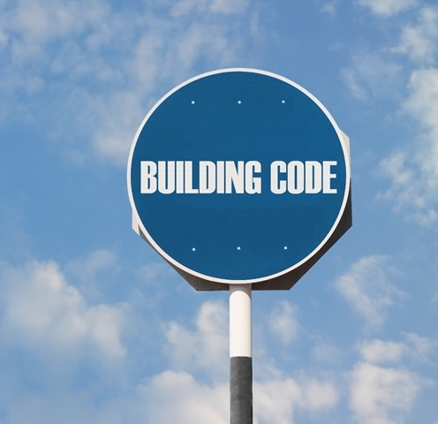
Steps to Disaster Resilience
The following are steps, combining both voluntary and mandatory mitigation strategies, to achieving disaster resilience:
Adopt Updated Building Codes
Adopt High Performance Building Standards
Incentivize Disaster Resilient Construction
Build with Robust Materials
Notes:
There are essentially two ways to approach disaster mitigation. There are voluntary programs where communities or building owners voluntarily reduce their risk of natural disaster through enhancements in structures, warning systems, and education.
The second approach is to install mandatory building requirements such that communities and building owners are obligated to design buildings and infrastructure to be more disaster resilient.

Slide 21
Adopt Updated Building Codes
A common misconception is that a new code-compliant building in the U.S. will be resilient against considerable damage after a major hazard event.
This is not always the case. The building code sets standards that guide design and construction of structures for minimum Life Safety, the first step towards resilience.
However, maintaining the functionality of structures after a disaster is also important and building codes do not address functionality effectively.
Sadly, special interest groups have convinced some state legislatures to reduce the stringency or limit the adoption of the latest building code.
Notes:
To date Texas, Mississippi, Alabama, and Delaware [to name a few] still do not have a statewide building code but pass the responsibility to the local jurisdictions to adopt the codes themselves. Florida, the state that faces more hurricanes than any other decided in 2017 to weaken its code adoption process.
The North Carolina state legislature decided to placate homebuilders and update the building code only once every six years instead of every three. Builders claimed that weaker code makes it easier and cheaper to build in North Carolina, but new homes were ill-prepared for Hurricane Florence’s high winds, storm surge, and rainfall.
These states are not alone. Unchecked development remains a priority for powerful lobbyists, creating short-term economic gains for some while increasing risks for everyone else. As a result, the American public are footing the bail-out bill to the tune of $90 billion in disaster relief.
If we are to take people’s vulnerability seriously, we must deploy—and insist on—much greater emphasis in mandatory code adoption.
While the design community can provide some of the expertise, their voices are not being effectively considered on the planning and policy level.
The missing element is participation among practitioners, the development community, and policy makers interested in public safety over economic opportunism.

Slide 22
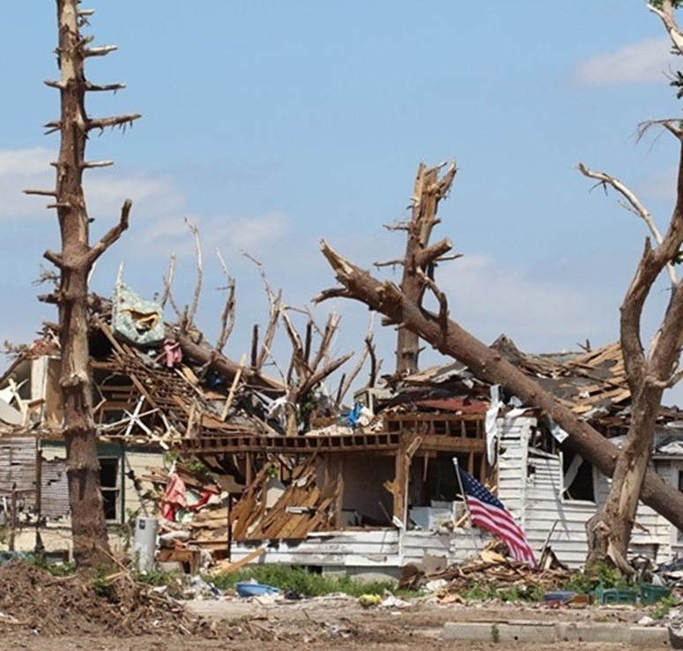
Adopt High Performance Building Standards
The following are programs and standards aimed at incorporating resilient building techniques into construction to provide an optimum level of protection against a variety of natural hazards:
Enhanced building codes
FORTIFIED for Safer Living and Safer Business
USRC Building Rating System
REDi Rating System
RELi Rating System for Resilience
Photo credit: RapidEye/iStock
Notes:
I mentioned earlier that building codes represent the bare minimum level of compliance.
0. Resilient buildings should consider a higher level of performance to protect property.
Property protection means the building can withstand impacts and continue to provide its primary functions after a major disruptive event.
The idea here is that….
[Buildings should not be a burden on their communities. They should have sufficient functionality after a hazard event and not place excessive demand on community resources such as emergency responders including fire, police, and hospitals.
Communities with disaster resilient buildings are more likely to be able to operate schools and businesses after a disaster.
Stronger homes and buildings mean people will have places to live and work after a disaster.
Less disruption for a community means robust commerce and consistent tax revenue.] Many of us of course are living through what disruption looks like right now because of COVID-19.

Slide 23
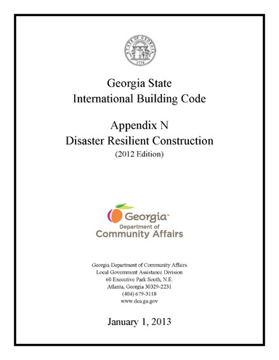
Adopt High Performance Building Standards
Enhanced building codes can be developed and adopted through the building code appendices. The appendices are provided in the International Building Code (IBC) and the International Residential Code (IRC) to offer supplemental criteria to the provisions in the main chapters of the code.
After damaging windstorms in 2008, the Georgia Department of Community Affairs created the Disaster Resilient Building Construction (DRBC) appendices to the IBC and IRC, which form the basis for the Georgia State Building Code.
The DRBC appendices offer an affordable, flexible, and simplified approach to improving resiliency at the local level. Local jurisdictions can adopt the complete appendices to improve building resiliency against flooding and high winds, or they can adopt select sections that apply to specific hazards in their geographic area.

Slide 24
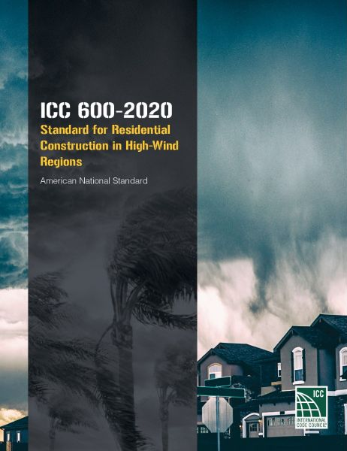
Adopt High Performance Building Standards
COMING SOON!
ICC 605: Standard for Residential Construction in Regions with Wildfire Hazard
Notes:
ICC Multi-Hazard Resiliency for Residential Construction Committee (IS-MHRRC)
ICC 610: Standard for Residential Construction in Regions with Seismic Hazard ICC 615: Standard for Residential Construction in Regions with Tsunami Hazard

Slide 25
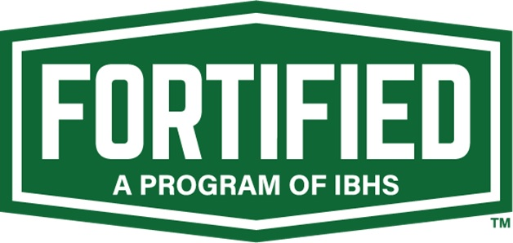
Adopt High Performance Building Standards
The FORTIFIED for Safer Living and Safer Business are programs of the Insurance Institute for Business and Home Safety (IBHS).
The program provides enhanced design criteria relative to code minimum and the necessary construction and inspection oversight to ensure high performing structures that are truly disaster resilient.
The IBHS is a not-for-profit applied research and communications organization supported by the insurance industry.

Slide 26
Adopt High Performance Building Standards
The U.S. Resiliency Council (USRC) is a national organization dedicated to improving the sustainability and resiliency of buildings during earthquakes and other natural hazards.
The performance-based USRC Building Rating System assigns one to five stars along the dimensions of Safety, Damage, expressed as repair cost, and Recovery, expressed as time to regain basic function.
Certified buildings are expected to perform in a manner that will preserve life safety of the occupants, limit damage to repairable levels, and allow functional recovery within a reasonable time period after a major seismic event.
USRC has a rating system for earthquakes and is working on other hazards.

Slide 27
Adopt High Performance Building Standards: The REDi Rating System
The REDi (Resilience-based Earthquake Design Initiative) Rating System is a set of specific design performance criteria which aims to minimize building damage and promote contingency planning for utility disruption and other threats to functional recovery. The success of the resulting design in meeting specific monetary loss and recovery time is demonstrated by performing a modified FEMA P-58 loss assessment developed specifically for REDi.
The RELi standard is a point-based system recently adopted by the U.S. Green Building Council (USGBC). It includes many LEED-centric credits along with risk mitigation credits at the building and neighborhood scale. The intent is to provide greater adaptability and resilience to weather and other natural hazards in the built environment as a compliment to LEED. USGBC is currently refining RELi to provide a comprehensive list of resilient design criteria.

Slide 28
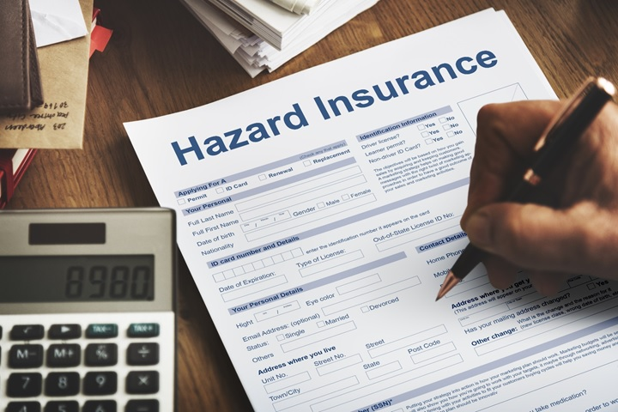
Incentivize Disaster Resilient Construction
According to Munich RE, insurance companies took a $135 billion hit from natural disasters experienced around the globe in 2017.
Half of all losses were in the U.S., and North America representing 83 percent of all insured losses last year.
The three successive Atlantic hurricanes—Harvey, Irma, and Maria—cost major U.S. insurers at least $14.5 billion. This made it the costliest year ever for insurers.
Photo credit: Rawpixel.com/Shutterstock

Slide 29
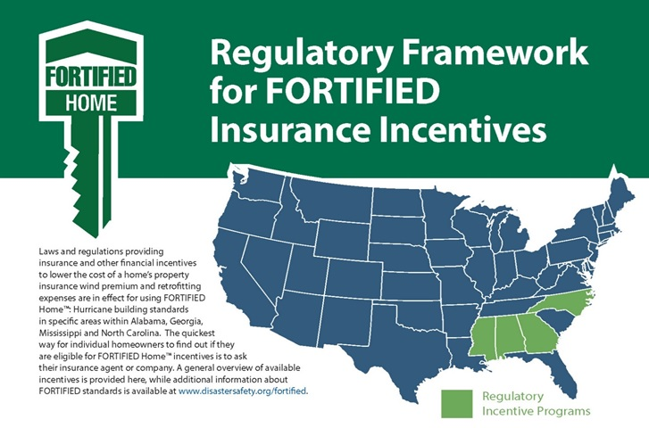
Incentivize Disaster Resilient Construction
Resilient buildings reduce the risks associated with property insurance. States can encourage building owners to build resilient structures by legislating insurance premium reductions to all policy-holders if they build to specific resilient design criteria.
Alabama, Georgia, Mississippi, North Carolina, and Oklahoma have enacted such laws. These states now require insurers to lower the cost of property insurance for building to the IBHS FORTIFIED standard.
Notes:
Oklahoma – Mandatory rebates (residential)
All other states are voluntary programs, Mississippi and Alabama: rebates for commercial properties in addition to residential

Slide 30
Incentivize Disaster Resilient Construction
Hazard mitigation increases loan security for lending institutions and decreases business interruptions and improved bond ratings for property owners and communities. Therefore, other potential incentives should be encouraged:
Building permit rebates
Property tax reductions
Accelerated local permitting and inspection procedures for resilient properties
Zoning benefits, e.g. density or height bonuses
More-favorable developer agreements for the construction of resilient properties
Revolving loan programs

Slide 31
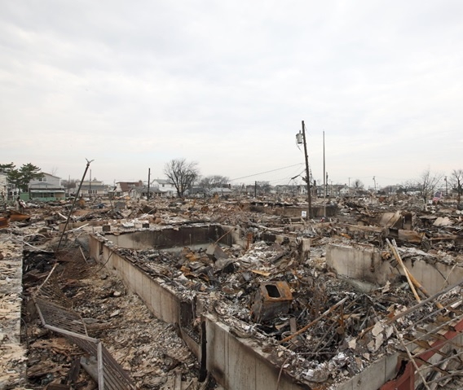
Build with Robust Materials
The last step towards disaster resilience is to build with robust building materials. Some of the qualities of robust building materials include versatility, strength, wind and water resistance, seismic resistance, fire resistance, energy efficiency, and durability.
Structural fires frequently occur after a natural disaster. Of all disasters, fire is by far the most common and the deadliest. The U.S. Fire Administration reports that every year, fire kills more Americans than all other natural disasters combined.
Photo credit: Steven Greaves/Alamy Stock Photo
Notes:
It is heartbreaking for a homeowner to survive a major earthquake, hurricane, or tornado only to witness their home burn down in the aftermath. This was the case in Breezy Point, New York after Hurricane Sandy in 2012.
Increased fire resistance of building elements reduces the amount of damage to the building and its contents. Additional benefits are enhanced life safety, less demand on community resources, especially for emergency response, and facilities that are more readily adaptable for reuse.
As population grows in the western states, we witness increased conflagrations from wildland-urban interfaces that devastate property, lives, and economic growth. Regardless of location, the best approach to reducing fire losses can be accomplished by adopting Appendix D of the IBC which establishes Fire Districts where combustible construction is limited.
The image shows burned-out buildings and debris in the aftermath of Hurricane Sandy in Breezy Point, New York on November 11, 2012.

Slide 32
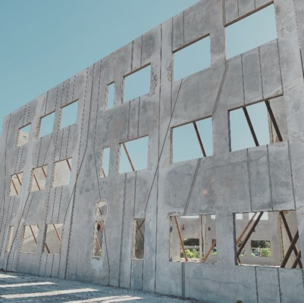
Insulating Concrete Form System
Concrete building systems are especially suited to provide resistance to natural hazards. Leslie Chapman-Henderson, president of the Federal Alliance for Safe Homes, called concrete homes “the ideal” for withstanding extreme weather. Concrete has the necessary hardness and mass to resist the high winds and flying debris of tornadoes and hurricanes.
Concrete is fire resistant and non-flammable, which means it can contain fires and will not contribute to the spreading of fire. Reinforced concrete framing systems can be designed to resist the most severe earthquakes without collapse. Concrete doesn’t rot or rust even if it is subject to flooding.
The image shows a tilt-up concrete wall system.
Photo credit: Little Diversified Architectural Consulting

Slide 33
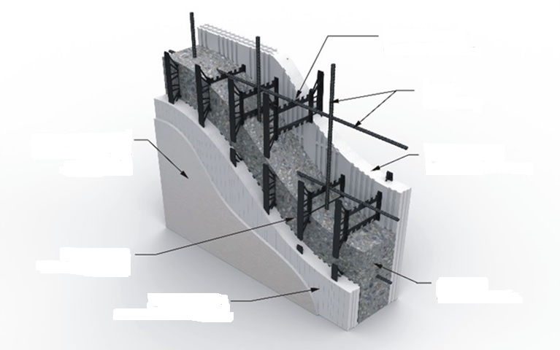
Insulating Concrete Form System
The image shows an example of an insulated concrete form (ICF) wall. In this type of concrete wall, the outer edges are EPS insulation 2 ⅜″ to 2 ¾″ thick. This forms continuous insulation on both sides of the wall.
The interior of the wall is comprised of concrete 4″ to 12″ thick and plastic ties placed 6″ to 8″ on center.
The ties determine the thickness of the total wall as per specs, offer form support during concrete placement, and help to eliminate thermal bridging.
Plastic ties 6″ to 8″ on center
Steel reinforcing
Gypsum wallboard screwed directly to the furring strips
EPS insulation 2 ⅜″ to 2 ¾″ thick
Furring strips 6″ to 8″ on center
Concrete 4″ to 12″ thick
EPS insulation 2 ⅜″ to 2 ¾″ thick

Slide 34
Quantifying the Benefits of Resilient Construction

Slide 35
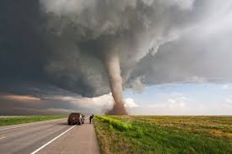
Quantifying the Benefits of Resilient Construction
There are several studies that attempt to quantify the benefits of resilient construction:
Urban Land Institute (ULI): Returns on Resilience: The Business case
NRMCA Insurance Cost Study
National Institute of Building Sciences (NIBS)
MIT Break-Even Mitigation Percentage Tool
Notes:
0. Building to a higher standard potentially adds cost and for an owner to accept the higher initial cost there must be convincing evidence of long-term savings.

Slide 36
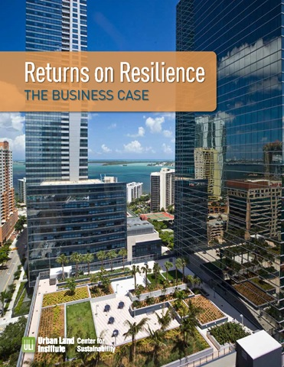
A. Urban Land Institute (ULI)
In their report Returns on Resilience: The Business Case, by the Urban Land Institute, ULI explores the economic benefits of resilient construction. The report presents ten detailed case studies that demonstrate cost savings from implementing resilient strategies.
In all cases, the projects were able to demonstrate economic justification for spending more up front to design and build resilient structures.
Notes:
The study is based primarily on interviews with developers, property owners, and their consultants to identify motivations to protect assets against climate-related threats, what resilience strategies were selected, the design and development processes, and ultimately the projects’ performance.
Hazards addressed included inland flooding, drought, hurricane wind, and storm surge.

Slide 37
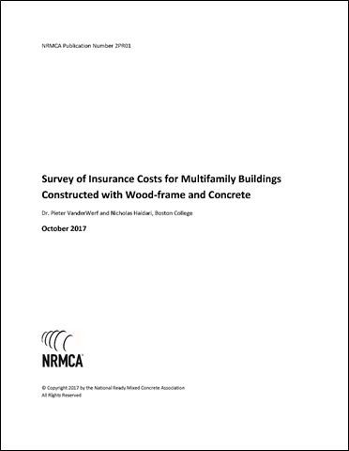
B. NRMCA Insurance Cost Study
The National Ready Mixed Concrete Association (NRMCA) undertook a research study to understand if insurance companies offered lower insurance rates for structures built using noncombustible materials for both builder’s risk insurance and commercial property insurance.
According to a report Total Cost of Fire in the United States by the Fire Protection Research Foundation and the National Fire Protection Association, the total cost of fires in 2014 was $328.5 billion, equaling 1.9% of the U.S. Gross Domestic Product.
https://www.nrmca.org/association-resources/codes-and-standards/
Notes:
1. One of the main drivers behind the study was the enormous loss in buildings each year due to structure fires.

Slide 38
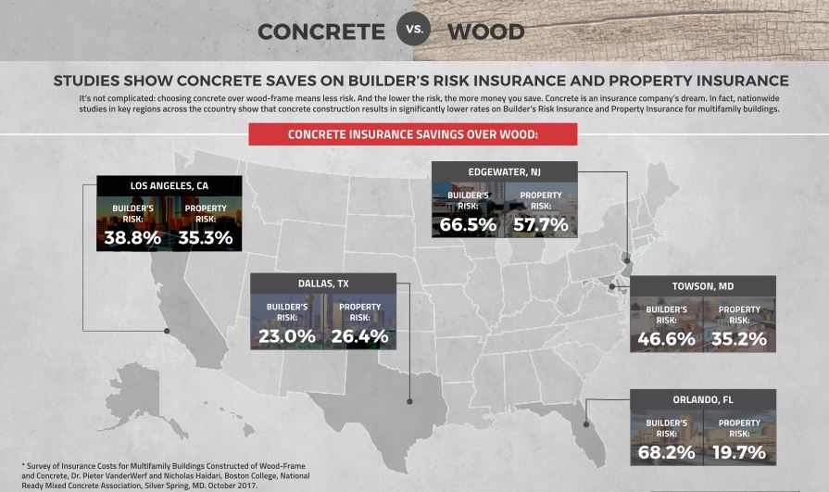
B. NRMCA Insurance Cost Study
The NRMCA study, titled Survey of Insurance Costs for Multifamily Buildings revealed that insurers are aware of the risks of building with combustible construction and the benefits of building with noncombustible construction.
Notes:
According to the study, some agents suggested that the gap between rates for wood frame and concrete is likely to grow in the future and that a growing number of insurers are declining to serve as sole insurer for wood‐frame apartment buildings.
Additionally, insurers of such buildings are increasingly requiring that the insured take extra measures to protect against fire loss.

Slide 39
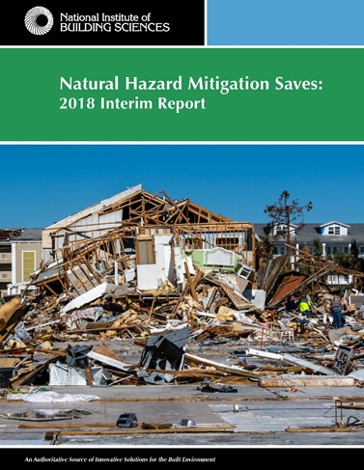
C. National Institute of Building Sciences (NIBS)
NIBS undertook a study in 2017 to quantify the value of designing buildings to exceed the 2015 IBC or IRC for hazards including riverine flooding, hurricane surge, wind, earthquakes, and wildfires with the objective of reducing losses.
Results revealed that for every dollar spent on building above code, the amount of money saved ranged from $4 to $7 depending on the hazard.

Slide 40
C. National Institute of Building Sciences (NIBS)
Strategies to exceed minimum requirements of the 2015 building codes include:
For flood resistance (to address riverine flooding and hurricane surge), build new buildings higher above base flood elevation than required by the 2015 IBC
For resistance to hurricane winds, build new homes to comply with the IBHS FORTIFIED Home Hurricane standards
For resistance to earthquakes, build new buildings stronger and stiffer than required by the 2015 IBC
For fire resistance in the wildland-urban interface, build new buildings to comply with the 2015 International Wildland-Urban Interface Code (IWUIC)
National Benefit-Cost Ratio per Peril for Designing Beyond Code Requirements (Adapted from NIBS)
Riverine flood | 5:1
Hurricane surge | 7:1
Wind | 5:1
Earthquake | 4:1
Wildland-urban interface fire | 4:1
Overall benefit-cost ratio | 4:1
Notes:
0. The report suggests that architects and engineers can help clients understand the potential risks associated with a project and determine an owner’s risk tolerance and ability to mitigate those risks.
4:1 Overall benefit-cost ratio – quiz question!

Slide 41
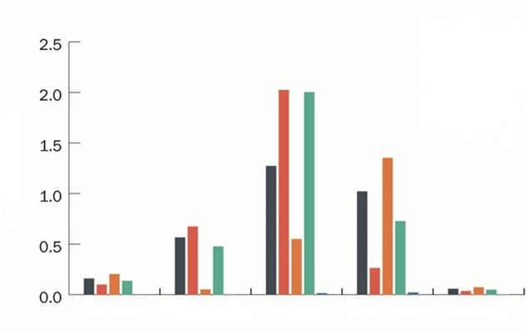
C. National Institute of Building Sciences (NIBS)
The NIBS report suggests that all major stakeholder including developers, lenders, tenants, and communities' benefit from resilient construction.
The greatest benefits are afforded to building owners who don’t have to spend as much to repair and rebuild after a disaster, but there are other benefits also.
Tenants benefit from having functioning shelter and places to work after a disaster, and the community benefits from reduced cost of disaster recovery both in terms of reduced loss of life and business continuity.
Hurricane wind
Earthquake
Wildfire
Riverine flood
Hurricane surge
Net benefit $bn
Lenders
Communities
Tenants
Title holders
Developers
Stakeholder net benefits resulting from one year of constructing all new buildings to exceed select 2015 IBC and IRC requirements or to comply with 2015 IWUIC. Source: FEMA

Slide 42
D. MIT Break-Even Mitigation Percentage Tool
According to MIT Concrete Sustainability Hub (CSHub), this is a diagram of the Life Cycle Cost of Hazard Resilience.
Researchers at the MIT Concrete Sustainability Hub (CSHub) have developed a new tool to calculate the economic benefits of investing in more hazard-resistant structures in hurricane prone areas.
Build
End of Life
Life Cycle
Energy Use
Wear & Tear
Hazard Repair
Including raw materials, labor, energy, & equipment
Including electricity, oil, & gas consumption throughout life
Paint, windows, siding, etc., included
Combines probability of hazard with repair costs
Including waste, recycling, labor, equipment, & energy
Notes:
0. Too often, building developers make decisions about materials or building techniques to keep initial costs down. Although the resulting structures are built to code, those codes often fail to factor in the long-term costs or impacts on future owners and communities.

Slide 43
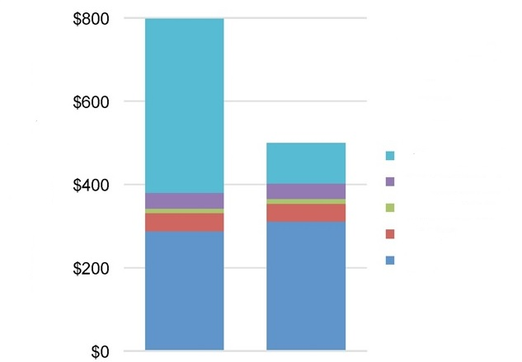
D. MIT Break-Even Mitigation Percentage Tool
MIT’s Break-Even Mitigation Percentage (BEMP) tool evaluates the cost-effectiveness of mitigation for a building in a location by factoring in the expected damage a conventional building designed to code would endure over its lifetime.
Then it compares that to the cost of a more resilient, enhanced building design to justify building to a higher standard.
Two-story wood-frame single family home in New Orleans
Present value of life cycle cost (thousands)
Hazard repair
Improvements
Maintenance
Energy
Initial
Conventional
Enhanced
Notes:
As would be expected, the greatest cost savings comes from building resilient buildings in counties directly on the Atlantic and Gulf coasts.
The graphs (from MIT Concrete Sustainability Hub) shows the costs of repairs due to hazards for conventional buildings in hazard-prone areas can exceed the initial building cost.

Slide 44
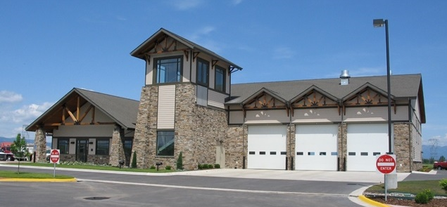
Case Studies
Photo credit: Logix

Slide 45
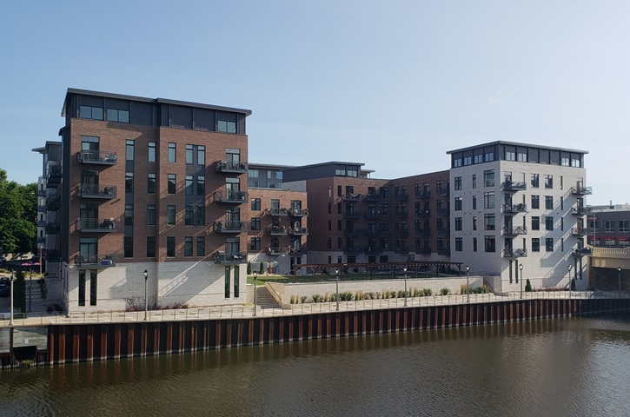
Case Study: Concrete Walls Provide Fire Separations at Infill Site
Walker’s Landing consists of two buildings, six stories each, with four floors of residential over two floors of parking. The site of was restricted due to a 10-foot setback from a river, a bridge, and two streets, making access for material storage and construction activities tight.
Bedford Development used concrete walls built using insulating concrete forms for Walker’s Landing in Milwaukee, Wisconsin for fire resistance, among other benefits.

Slide 46
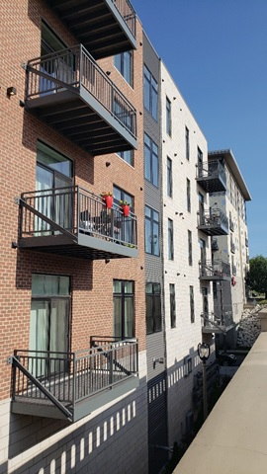
Case Study: Concrete Walls Provide Fire Separations at Infill Site
The project is located on an infill urban site requiring fire rated exterior walls. This is ideal for concrete walls since they provide more than enough fire rating at a significant cost savings over wood frame, especially when compared to many other projects in the city that had to use expensive fire treated wood. For Walker’s Landing, the developer used insulating concrete forms (ICFs) for the exterior fire separations.
In addition to fire resistance, the developer chose ICF walls and precast hollow-core floors for thermal efficiency and speed of construction. Construction projects are always on timelines and the developer has found that their install speed has increased significantly by using ICFs since they are fast and efficient to install.

Slide 47
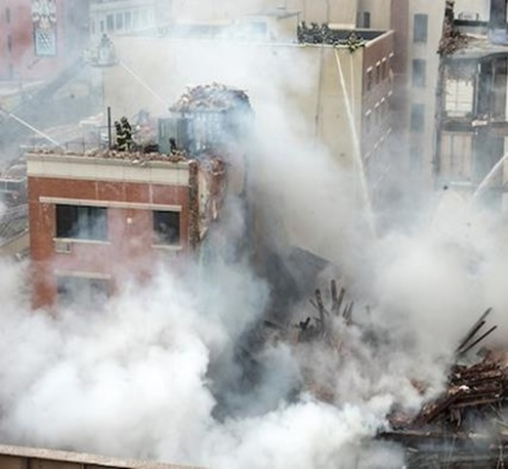
Case Study: Concrete Apartment Building Survives Blast and Fire
In 2014, a massive natural gas explosion in East Harlem, New York City, destroyed two apartment buildings, vacated four neighboring properties, and shattered windows blocks away. Bricks, wood, and other debris landed on the adjacent elevated Metro railroad tracks, suspending service to and from Manhattan for most of the day.
Nearby, buildings and households affected by the blast had to deal with the cost to remediate elevated levels of lead and asbestos. In total, the devastation caused 8 deaths, 70 injuries and displaced 100 families. Over 250 firefighters, paramedics, and police officers responded. The local utility was responsible for $153.3 million damages, the highest payout for a gas safety incident in state history.
A concrete building survived a blast and fire in New York City and reopened after repairs.
Photo credit: The Bluestone Organization

Slide 48
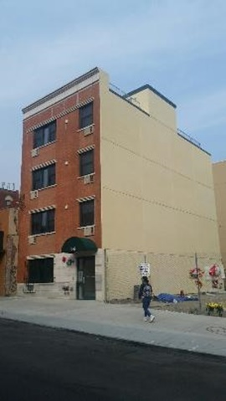
Case Study: Concrete Apartment Building Survives Blast and Fire
Through it all, the adjacent four-story concrete building stood strong. The New York Building Department engineer’s report said that amazingly, “there was no structural damage at all,” and the blast was located “inches, not feet” from the concrete walls, yet the building was in remarkably good-shape.
Damage to the concrete building was caused by falling debris from the blast next door which penetrated the roof membrane resulting in water damage from firefighting efforts. The building, built using insulating concrete form walls, was reopened after repairs.
Chicago and New York City both employ Fire Districts to limit combustible construction within dense urban boundaries. The City of Sandy Springs, Georgia and other adjacent communities have enacted similar ordinances to preserve the health, safety, and welfare of its citizens.
Photo credit: The Bluestone Organization

Slide 49
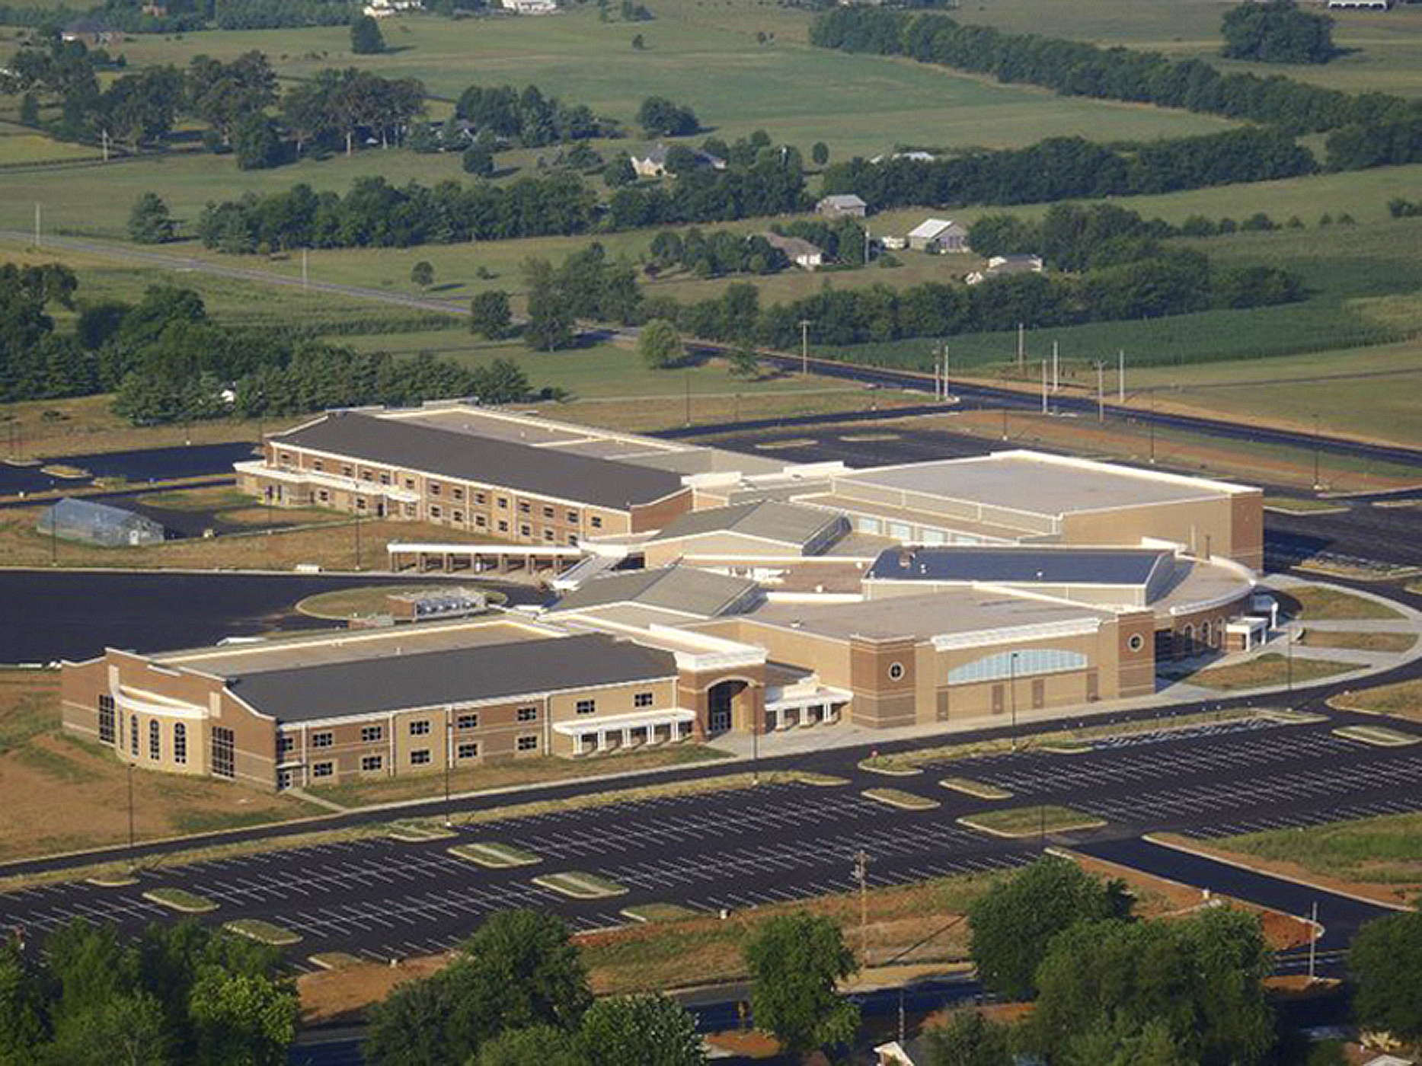
Case Study: Resilience to Tornadic Activity, South Warren Middle and High School, Bowling Green, KY
At the time of construction, South Warren was the largest K-12 school building in the state of Kentucky. Comprising 332,000 square feet, the building sits
on an 85-acre site.
This was the first educational project anywhere to utilize ICF construction for the entire structural wall system of the building, both exterior and interior bearing walls.
The school includes a gymnasium which has 40-foot-tall ICF walls, two “cafetoriums” with 35-foot-tall walls and a performing art center with a compound curve, the 8-inch and 12-inch ICF wall system provides students a safer building even during the severe tornadic activity that is common during Kentucky’s spring and summer seasons.
The inherent core strength of the concrete in the ICF wall system, coupled with the hollow-core concrete plank floor system, created a building structure capable of resisting 250-mph winds.
Notes:
At the time of construction, South Warren was the largest K-12 school building in the state of Kentucky. Comprising 332,000 square feet, the building sits on an 85-acre site.
This was the first educational project anywhere to utilize ICF construction for the entire structural wall system of the building, both exterior and interior bearing walls. Construction spanned the winter without delay. ICFs allow the concrete to be protected and insulated when placed, permitting continuity of the construction schedule.
The school includes a gymnasium which has 40-foot-tall ICF walls, two “cafetoriums” with 35-foot-tall walls and a performing art center with a compound curve, the 8-inch and 12-inch ICF wall system provides students a safer building even during the severe tornadic activity that is common during Kentucky’s spring and summer seasons.
The inherent core strength of the concrete in the ICF wall system, coupled with the hollow-core concrete plank floor system, created a building structure capable of resisting 250-mph winds.

Slide 50
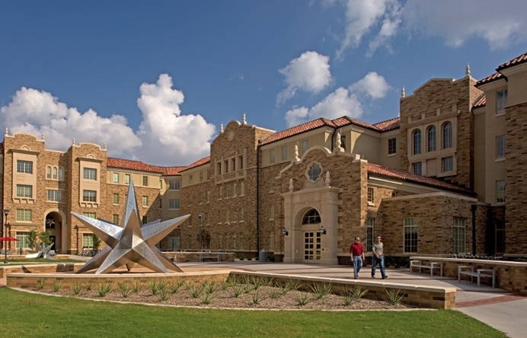
Conclusion
There are increased risks posed by natural hazards from weather related, seismic and fire events.
Resilient construction can address these risks by addressing asset protection and building functionality in addition to life safety.
A number of approaches exist to mitigating the effect of natural hazards including adoption of updated building codes and high-performance standards, incentivizing disaster resilient construction, and building with robust materials.
A/E professionals can re-consider minimum code performance and design for improved building performance and natural hazard mitigation, resulting in overall cost savings for the building cycle.
West Village Student Housing at Texas Tech University, Lubbock, Texas built using Insulating Concrete Forms. Photo: Courtesy of Mackey Mitchell Architects
Notes:
Resiliency planning offers communities, building owners, and design professionals an opportunity to play a key role in determining the essential services and infrastructure needs that underpin economic vitality, health and safety of citizens, and support sustainability.
Resilient building standards are not a panacea for all problems. Nevertheless, to subject our vulnerable population to the all too often, shortsighted political or economic decisions that trump safety considerations is unconscionable when the technology and economic returns of disaster resilience are well understood. Put simply, we all know that we must embrace change and build differently if we are to have a resilient future.
High performance standards can help to make that happen. And, by promoting the development and adoption of advanced codes, standards and ratings systems, incentives and other measures that emphasize and encourage resilience, architects and engineers can lead by example.
In the end, no community can ever be completely safe from all hazards. Generally, it would be uneconomical to design commercial or residential buildings to survive a direct blow from a tornado with 300 mph wind speeds or magnitude 9.0 earthquake.
But resilience promotes greater emphasis on what communities can do for themselves before a disaster hits, and how to strengthen their local capacities, rather than be dependent on our overwhelmed governmental agencies and aging infrastructure. Disasters are inevitable, but their consequences need not be.

Slide 51
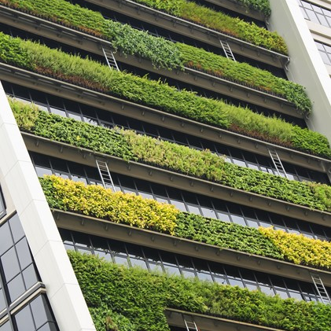
Questions?
ssumar@nrmca.org

Slide 52
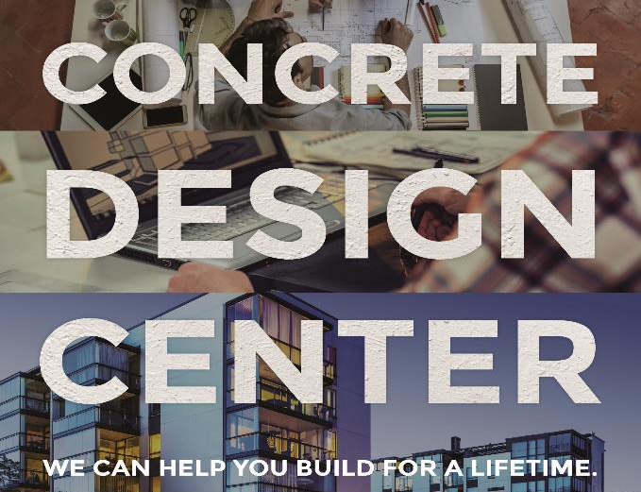

Slide 53
www.buildwithstrength.com/design-center
Structural system recommendations
Cost comparisons
Specification review
Design/construction team collaboration

Slide 54
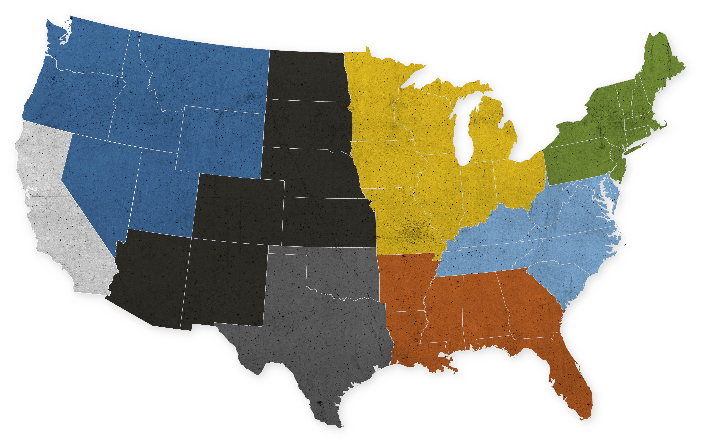
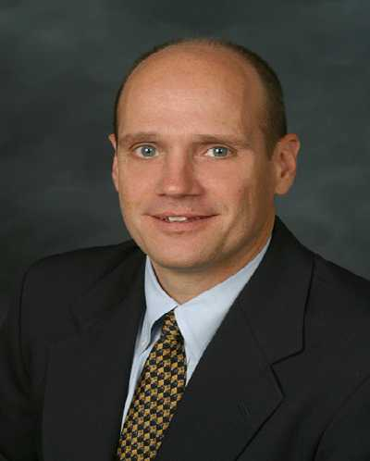
Build With Strength: Concrete Design Center
Patrick Matsche
PMatsche@nrmca.org
(415) 672-5275
Donn Thompson
DThompson@nrmca.org
(224) 627-3933
Frank Mruk
Fmruk@nrmca.org
(401)585-7756
Frank Gordon
FGordon@nrmca.org
865-719-2861
Brandon Wray
BWray@nrmca.org
(408) 806-0453
Lionel Lemay
Llemay@nrmca.org
(847) 922-7995
Chris Dagosta
CDagosta@nrmca.org
(602) 930-3793
Derek Logan
DLogan@nrmca.org
(419) 650-8054
Justin McCain
Jmccain@nrmca.org
(253) 228-6295
Michael Wymant
MWymant@nrmca.org
(850) 818-2057
Derek Torres
DTorres@nrmca.org
(973) 876-0938

Slide 55
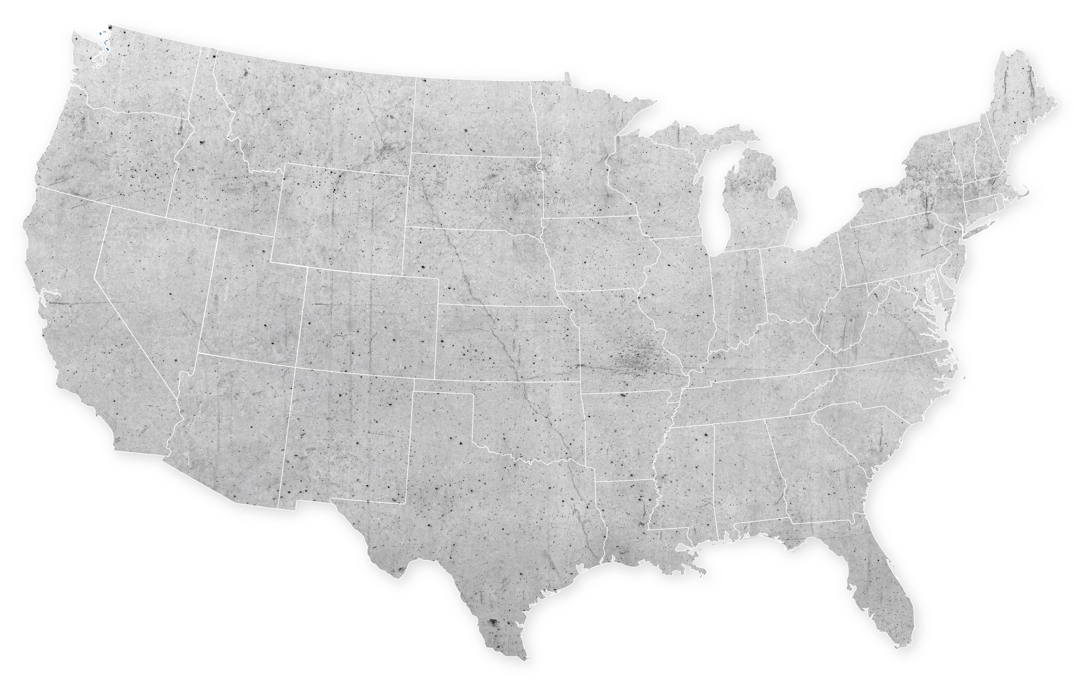
Build With Strength: Codes and Standards
Matthew Lemay
Manager, Codes and Sustainability
*EPDs, Responsible Sourcing
MLemay@nrmca.org
(847) 323-0413
Director Sustainability Codes and Standards
Open Position
Shamim Rashid-Sumar
SVP Codes and Standards
*Fire safety, resilience, team leader
SSumar@nrmca.org
(917) 484-1960
Julian Mills-Beale
Director, Codes and Standards
*Civil/structural, energy, sustainability
jmills-beale@nrmca.org
(484)633-7452

Slide 56
Thank You!
ssumar@nrmca.org

