Slide 1
Rethinking how timber is used in construction
FEBRUARY 13, 2024 | 10:00AM

Slide 2
Design
Preconstruction
Construction
Session agenda
Operation & Maintenance

Slide 3
DESIGN
Develop the ability to integrate mass timber seamlessly into architectural designs, considering structural, aesthetic, and sustainability aspects to create innovative and functional spaces.

Slide 4
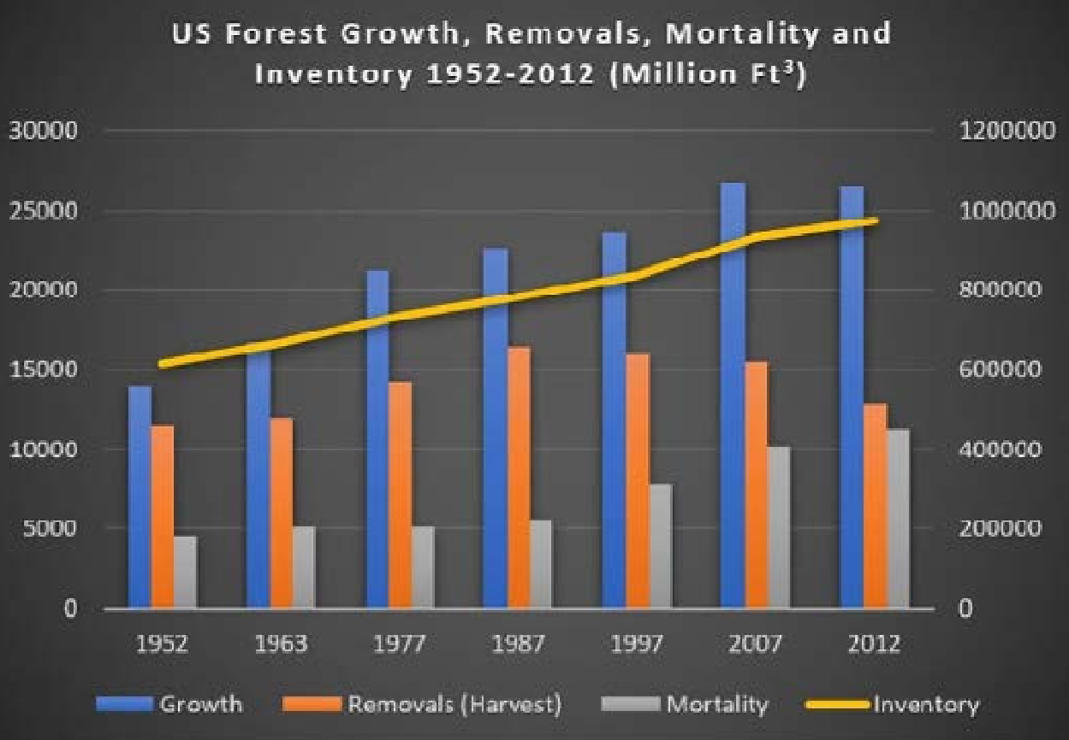
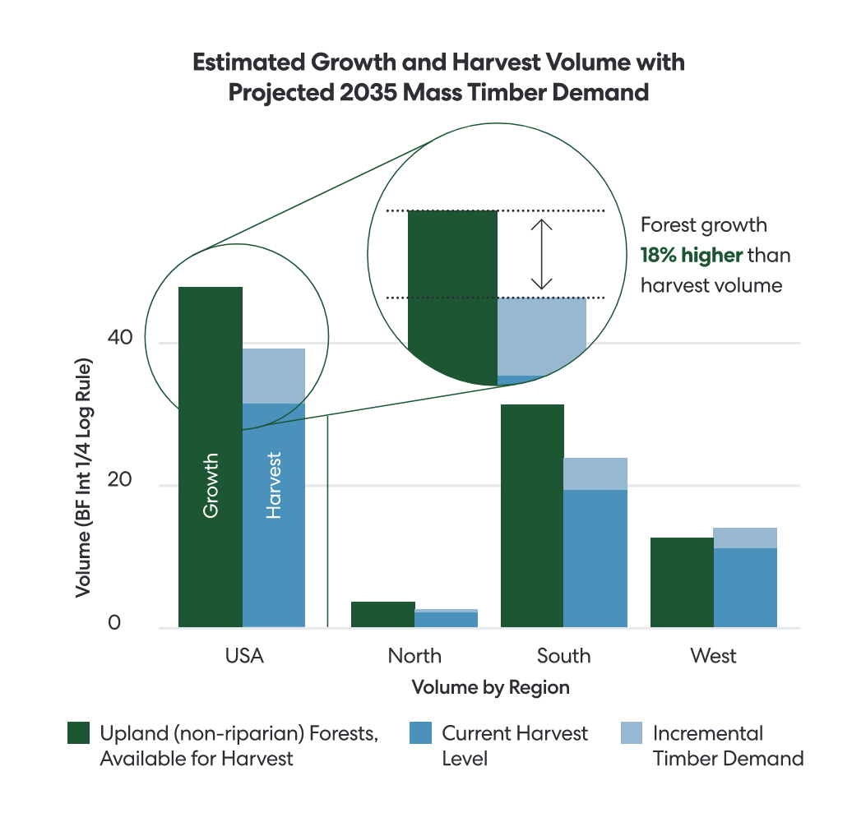
Sustainability
Source: WoodWorks

Slide 5
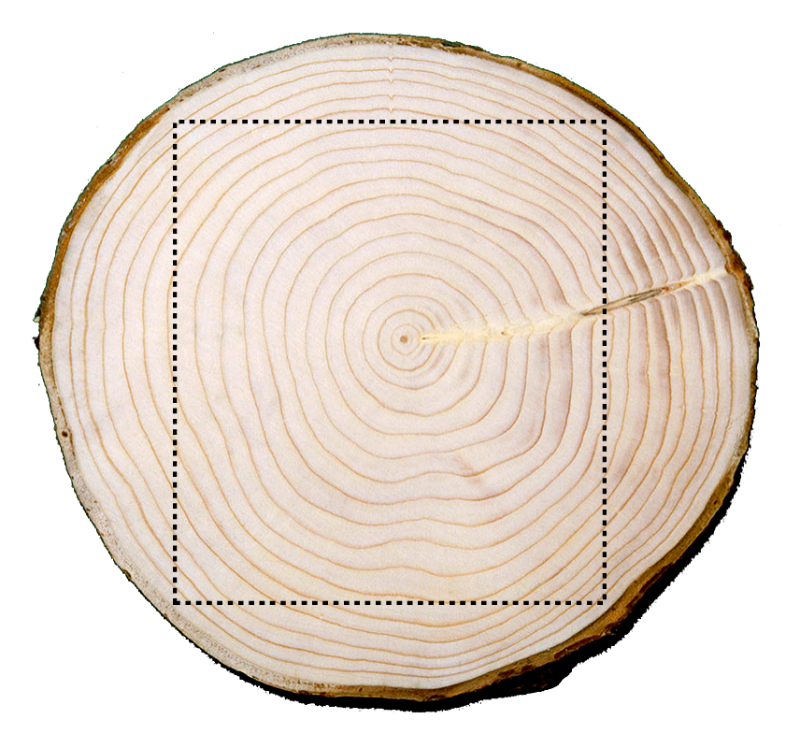
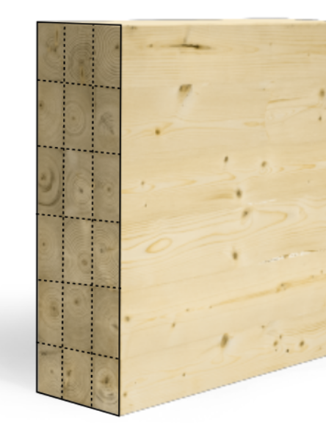
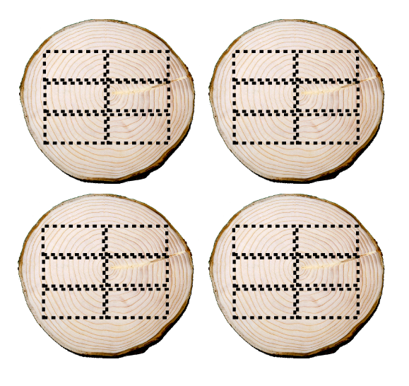
Sustainability
Heavy Timber vs Mass Timber
Old Growth = Heavy Timber
New Growth = Mass Timber

Slide 6
Major Design Steps
Pre-Design
Understanding what’s unique or critical to mass timber projects
Coordination and timing
Insurance requirements
Fabricator and installer experience/availability
Schematic Design
Mass timber building systems (CLT/DLT/NLT)
Efficient structural grid designs
Acoustics
Fire resistance
MEPF system programing
Design Development
Cost estimating
Pre-construction coordination
MEPF systems routing
Fire protection coverage
Building enclosure connections

Slide 7
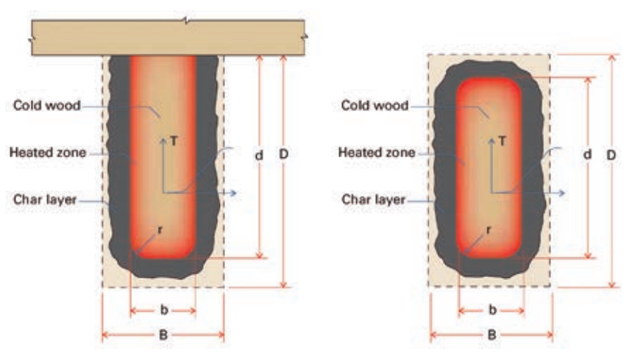
Fire Resistance
Fire resistance of mass timber is directly tied to the size/thickness of each member.
Source: TR 10, AWC
Source: David Barber, ARUP
Reduction in member width and depth over time.

Slide 8
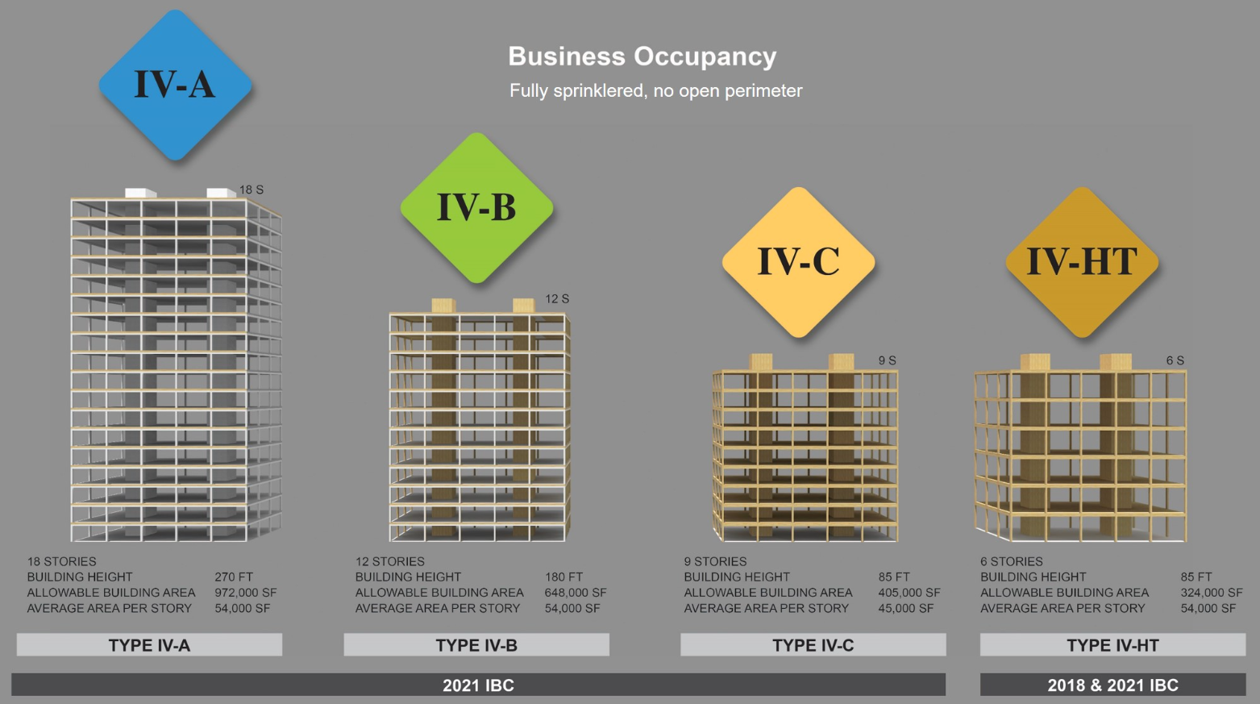
Fire Resistance
Source: Building Safety Journal

Slide 9
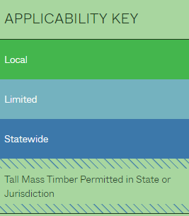
Code Adoption
As of January 2024 (visit AWC.org for interactive map)
Source: American Wood Council

Slide 10
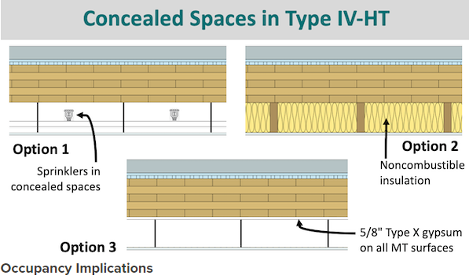
Fire Protection
Timber in concealed spaces must be protected.
Source: WoodWorks

Slide 11
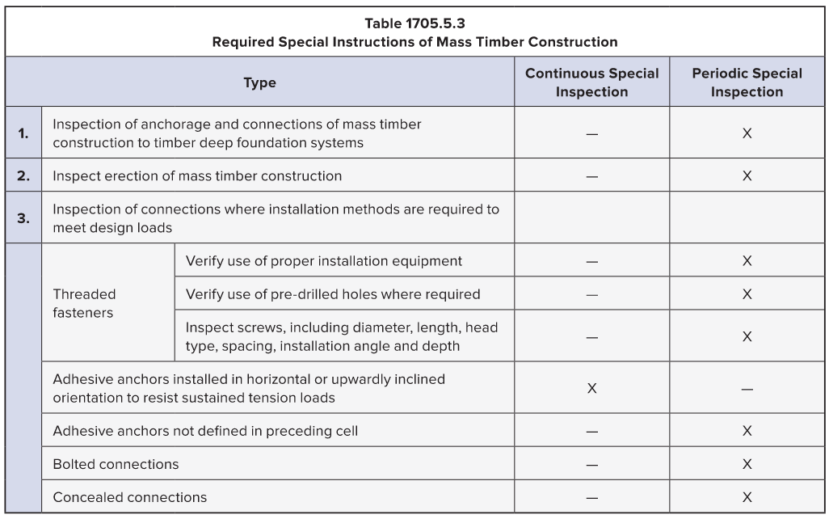
Special Inspections
Required special inspections for Types IV-A, IV-B and IV-C construction under the 2021 IBC
Source: International Code Council

Slide 12
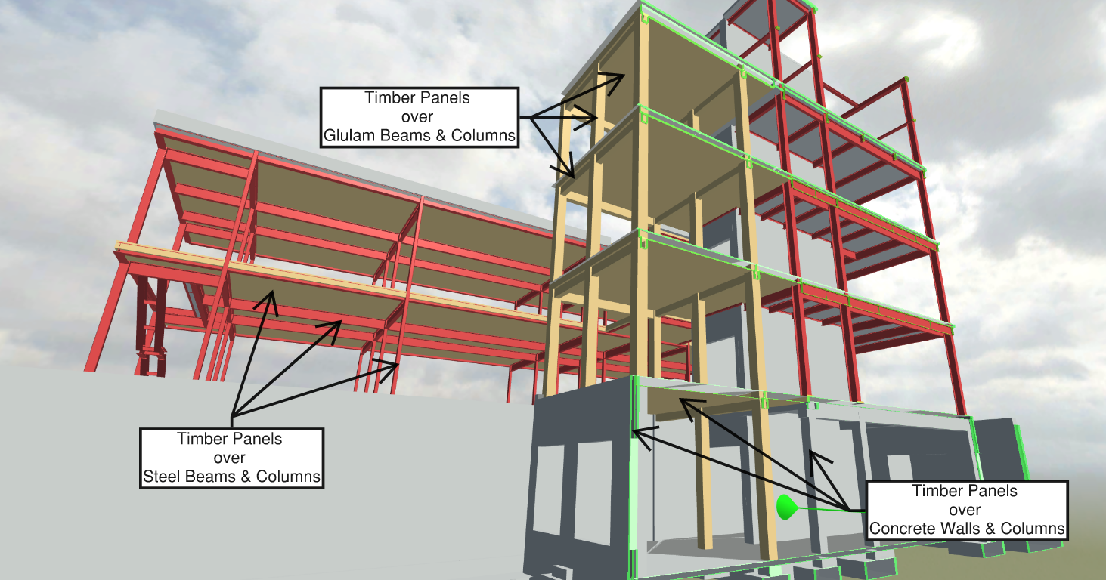
Primary Design Options
Timber over Steel / Timber over Timber / Timber over Concrete

Slide 13
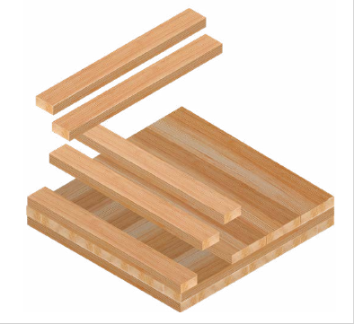
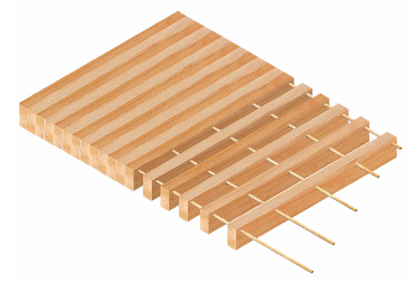
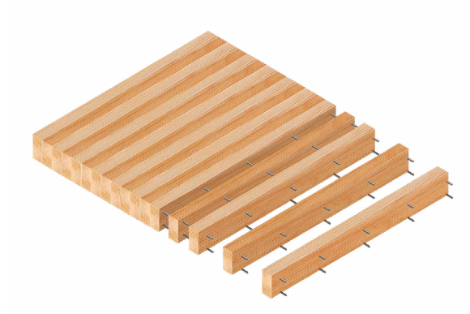
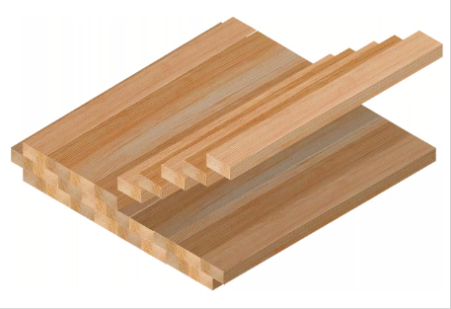
Panel Selection
4 Major Types of Structural Floor Panels
CLT
(Cross Laminated Timber)
DLT
(Dowel Laminated Timber)
NLT
(Nail Laminated Timber)
GLT
(Glue Laminated Timber)

Slide 14
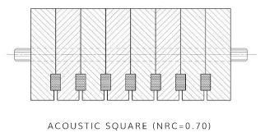
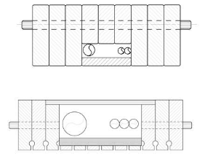
DLT Profiles
Standard / Acoustic / Specialty & Service Chases
Source: StructureCraft

Slide 15
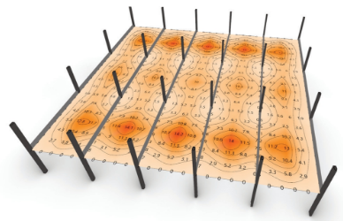
Vibration
Vibration can be reduced in mass timber buildings by:
Using shorter spans and heavier mass floors.
Shorter spans will increase the mass of the floor, which will make it more resistant to vibration. Heavier mass floors will also be more resistant to vibration.
Using composite system effects.
Mass timber floor panels are rarely used as the only component of a floor assembly. Other structural and nonstructural components can increase the overall effective stiffness of the floor, which will reduce vibration.
Avoiding designing corridors and circulation areas at mid-span locations
This will help to reduce the potential for people to feel vibration.
Using partitions and nonstructural walls.
Partitions and nonstructural walls can help to improve vibration performance by imparting additional mass and stiffness to the floor.
Source: WoodWorks
Source: WoodWorks
Resonant modal response analysis results across a typical floorplate

Slide 16
Hybrid construction

Slide 17
PRECONSTRUCTION
Acquire skills in project planning specific to mass timber construction including coordination, buyout, risk management, and regulatory compliance ensuring successful project execution from concept to completion.

Slide 18
Precon contracting Strategies
Delegated Design (SD Start) | Design/Assist (DD Start) | Design-Bid-Build (CD Start)
+ Single point of design responsibility + Construction input on day 1 + Designer with most experience + Expert resource part of team | + Early construction input + Early design feedback + Early pricing feedback | + Competitive Bidding
- Typically locked in for construction - GMP accounting | - Share design responsibility - Deferred submittals | - No construction input during design - No ability for early coordination - Longer schedule

Slide 19
Design is front loaded
Source: WoodWorks

Slide 20
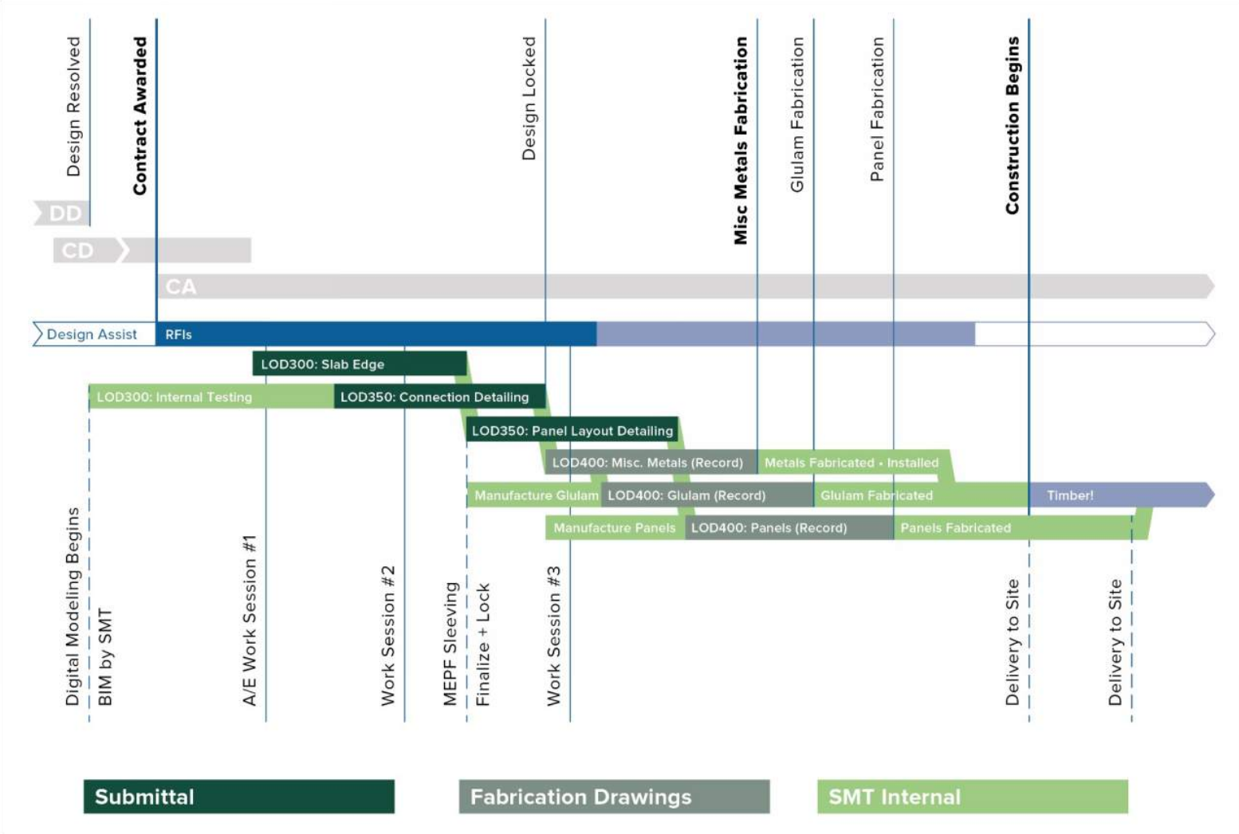
Modeling / fabrication schedule
Source: Timberlab

Slide 21
Schedule & budget

Slide 22
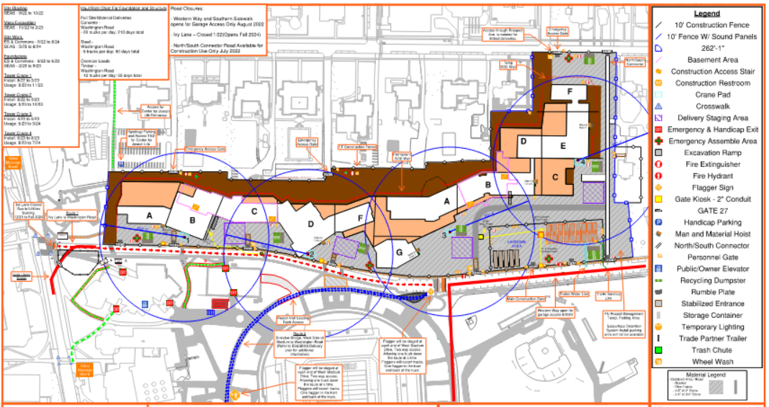
Site & Sequence planning
Sequence Planning
Erection Sequence
Delivery Sequence
Fabrication Sequence
Submittal Sequence
Staging Plan & Logistics
Weatherproofing Strategies
Crane Selection

Slide 23
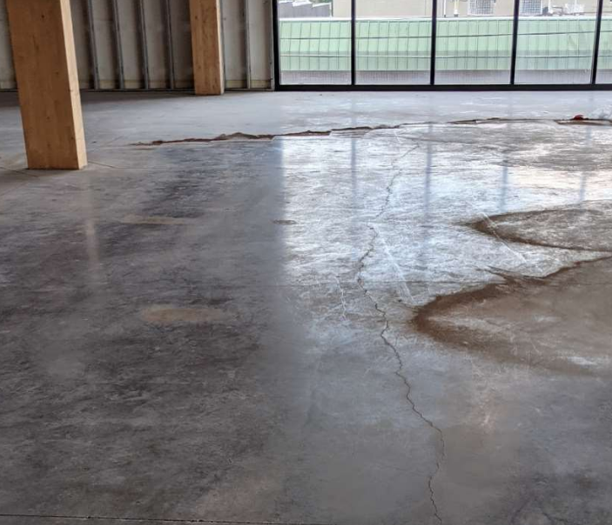
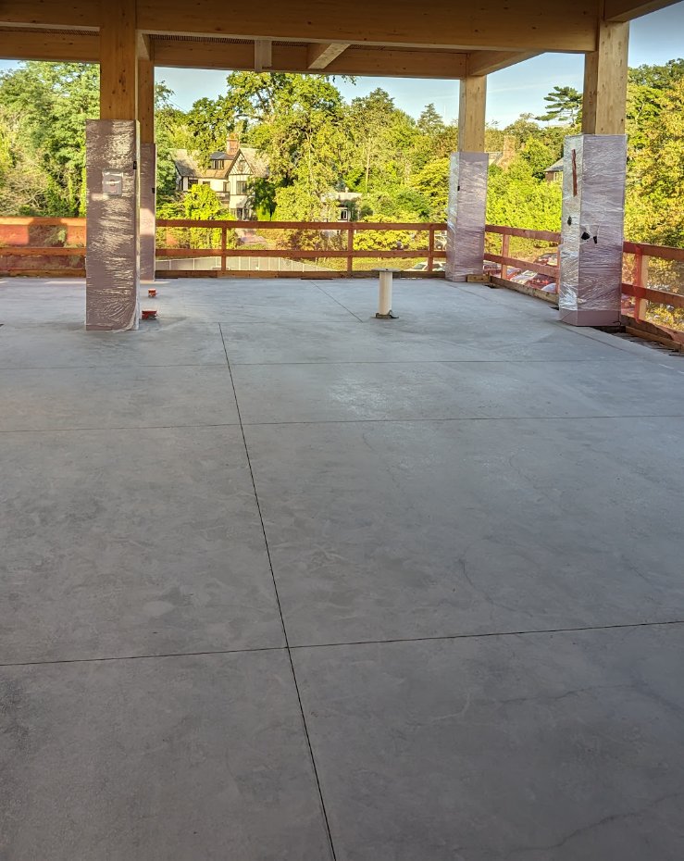
Polished & Exposed slabs
Topping slabs are thin, buy out low shrinkage concrete to minimize cracking

Slide 24
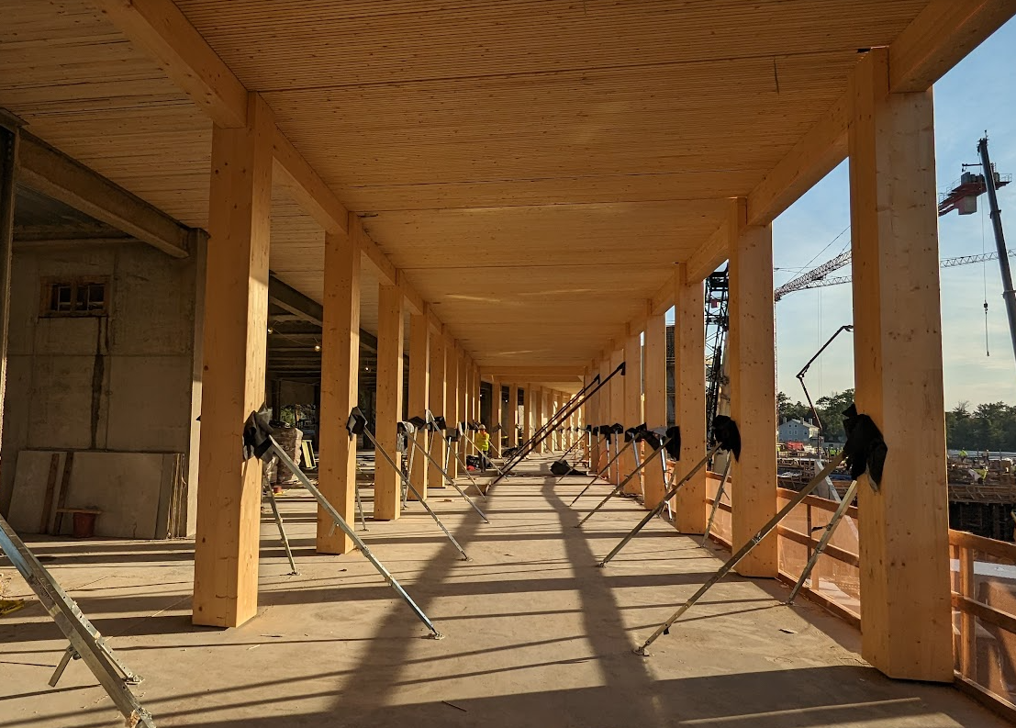
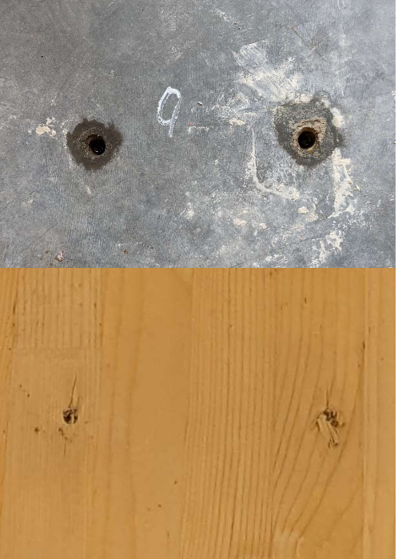
Bracing
Coordinate bracing plans with floor finishes & budget for any repairs

Slide 25
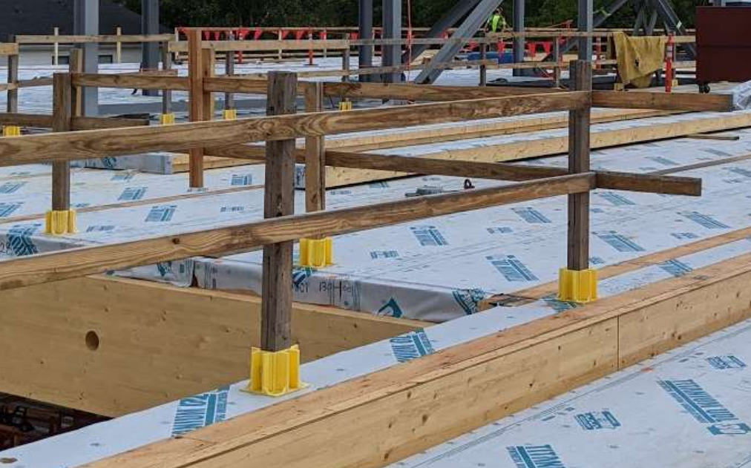
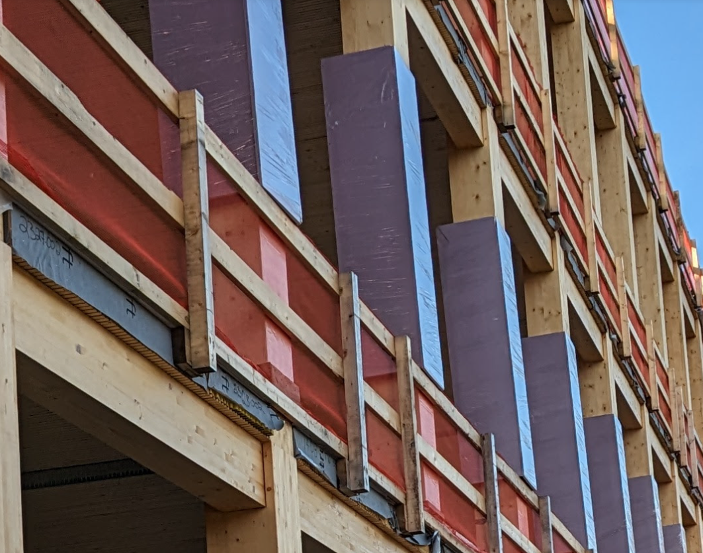
Fall protection costs
Buy out a sturdy, coordinated fall protection barrier which works for all subsequent trades

Slide 26
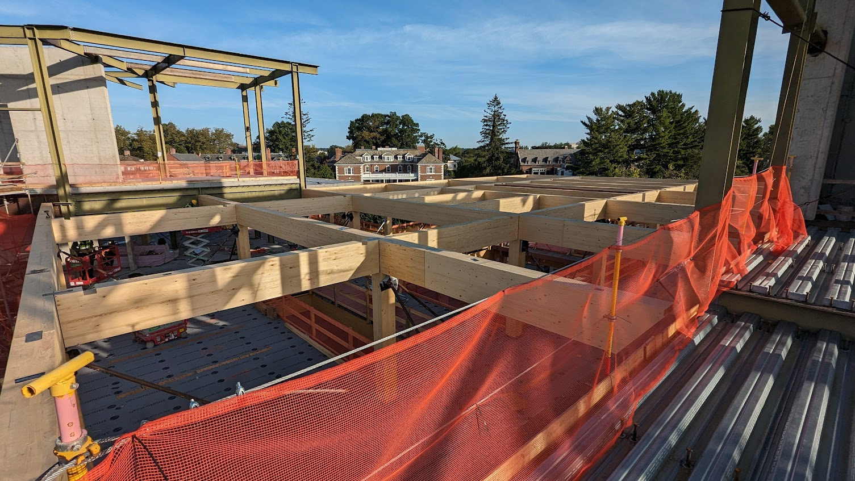
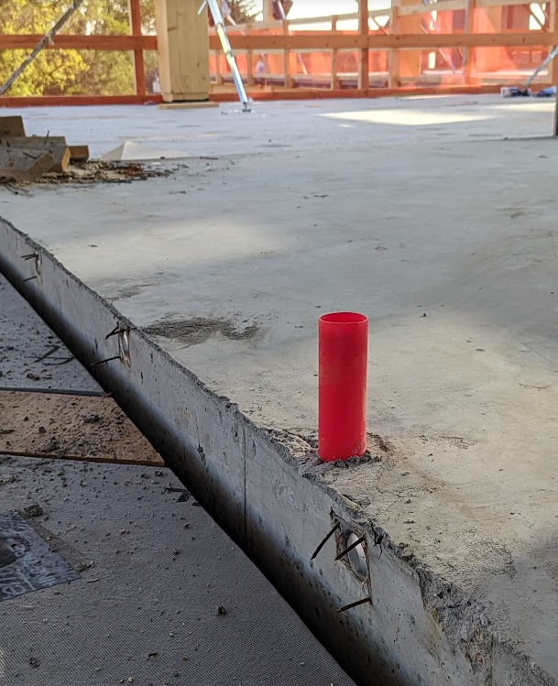
Fall protection coordination
For hybrid structures, use “Perimeter Protection Products” at steel areas adjacent to timber.
(No L Angle Posts)

Slide 27
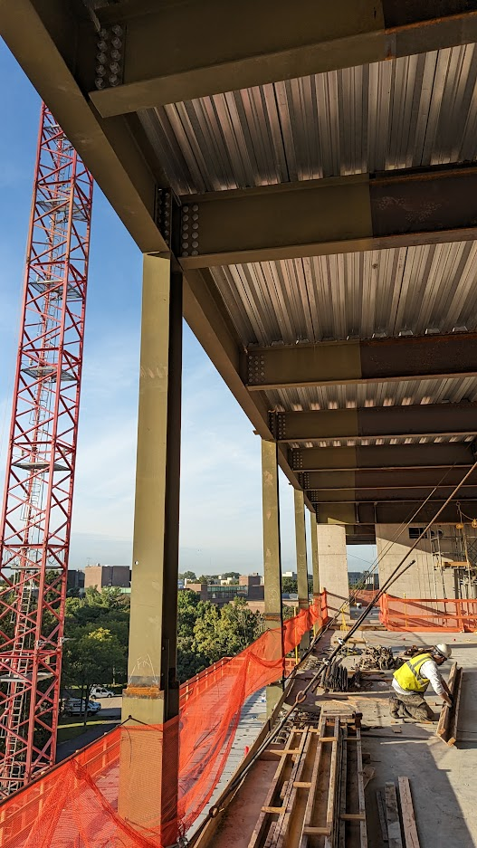
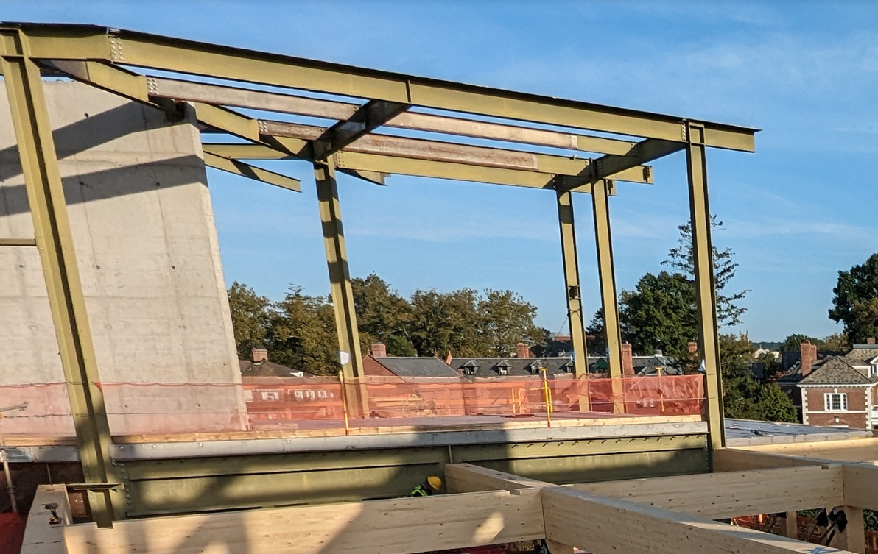
Rust protection
Buy out galvanized bolts & priming of all steel within 5 horizontal feet of any timber

Slide 28
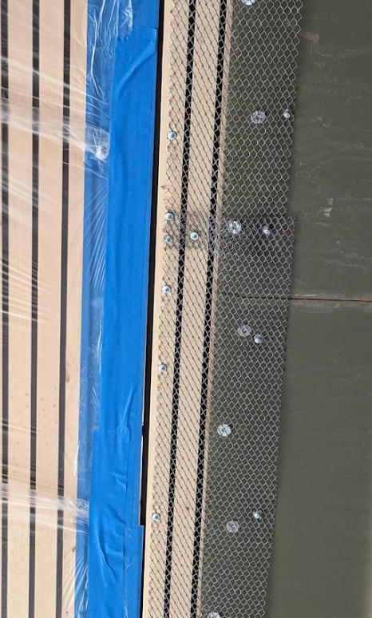
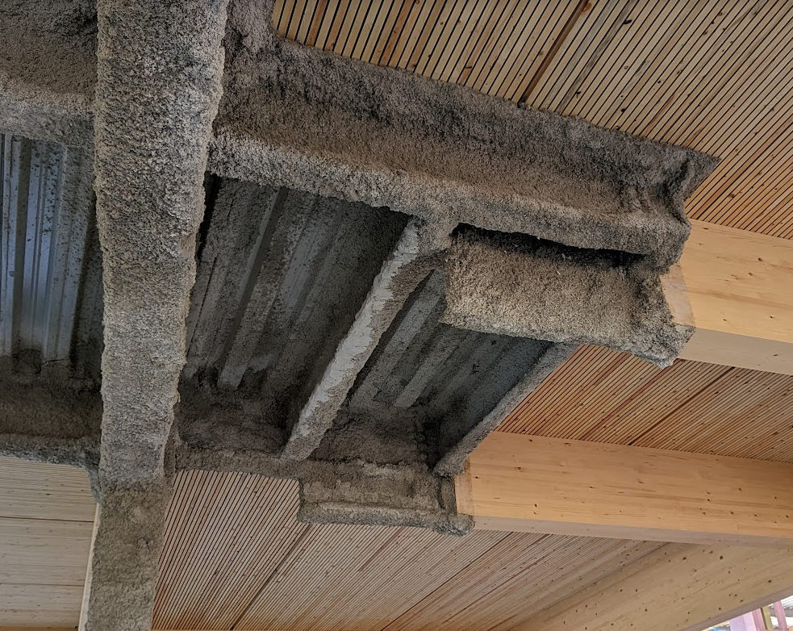
Spray Fireproofing
Buy out temporary protection and lath at timber transitions and primed steel areas

Slide 29
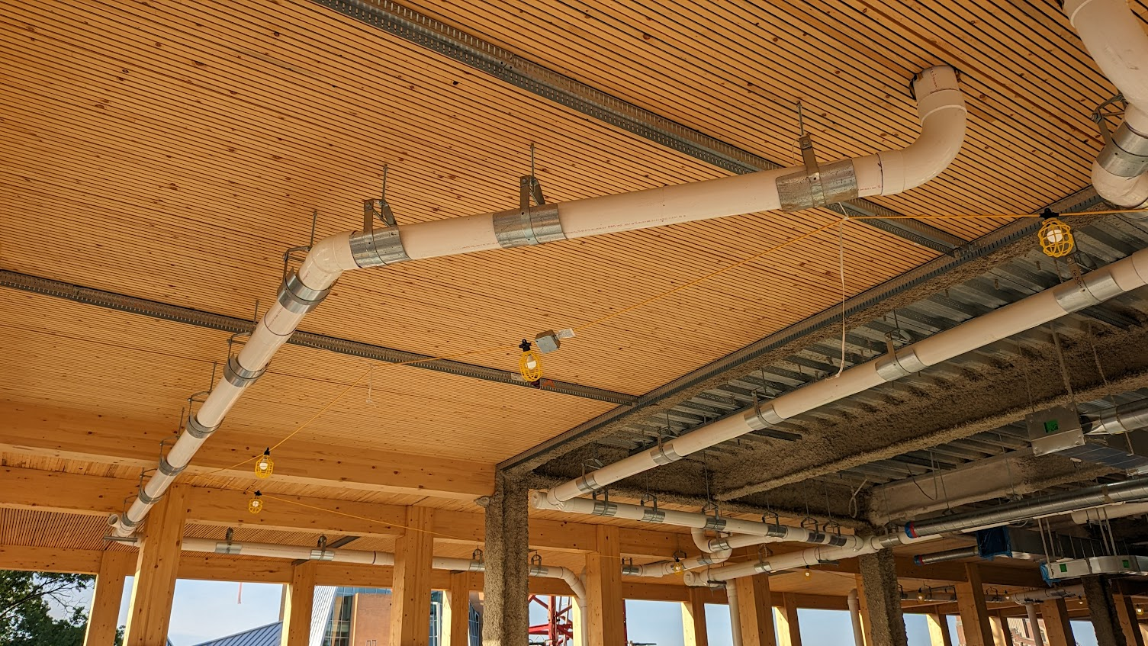
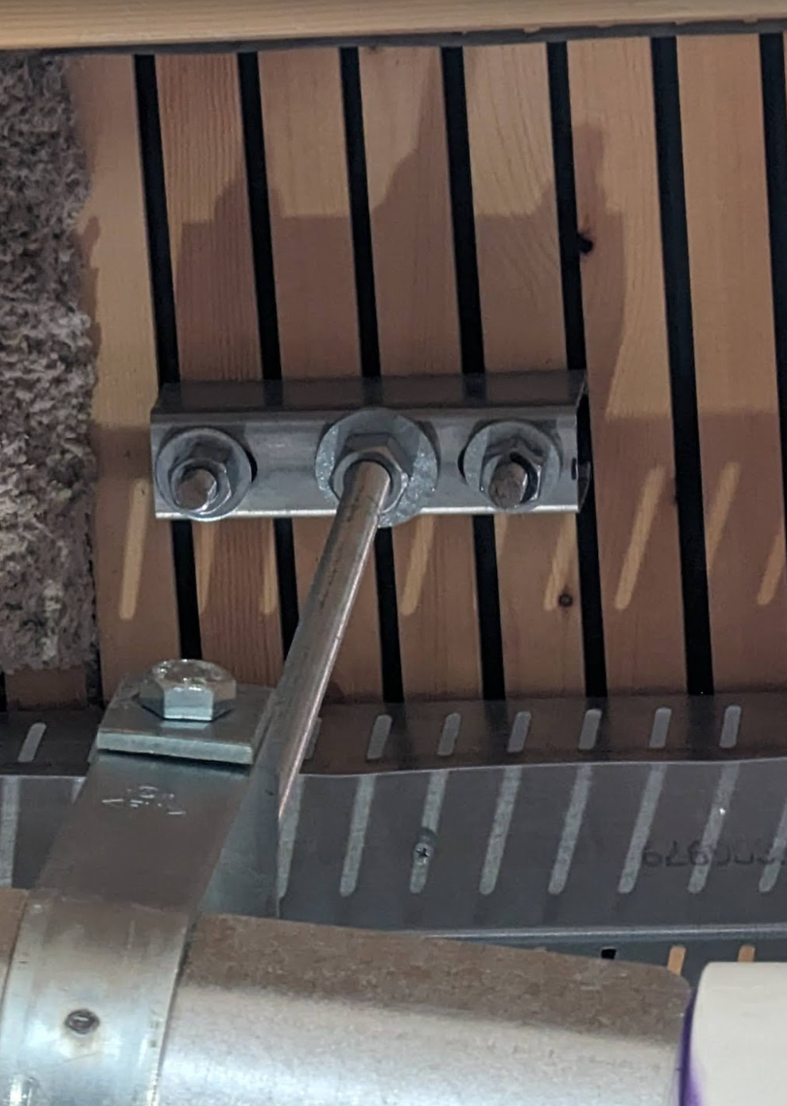
MEP Hidden Costs
Pilot hole drilling and load distribution

Slide 30
CONSTRUCTION
Master the techniques and methodologies unique to mass timber construction from site preparation and installation to quality control and temporary protection.

Slide 31
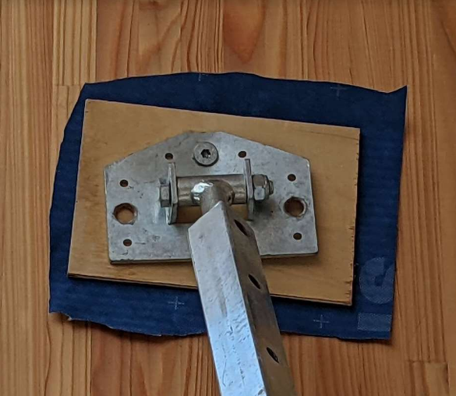
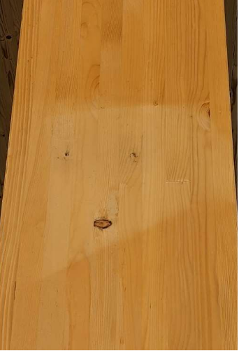
Sun Tanning
Results of bracing directly to timber with rigid protection such as cardboard

Slide 32
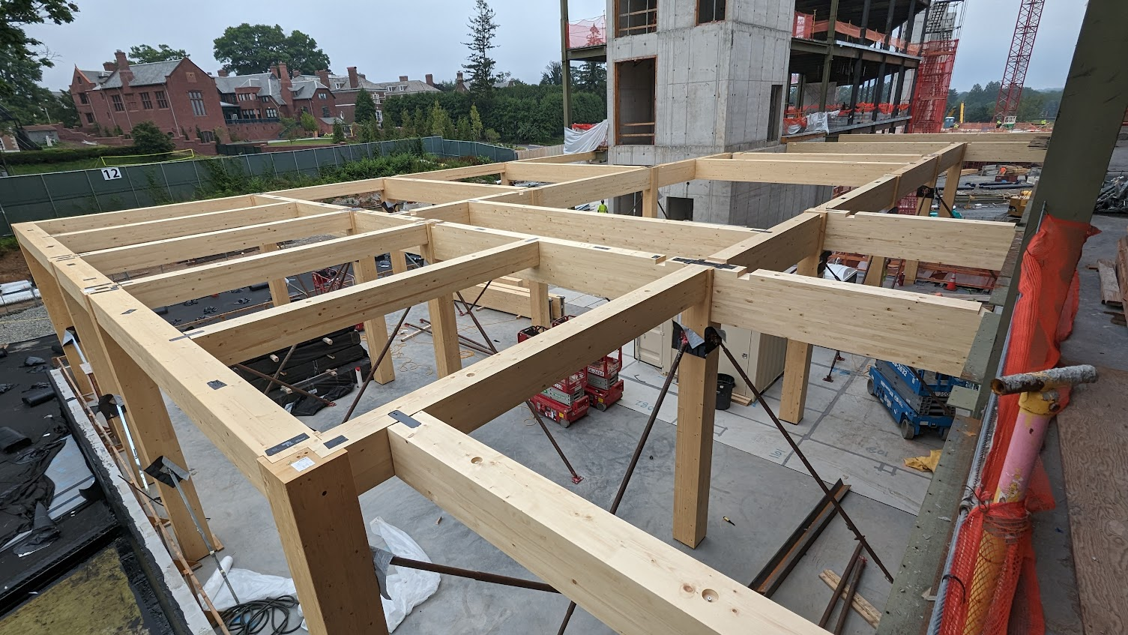
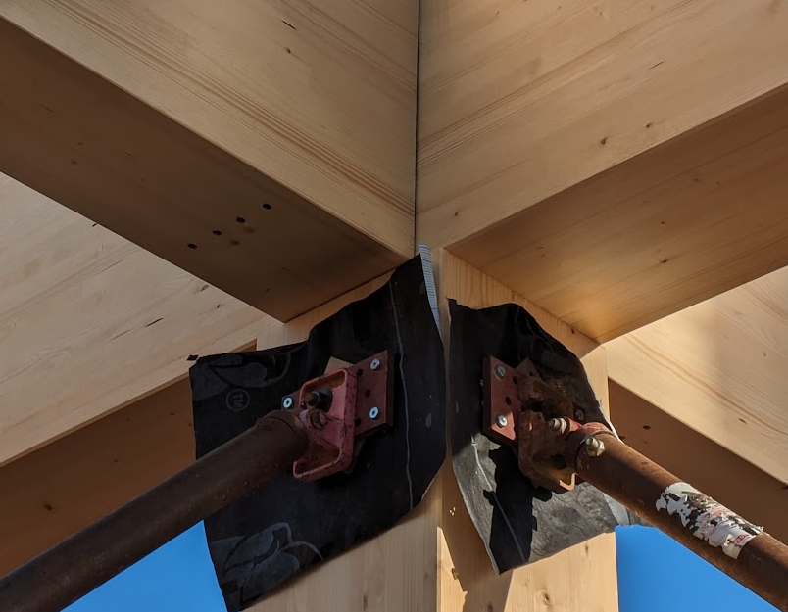
Sun Tanning
Can be avoided by using a flexible material that creates a gradient

Slide 33
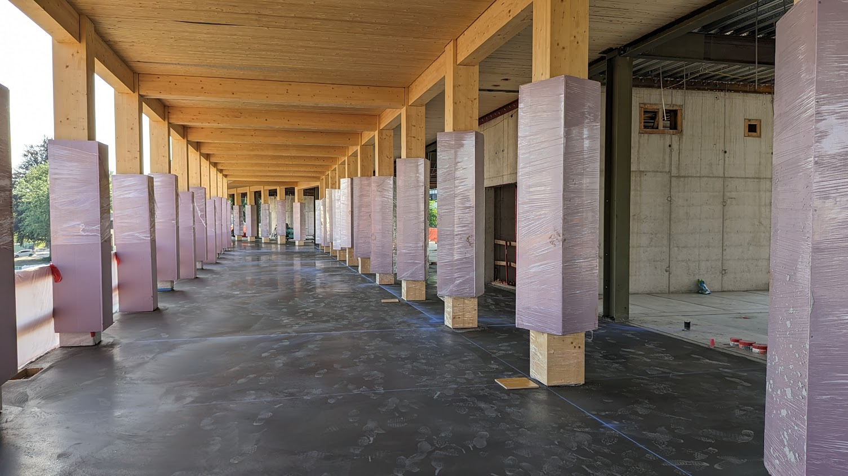
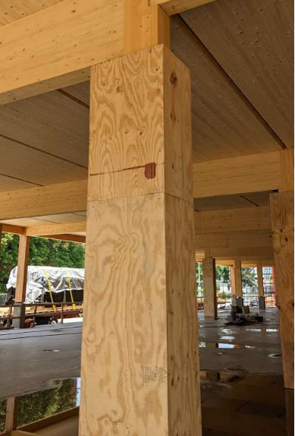
Sun Tanning
Can be avoided by using adjustable protection

Slide 34
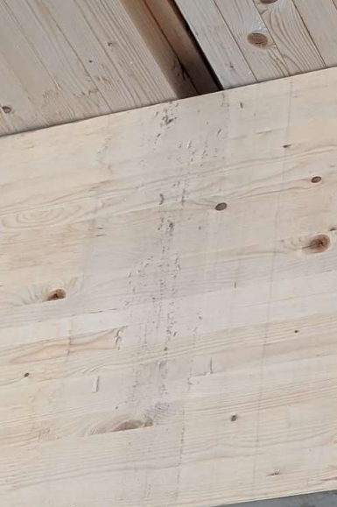
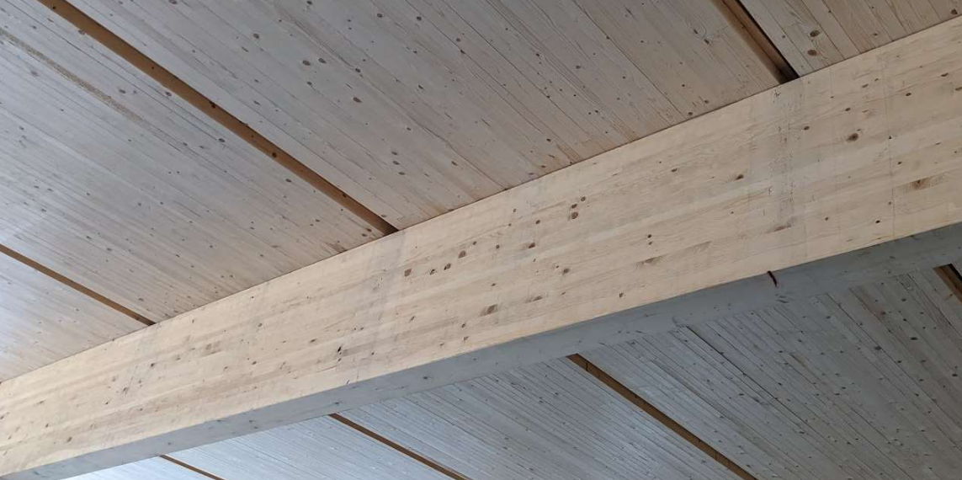
Regular Cleaning
Keep decks clean. Dirty water will Stain beams below when water drips down.

Slide 35
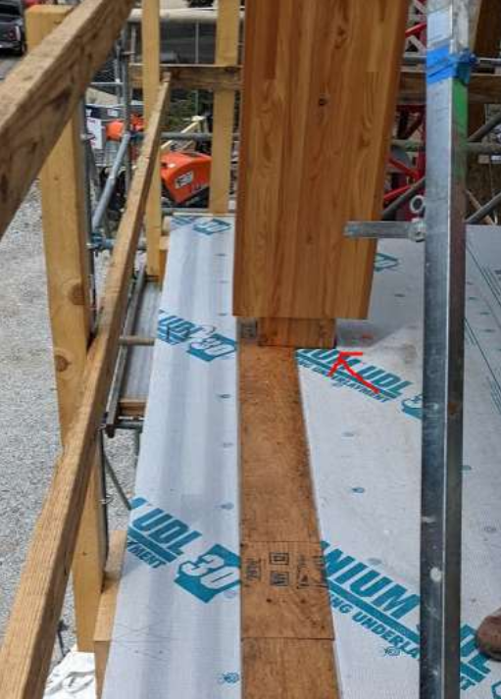
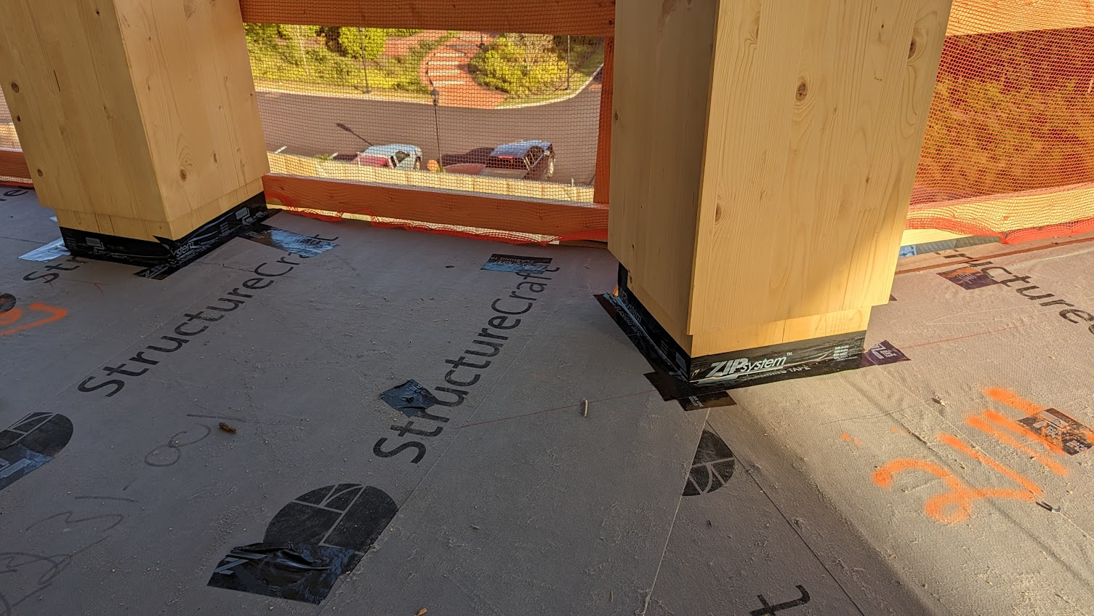
Water Channeling & Diversion
Seal gaps next to columns and over beams

Slide 36
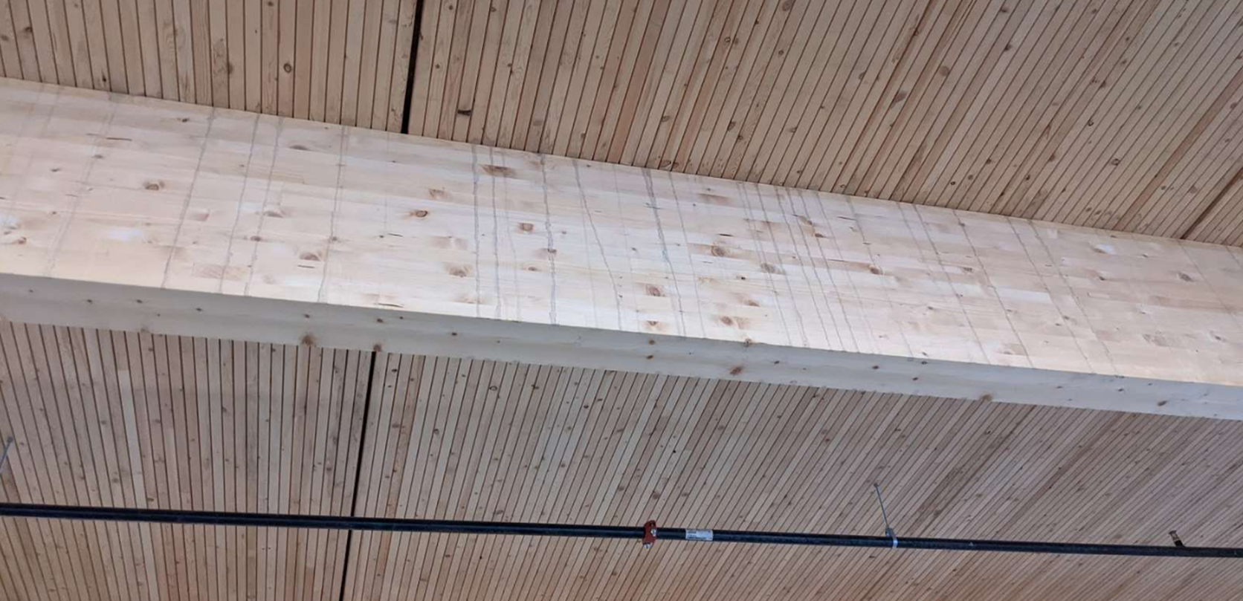
Topping Slab Protection
Ensure a water source is available to hose down timber before and after topping slab pours

Slide 37
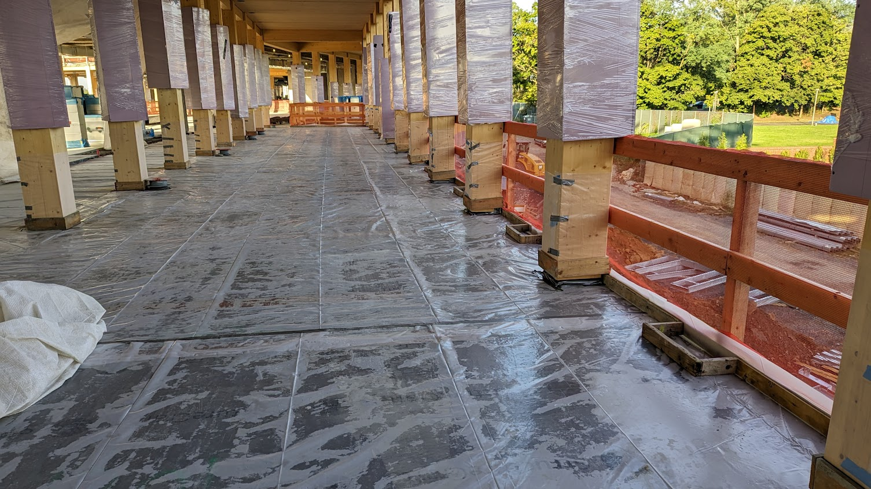
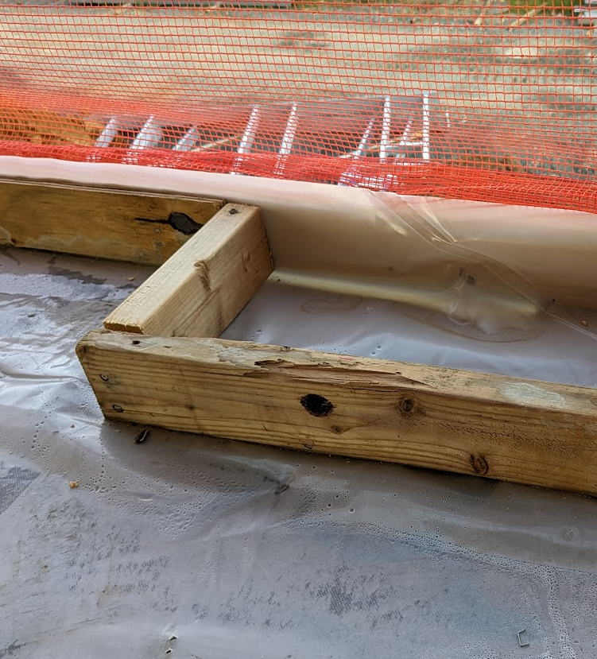
Topping Slab Protection
Buy out the installation of a plastic slip sheet to be installed prior to concrete placement

Slide 38
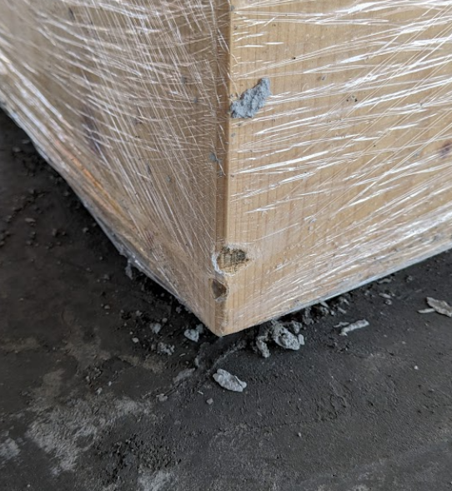
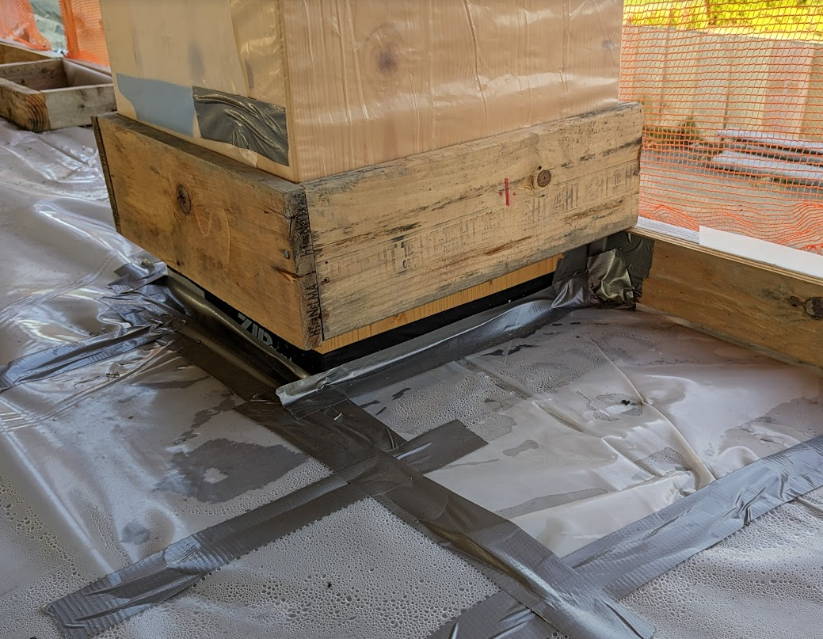
Topping Slab finish Protection
Physical protection is needed around columns during pours to prevent damage from concrete floats

Slide 39
OPERATION & MAINTENANCE
Understanding the long-term implications of mass timber structures, including lifecycle analysis, maintenance considerations, and sustainable practices enabling informed decision-making for the ongoing performance and resilience of timber structures.

Slide 40
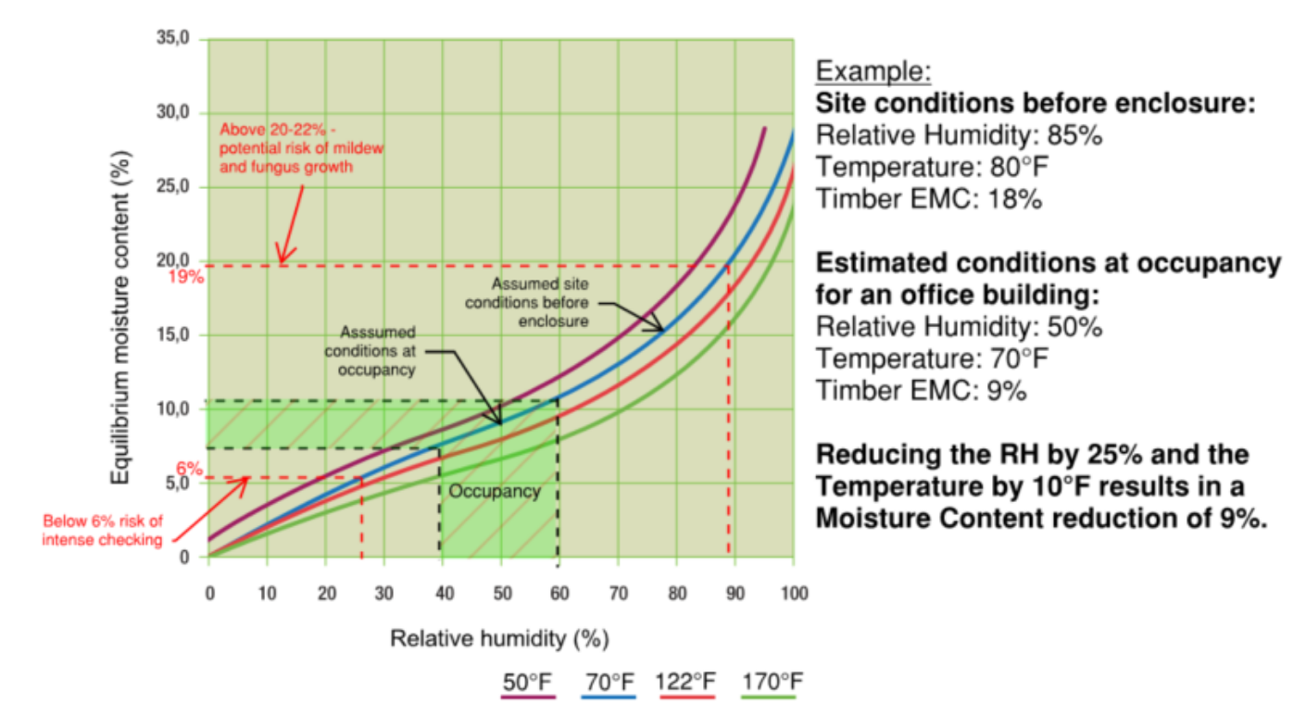
Commissioning
Important Steps:
Gradually increase heat over several days. This will help to prevent the wood from drying out too quickly and cracking.
Use a dehumidifier to help control the humidity level in the building. The ideal humidity level for mass timber is between 40% and 60%.
Avoid placing furniture or other objects directly against the mass timber walls or ceilings. This will help to create a space for air to circulate and prevent moisture from building up.
Regularly inspect the mass timber for signs of moisture damage, such as cracks, stains, or warping. If any damage is found, it should be repaired immediately to prevent further problems.
Source: StructureCraft

Slide 41
maintenance
Periodic scraping of sap after initial turnover

Slide 42
Repairs
Damage & Repairs:
Repairing damage to mass timber structures can be a complex and time-consuming process, so it is important to consult with a qualified professional before attempting any repairs.
In general, the following steps may be involved in repairing damage to mass timber structures:
Dry the affected area thoroughly. This can be done by using fans, heaters, or dehumidifiers.
Remove any loose debris or materials from the area.
Apply a sealant or filler to the damaged area.
Sand the area smooth and apply a finish.
The specific steps involved in repairing damage will vary depending on the type and extent of the damage.

Slide 43
Thomas Ritucci
Project Manager
Thomas.Ritucci@whiting-turner.com
(540) 748-8224

