Slide 1


The Insider’s Edge to Real Estate Investing
James Nelson
Principal and Head of Tri-State Investment Sales at Avison Young
@jamesnelsonnyc

Slide 2




Who INVESTS in real estate?
For those who don’t,
WHAT’S HOLDING
YOU BACK?

Slide 3

FEAR? Lack of….
capital, knowledge, infrastructure?

Slide 4

The GOOD news,
there’s likely A DEAL in THE ROOM
with the people to EXECUTE on it.

Slide 5
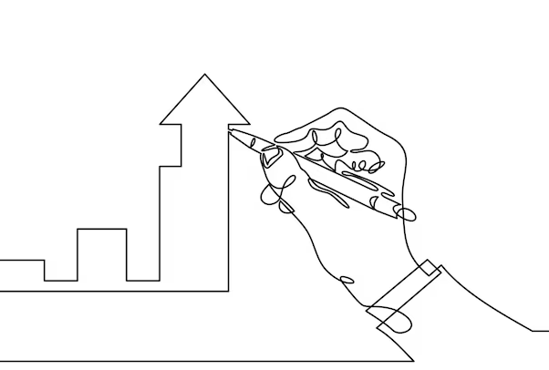
A STORY about
my FIRST investment –
The GIVING TREE

Slide 6

REAL ESTATE INVESTING
is an insider’s game
You can gain the ADVANTAGE
to OUTPERFORM THE MARKET
Notes:
The Morning Brew, theSkimm, Snoozeletter, Girls Night In

Slide 7

Find your NICHE and become THE EXPERT

Slide 8

SUCCESS is a TEAM sport.
Bringing the RIGHT PLAYERS to the table will HELP YOU GAIN AN EDGE.

Slide 9

Make BROKERS your BEST FRIENDS.
They are the SOURCE
of MOST OPPORTUNITIES.

Slide 10

DON’T WAIT for deals to come to you.
LOOK for OPPORTUNITIES
in UNLIKELY PLACES.

Slide 11
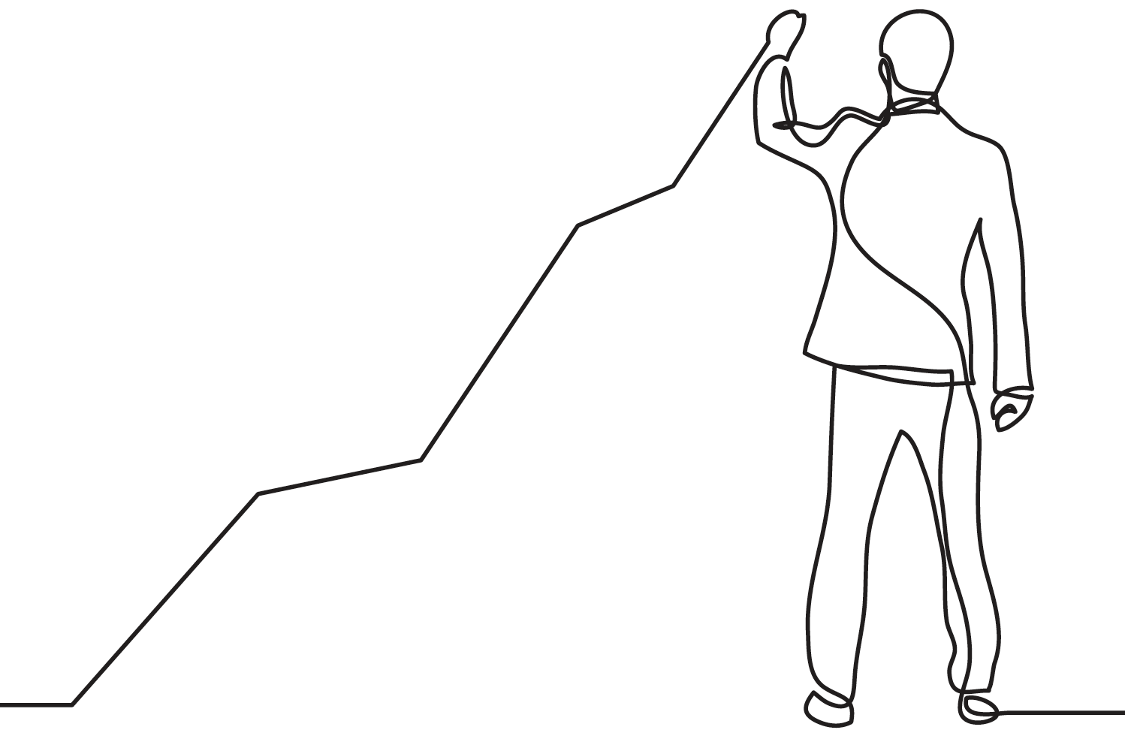
FIND OUT the seller’s motivation!
It is the SINGLE MOST IMPORTANT QUESTION to DETERMINE if you can get a GREAT DEAL

Slide 12

The ONLY THING you CAN’T CHANGE about
an investment is what you PAID FOR it.
Look at DOZENS, if not HUNDREDS, of OPPORTUNITIES!

Slide 13

Pick a TRUSTWORTHY PARTNER
who has a STRONG TRACK
RECORD with great investor
and lender RELATIONSHIP

Slide 14

Your BUSINESS PLAN is the KEY to your SUCCESS

Slide 15

You’re ultimately RESPONSIBLE
for DILIGENCING the deal.
This will SAVE YOU
headaches—and lost returns—LATER.

Slide 16

DON’T shy away RAISING CAPITAL, especially from FAMILY & FRIENDS.

Slide 17

KNOW the COMPETITION when you LOOK to RENOVATE.
Don’t over improve, but stay AHEAD OF DEMAND

Slide 18

REPUTATION---and BEING SURROUNDED by CREDIBLE PEOPLE---is EVERYTHING.
Always do the RIGHT THING.

Slide 19

PLEASE VISIT JAMESNELSON.COM
And sign up to my newsletter!

