Slide 1
The Role of BIM in Creating Smart Cities
NY Build 2024
Laurie Matkowski – VP/Director of Planning
Christian Birch – Senior Engineering Technology Manager
David Butts - Engineering Technology Manager
February 2024

Slide 2
Objectives
Review the state of current Smart City concepts
Learn how BIM tools actively integrate with transportation and infrastructure systems
Understand best practices and touch points to maximize the ROI for BIM implementation
Discover innovative technologies that can be used to further smart city integrations and improvements
Notes:
The agenda for this course includes the following topics:
An Introduction to the Engineering Technology Team, and the services offered by this group from IT Services;
An Overview of the Service Desk, where you can get product support, request software and training, and help with many other work-related items
An Overview of the Pinnacle Series training platform, which is the website where you can participate in application training, review Gannett Fleming standards and workflows, and access learning paths, courses, live events and quizzes for the software products used on a daily basis.
We will also cover the Primary Design and Document Management Platforms used to host and edit design authoring documents and content.
This includes an overview of Autodesk Construction Cloud, which is the primary design authoring cloud platform used with Autodesk design tools such as Revit, AutoCAD, Civil 3D, Plant 3D and other Autodesk applications.
We will also review Bentley ProjectWise applications that are used for design and document management;
And we will take a look at the Corporate Standards Documentation and locations needed, that support Gannett Fleming technology guidelines and usage.

Slide 3
State of Smart Cities and BIM Design Concepts

Slide 4
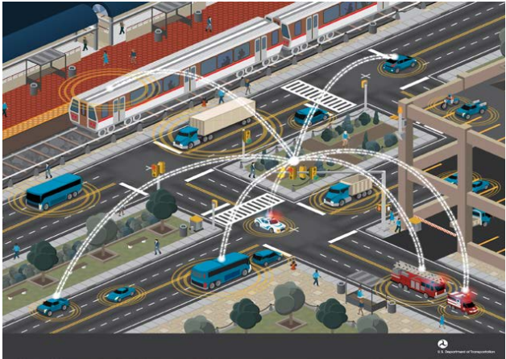
What is a Smart City?
A technologically modern urban area…
…Uses electronic methods and sensors to gather specific data (including IOT)
…Builds data helps to manage resources and services
…Leverages data to help improve operations

Slide 5
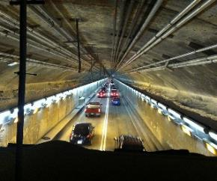
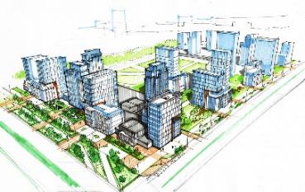
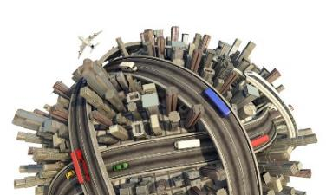
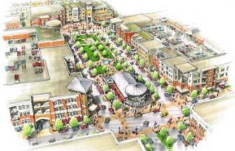
Engineering
Sociology
Data Science
Demography
Smart Cities/Communities = Connections through Technology
Urban Planning
Transportation Planning
Community Planning

Slide 6
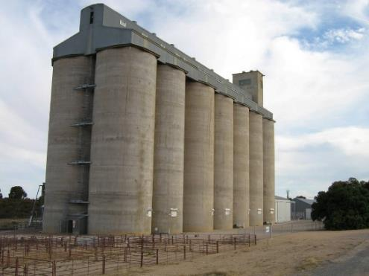
What Does a Smart City/Community Look Like?
3 Components
Data
Communications
Policies

Slide 7
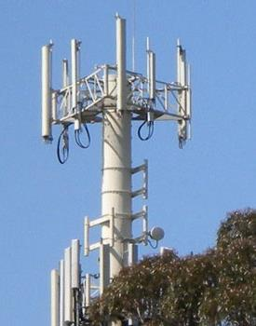
What Does a Smart City/Community Look Like?
3 Components
Data
Communications
Policies

Slide 8
What Does a Smart City/Community Look Like?
3 Components
Data
Communications
Policies

Slide 9
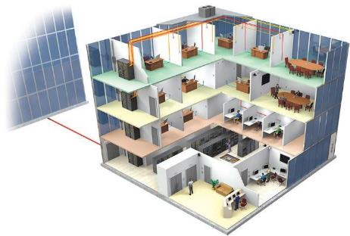
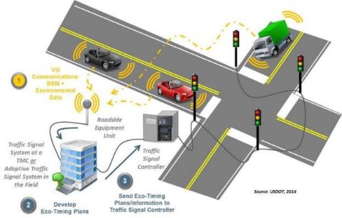
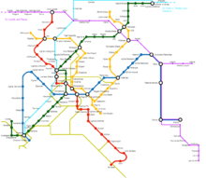
REAL WORLD EXAMPLE
BIM + Traffic Signals + Transit Systems = Balanced Energy Use and Maximized Mobility
BIM
Maintenance
Security
Energy use
Systems health
Traffic Signals
LED
Connected to central systems
Communicating with vehicles
Congestion responsive
Transit
Occupancy
Real-time schedule
Maintenance

Slide 10
THE WAY TECHNOLOGY “TALKS”… IS CHANGING HOW TECHNOLOGY AFFECTS OUR LIVES
Data is like raindrops
Sensors are like leaves
Internet of things
Machine learning
Big data
Mobility-as-a-Service
Social change
Communications network is like branches and a trunk
Information is like the root system

Slide 11
BIM Tool Integration for Smart Cities

Slide 12
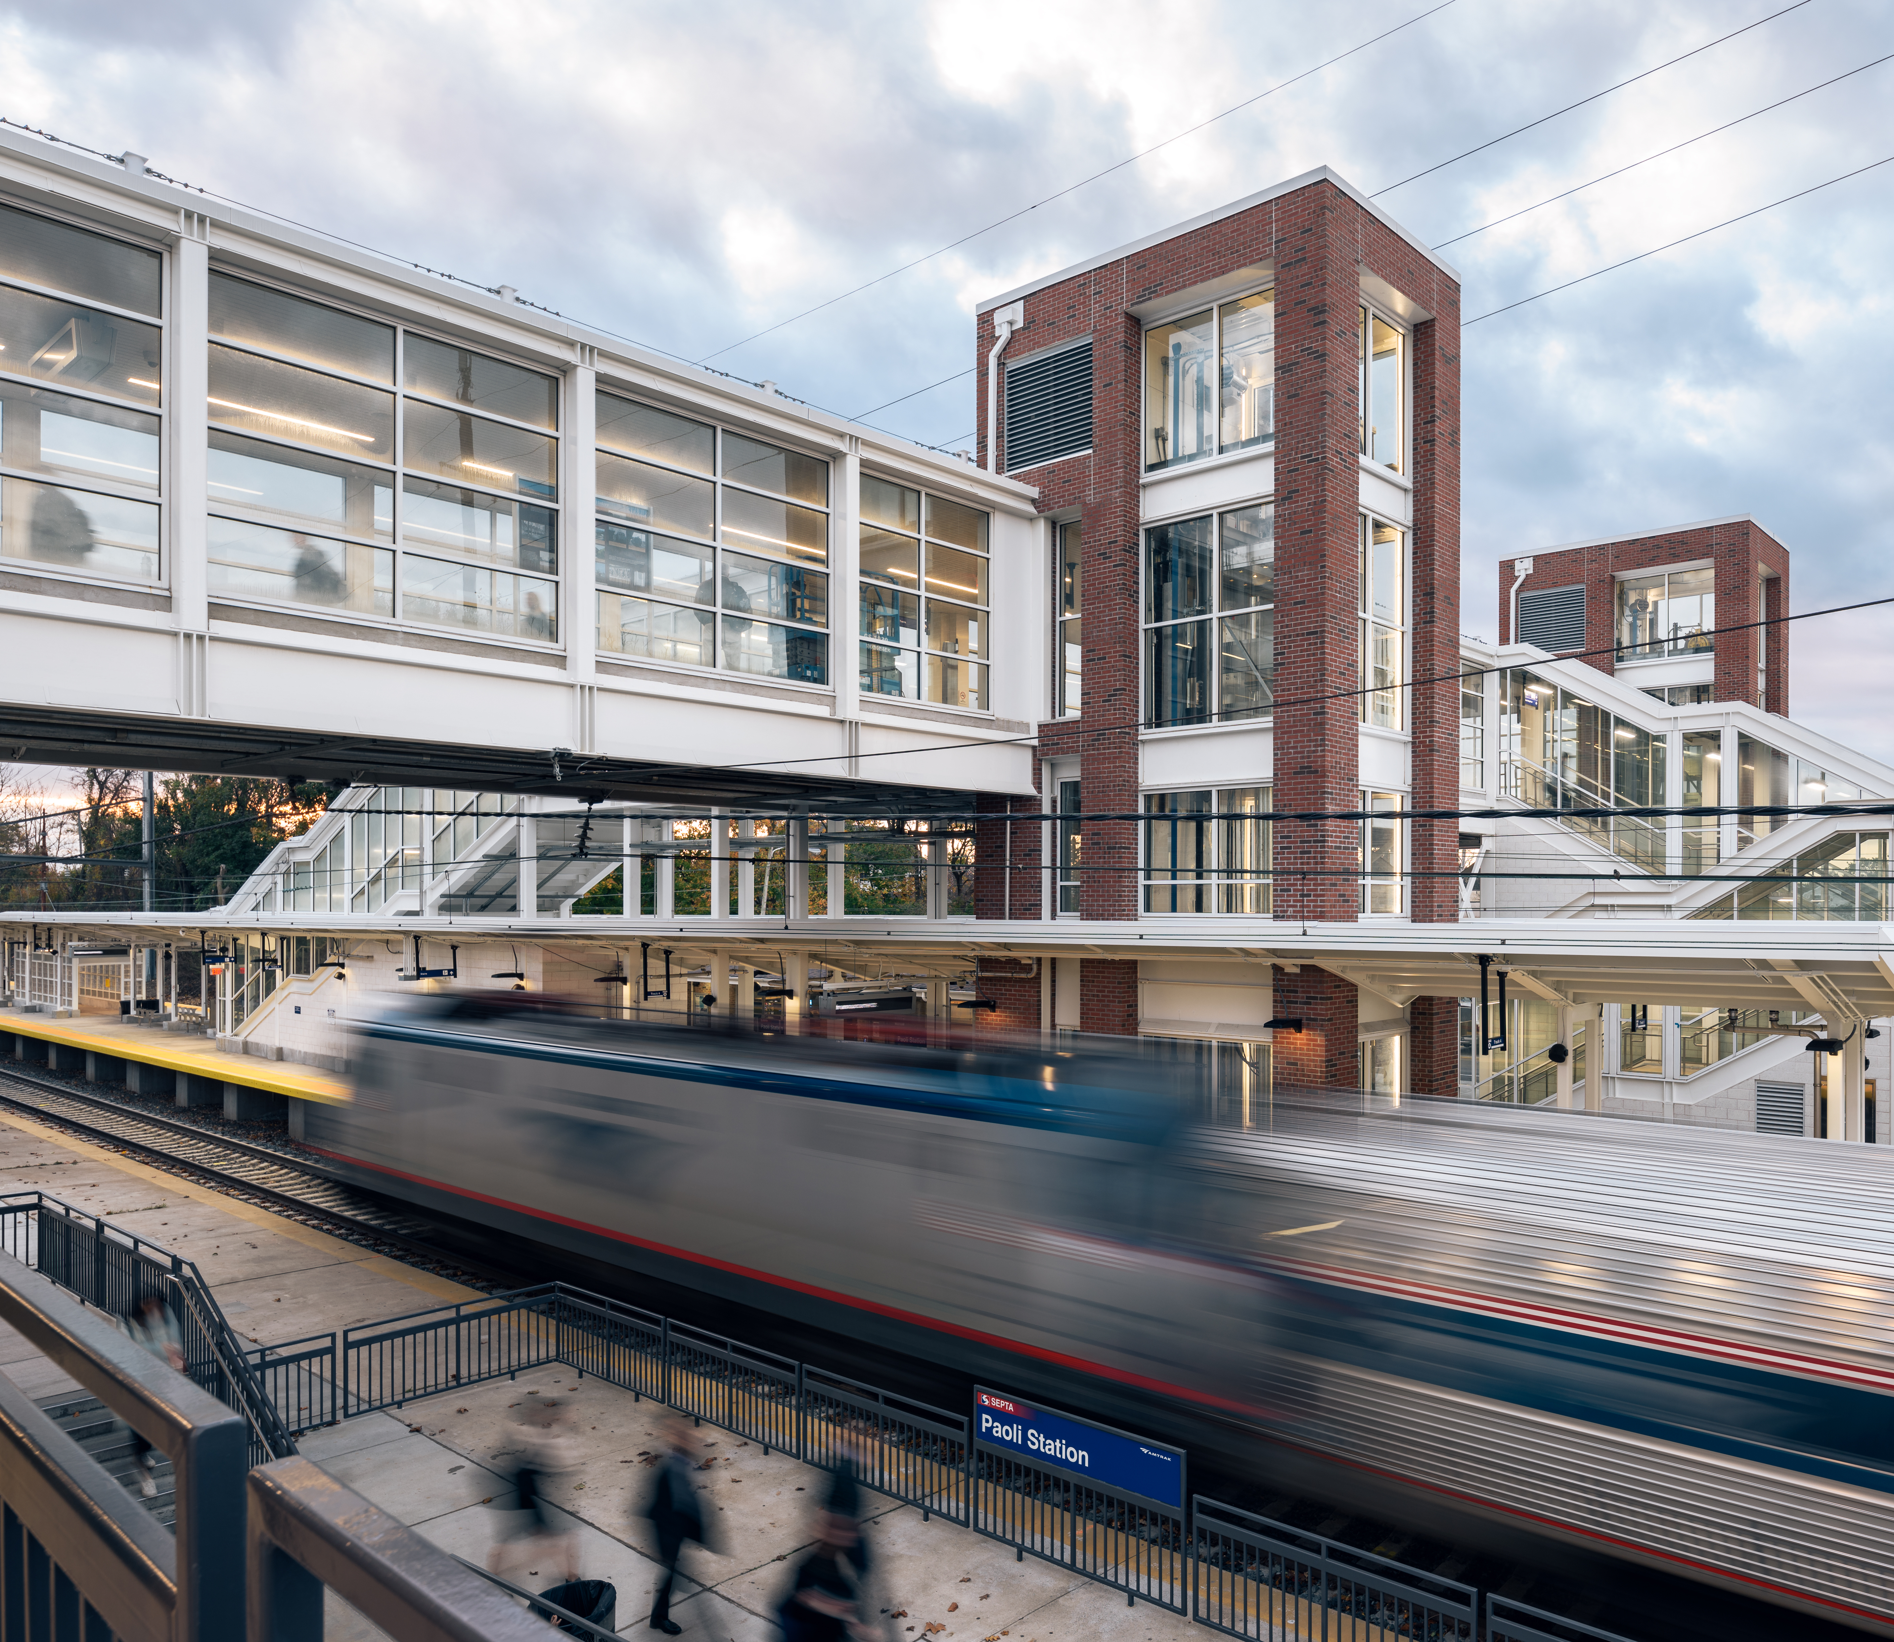
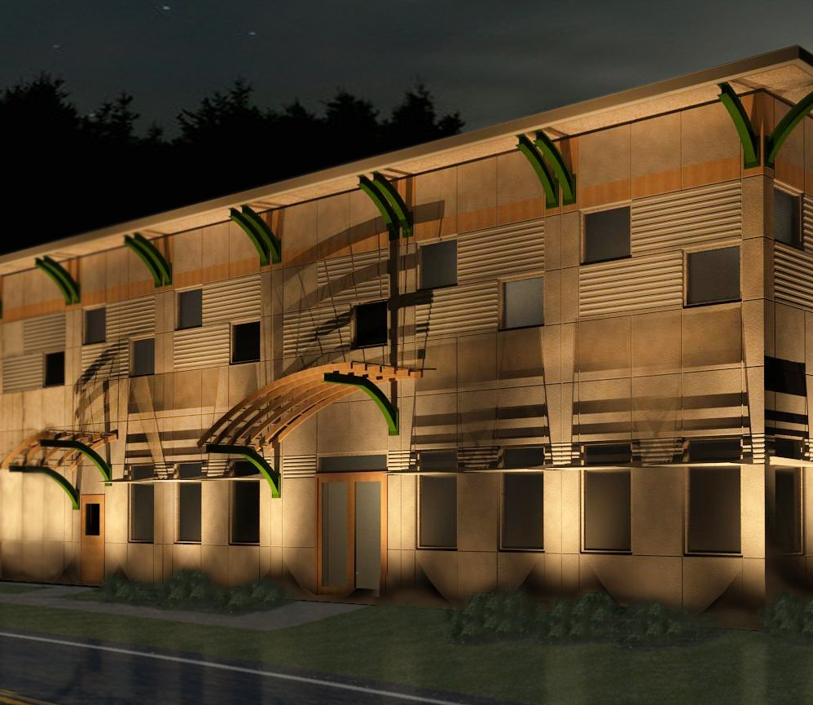
What is BIM?
Building Information Modeling
Building (V): the act of building something…
…D A T A…
- Modeling – act of creating an accurate 3D model representation of real world elements
- Information – data associated with the physical elements
Image Credit: ©Copyright Gannett Fleming, Various Projects

Slide 13
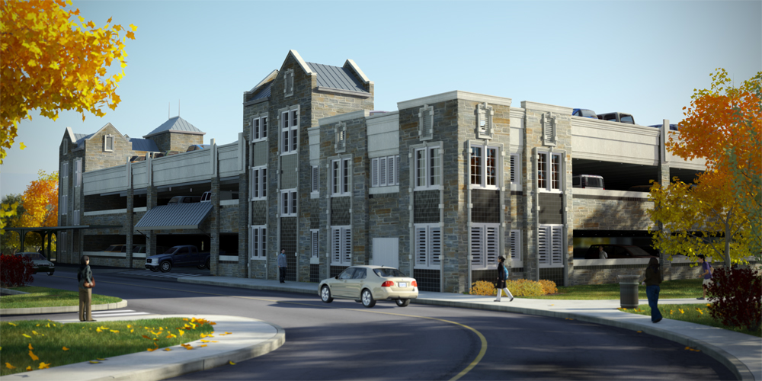
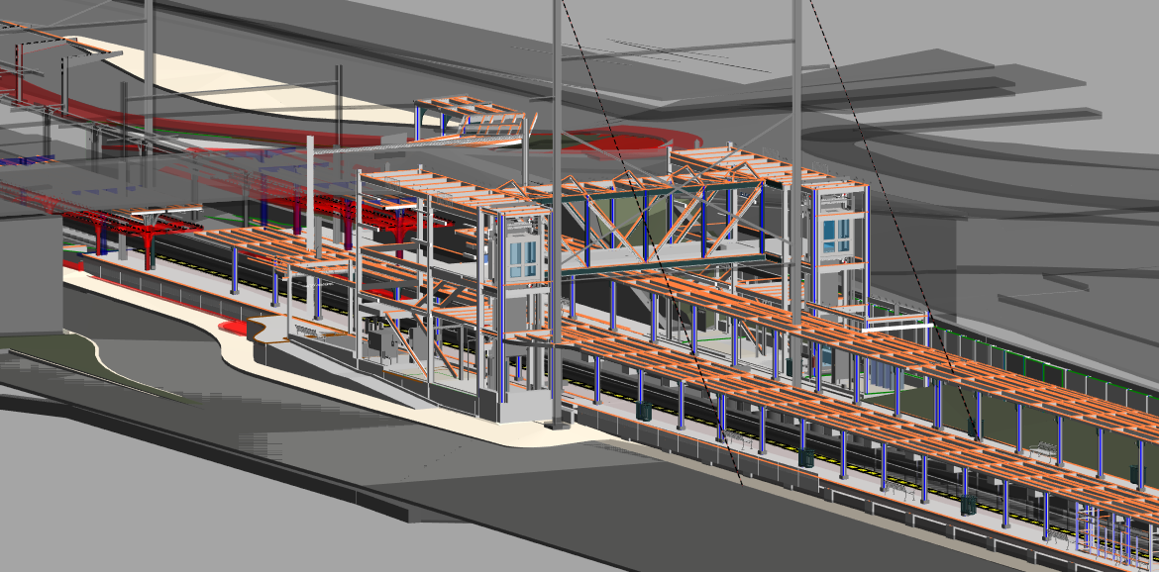
How do BIM applications impact Smart Cities?
BIM designs and workflows create and enable:
digital representation of physical systems and associated processes
Improve planning, design, simulation, testing, scheduling, costing, constructing, recording existing conditions, monitoring and maintenance
=
Image Credit: ©Copyright Gannett Fleming, Various Projects

Slide 14
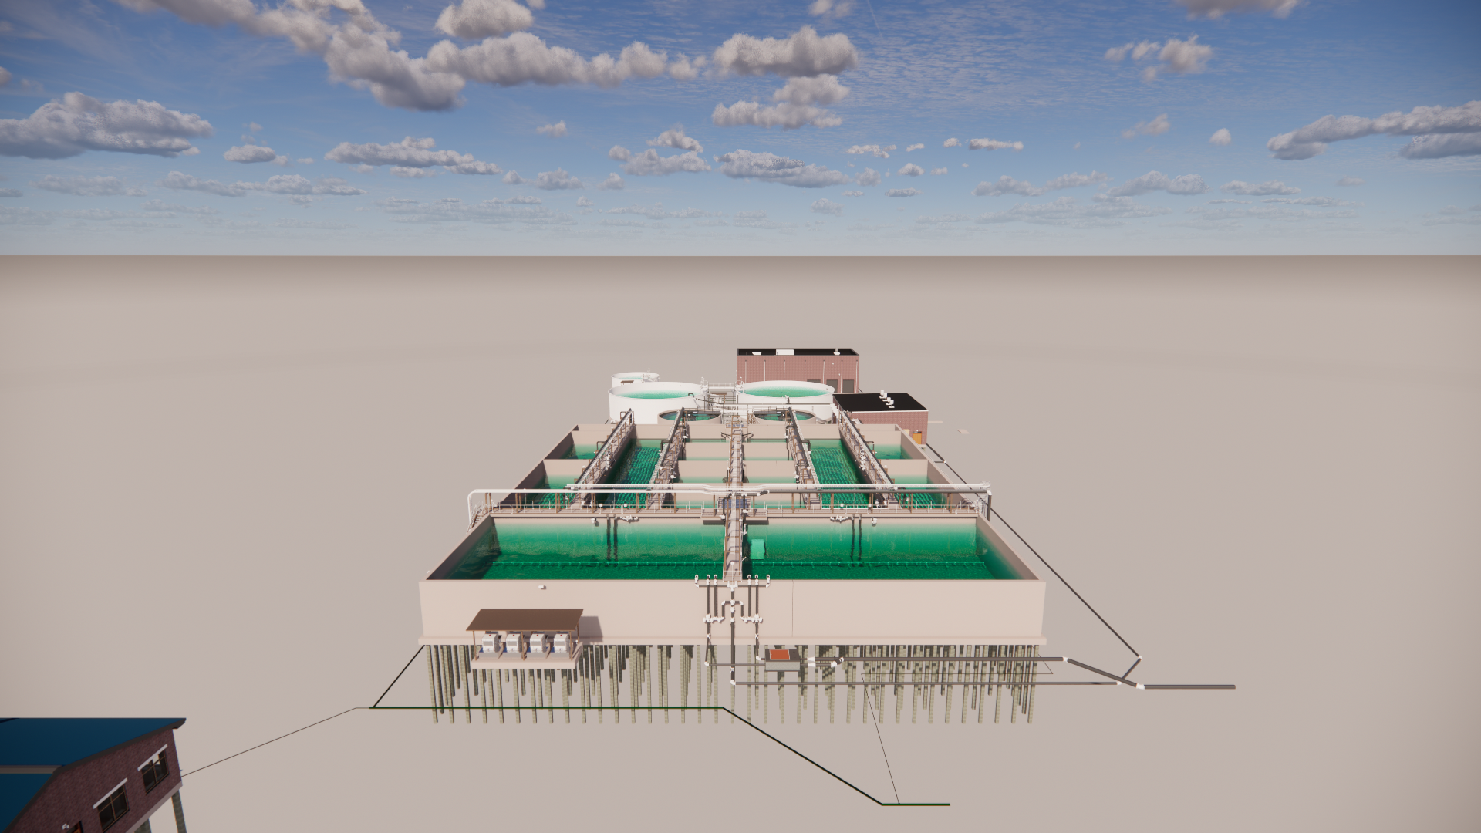
How do they integrate? The Digital Twin Environment
Virtual representation of real-world objects
Maintained throughout a structure’s life cycle
Leverages sensors to monitor behavior and operations
Operates from single element to entire assembly
The data connection for BIM content and Smart City objectives
Image Credit: ©Copyright Gannett Fleming, Stephen Biggs AWT Facility

Slide 15
The Digital Twin Environment…is not one.
There are a host of cloud solutions used by BIM technology for today’s common data environment…
Cloud Image Credit: Autodesk, Inc. https://constructionblog.autodesk.com/common-data-environment/
Notes:
Note – during research I could not find any relevant data regarding adoption of NCS 6 or the amount of time typically consumed to comply with client, company or national CAD standards.

Slide 16
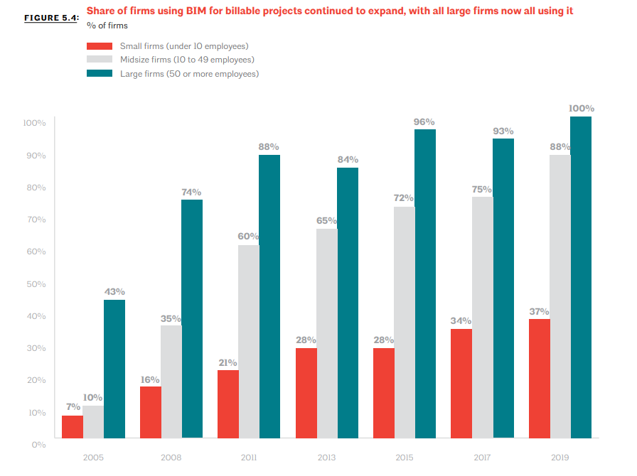
State of BIM in AEC
BIM tool usage continues to increase
Mid to Large size firms have adapted at a faster pace
Most frequent use by institutional firms
Operates from single element to entire assembly
Less than 20% of all design firms do not use BIM tools
Image Credit: ©AIA 2020 Firm Survey Report

Slide 17
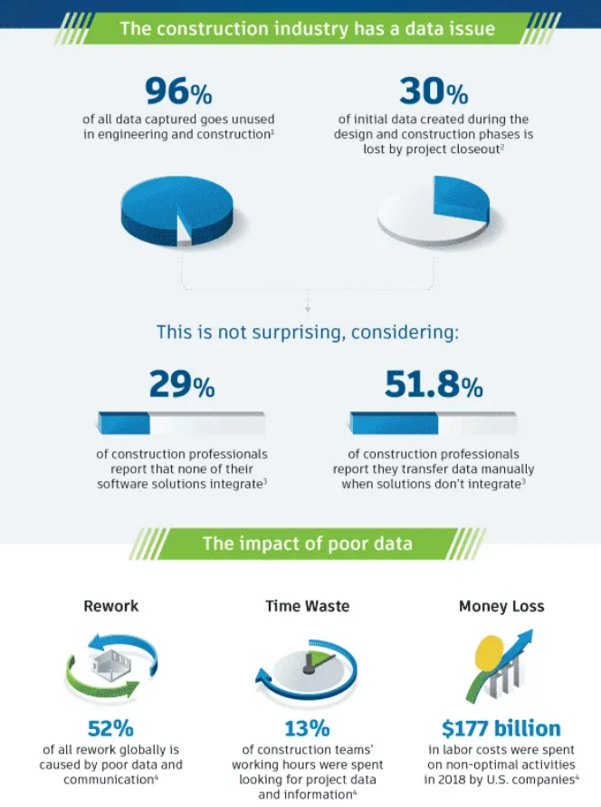
What are the barriers?
Dependence on Legacy Technology
Lack of Continuity for Data in project lifecycle
Extended Lifecycle for Contractual obligations
Outdated Standards, Workflows and Processes
Cloud Image Credit: ©Autodesk, Inc. https://constructionblog.autodesk.com/common-data-environment/

Slide 18
Maximize BIM ROI

Slide 19
BIM ROI for Smart Cities
Incorporate more detailed existing conditions – capture and introduce into design environment more, detailed as-is data
Minimize clashes and rework – more effectively incorporates sub-contractor contributions and issues tracking/resolution
Strengthen design collaboration – shared design models and reviews enhance stakeholder access and communication
Increase efficiency through automation – reduce error, increase prototyping by automating process, design, and operational tasks
Streamline client approvals – increased review frequency using models results in greater transparency and client confidence/trust
Improve constructability – review alternative approaches in advance of construction to detect/document/resolve problems
Derive more accurate quantity and cost estimates – automated extraction of components and materials
Improve safety – virtual tours identify potential hazards prior to their occurrence allowing for proactive changes
Enrich knowledge capture and transfer - record lessons learned throughout the lifecycle available for future teams/projects

Slide 20
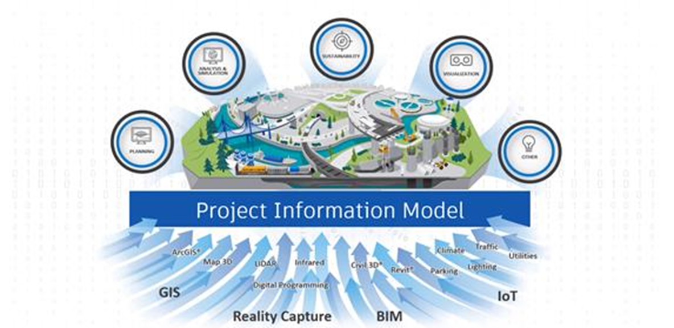
Investment in Cloud Platforms
Gather assets into a digital environment
Industry-based data structure – formatting, usage, etc.
Summary of everything connected
Layer connectivity to get data to the right place
Leverage tools that can consume the data agnostically

Slide 21
Innovative Technologies for Smart City Integration

Slide 22
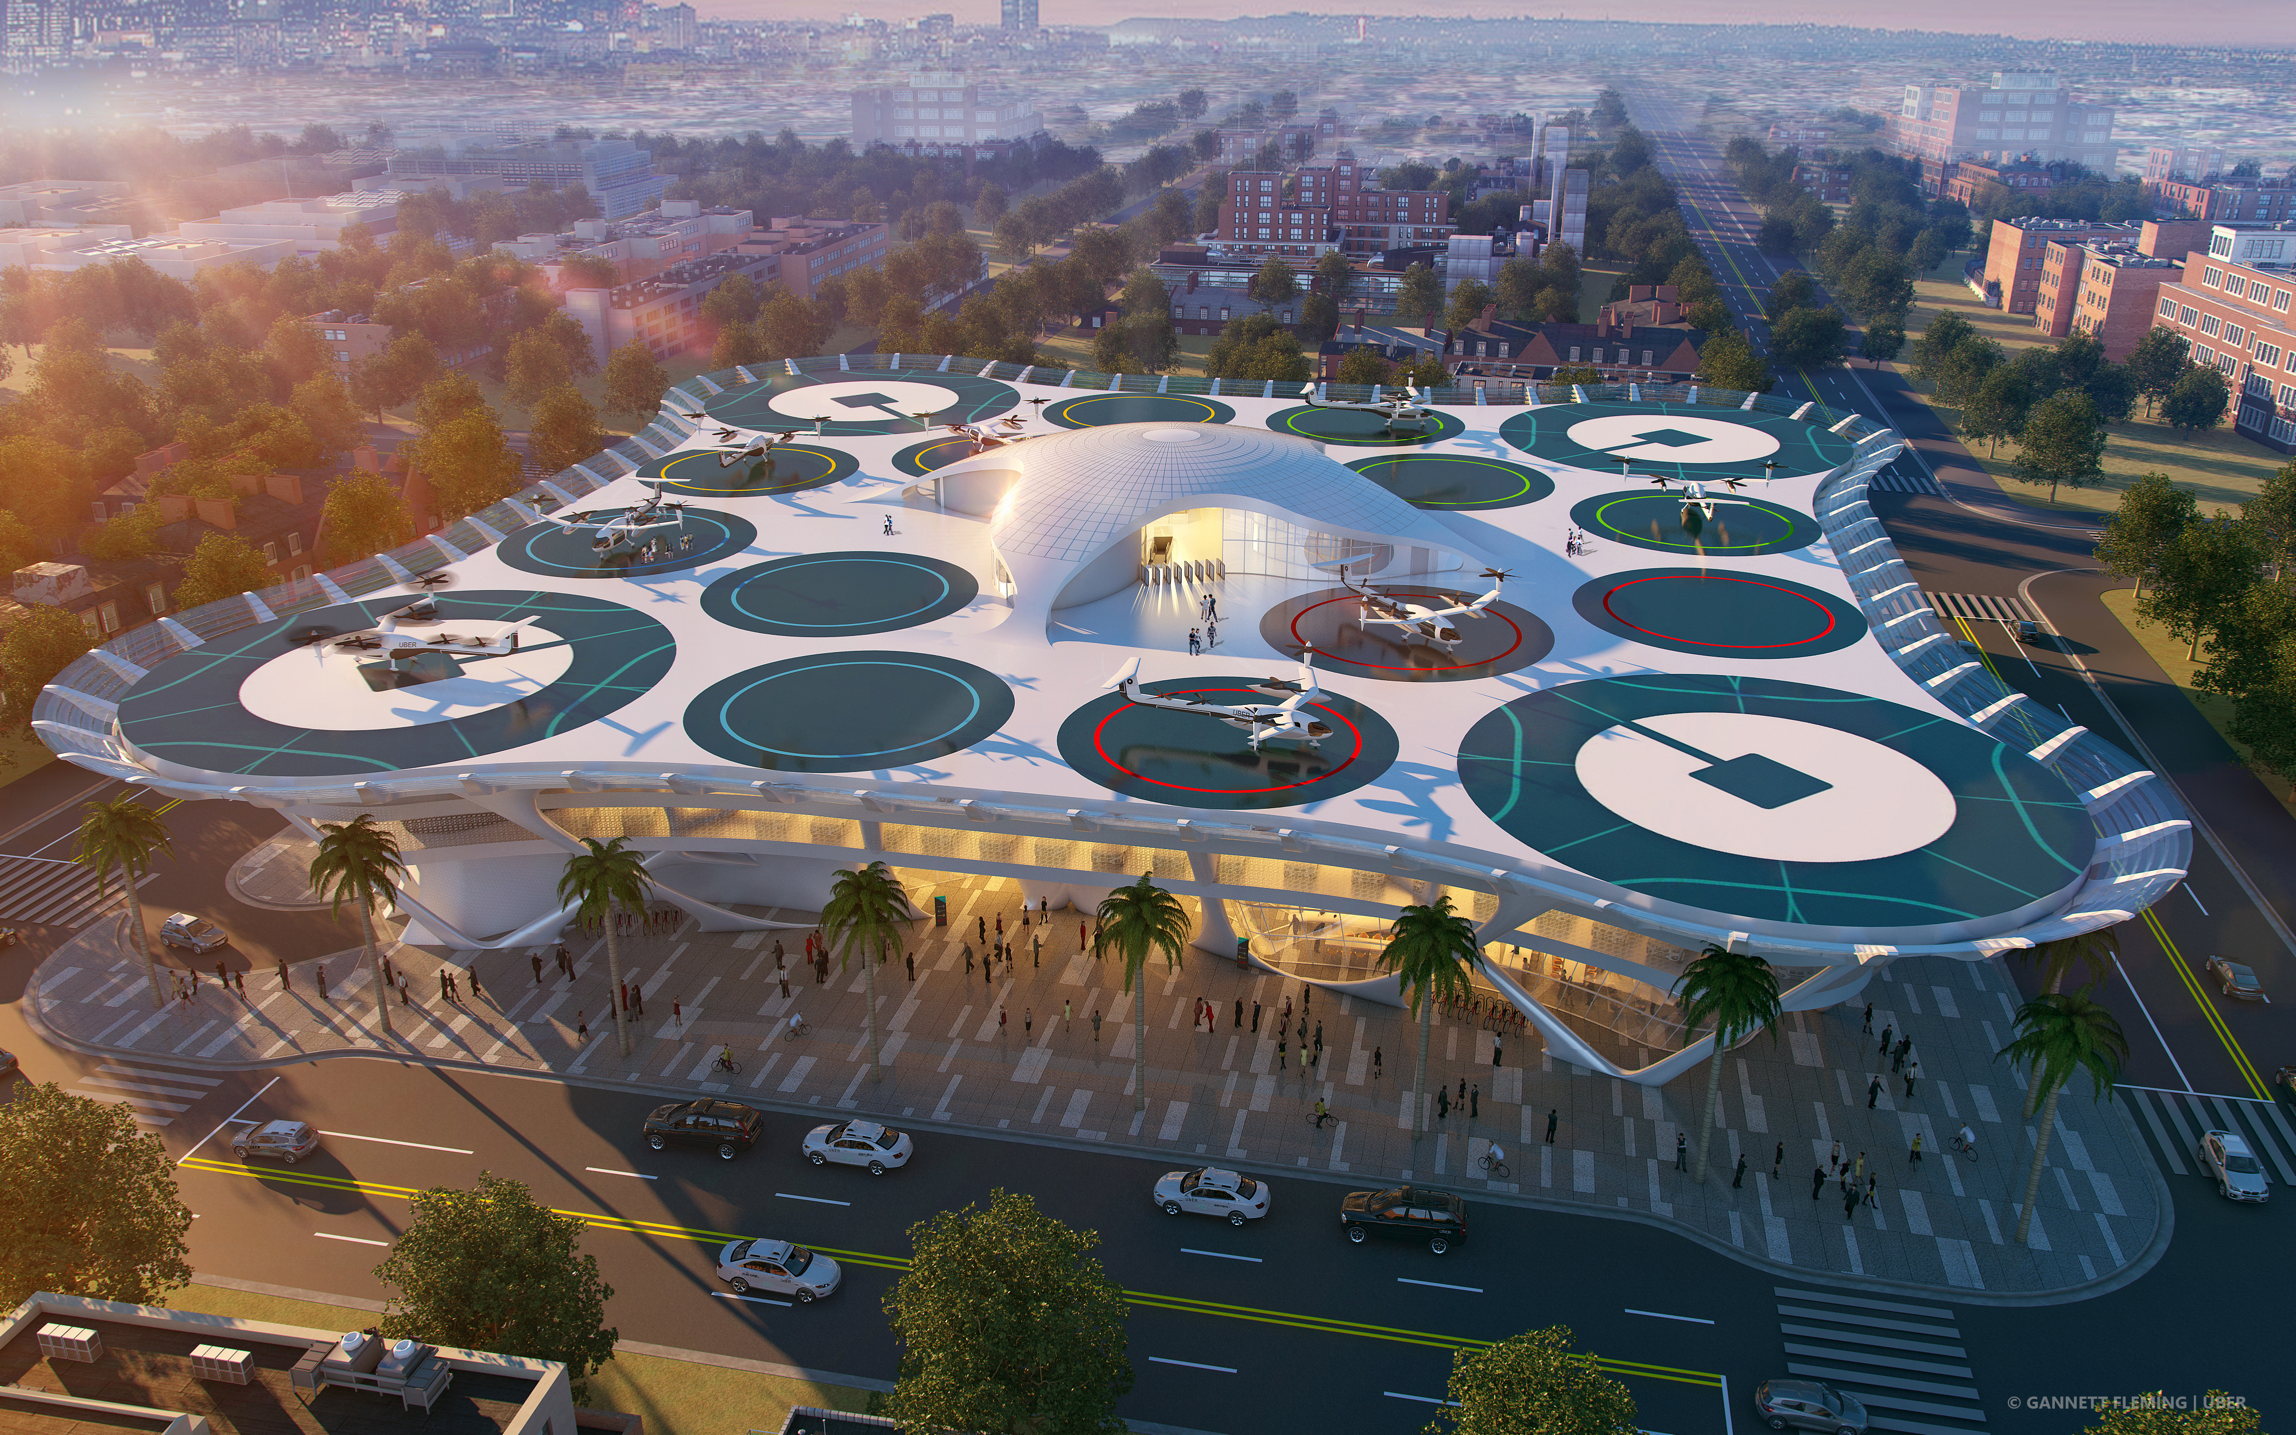
Where do we want to end up…
Establishing goals and standards for CDE
Eliminate/reduce silos and barriers
Integrate temporal data (4D)
Layer connectivity to get data to the right place
Leverage tools that can consume the data agnostically
Image Credit: ©Copyright Gannett Fleming, Uber Skyport VTOL Final Approach

Slide 23
THANK YOU for your Participation!

