Slide 1





Training the
Next Generation to
Supplement the
ACED Industry
NY Build 2024

Slide 2
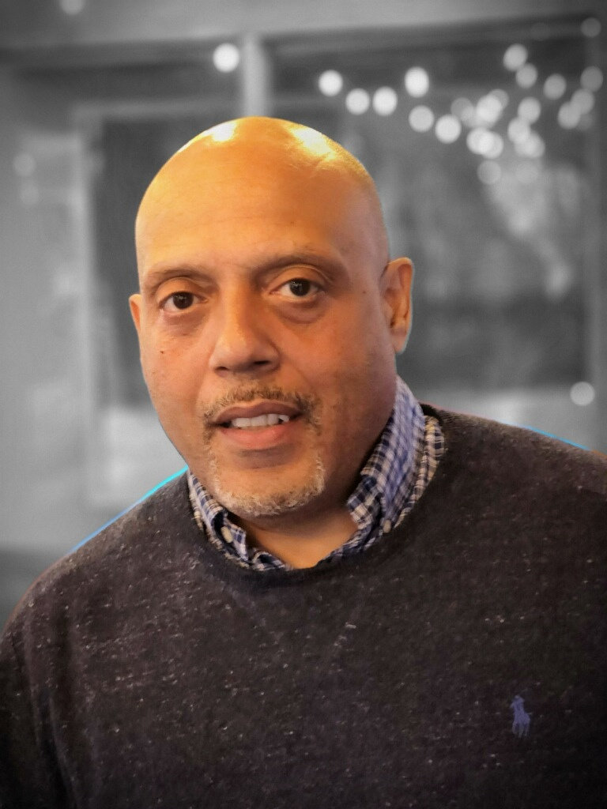

Derek
Perkinson
Executive Director
Youth Construct

Slide 3
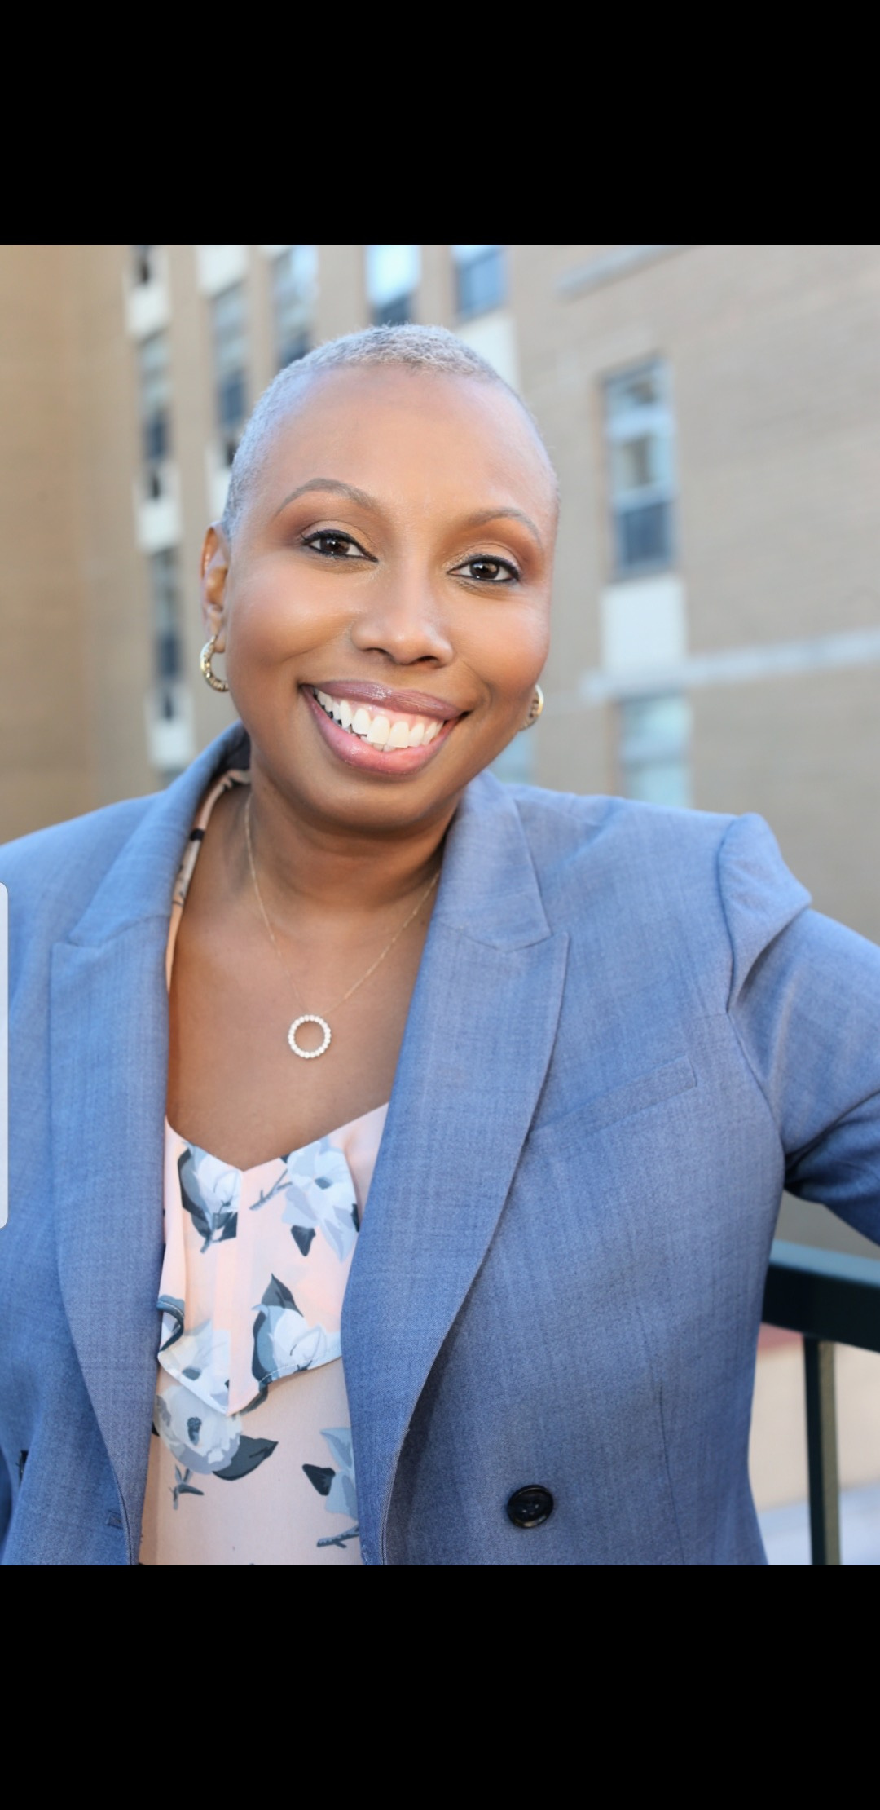
Alexis McSween
Founder
Bottom Line Construction
& Development
Youth Construct

Slide 4
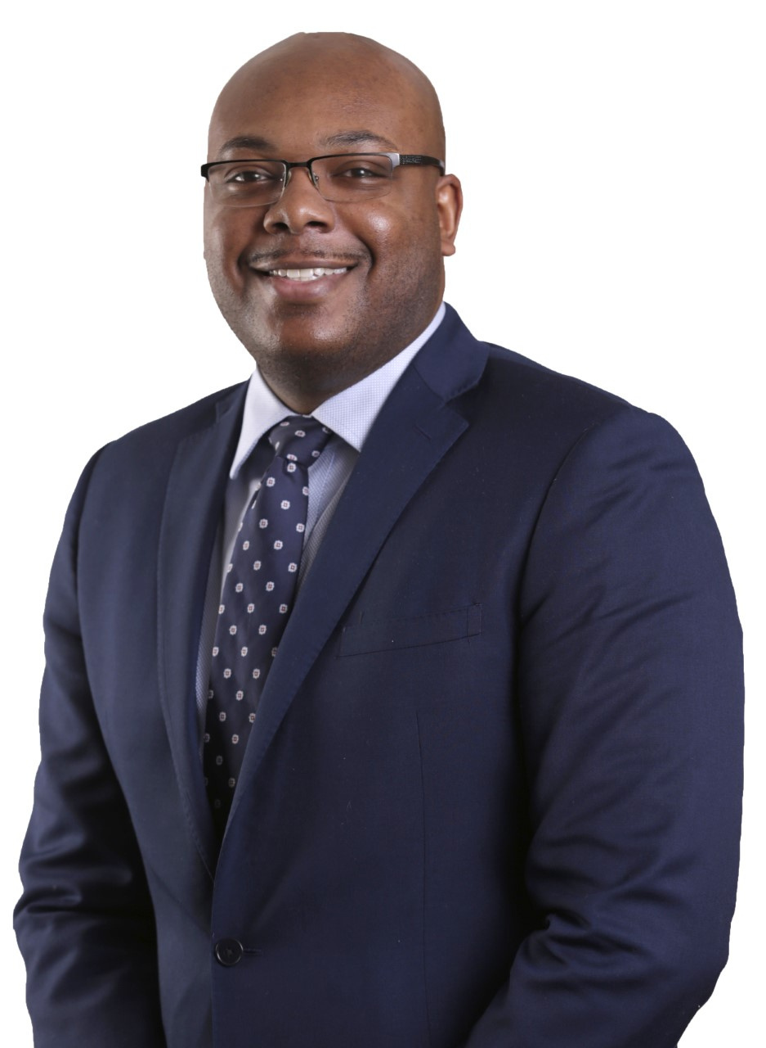
Fuquan Collins
Vice President Chief Diversity Officer
Turner Construction Company

Slide 5
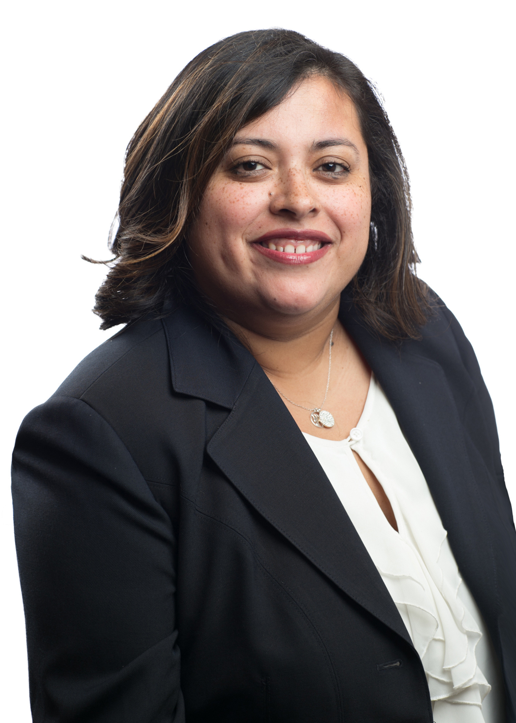

Nelly Vasquez
Business Development Manager
Turner Construction Company

Slide 6
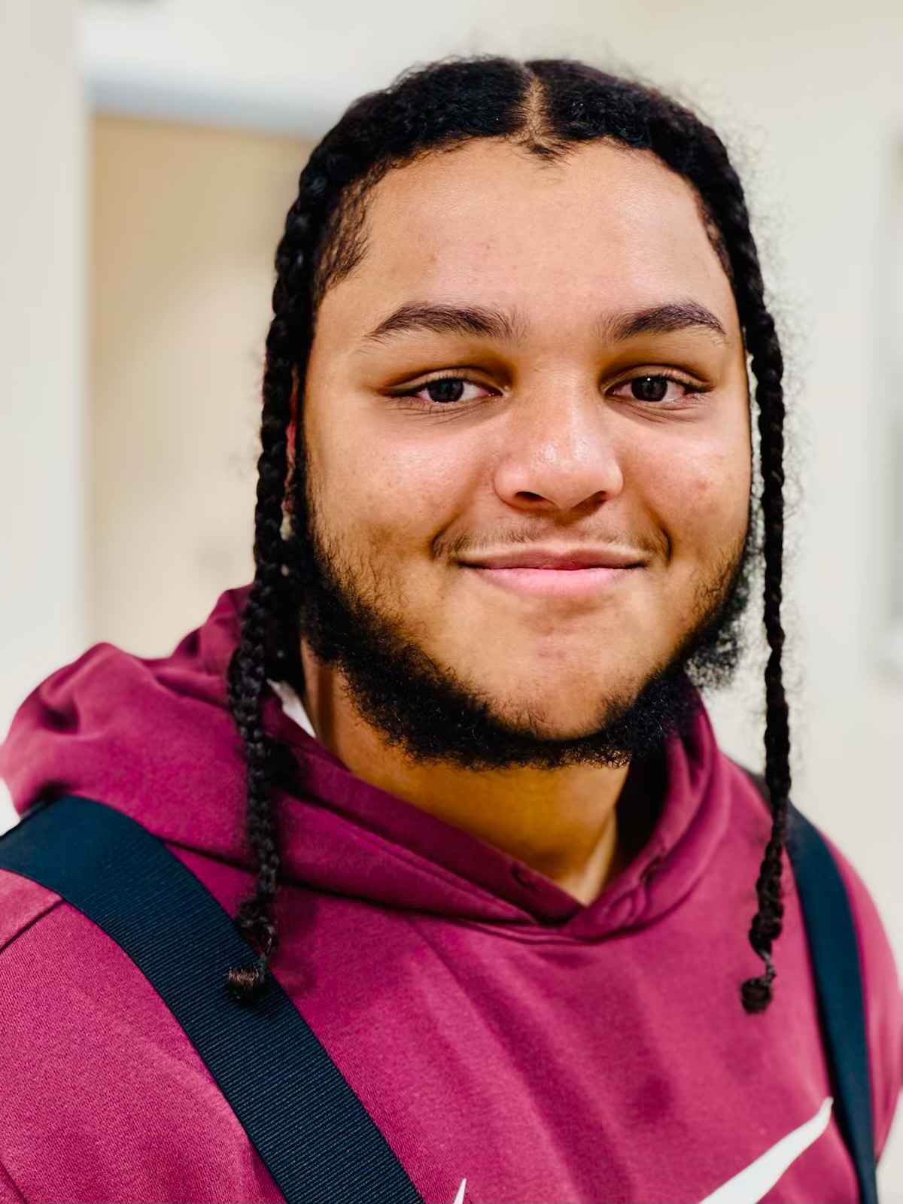
Joshua
Reid
Youth Construct Graduate ‘23
Helper
Almar Plumbing

Slide 7
MODERATOR
Training the
Next Generation to
Supplement the
ACED Industry
Derek Perkinson
Youth Construct
PANELISTS
Alexis McSween
Bottom Line Construction & Development
Youth Construct
Fuquan Collins
Turner Construction Company
Nelly Vasquez
Turner Construction Company
Joshua Reid
Youth Construct Graduate ‘23

Slide 8

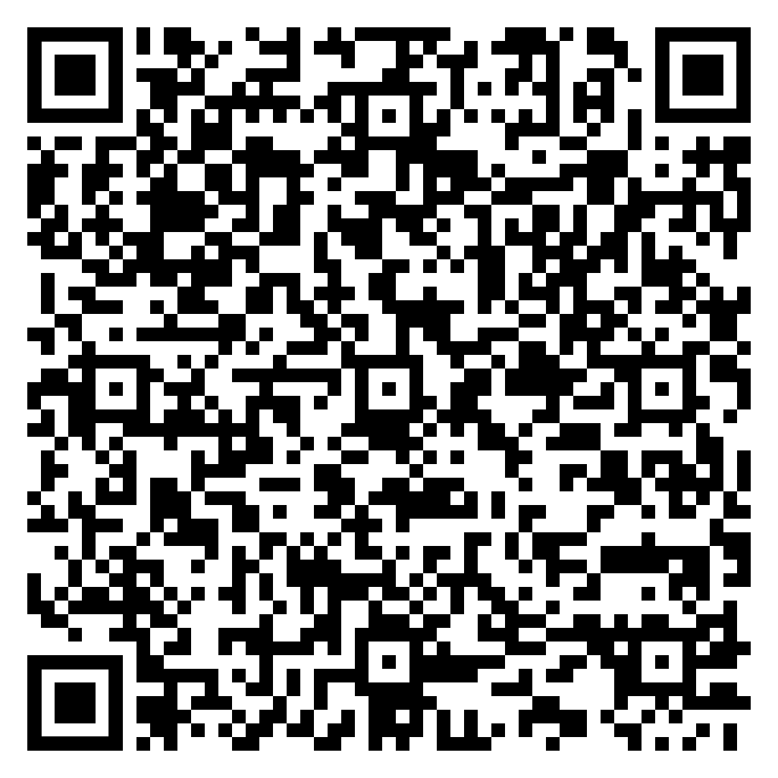


SCAN HERE
CONNECT WITH US!
Calle Cualquiera 123, Cualquier Lugar
Visit Booth #874

