Slide 1
zeroconstruct.com

Slide 2
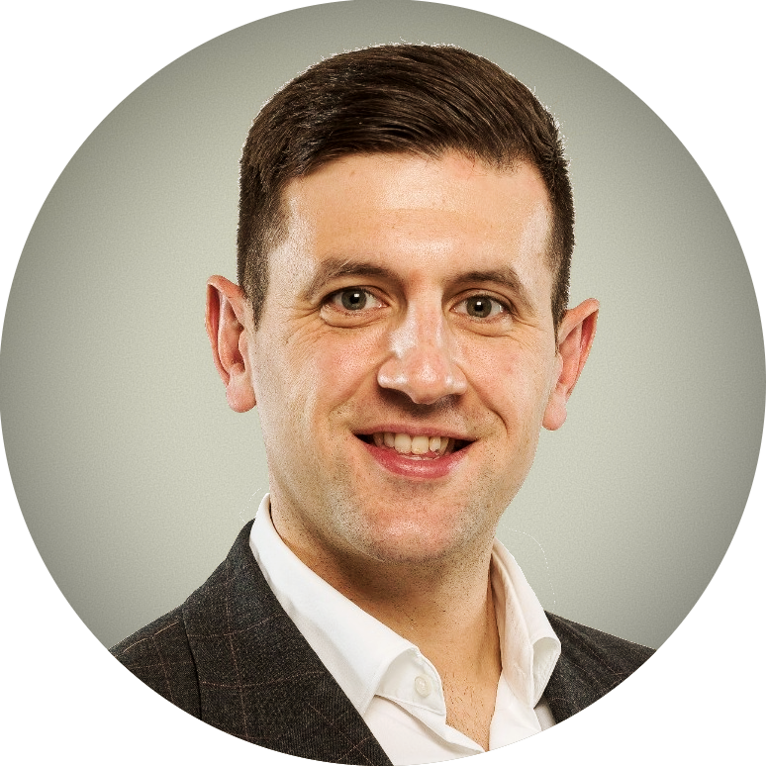
Johnathan Munkley
Co-Founder of ZERO
Brittany Harris Co-founder & CEO of
Qualis Flow
zeroconstruct.com

Slide 3
zeroconstruct.com
qualisflow.com

Slide 4
What is ZERO?
Our Mission is to Unite the built environment to tackle its Carbon Addiction
zeroconstruct.com

Slide 5
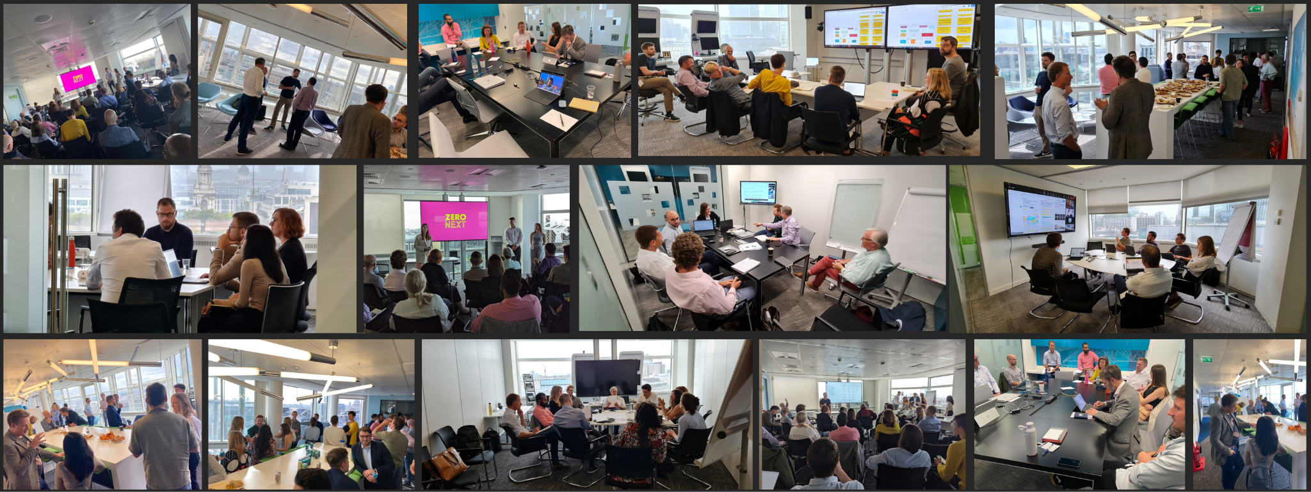
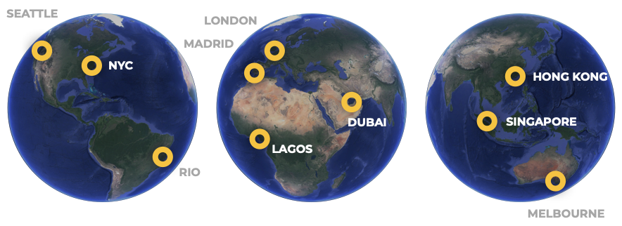
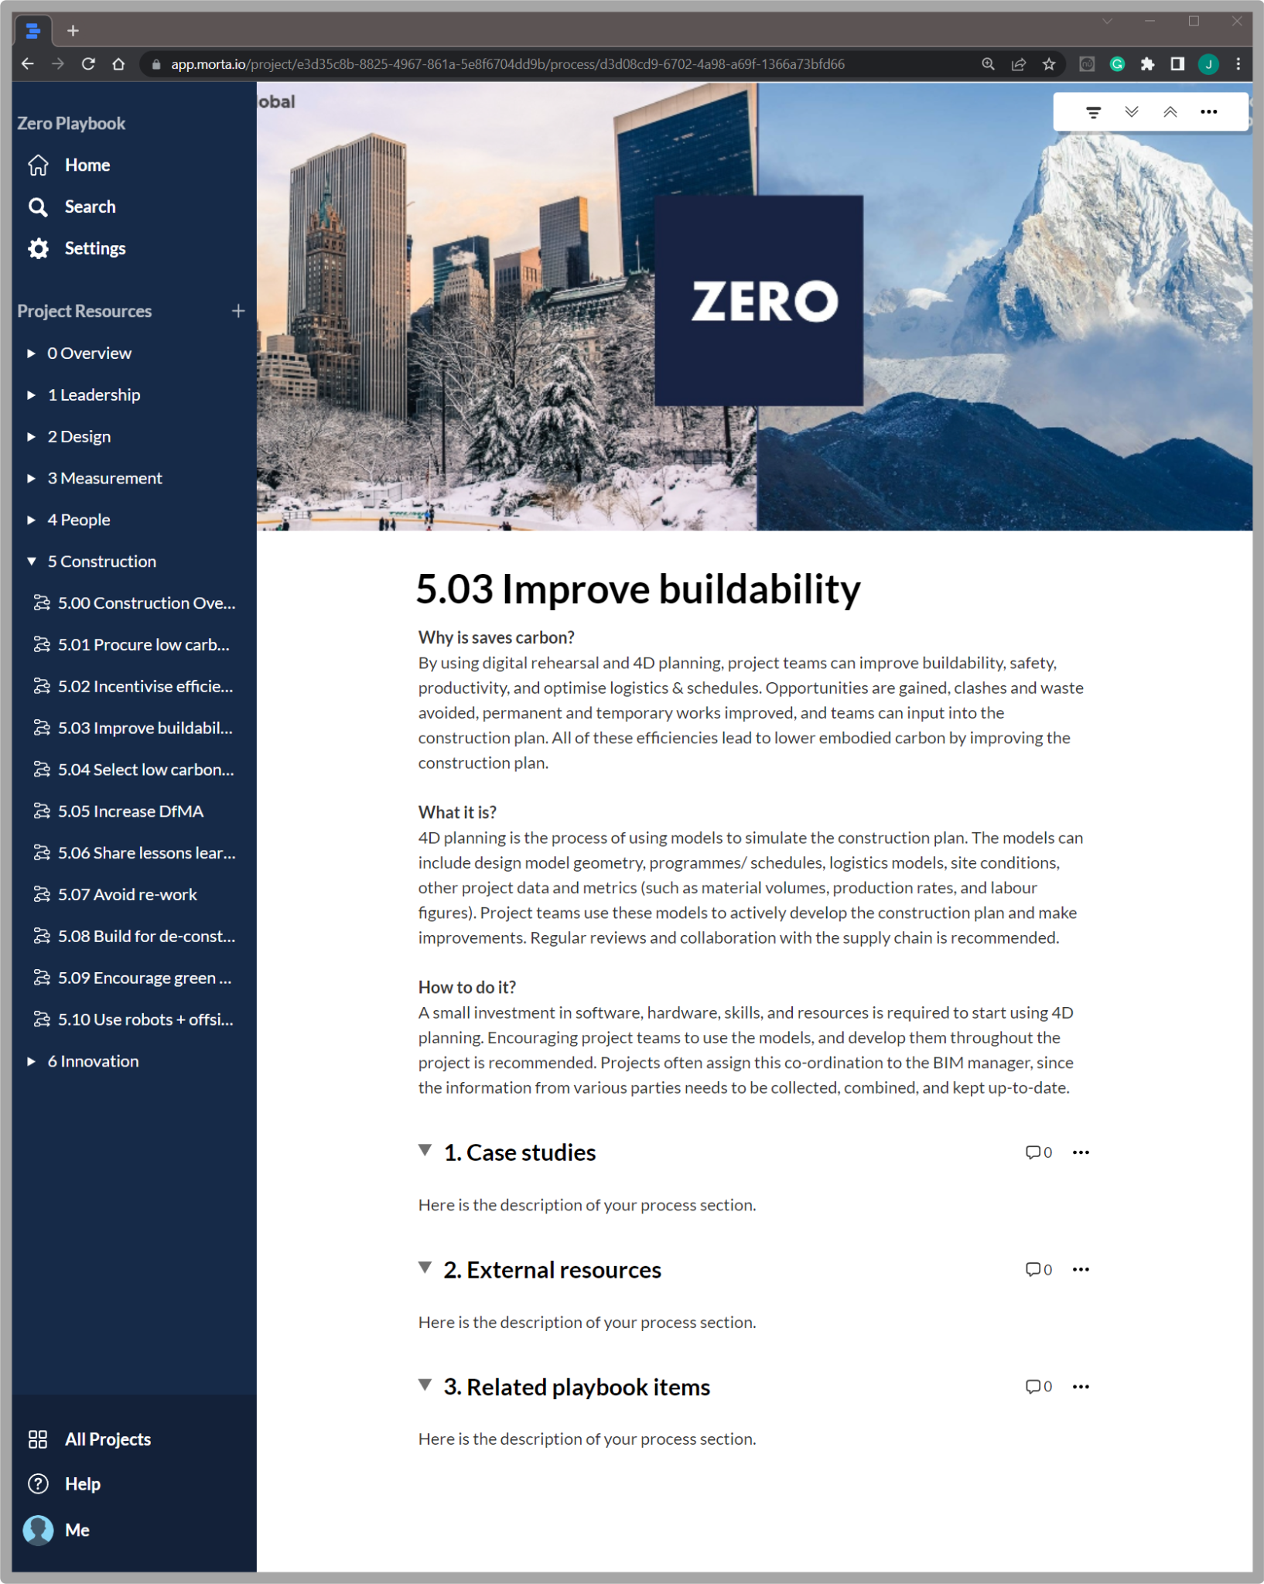
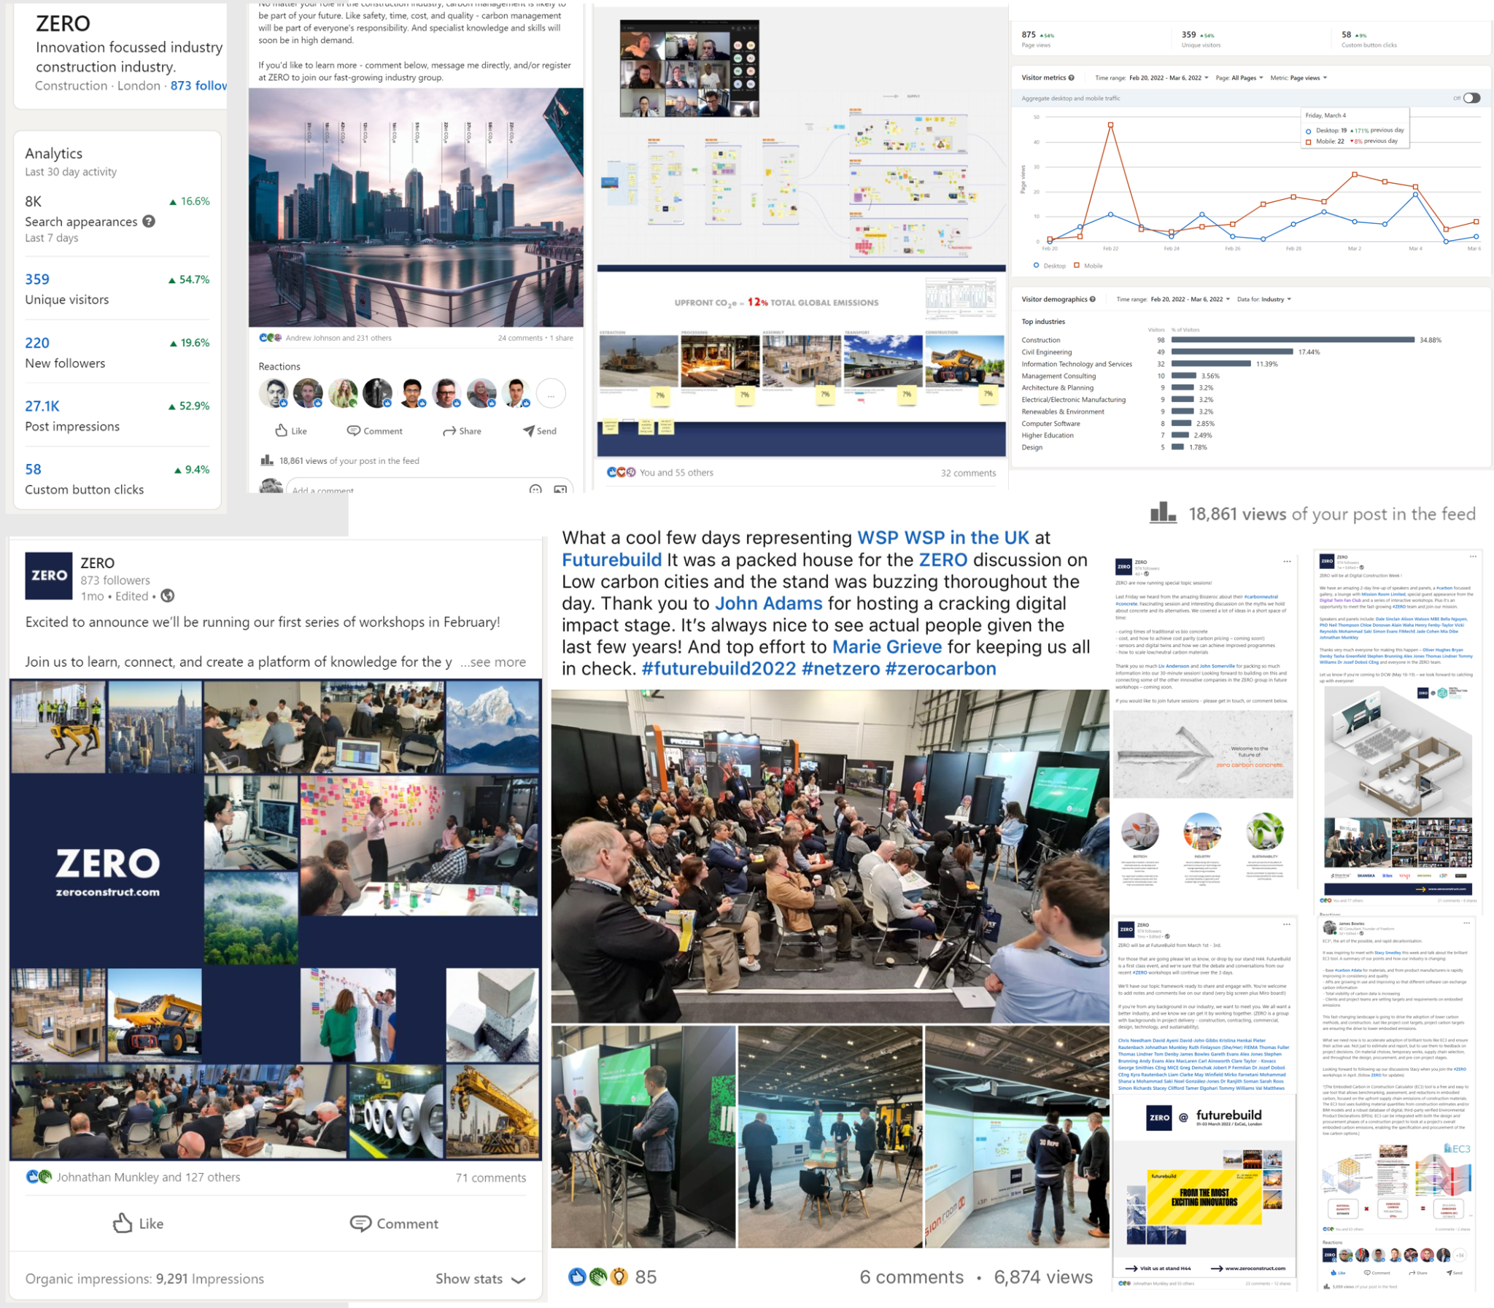
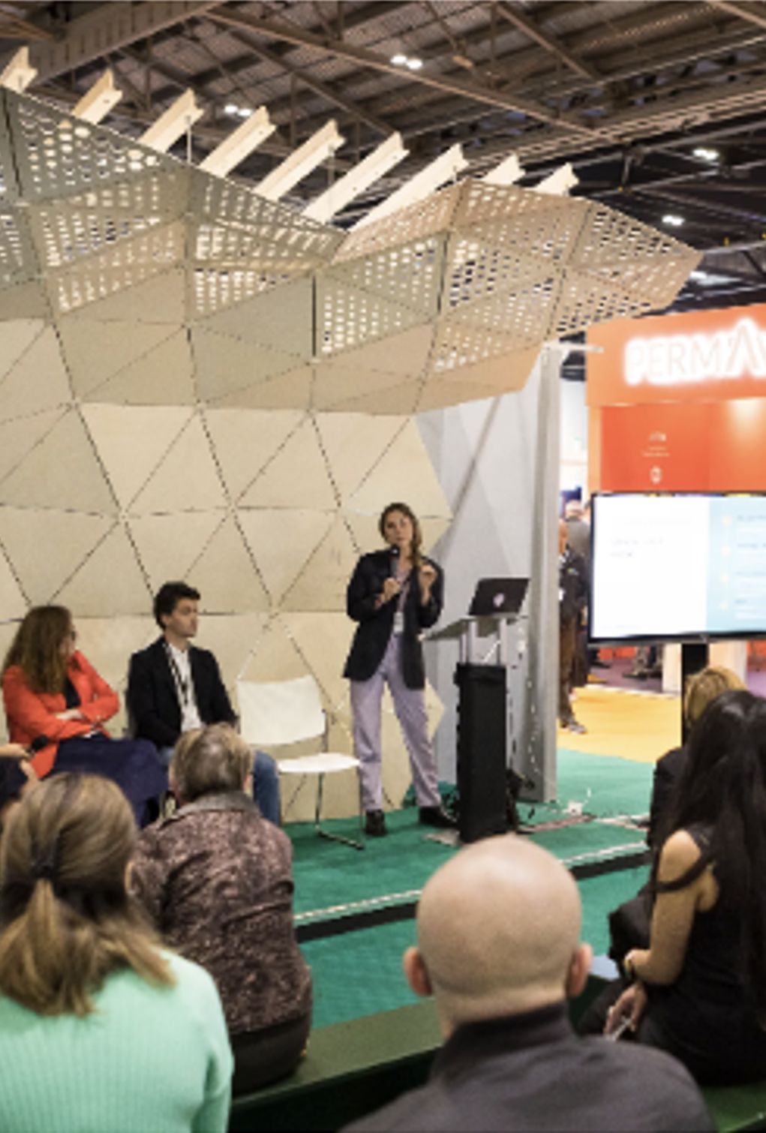
3200+ members
62 countries
35 professions
Events, Physical and Virtual Conferences Education, ZERO Academy Thought leadership, ZERO Playbook Content, Podcasts, Webinars, Articles

Slide 6
Road transport
Total human
GHG emissions
Manufacturing
Embodied emissions = 12%
12% = 4-5 billion tonnes
Aviation
Building energy
We’re here to decarbonise construction.
Agriculture
Other energy

Slide 7
Creating Carbon Literacy
zeroconstruct.com

Slide 8
Operational vs Embodied
zeroconstruct.com

Slide 9
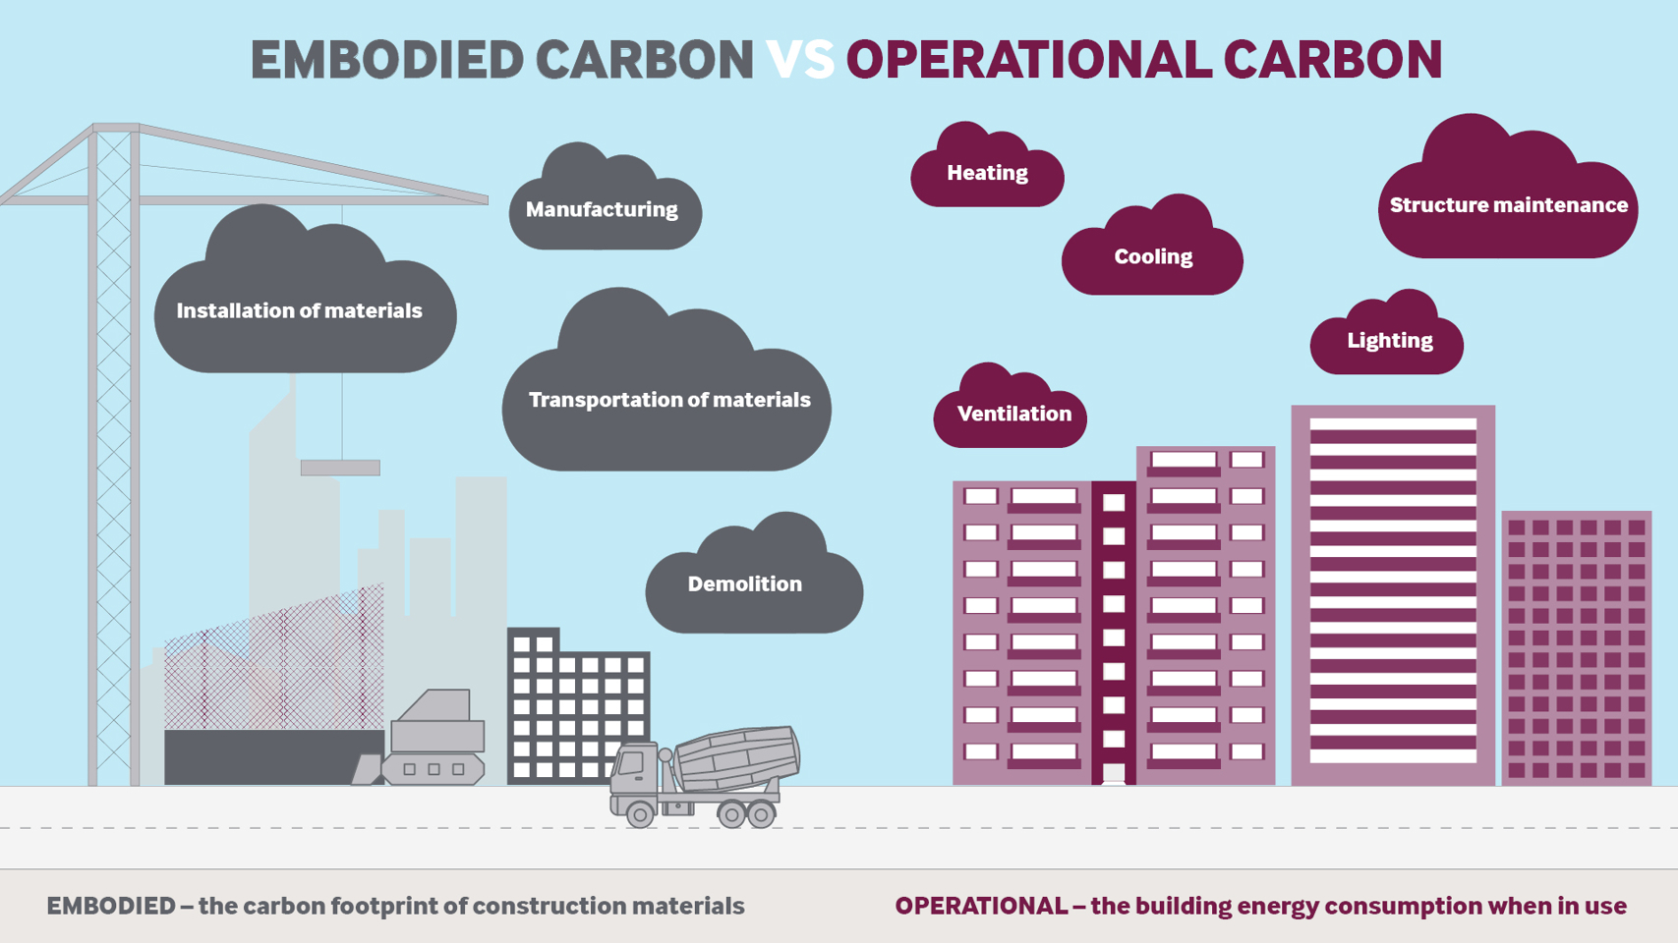
Image credit: RPS Group

Slide 10
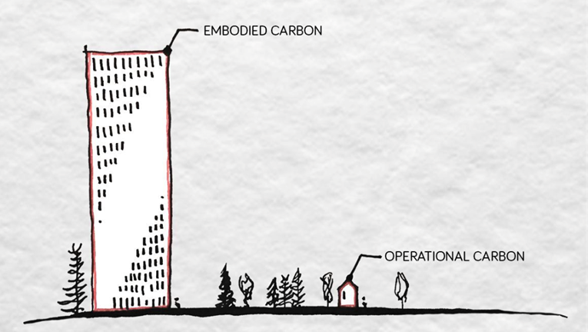
Road transport
Total human
GHG emissions
Manufacturing
Embodied emissions = 12%
12% = 4-5 billion tonnes
Aviation
Building energy
We’re here to decarbonise construction.
Agriculture
Other energy
Notes:
Britt share this one - Avg 53 year life of a building. Therefore embodied has an almost equal impact on a buildings WLC as operational. https://www.commbuildings.com/ResearchComm.html
Properly commissioned assets give better embodied AND operational carbon
James Pellat shared the need to commission it properly.

Slide 11
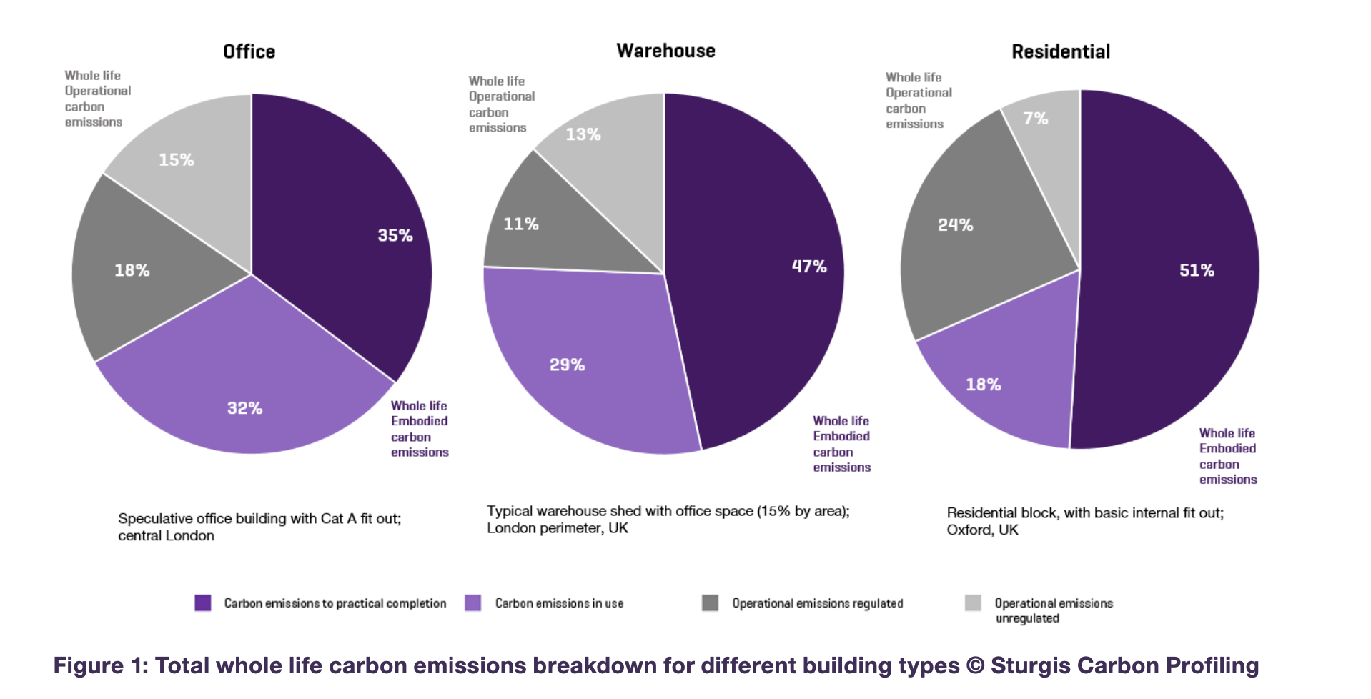
Ref: RICS Whole Life Carbon Assessment

Slide 12
You don’t know what you don’t know
Gandi (probably)

Slide 13
Thought experiment
There are 8b people on Earth and as a whole we produce 37b tonnes of co2 per annum.
Therefore you could say that everyone is responsible for 4.6 tonnes each to reach Net Zero
(I know this is a poor metric because of co2 per capita but go with me on this)
Construction produces 4.5b tonnes with a workforce of 275m. If we say 10% of those people have active decision making to impact this number we get 27.5m people.
Those 27.5m people are therefore responsible for 163 tonnes each to reach Net Zero.
As a decision maker in construction you have a global impact of 35x more than the average person to reduce carbon emissions.

Slide 14
What’s 163 tonnes?
165 return trips between London’s Heathrow and New York’s JFK
407 500 cups of black coffee
69 361 Big Macs
27 000 wooden (pine) chairs
400m³ concrete

Slide 16
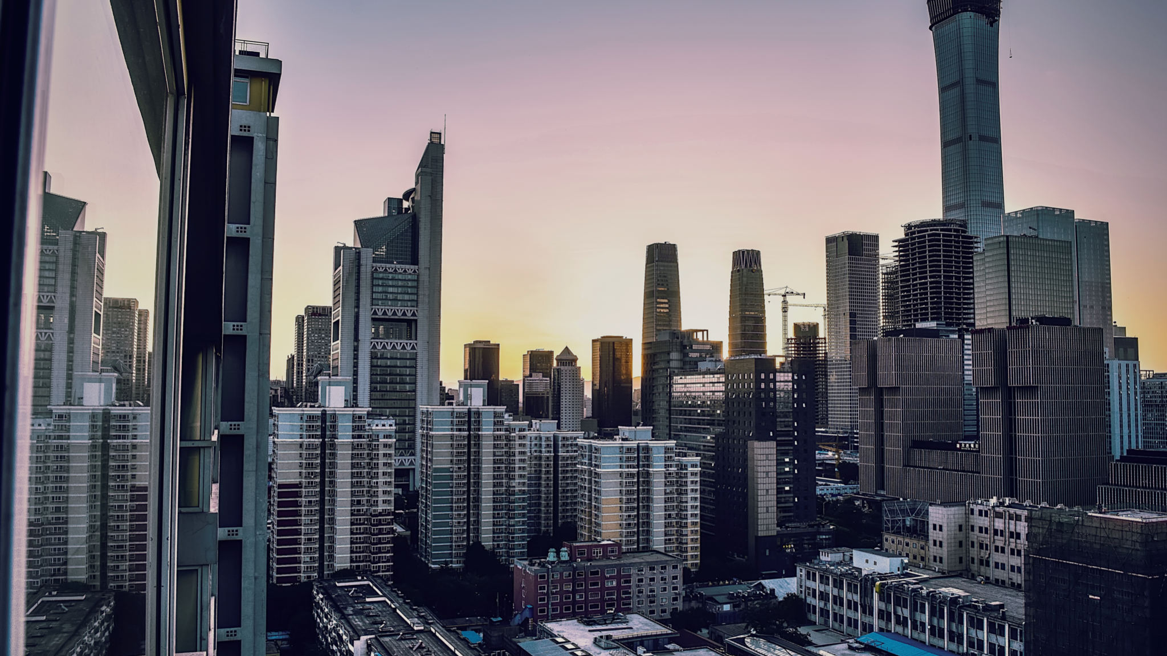
Carbon Footprint
in tonnes CO²
Groundworks
Substructure
Superstructure
Facade
MEP
Interior Fit Out
Transport
Labour
End of Life
TOTAL
Carbon literacy, accountability and transparency. This is future we’re promoting.
We want to help create the receipts.
1 200
2 500
18 000
1 800
6 000
2 000
2 500
1 200
6 000
41 200

Slide 17
Are we enjoying New York Build?
ⓘ
Click Present with Slido or install our Chrome extension to activate this poll while presenting.
Notes:
📣 This is Slido interaction slide, please don't delete it. ✅ Click on 'Present with Slido' and the poll will launch automatically when you get to this slide.

Slide 18
If you reduce 1% of the embodied Carbon of an average London Commercial office. How much carbon is saved?
ⓘ
Click Present with Slido or install our Chrome extension to activate this poll while presenting.
Notes:
📣 This is Slido interaction slide, please don't delete it. ✅ Click on 'Present with Slido' and the poll will launch automatically when you get to this slide.

Slide 19
200,000 Air miles!

Slide 20
Do you have the skills to decarbonise your projects?
ⓘ
Click Present with Slido or install our Chrome extension to activate this poll while presenting.
Notes:
📣 This is Slido interaction slide, please don't delete it. ✅ Click on 'Present with Slido' and the poll will launch automatically when you get to this slide.

Slide 21
Which of the following do you see as the biggest lever we can pull in built environment to push Decarbonisation
ⓘ
Click Present with Slido or install our Chrome extension to activate this poll while presenting.
Notes:
📣 This is Slido interaction slide, please don't delete it. ✅ Click on 'Present with Slido' and the poll will launch automatically when you get to this slide.

Slide 22
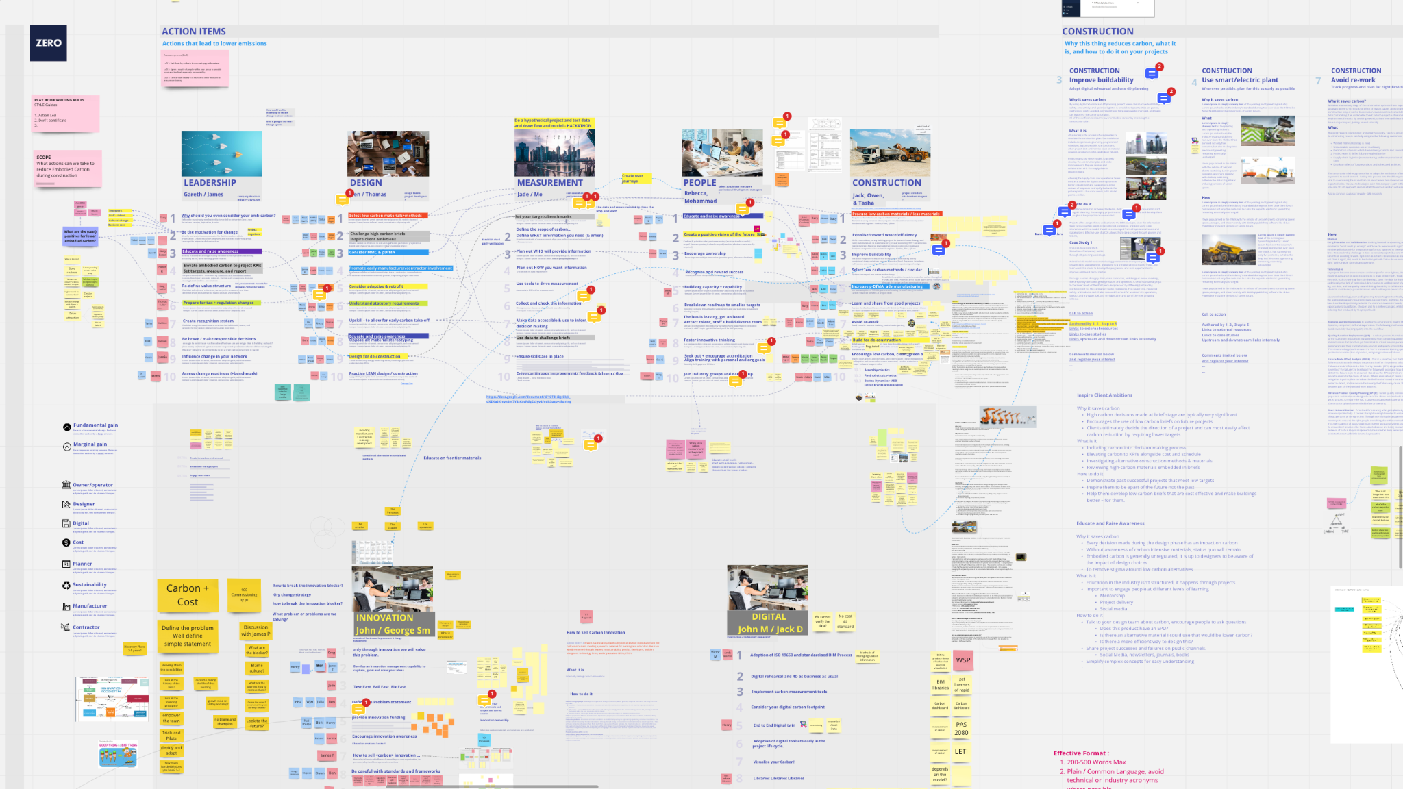

Slide 23
How much Co2 is in typical 1m3 of concrete? @180kg/tonne @ density 2.3g/cm3
ⓘ
Click Present with Slido or install our Chrome extension to activate this poll while presenting.
Notes:
📣 This is Slido interaction slide, please don't delete it. ✅ Click on 'Present with Slido' and the poll will launch automatically when you get to this slide.

Slide 24
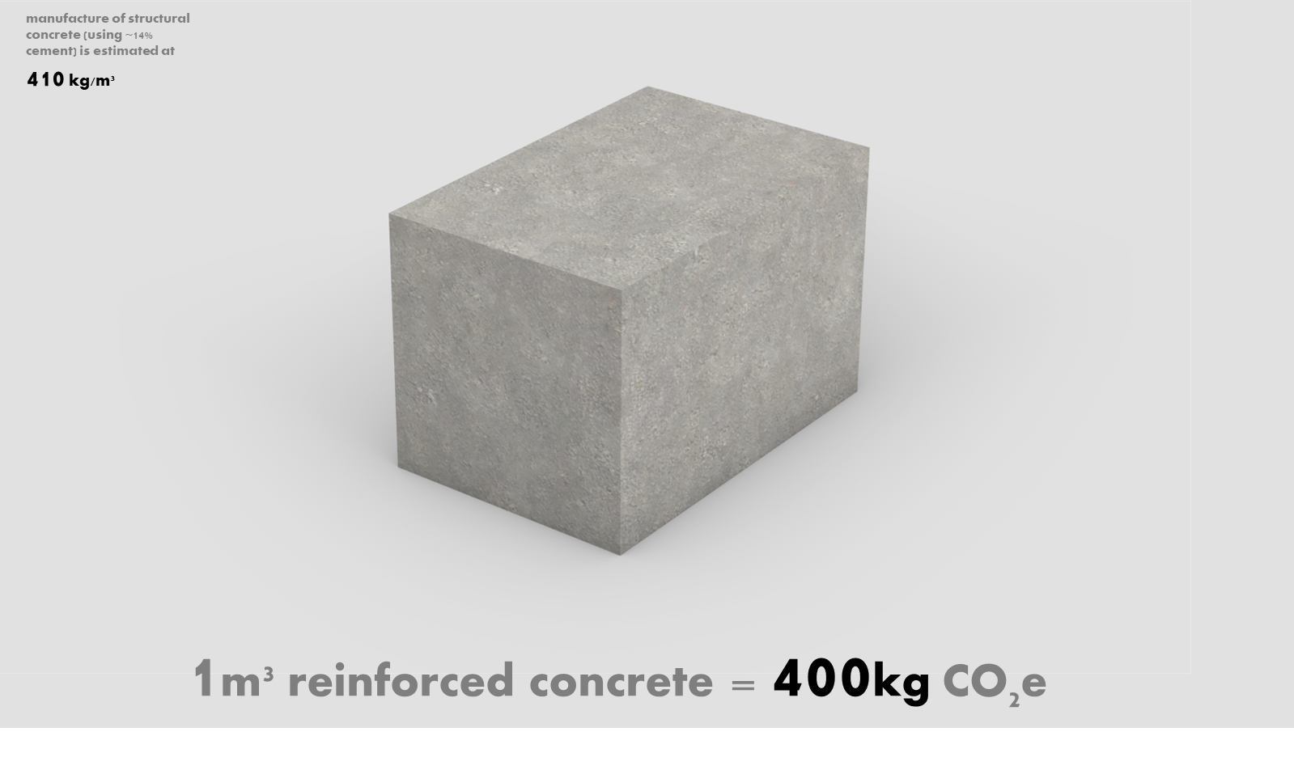

Slide 25
How much of the globe's waste that goes to landfill comes from construction sites annually?
ⓘ
Click Present with Slido or install our Chrome extension to activate this poll while presenting.
Notes:
📣 This is Slido interaction slide, please don't delete it. ✅ Click on 'Present with Slido' and the poll will launch automatically when you get to this slide.

Slide 26
40%!
qualisflow.com
Notes:
UK - 36%
Aus - 44%
New Zealand - 50%
USA - NO ONE KNOWS! EPA Only track Municipal waste NOT industrial and construction!
EPA does not maintain a list of all the landfills in the United States, so we can't provide a definitive number on how many there are. There are several types of landfills in the United States – municipal solid waste, hazardous waste, industrial waste, coal combustion residuals, polychlorinated biphenyls, and construction and demolition debris. Below are links to EPA databases of landfills; however, none of them are comprehensive.
Worldwide, the biggest producer of waste per capita is Canada. At an estimated 36.1 metric tons per year, this was 10 metric tons more per capita than the United States. Canada produces an estimated 1.33 billion metric tons of waste per year, with 1.12 billion metric tons of this generated by industrial waste.
​​In particular, the construction industry is responsible for utilizing a large portion of natural resources (32%) [1]. Although this value is less than the amount of natural resources used in the 1990s (~40%) [2], it is estimated that more than 75% of waste generated by the construction industry has a residual value and is not currently reused nor recycled. https://www.ncbi.nlm.nih.gov/pmc/articles/PMC8745857/

Slide 27
Does Net Zero Exist in the Built Environment? Without using offsets
ⓘ
Click Present with Slido or install our Chrome extension to activate this poll while presenting.
Notes:
📣 This is Slido interaction slide, please don't delete it. ✅ Click on 'Present with Slido' and the poll will launch automatically when you get to this slide.

Slide 28
How do we define
Net Zero?
qualisflow.com
Notes:
GBC
Net Zero Operational Carbon
Definition
When the amount of carbon dioxide emissions associated with building operations on an annual basis is reduced (highly energy efficient and fully powered from on-site and/or off-site renewable energy sources) to a level that is consistent with reaching net zero at the global or sector level in 1.5oC pathways. Any residual emissions that remain unfeasible to eliminate should be neutralised through carbon removals.
Guiding Principles
Reduce and optimise energy demand Prioritise consumption reduction and energy efficiency to ensure that buildings are performing as efficiently as possible, and not wasting energy.
Generate balance from renewables Supply remaining demand from renewable energy sources, either on-site or off-site.
Compensate for residual emissions Offset residual operational emissions, such as from refrigerants or the use of unavoidable fossil fuels in buildings with high quality, credible compensation activities.
Plan for deep decarbonisation Set up action plans to remove any remaining sources of fossil fuels in buildings as soon as possible.
Net Zero Whole Life Carbon
Definition
When, in addition to net zero operational carbon, upfront carbon and other embodied carbon across the building lifecycle is reduced to a level that is consistent with reaching net zero at the global or sector level in 1.5oC pathways. Any residual emissions that remain unfeasible to eliminate should be neutralised through carbon removals1.
Guiding Principles
Prevent Avoid embodied carbon from the outset by considering alternative strategies to deliver the desired function (e.g. renovation of existing buildings rather than new development etc.)
Reduce and optimise Evaluate each design choice using a whole lifecycle approach and seek to minimise upfront carbon impacts (e.g. lean construction, low carbon materials and construction processes etc.)
Plan for the future Take steps to avoid future embodied carbon during and at end of life (e.g. maximise potential for renovation, future adaptation, circularity etc.)
Compensate for residual emissions Offset residual upfront embodied carbon emissions with high quality, credible compensation activities.

Slide 29
What is the average % of construction capital cost that is spent on rework?
ⓘ
Click Present with Slido or install our Chrome extension to activate this poll while presenting.
Notes:
📣 This is Slido interaction slide, please don't delete it. ✅ Click on 'Present with Slido' and the poll will launch automatically when you get to this slide.

Slide 30
15%

Slide 31
Does Net Zero Exist in the Built Environment? Without using offsets
ⓘ
Click Present with Slido or install our Chrome extension to activate this poll while presenting.
Notes:
📣 This is Slido interaction slide, please don't delete it. ✅ Click on 'Present with Slido' and the poll will launch automatically when you get to this slide.

Slide 32
Why is Good Data Important?
ⓘ
Click Present with Slido or install our Chrome extension to activate this poll while presenting.
Notes:
📣 This is Slido interaction slide, please don't delete it. ✅ Click on 'Present with Slido' and the poll will launch automatically when you get to this slide.

Slide 33
You can’t manage what you can’t measure
Aristotle (probably)
qualisflow.com
Notes:
GBC
Net Zero Operational Carbon
Definition
When the amount of carbon dioxide emissions associated with building operations on an annual basis is reduced (highly energy efficient and fully powered from on-site and/or off-site renewable energy sources) to a level that is consistent with reaching net zero at the global or sector level in 1.5oC pathways. Any residual emissions that remain unfeasible to eliminate should be neutralised through carbon removals.
Guiding Principles
Reduce and optimise energy demand Prioritise consumption reduction and energy efficiency to ensure that buildings are performing as efficiently as possible, and not wasting energy.
Generate balance from renewables Supply remaining demand from renewable energy sources, either on-site or off-site.
Compensate for residual emissions Offset residual operational emissions, such as from refrigerants or the use of unavoidable fossil fuels in buildings with high quality, credible compensation activities.
Plan for deep decarbonisation Set up action plans to remove any remaining sources of fossil fuels in buildings as soon as possible.
Net Zero Whole Life Carbon
Definition
When, in addition to net zero operational carbon, upfront carbon and other embodied carbon across the building lifecycle is reduced to a level that is consistent with reaching net zero at the global or sector level in 1.5oC pathways. Any residual emissions that remain unfeasible to eliminate should be neutralised through carbon removals1.
Guiding Principles
Prevent Avoid embodied carbon from the outset by considering alternative strategies to deliver the desired function (e.g. renovation of existing buildings rather than new development etc.)
Reduce and optimise Evaluate each design choice using a whole lifecycle approach and seek to minimise upfront carbon impacts (e.g. lean construction, low carbon materials and construction processes etc.)
Plan for the future Take steps to avoid future embodied carbon during and at end of life (e.g. maximise potential for renovation, future adaptation, circularity etc.)
Compensate for residual emissions Offset residual upfront embodied carbon emissions with high quality, credible compensation activities.

Slide 34
Design
Build
Verify
Reduce materials
Specify low carbon
Design for operation
Optimise transport
Minimise waste
Reduce carbon
REDUCE RE-WORK
Identify opportunities to improve next time
Records for future Circular Economy

Slide 35
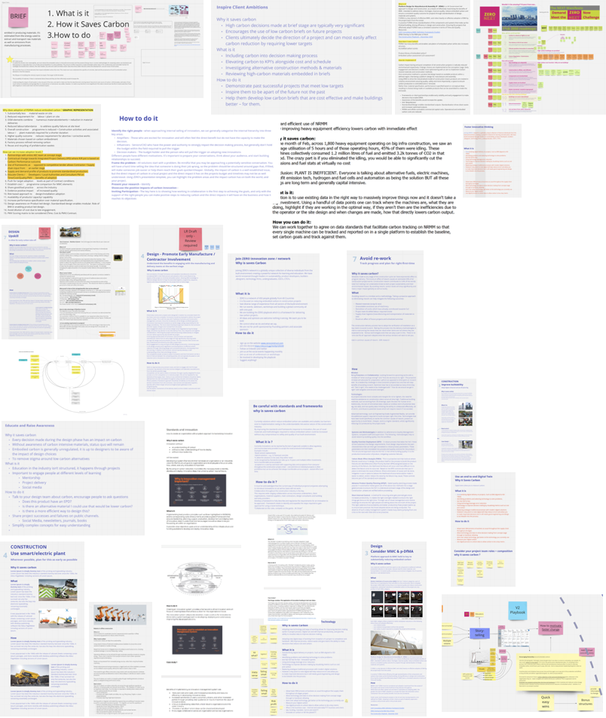
Creating the ZERO playbook
The playbook we’ve created will soon be publicly available. We’ll share it to our networks and membership. We’ll encourage reviews, comments, and for our members to submit more case studies.

Slide 36
The ZERO Playbook
Six existing pillars
Leadership
Design
Measurement
People
Construction
Innovation
Four new pillars
Circularity
Digital
Finance
Materials

Slide 37
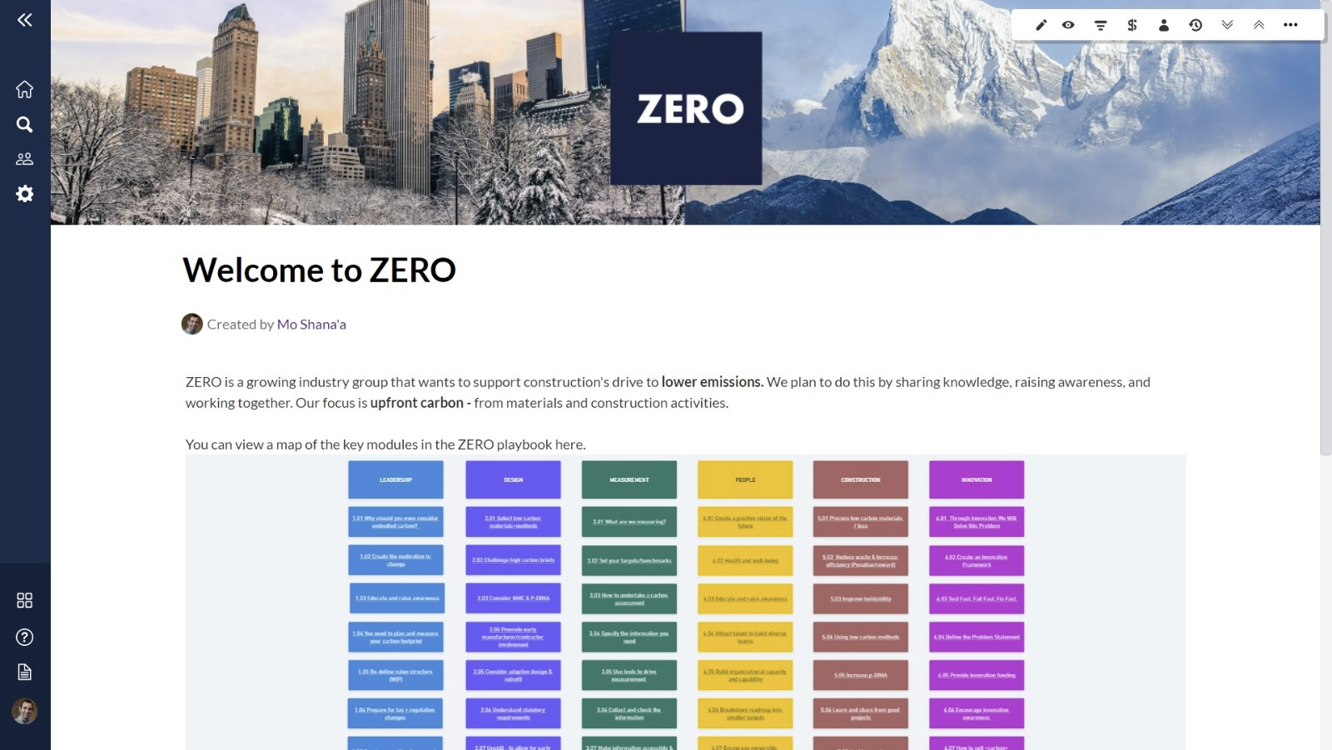
The ZERO Playbook

Slide 38
Let’s play cards
Learning is usually boring anyway
zeroconstruct.com

Slide 39
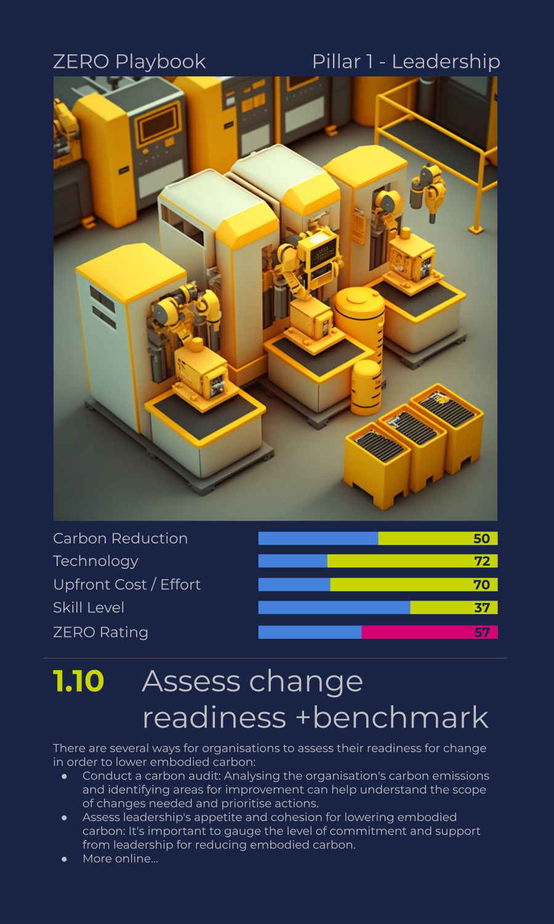
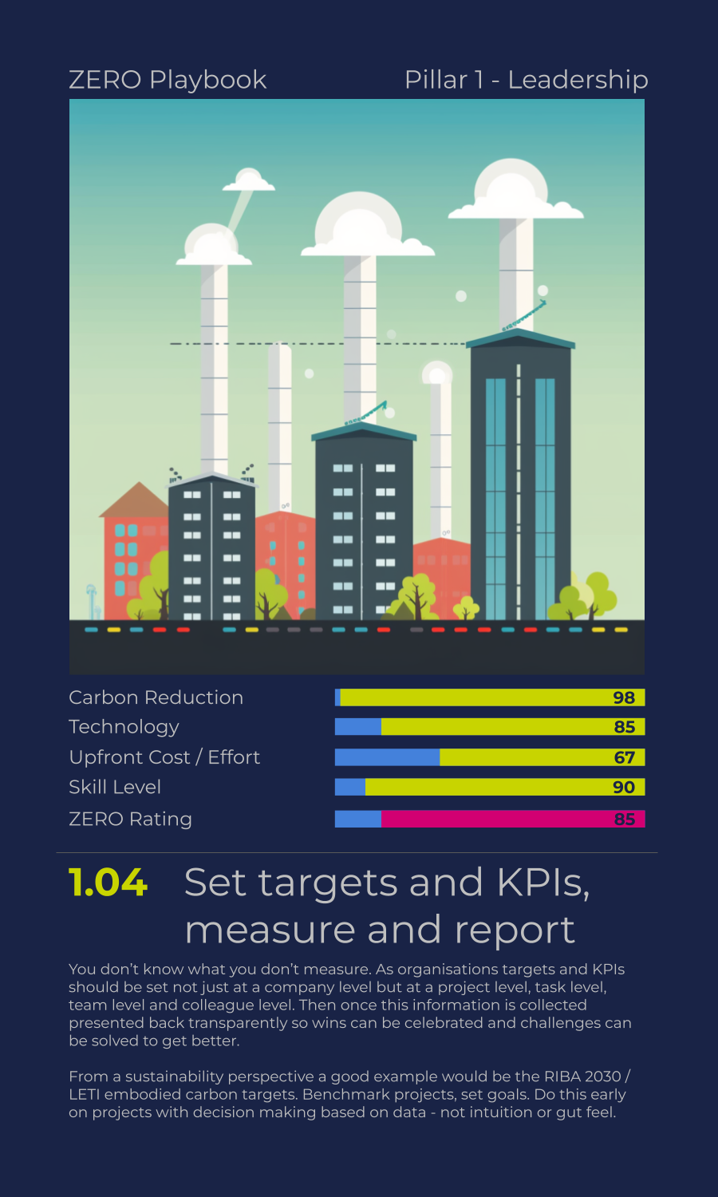
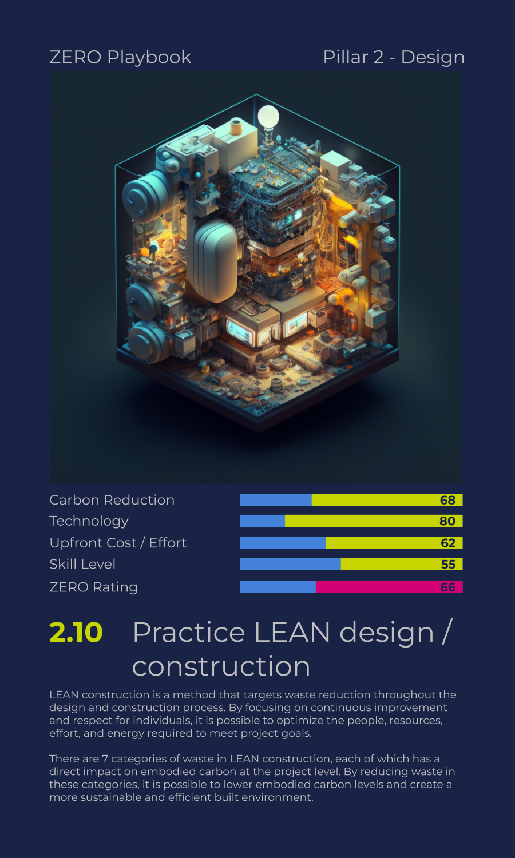
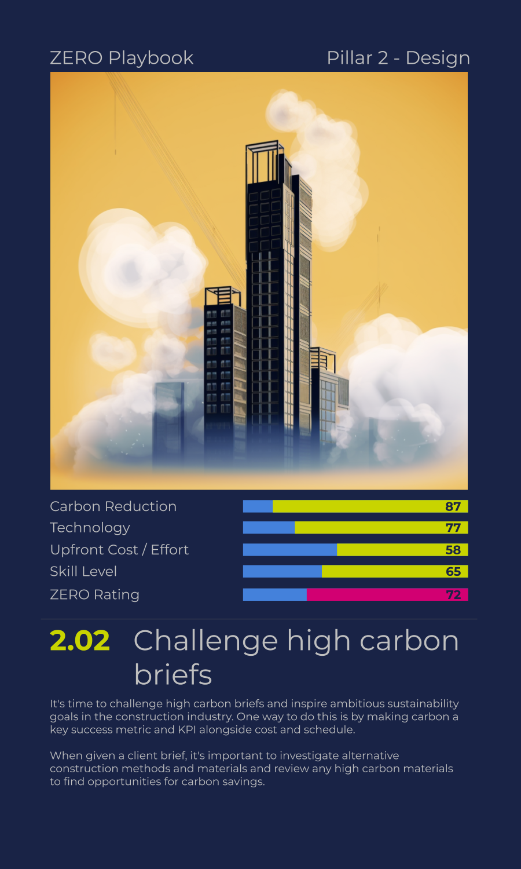
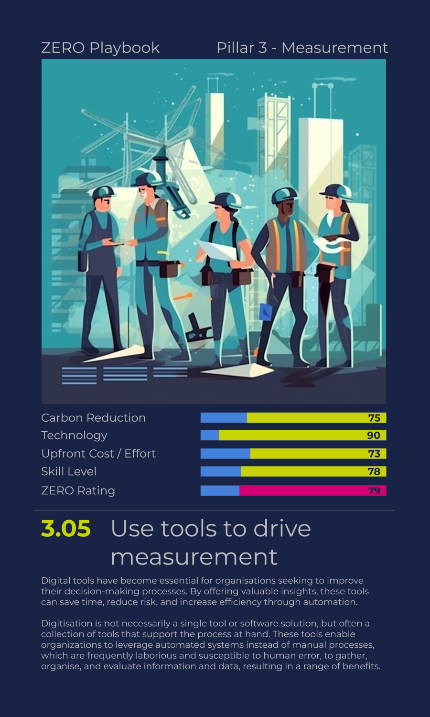
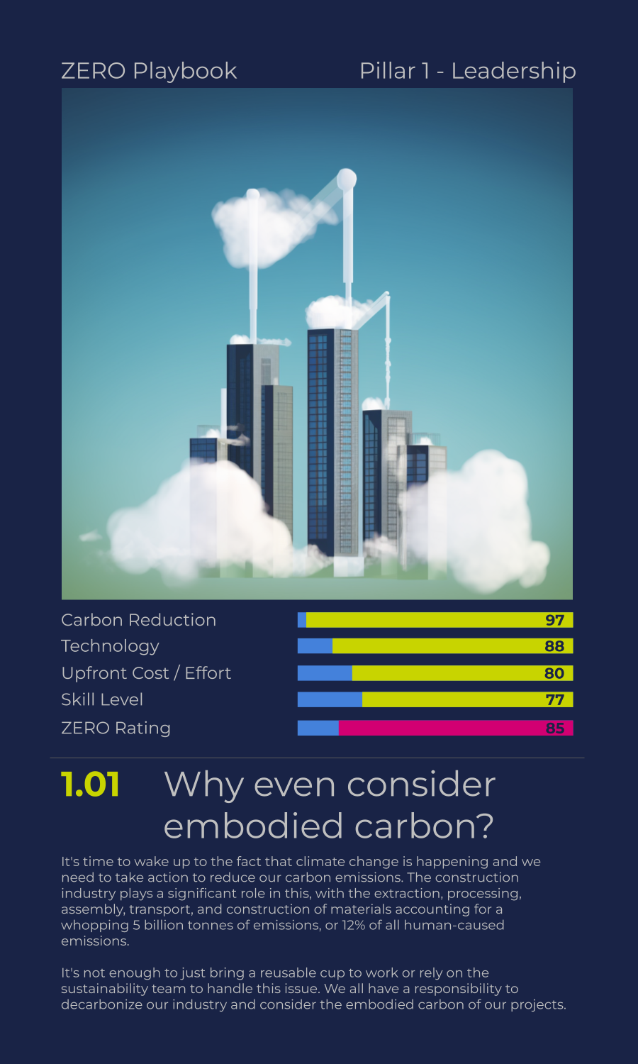
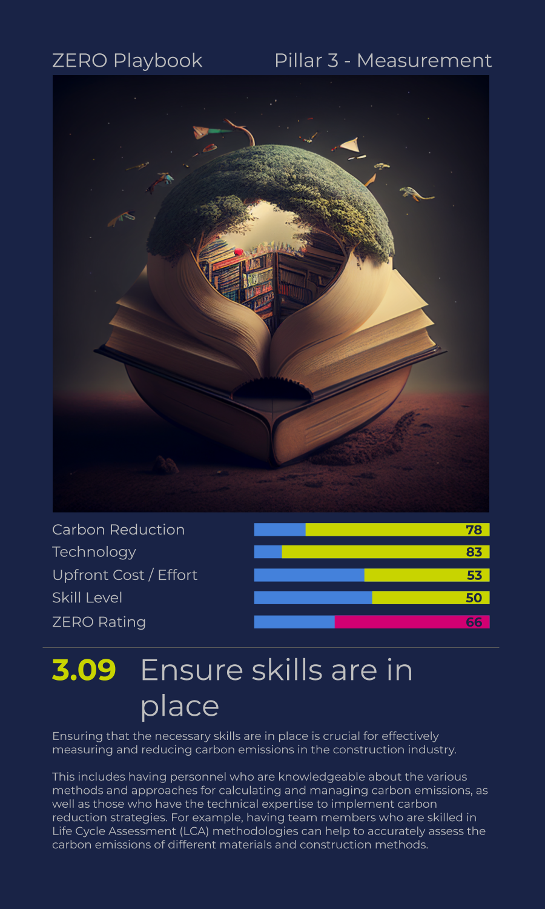
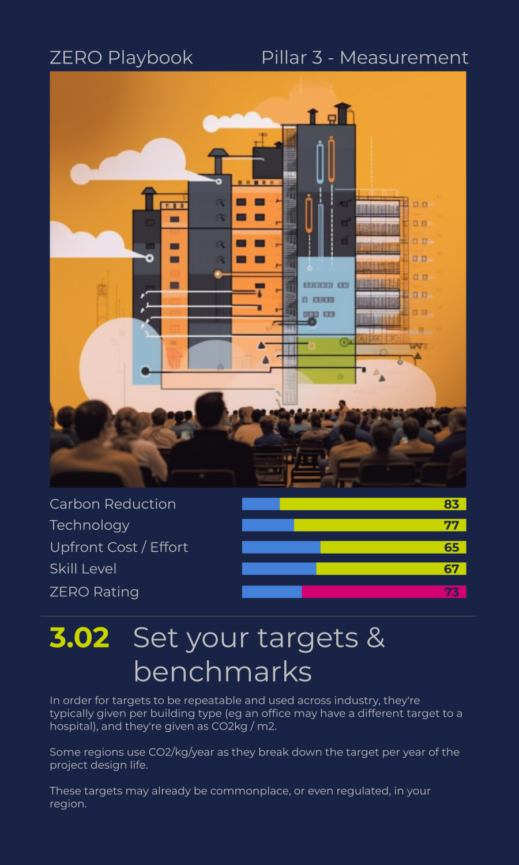
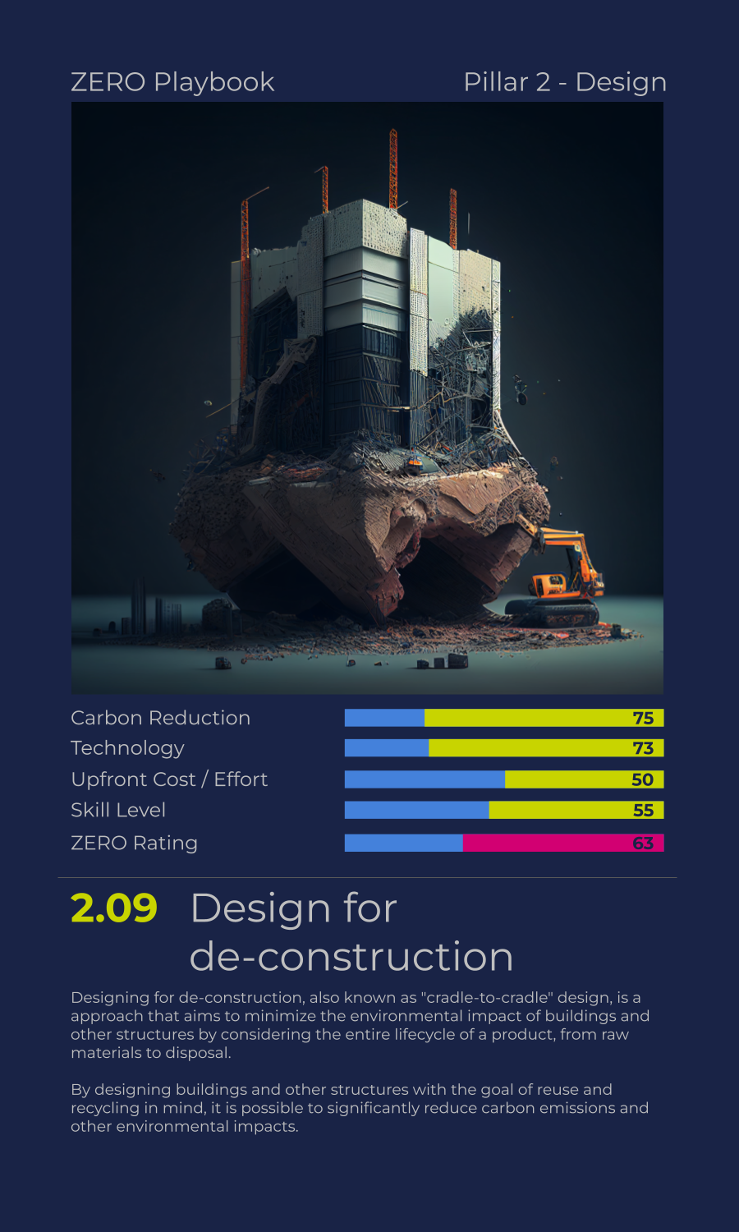
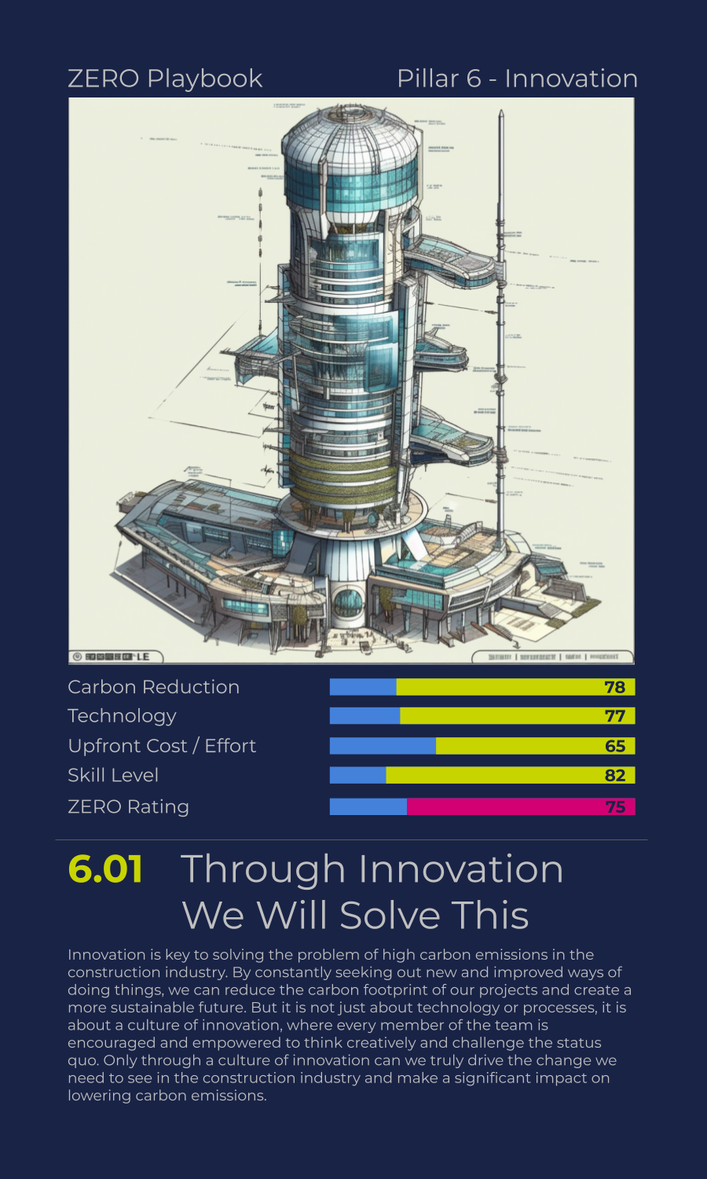
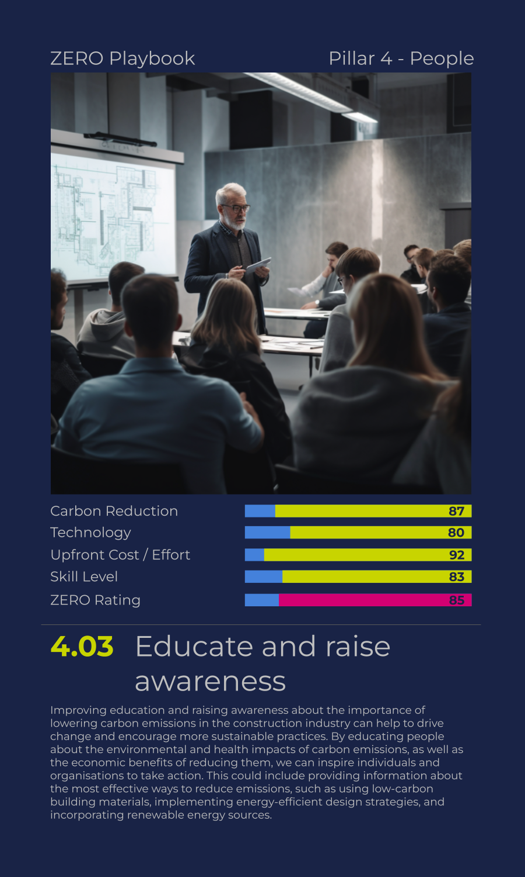
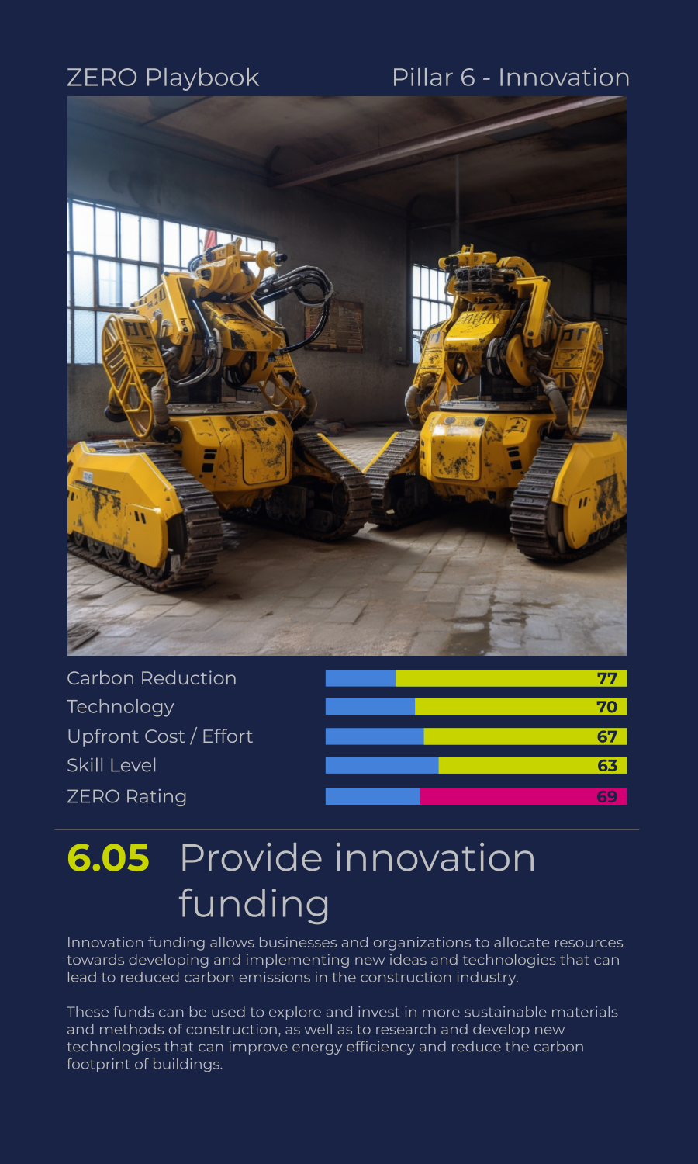
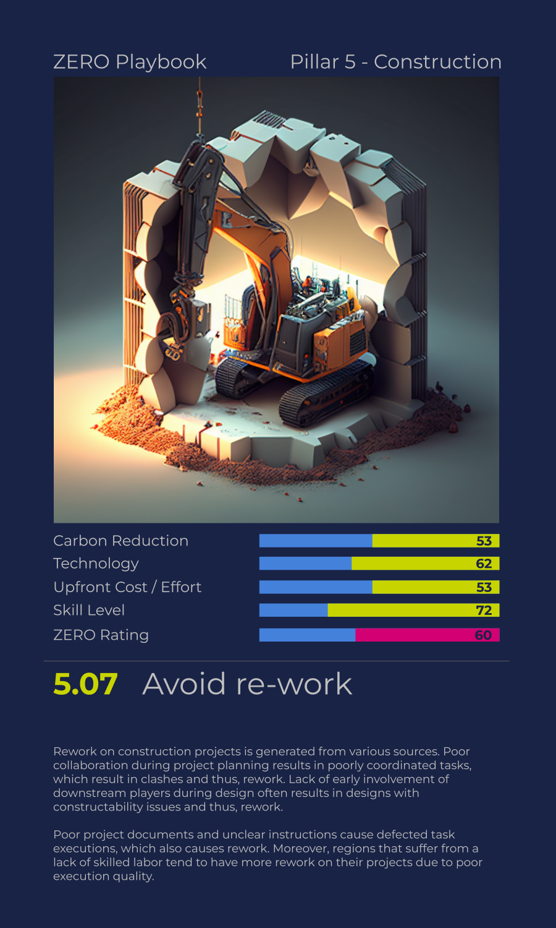
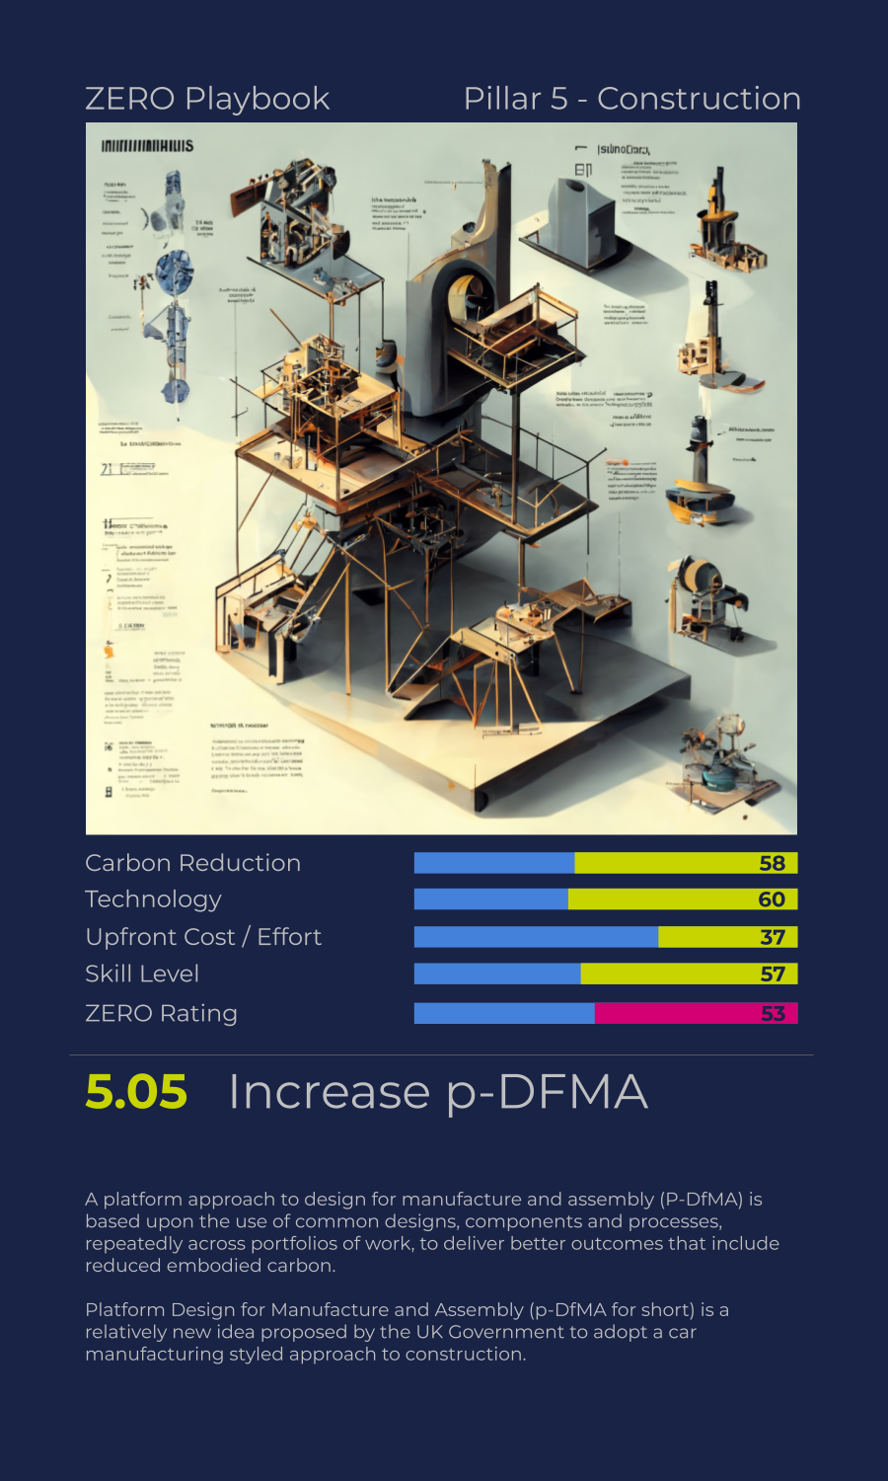
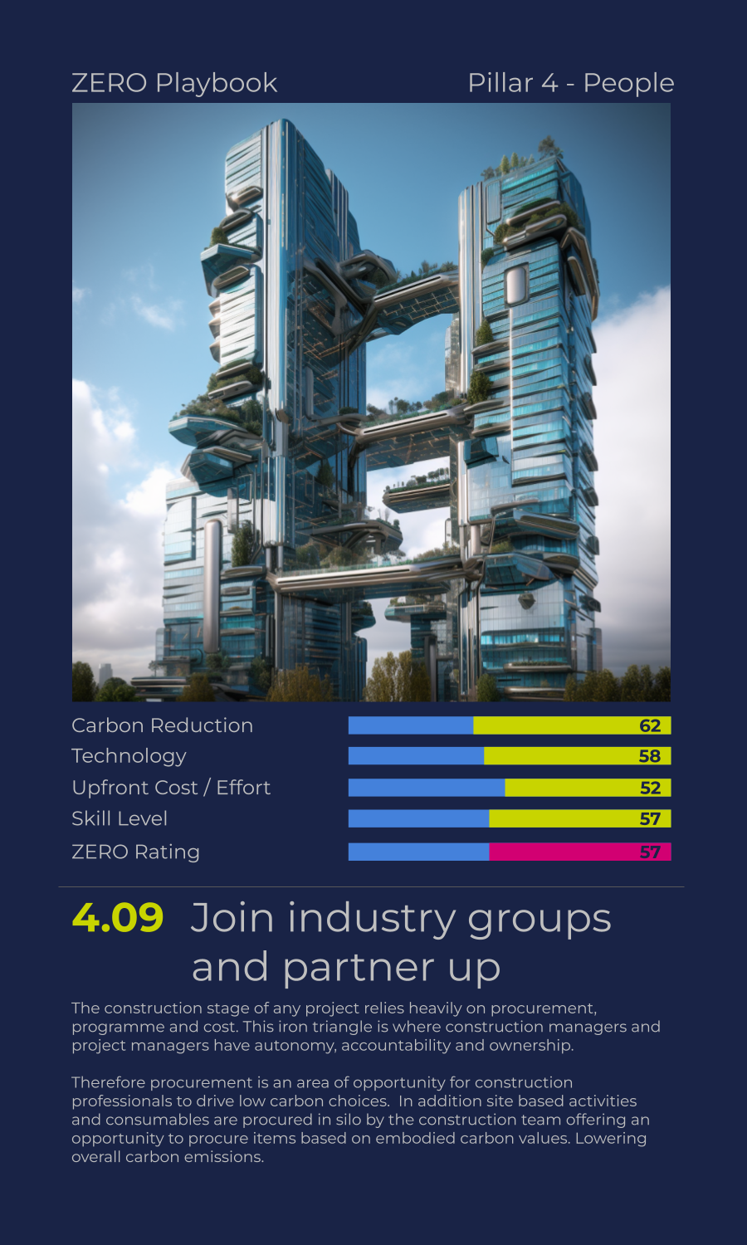
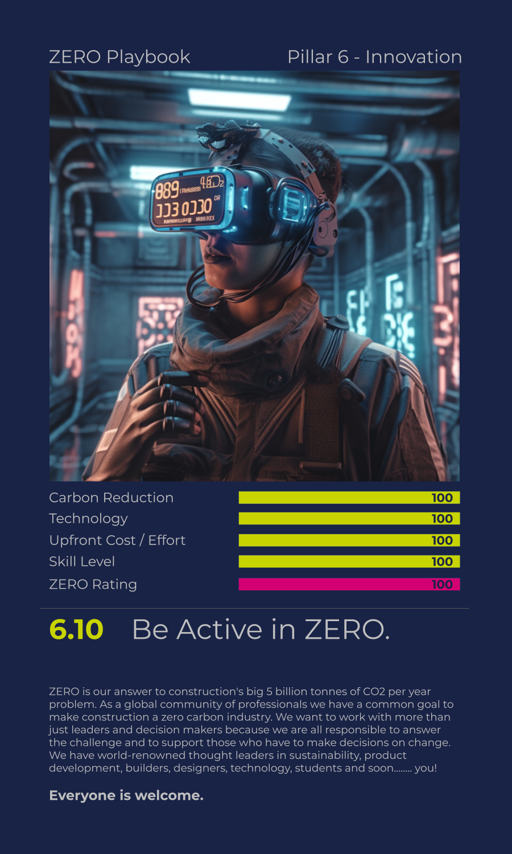
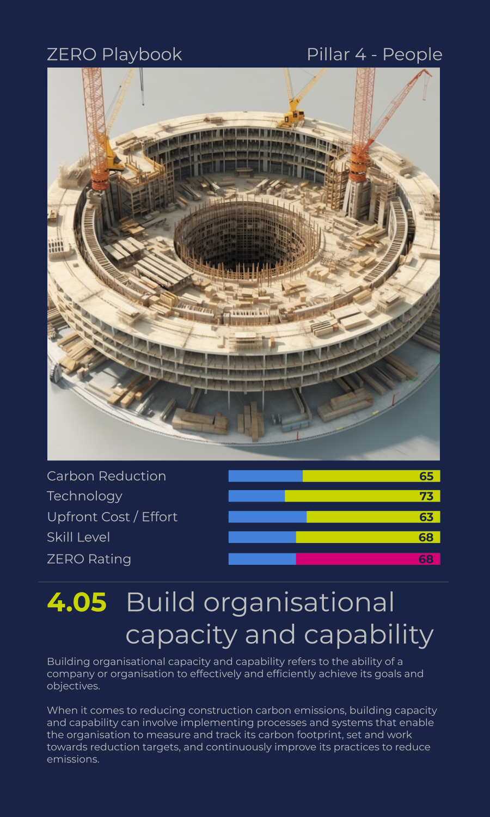

Slide 40
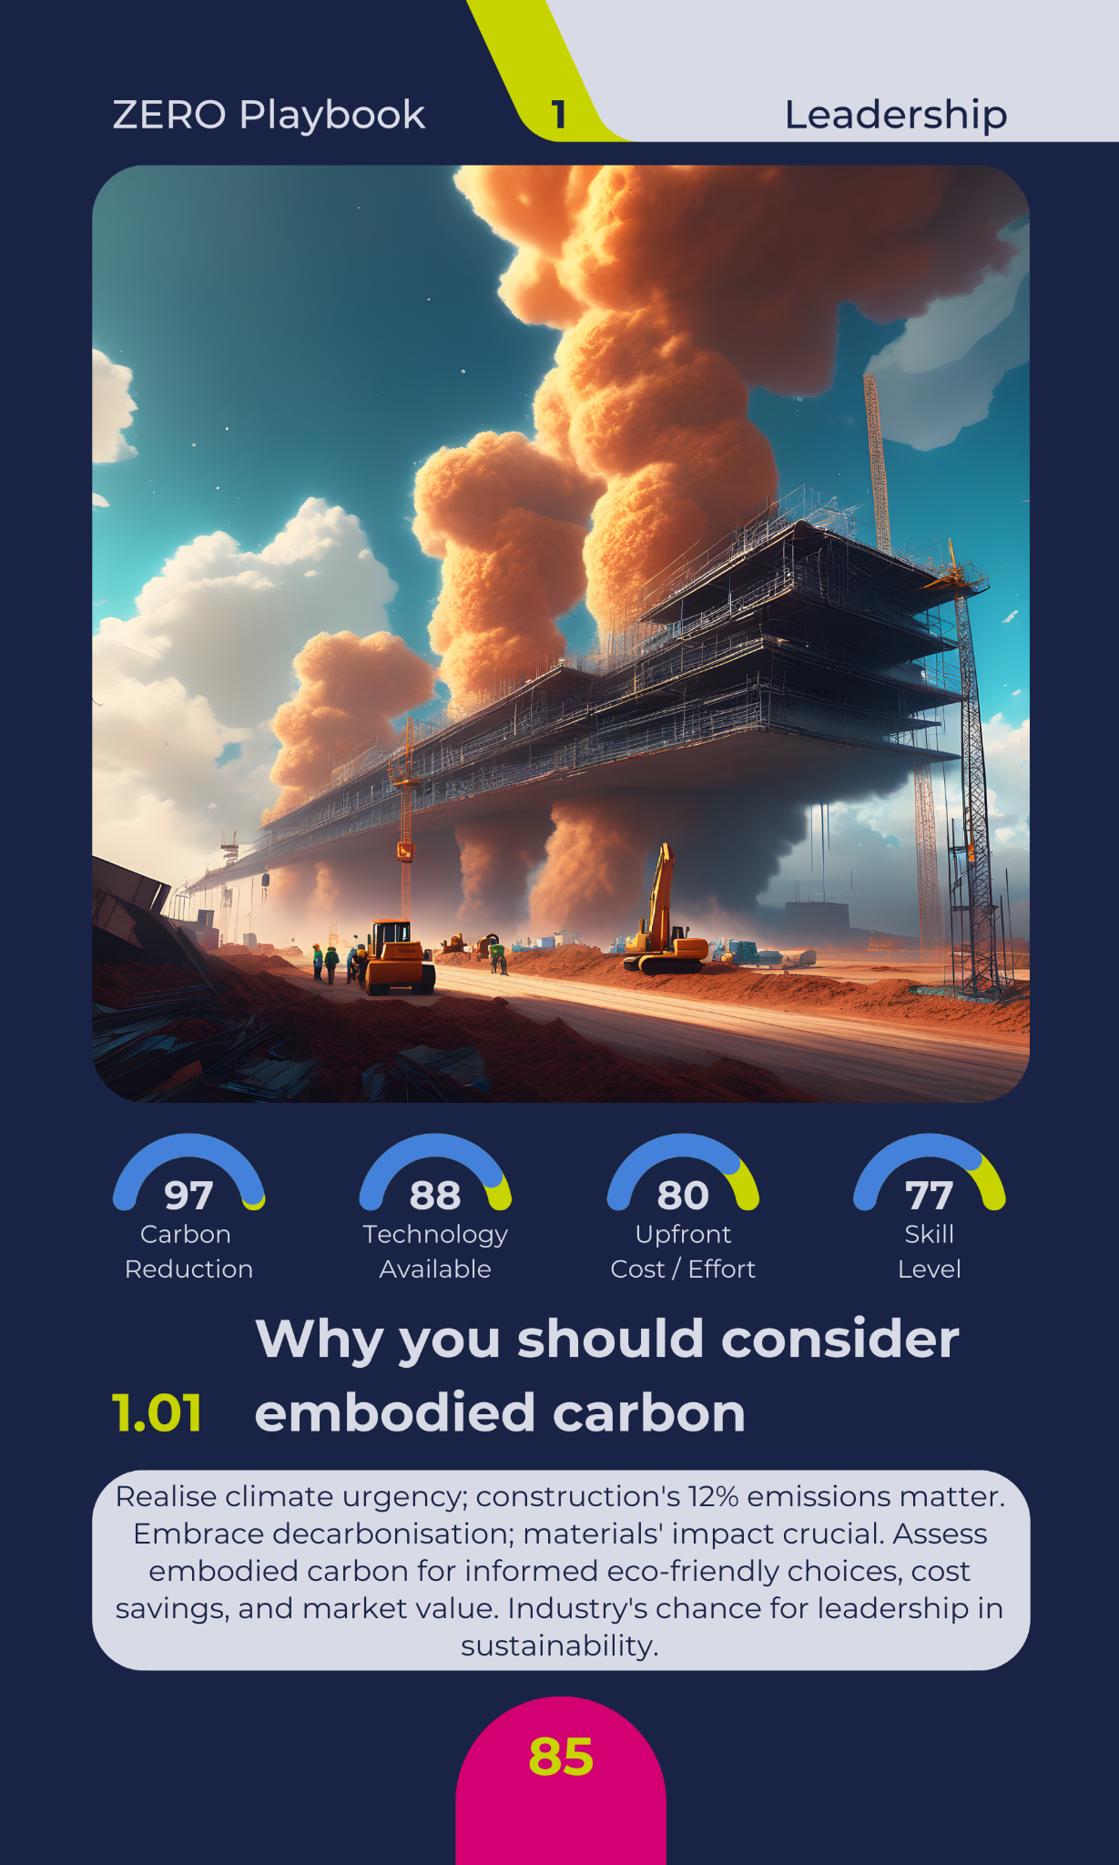
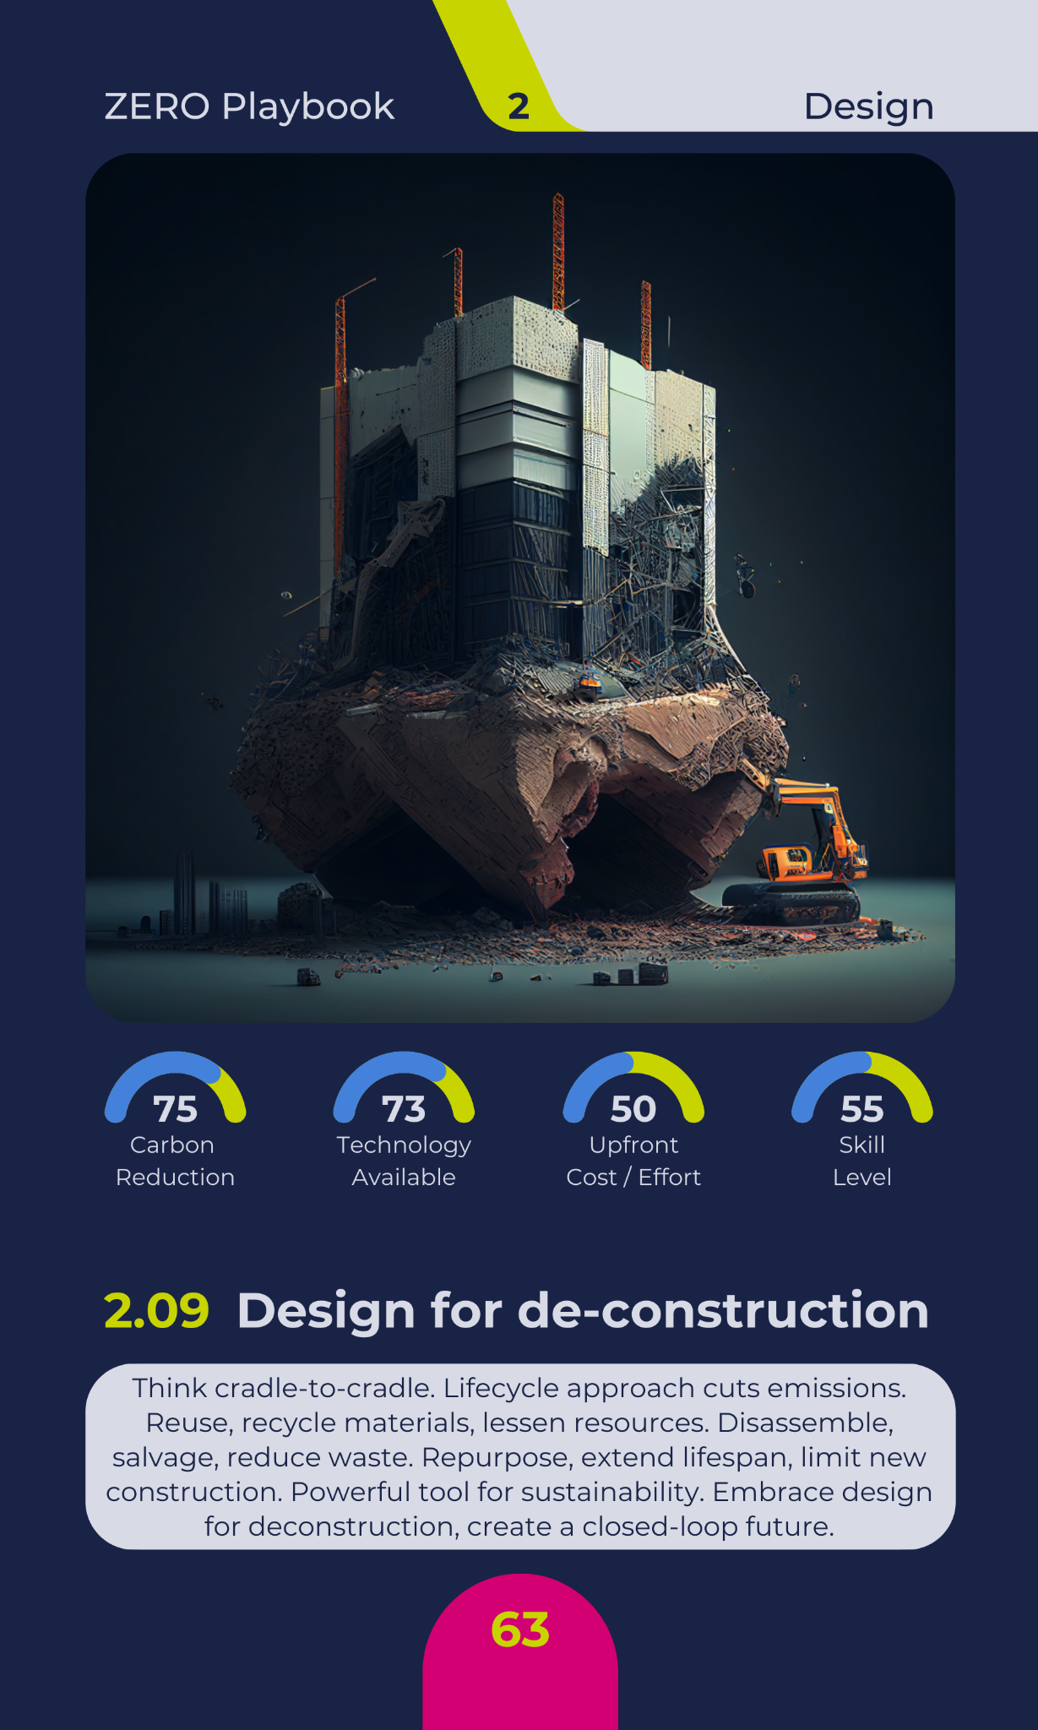

Slide 41
Playing Cards
Available online to purchase
October 2023

Slide 43
ZERO CON Live
Digital
23th April 2024
24hr LIVE event
Different case studies and speakers from around the world
Physical
October 2024
London
Whole day of classes, debates, workshop and lectures

Slide 44
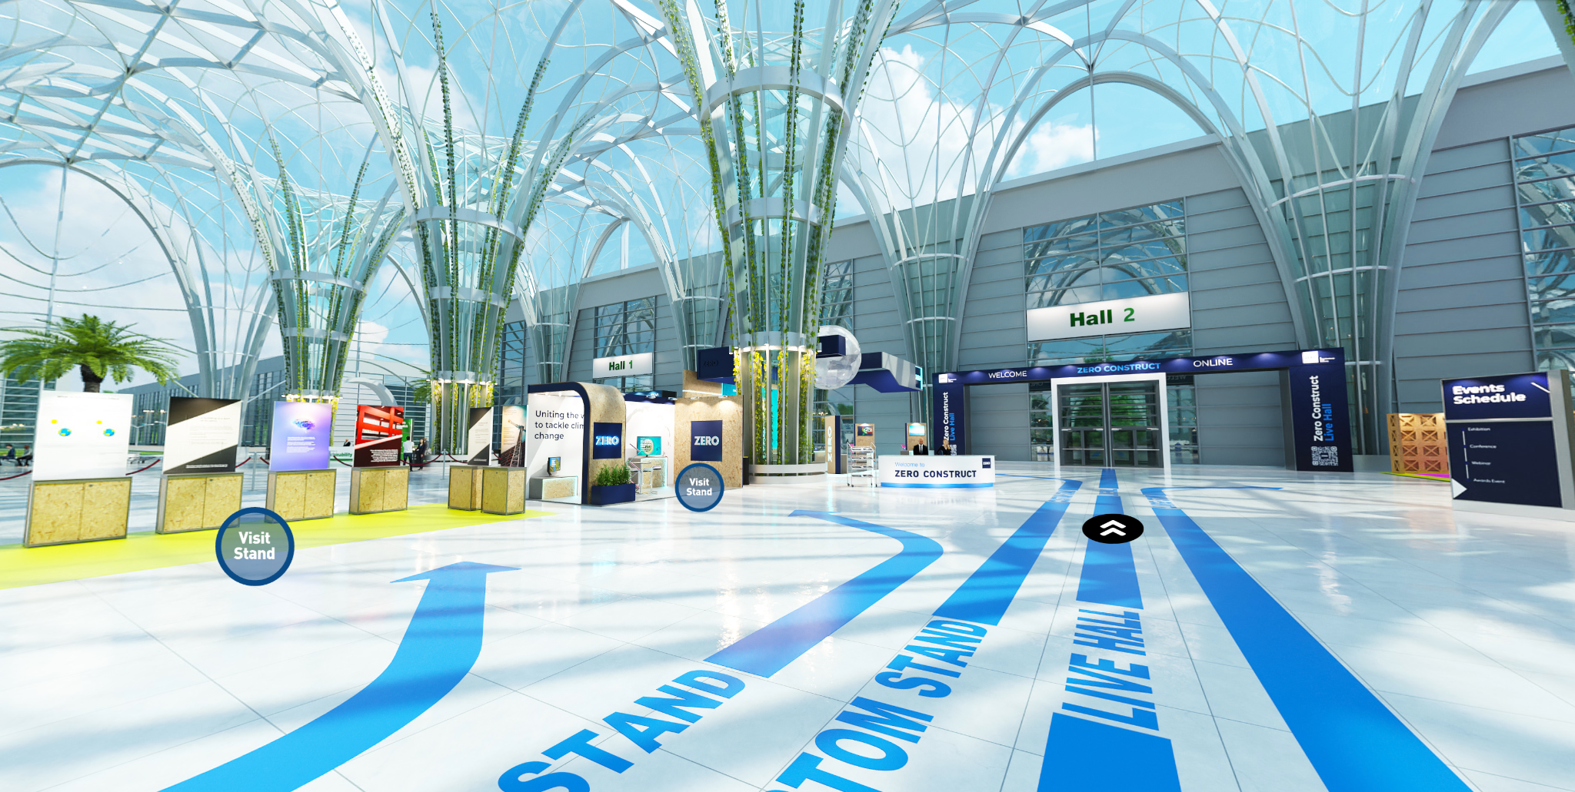

Slide 45
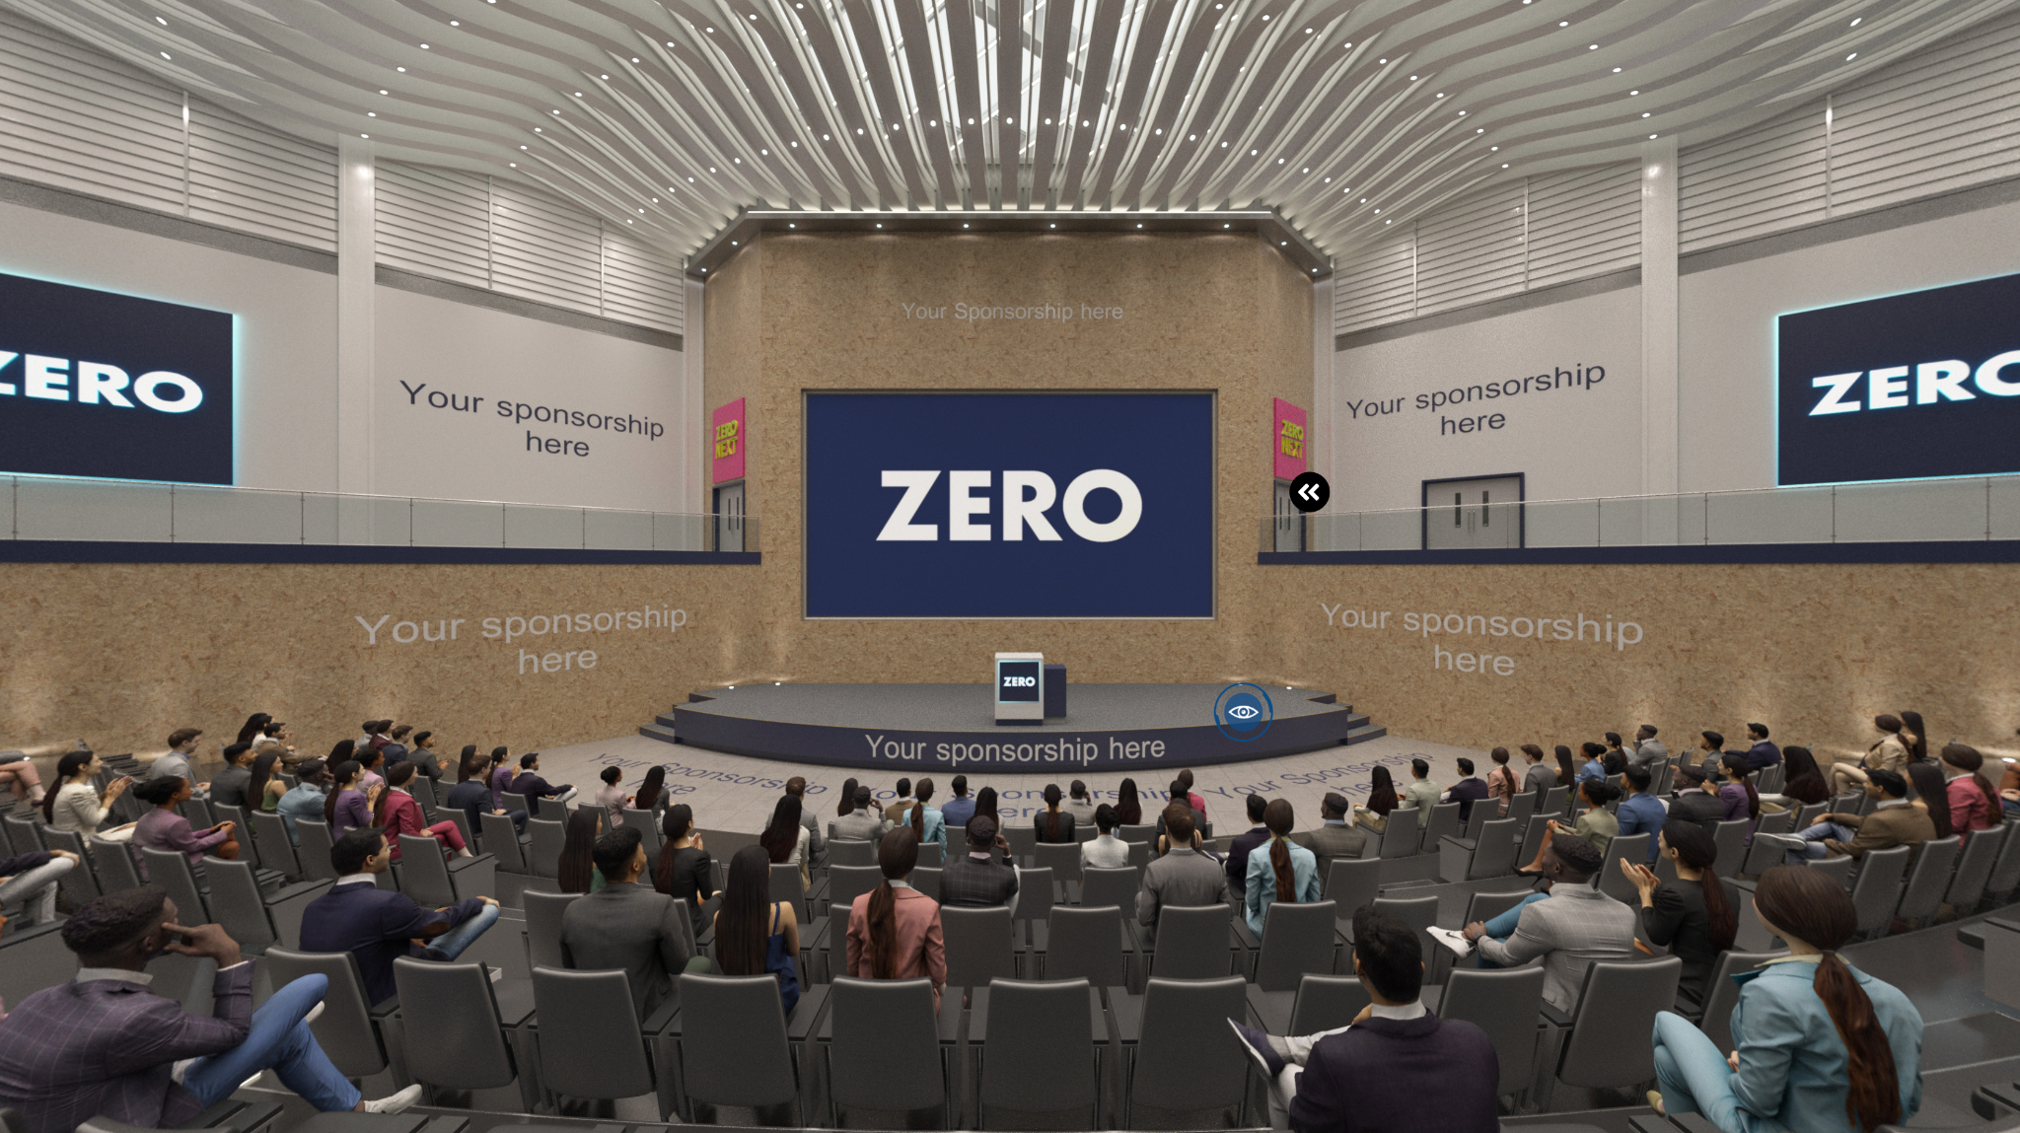

Slide 46
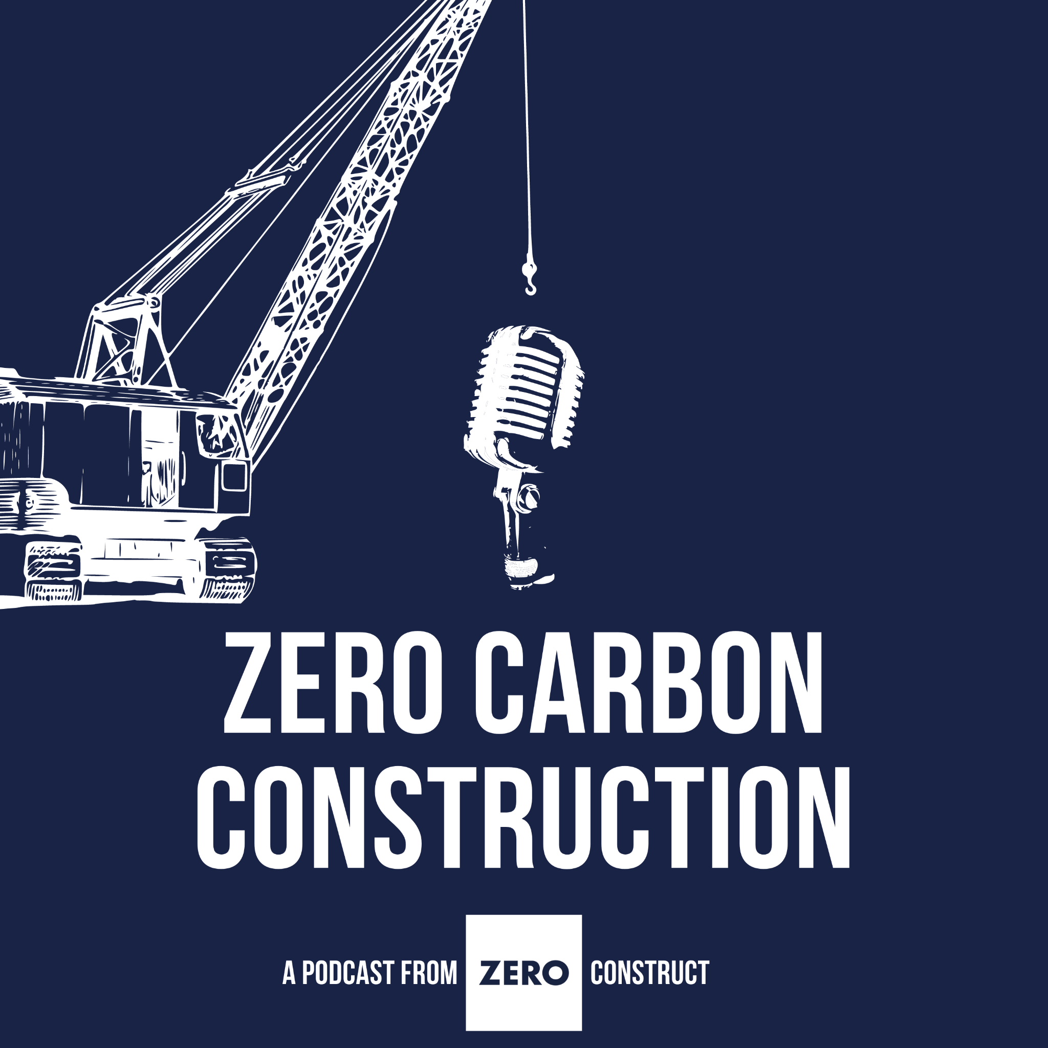

Slide 47
Founding partners
Associate sponsors
Supporters

Slide 48
Join us, help us, sponsor us.
We can only solve this as an industry community.
zeroconstruct.com

Slide 49
company/zeroconstruct
company/qualis-flow
@zeroconstruct
@qualisflow
WhatsApp Community
www.qualisflow.com
YouTube

Slide 50
zeroconstruct.com
qualisflow.com

