Slide 1
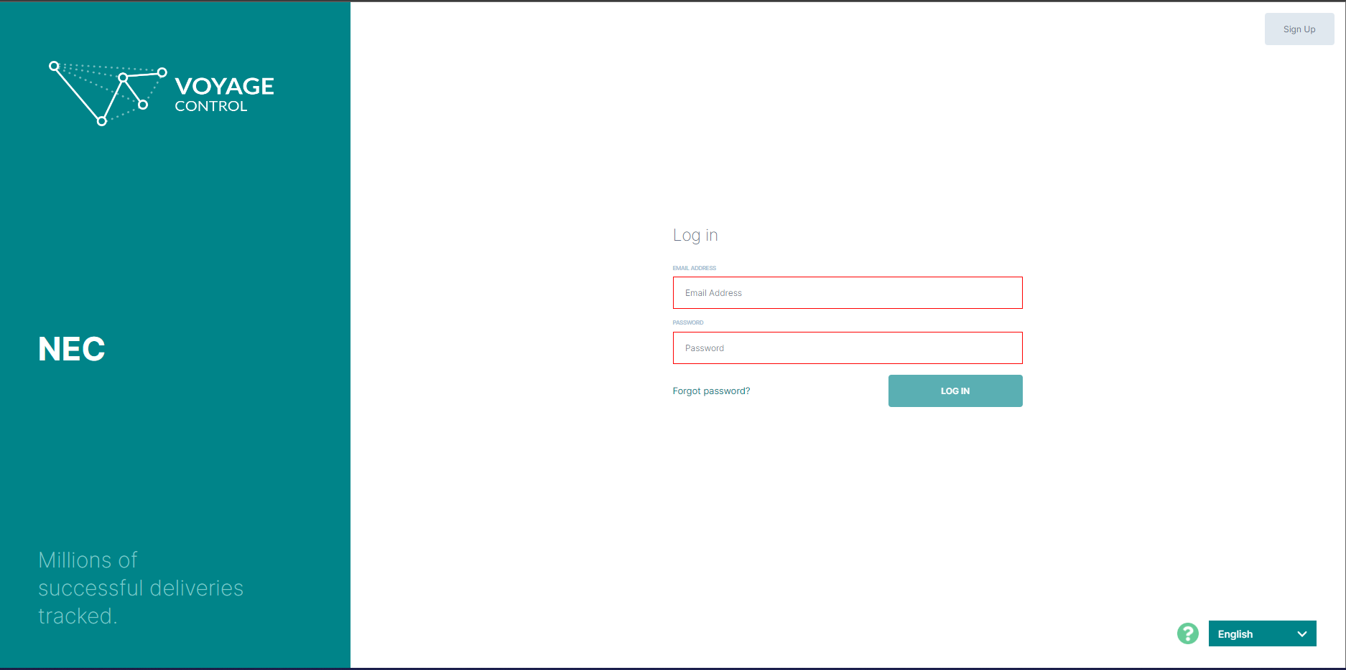
1. Click here
to sign up
for an
account
Note: If you already have an account, log in here and skip to page 4.

Slide 2
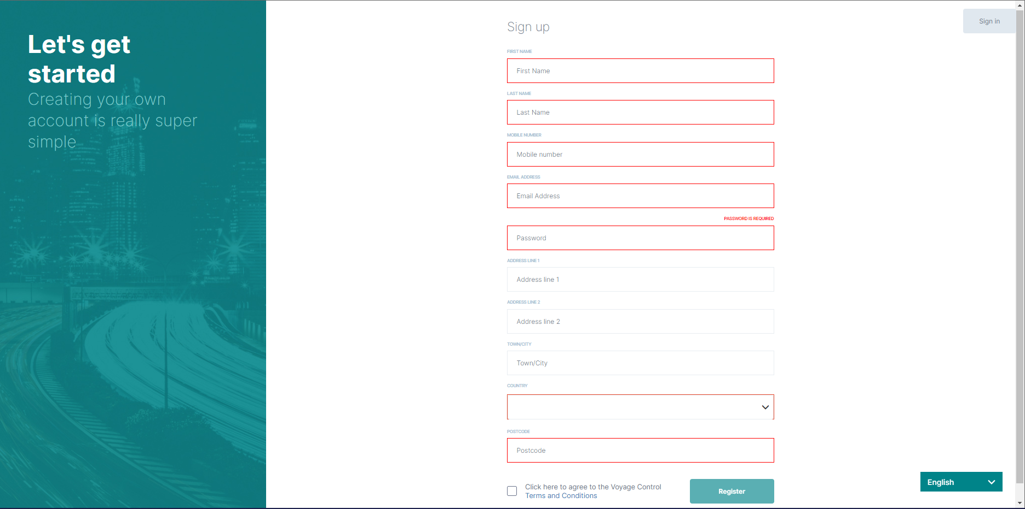
2. You will need to fill in these personal details so that your account can be set up.
3. Check box
4. Click to finish registering

Slide 3
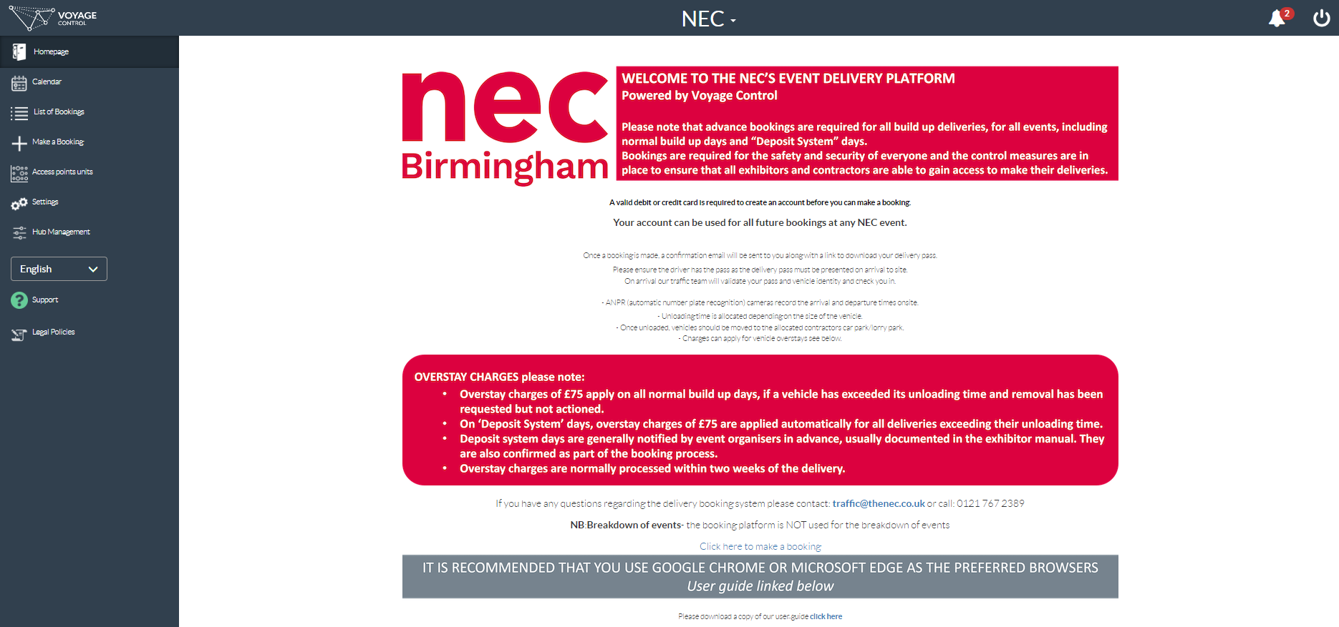
5. You should have received an email with a link to verify your account.
Once you click that you should land on the log in page (seen on page 1).
Enter the email you set up to sign in.
Enter your company name when asked. If you don’t have a company name, enter your name.
You will then get taken here -

Slide 4
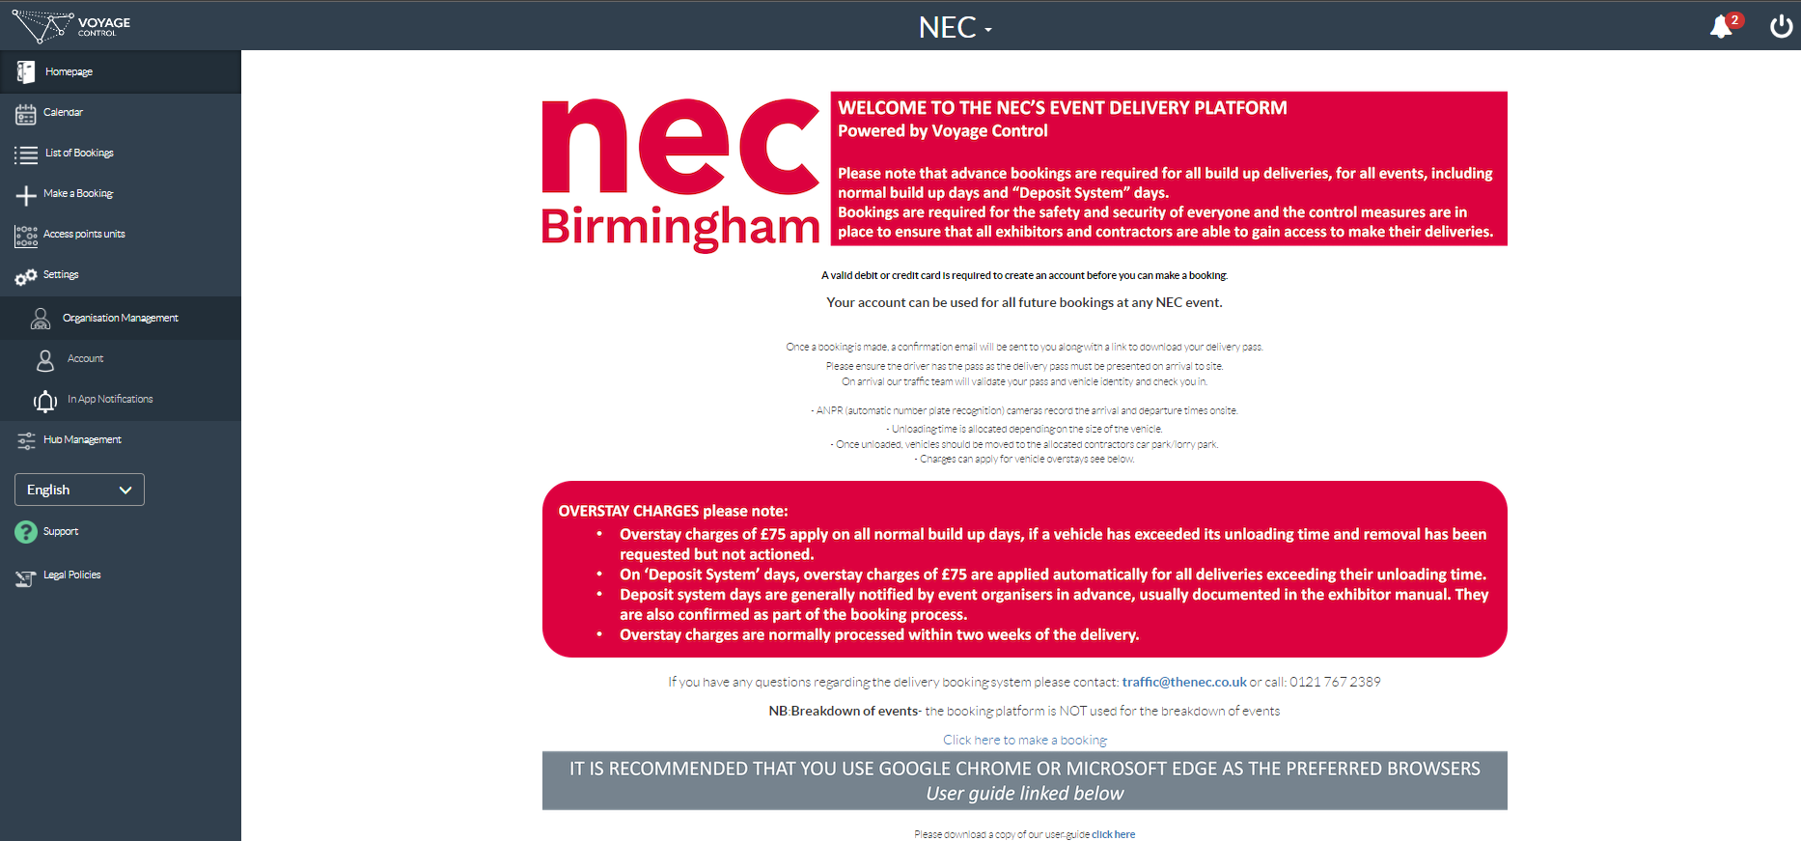
6. Click Settings
7. Click Account

Slide 5
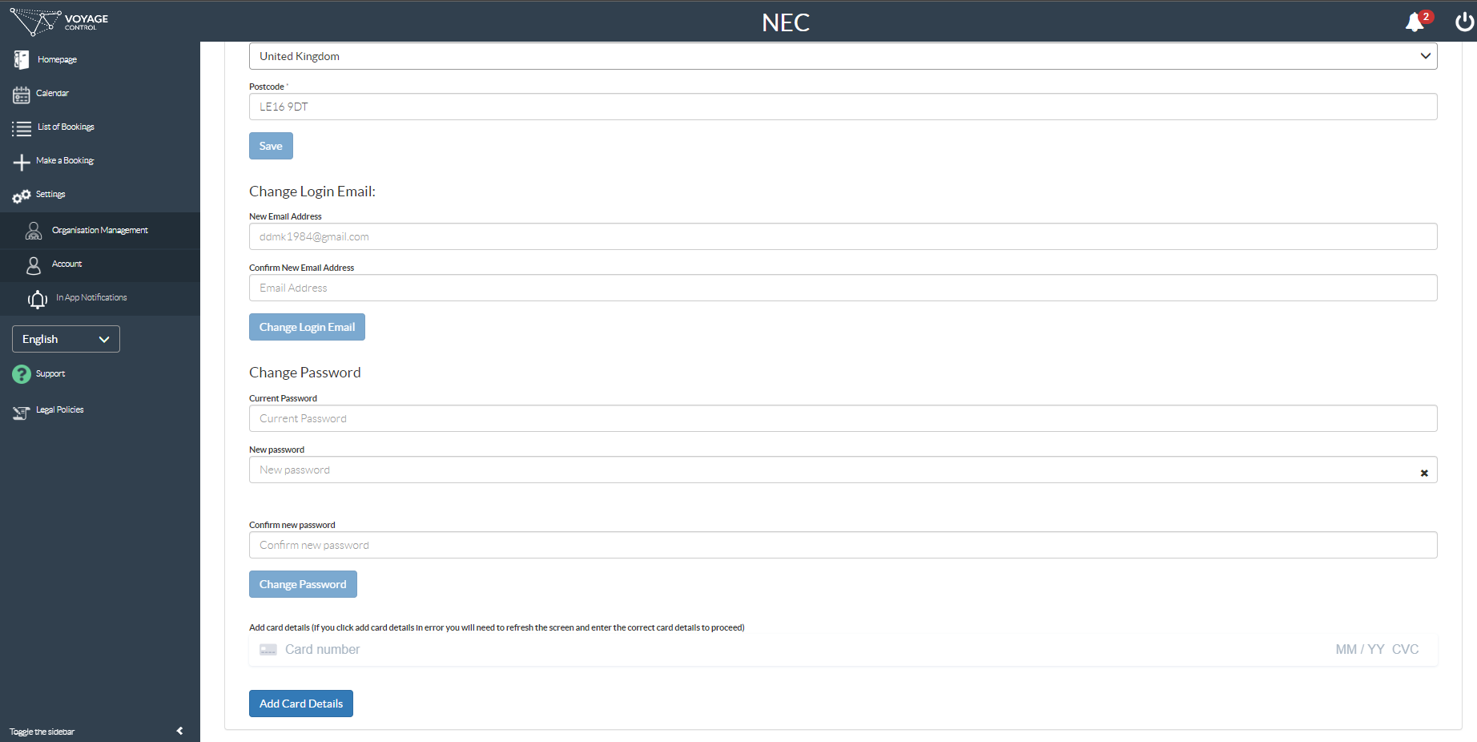
8. Scroll all the way to the bottom of the Account page until you see the “Add Card Details” button at the very bottom.
Before you click this button follow these steps -
9. Enter your long card number then your expiry date, 3 digit security number and PostCode. You can keep typing and it will automatically move on to each section for you.
10. Click Add Card Details

Slide 6
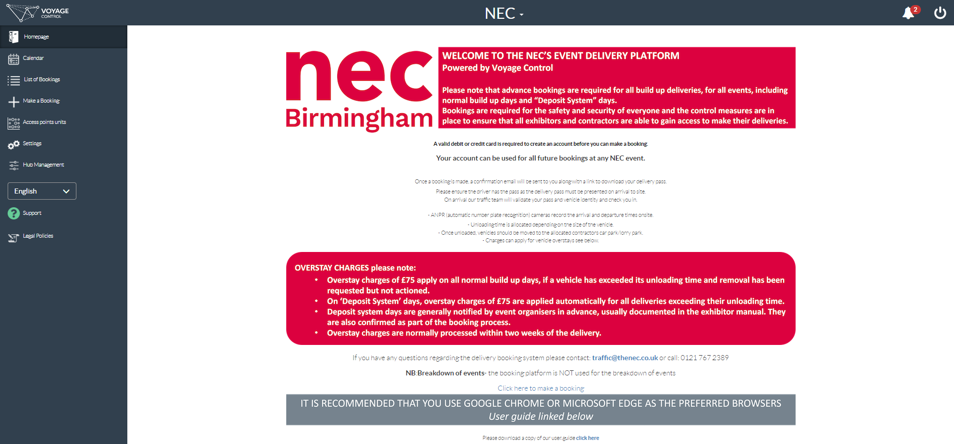
11. Click Make a Booking

Slide 7
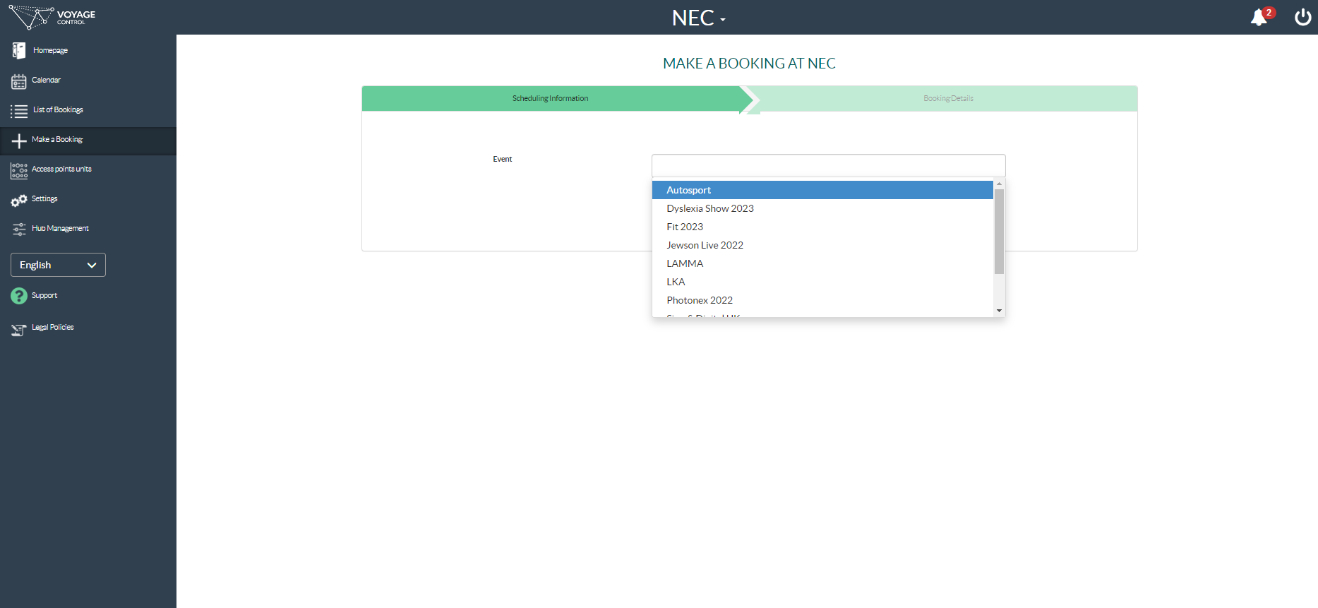
12. Select show from the event drop down box.

Slide 8
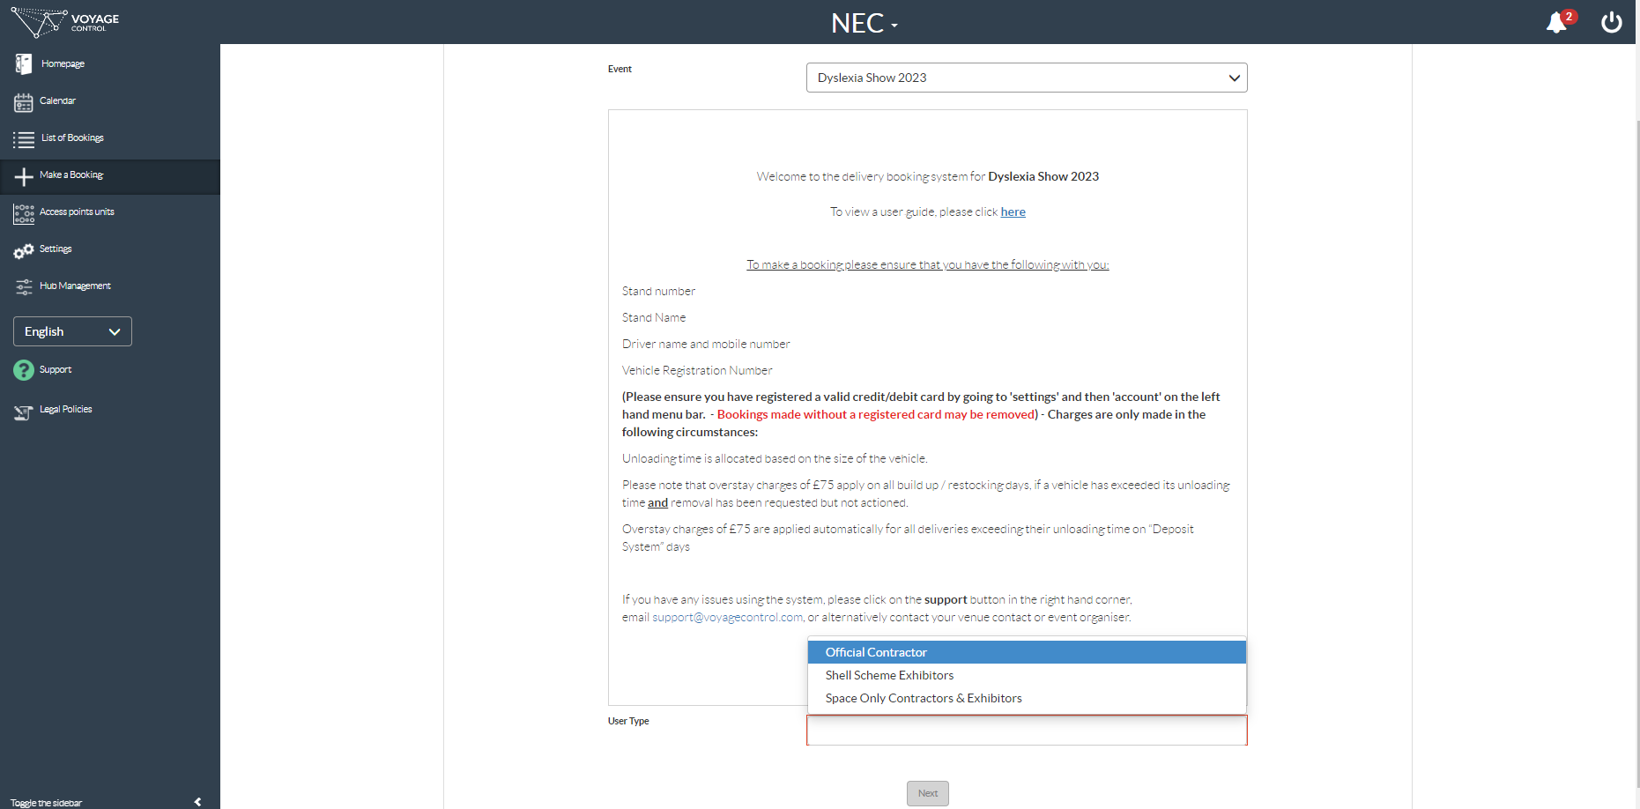
13. You can scroll past this section to the bottom of the page.
The key point to remember is that a charge of £75 will be made if the vehicle over-stays their time slot.
14. Select your user type from the drop down box. Your event organiser can tell you which applies to you if you’re not sure.
15. Click Next

Slide 9
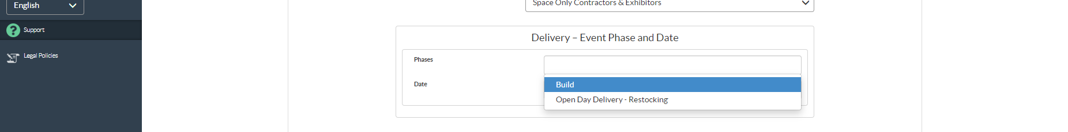
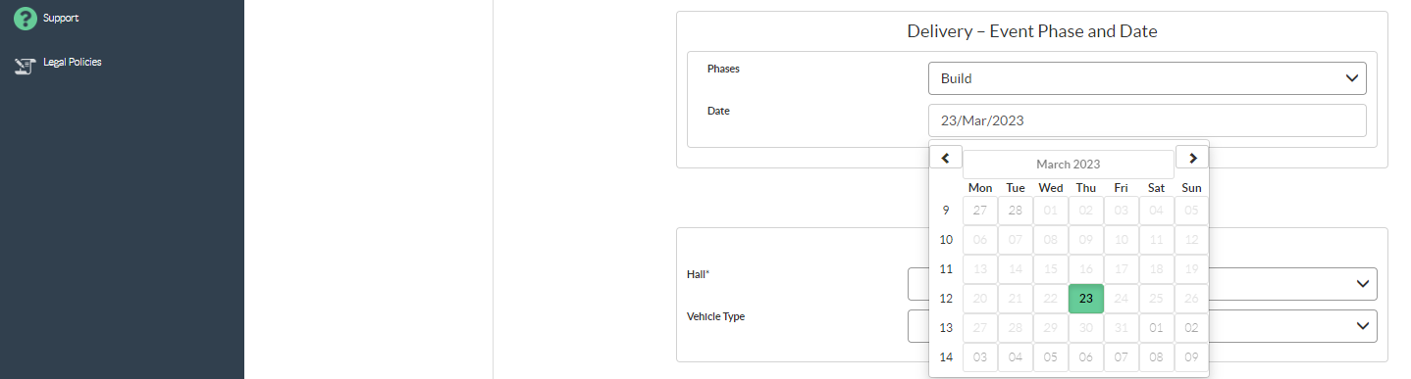
Note: Build phase is for building up / dressing your stand.
Open Day phase is for restocking your stand during open days
16. Select the Phase
17. Clicking on the date box will show you the available dates in green.
Click on the date you want.
18. Click on the Hall drop down and select the hall your stand is in.

Slide 10
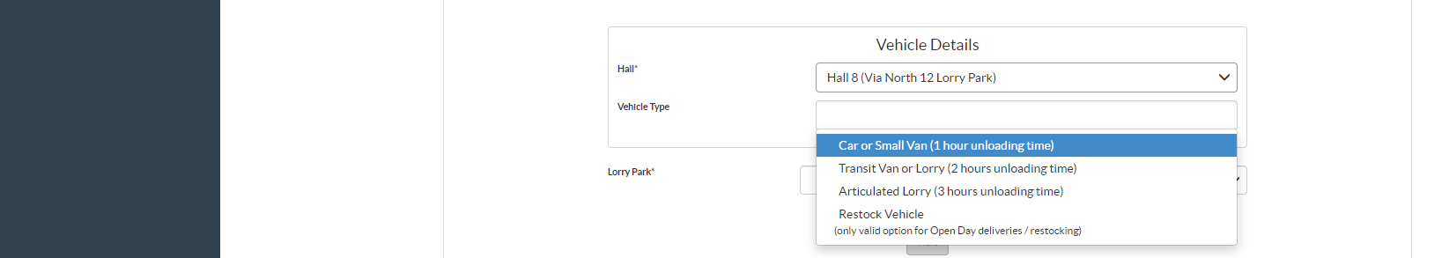

19. Click on the Vehicle Type drop down. Select your vehicle type. The amount of time you get at the loading door is listed next to each vehicle type.
20. Click the Lorry Park Dropdown and select the lorry park.
21. This button should then change to say “Get Times” (see next page)

Slide 11
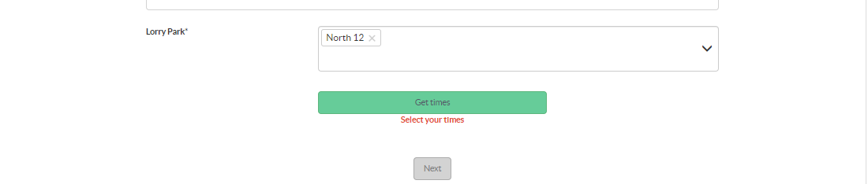
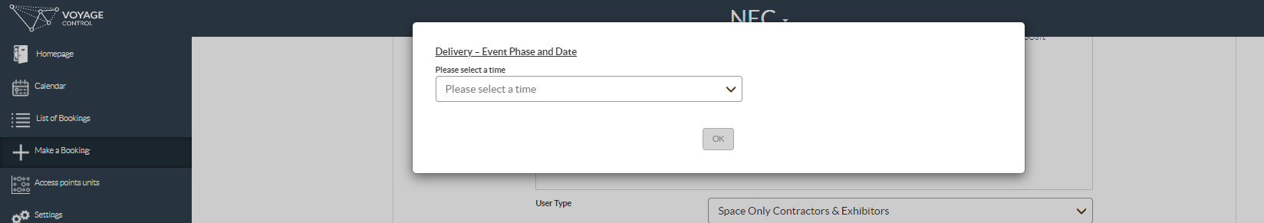
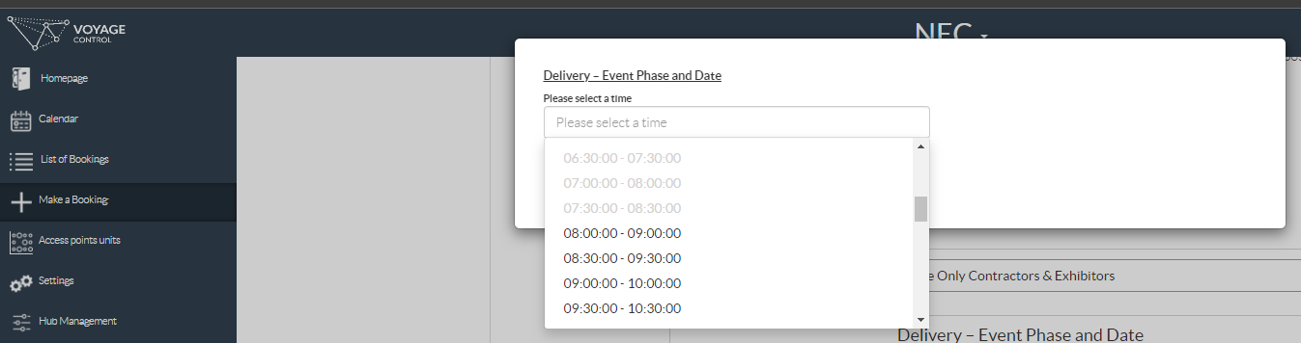
22. Click Get Times. A pop up will appear.
23. Click the drop down to show a list of available times.
24. Select a time. This is an estimated time of arrival. Your timeslot will only officially start when you arrive and get scanned in.

Slide 12
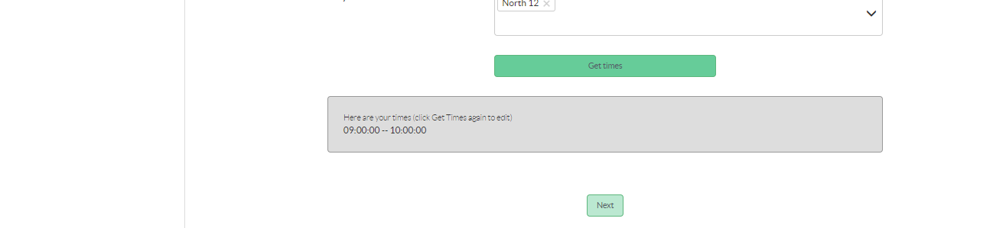
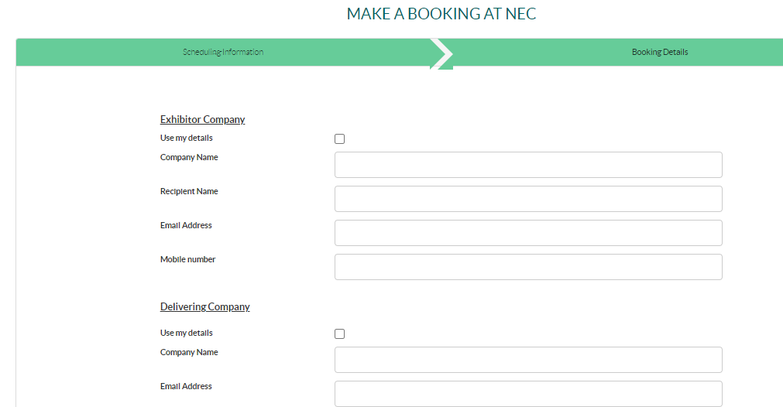
25. Your selected time will appear here
26. Click Next
27. If you are making a booking for yourself, you can check both of these boxes. It will auto fill your details.
If the booking is for somebody else, you will need to fill in all of these boxes manually.

Slide 13
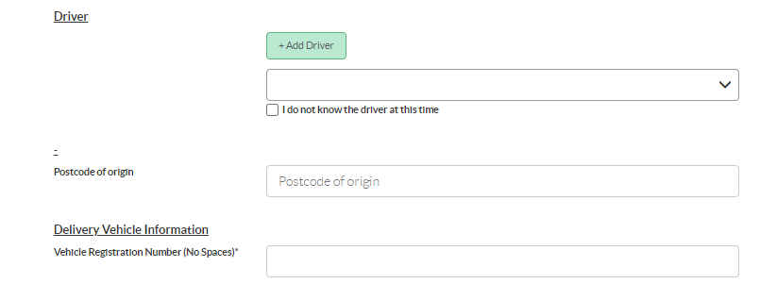
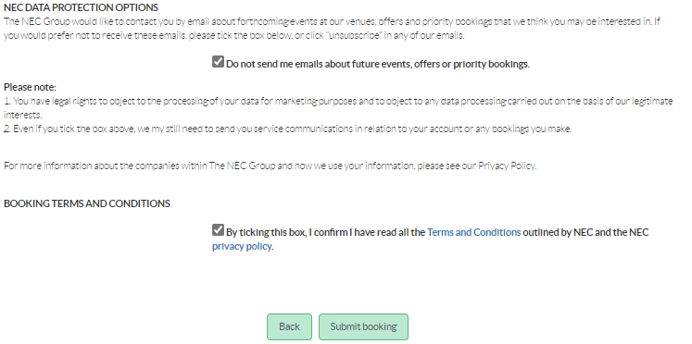
28. Click Add Driver
29. Enter your home or company postcode
30. Enter the vehicle reg without any spaces
31. Check both of these boxes
32. Click Submit Booking

Slide 14
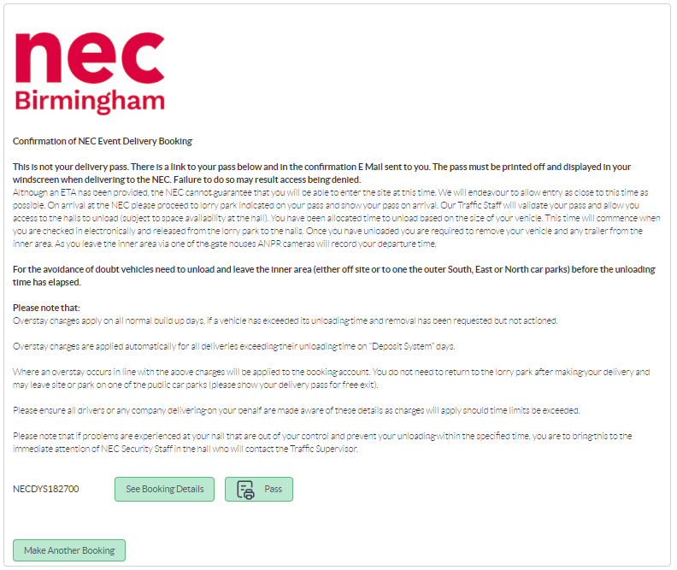
33. Click Pass

Slide 15
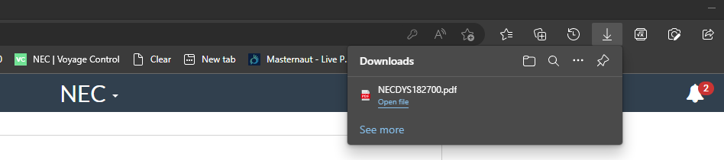
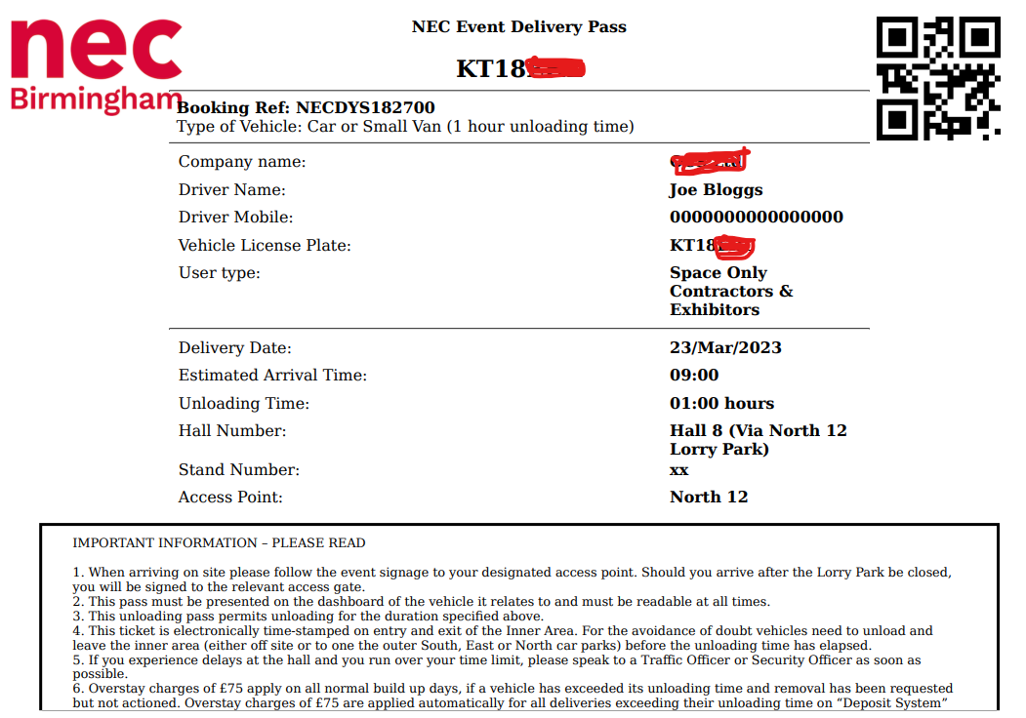
34. Your computer may show you a pop up with your pass download file. Click on this to view your pass. If you don’t see this, check your “Downloads” folder for a file starting with NEC. That’s your pass.
35. This is what your pass should look like. Print this and put it in your vehicle before you arrive. The QR Code in the top corner will be scanned on arrival, kicking off your time slot.
The second page will be a site map.

