Slide 1
Grain Match
Level 1
Level 2

Slide 2
Level 1
Next

Slide 3
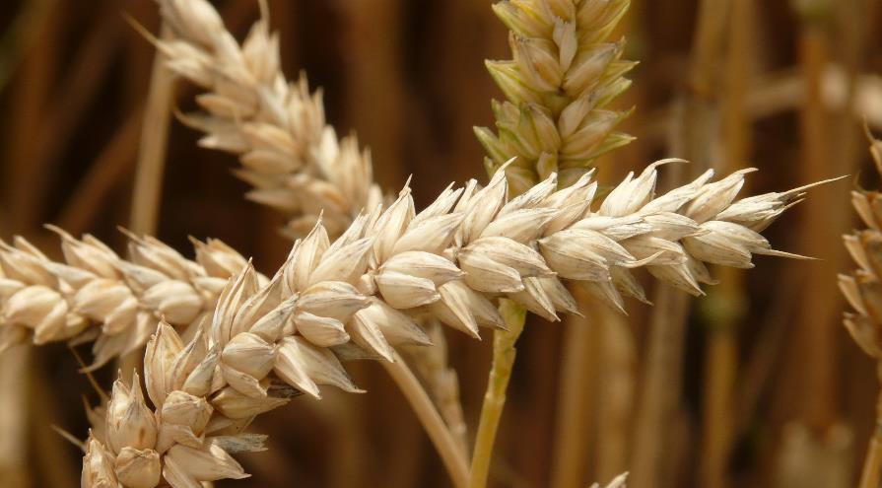
Wheat
Next

Slide 4
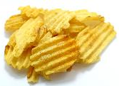
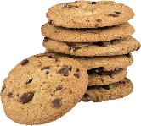
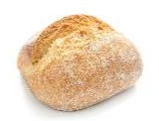
Which of these food products is
not made from wheat?
Crisps
Biscuits
Bread

Slide 5
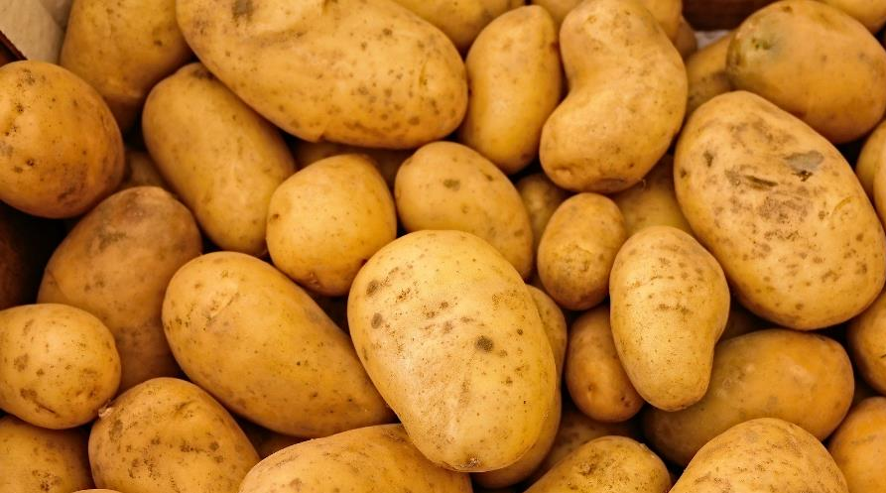
Crisps are usually made from potatoes
Correct
Next

Slide 6
Biscuits are usually made with wheat flour. The correct answer was crisps.
Incorrect
Next

Slide 7
Bread is usually made with wheat flour. The correct answer was crisps.
Incorrect
Next

Slide 8
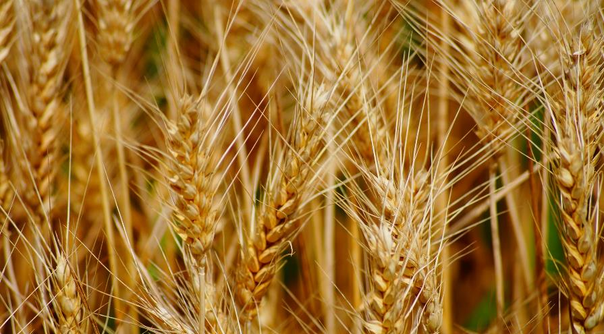
Durum Wheat
Next

Slide 9
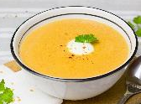
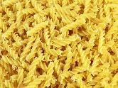
Which of these food products is
not made from durum wheat?
Noodles
Soup
Pasta

Slide 10
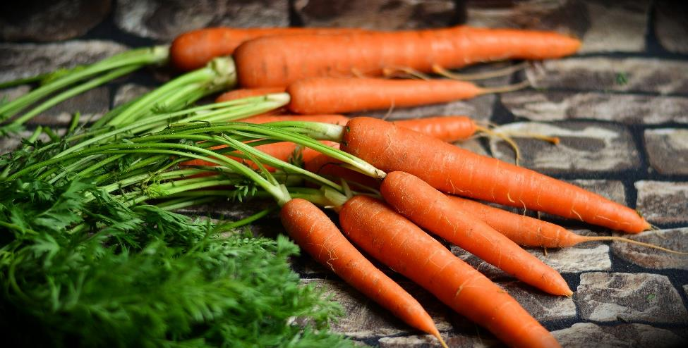
Soup is usually made from vegetables along with other ingredients. In this case carrots.
Correct
Next

Slide 11
Pasta is commonly made with durum wheat flour. The correct answer was soup.
Incorrect
Next

Slide 12
Noodles are commonly made with durum wheat flour. The correct answer was soup.
Incorrect
Next

Slide 13
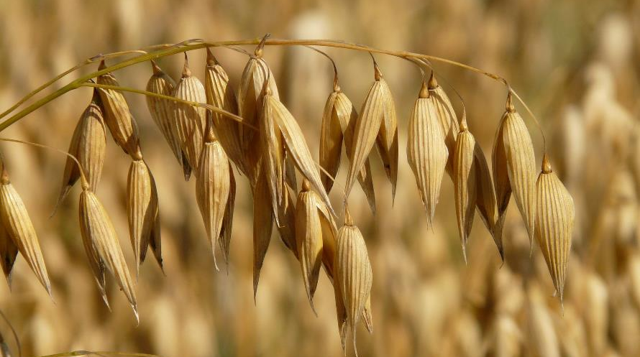
Oats
Next

Slide 14
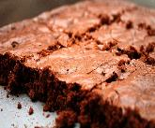
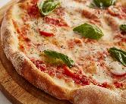
Which of these food products is
most commonly made using oats?
Porridge
Brownie
Pizza

Slide 15
Porridge is commonly made from oats the others are commonly made with wheat.
Correct
Next

Slide 16
Brownies are usually made with wheat flour, although oatmeal is an alternative that can be used. The correct answer was porridge.
Incorrect
Next

Slide 17
Pizza is usually made with wheat flour, although oatmeal is an alternative that can be used. The correct answer was porridge.
Incorrect
Next

Slide 18
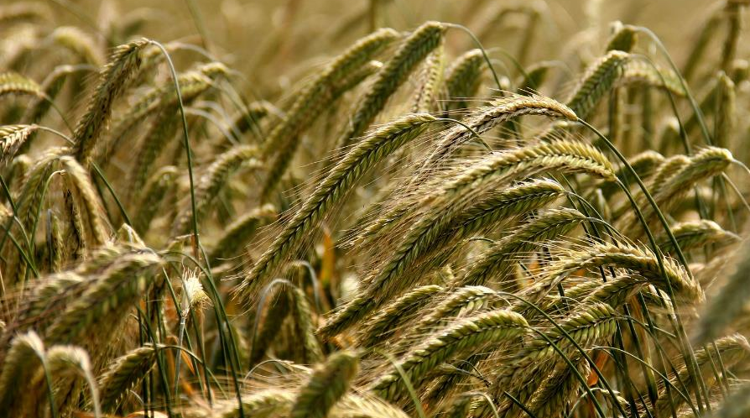
Rye
Next

Slide 19
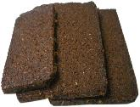
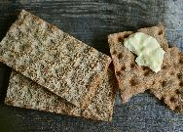
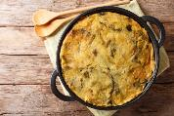
Which of these food products is not commonly made using rye?
Pumpernickel
Crispbread
Bubble and squeak

Slide 20
Pumpernickel
is a brown bread usually made with rye flour. The correct answer was bubble and squeak which is made from potatoes and cabbage.
Incorrect
Next

Slide 21
Crispbread is usually made with rye flour. The correct answer was bubble and squeak which is made from potatoes and cabbage.
Incorrect
Next

Slide 22
Bubble and squeak is made from potatoes and cabbage.
Correct
Next

Slide 23
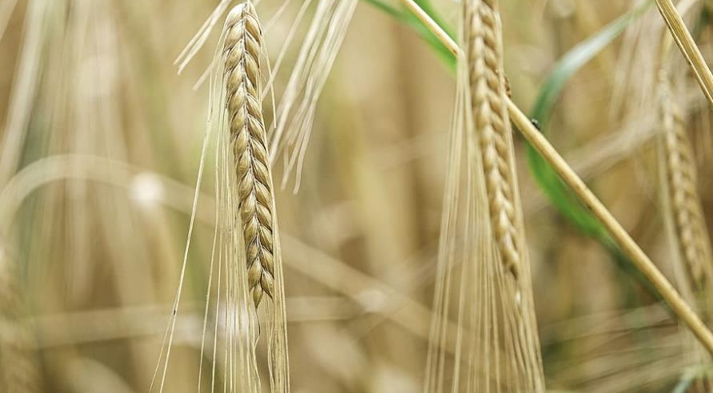
Barley
Next

Slide 24
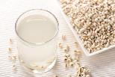
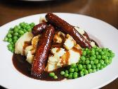
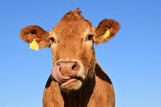
Which of these food products is not commonly made using barley?
Barley water
Bangers and
mash
Animal feed

Slide 25
In Western countries most barley grain is used to feed farm animals. Animal feeds use a number of cereals grains; wheat being used the most.
The correct answer was bangers and mash.
Incorrect
Next

Slide 26
Barley water, as the name suggests uses barley. The correct answer was bangers and mash.
Incorrect
Next

Slide 27
Bangers are the sausages and mash is obviously mashed potato.
Correct
Next

Slide 28
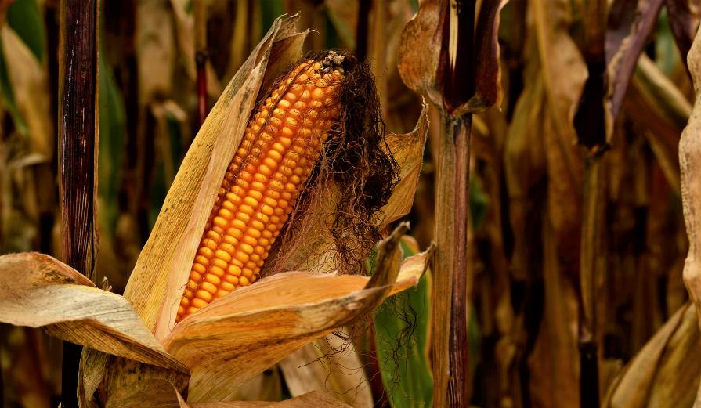
Maize (corn)
Next

Slide 29
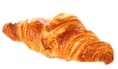
Which of these food products is not commonly made using corn?
Cornflakes
Popcorn
Croissant

Slide 30
Cornflakes, as the name suggests, are made from corn. The correct answer was croissant which are usually made from wheat flour.
Incorrect
Next

Slide 31
Popcorn, as the name suggests, are made from corn. The correct answer was croissant which are usually made from wheat flour.
Incorrect
Next

Slide 32
Croissants are usually made using flour from wheat.
Correct
Next

Slide 33
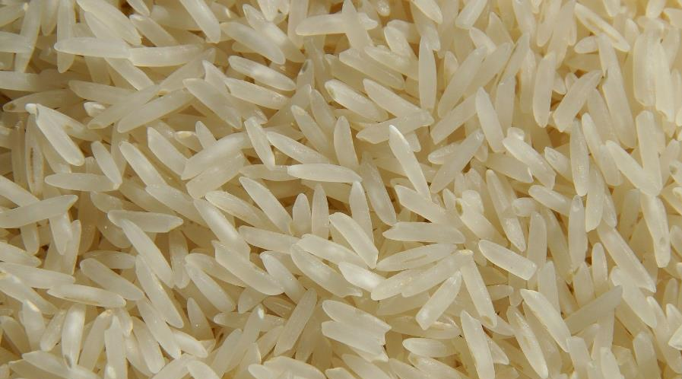
Rice
Next

Slide 34
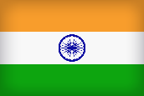
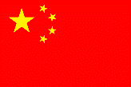
Which country does not grow rice?
The United Kingdom
India
China

Slide 35
Britain is unable to grow the crop as it does not have the warm and wet tropical climate that is required.
Correct
Next

Slide 36
Rice requires a warm and wet tropical climate. China is the largest rice producer in the world and India is second.
The correct answer was the UK; we don’t have a warm and wet tropical climate.
Incorrect
Next

Slide 37
Level 2
Next

Slide 38
Rye
Rice
Oats
Maize
What cereal grain is this?

Slide 39
Correct
Next

Slide 40
The correct answer is: rice
Incorrect
Next

Slide 41
Rye
Barley
Oats
Maize
What cereal grain is this?

Slide 42
Correct
Next

Slide 43
The correct answer is: maize (also known as corn)
Incorrect
Next

Slide 44
Rye
Wheat
Oats
Barley
What cereal grain is this?

Slide 45
Correct
Next

Slide 46
The correct answer is: wheat
Incorrect
Next

Slide 47
Maize
Rice
Oats
Rye
What cereal grain is this?

Slide 48
Correct
Next

Slide 49
The correct answer is: oats
Incorrect
Next

Slide 50
Durum Wheat
Rye
Barley
What cereal grain is this?
Maize

Slide 51
Correct
Next

Slide 52
The correct answer is: barley
Incorrect
Next

Slide 53
Durum Wheat
Rice
Rye
What cereal grain is this?
Oats

Slide 54
Correct
Next

Slide 55
The correct answer is: durum wheat
Incorrect
Next

Slide 56
Oats
Wheat
Barley
Rye
What cereal grain is this?

Slide 57
Correct
Next

Slide 58
The correct answer is: rye
Incorrect
Next

Slide 59
Thank you for taking part ☺

