Slide 1
Teachers’ Pack
Magnificent Magnets & Cool Currents

Slide 2
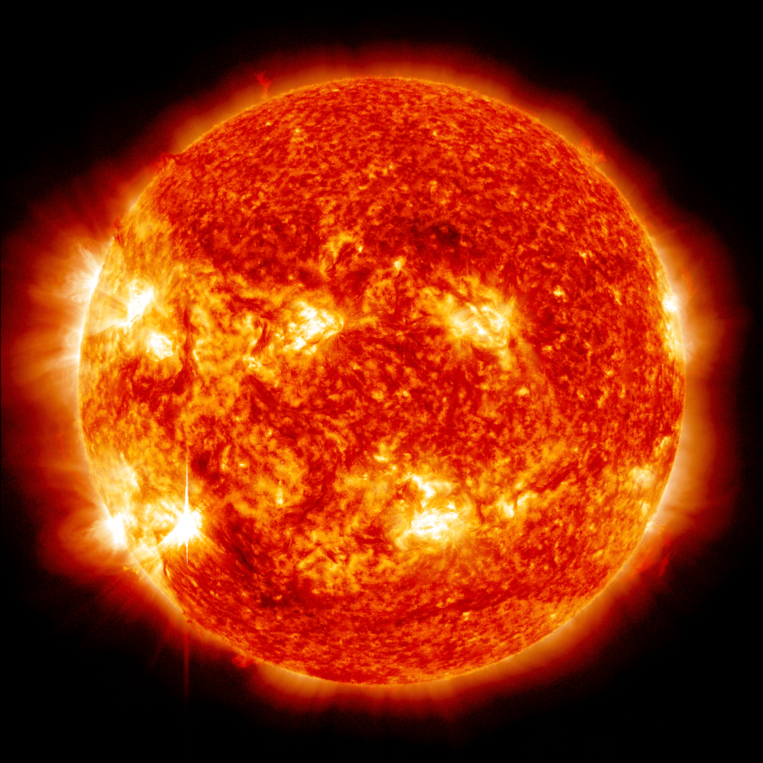
The Sun
hot
big
… far away
heavy
bright
Magnificent magnets & cool currents
Notes:
Image from NASA GMS: Sun Emits a Mid-level Flare (nasa.gov)

Slide 3
States of matter
solid
liquid
gas
plasma

Slide 4
An atom
nucleus
electrons

Slide 5
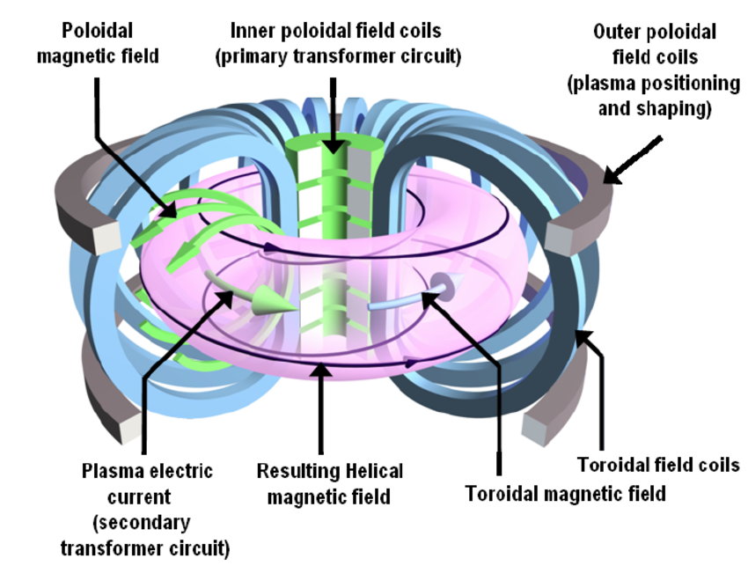
Tokamak

Slide 6
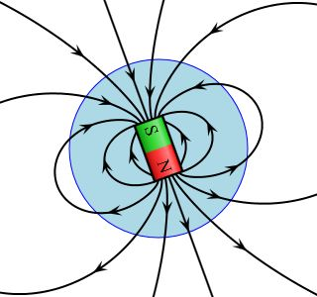
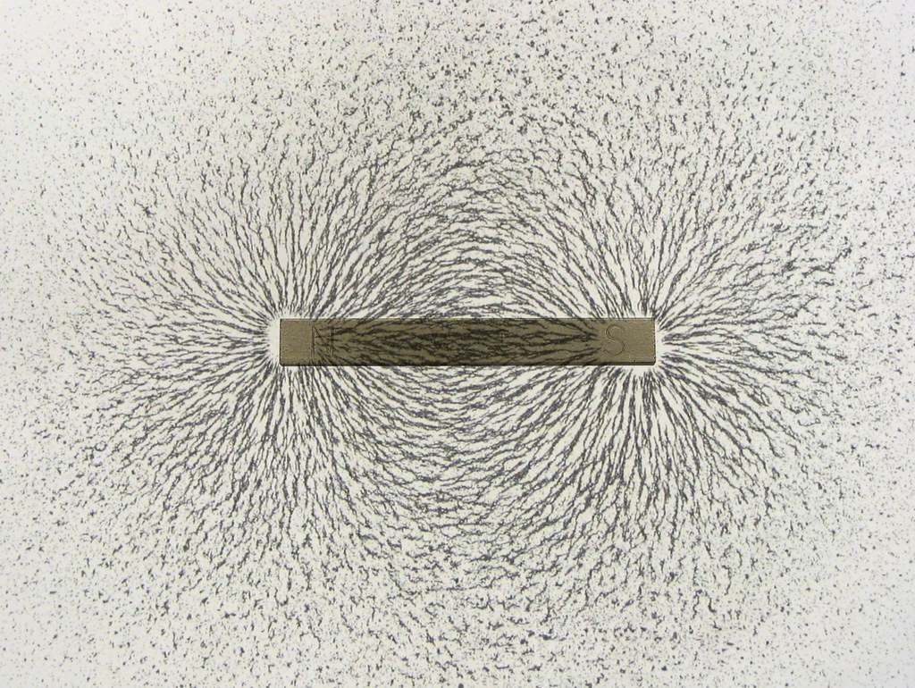
Magnetic field lines
Magnificent magnets & cool currents
Notes:
Left image File:Magnetic field.svg – Wikipedia licensed under Creative commons licence
Right image by Unknown Author is licensed under CC BY-SA-NC

Slide 7
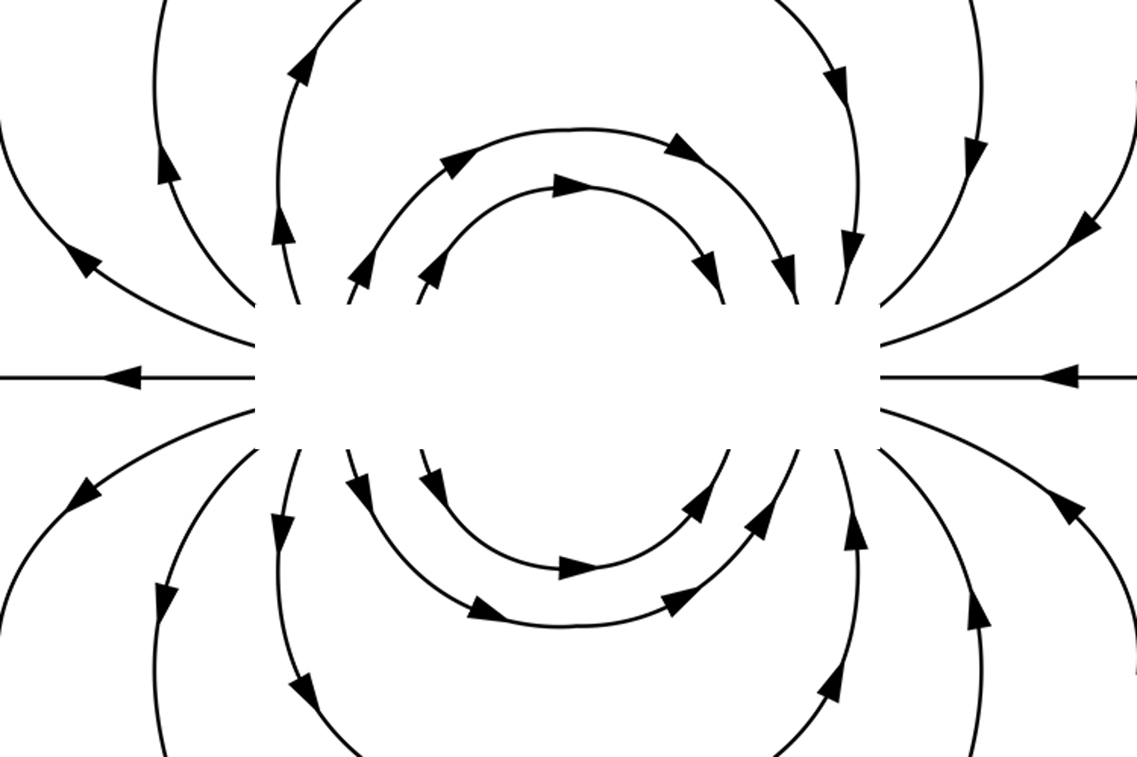
movement of charged particles generates a magnetic field
charged
particles

Slide 8
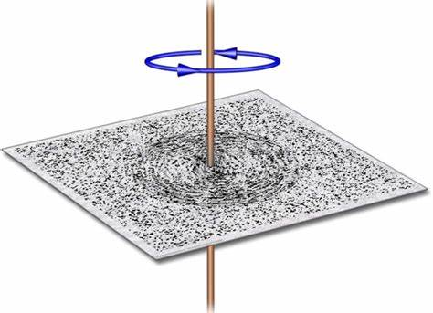
More magnetic field lines
Magnetic fields interacting
opposite poles attract
charged particles moving through a wire
(as current) creates a magnetic field
like poles repel
Magnificent magnets & cool currents
Notes:
Credit for left image: Magnet Academy - Magnet Academy (nationalmaglab.org)

