Slide 1


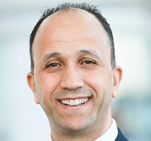
SPE Workshop: Fiber-Optic Sensing Applications for Well, Reservoir and Asset Management
Presenter Name
Presentation
Title
Company Name

Slide 2

SPE Workshop: Fiber-Optic Sensing Applications for Well, Reservoir and Asset Management

Slide 4
SPE Workshop: Fiber-Optic Sensing Applications for Well, Reservoir and Asset Management
Thank You!
Questions?

