Slide 1
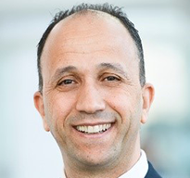
Cementing Challenges with Carbon Capture & Storage Wells
14–15 May 2024 | San Luis Resort, Spa & Conference Center, Galveston Texas
Presenter Name
Presentation
Title
Company Name

Slide 2
Cementing Challenges with Carbon Capture & Storage Wells
14–15 May 2024 | San Luis Resort, Spa & Conference Center, Galveston Texas

Slide 4
Cementing Challenges with Carbon Capture & Storage Wells
14–15 May 2024 | San Luis Resort, Spa & Conference Center, Galveston Texas
Thank You!
Questions?

