Slide 1
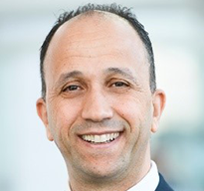
Digital Transformation
6–7 November 2024 | JW Marriott Hotel | Rio de Janeiro, Brazil
Presenter Name
Presentation
Title
Company Name

Slide 2
Digital Transformation
6–7 November 2024 | JW Marriott Hotel | Rio de Janeiro, Brazil

Slide 3
Digital Transformation
6–7 November 2024 | JW Marriott Hotel | Rio de Janeiro, Brazil

Slide 5
Digital Transformation
6–7 November 2024 | JW Marriott Hotel | Rio de Janeiro, Brazil
Thank You!
Questions?

