Slide 1



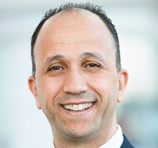
Membrane Separation Processes Applied to
Water Management in E&P
16 – 18 September 2025, Rio de Janeiro, Brazil
Presenter Name
Presentation
Title
Company Name

Slide 2


Membrane Separation Processes Applied to
Water Management in E&P
16 – 18 September 2025, Rio de Janeiro, Brazil

Slide 5
Membrane Separation Processes Applied to
Water Management in E&P
16 – 18 September 2025, Rio de Janeiro, Brazil
Thank You!
Questions?

