Slide 1



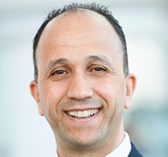
Field Performance and Design of Water Injectors: Injectivity, Fluid Conformance and Containment
03 – 05 November 2025, San Antonio, Texas, USA
Presenter Name
Presentation
Title
Company Name

Slide 2


Field Performance and Design of Water Injectors: Injectivity, Fluid Conformance and Containment
03 – 05 November 2025, San Antonio, Texas, USA

Slide 5
Field Performance and Design of Water Injectors: Injectivity, Fluid Conformance and Containment
03 – 05 November 2025, San Antonio, Texas, USA
Thank You!
Questions?

