Slide 1

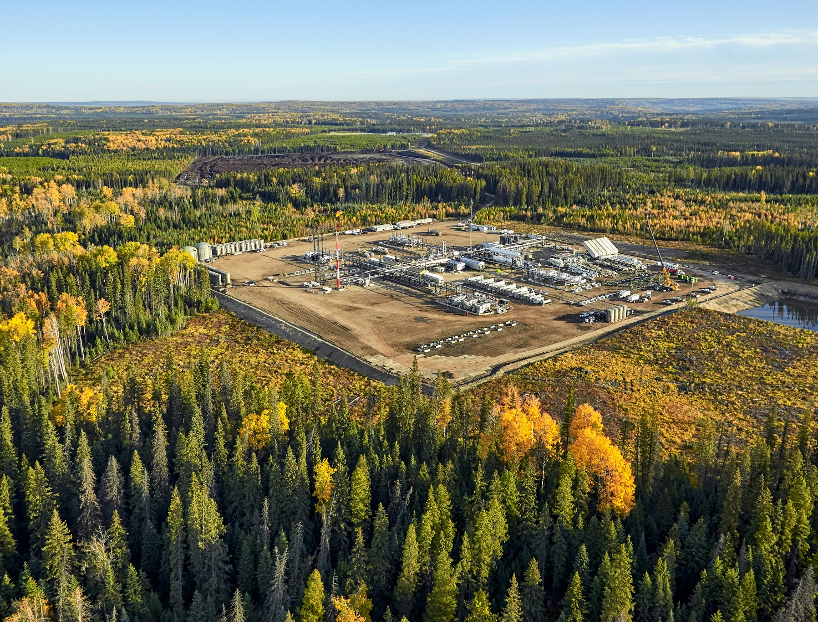
SPE Montney/Duvernay Symposium – World Class Resource to Revenue
5–7 November 2025 | Banff, Alberta, Canada
WE'RE EXHIBITING!

Slide 2
SPE Montney/Duvernay Symposium – World Class Resource to Revenue
5–7 November 2025 | Banff, Alberta, Canada
WE'RE EXHIBITING!
INSERT COMPANY LOGO

