Slide 1

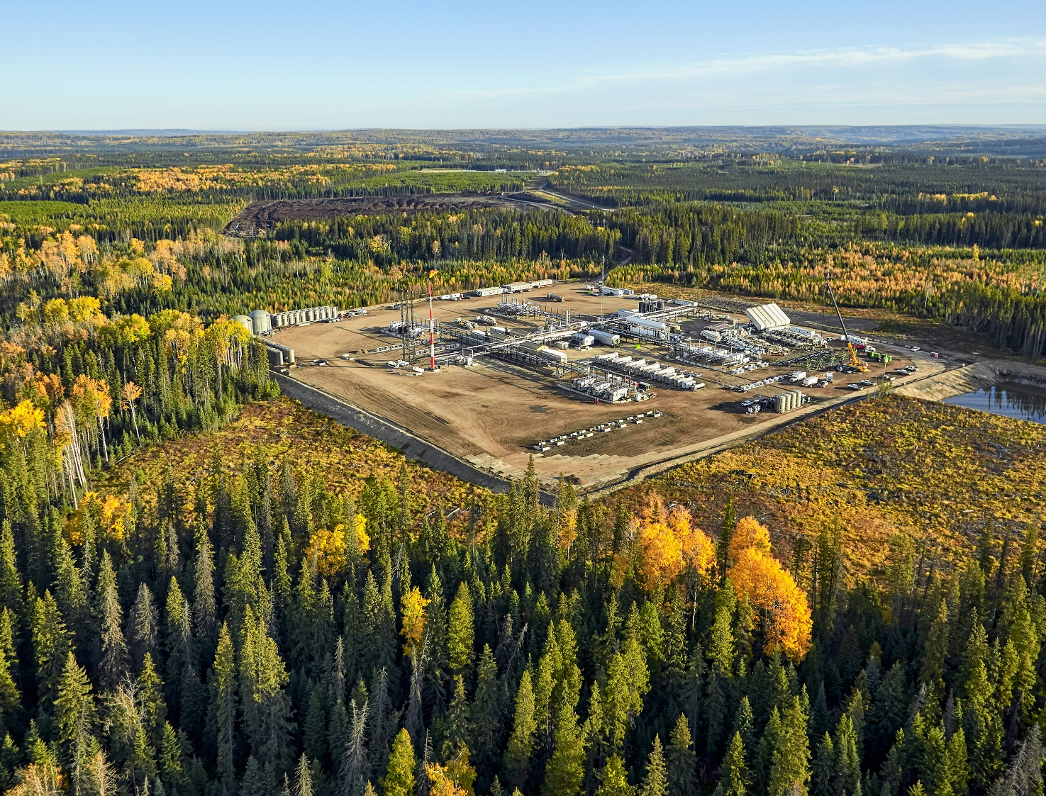
SPE Montney/Duvernay Symposium – World Class Resource to Revenue
5–7 November 2025 | Banff, Alberta, Canada
Proud to Sponsor
INSERT COMPANY LOGO

