Slide 1
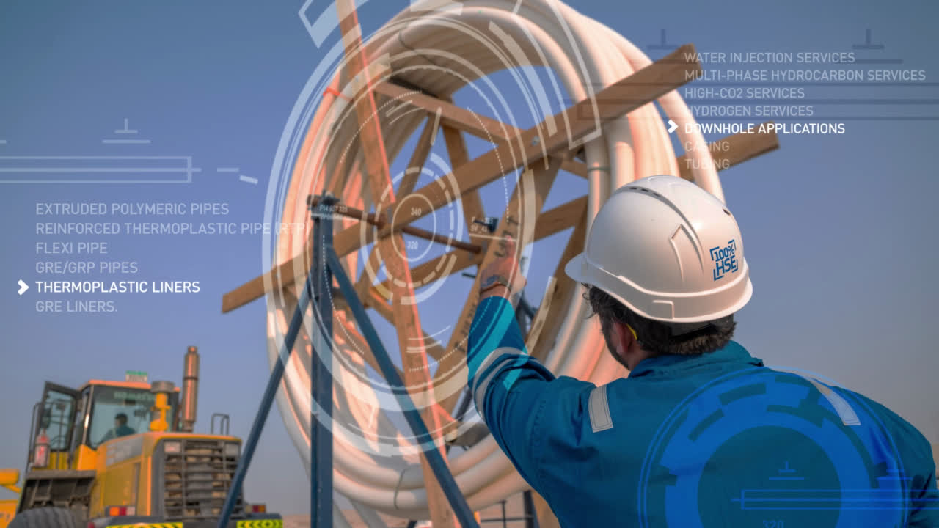







Host Organisation
Accelerating Non-Metallics:
Building Resilient Energy
Infrastructures
COMMITTEE
CHAIR
26–27 February 2025
Abu Dhabi Energy Center, Abu Dhabi, UAE
Registration Open
Scan to view website.

