Slide 1
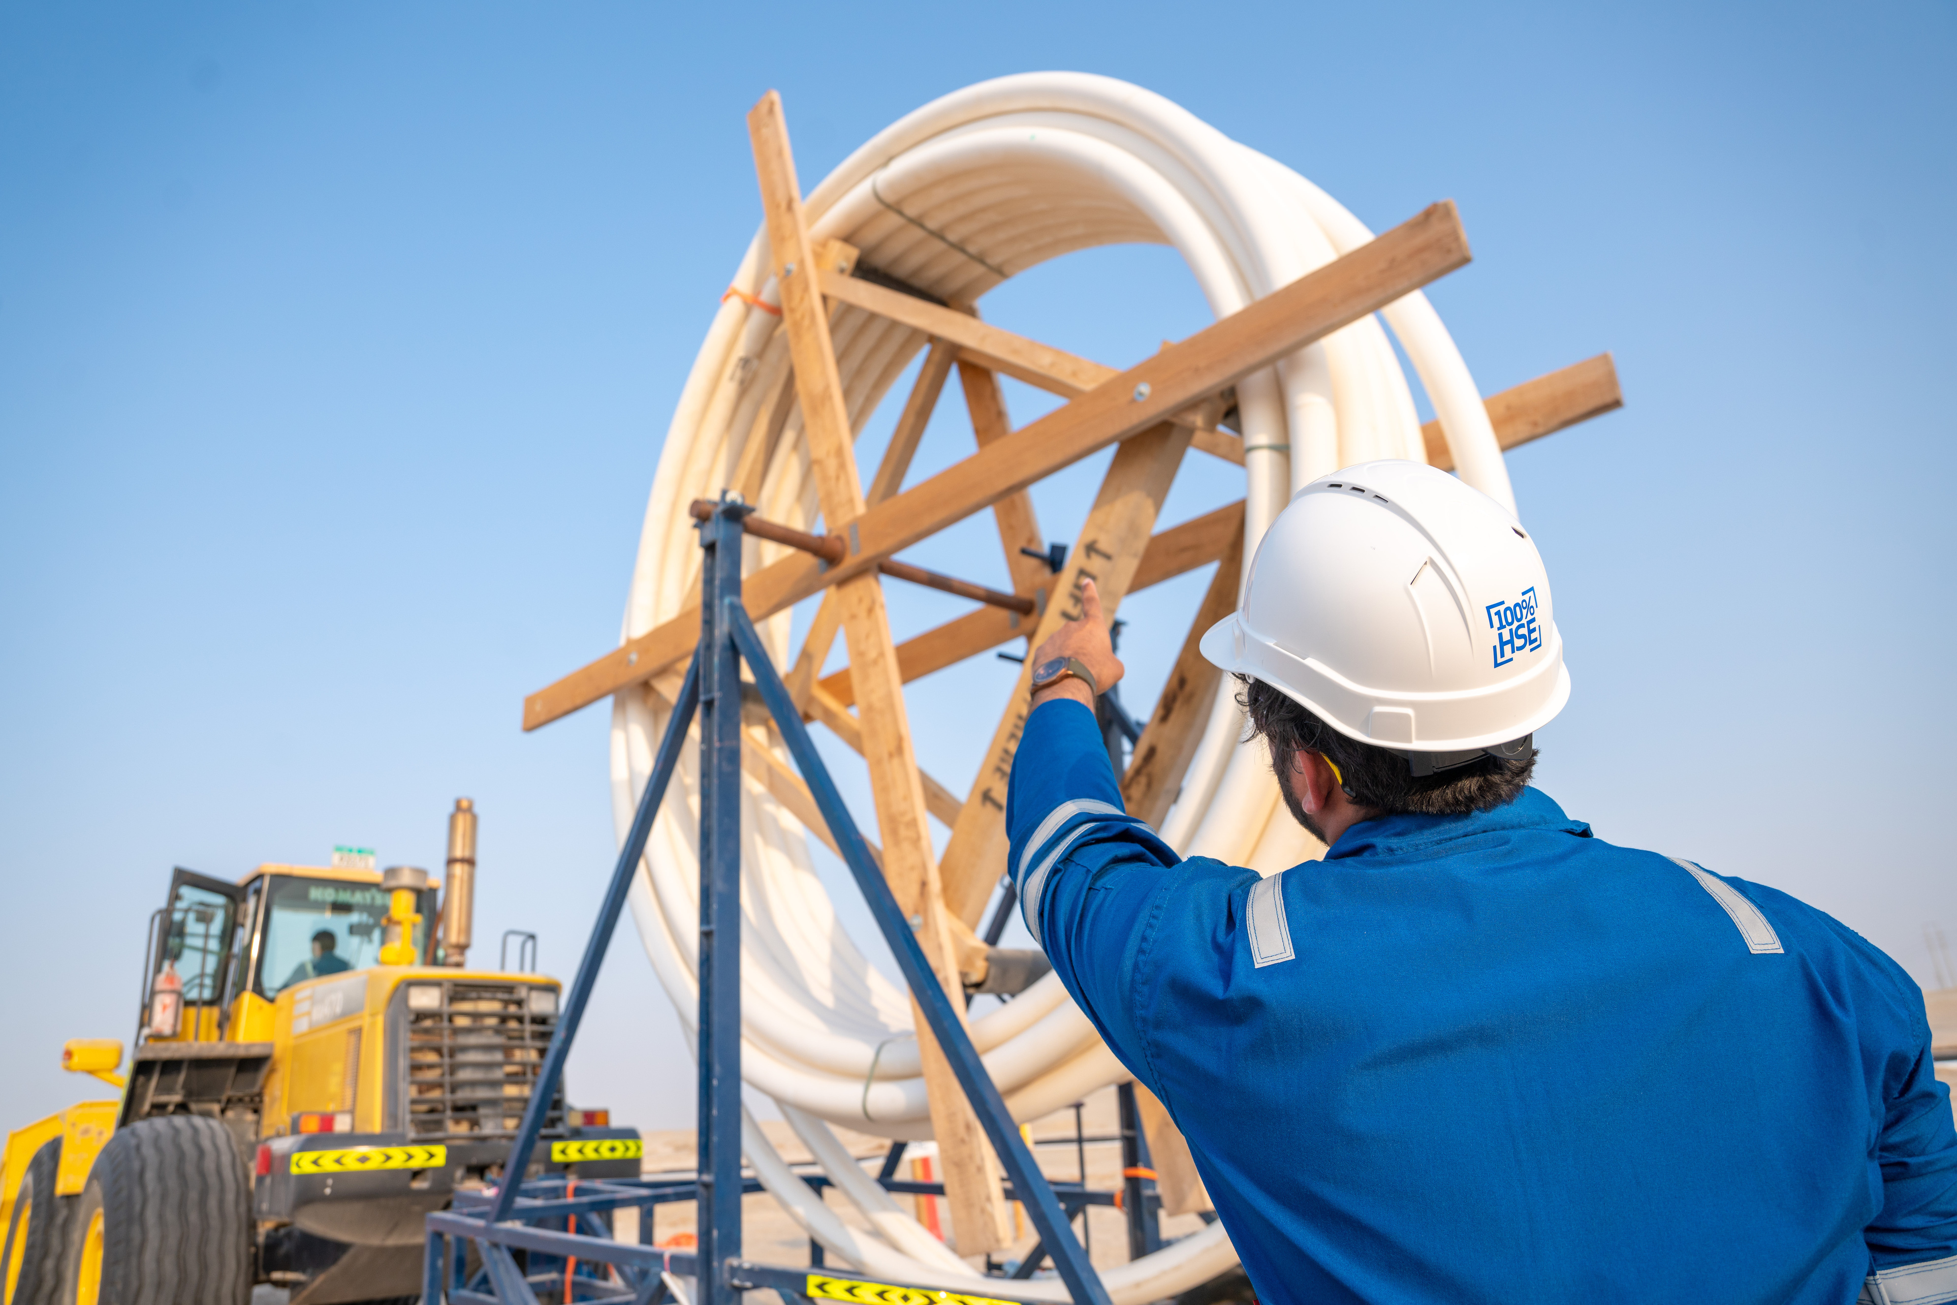



Host Organisation
Accelerating Non-Metallics:
Building Resilient Energy Infrastructures
26–27 February 2025 | Abu Dhabi Energy Center, Abu Dhabi, UAE
COMMITTEE MEMBER
Insert
Photo
Here
Register Now
go.spe.org/RegNM

