Slide 1



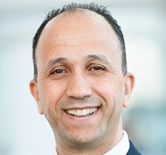
SPE Workshop: Holistic Approaches to Understanding Water Management,
Injection, Production And Disposal In A Low Carbon Economy
10 –12 September 2024 | JW Marriott Copacabana, Rio de Janeiro, Brazil
Presenter Name
Presentation
Title
Company Name

Slide 2

SPE Workshop: Holistic Approaches to Understanding Water Management,
Injection, Production And Disposal In A Low Carbon Economy
10 –12 September 2024 | JW Marriott Copacabana, Rio de Janeiro, Brazil

Slide 4
SPE Workshop: Holistic Approaches to Understanding Water Management,
Injection, Production And Disposal In A Low Carbon Economy
10 –12 September 2024 | JW Marriott Copacabana, Rio de Janeiro, Brazil
Thank You!
Questions?

