Slide 1



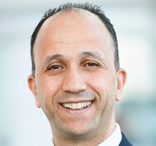
Integrated Water Management - Pathways for Sustainable and Environmentally Responsible Oilfield Operations
15–17 September 2026 | Rio de Janeiro, Brazil
Presenter Name
Presentation
Title
Company Name

Slide 2
Integrated Water Management - Pathways for Sustainable and Environmentally Responsible Oilfield Operations
15–17 September 2026 | Rio de Janeiro, Brazil

Slide 4
Integrated Water Management - Pathways for Sustainable and Environmentally Responsible Oilfield Operations
15–17 September 2026 | Rio de Janeiro, Brazil
Thank You!
Questions?

