Slide 1



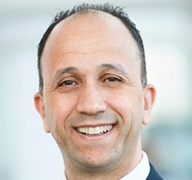
Digital Transformation
12–13 November 2025 | JW Marriott Hotel | Rio de Janeiro, Brazil
Presenter Name
Presentation
Title
Company Name

Slide 2


Digital Transformation
12–13 November 2025 | JW Marriott Hotel | Rio de Janeiro, Brazil

Slide 4
Digital Transformation
12–13 November 2025 | JW Marriott Hotel | Rio de Janeiro, Brazil
Thank You!
Questions?

