Slide 1



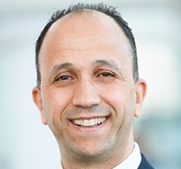
Subsea Fiber-Optic Sensing Applications: How To Make It Happen
10–12 April 2024 | JW Marriott Hotel, Rio de Janeiro, Brazil
Presenter Name
Presentation
Title
Company Name

Slide 2

Subsea Fiber-Optic Sensing Applications: How To Make It Happen
10–12 April 2024 | JW Marriott Hotel, Rio de Janeiro, Brazil

Slide 4
Subsea Fiber-Optic Sensing Applications: How To Make It Happen
10–12 April 2024 | JW Marriott Hotel, Rio de Janeiro, Brazil
Thank You!
Questions?

