Slide 1



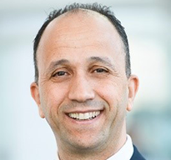
SPE Workshop: Subsea Fiber Optic Sensing: From Deployment to Decision Making
12–13 November 2026 | Petrobras CENPES, Rio de Janeiro, Brazil
Presenter Name
Presentation
Title
Company Name

Slide 2

SPE Workshop: Subsea Fiber Optic Sensing: From Deployment to Decision Making
12–13 November 2026 | Petrobras CENPES, Rio de Janeiro, Brazil

Slide 4
SPE Workshop: Subsea Fiber Optic Sensing: From Deployment to Decision Making
12–13 November 2026 | Petrobras CENPES, Rio de Janeiro, Brazil
Thank You!
Questions?

