Slide 1



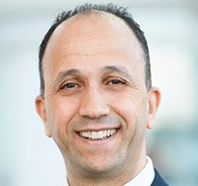
Subsea Well Intervention and Wells Integrity
04 – 06 March 2026, Rio de Janeiro, Brazil
Presenter Name
Presentation
Title
Company Name

Slide 2


Subsea Well Intervention and Wells Integrity
04 – 06 March 2026, Rio de Janeiro, Brazil

Slide 5
Subsea Well Intervention and Wells Integrity
04 – 06 March 2026, Rio de Janeiro, Brazil
Thank You!
Questions?

