Slide 1
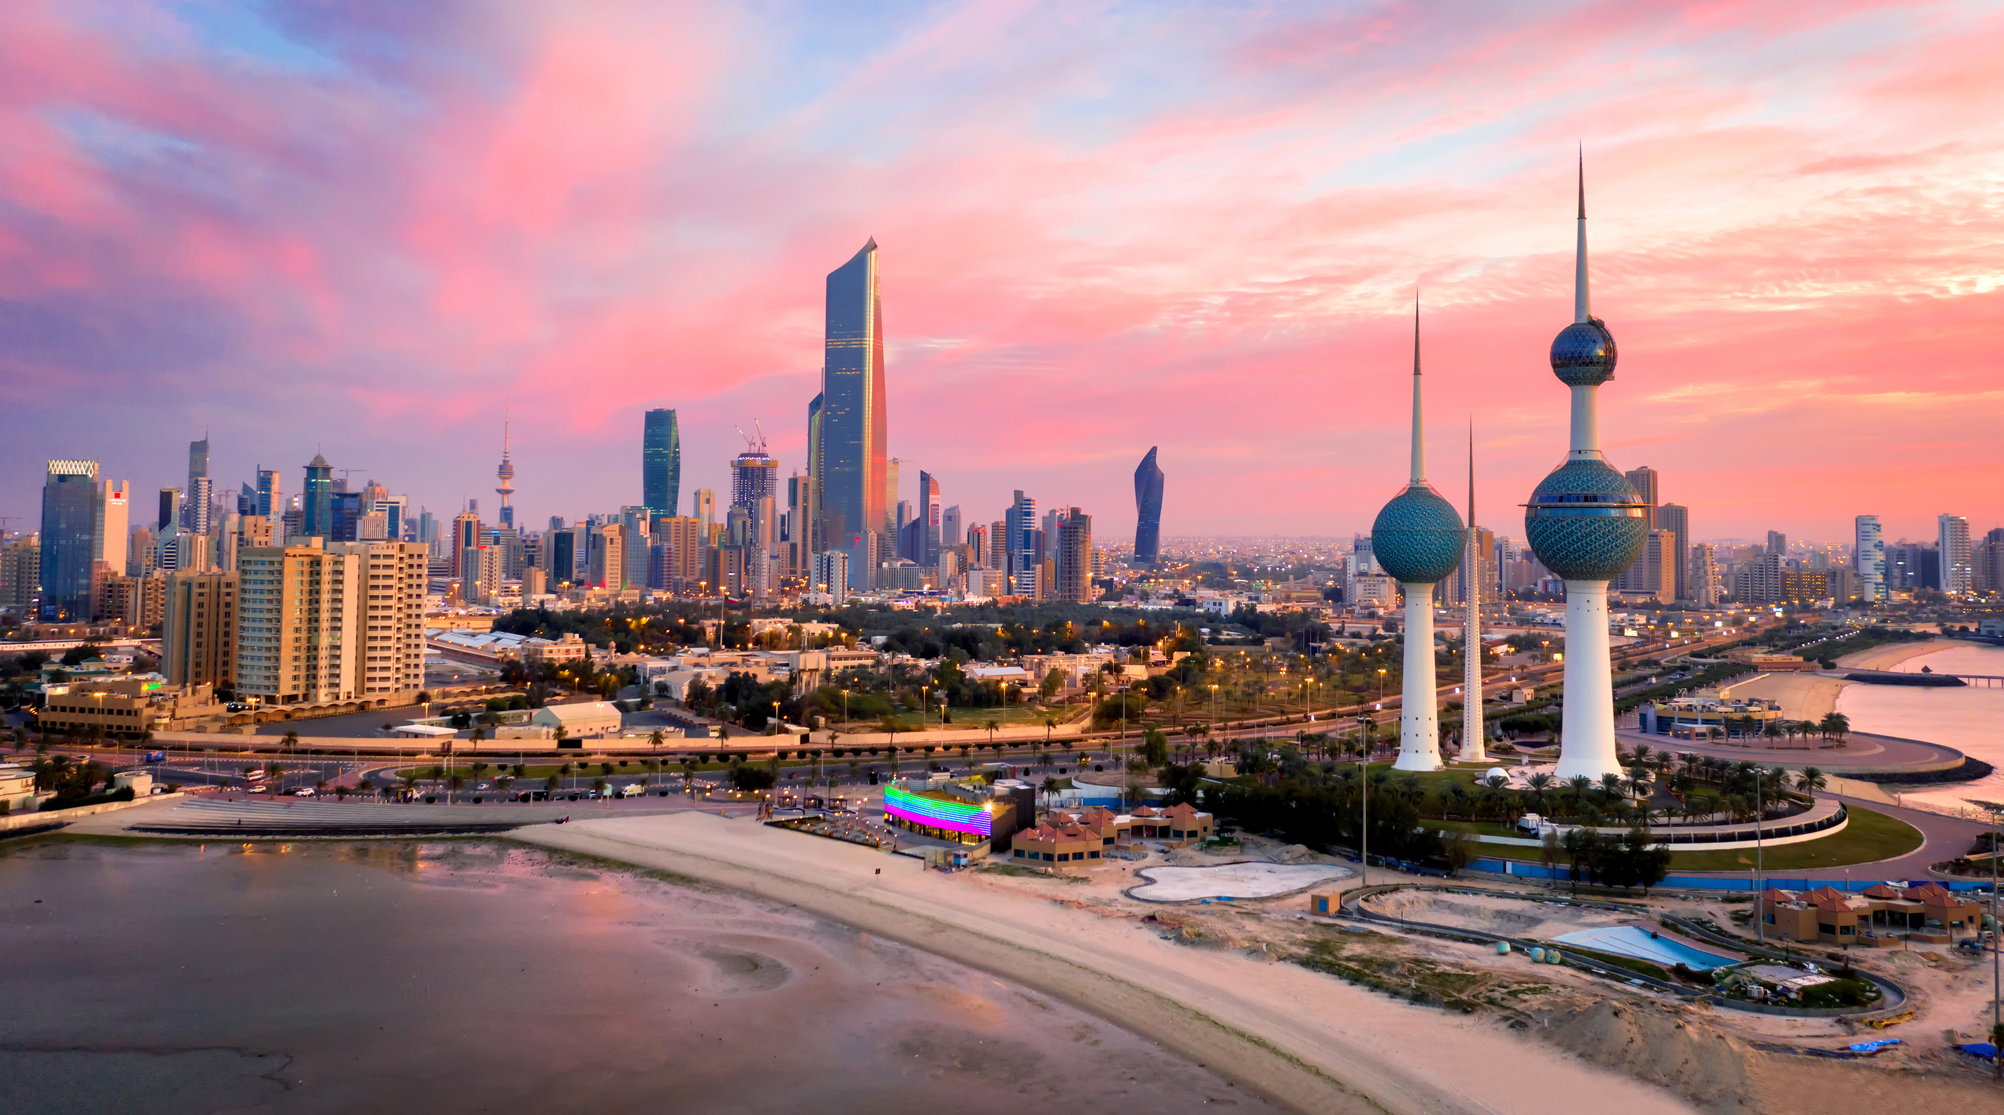



Under the Patronage of
His Highness Sheikh Ahmed Abdullah Al Ahmed Al Sabah, Prime Minister of Kuwait
Host Organisation
Shaping Tomorrow’s Energy
3–5 February 2026 | Kuwait
Executive Committee Member
Name
Designation
Company

Slide 2
Under the Patronage of
His Highness Sheikh Ahmed Abdullah Al Ahmed Al Sabah, Prime Minister of Kuwait
Host Organisation
Host Organisation
Shaping Tomorrow’s Energy
3–5 February 2026 | Kuwait
I’m Attending KOGS 2026—Join Me in Kuwait
Name
Designation
Company

