Slide 1
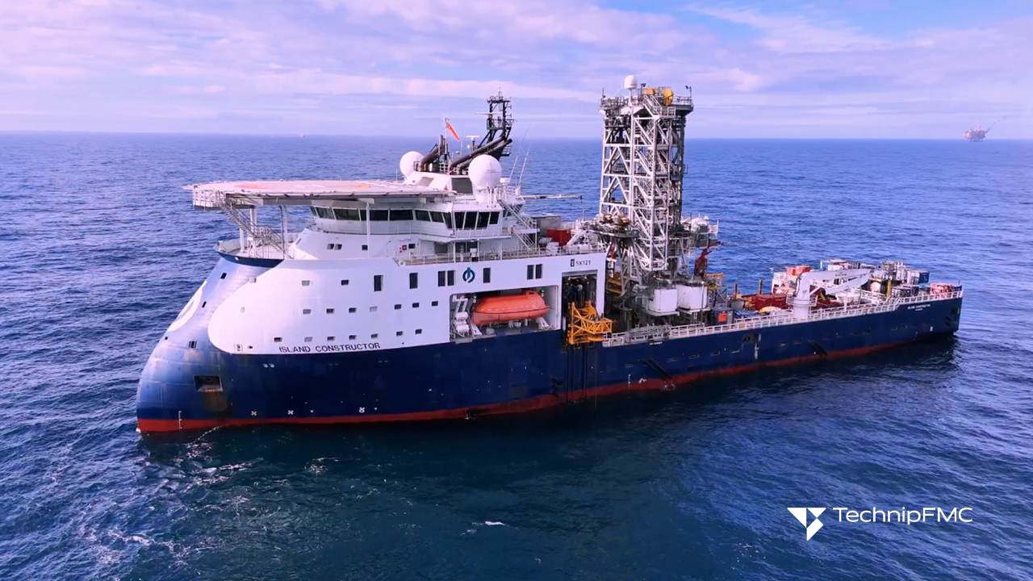
SPE Subsea Well Intervention Symposium
25–27 August 2026 | Galveston, Texas, USA
WE'RE EXHIBITING!
Speak to our dedicated
team in the exhibit hall.
INSERT COMPANY LOGO

