Slide 1

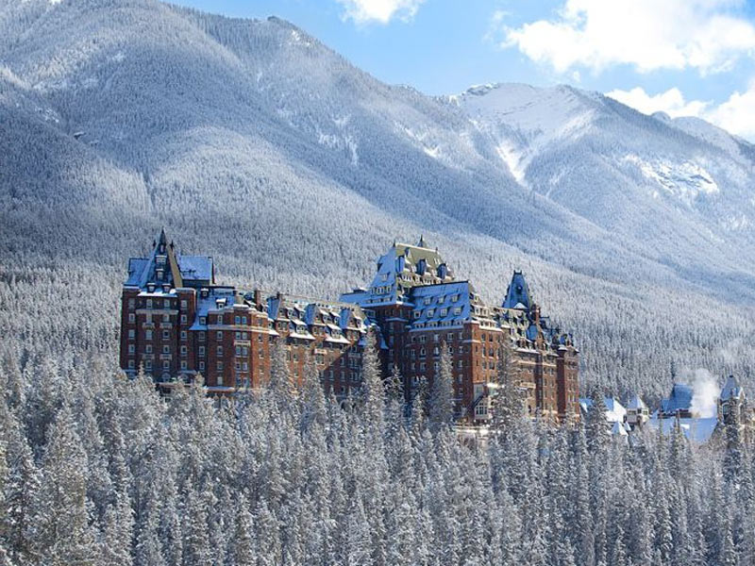
SPE Thermal Well
Integrity and Production Symposium
1–4 December 2025 | Banff, Alberta, Canada
WE'RE EXHIBITING!
Speak to our dedicated team
in the exhibit hall.

Slide 2
SPE Thermal Well
Integrity and Production Symposium
1–4 December 2025 | Banff, Alberta, Canada
SEE YOU SOON!
We're Exhibiting -
Visit us in the Exhibit Hall.

Slide 3
SPE Thermal Well
Integrity and Production Symposium
1–4 December 2025 | Banff, Alberta, Canada
WE’RE EXHIBITING!
Speak to our dedicated team in the exhibit hall.
INSERT COMPANY LOGO

Slide 4
SPE Thermal Well
Integrity and Production Symposium
1–4 December 2025 | Banff, Alberta, Canada
I’M PRESENTING!
• Learn More About Well Integrity Across the Full Lifecycle: Collaboration, Innovation, and Responsibility

Slide 5
SPE Thermal Well
Integrity and Production Symposium
1–4 December 2025 | Banff, Alberta, Canada
[Type] Sponsor
INSERT COMPANY LOGO

