Slide 1



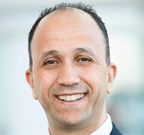
Improving Recovery Factors in Onshore Fields
10–11 March 2026 | Hotel Deville Prime | Salvador-Bahia, Brazil
Presenter Name
Presentation
Title
Company Name

Slide 2

Improving Recovery Factors in Onshore Fields
10–11 March 2026 | Hotel Deville Prime | Salvador-Bahia, Brazil

Slide 4
Improving Recovery Factors in Onshore Fields
10–11 March 2026 | Hotel Deville Prime | Salvador-Bahia, Brazil
Thank You!
Questions?

