Slide 1
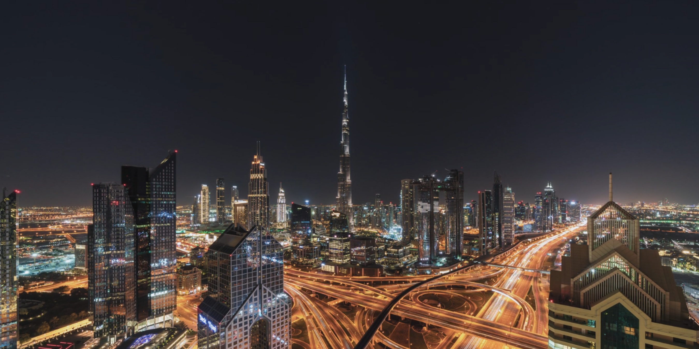



Under the Patronage of His Highness Sheikh Ahmed Bin Saeed Al Maktoum Chairman of the Dubai Supreme Council of Energy
Exclusive Host
13–15 April 2026 | Dubai World Trade Centre, Dubai, UAE

Slide 2
Exclusive Host
13–15 April 2026
Dubai, UAE

