Slide 1
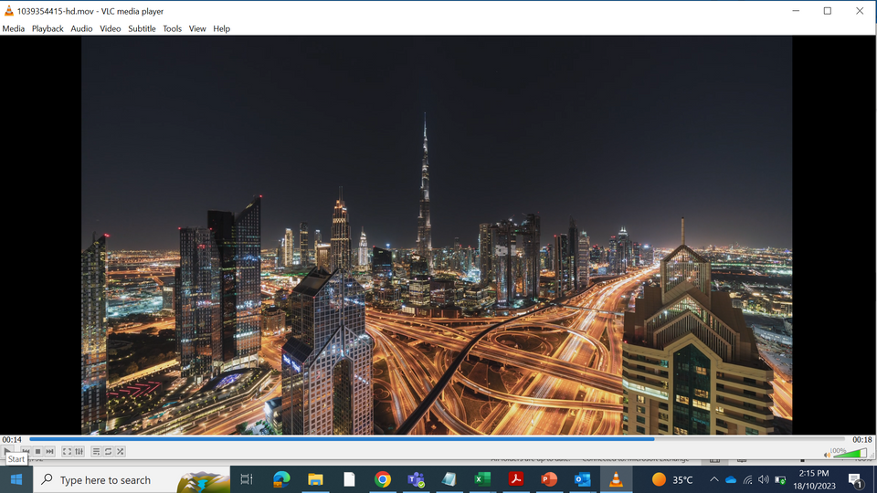



UNDER THE PATRONAGE OF HIS HIGHNESS SHEIKH AHMED BIN SAEED AL MAKTOUM
Chairman of the Dubai Supreme Council of Energy
Exclusive Host
Sponsor Title/Exhibitor
INSERT LOGO
13–15 April | Dubai World Trade Centre

