Slide 1
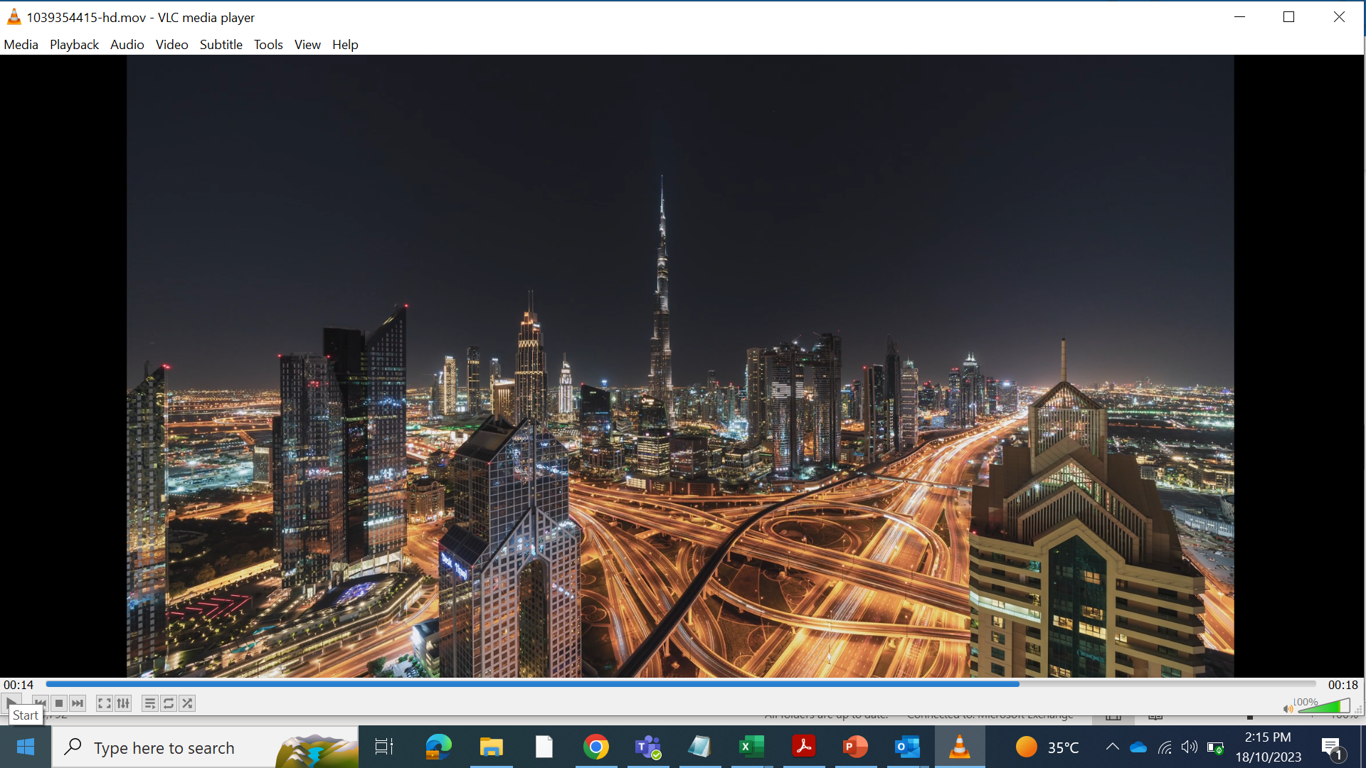




Exclusive Host
Dubai World Trade Centre, Dubai, UAE
Add Sponsor Title
Add Logo Here
go.spe.org/GOTECH_Visit

Slide 2
Exclusive Host
Dubai World Trade Centre, Dubai, UAE
Confirmed Exhibitor
Add Logo Here
go.spe.org/GOTECH_Visit

