Slide 1
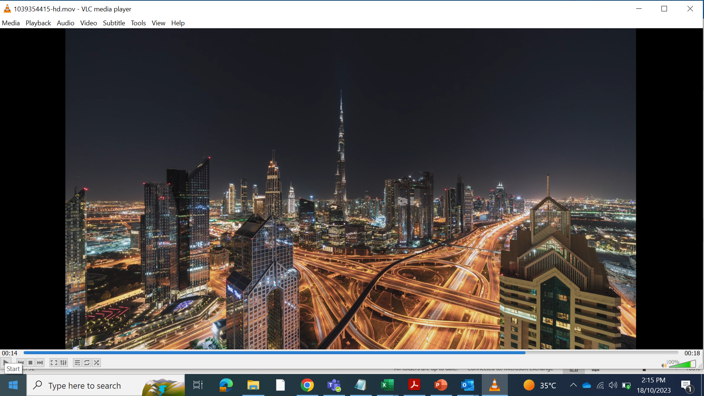




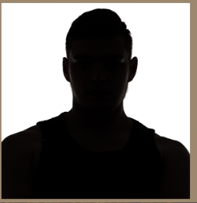
UNDER THE PATRONAGE OF HIS HIGHNESS SHEIKH AHMED BIN SAEED AL MAKTOUM, CHAIRMAN OF THE DUBAI SUPREME COUNCIL OF ENERGY
Exclusive Host
13–15 April 2026 | Dubai World Trade Centre, Dubai, UAE
I am a GOTECH 2026 committee member/chair/speaker/delegate!
Let’s Connect, Network and Unlock Opportunities!
Register Now and Join Me

