Slide 1
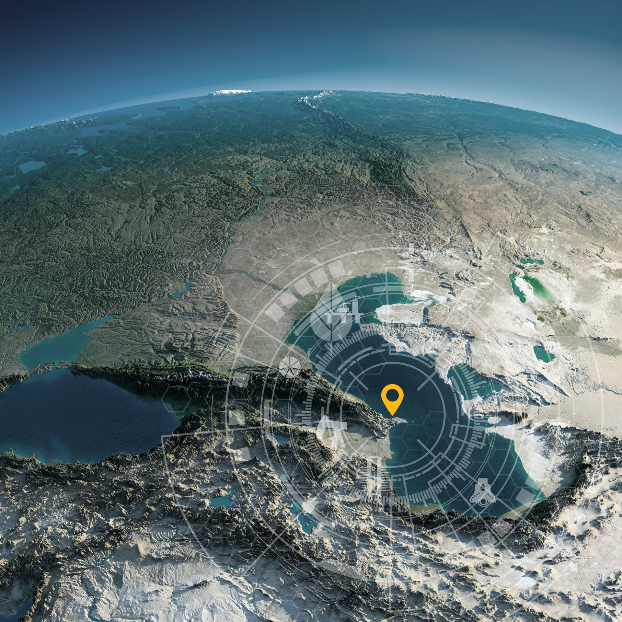


SPE Annual Caspian Technical Conference and Exhibition
25–27 November 2025
Baku, Azerbaijan

Slide 2
SPE Annual Caspian Technical
Conference and Exhibition
25–27 November 2025
Baku, Azerbaijan
Insert Your Paper Title HERE

Slide 3
SPE Annual Caspian Technical
Conference and Exhibition
25–27 November 2025
Baku, Azerbaijan

