Slide 1

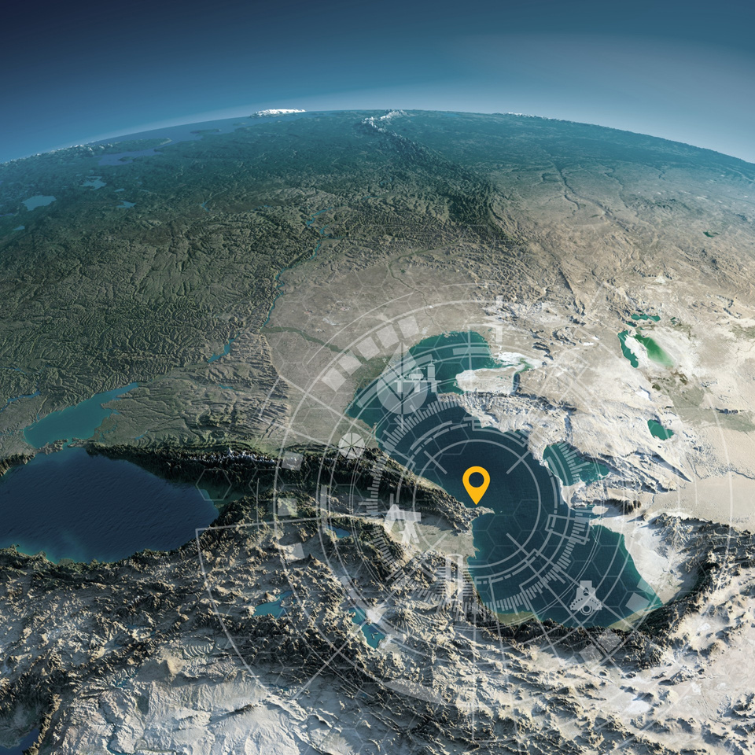


Host Organisation
Sponsor Title/Exhibitor
SPE Annual Caspian Technical Conference
INSERT LOGO
Learning from the Past, Rejuvenating Today, Inspiring Tomorrow
25–27 November 2025
JW Marriott Absheron Baku, Azerbaijan

