Slide 1
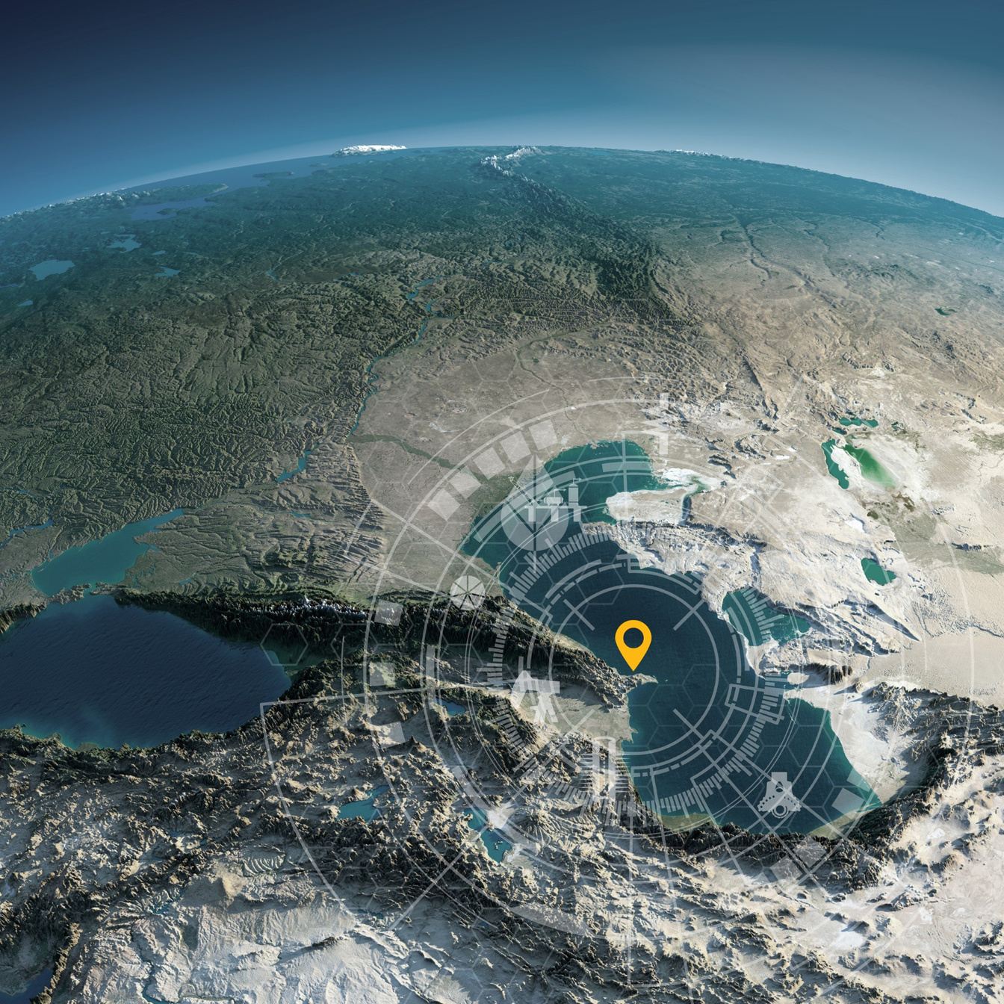




Host Organisation
SPE Annual Caspian
Technical Conference
25–27 November 2025 | JW Marriott Absheron Baku, Azerbaijan
Learning from the Past, Rejuvenating Today, Inspiring Tomorrow.
Sponsor Title/Exhibitor
INSERT LOGO

