Slide 1
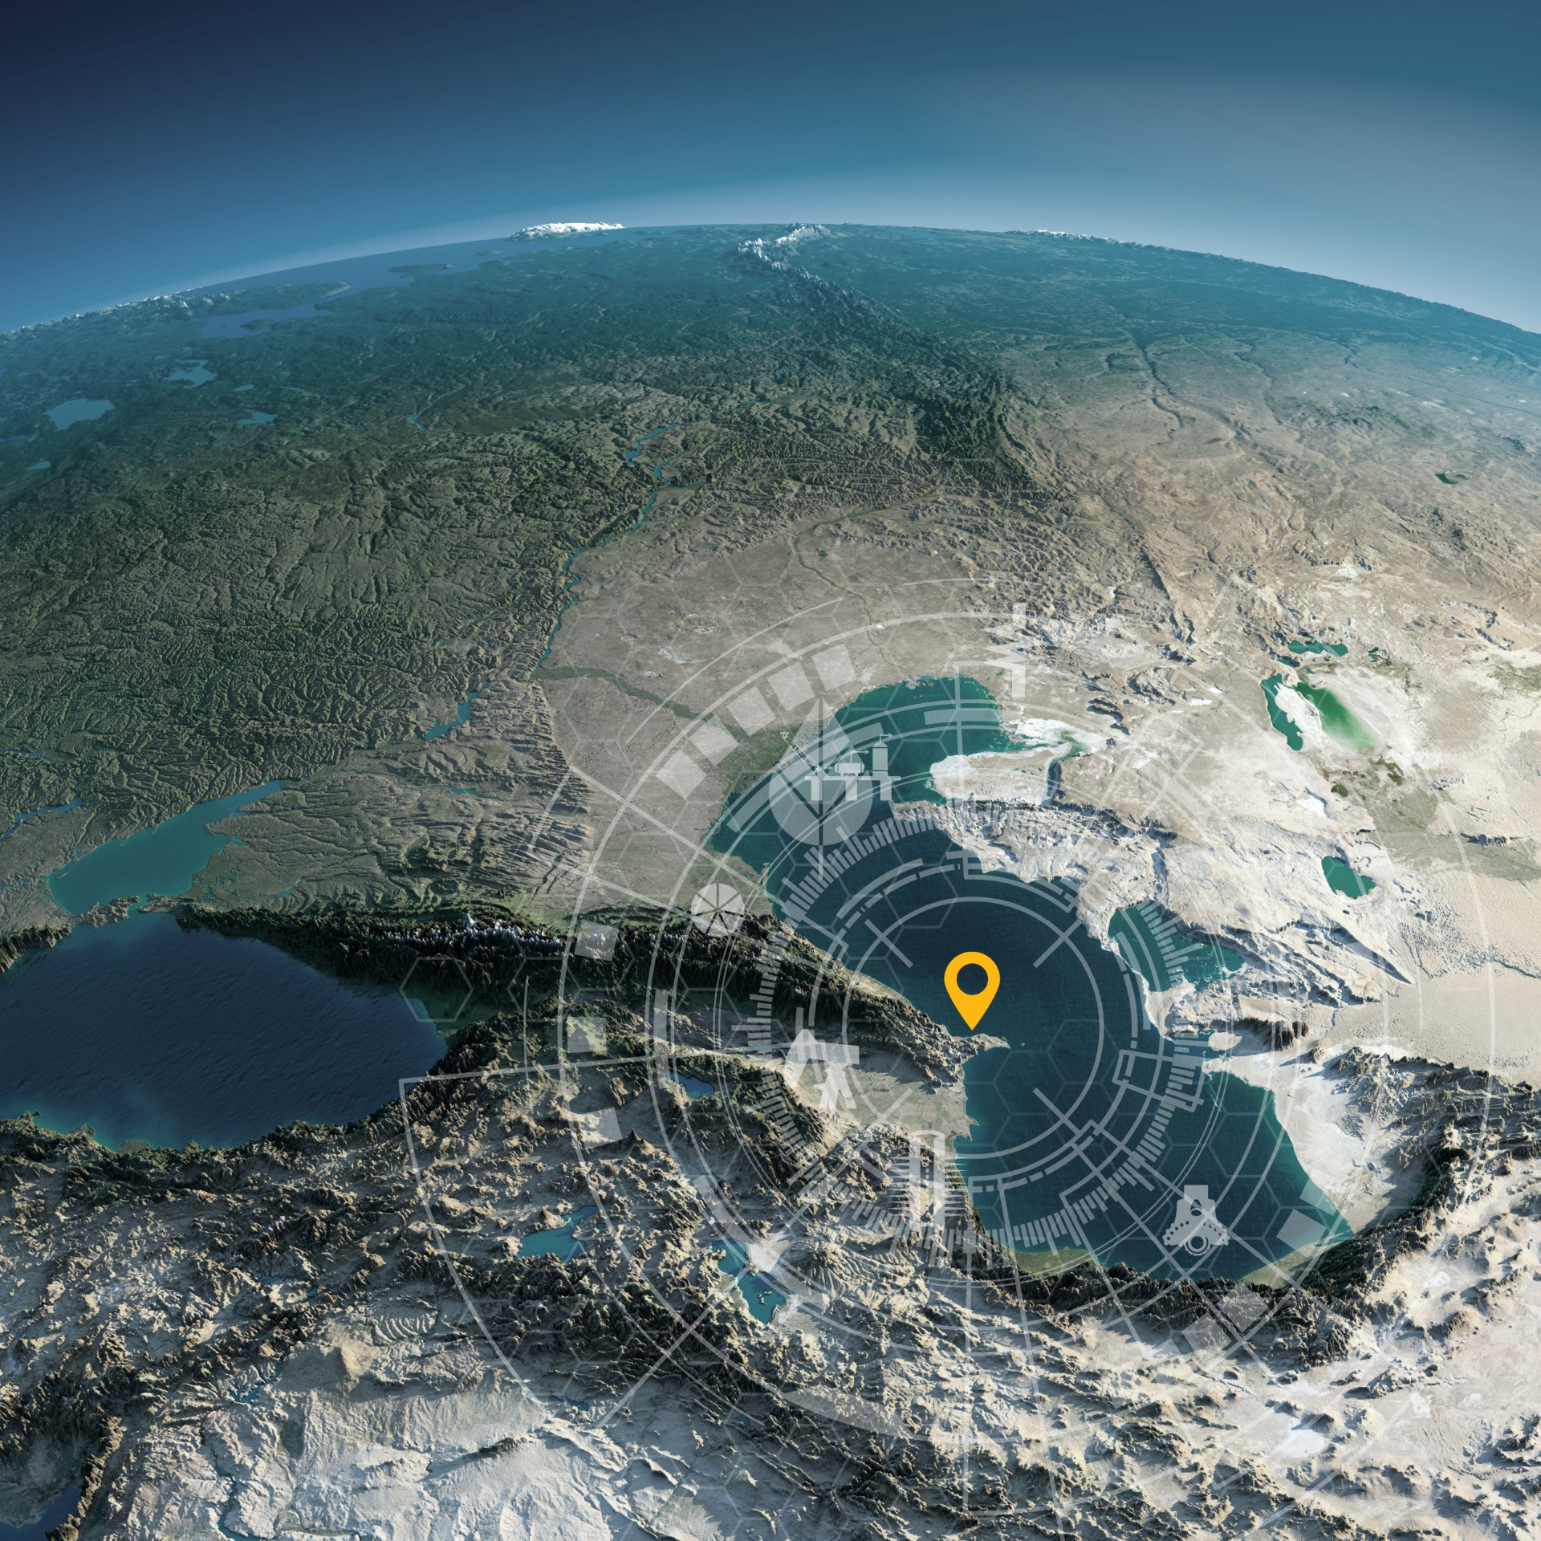




Host Organisation
SPE Annual Caspian Technical Conference
25–27 November 2025 | JW Marriott Absheron, Baku, Azerbaijan
Learning from the Past, Rejuvenating Today, Inspiring Tomorrow
I am attending/speaking/a committee member (select one)
Insert Photo Here
Name
Title
Company
REGISTER

