Slide 1
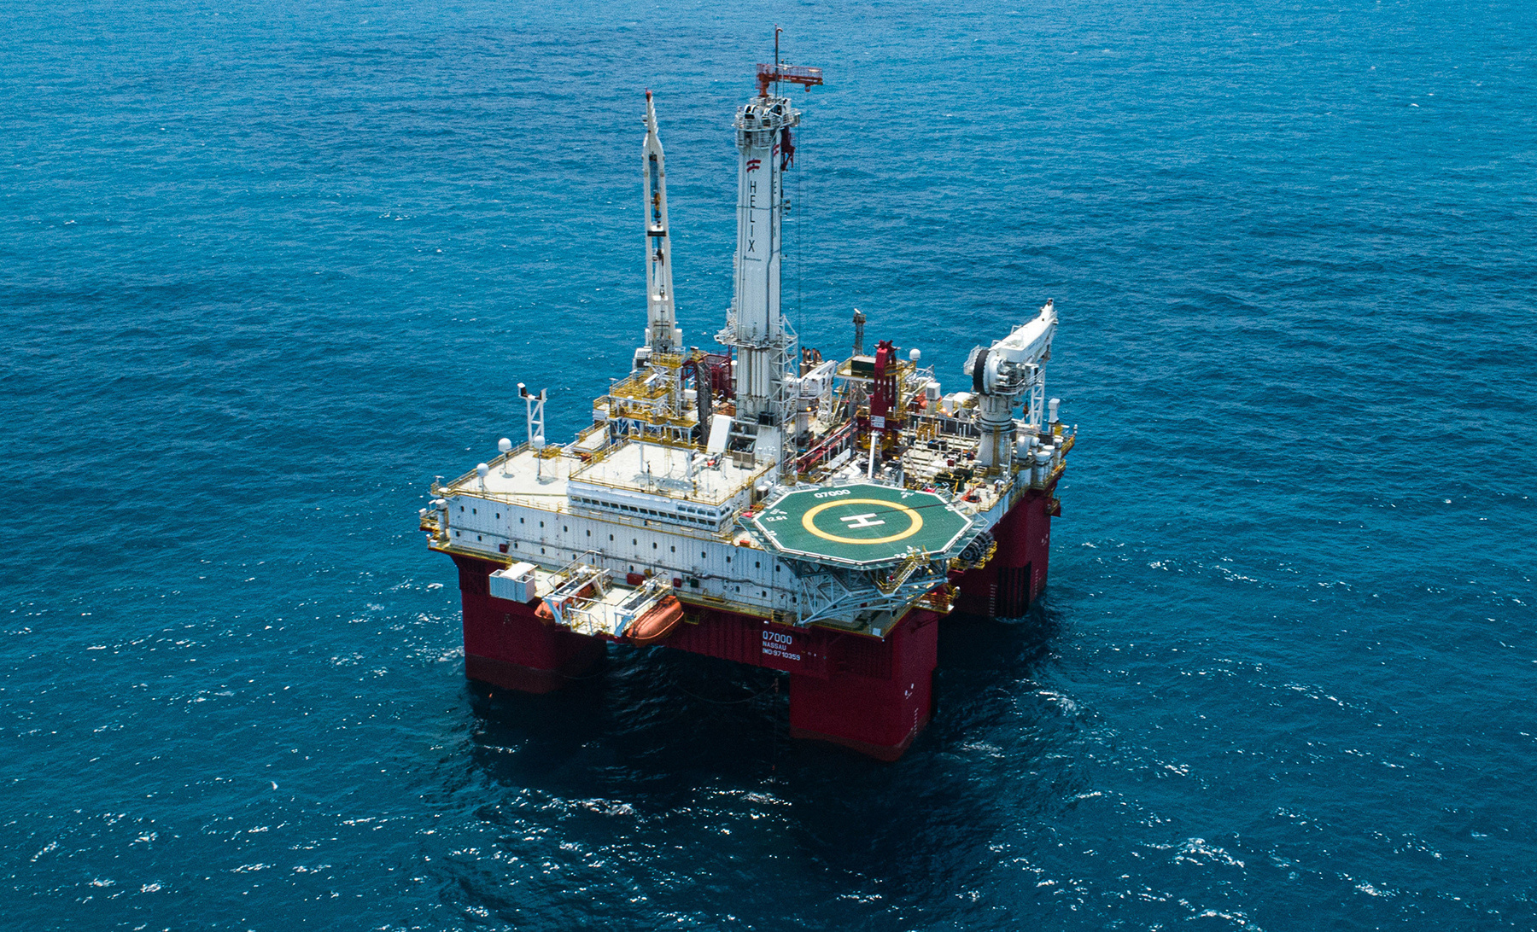

SPE Subsea Well Intervention Symposium
19–21 August 2025 | Galveston, Texas, USA
WE'RE EXHIBITING!
Speak to our dedicated team
in the exhibit hall.
Photo credit: Helix Energy Solutions

Slide 2
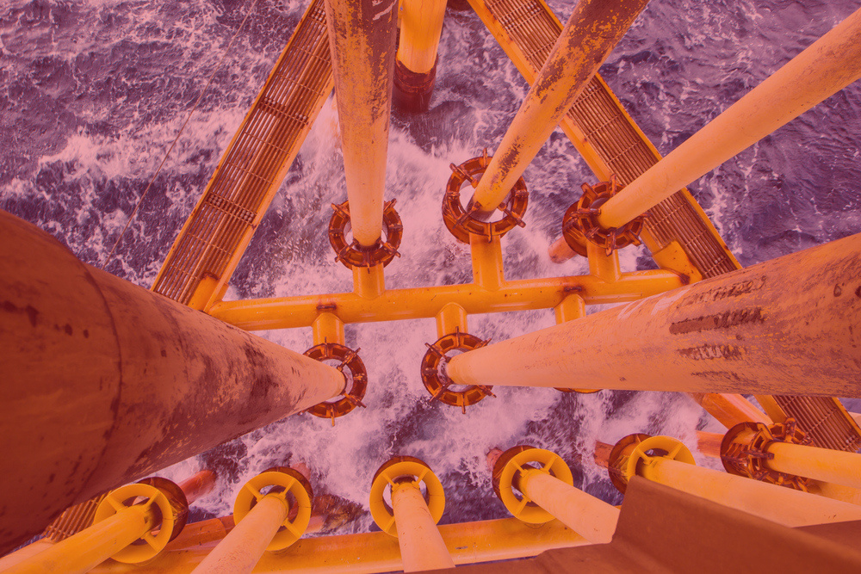
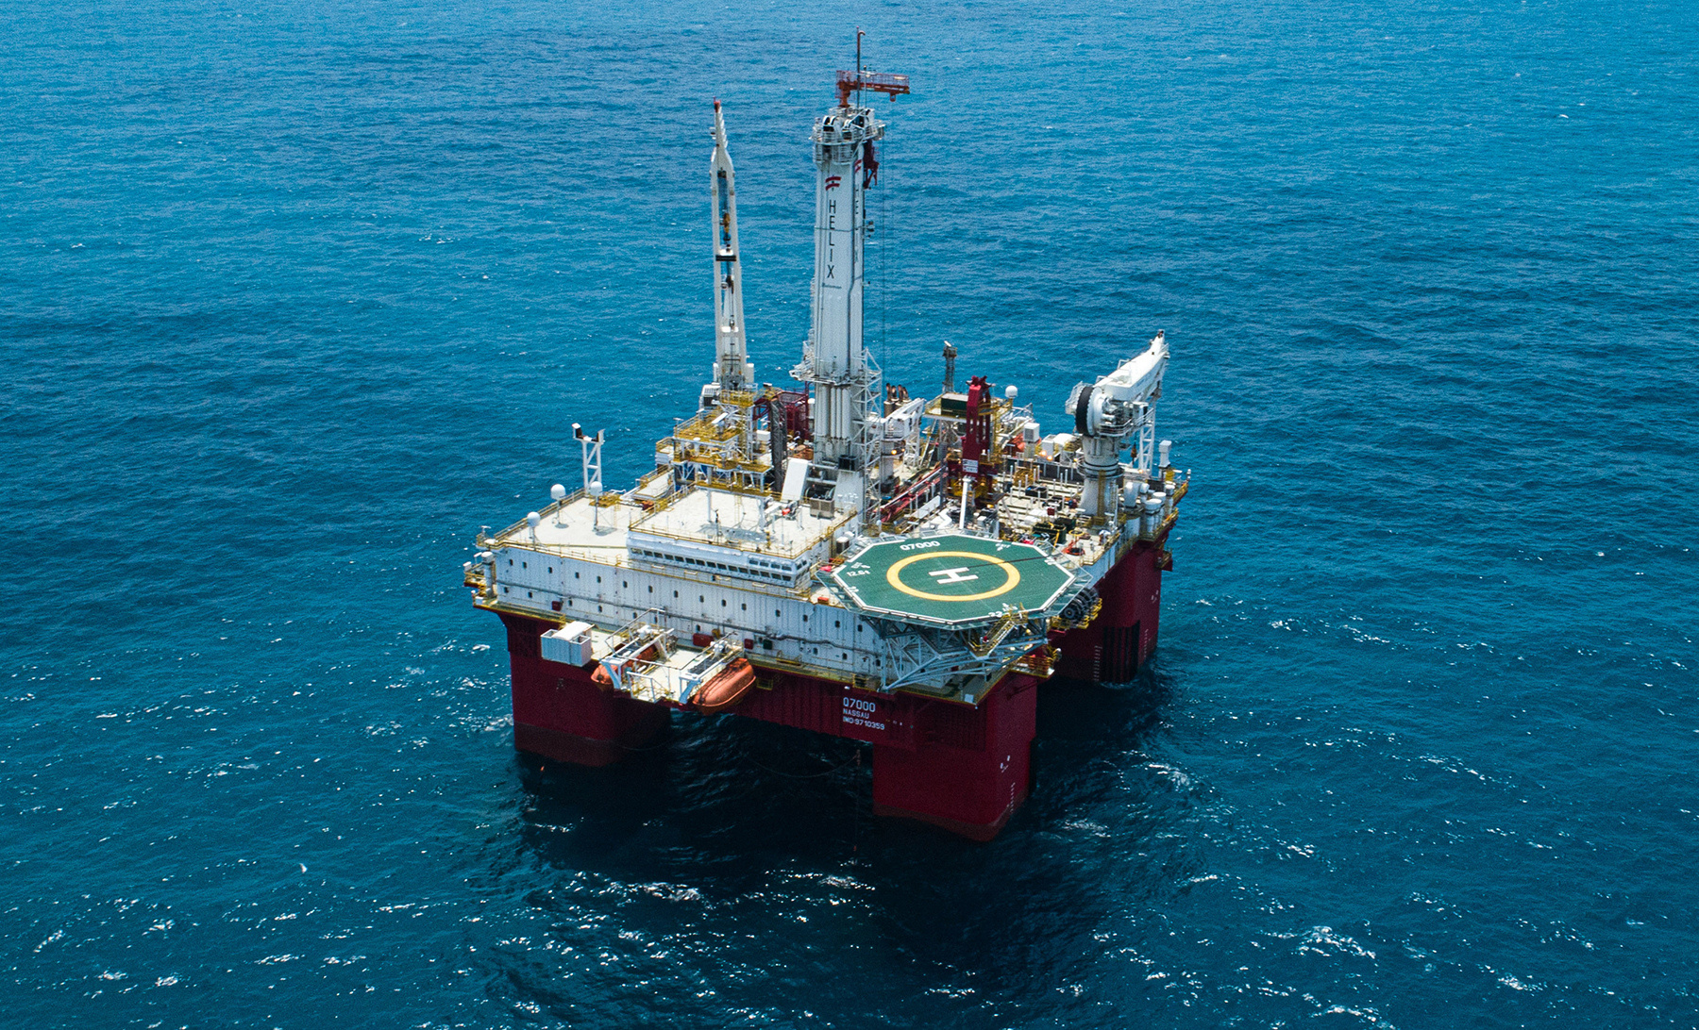
SPE Subsea Well Intervention Symposium
19–21 August 2025 | Galveston, Texas, USA
Photo credit: Helix Energy Solutions
SEE YOU SOON!
We're Exhibiting -
Visit us in the Exhibit Hall.

Slide 3
SPE Subsea Well Intervention Symposium
19–21 August 2025 | Galveston, Texas, USA
Photo credit: Helix Energy Solutions
WE'RE EXHIBITING!
Speak to our dedicated
team in the exhibit hall.
INSERT COMPANY LOGO

