Slide 1
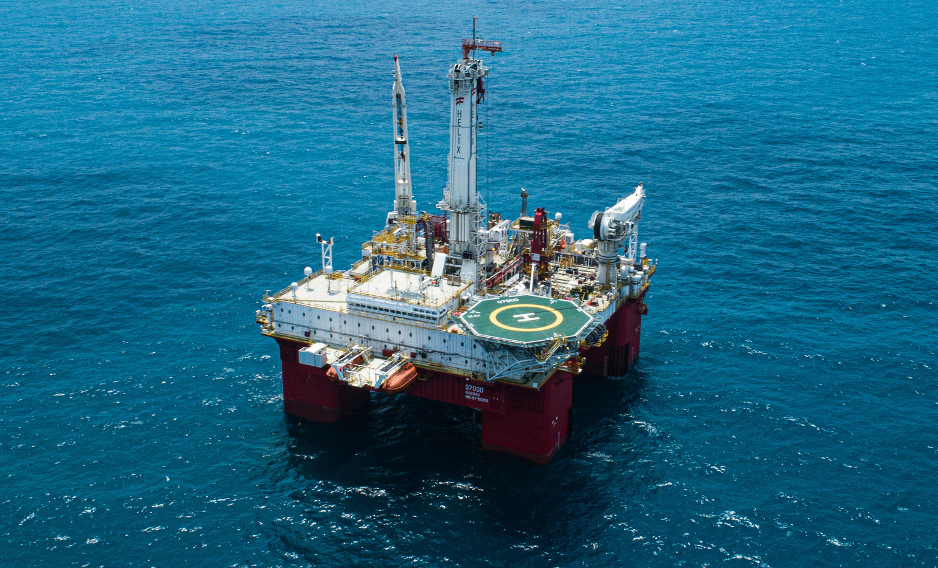

SPE Subsea Well Intervention Symposium
19–21 August 2025 | Galveston, Texas, USA
WE'RE EXHIBITING!
Speak to our dedicated team in the exhibit hall. #WeAreSPE
Photo credit: Helix Energy Solutions

Slide 2
SPE Subsea Well Intervention Symposium
19–21 August 2025 | Galveston, Texas, USA
SEE YOU SOON!
We're Exhibiting - Visit us in the Exhibit Hall
#WeAreSPE
Photo credit: Helix Energy Solutions

Slide 3
SPE Subsea Well Intervention Symposium
19–21 August 2025 | Galveston, Texas, USA
WE'RE EXHIBITING!
Speak to our dedicated team in the exhibit hall. #WeAreSPE
INSERT COMPANY LOGO
Photo credit: Helix Energy Solutions

Slide 4
SPE Subsea Well Intervention Symposium
19–21 August 2025 | Galveston, Texas, USA
INSERT COMPANY LOGO
WE'RE EXHIBITING!
Speak to our dedicated team in the exhibit hall. #WeAreSPE
Photo credit: Helix Energy Solutions

